Slide 1
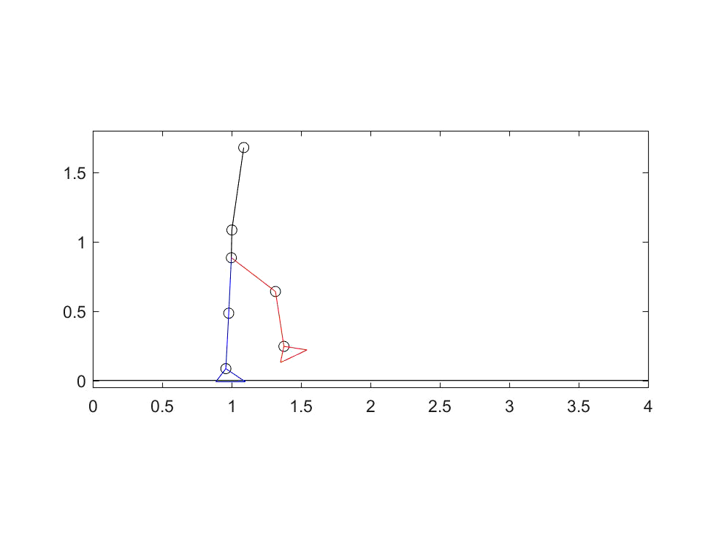
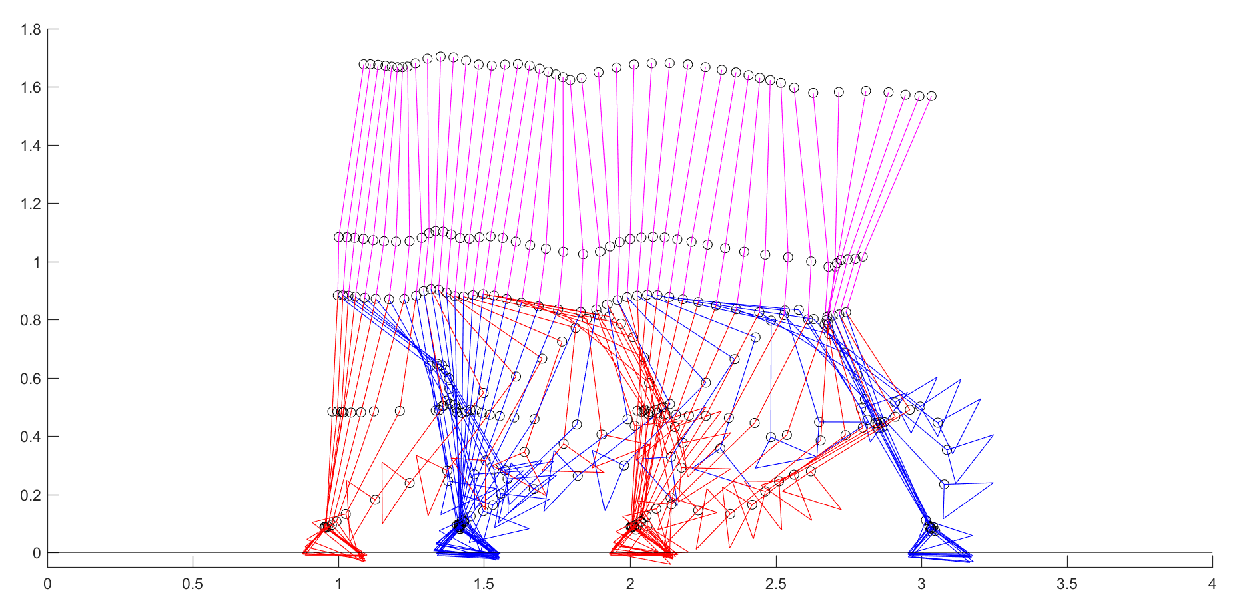
Better Simulation Result
I improve the MATLAB scripts in calculating ground reaction force, which improves the simulation results. Now it can provide whole gait cycle walking. Related diagrams are shown in following slides.

Slide 2
Angles of Body Segments in Full Gait Cycle

Slide 3
Active Torque in Full Gait Cycle

Slide 4
Passive Torque in Full Gait Cycle

