Slide 1
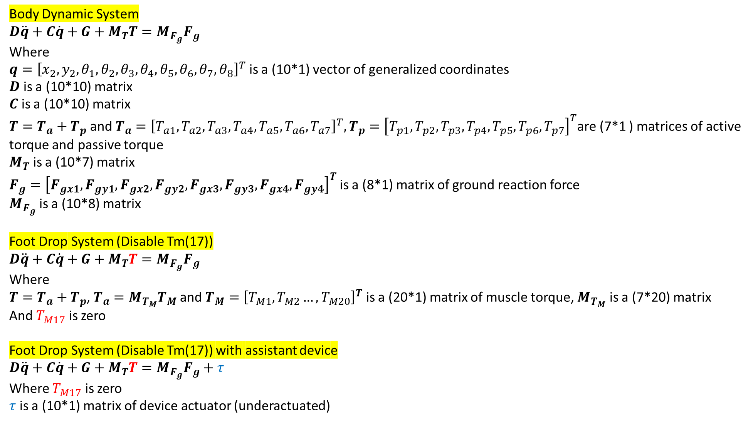
Body Dynamic System
$$D\ddot{q}+C\dot{q}+G+M_{T}T=M_{F_{g}}F_{g}$$
Where
$q={\left[x_{2},y_{2},θ_{1},θ_{2},θ_{3},θ_{4},θ_{5},θ_{6},θ_{7},θ_{8}\right]}^{T}$ is a (10*1) vector of generalized coordinates
$D$ is a (10*10) matrix
$C$ is a (10*10) matrix
$T=T_{a}+T_{p}$ and $T_{a}={\left[T_{a1},T_{a2},T_{a3},T_{a4},T_{a5},T_{a6},T_{a7}\right]}^{T},T_{p}={\left[T_{p1},T_{p2},T_{p3},T_{p4},T_{p5},T_{p6},T_{p7}\right]}^{T}$are (7*1 ) matrices of active torque and passive torque
$M_{T}$ is a (10*7) matrix
$F_{g}={\left[F_{gx1},F_{gy1},F_{gx2},F_{gy2},F_{gx3},F_{gy3},F_{gx4},F_{gy4}\right]}^{T}$ is a (8*1) matrix of ground reaction force
$M_{F_{g}}$ is a (10*8) matrix
Foot Drop System (Disable Tm(17))
$$D\ddot{q}+C\dot{q}+G+M_{T}T=M_{F_{g}}F_{g}$$
Where
$T=T_{a}+T_{p}$, $T_{a}=M_{T_{M}}T_{M}$ and $T_{M}={\left[T_{M1},T_{M2}…,T_{M20}\right]}^{T}$ is a (20*1) matrix of muscle torque, $M_{T_{M}}$ is a (7*20) matrix
And $T_{M17}$ is zero
Foot Drop System (Disable Tm(17)) with assistant device
$$D\ddot{q}+C\dot{q}+G+M_{T}T=M_{F_{g}}F_{g}+τ$$
Where $T_{M17}$ is zero
$τ$ is a (10*1) matrix of device actuator (underactuated)

Slide 2
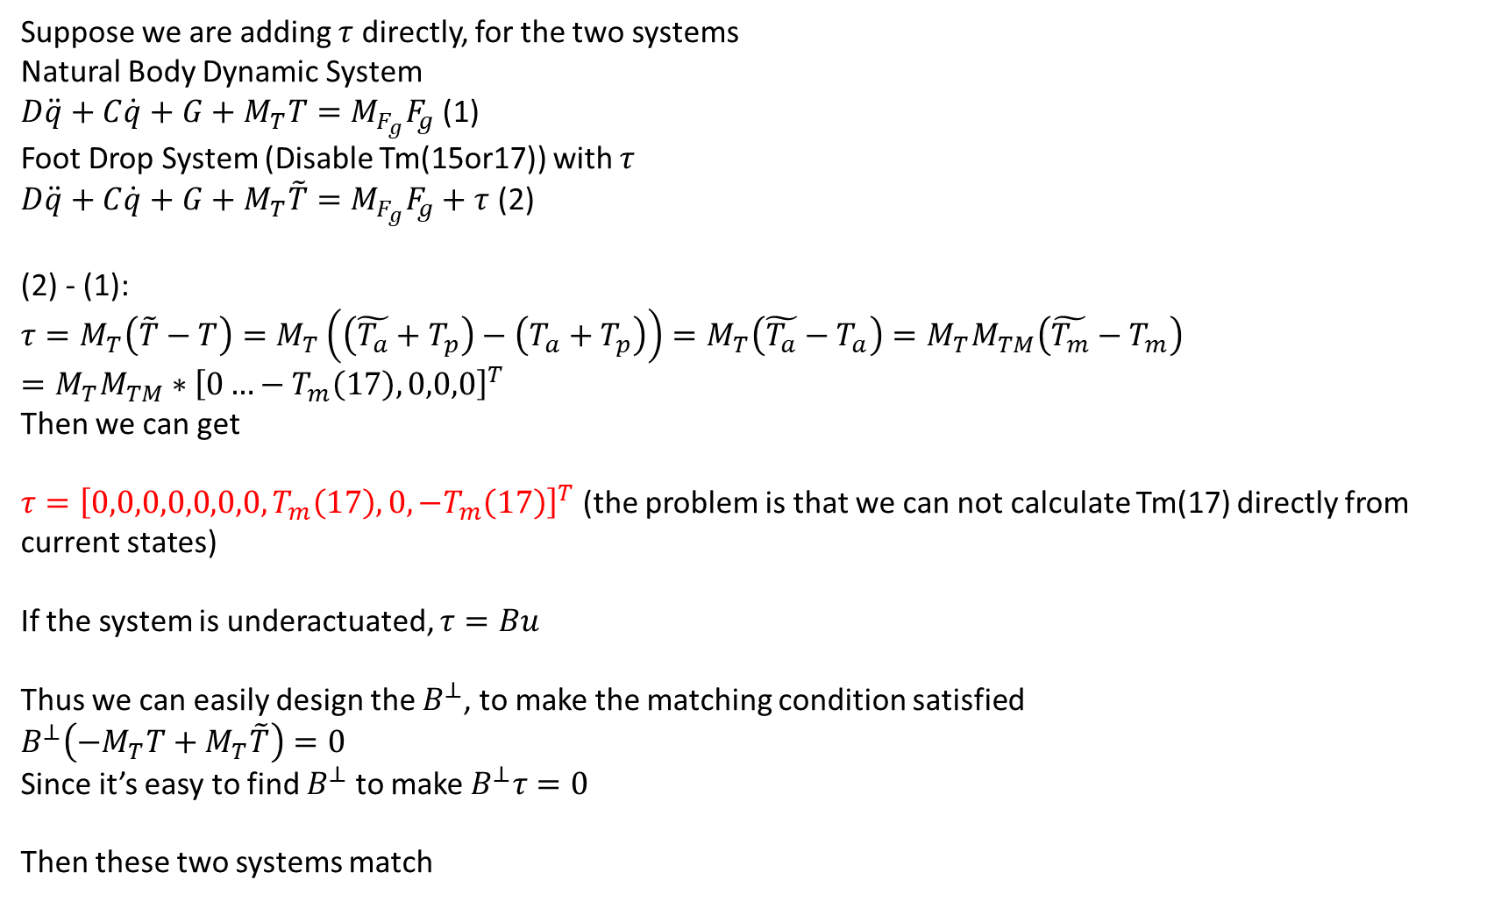
Calculate $τ$
Suppose we are adding $τ$ directly, for the two systems
Natural Body Dynamic System
$D\ddot{q}+C\dot{q}+G+M_{T}T=M_{F_{g}}F_{g}$ (1)
Foot Drop System (Disable Tm(15or17)) with $τ$
$D\ddot{q}+C\dot{q}+G+M_{T}\tilde{T}=M_{F_{g}}F_{g}+τ$ (2)
(2) - (1):
$$τ=M_{T}\left(\tilde{T}−T\right)=M_{T}\left(\left(\tilde{T_{a}}+T_{p}\right)−\left(T_{a}+T_{p}\right)\right)=M_{T}\left(\tilde{T_{a}}−T_{a}\right)=M_{T}M_{TM}\left(\tilde{T_{m}}−T_{m}\right)=M_{T}M_{TM}∗{\left[0…−T_{m}\left(17\right),0,0,0\right]}^{T}$$
Then we can get
$τ={\left[0,0,0,0,0,0,0,T_{m}\left(17\right),0,−T_{m}\left(17\right)\right]}^{T}$ (the problem is that we can not calculate Tm(17) directly from current states)
If the system is underactuated, $τ=Bu$
Thus we can easily design the $B^{⊥}$, to make the matching condition satisfied
$$B^{⊥}\left({−M}_{T}T+M_{T}\tilde{T}\right)=0$$
Since it’s easy to find $B^{⊥}$ to make $B^{⊥}τ=0$
Then these two systems match

