Slide 1
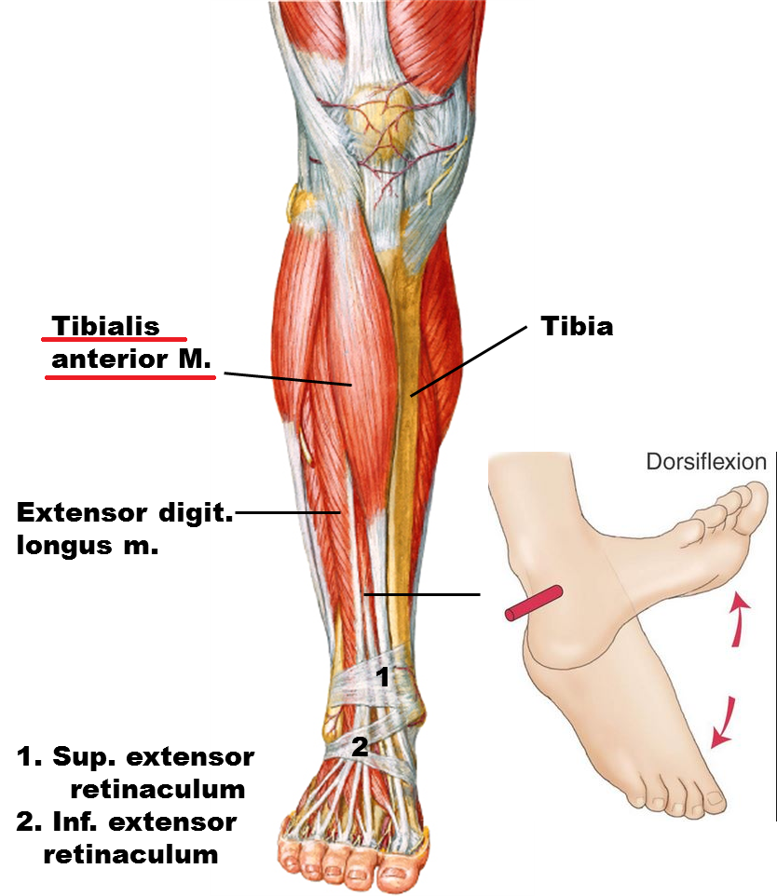
Cause of Foot Drop
Most of the time, foot drop is the result of neurological disorder*
The source for the neurological impairment can be central (spinal cord or brain) or peripheral (nerves located connecting from the spinal cord to an end-site muscle or sensory receptor)
The anterior tibialis is the muscle that picks up the foot (dorsiflexion)*, also assisted by fibularis tertius, extensor digitorum longus and the extensor hallucis longus (all innervated by the deep fibular (peroneal) nerve)
*Pritchett, James W., and M. A. Porembski. "Foot drop." E-Medicine.[Online] (2006).
*Stewart, John D. "Foot drop: where, why and what to do?." Practical neurology 8.3 (2008): 158-169.
*Westhout, Franklin D., Laura S. Paré, and Mark E. Linskey. "Central causes of foot drop: rare and underappreciated differential diagnoses." The journal of spinal cord medicine 30.1 (2007): 62-66.

Slide 2
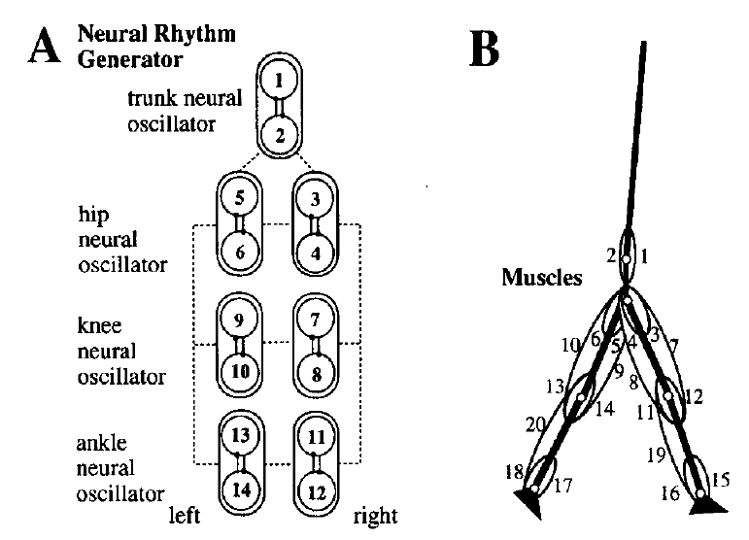
Muscles in the Model
1 Rectus abdominis
2 Erector spinae
3,5 Iliopsoas
4,6 gluteus maximus
7,9 Rectus Femoris
8,10 Hamstrings
11,13 Biceps femoris
12,14 Vastus
15,17 Tibialis anterior
16,18 Soleus
19,20 Gastrocnemius

Slide 3
Disable Tibialis Anterior
Set Tm(17) = 0
Simulation starts from the begin of swing phase of the affected leg
From the result, at the terminal swing phase, the affected foot fails to be picked up

Slide 4
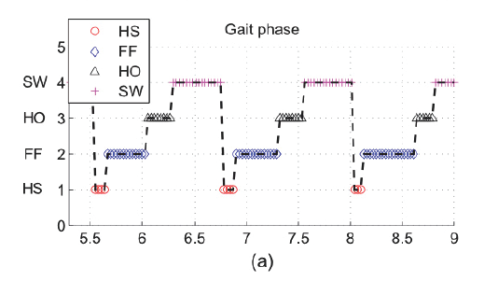
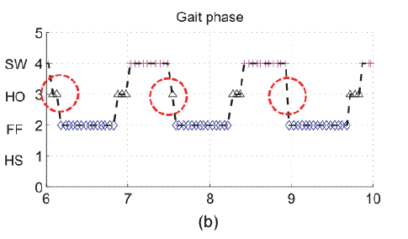
Gait Difference in Stance
Normal Gait:
Heel Strike – Flat Foot – Heel Off – Swing
Foot Drop Gait:
Heel Off – Flat Foot – Heel Off – Swing

Slide 5
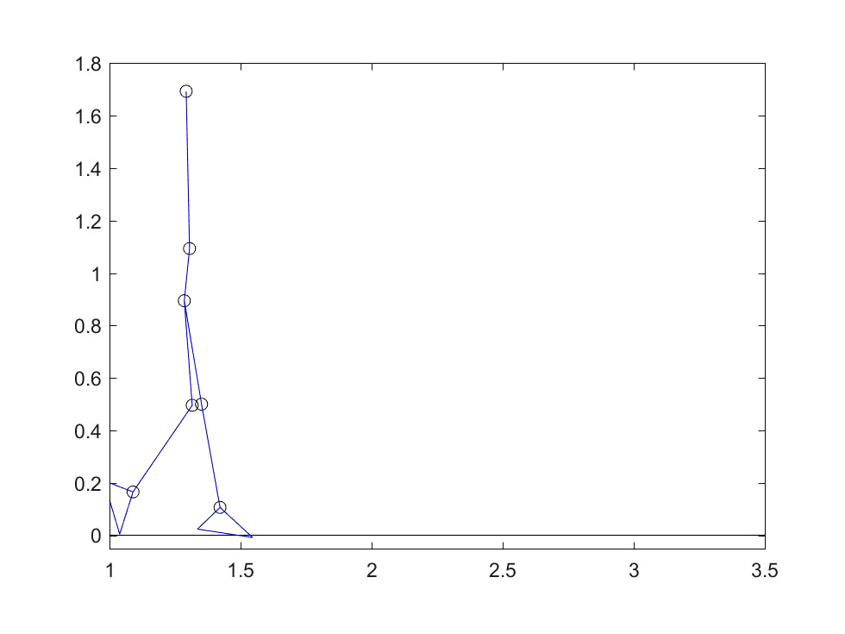
Gait Difference in Stance
Normal Gait:
Heel Strike – Flat Foot – Heel Off – Swing
Foot Drop Gait:
Heel Off – Flat Foot – Heel Off – Swing

Slide 6
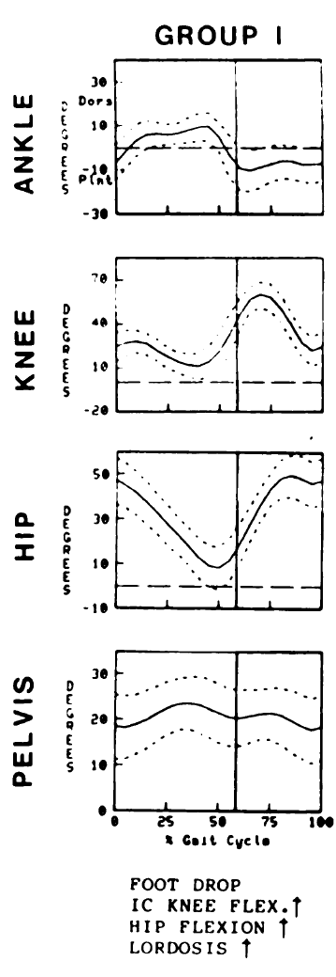
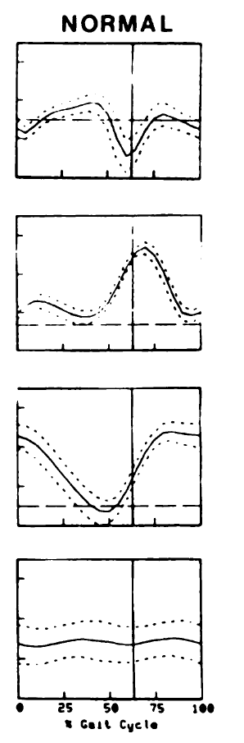
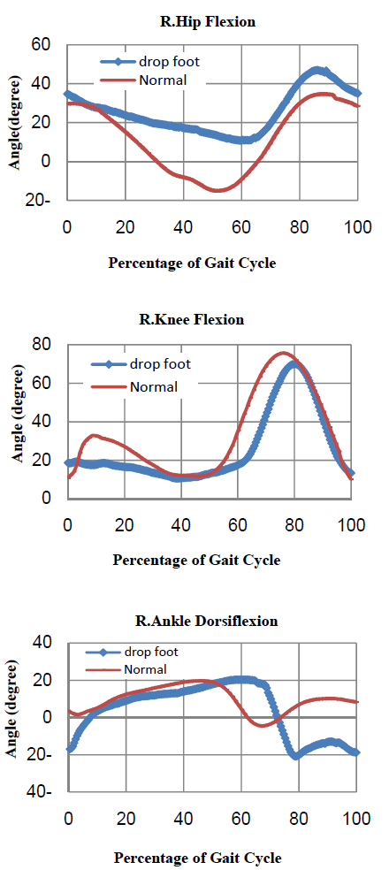
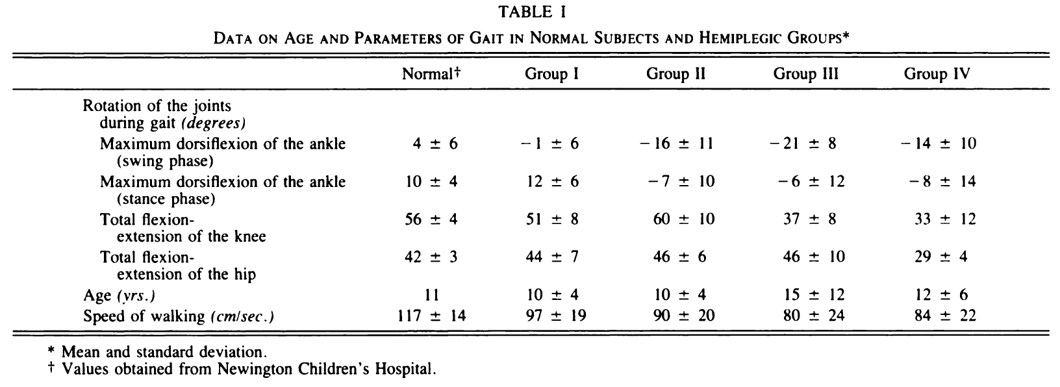
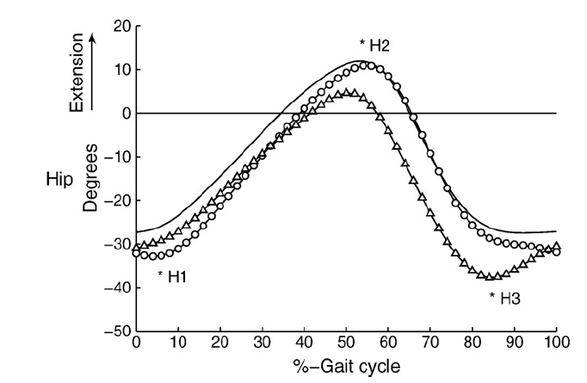
Foot Drop Characterization: Hip
Foot Drop
Normal
In general, the hip angles of foot drop will be higher than normal
Especially during Swing Phase, the hip will rotate externally to avoid toe dragging during swing phase.
Overall change of foot drop hip angles will be smaller than normal.
And the valley of both gait occur in different time. The valley of foot drop is higher than normal while the valley of normal gait will be lower than 0 degree.
[1] Winters, T. F., J. R. Gage, and R. Hicks. "Gait patterns in spastic hemiplegia in children and young adults." J Bone Joint Surg Am69.3 (1987): 437-441.
[2] Matinmanesh, Ali, and Mohammadreza Mallakzadeh. "Inverse kinetic and kinematic analysis of drop-foot patient's walking." E-Health and Bioengineering Conference (EHB), 2011. IEEE, 2011.
[3] Simonsen, Erik B., et al. "Redistribution of joint moments during walking in patients with drop-foot." Clinical Biomechanics 25.9 (2010): 949-952.
I
II
III

Slide 7
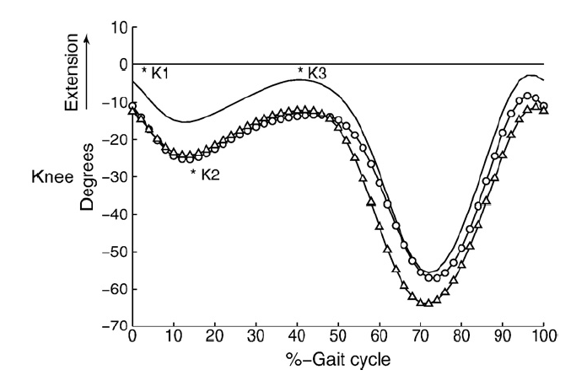
Foot Drop Characterization: Knee
Foot Drop
Normal
I
During stance phase, knee flexion angle is remained almost constant.
At terminal of swing phase, the knee flexion angle will increase of foot drop, as will as at initial contact and in loading response.
And the peak is higher in normal gait during swing phase (normally after the begin of swing: 60% to 80%)
II
III

Slide 8
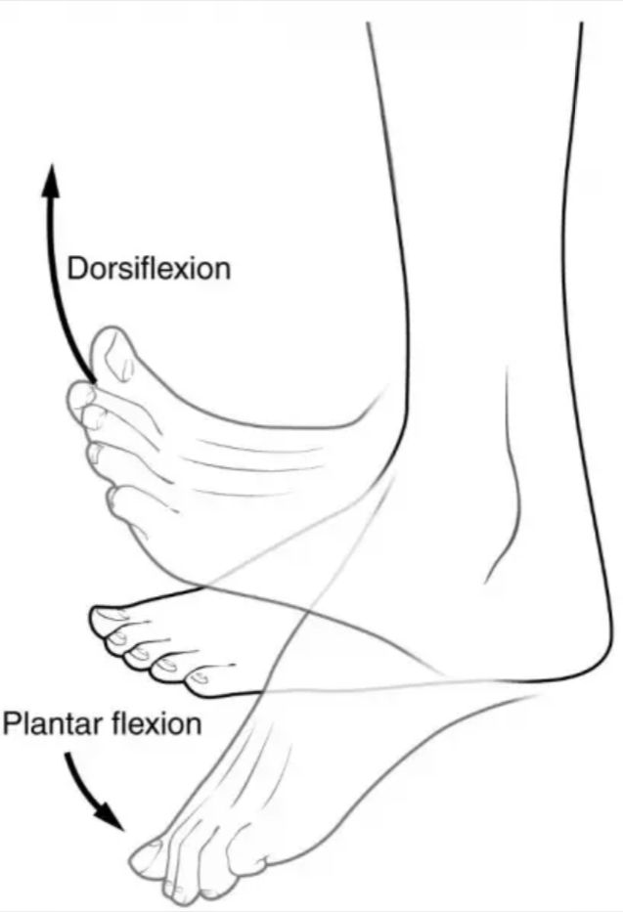
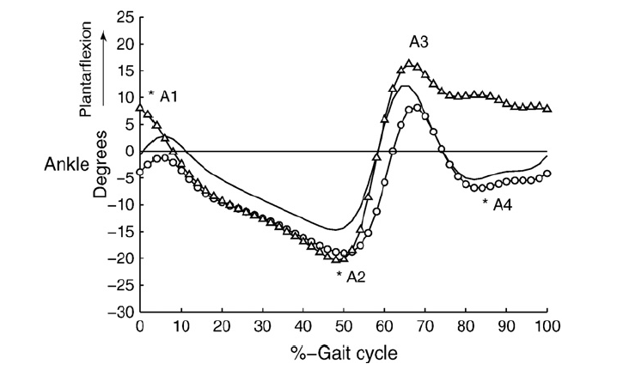
Foot Drop Characterization: Ankle
Foot Drop
Normal
During stance phase, there is no much difference in normal and foot drop gait. Adequate range of dorsiflexion of the ankle during the stance phase
During swing phase, the normal foot will have dorsiflexion while the foot drop will have plantar flexion. In other words, the foot drop ankle angle will be lower
The peak and valley of both gait occur in different time
I
II
III

Slide 9
Compare with Simulation
Stance
Swing
Not much difference since the model already externally rotates the thigh
During stance phase, knee flexion angle is remained almost constant.
At begin of initial contact, the knee flexion angle of normal will be higher
And the peak is higher in normal gait during swing phase
During swing phase, the normal foot will have dorsiflexion while the foot drop will have plantar flexion. In other words, the foot drop ankle angle will be lower
The peak and valley of both gait occur in different time

