Slide 1
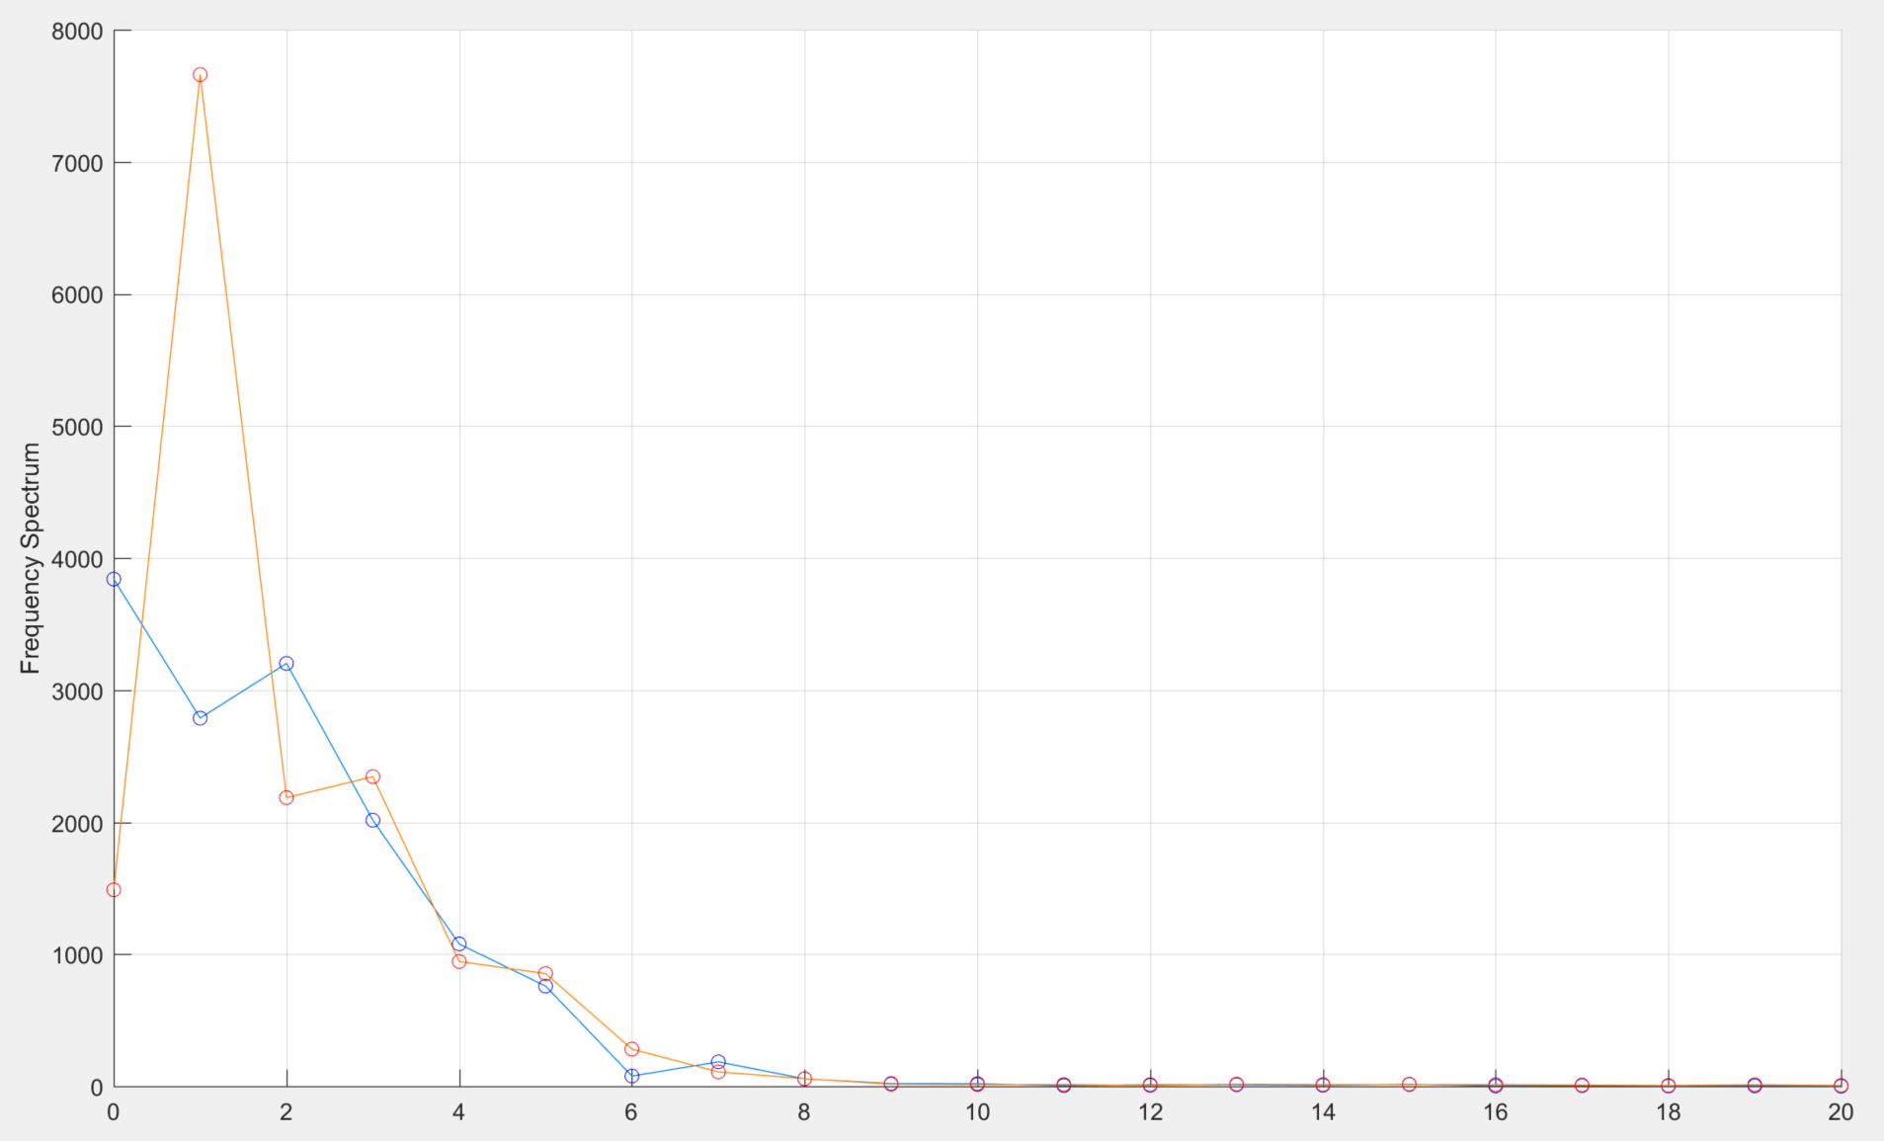
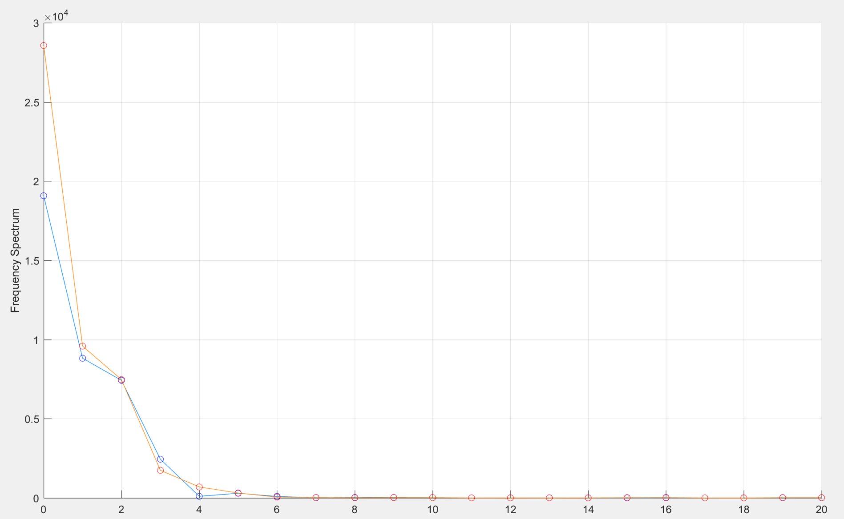
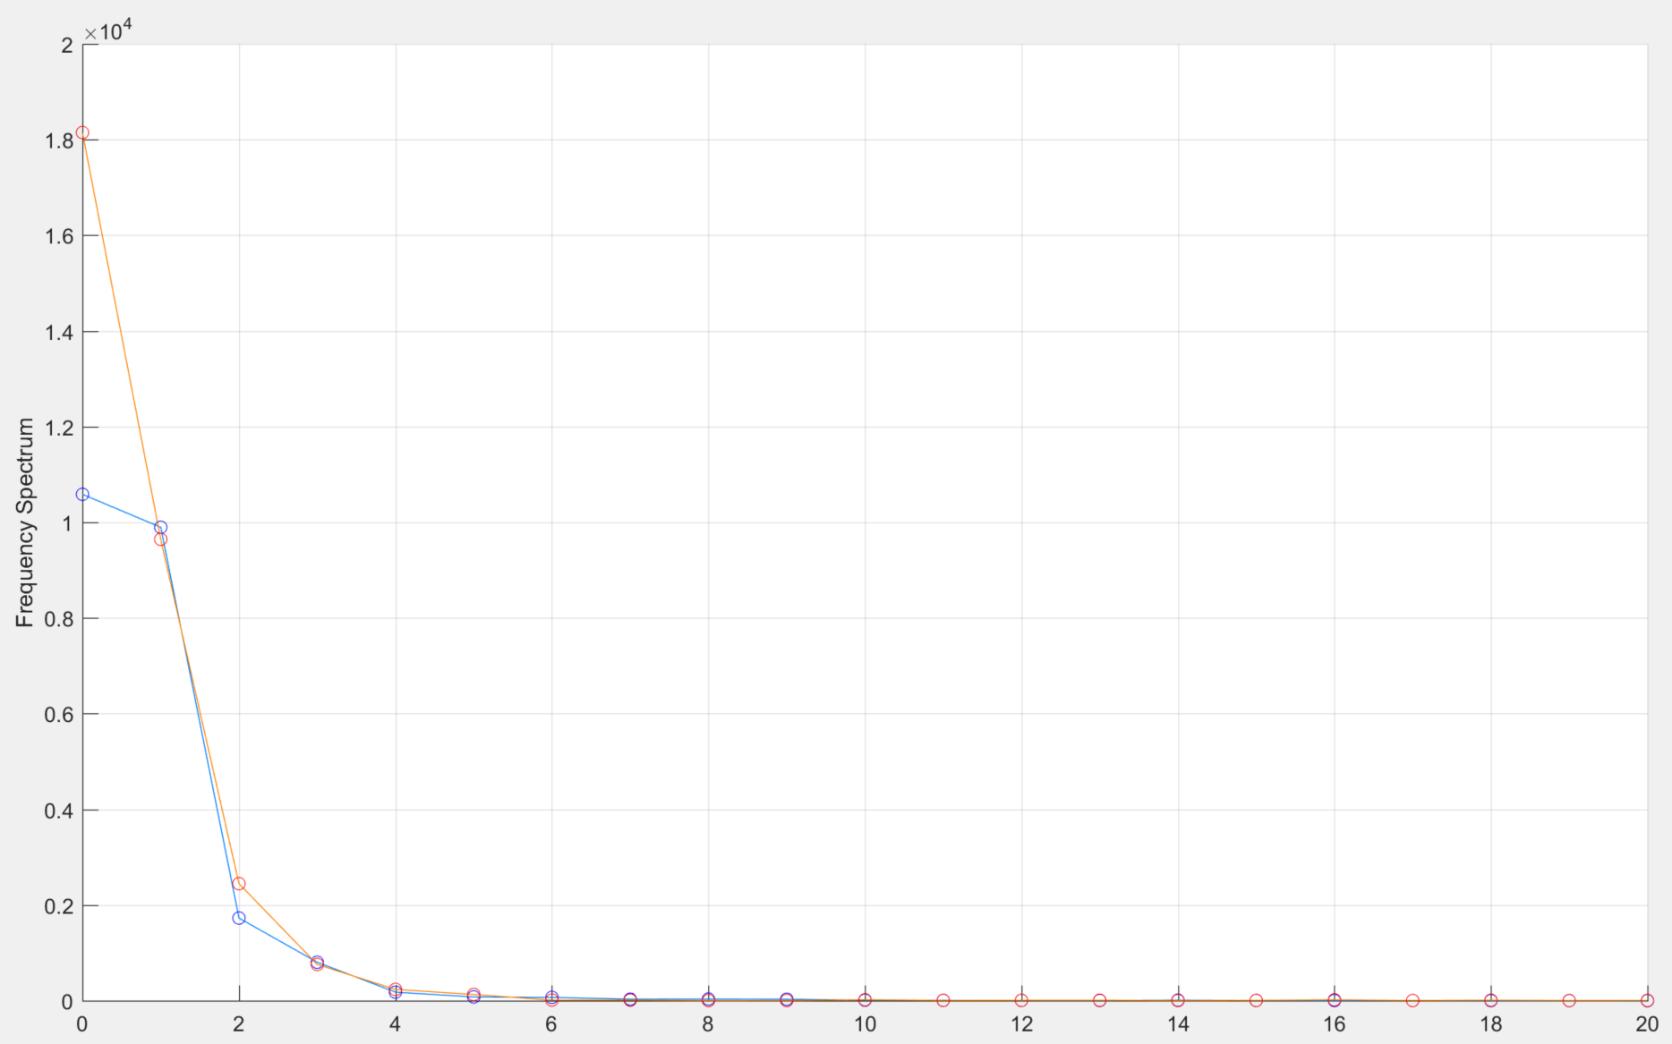
Fourier Analysis of Reference Joint Angles
Ankle
Knee
Hip
Reference 1
Normal
Foot Drop
Frequency Spectrum
Frequency Spectrum
Frequency Spectrum
At frequency zero, foot drop shows lower amplitude than normal, which means the curve of foot drop that is nearly constant tends to have smaller magnitude. This happens to match the foot drop gait pattern during swing phase. (red)
Later at higher frequency, the amplitude of foot drop increases to the peak much higher than normal. This also match the (blue) during stance phase.
The amplitudes of foot drop gait FT are generally higher than normal at any frequency, which means foot drop knee and hip joint angles are higher than normal.
“Fourier transform of a constant is an impulse function at zero frequency, and that the amplitude of the impulse is the constant value.” [1]
[1] https://www.chem.purdue.edu/courses/chm621/text/ft/basic/fandt/fandt.htm

Slide 2
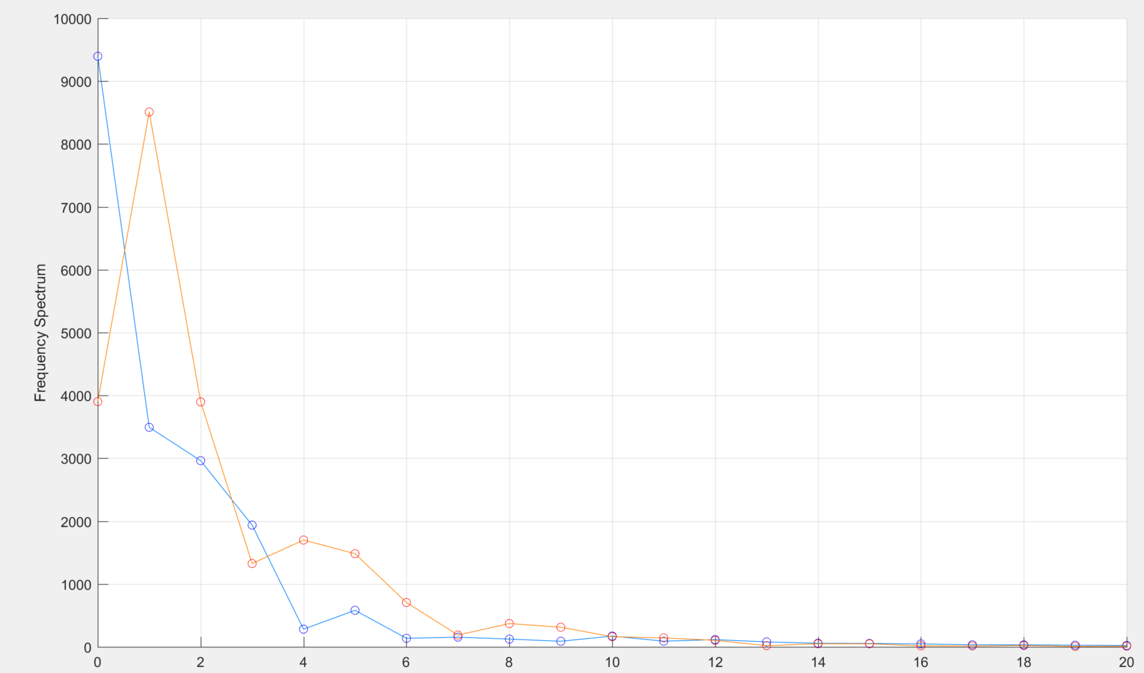
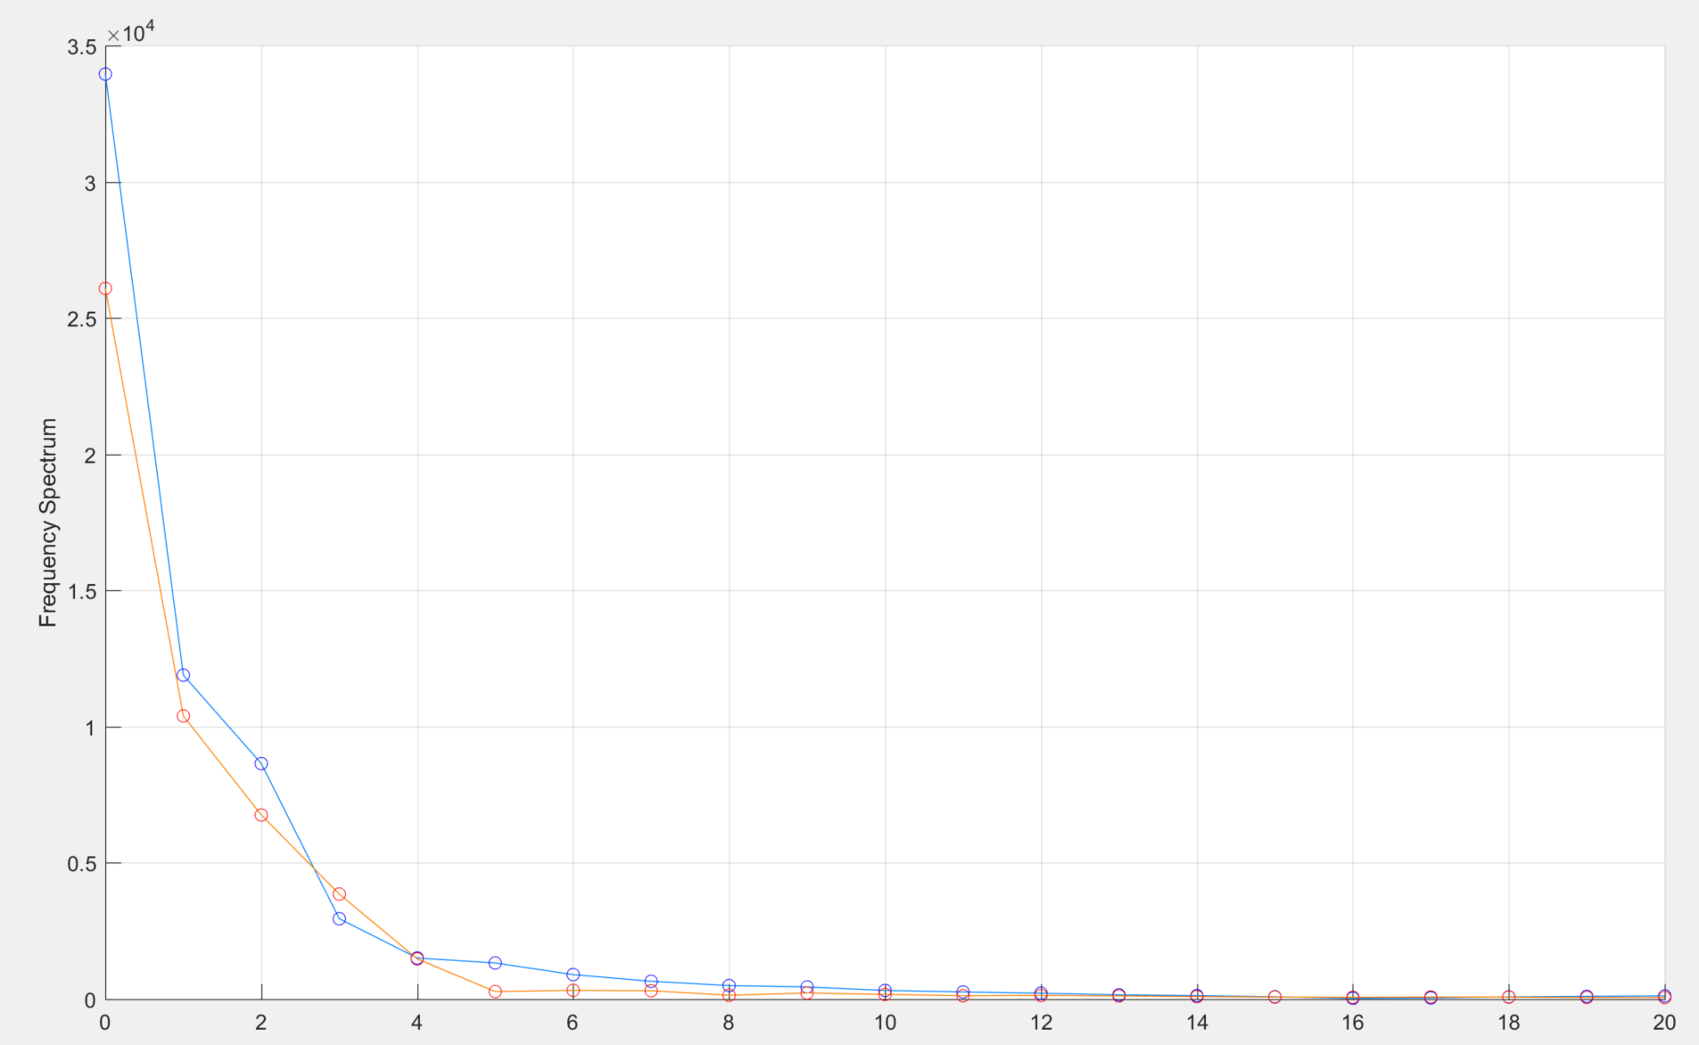
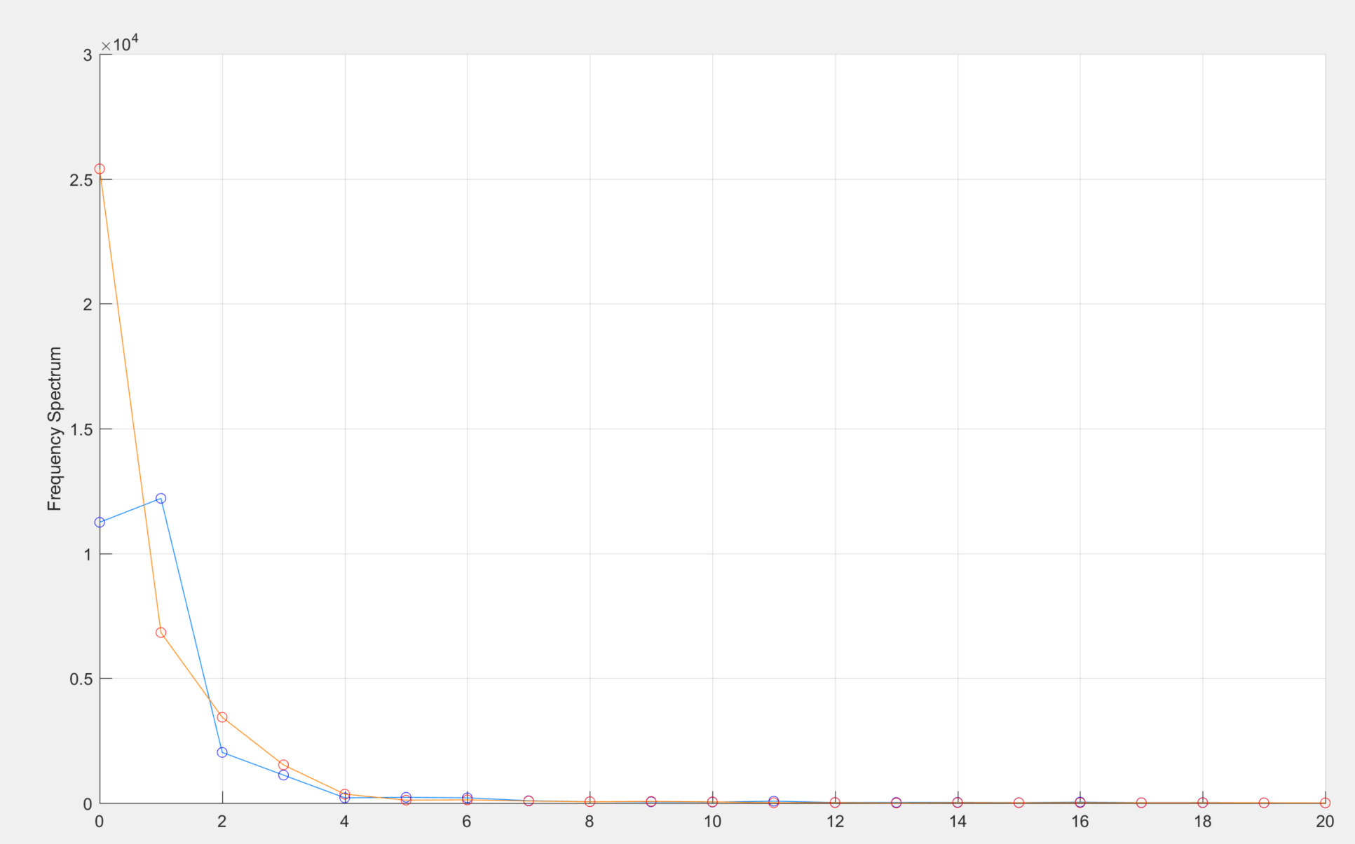
Fourier Analysis of Reference Joint Angles
Ankle
Knee
Hip
Reference 2
Normal
Foot Drop
Frequency Spectrum
Frequency Spectrum
Frequency Spectrum
At frequency zero, foot drop shows lower amplitude than normal, which means the curve of foot drop that is nearly constant tends to have smaller magnitude. This happens to match the foot drop gait pattern during swing phase. (red)
Later at higher frequency, the amplitude of foot drop increases to the peak much higher than normal. This also match the (blue) during stance phase.
The amplitudes of foot drop gait FT are generally higher than normal at any frequency, which means foot drop hip joint angles are higher than normal.

Slide 3
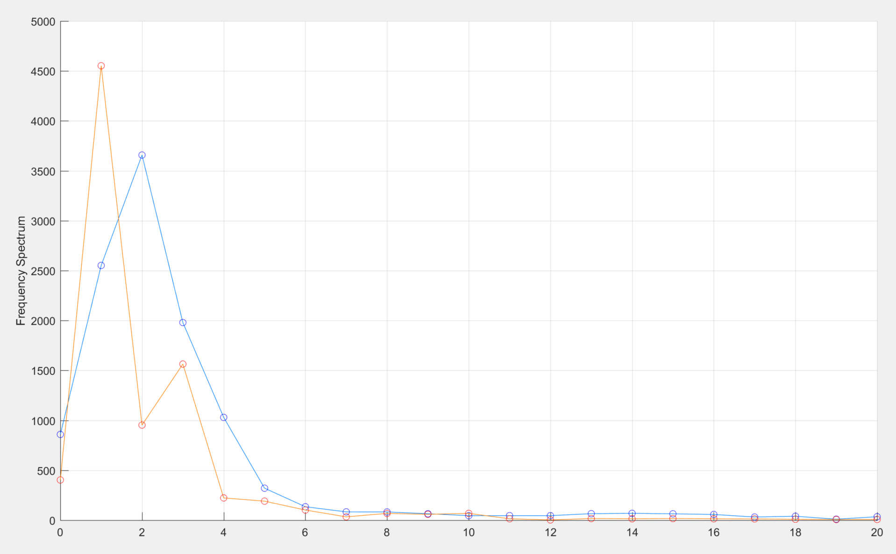
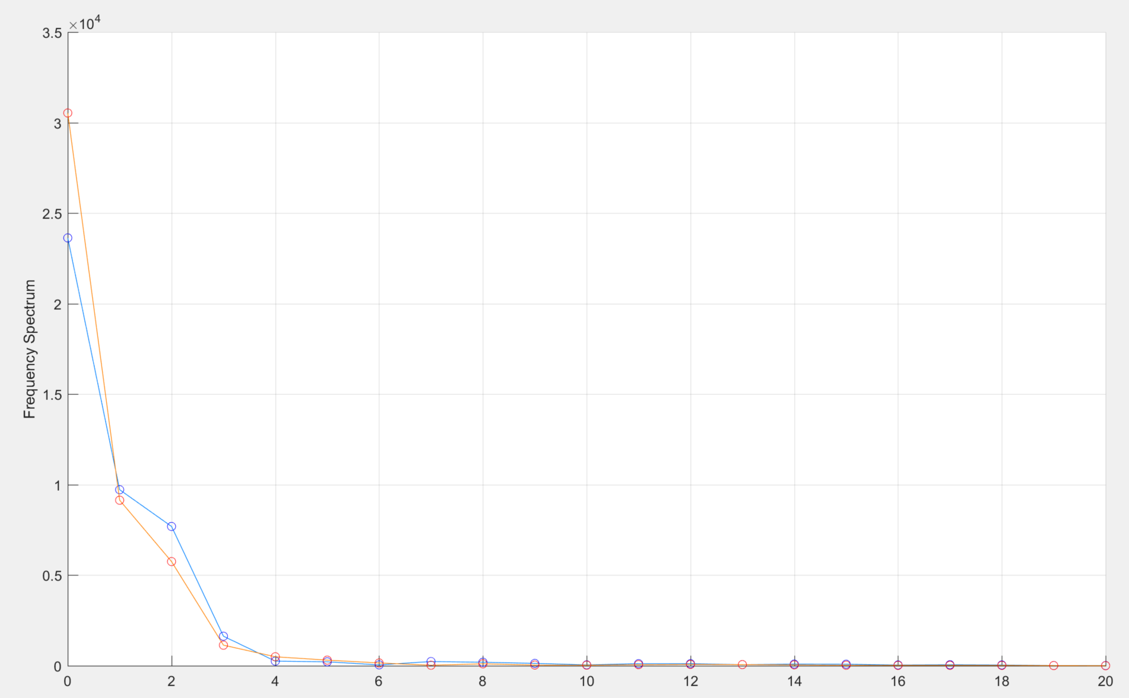
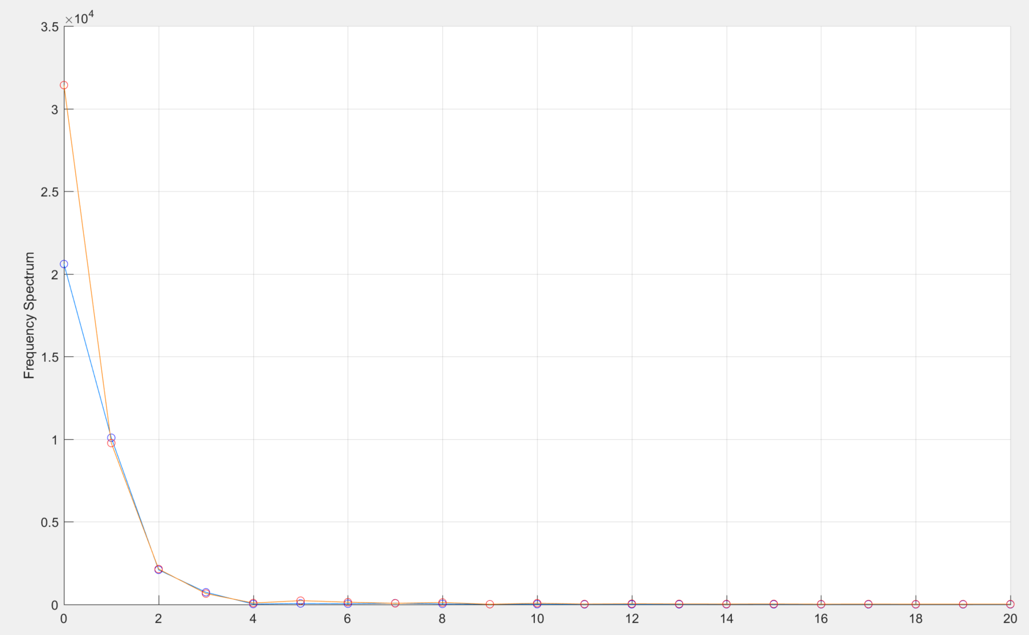
Fourier Analysis of Reference Joint Angles
Ankle
Knee
Hip
Reference 3
Frequency Spectrum
Frequency Spectrum
Frequency Spectrum
Conclusion:
At frequency zero, foot drop shows lower amplitude than normal. Later at higher frequency, the amplitude of foot drop increases to the peak much higher than normal, then decline
The amplitudes of foot drop gait FT are generally higher than normal at any frequency, which means foot drop hip joint angles are higher than normal, especially at frequency zero

Slide 4
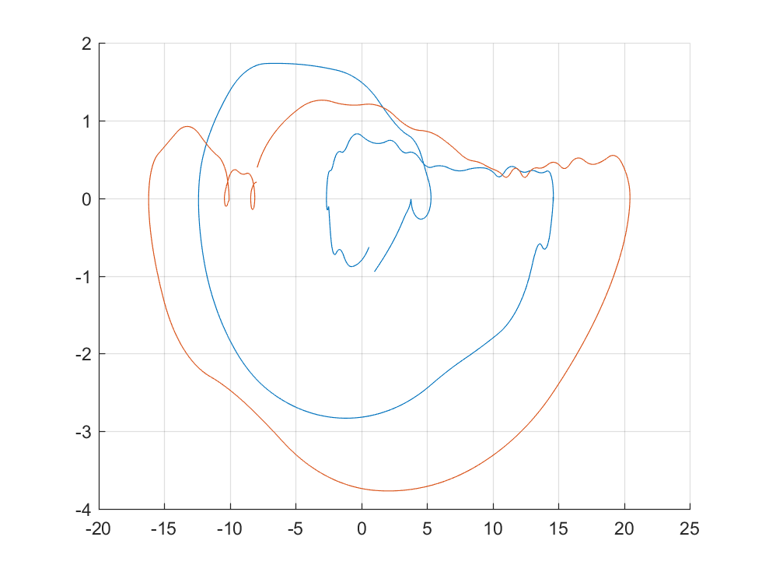
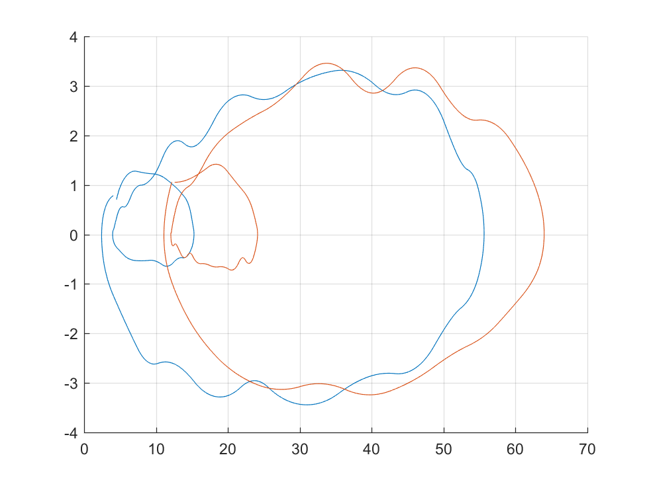
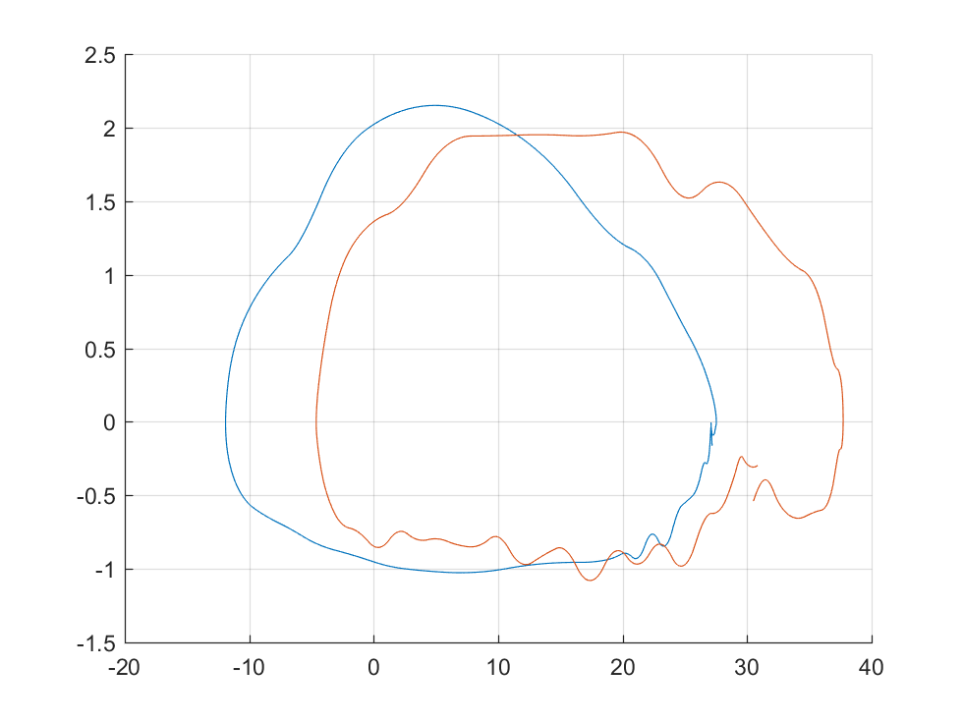
Phase Portrait of Reference Joint Angles
Ankle
Knee
Hip
Reference 1
Normal
Foot Drop
Phase Portrait
Phase Portrait
Phase Portrait

Slide 5
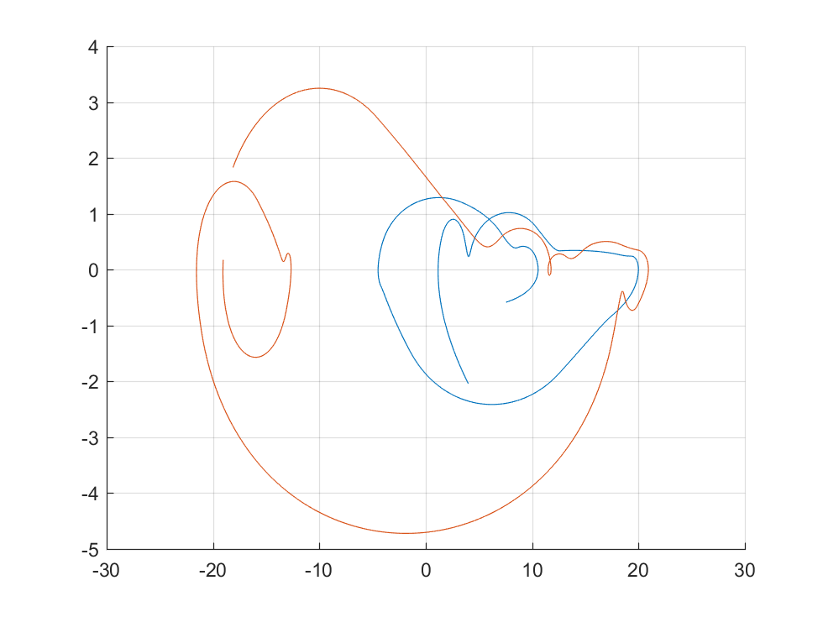
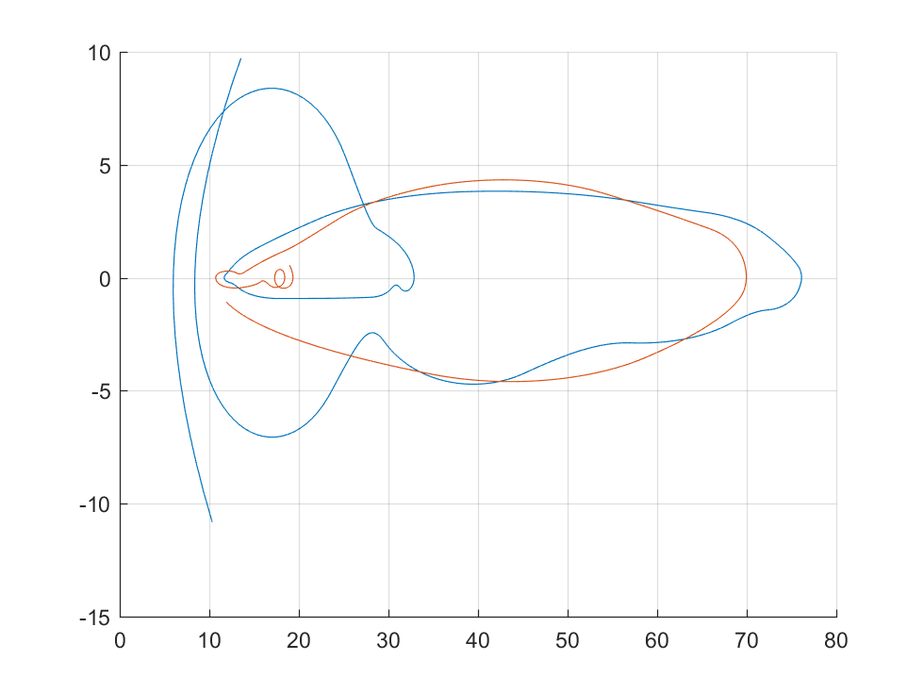
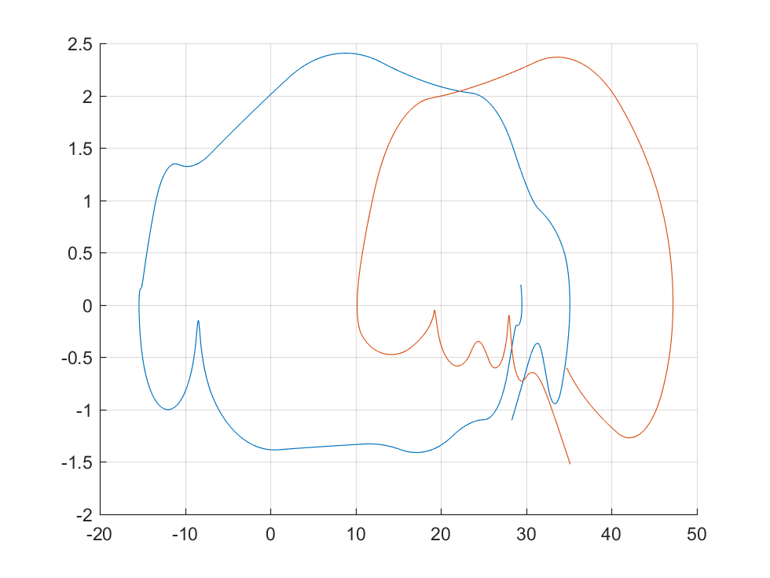
Fourier Analysis of Reference Joint Angles
Ankle
Knee
Hip
Reference 2
Normal
Foot Drop
Phase Portrait
Phase Portrait
Phase Portrait

Slide 6
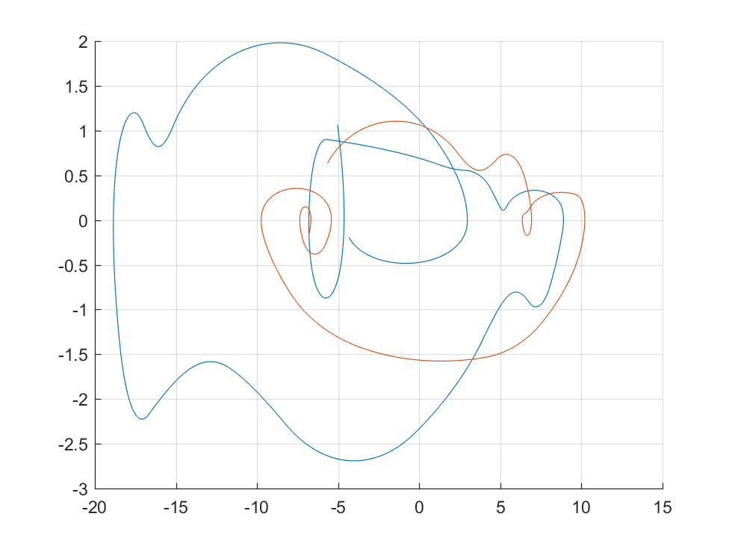
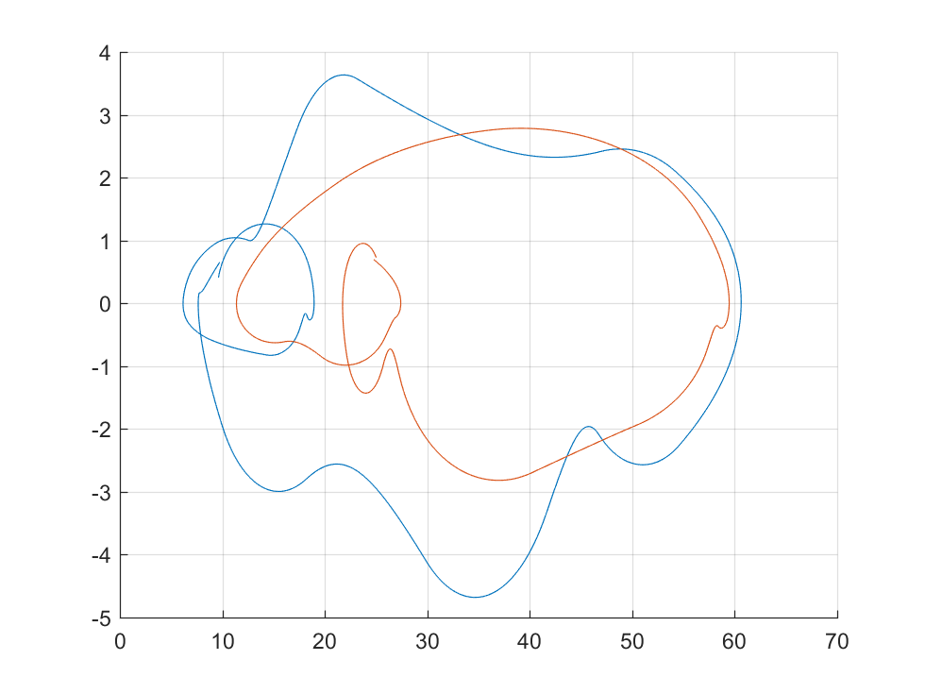
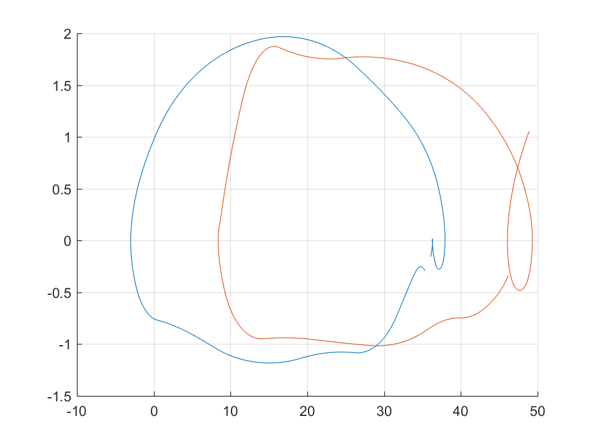
Fourier Analysis of Reference Joint Angles
Ankle
Knee
Hip
Reference 3
Phase Portrait
Phase Portrait
Phase Portrait
Conclusion:
During swing phase, the joint angle of ankle is generally lower in foot drop gait
Joint angle of hip is higher in drop foot gait

