Slide 1
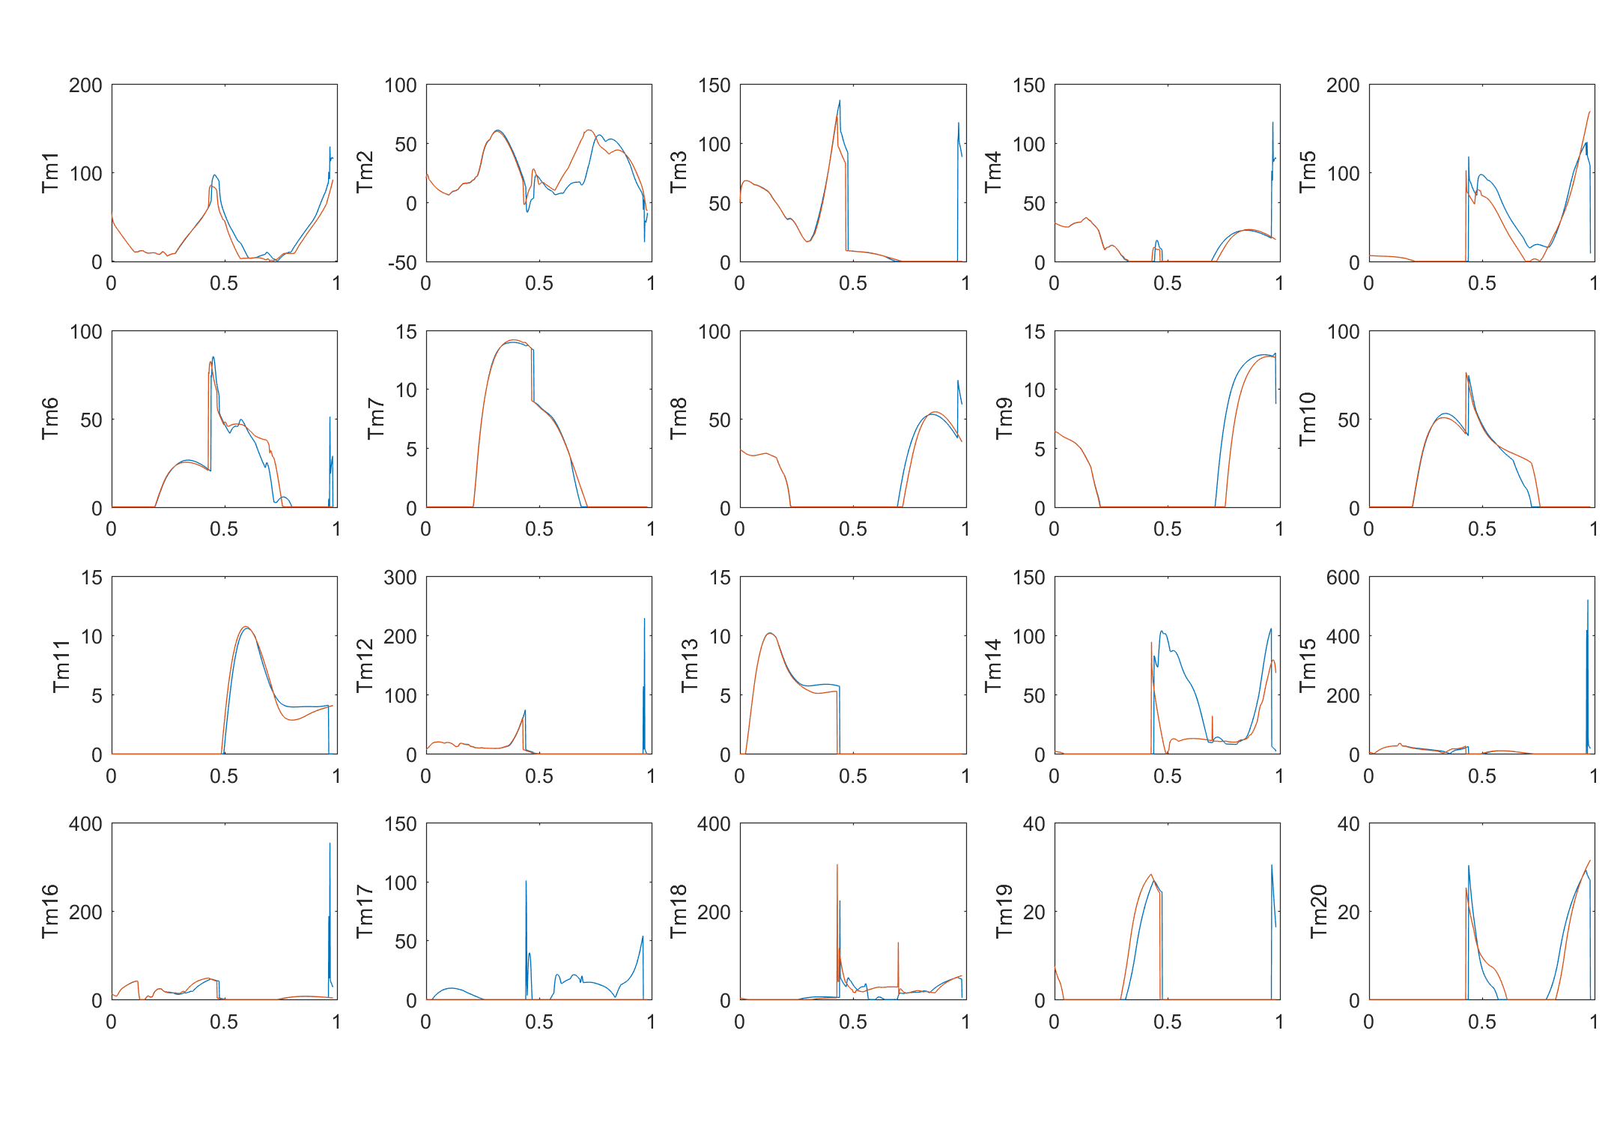
Normal
DisableTm17

Slide 2
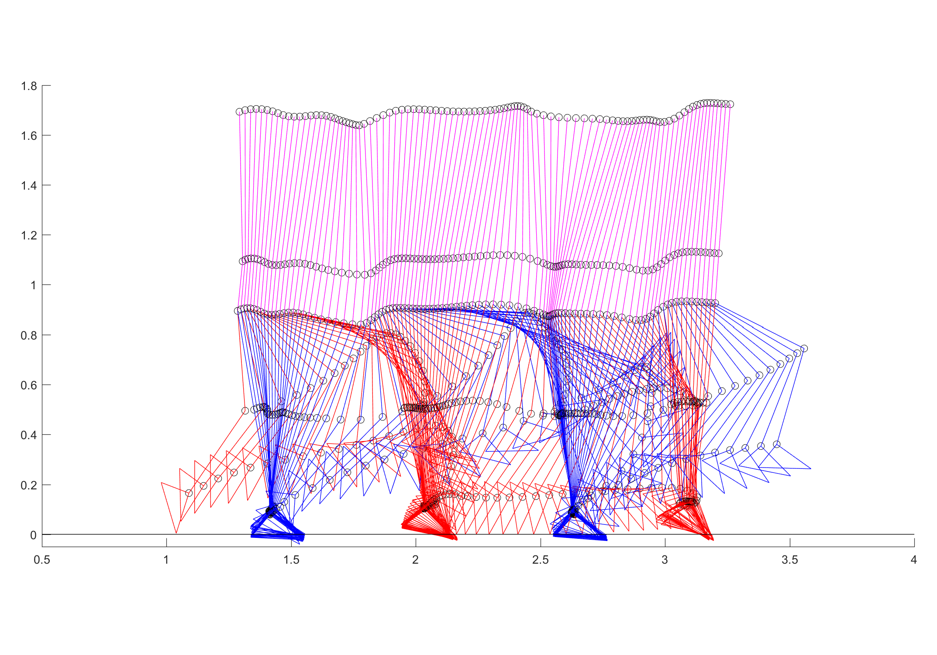
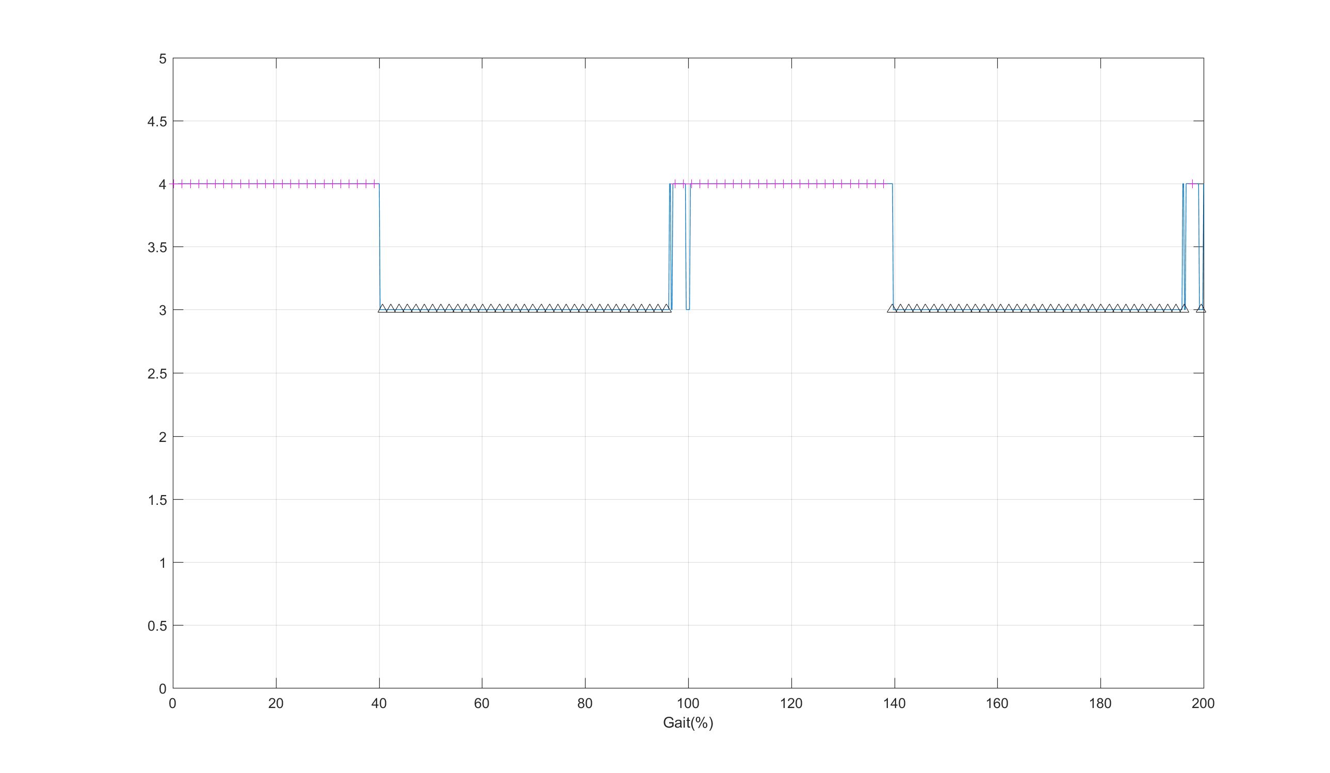
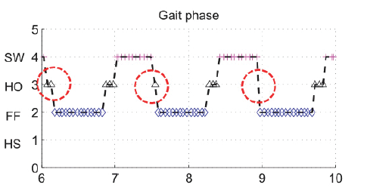
Set u(13) = 0
Initial Condition, u(13)=0; u_dot(13)=0;
Result I: Stance Sequence
Stance
Heel off
Flat foot
Heel strike
Toe dragging

Slide 3
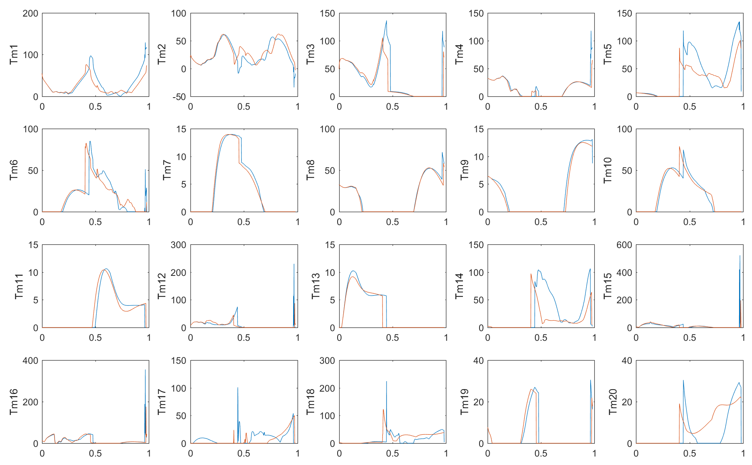
Normal
DisableU13
Increase of plantarflexion during stance phase

