Slide 1
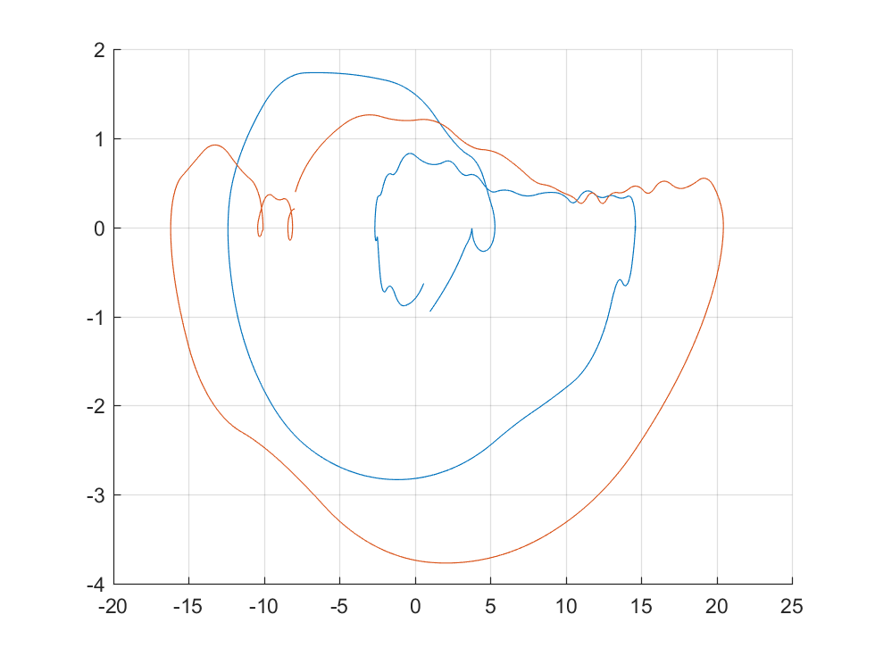
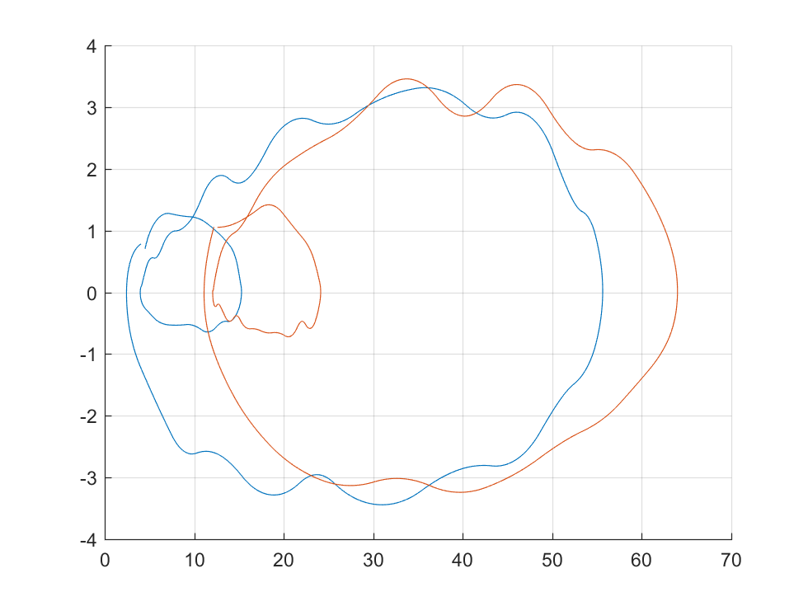
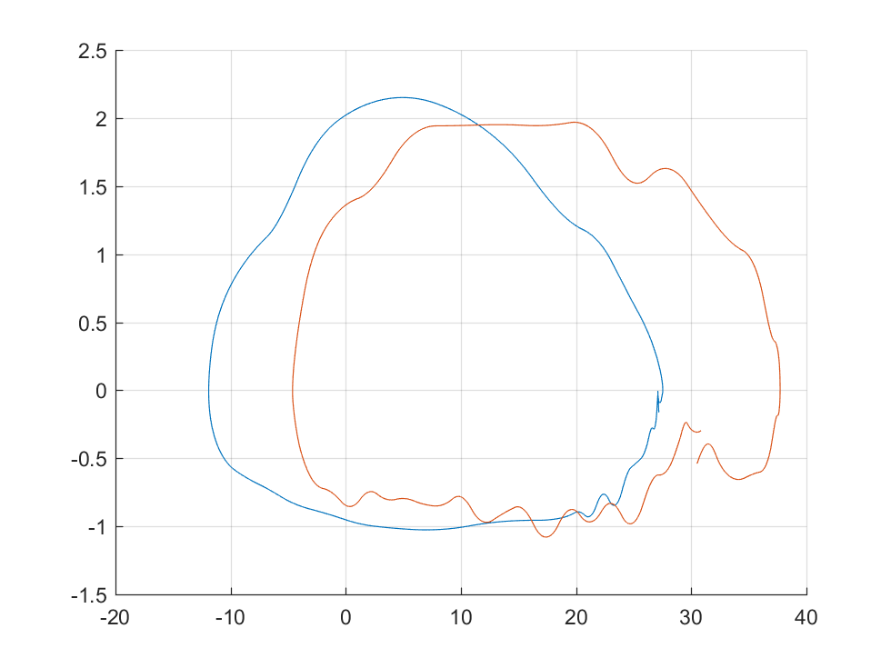
Phase Portrait of Reference Joint Angles
Ankle
Knee
Hip
Reference 1
Normal
Foot Drop
Phase Portrait
Phase Portrait
Phase Portrait
At peak of each gait, the phase portrait of foot drop is larger than that of normal in horizontal dimension.
But, it is lower than that of normal during swing phase.
In horizontal dimension (dimension of position), the foot drop gait is generally right-shift of normal, which means foot drop hip angle is higher than normal

Slide 2
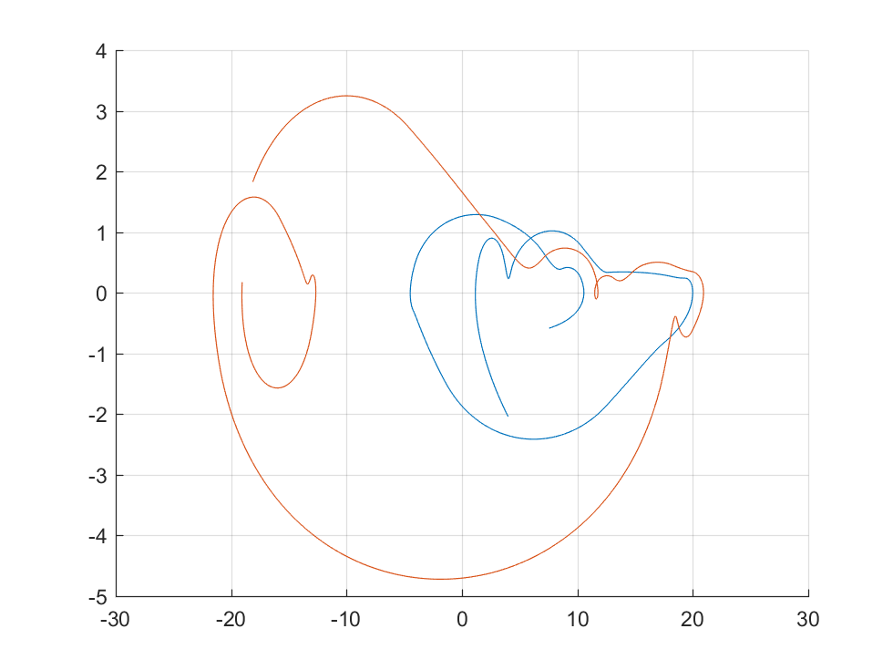
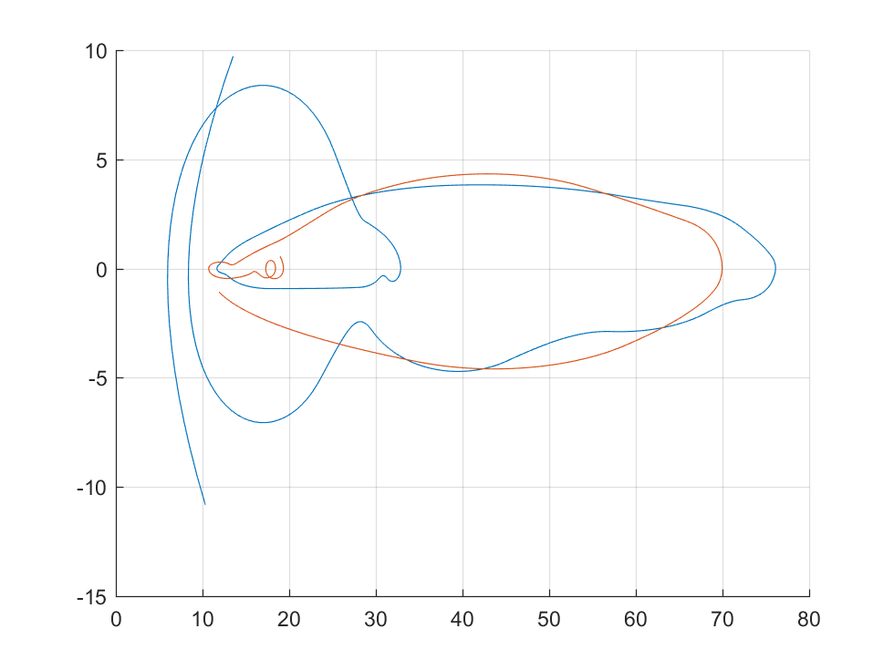
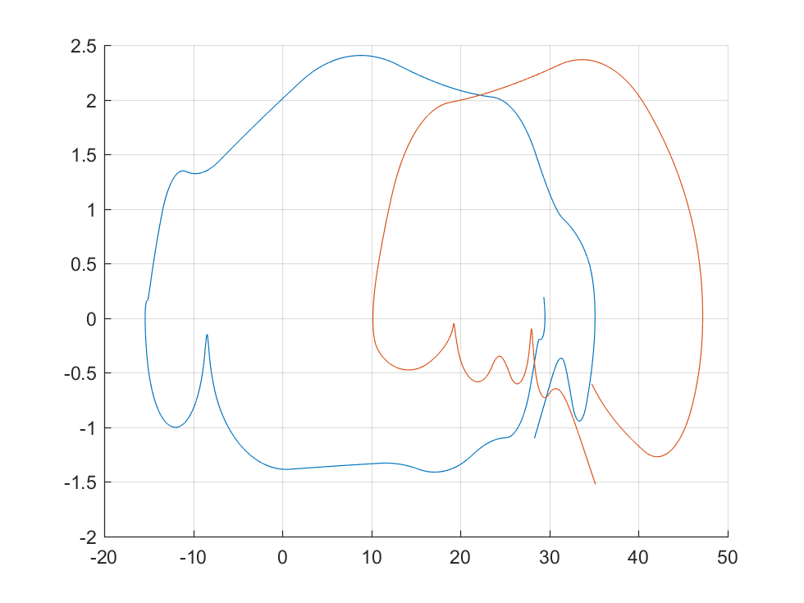
Fourier Analysis of Reference Joint Angles
Ankle
Knee
Hip
Reference 2
Normal
Foot Drop
Phase Portrait
Phase Portrait
Phase Portrait

Slide 3
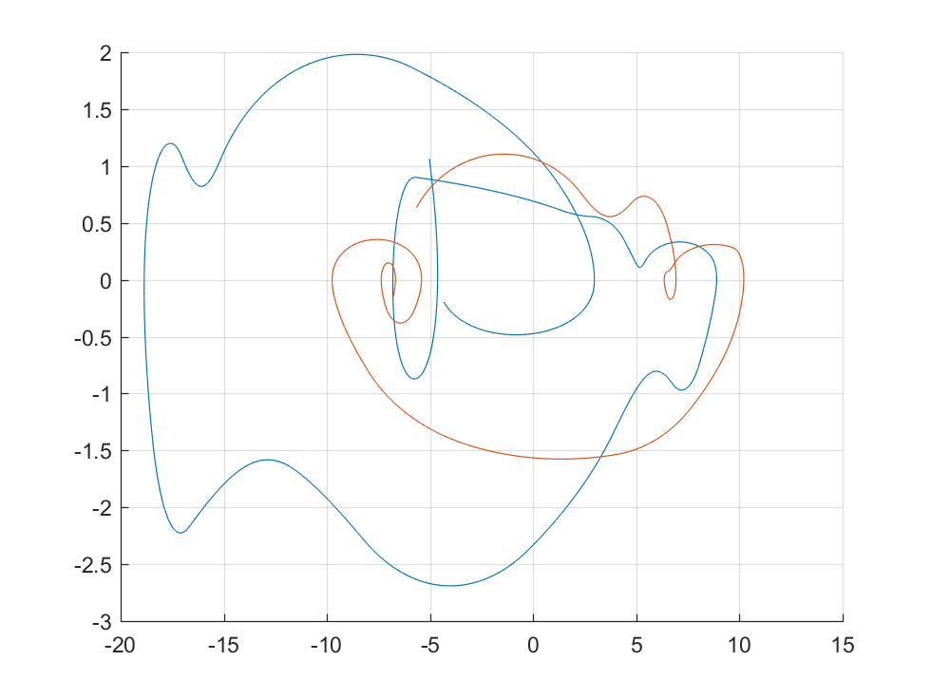
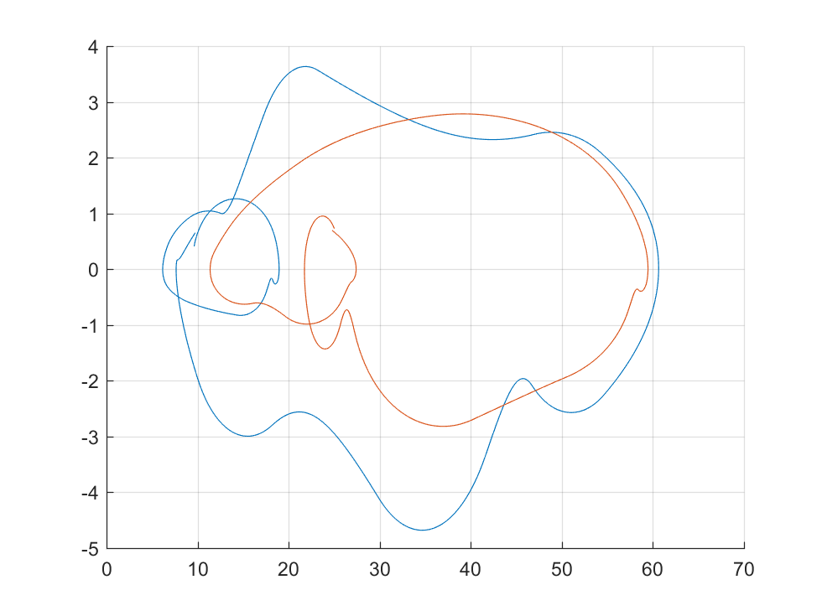
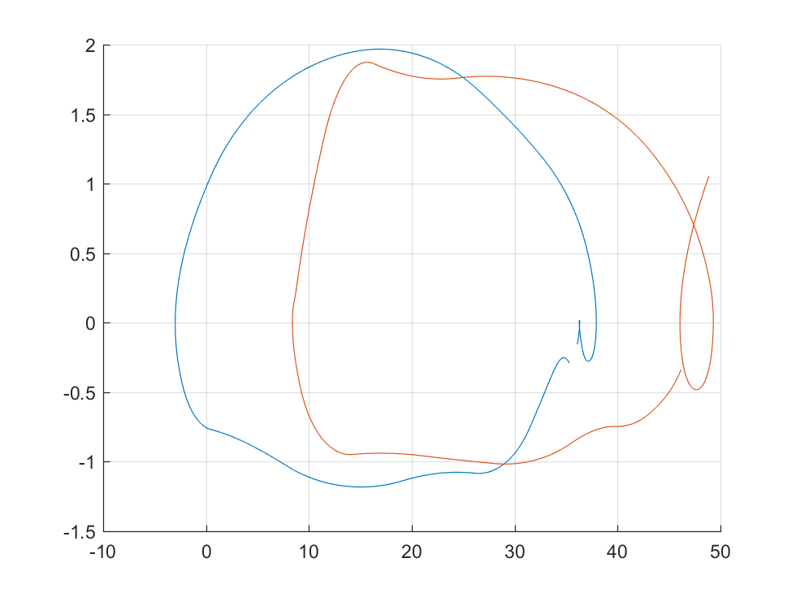
Fourier Analysis of Reference Joint Angles
Ankle
Knee
Hip
Reference 3
Phase Portrait
Phase Portrait
Phase Portrait
Conclusion:
During swing phase, the joint angle of ankle is generally lower in foot drop gait
Joint angle of hip is higher in drop foot gait

