Slide 1
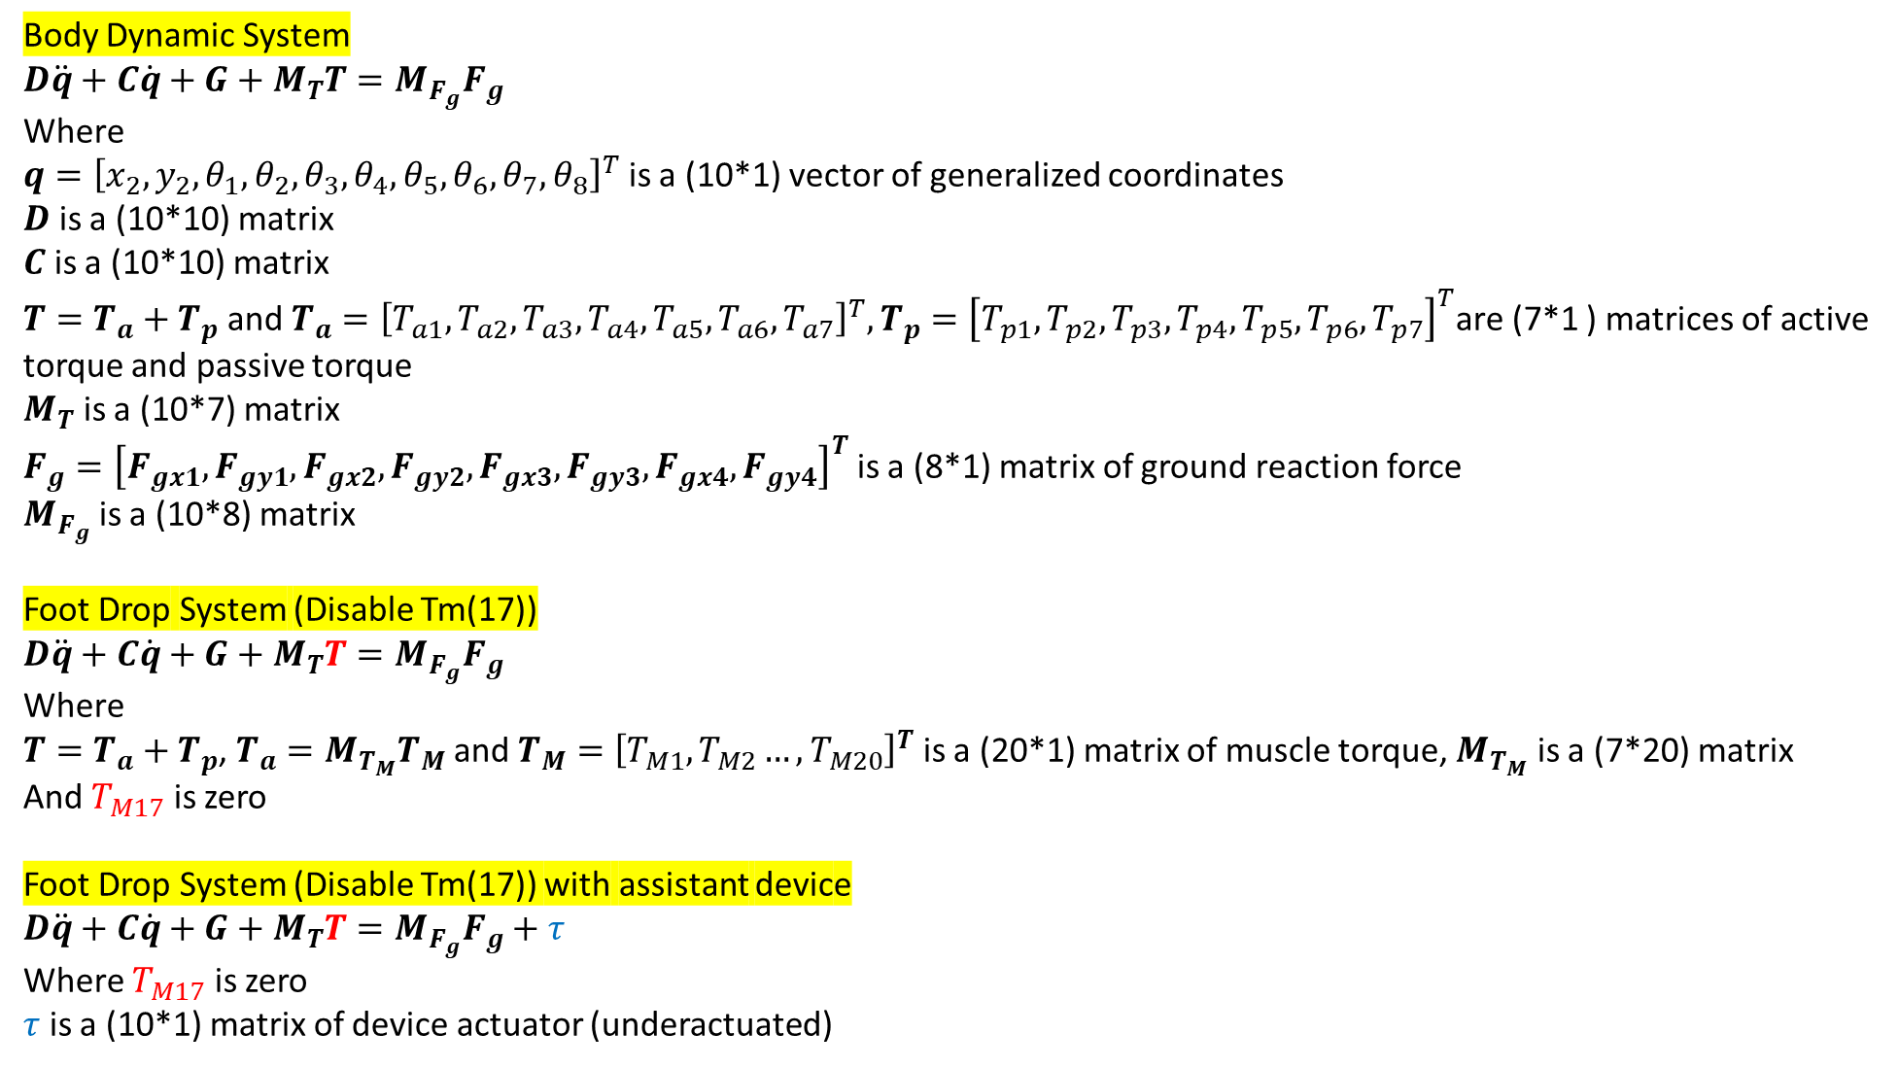
Body Dynamic System
$$D\ddot{q}+C\dot{q}+G+M_{T}T=M_{F_{g}}F_{g}$$
Where
$q={\left[x_{2},y_{2},θ_{1},θ_{2},θ_{3},θ_{4},θ_{5},θ_{6},θ_{7},θ_{8}\right]}^{T}$ is a (10*1) vector of generalized coordinates
$D$ is a (10*10) matrix
$C$ is a (10*10) matrix
$T=T_{a}+T_{p}$ and $T_{a}={\left[T_{a1},T_{a2},T_{a3},T_{a4},T_{a5},T_{a6},T_{a7}\right]}^{T},T_{p}={\left[T_{p1},T_{p2},T_{p3},T_{p4},T_{p5},T_{p6},T_{p7}\right]}^{T}$are (7*1 ) matrices of active torque and passive torque
$M_{T}$ is a (10*7) matrix
$F_{g}={\left[F_{gx1},F_{gy1},F_{gx2},F_{gy2},F_{gx3},F_{gy3},F_{gx4},F_{gy4}\right]}^{T}$ is a (8*1) matrix of ground reaction force
$M_{F_{g}}$ is a (10*8) matrix
Foot Drop System (Disable Tm(17))
$$D\ddot{q}+C\dot{q}+G+M_{T}T=M_{F_{g}}F_{g}$$
Where
$T=T_{a}+T_{p}$, $T_{a}=M_{T_{M}}T_{M}$ and $T_{M}={\left[T_{M1},T_{M2}…,T_{M20}\right]}^{T}$ is a (20*1) matrix of muscle torque, $M_{T_{M}}$ is a (7*20) matrix
And $T_{M17}$ is zero
Foot Drop System (Disable Tm(17)) with assistant device
$$D\ddot{q}+C\dot{q}+G+M_{T}T=M_{F_{g}}F_{g}+τ$$
Where $T_{M17}$ is zero
$τ$ is a (10*1) matrix of device actuator (underactuated)

Slide 2
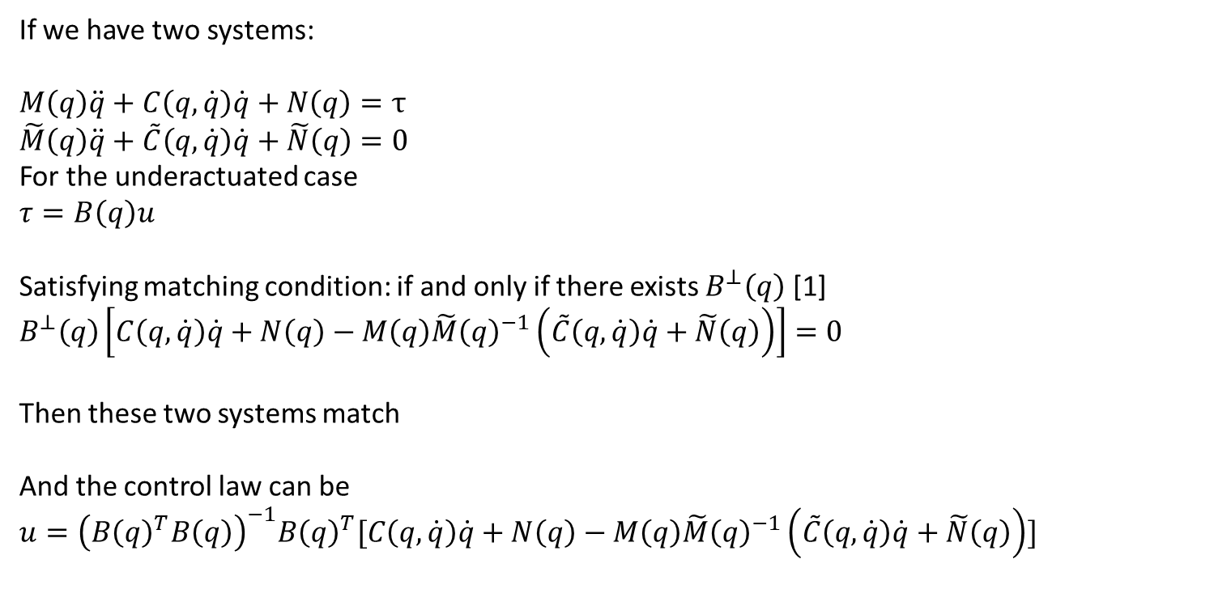
Review of literature: Energy-shaping control of lower limb exoskeleton
If we have two systems:
$M\left(q\right)\ddot{q}+C\left(q,\dot{q}\right)\dot{q}+N\left(q\right)=τ$
$\tilde{M}\left(q\right)\ddot{q}+\tilde{C}\left(q,\dot{q}\right)\dot{q}+\tilde{N}\left(q\right)=0$
For the underactuated case
$$τ=B\left(q\right)u$$
Satisfying matching condition: if and only if there exists $B^{⊥}\left(q\right)$ [1]
$$B^{⊥}\left(q\right)\left[C\left(q,\dot{q}\right)\dot{q}+N\left(q\right)−M\left(q\right)\tilde{M}{\left(q\right)}^{−1}\left(\tilde{C}\left(q,\dot{q}\right)\dot{q}+\tilde{N}\left(q\right)\right)\right]=0$$
Then these two systems match
And the control law can be
$$u={\left(B{\left(q\right)}^{T}B\left(q\right)\right)}^{−1}B{\left(q\right)}^{T}[C\left(q,\dot{q}\right)\dot{q}+N\left(q\right)−M\left(q\right)\tilde{M}{\left(q\right)}^{−1}\left(\tilde{C}\left(q,\dot{q}\right)\dot{q}+\tilde{N}\left(q\right)\right)]$$
[1] Blankenstein, Guido, Romeo Ortega, and Arjan J. Van Der Schaft. "The matching conditions of controlled Lagrangians and IDA-passivity based control." International Journal of Control75.9 (2002): 645-665.

Slide 3
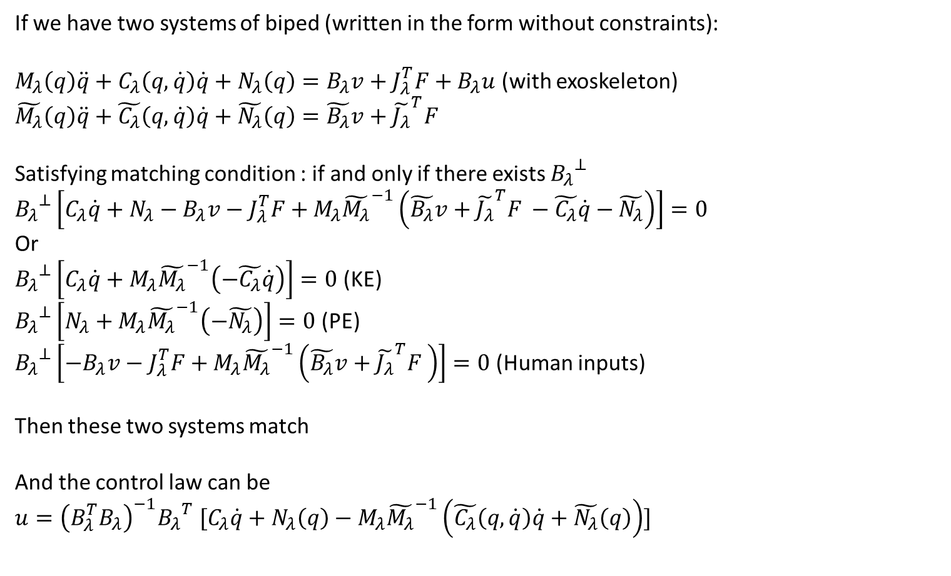
Review of literature: Energy-shaping control of lower limb exoskeleton
If we have two systems of biped (written in the form without constraints):
$M_{λ}\left(q\right)\ddot{q}+C_{λ}\left(q,\dot{q}\right)\dot{q}+N_{λ}\left(q\right)=B_{λ}v+J_{λ}^{T}F+B_{λ}u$ (with exoskeleton)
$$\tilde{M_{λ}}\left(q\right)\ddot{q}+\tilde{C_{λ}}\left(q,\dot{q}\right)\dot{q}+\tilde{N_{λ}}\left(q\right)=\tilde{B_{λ}}v+{\tilde{J_{λ}}}^{T}F$$
Satisfying matching condition : if and only if there exists ${B_{λ}}^{⊥}$
$${B_{λ}}^{⊥}\left[C_{λ}\dot{q}+N_{λ}−B_{λ}v−J_{λ}^{T}F+M_{λ}{\tilde{M_{λ}}}^{−1}\left(\tilde{B_{λ}}v+{\tilde{J_{λ}}}^{T}F −\tilde{C_{λ}}\dot{q}−\tilde{N_{λ}}\right)\right]=0$$
Or
${B_{λ}}^{⊥}\left[C_{λ}\dot{q}+M_{λ}{\tilde{M_{λ}}}^{−1}\left(−\tilde{C_{λ}}\dot{q}\right)\right]=0$ (KE)
${B_{λ}}^{⊥}\left[N_{λ}+M_{λ}{\tilde{M_{λ}}}^{−1}\left(−\tilde{N_{λ}}\right)\right]=0$ (PE)
${B_{λ}}^{⊥}\left[−B_{λ}v−J_{λ}^{T}F+M_{λ}{\tilde{M_{λ}}}^{−1}\left(\tilde{B_{λ}}v+{\tilde{J_{λ}}}^{T}F \right)\right]=0$ (Human inputs)
Then these two systems match
And the control law can be
$$u={\left(B_{λ}^{T}B_{λ}\right)}^{−1}{B_{λ}}^{T} [C_{λ}\dot{q}+N_{λ}\left(q\right)−M_{λ}{\tilde{M_{λ}}}^{−1}\left(\tilde{C_{λ}}\left(q,\dot{q}\right)\dot{q}+\tilde{N_{λ}}\left(q\right)\right)]$$

Slide 4
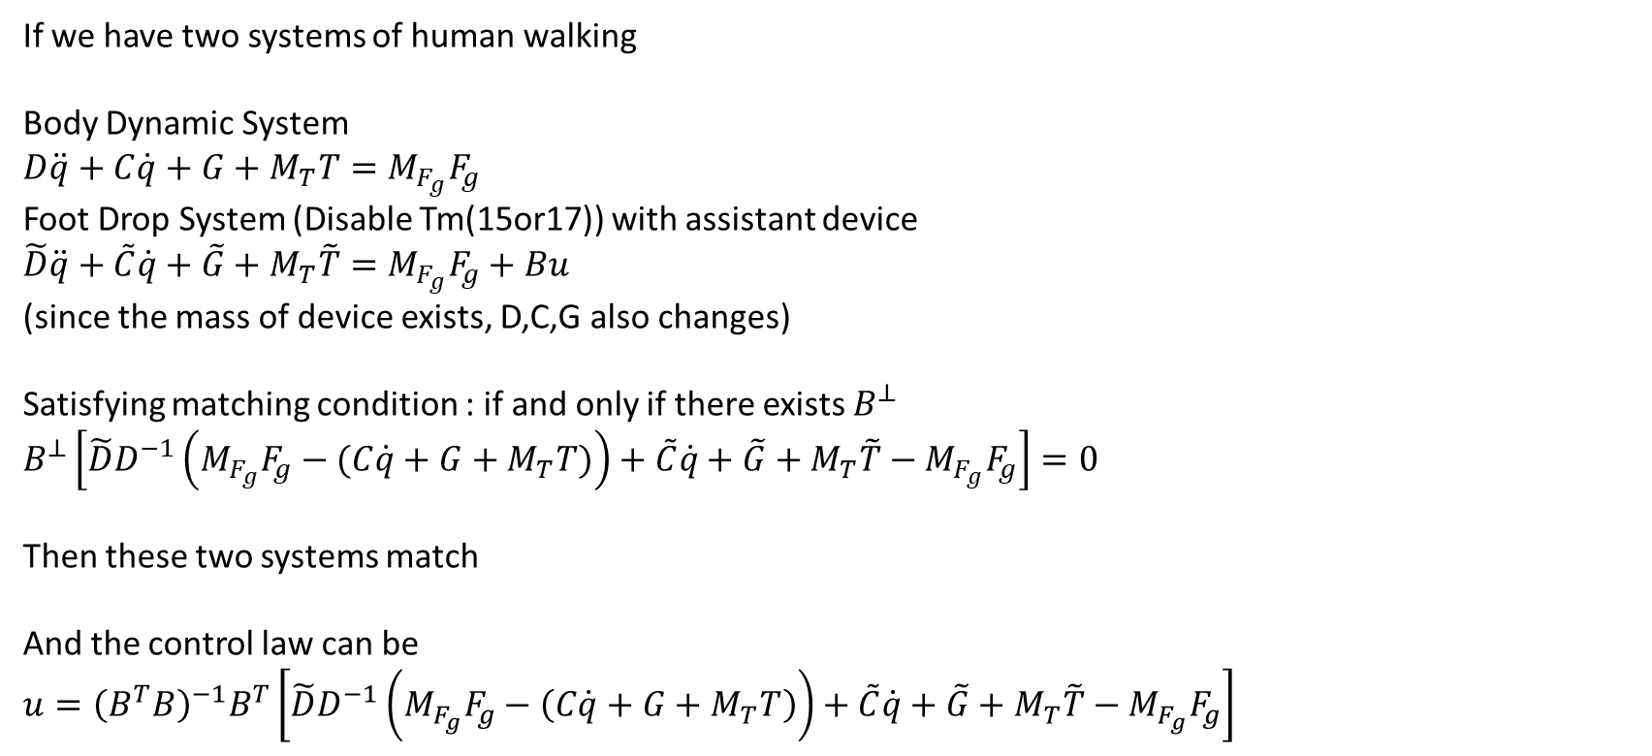
Then we can pose the problem as:
If we have two systems of human walking
Body Dynamic System
$$D\ddot{q}+C\dot{q}+G+M_{T}T=M_{F_{g}}F_{g}$$
Foot Drop System (Disable Tm(15or17)) with assistant device
$$\tilde{D}\ddot{q}+\tilde{C}\dot{q}+\tilde{G}+M_{T}\tilde{T}=M_{F_{g}}F_{g}+Bu$$
(since the mass of device exists, D,C,G also changes)
Satisfying matching condition : if and only if there exists $B^{⊥}$
$$B^{⊥}\left[\tilde{D}D^{−1}\left(M_{F_{g}}F_{g}−(C\dot{q}+G+M_{T}T)\right)+\tilde{C}\dot{q}+\tilde{G}+M_{T}\tilde{T}−M_{F_{g}}F_{g}\right]=0$$
Then these two systems match
And the control law can be
$$u={\left(B^{T}B\right)}^{−1}B^{T}\left[\tilde{D}D^{−1}\left(M_{F_{g}}F_{g}−\left(C\dot{q}+G+M_{T}T\right)\right)+\tilde{C}\dot{q}+\tilde{G}+M_{T}\tilde{T}−M_{F_{g}}F_{g}\right]$$

