Slide 1
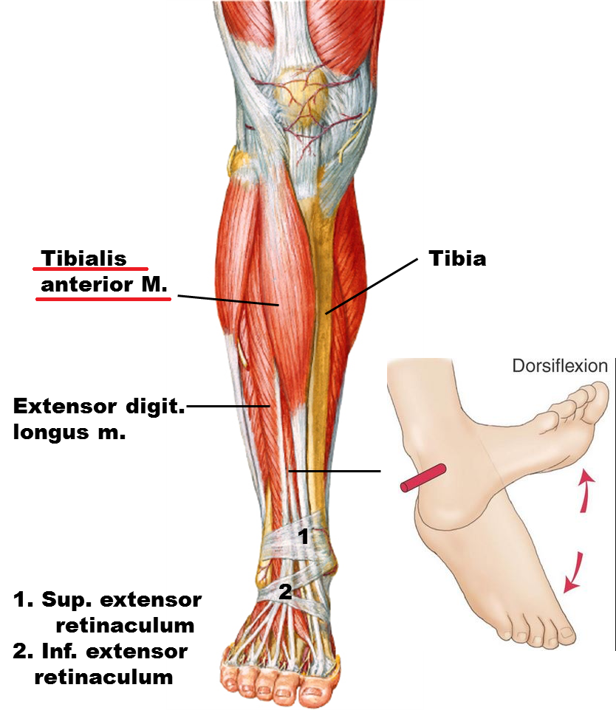
Cause of Foot Drop
Most of the time, foot drop is the result of neurological disorder [1]
With respect to the muscles that are influenced, foot drop can be defined as the weakness of tibialis anterior [3].
The anterior tibialis is the muscle that picks up the foot, responsible for dorsiflexion and inverting the foot
[1] Pritchett, James W., and M. A. Porembski. "Foot drop." E-Medicine.[Online] (2006).
[2] Stewart, John D. "Foot drop: where, why and what to do?." Practical neurology 8.3 (2008): 158-169.
[3] Westhout, Franklin D., Laura S. Paré, and Mark E. Linskey. "Central causes of foot drop: rare and underappreciated differential diagnoses." The journal of spinal cord medicine 30.1 (2007): 62-66.

Slide 2
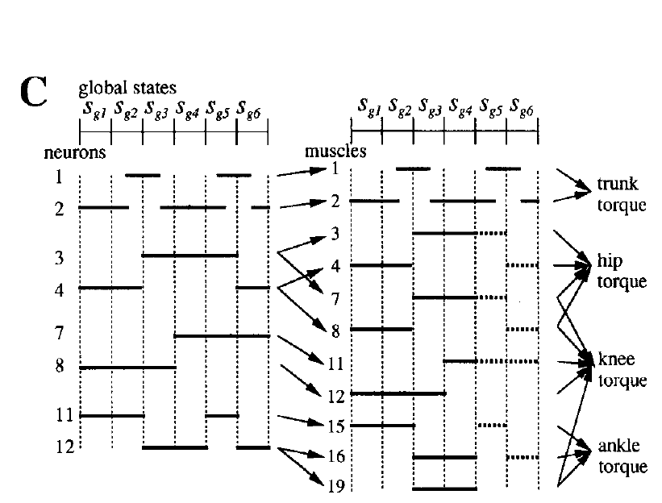
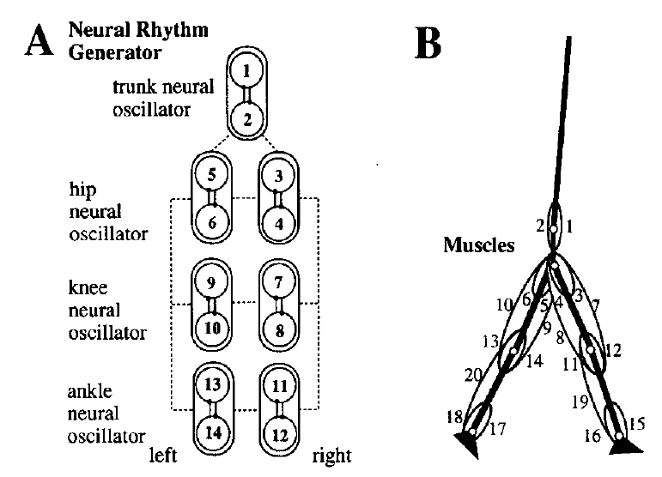
Muscles in the Model
1 Rectus abdominis
2 Erector spinae
3,5 Iliopsoas
4,6 gluteus maximus
7,9 Rectus Femoris
8,10 Hamstrings
11,13 Biceps femoris
12,14 Vastus
15,17 Tibialis anterior
16,18 Soleus
19,20 Gastrocnemius
These muscle torques are actuated by the neural oscillators, which send different signals in different stages (phases), and can be combined as active torques at each joint.

Slide 3
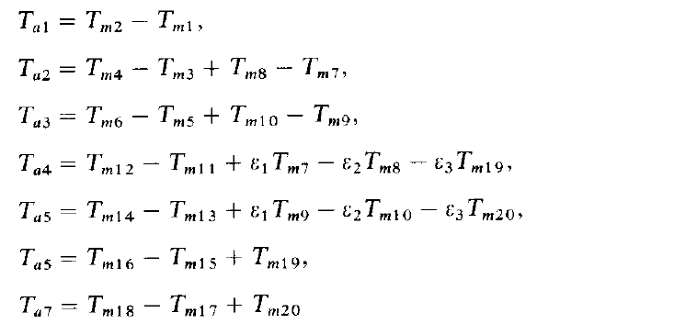
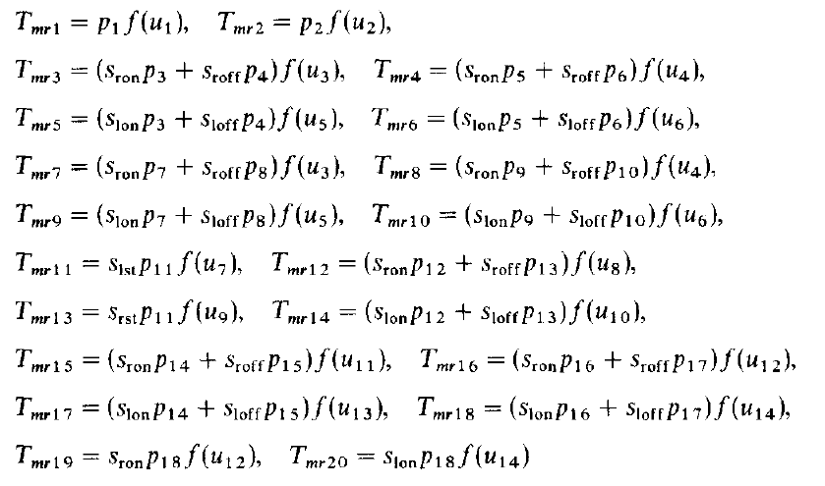
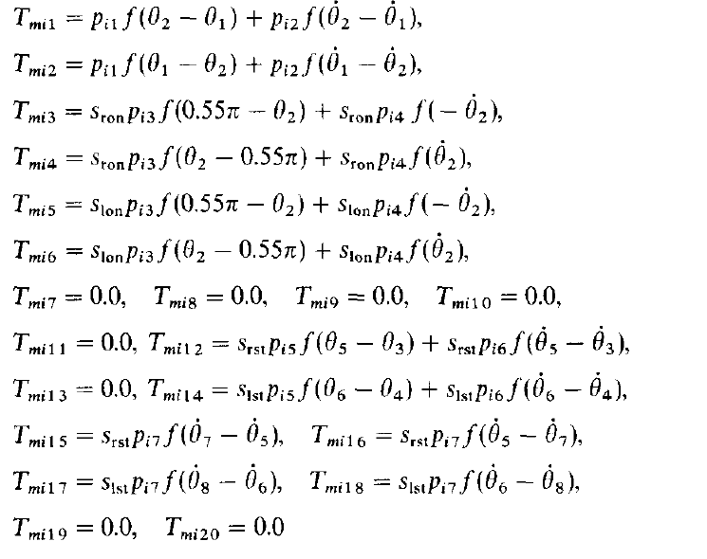
Subsystems: Active Torque
$$T_{m}=T_{mr}+T_{mi}$$
By the output of the neural rhythm generator
Assuming muscle forces are proportional to the output of the neural system
Tmr
By the impedance controller
Consists of elastic and damping forces
Tmi

Slide 4
Subsystems: Active Torque
Active torque consists of rhythmic force (proportional to the output of neural system), elastic force and damping force
Active Torque 1
$T_{a1}=T_{m2}−T_{m1}=p_{2}f\left(u_{2}\right)+p_{i1}f\left(θ_{1}−θ_{2}\right)+p_{i2}f\left(\dot{θ_{1}}−\dot{θ_{2}}\right)−p_{1}f\left(u_{1}\right)−$ $p_{i1}f\left(θ_{2}−θ_{1}\right)−p_{i2}f\left(\dot{θ_{2}}−\dot{θ_{1}}\right)=\left(p_{2}f\left(u_{2}\right)−p_{1}f\left(u_{1}\right)\right)+p_{i1}\left(f\left(θ_{1}−θ_{2}\right)−f\left(θ_{2}−θ_{1}\right)\right)+p_{i2}\left(f\left(\dot{θ_{1}}−\dot{θ_{2}}\right)−f\left(\dot{θ_{2}}−\dot{θ_{1}}\right)\right)$
Rhythmic Force
Elastic
Damping
Active Torque 3: Stage 1
$$T_{a3}=T_{m6}−T_{m5}+T_{m10}−T_{m9}=\left((p_{5}+p_{9}) f\left(u_{6}\right)−(p_{3}+p_{7})f\left(u_{5}\right)\right)+p_{i3}\left(f\left(θ_{2}−0.55π\right)−f\left(0.55π−θ_{2}\right)\right)+p_{i4}\left(f\left(\dot{θ_{2}}\right)−f\left(−\dot{θ_{2}}\right)\right)$$
Active Torque 3: Stage 2
$$T_{a3}=T_{m6}−T_{m5}+T_{m10}−T_{m9}=\left((p_{6}+p_{10}) f\left(u_{6}\right)−(p_{4}+p_{8})f\left(u_{5}\right)\right)$$
Active Torque 3: Stage 3
$$T_{a3}=T_{m6}−T_{m5}+T_{m10}−T_{m9}=\left((p_{6}+p_{10}) f\left(u_{6}\right)−(p_{4}+p_{8})f\left(u_{5}\right)\right)$$
Active Torque 3: Stage 4
$$T_{a3}=T_{m6}−T_{m5}+T_{m10}−T_{m9}=\left((p_{5}+p_{9}) f\left(u_{6}\right)−(p_{3}+p_{7})f\left(u_{5}\right)\right)+p_{i3}\left(f\left(θ_{2}−0.55π\right)−f\left(0.55π−θ_{2}\right)\right)+p_{i4}\left(f\left(\dot{θ_{2}}\right)−f\left(−\dot{θ_{2}}\right)\right)$$
Active Torque 3: Stage 5
$$T_{a3}=T_{m6}−T_{m5}+T_{m10}−T_{m9}=\left((p_{5}+p_{9}) f\left(u_{6}\right)−(p_{3}+p_{7})f\left(u_{5}\right)\right)+p_{i3}\left(f\left(θ_{2}−0.55π\right)−f\left(0.55π−θ_{2}\right)\right)+p_{i4}\left(f\left(\dot{θ_{2}}\right)−f\left(−\dot{θ_{2}}\right)\right)$$
Active Torque 3: Stage 6
$$T_{a3}=T_{m6}−T_{m5}+T_{m10}−T_{m9}=\left((p_{5}+p_{9}) f\left(u_{6}\right)−(p_{3}+p_{7})f\left(u_{5}\right)\right)+p_{i3}\left(f\left(θ_{2}−0.55π\right)−f\left(0.55π−θ_{2}\right)\right)+p_{i4}\left(f\left(\dot{θ_{2}}\right)−f\left(−\dot{θ_{2}}\right)\right)$$

Slide 5
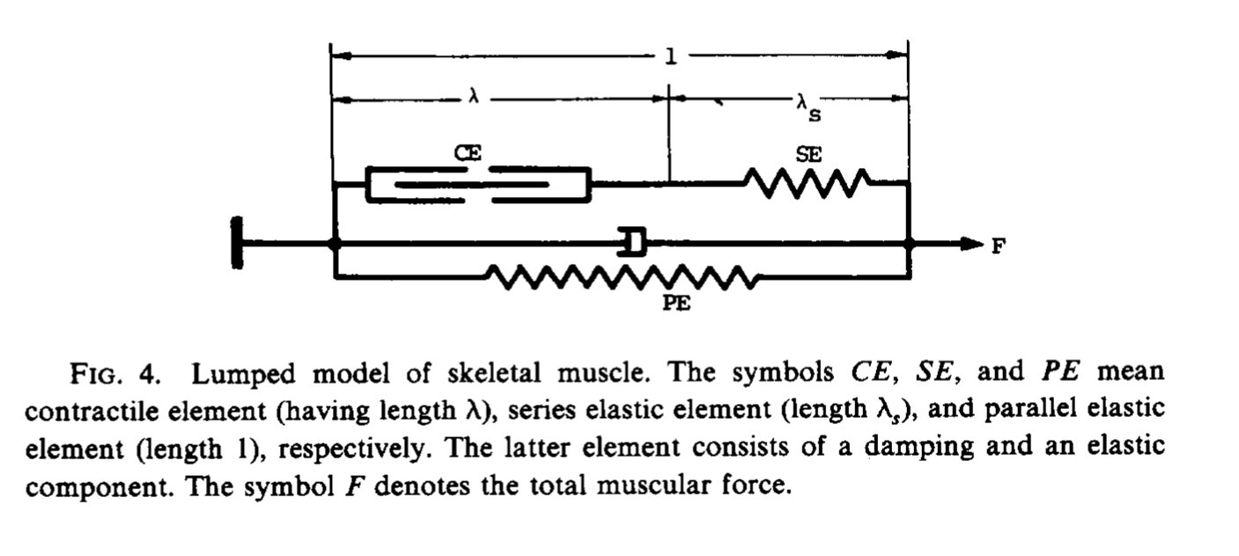
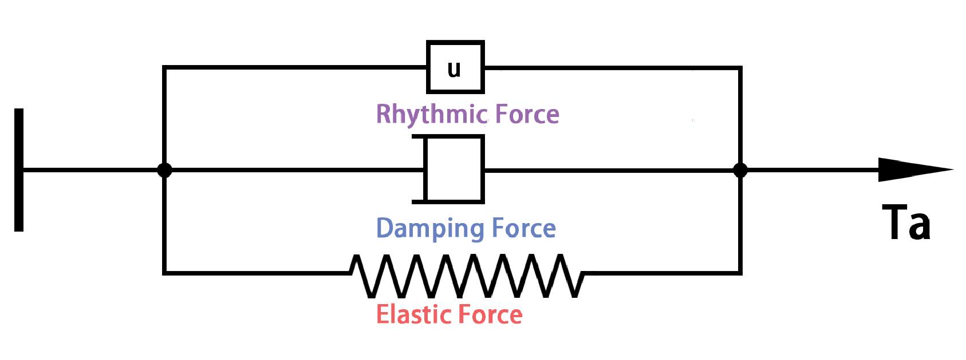
Subsystems: Active Torque
From Hatze 1976 [1], the active torque exerted by a muscle should be given by the muscle force multiplied by its moment arm, which changes according to the displacement of the joint angle
By the output of the neural rhythm generator
For simplicity, assume the moment arms of the muscles have constant values and the muscle forces are proportional to the output of the neural system
Active torque consists of rhythmic force (proportional to the output of neural system), elastic force and damping force
By the impedance controller
[1] Hatze, Herbert. "The complete optimization of a human motion." Mathematical Biosciences 28.1-2 (1976): 99-135.

Slide 6
Muscles in the Model
1 Rectus abdominis
2 Erector spinae
3,5 Iliopsoas
4,6 gluteus maximus
7,9 Rectus Femoris
8,10 Hamstrings
11,13 Biceps femoris
12,14 Vastus
15,17 Tibialis anterior
16,18 Soleus
19,20 Gastrocnemius
Simulation is done when one of the tibialis anterior muscle torques is disabled

Slide 7
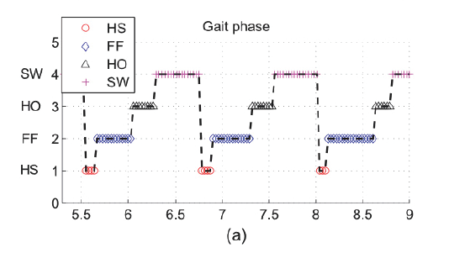
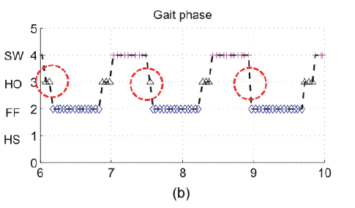
Simulation Result I: Gait Difference in Stance
Normal Gait:
Heel Strike – Flat Foot – Heel Off – Swing
Foot Drop Gait:
Heel Off – Flat Foot – Heel Off – Swing
[1] Gu, Gwang Min, et al. "SMAFO: Stiffness modulated Ankle Foot Orthosis for a patient with foot drop." Rehabilitation Robotics (ICORR), 2015 IEEE International Conference on. IEEE, 2015.

Slide 8
Simulation Result II: Reference Joint Angles
[1] Winters, T. F., J. R. Gage, and R. Hicks. "Gait patterns in spastic hemiplegia in children and young adults." J Bone Joint Surg Am69.3 (1987): 437-441.
[2] Matinmanesh, Ali, and Mohammadreza Mallakzadeh. "Inverse kinetic and kinematic analysis of drop-foot patient's walking." E-Health and Bioengineering Conference (EHB), 2011. IEEE, 2011.
[3] Simonsen, Erik B., et al. "Redistribution of joint moments during walking in patients with drop-foot." Clinical Biomechanics 25.9 (2010): 949-952.
Ankle
Knee
Hip
Reference 1 [1]
Reference 2 [2]
Reference 3 [3]

Slide 9
Simulation Result II: Fourier Analysis of Reference Joint Angles
Amplitude
Amplitude
Normal
Foot Drop
Normal
Foot Drop
Ankle
Phase
Phase
Amplitude
Amplitude
Knee
Phase
Phase
Amplitude
Amplitude
Hip
Phase
Phase
Reference 1
Reference 2

Slide 10
Simulation Result II: Fourier Analysis of Reference Joint Angles
Cannot conclude there is phase shifting between foot drop and normal gait.
Phase shift may occur, but the references data show that also depends on the measurements and other conditions in the experiments
Ankle
Knee
Hip
Reference 3

Slide 11
Simulation Result II: Characterize Foot Drop Joint Angles from References
Stance
Swing
 | Stance | Swing
Ankle | Foot Drop: At begin of stance phase, the ankle angle is lower Increase to the peak, higher than normal (around 40%-60%) then decline | Foot Drop: Reduce to the valley (around 60%-70%) , lower than normal Behave less change than normal after the valley and generally lower than normal
Knee | Foot Drop: At begin of stance phase, the knee flexion angle is higher Similar tendency as normal | Foot Drop: Increase to the peak then decline Peak occurs as similar time as normal (around 70%-80%)
Hip | Foot Drop: Generally higher than normal Decline to the valley from beginning Valley occurs around the switch from stance to swing (around 50%-60%) | Foot Drop: Generally higher than normal Increase to the peak (around 80%-90%) from switch then reduce More change at the peak than normal (the hip will rotate externally to avoid toe dragging during swing phase. )
Normal
Foot Drop
Ankle
Knee
Hip
Reference 1
Reference 2
Reference 3

Slide 12
Simulation Result II: Compare Simulation Results with References
Stance
Swing
Normal
Foot Drop
During swing phase, the normal foot will have dorsiflexion while the foot drop will have plantar flexion. In other words, the foot drop ankle angle will be lower
Ankle
During stance phase, knee flexion angle is remained almost constant.
And the peak is higher in normal gait during swing phase
Knee
Not much difference since the model already externally rotates the thigh
Hip
Reference 1
Reference 2
Reference 3

