Slide 1
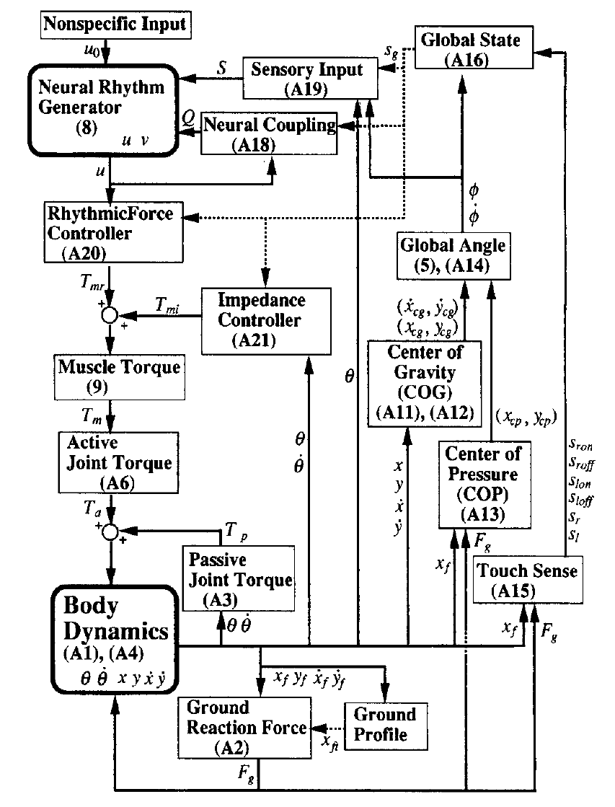





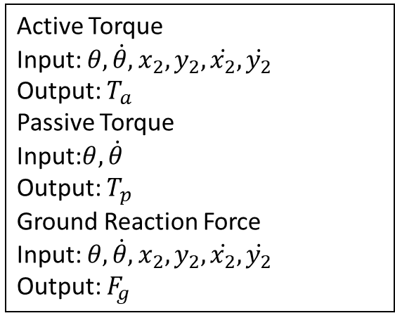


Subsystems
Active Torque
Input: $θ,\dot{θ},x_{2},y_{2},\dot{x_{2}},\dot{y_{2}}$
Output: $T_{a}$
Passive Torque
Input:$θ,\dot{θ}$
Output: $T_{p}$
Ground Reaction Force
Input: $θ,\dot{θ},x_{2},y_{2},\dot{x_{2}},\dot{y_{2}}$
Output: $F_{g}$
$$T_{a}$$
$$T_{p}$$
Passive Torque
Active Torque
$$θ,\dot{θ}$$
$$θ,\dot{θ},x_{2},y_{2},\dot{x_{2}},\dot{y_{2}}$$
Body Dynamics
$$θ,\dot{θ},x_{2},y_{2},\dot{x_{2}},\dot{y_{2}}$$
$$θ,\dot{θ},x_{2},y_{2},\dot{x_{2}},\dot{y_{2}}$$
Ground Reaction Force
$$F_{g}$$

Slide 2
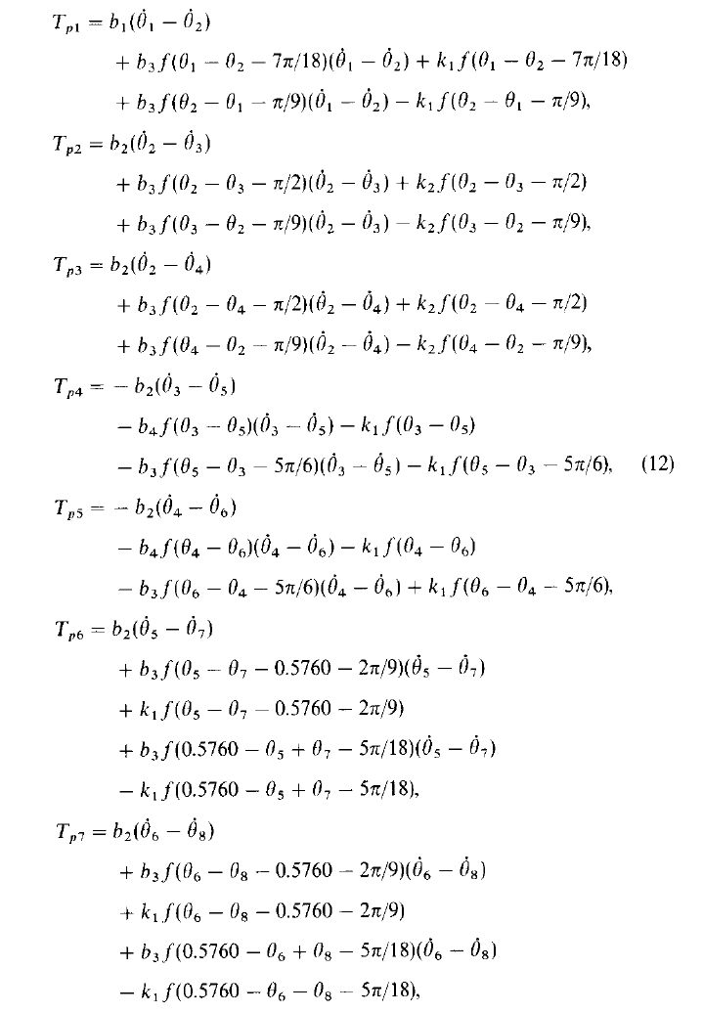
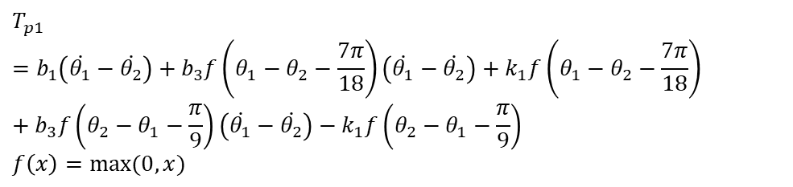
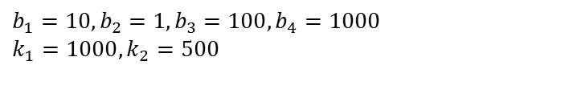
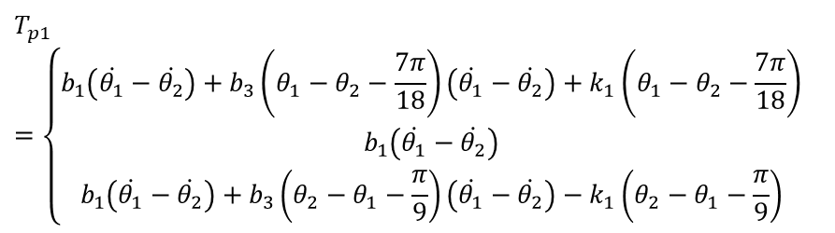
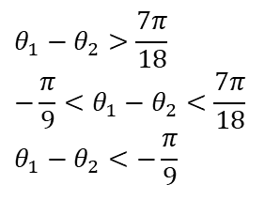
Subsystems: Passive Torque
Passive Torque 1
$$T_{p1}=b_{1}\left(\dot{θ_{1}}−\dot{θ_{2}}\right)+b_{3}f\left(θ_{1}−θ_{2}−\frac{7π}{18}\right)\left(\dot{θ_{1}}−\dot{θ_{2}}\right)+k_{1}f\left(θ_{1}−θ_{2}−\frac{7π}{18}\right)+b_{3}f\left(θ_{2}−θ_{1}−\frac{π}{9}\right)\left(\dot{θ_{1}}−\dot{θ_{2}}\right)−k_{1}f\left(θ_{2}−θ_{1}−\frac{π}{9}\right)$$
$$f\left(x\right)=max(0,x)⁡$$
$$T_{p1}=\left\{\begin{aligned}b_{1}\left(\dot{θ_{1}}−\dot{θ_{2}}\right)+b_{3}\left(θ_{1}−θ_{2}−\frac{7π}{18}\right)\left(\dot{θ_{1}}−\dot{θ_{2}}\right)+k_{1}\left(θ_{1}−θ_{2}−\frac{7π}{18}\right) \\ b_{1}\left(\dot{θ_{1}}−\dot{θ_{2}}\right) \\ b_{1}\left(\dot{θ_{1}}−\dot{θ_{2}}\right)+b_{3}\left(θ_{2}−θ_{1}−\frac{π}{9}\right)\left(\dot{θ_{1}}−\dot{θ_{2}}\right)−k_{1}\left(θ_{2}−θ_{1}−\frac{π}{9}\right)\end{aligned}\right.$$
$$θ_{1}−θ_{2}>\frac{7π}{18}$$
$$−\frac{π}{9}<θ_{1}−θ_{2}<\frac{7π}{18}$$
$$θ_{1}−θ_{2}<−\frac{π}{9}$$
$$b_{1}=10,b_{2}=1,b_{3}=100,b_{4}=1000$$
$$k_{1}=1000,k_{2}=500$$

Slide 3
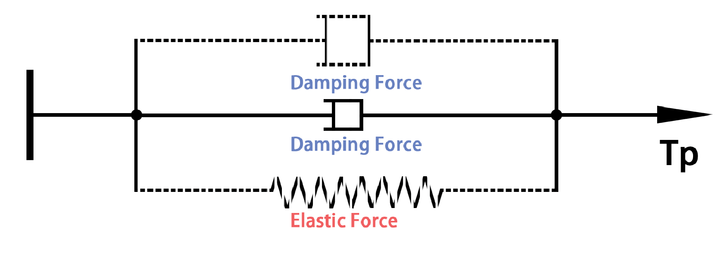
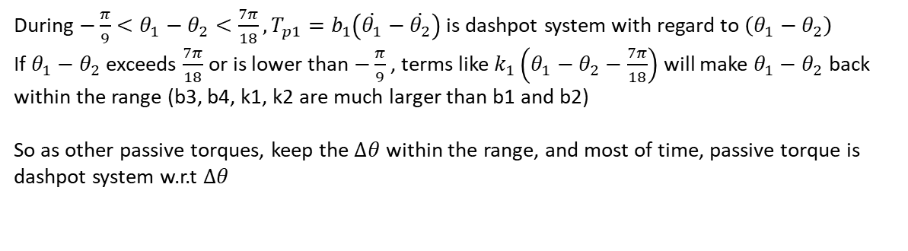
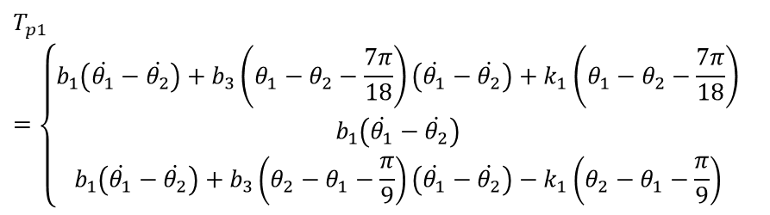
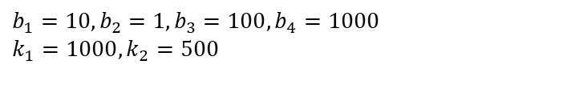
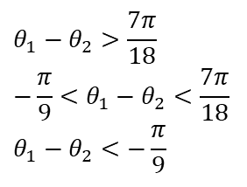

Subsystems: Passive Torque
$$T_{p1}=\left\{\begin{aligned}b_{1}\left(\dot{θ_{1}}−\dot{θ_{2}}\right)+b_{3}\left(θ_{1}−θ_{2}−\frac{7π}{18}\right)\left(\dot{θ_{1}}−\dot{θ_{2}}\right)+k_{1}\left(θ_{1}−θ_{2}−\frac{7π}{18}\right) \\ b_{1}\left(\dot{θ_{1}}−\dot{θ_{2}}\right) \\ b_{1}\left(\dot{θ_{1}}−\dot{θ_{2}}\right)+b_{3}\left(θ_{2}−θ_{1}−\frac{π}{9}\right)\left(\dot{θ_{1}}−\dot{θ_{2}}\right)−k_{1}\left(θ_{2}−θ_{1}−\frac{π}{9}\right)\end{aligned}\right.$$
$$θ_{1}−θ_{2}>\frac{7π}{18}$$
$$−\frac{π}{9}<θ_{1}−θ_{2}<\frac{7π}{18}$$
$$θ_{1}−θ_{2}<−\frac{π}{9}$$
$$b_{1}=10,b_{2}=1,b_{3}=100,b_{4}=1000$$
$$k_{1}=1000,k_{2}=500$$
During $−\frac{π}{9}<θ_{1}−θ_{2}<\frac{7π}{18},T_{p1}=b_{1}\left(\dot{θ_{1}}−\dot{θ_{2}}\right)$ is dashpot system with regard to $\left(θ_{1}−θ_{2}\right)$
If $θ_{1}−θ_{2}$ exceeds $\frac{7π}{18}$ or is lower than $−\frac{π}{9}$ , terms like $k_{1}\left(θ_{1}−θ_{2}−\frac{7π}{18}\right)$ will make $θ_{1}−θ_{2}$ back within the range (b3, b4, k1, k2 are much larger than b1 and b2)
So as other passive torques, keep the $∆θ$ within the range, and most of time, passive torque is dashpot system w.r.t $∆θ$
z
z
Keep $∆θ$ within the range

Slide 4
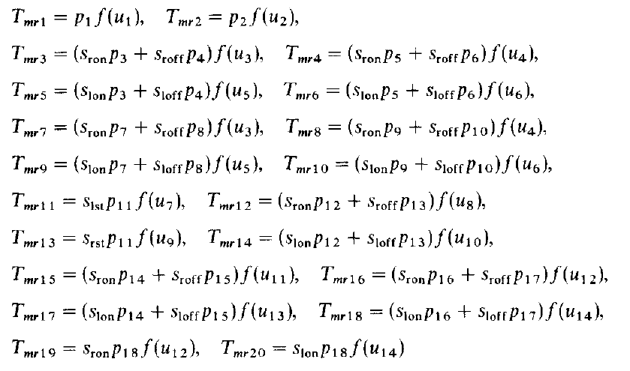
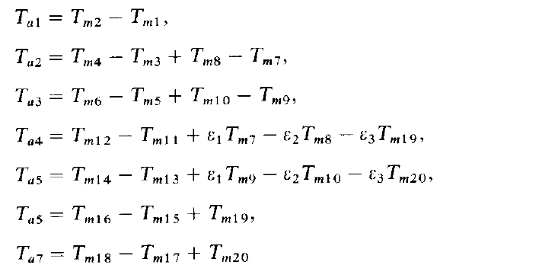
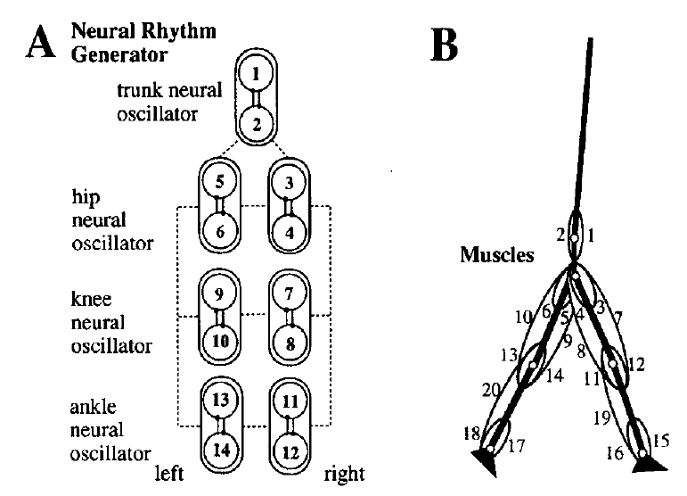
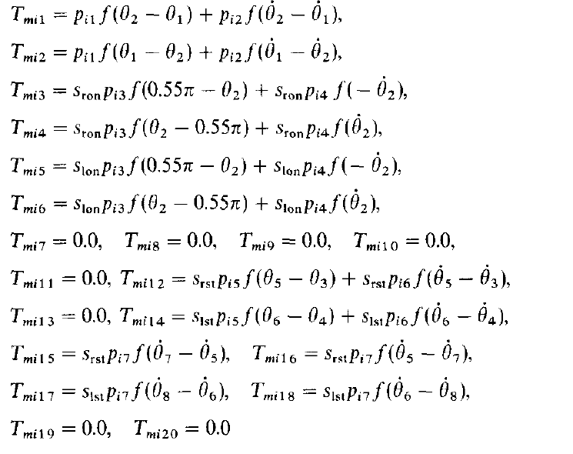
Subsystems: Active Torque
$$T_{m}=T_{mr}+T_{mi}$$
By the output of the neural rhythm generator
Assuming muscle forces are proportional to the output of the neural system
By the impedance controller
Consists of elastic and damping forces

Slide 5
Subsystems: Active Torque
Active torque consists of rhythmic force (proportional to the output of neural system), elastic force and damping force
Active Torque 1
$T_{a1}=T_{m2}−T_{m1}=p_{2}f\left(u_{2}\right)+p_{i1}f\left(θ_{1}−θ_{2}\right)+p_{i2}f\left(\dot{θ_{1}}−\dot{θ_{2}}\right)−p_{1}f\left(u_{1}\right)−$ $p_{i1}f\left(θ_{2}−θ_{1}\right)−p_{i2}f\left(\dot{θ_{2}}−\dot{θ_{1}}\right)=\left(p_{2}f\left(u_{2}\right)−p_{1}f\left(u_{1}\right)\right)+p_{i1}\left(f\left(θ_{1}−θ_{2}\right)−f\left(θ_{2}−θ_{1}\right)\right)+p_{i2}\left(f\left(\dot{θ_{1}}−\dot{θ_{2}}\right)−f\left(\dot{θ_{2}}−\dot{θ_{1}}\right)\right)$
Rhythmic Force
Elastic
Damping
Active Torque 3: Stage 1
$$T_{a3}=T_{m6}−T_{m5}+T_{m10}−T_{m9}=\left((p_{5}+p_{9}) f\left(u_{6}\right)−(p_{3}+p_{7})f\left(u_{5}\right)\right)+p_{i3}\left(f\left(θ_{2}−0.55π\right)−f\left(0.55π−θ_{2}\right)\right)+p_{i4}\left(f\left(\dot{θ_{2}}\right)−f\left(−\dot{θ_{2}}\right)\right)$$
Active Torque 3: Stage 2
$$T_{a3}=T_{m6}−T_{m5}+T_{m10}−T_{m9}=\left((p_{6}+p_{10}) f\left(u_{6}\right)−(p_{4}+p_{8})f\left(u_{5}\right)\right)$$
Active Torque 3: Stage 3
$$T_{a3}=T_{m6}−T_{m5}+T_{m10}−T_{m9}=\left((p_{6}+p_{10}) f\left(u_{6}\right)−(p_{4}+p_{8})f\left(u_{5}\right)\right)$$
Active Torque 3: Stage 4
$$T_{a3}=T_{m6}−T_{m5}+T_{m10}−T_{m9}=\left((p_{5}+p_{9}) f\left(u_{6}\right)−(p_{3}+p_{7})f\left(u_{5}\right)\right)+p_{i3}\left(f\left(θ_{2}−0.55π\right)−f\left(0.55π−θ_{2}\right)\right)+p_{i4}\left(f\left(\dot{θ_{2}}\right)−f\left(−\dot{θ_{2}}\right)\right)$$
Active Torque 3: Stage 5
$$T_{a3}=T_{m6}−T_{m5}+T_{m10}−T_{m9}=\left((p_{5}+p_{9}) f\left(u_{6}\right)−(p_{3}+p_{7})f\left(u_{5}\right)\right)+p_{i3}\left(f\left(θ_{2}−0.55π\right)−f\left(0.55π−θ_{2}\right)\right)+p_{i4}\left(f\left(\dot{θ_{2}}\right)−f\left(−\dot{θ_{2}}\right)\right)$$
Active Torque 3: Stage 6
$$T_{a3}=T_{m6}−T_{m5}+T_{m10}−T_{m9}=\left((p_{5}+p_{9}) f\left(u_{6}\right)−(p_{3}+p_{7})f\left(u_{5}\right)\right)+p_{i3}\left(f\left(θ_{2}−0.55π\right)−f\left(0.55π−θ_{2}\right)\right)+p_{i4}\left(f\left(\dot{θ_{2}}\right)−f\left(−\dot{θ_{2}}\right)\right)$$

Slide 6
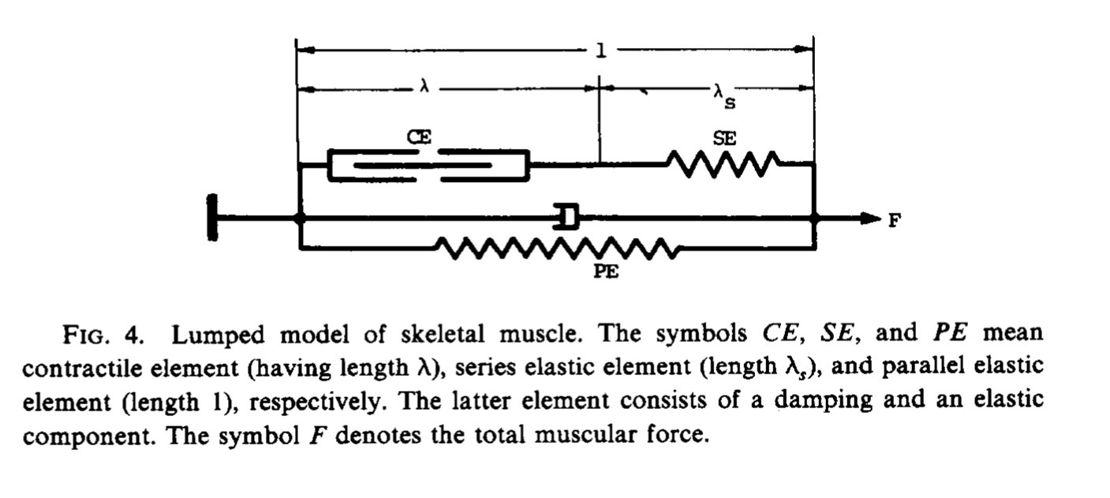
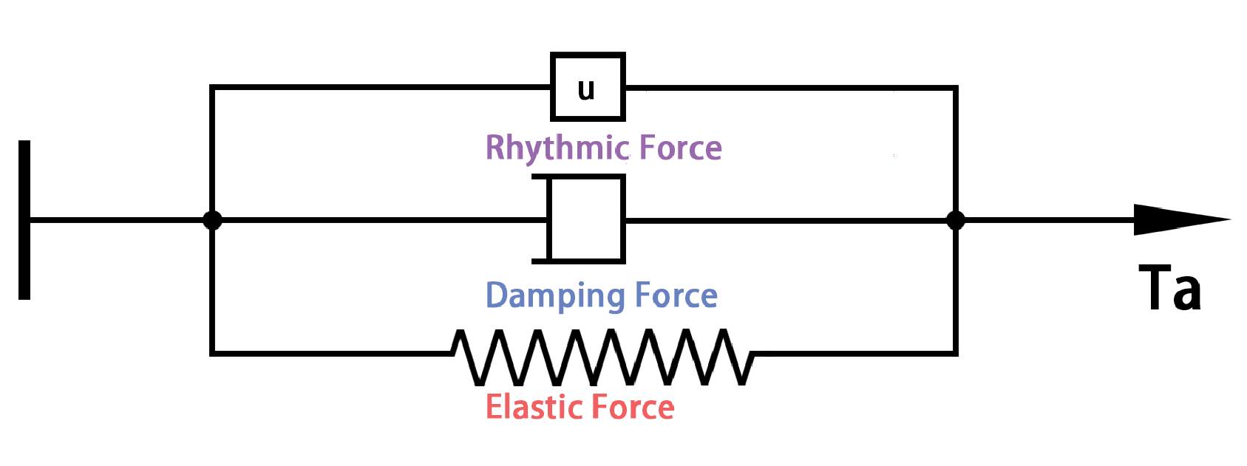
Subsystems: Active Torque
From Hatze 1976*, the active torque exerted by a muscle should be given by the muscle force multiplied by its moment arm, which changes according to the displacement of the joint angle
By the output of the neural rhythm generator
For simlicity, assume the moment arms of the muscles have constant values and the muscle forces are proportional to the output of the neural system
Active torque consists of rhythmic force (proportional to the output of neural system), elastic force and damping force
By the impedance controller
*Hatze, Herbert. "The complete optimization of a human motion." Mathematical Biosciences 28.1-2 (1976): 99-135.

Slide 7
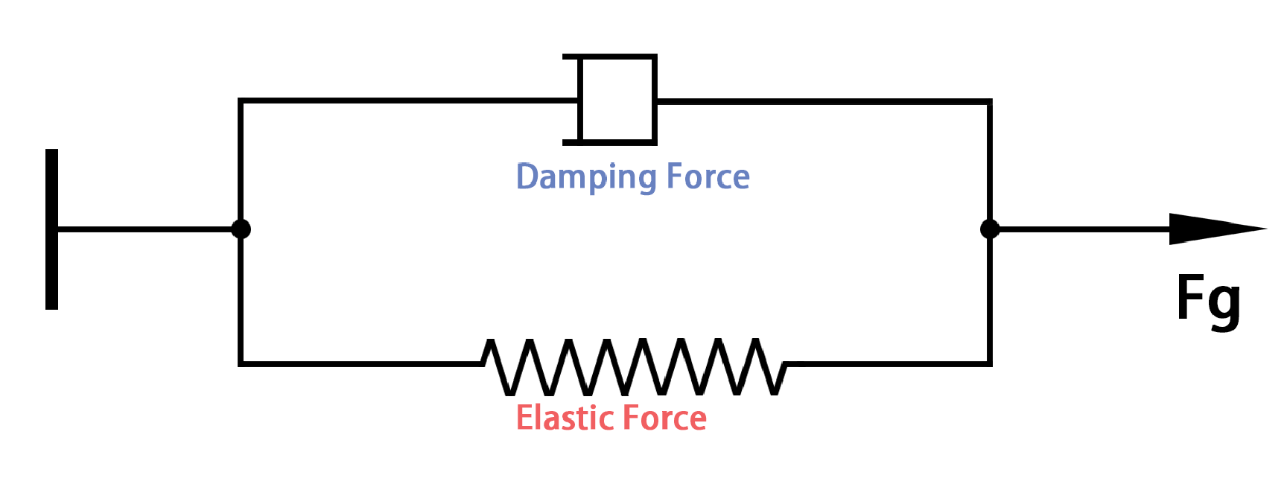
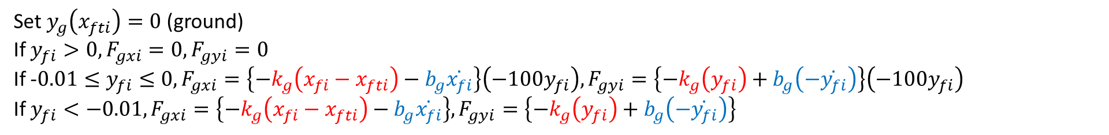
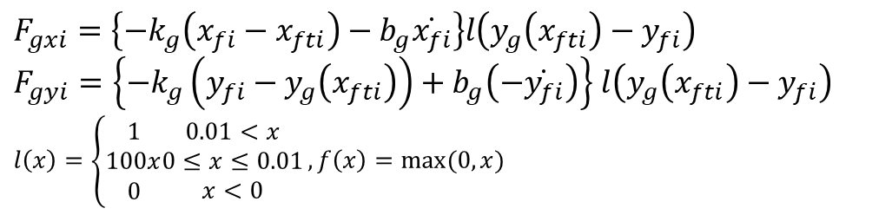
Subsystems: Ground Reaction Force
$$F_{gxi}=\left\{−k_{g}\left(x_{fi}−x_{fti}\right)−b_{g}\dot{x_{fi}}\right\}l\left(y_{g}\left(x_{fti}\right)−y_{fi}\right)$$
$F_{gyi}=\left\{−k_{g}\left(y_{fi}−y_{g}\left(x_{fti}\right)\right)+b_{g}\left(−\dot{y_{fi}}\right)\right\}$ $l\left(y_{g}\left(x_{fti}\right)−y_{fi}\right)$
$$l\left(x\right)=\left\{\begin{aligned}1 \\ 100x \\ 0\end{aligned}\begin{matrix}0.01<x \\ 0≤x≤0.01 \\ x<0\end{matrix}\right.,f\left(x\right)=max⁡(0,x)$$
Set $y_{g}\left(x_{fti}\right)=0$ (ground)
If $y_{fi}>0, F_{gxi}=0,F_{gyi}=0$
If -$0.01≤y_{fi}≤0, F_{gxi}=\left\{−k_{g}\left(x_{fi}−x_{fti}\right)−b_{g}\dot{x_{fi}}\right\}\left(−100y_{fi}\right),F_{gyi}=\left\{−k_{g}\left(y_{fi}\right)+b_{g}\left(−\dot{y_{fi}}\right)\right\}\left(−100y_{fi}\right)$
If $y_{fi}<−0.01, F_{gxi}=\left\{−k_{g}\left(x_{fi}−x_{fti}\right)−b_{g}\dot{x_{fi}}\right\},F_{gyi}=\left\{−k_{g}\left(y_{fi}\right)+b_{g}\left(−\dot{y_{fi}}\right)\right\}$
Elastic
Damping
Ground reaction force consists of elastic force and damping force

Slide 8
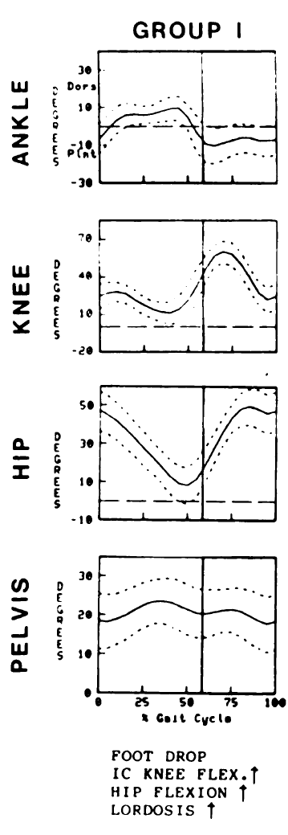
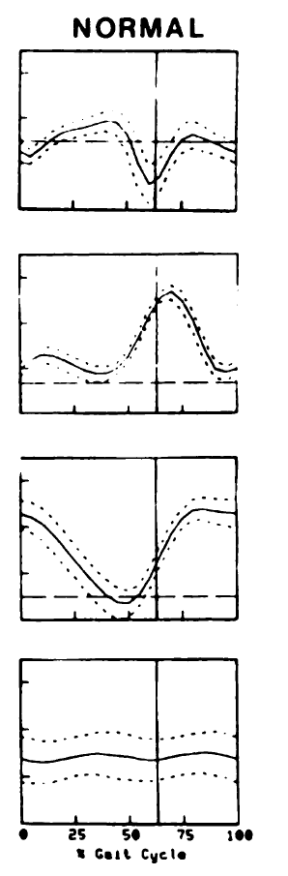
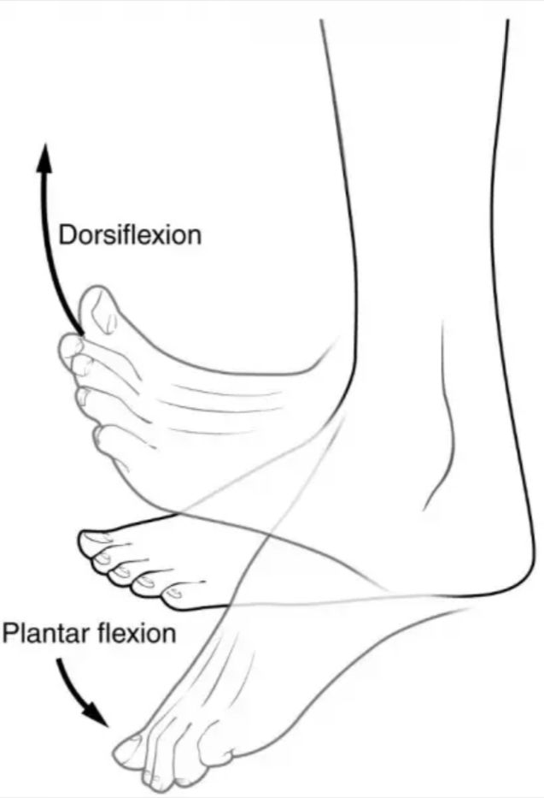
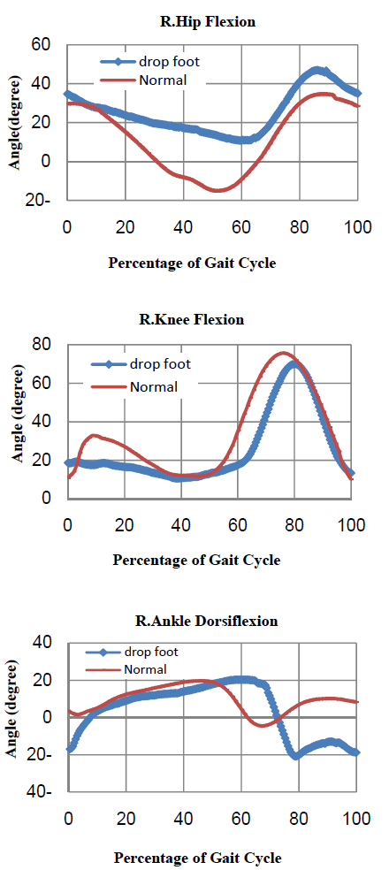
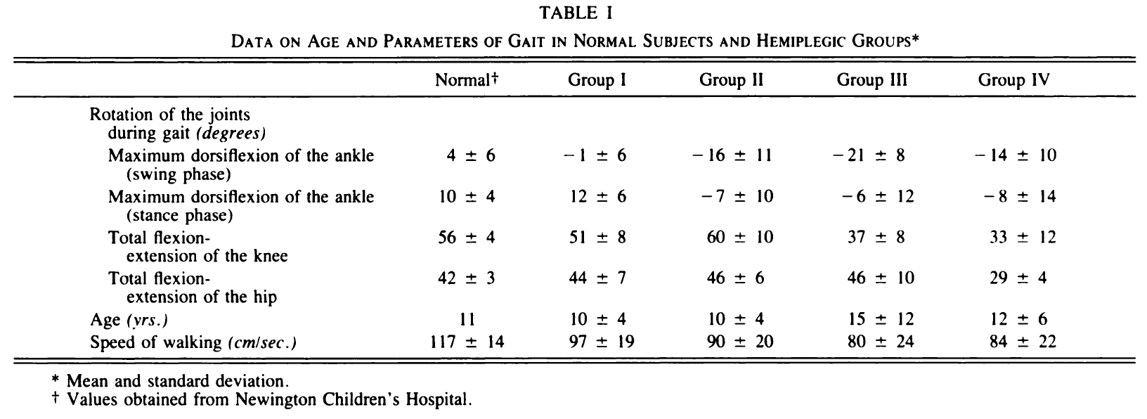
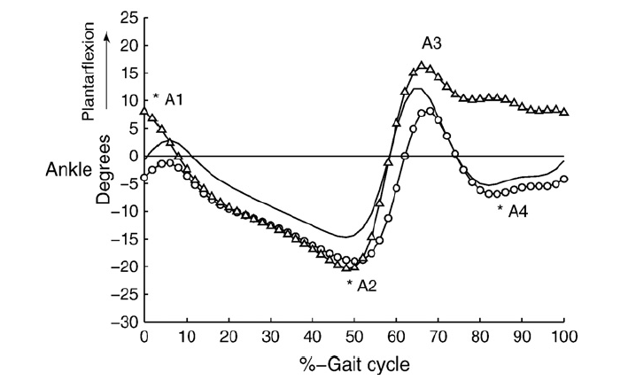
Foot Drop Characterization: Joint Angle: Ankle
Foot Drop
Normal
Drop foot in the swing phase (Figure)
Adequate range of dorsiflexion of the ankle during the stance phase (Table)
Maximum amount of dorsiflexion in the stance phase is more than 0
I
In the moment of right foot contact (start of the cycle), 17 degrees of planter flexion and 3 degrees of dorsiflexion in foot drop and normal. After opposite foot strike, downward trend continues twice of more than 20 degrees during swing phase
II
III

Slide 9
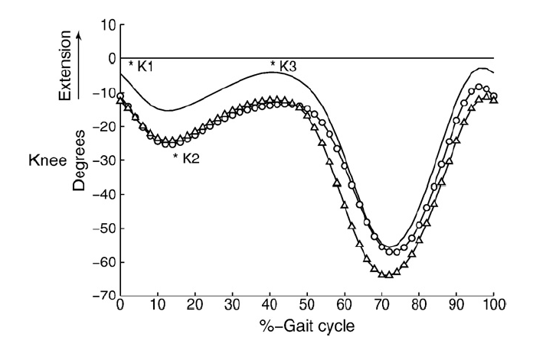
Foot Drop Characterization: Joint Angle: Knee
Foot Drop
Normal
Increased flexion of the knee at terminal swing phase, at initial contact and in loading response
I
Knee flexion angle is remained almost constant in initial double support period. Max knee flexion is 5 degrees less than normal during swing phase
II
III

Slide 10
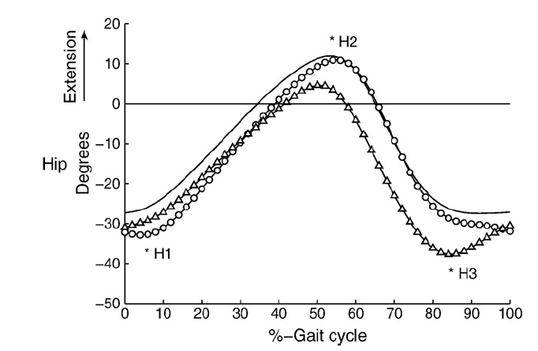
Foot Drop Characterization: Joint Angle: Hip
Foot Drop
Normal
[1] Winters, T. F., J. R. Gage, and R. Hicks. "Gait patterns in spastic hemiplegia in children and young adults." J Bone Joint Surg Am69.3 (1987): 437-441.
[2] Matinmanesh, Ali, and Mohammadreza Mallakzadeh. "Inverse kinetic and kinematic analysis of drop-foot patient's walking." E-Health and Bioengineering Conference (EHB), 2011. IEEE, 2011.
[3] Simonsen, Erik B., et al. "Redistribution of joint moments during walking in patients with drop-foot." Clinical Biomechanics 25.9 (2010): 949-952.
Hyperfleion of the hip during the swing phase
I
Hip angles are limited to positive values. Max hip flexion is about 13 degrees more than that of the normal (excessive hip flexion during terminal swing)
II
III

