Slide 1
Stance
Swing
Normal
Foot Drop
Ankle
Knee
Hip
Reference 1
Reference 2
Reference 3

Slide 2
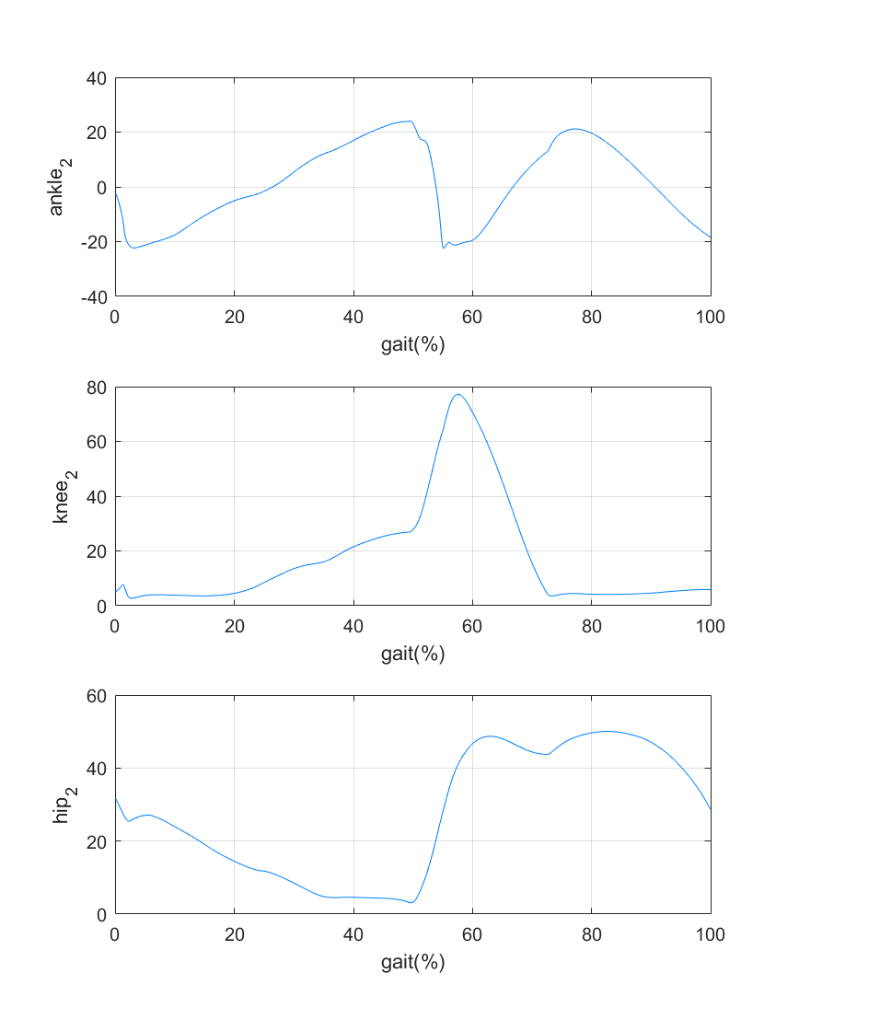
Stance
Swing
Normal
Foot Drop
Ankle
Knee
Hip
Reference 1
Reference 2
Reference 3

