Slide 1
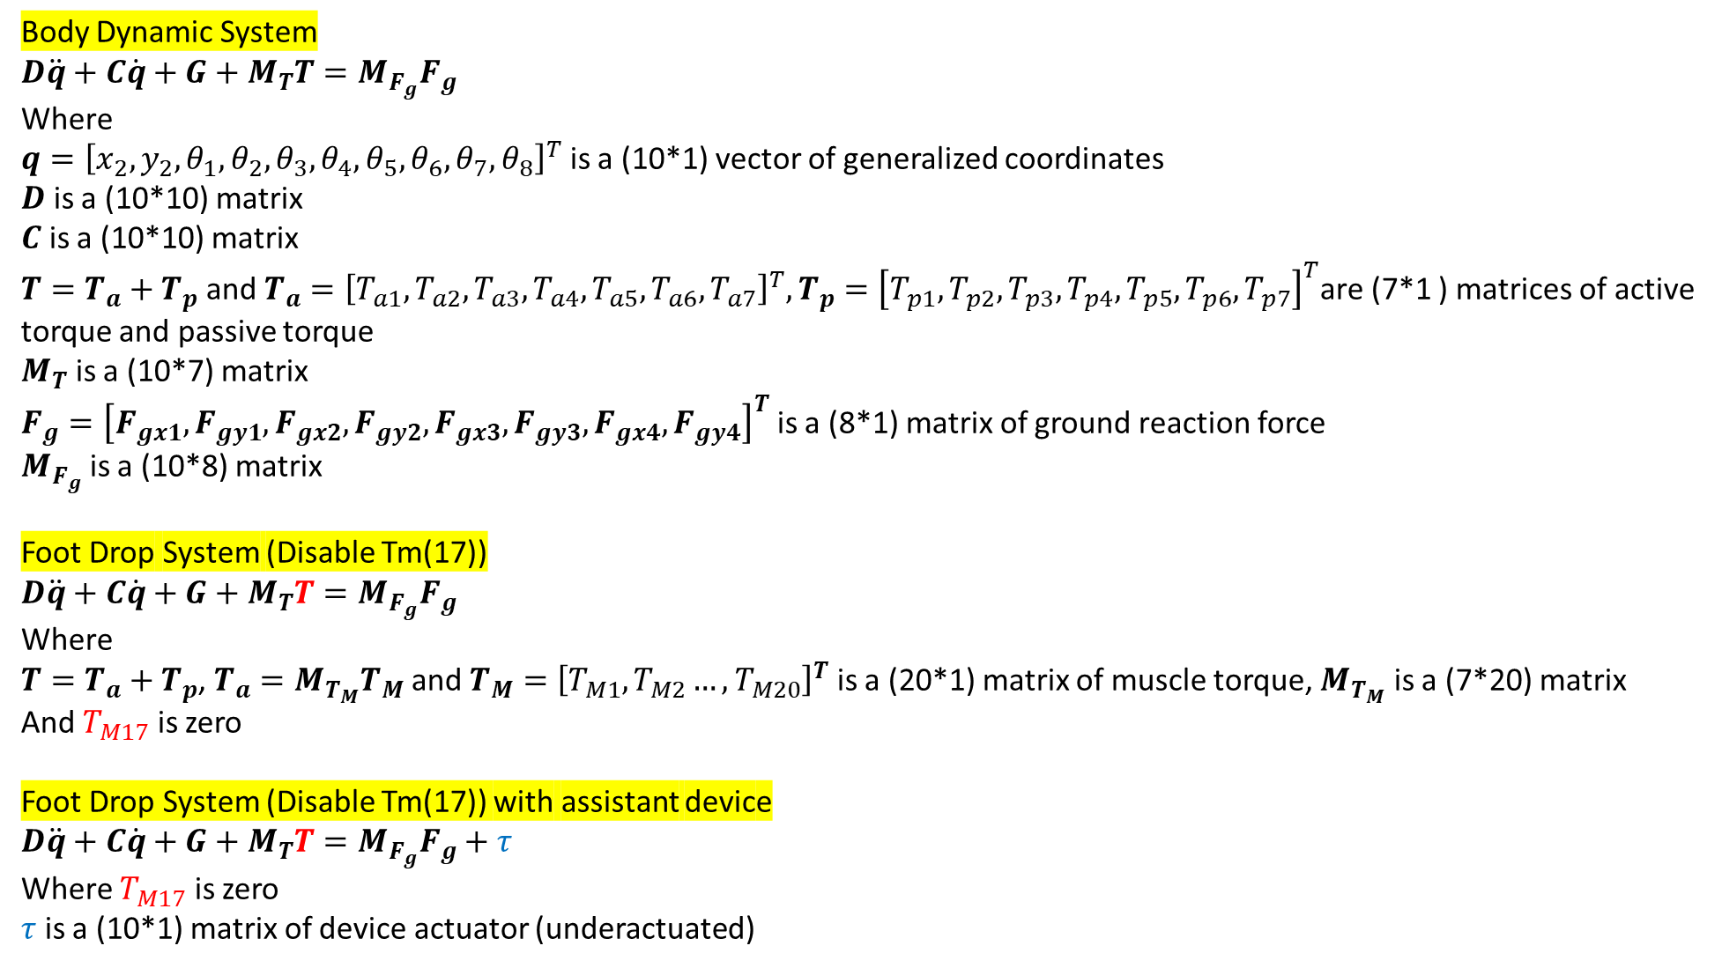
Body Dynamic System
$$D\ddot{q}+C\dot{q}+G+M_{T}T=M_{F_{g}}F_{g}$$
Where
$q={\left[x_{2},y_{2},θ_{1},θ_{2},θ_{3},θ_{4},θ_{5},θ_{6},θ_{7},θ_{8}\right]}^{T}$ is a (10*1) vector of generalized coordinates
$D$ is a (10*10) matrix
$C$ is a (10*10) matrix
$T=T_{a}+T_{p}$ and $T_{a}={\left[T_{a1},T_{a2},T_{a3},T_{a4},T_{a5},T_{a6},T_{a7}\right]}^{T},T_{p}={\left[T_{p1},T_{p2},T_{p3},T_{p4},T_{p5},T_{p6},T_{p7}\right]}^{T}$are (7*1 ) matrices of active torque and passive torque
$M_{T}$ is a (10*7) matrix
$F_{g}={\left[F_{gx1},F_{gy1},F_{gx2},F_{gy2},F_{gx3},F_{gy3},F_{gx4},F_{gy4}\right]}^{T}$ is a (8*1) matrix of ground reaction force
$M_{F_{g}}$ is a (10*8) matrix
Foot Drop System (Disable Tm(17))
$$D\ddot{q}+C\dot{q}+G+M_{T}T=M_{F_{g}}F_{g}$$
Where
$T=T_{a}+T_{p}$, $T_{a}=M_{T_{M}}T_{M}$ and $T_{M}={\left[T_{M1},T_{M2}…,T_{M20}\right]}^{T}$ is a (20*1) matrix of muscle torque, $M_{T_{M}}$ is a (7*20) matrix
And $T_{M17}$ is zero
Foot Drop System (Disable Tm(17)) with assistant device
$$D\ddot{q}+C\dot{q}+G+M_{T}T=M_{F_{g}}F_{g}+τ$$
Where $T_{M17}$ is zero
$τ$ is a (10*1) matrix of device actuator (underactuated)

Slide 2
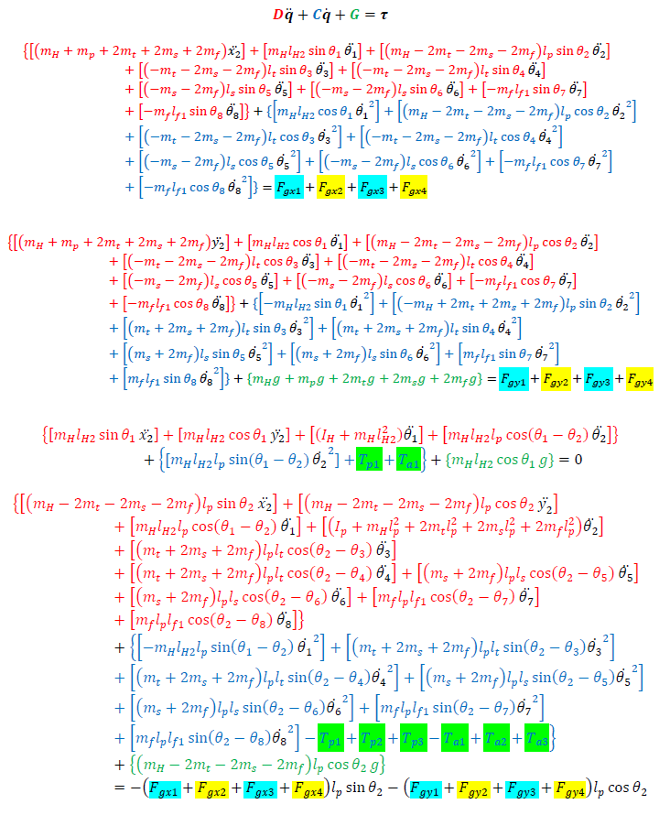
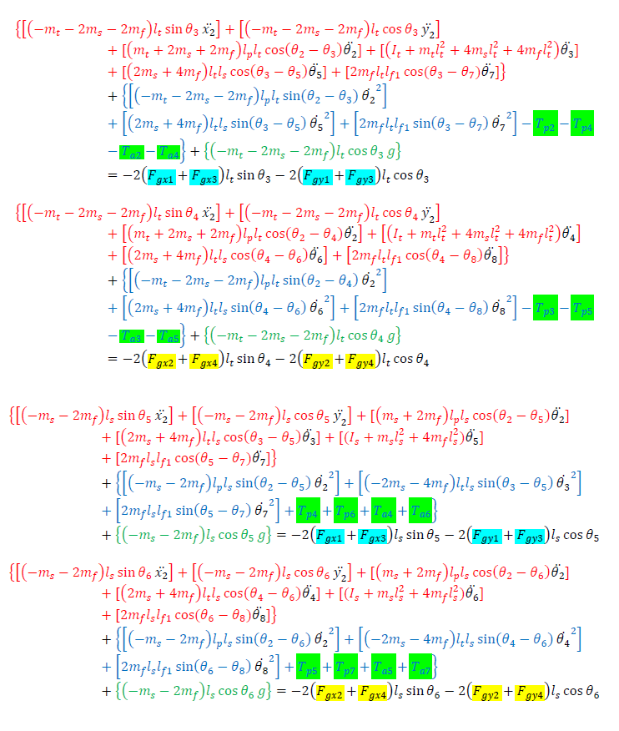
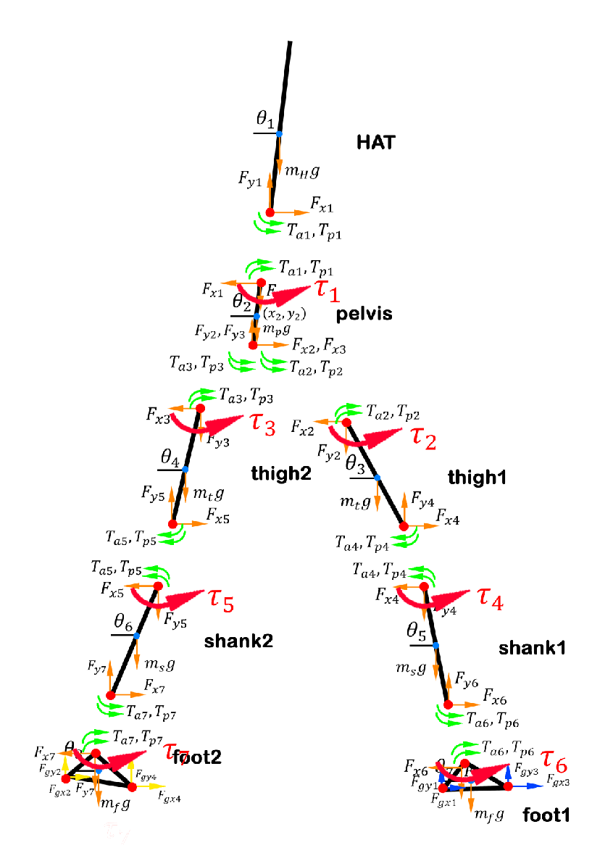
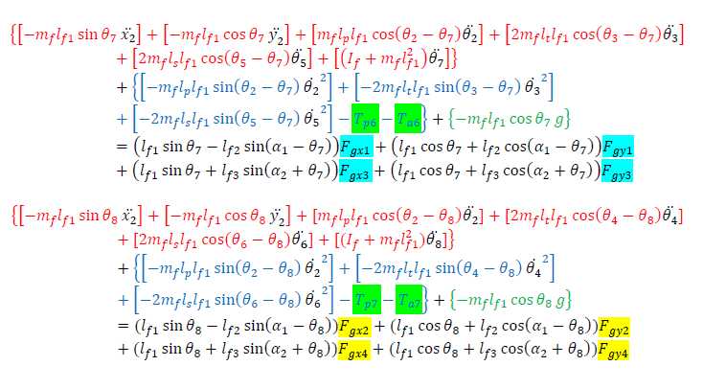







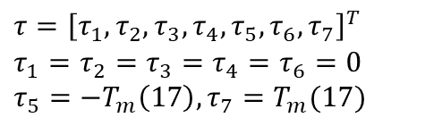
Suppose we add $τ$ at every joint
$$+τ_{2}$$
$$+τ_{3}$$
$$+τ_{4}$$
$$+τ_{5}$$
$$+τ_{1}$$
$$+τ_{6}$$
$$+τ_{7}$$
$$τ={\left[τ_{1},τ_{2},τ_{3},τ_{4},τ_{5},τ_{6},τ_{7}\right]}^{T}$$
$$τ_{1}=τ_{2}=τ_{3}=τ_{4}=τ_{6}=0$$
$$τ_{5}={−T}_{m}\left(17\right), τ_{7}=T_{m}(17)$$

Slide 3
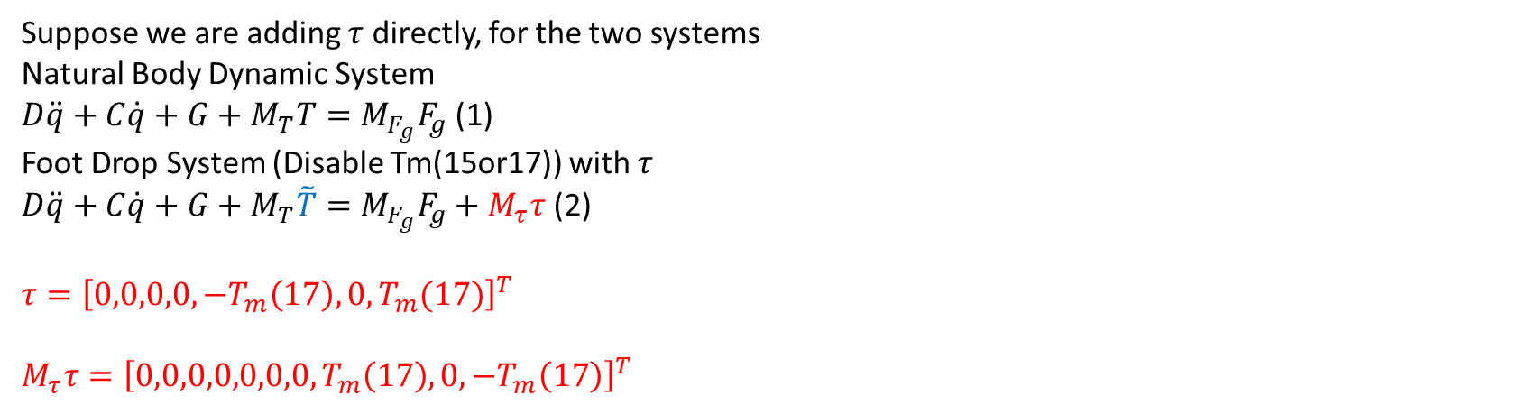
Calculate $τ$
Suppose we are adding $τ$ directly, for the two systems
Natural Body Dynamic System
$D\ddot{q}+C\dot{q}+G+M_{T}T=M_{F_{g}}F_{g}$ (1)
Foot Drop System (Disable Tm(15or17)) with $τ$
$D\ddot{q}+C\dot{q}+G+M_{T}\tilde{T}=M_{F_{g}}F_{g}+M_{τ}τ$ (2)
$$τ={\left[0,0,0,0,−T_{m}\left(17\right),0,T_{m}(17)\right]}^{T}$$
$$M_{τ}τ={\left[0,0,0,0,0,0,0,T_{m}\left(17\right),0,−T_{m}\left(17\right)\right]}^{T}$$

Slide 4
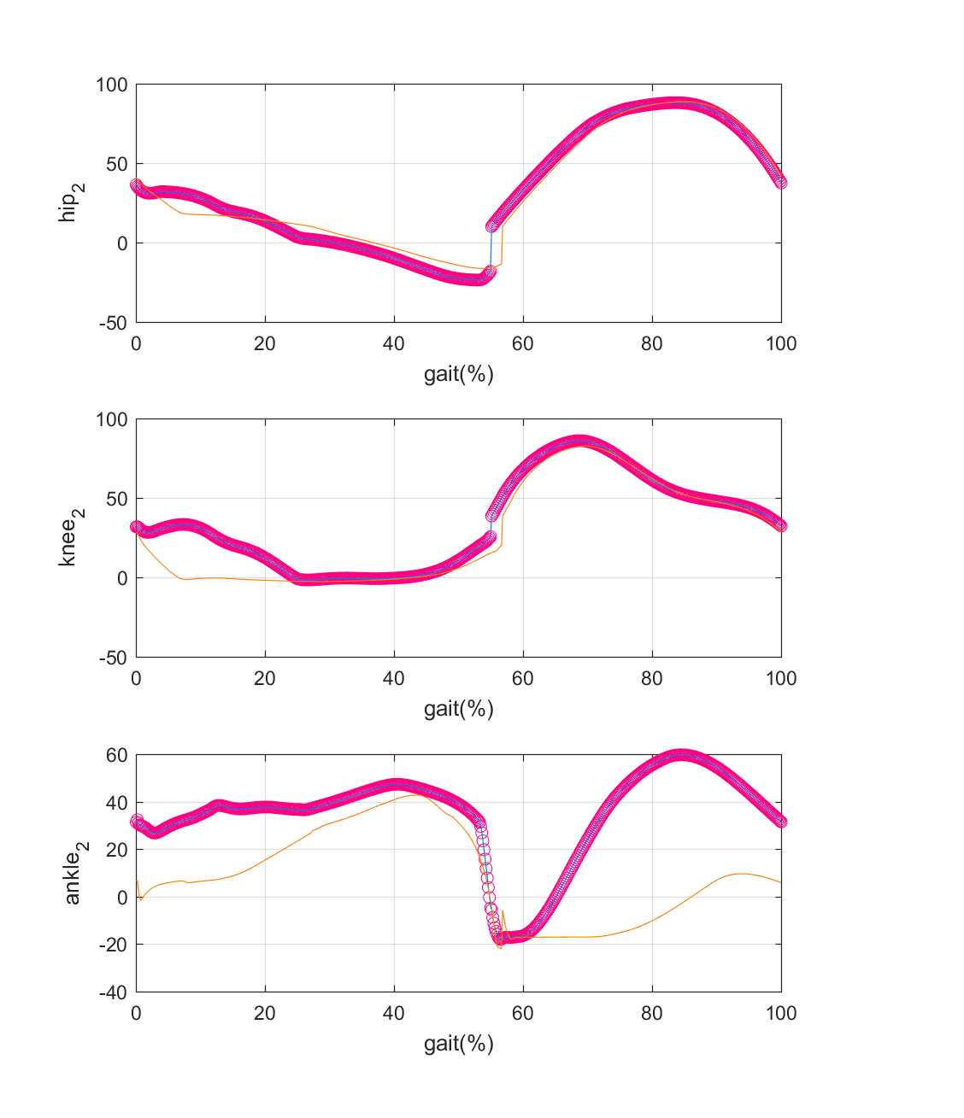
Simulation Result 1: Joint Angle
Normal
Foot Drop
Foot Drop with tau

Slide 5
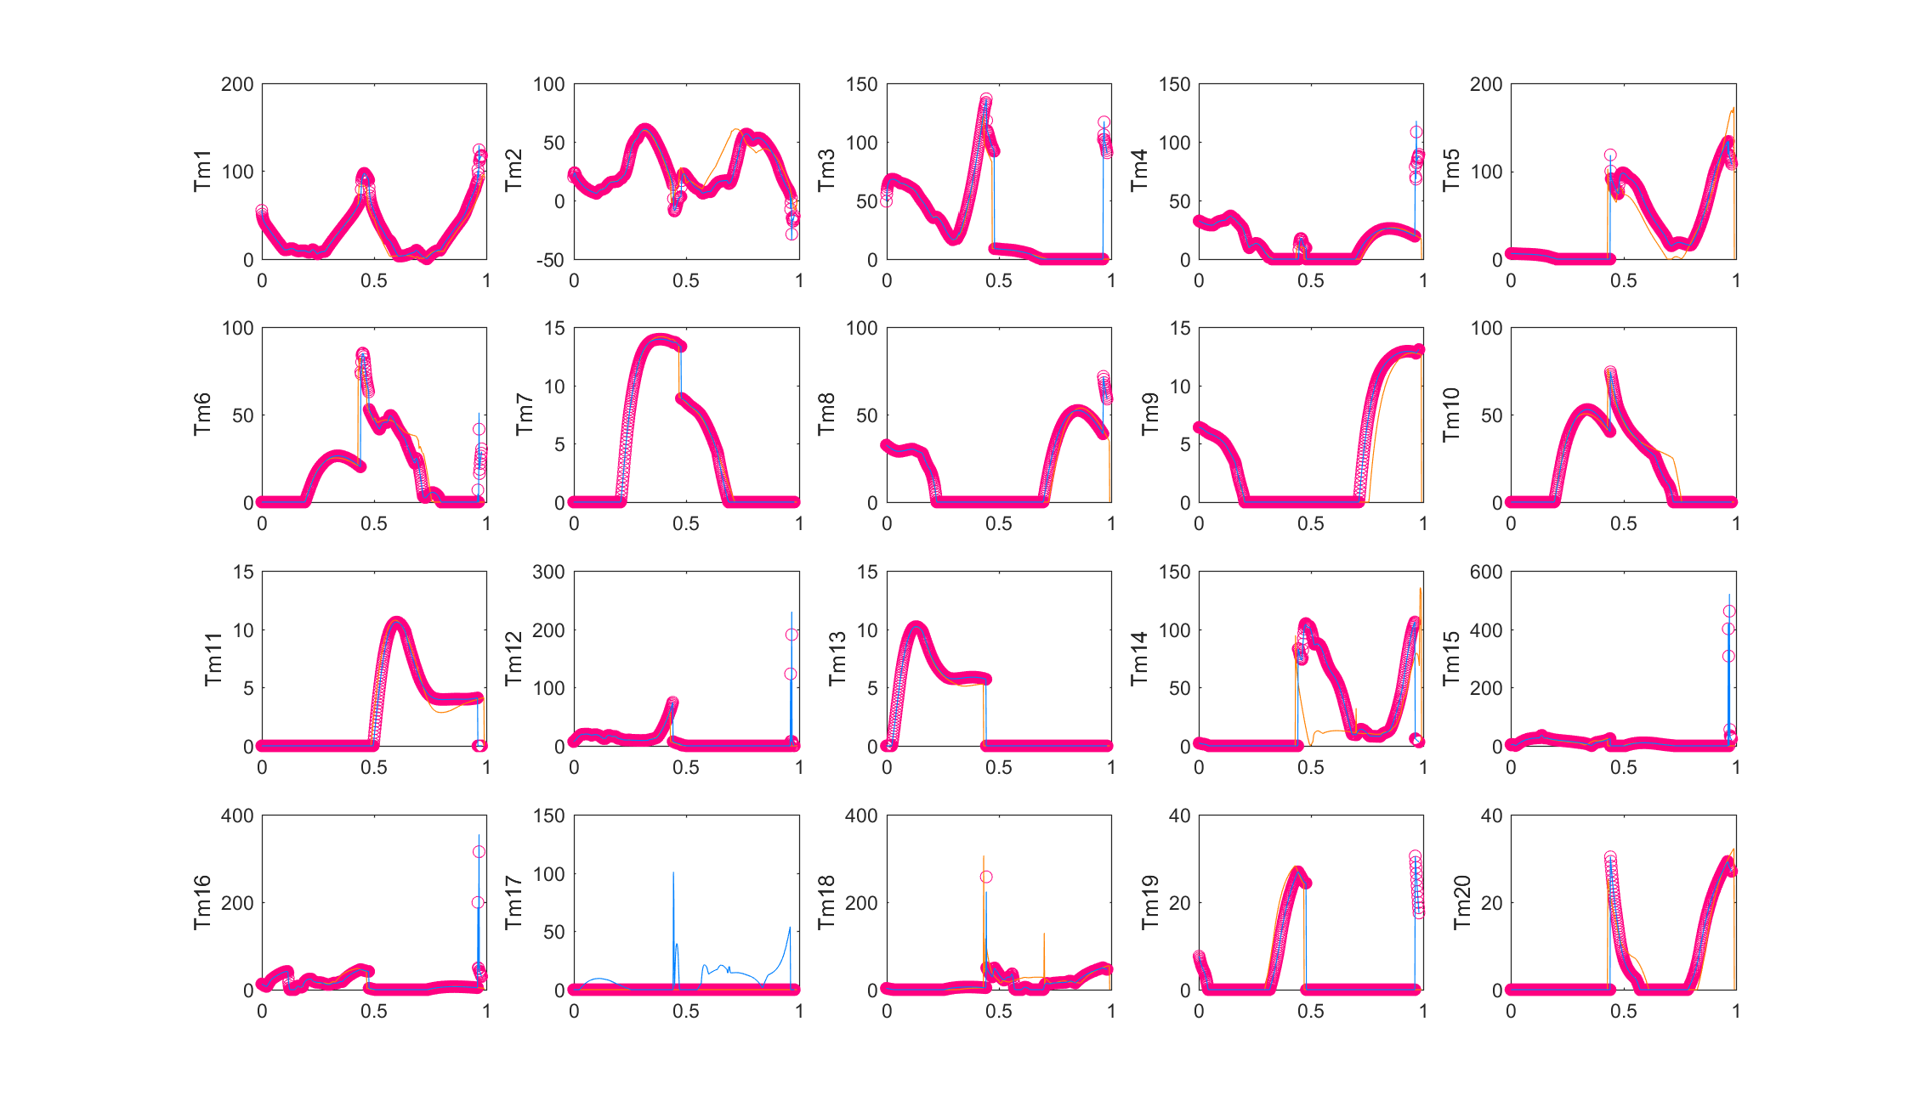
Simulation Result 2: Muscle Torque
Normal
Foot Drop
Foot Drop with tau

