Slide 1
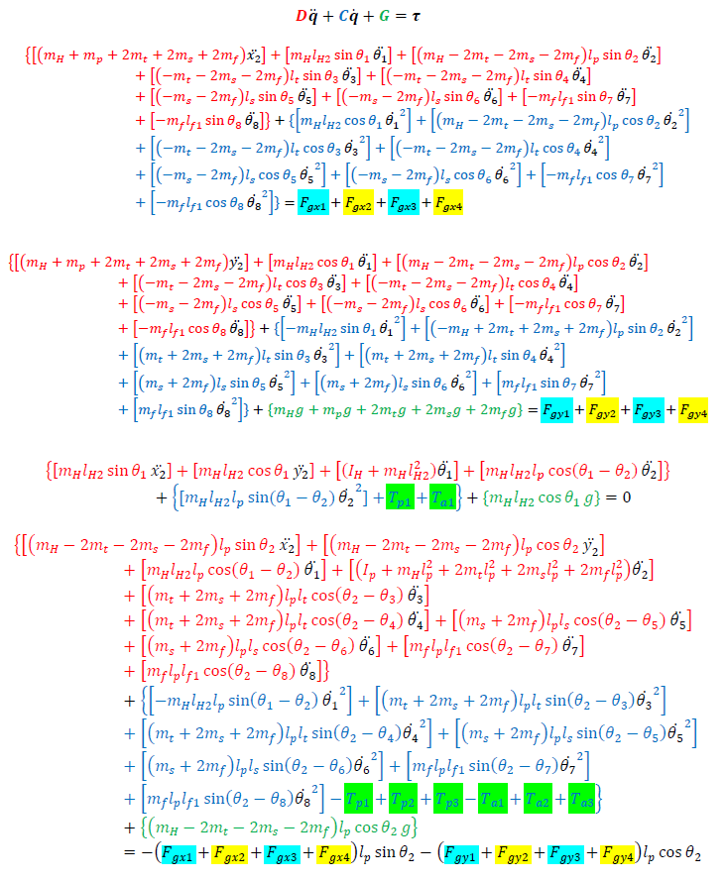
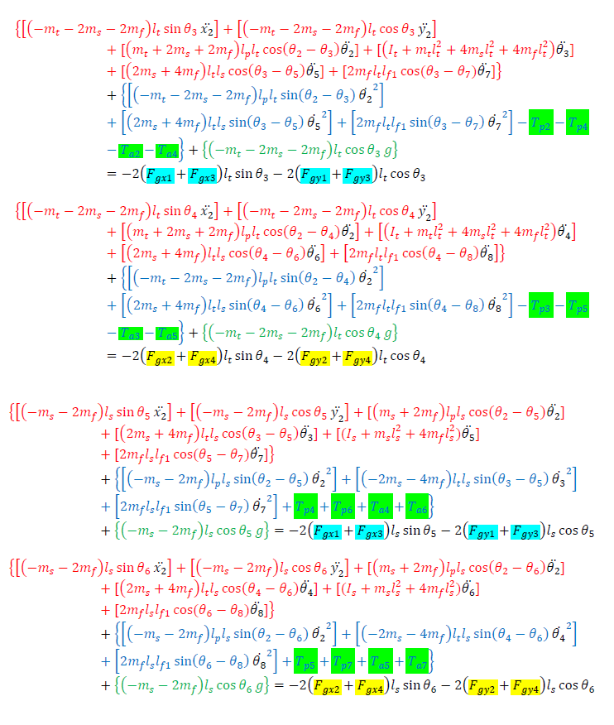
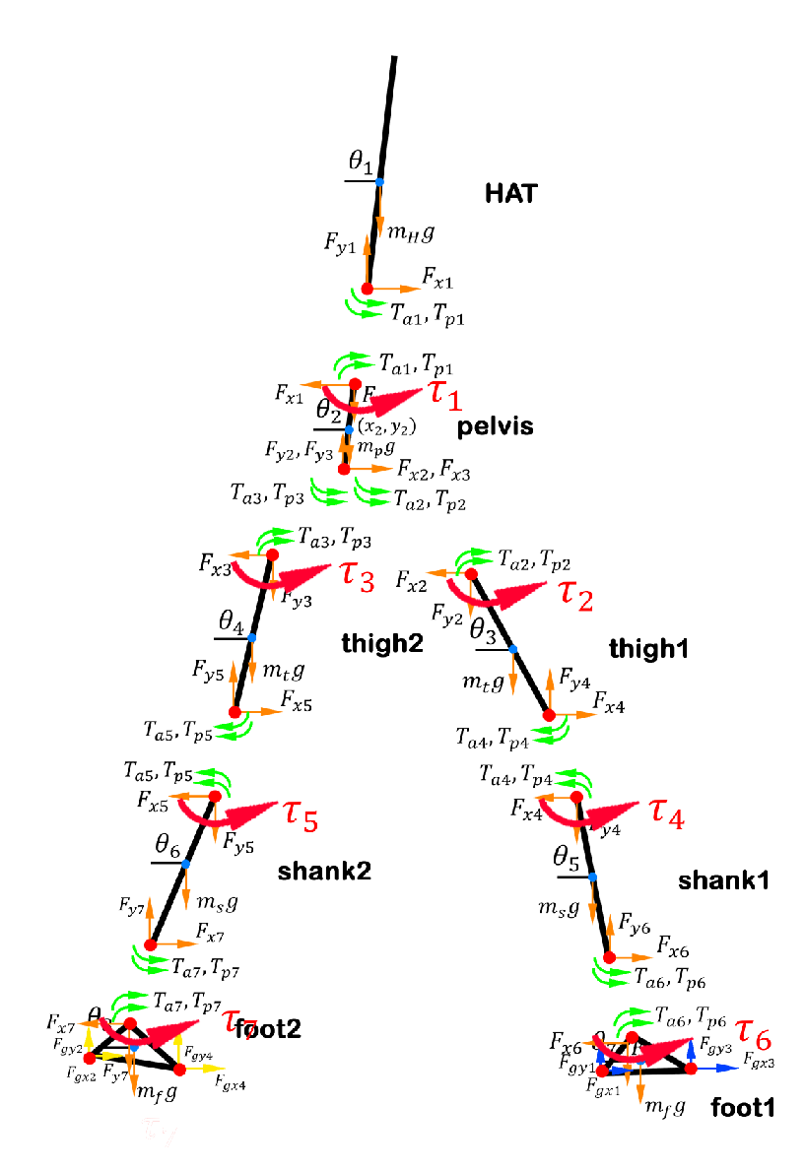
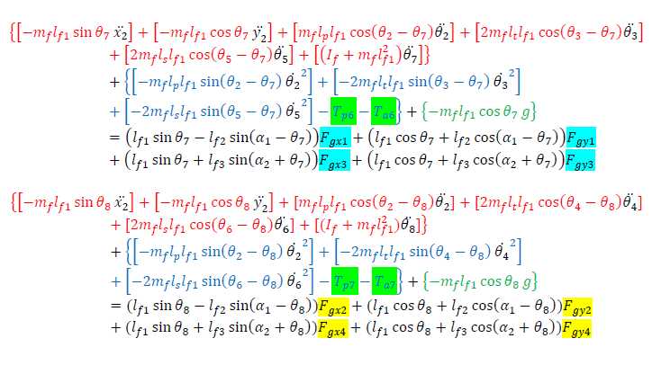







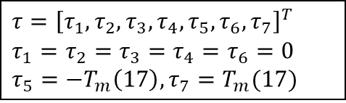
Suppose we add $τ$ at every joint
$$+τ_{2}$$
$$+τ_{3}$$
$$+τ_{4}$$
$$+τ_{5}$$
$$+τ_{1}$$
$$+τ_{6}$$
$$τ={\left[τ_{1},τ_{2},τ_{3},τ_{4},τ_{5},τ_{6},τ_{7}\right]}^{T}$$
$$τ_{1}=τ_{2}=τ_{3}=τ_{4}=τ_{6}=0$$
$$τ_{5}={−T}_{m}\left(17\right), τ_{7}=T_{m}(17)$$
$$+τ_{7}$$

Slide 2
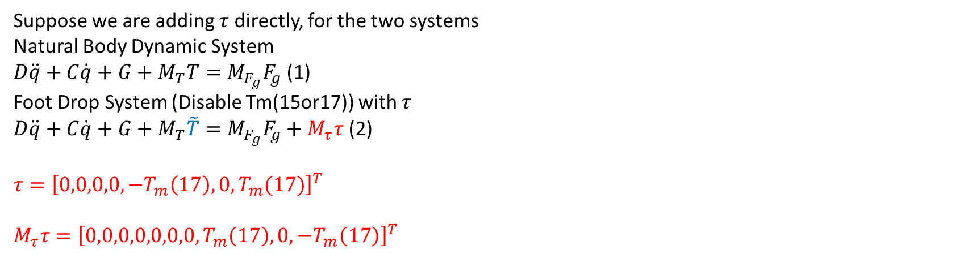
Calculate $τ$
Suppose we are adding $τ$ directly, for the two systems
Natural Body Dynamic System
$D\ddot{q}+C\dot{q}+G+M_{T}T=M_{F_{g}}F_{g}$ (1)
Foot Drop System (Disable Tm(15or17)) with $τ$
$D\ddot{q}+C\dot{q}+G+M_{T}\tilde{T}=M_{F_{g}}F_{g}+M_{τ}τ$ (2)
$$τ={\left[0,0,0,0,−T_{m}\left(17\right),0,T_{m}(17)\right]}^{T}$$
$$M_{τ}τ={\left[0,0,0,0,0,0,0,T_{m}\left(17\right),0,−T_{m}\left(17\right)\right]}^{T}$$
From above analysis, we know that to calculate device torque $τ$, Tm(17) is the key

Slide 3
Tm(17)
The formation of Tm(17) is shown as below
$$T_{m17}=\left(S_{lon}p_{14}+S_{loff}p_{15}\right)f\left(u_{13}\right)+S_{lst}p_{i7}f(\dot{θ_{8}}−\dot{θ_{6}})$$
Normal
Stage 1
$$T_{m17}=\left(S_{lon}p_{14}\right)f\left(u_{13}\right)$$
Stage 2
$$T_{m17}=\left(S_{loff}p_{15}\right)f\left(u_{13}\right)$$
Stance
Stage 3
$$T_{m17}=\left(S_{loff}p_{15}\right)f\left(u_{13}\right)$$
Stage 4
$$T_{m17}=\left(S_{lon}p_{14}\right)f\left(u_{13}\right)+S_{lst}p_{i7}f(\dot{θ_{8}}−\dot{θ_{6}})$$
Stage 5
$$T_{m17}=\left(S_{lon}p_{14}\right)f\left(u_{13}\right)+S_{lst}p_{i7}f(\dot{θ_{8}}−\dot{θ_{6}})$$
Swing
Stage 6
$$T_{m17}=\left(S_{lon}p_{14}\right)f\left(u_{13}\right)+S_{lst}p_{i7}f(\dot{θ_{8}}−\dot{θ_{6}})$$
Ideally, from sensors, we can acquire the information of current positions and velocities of each joint. However, it not easy to know the value of neural signals sent to the muscles. Thus, we need to estimate the value u(13) to calculate Tm(17)

Slide 4
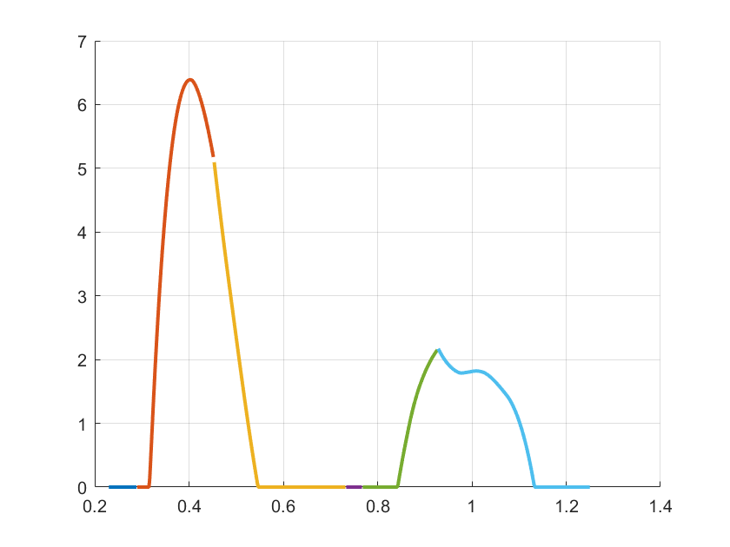

Estimate u(13) from current states ($x,\dot{x},y,\dot{y},θ,\dot{θ}$)
The basic idea of my way to estimate u(13) is that we have known what u(13) of normal gait will be like, based on previous research, we can easily get the curve of u(13) during whole gait (Figure 1)
Stage 1
Stage 2
Stage 3
Stage 4
Stage 5
Stage 6
$$f(u(13))$$
time
Figure 1
Thus, to estimate u(13), we just need to know what current status of the gait in gait cycle is, then using Figure 1 to map the current status to corresponding u(13)
Then the problem becomes how to know the current status of the gait

Slide 5
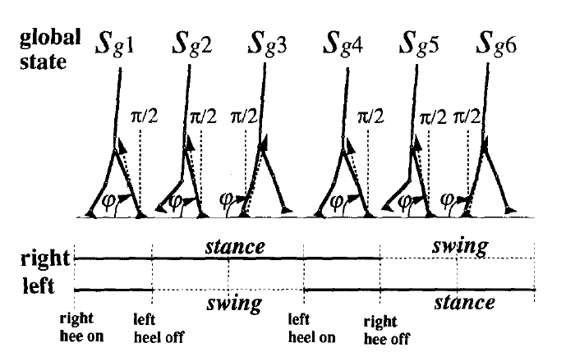
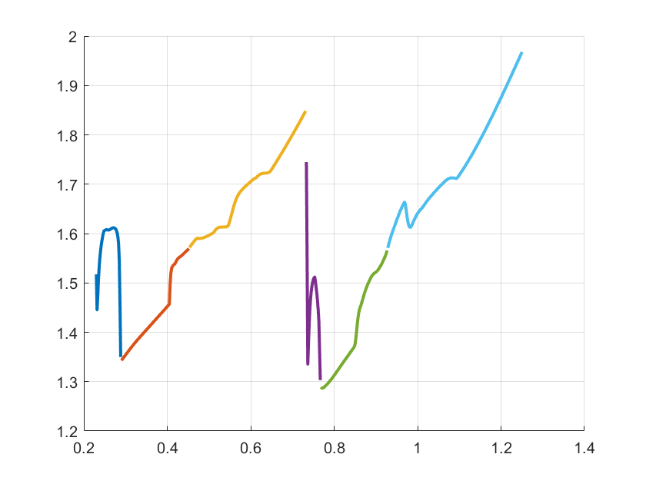
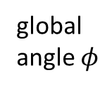
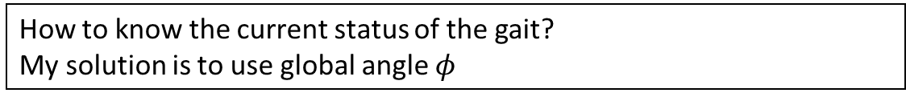
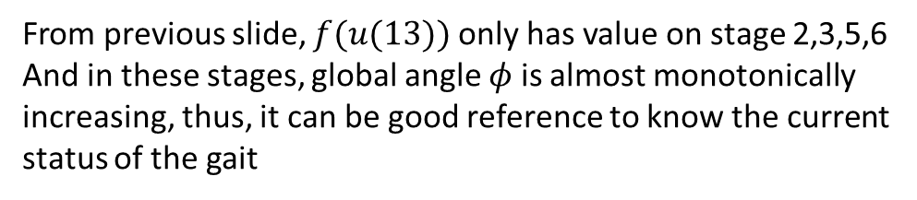
Use global angle $φ$ to estimate u(13)
How to know the current status of the gait?
My solution is to use global angle $φ$
Global Angle $φ$
From previous slide, $f(u(13))$ only has value on stage 2,3,5,6
And in these stages, global angle $φ$ is almost monotonically increasing, thus, it can be good reference to know the current status of the gait
Stage 1
Stage 2
Stage 3
Stage 4
Stage 5
Stage 6
global angle $φ$
time

Slide 6
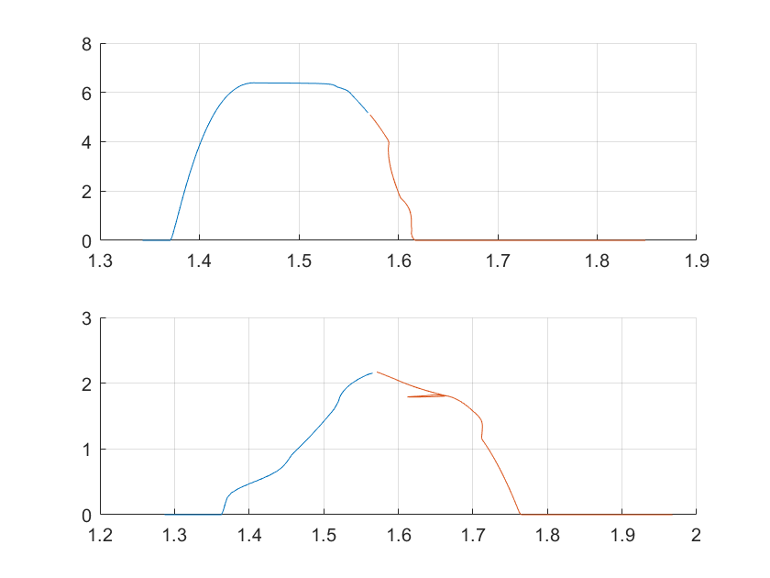
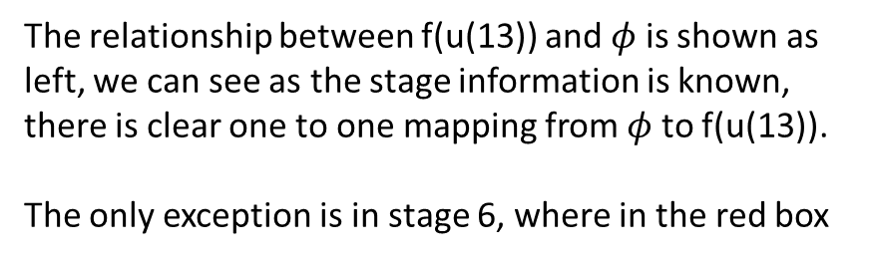




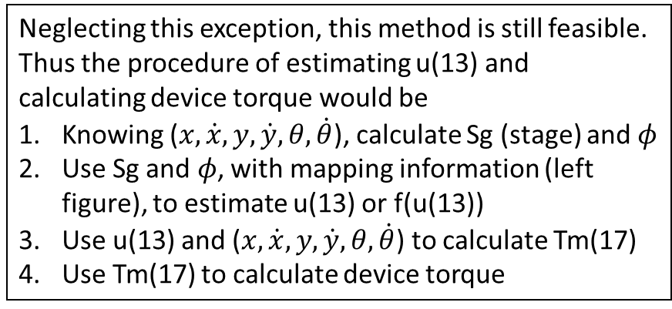
Use global angle $φ$ to estimate u(13)
In Stage 2,3
The relationship between f(u(13)) and $φ$ is shown as left, we can see as the stage information is known, there is clear one to one mapping from $φ$ to f(u(13)).
The only exception is in stage 6, where in the red box
$$f(u(13))$$
global angle $φ$
In Stage 5,6
$$f(u(13))$$
Neglecting this exception, this method is still feasible. Thus the procedure of estimating u(13) and calculating device torque would be
Knowing ($x,\dot{x},y,\dot{y},θ,\dot{θ}$), calculate Sg (stage) and $φ$
Use Sg and $φ$, with mapping information (left figure), to estimate u(13) or f(u(13))
Use u(13) and ($x,\dot{x},y,\dot{y},θ,\dot{θ}$) to calculate Tm(17)
Use Tm(17) to calculate device torque
global angle $φ$

Slide 7
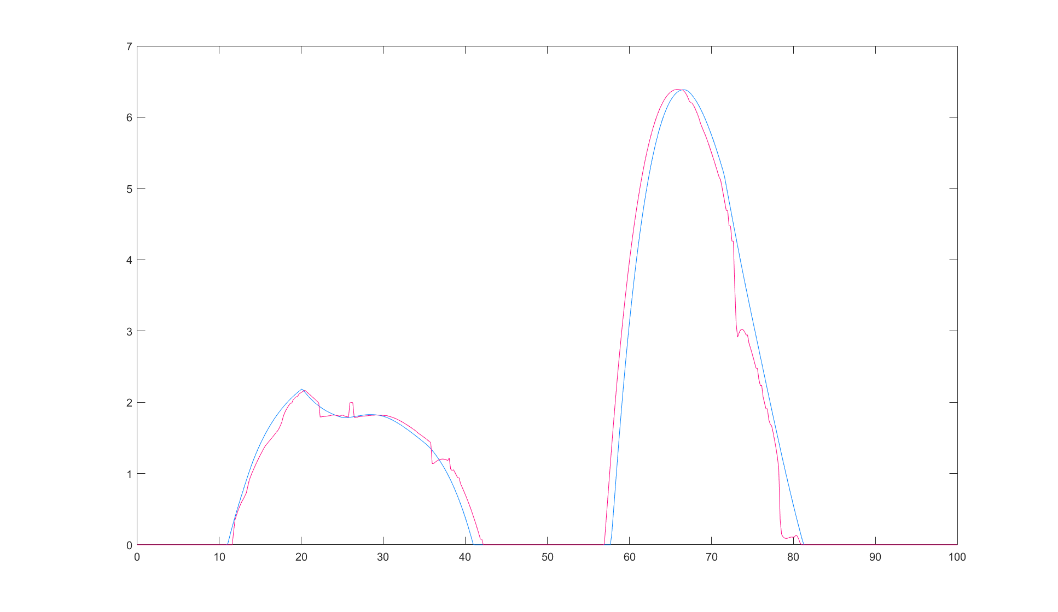
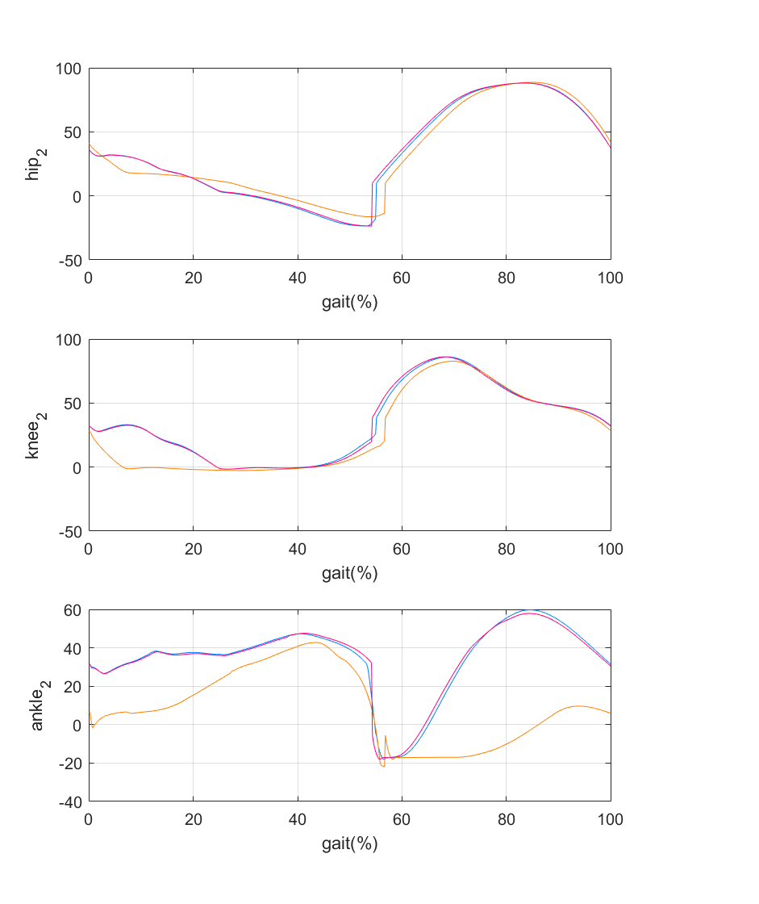
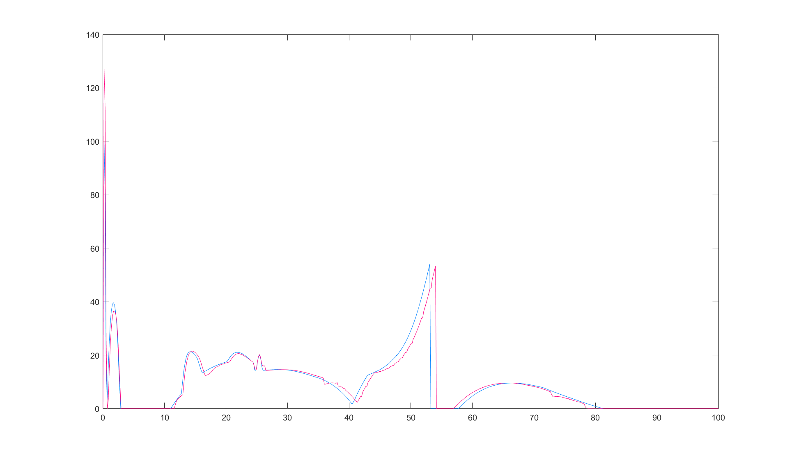
Simulation about System with Tm(17) disabled and Adding Device Torque by Estimating u(13)
Result II: Compare of f(u(13))
Result I: Joint Angle
Normal
Estimated
Normal
Foot Drop
Foot Drop with tau
f(u(13))
Gait(%)
Result III: Compare of Tm(17)
Normal
Estimated
Tm(17)
Gait(%)

