Slide 1
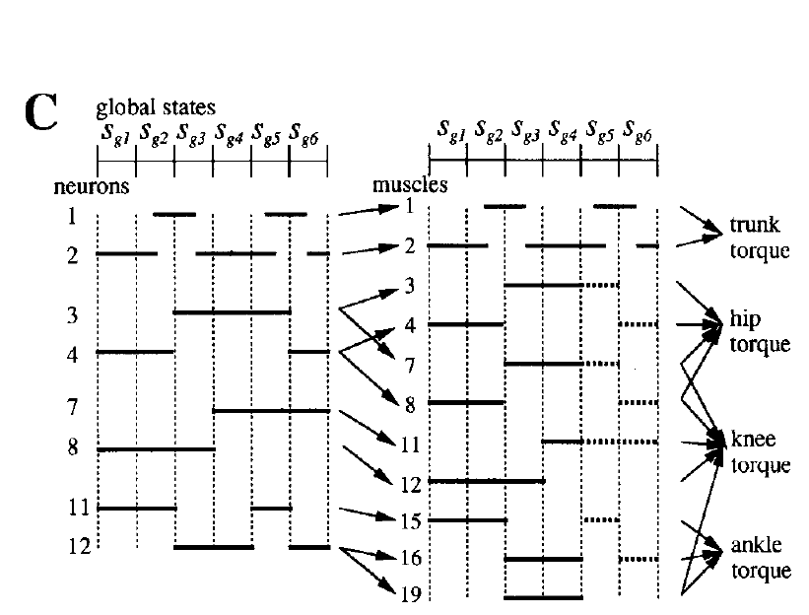
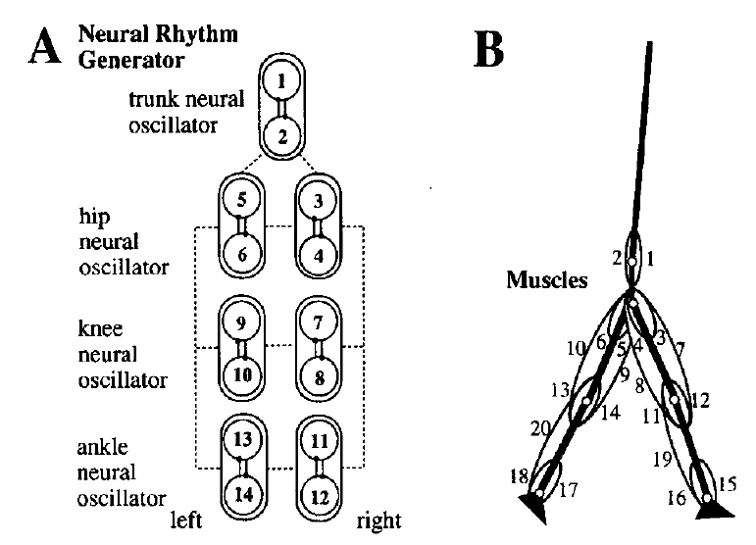
Muscles in the Model
1 Rectus abdominis
2 Erector spinae
3,5 Iliopsoas
4,6 gluteus maximus
7,9 Rectus Femoris
8,10 Hamstrings
11,13 Biceps femoris
12,14 Vastus
15,17 Tibialis anterior
16,18 Soleus
19,20 Gastrocnemius
Neuron 11 is the only neuron will influence tibialis anterior 15
Set u(11) = 0, and what will change?

Slide 2
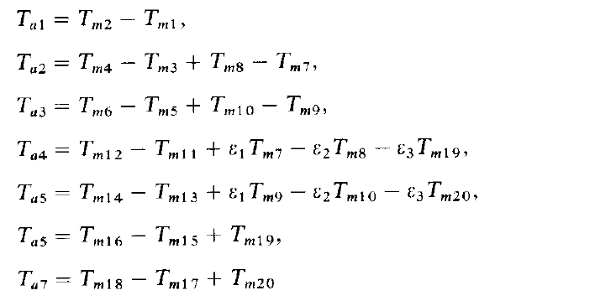
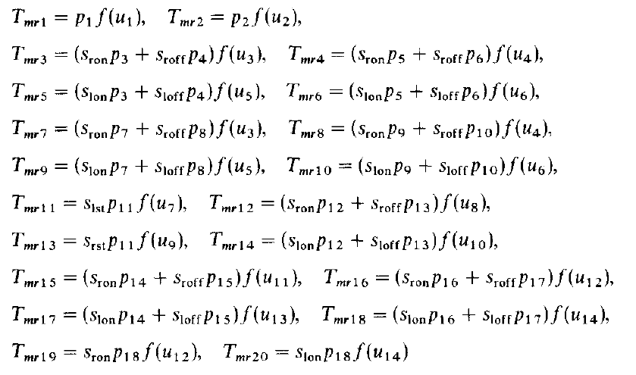
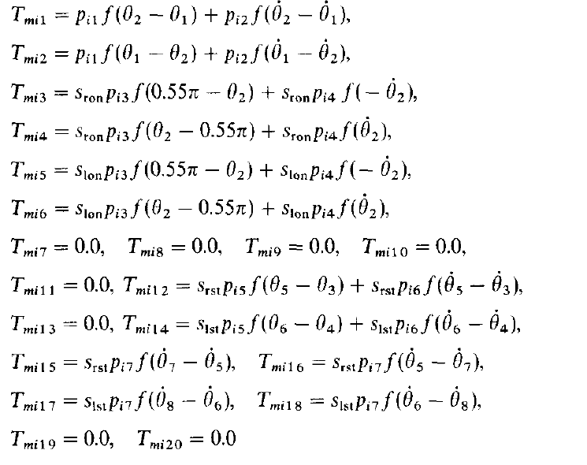
Set u(11) = 0: influence on the muscle torque
$$T_{m}=T_{mr}+T_{mi}$$
By the output of the neural rhythm generator
Assuming muscle forces are proportional to the output of the neural system
Tmr
By the impedance controller
Consists of elastic and damping forces
Tmi
If set u(11) = 0; Tmr(15) = 0;
But Tmi(15) still works;
Thus, it’s different from directly set Tm(15) = 0

Slide 3
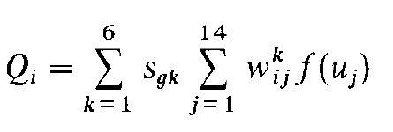
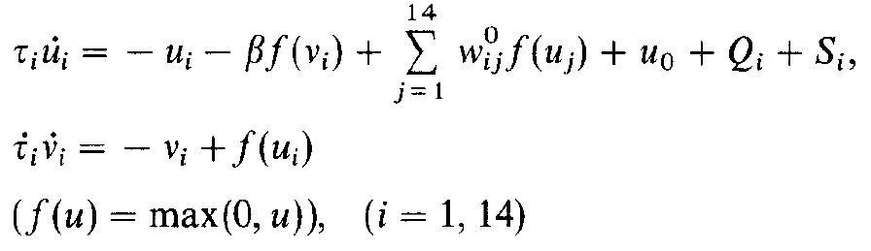
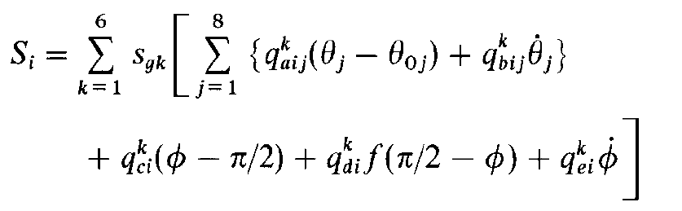
Set u(11) = 0: influence on the neural system
Neural Rhythm Generator: u,v
Setting u(11) = 0 will also influence the calculation of states of Neural Rhythm Generator u (inner state of the neuron)
But why u(11)?

Slide 4
Cause of Foot Drop
Most of the time, foot drop is the result of neurological disorder. [1]
“If the drop foot is caused by neurological disorder all of these muscles could be affected because they are all innervated by the deep fibular (peroneal) nerve.” [1]
With respect to the muscles that are influenced, foot drop can be defined as the weakness of tibialis anterior [2].
Although the anterior tibialis plays a major role in dorsiflexion, it is assisted by the fibularis tertius, extensor digitorum and the extensor hallucis longus. [1]
Occasionally, the spasticity in soleus and gastrocnemius exists in the presence of foot drop.
1 Rectus abdominis
2 Erector spinae
3,5 Iliopsoas
4,6 gluteus maximus
7,9 Rectus Femoris
8,10 Hamstrings
11,13 Biceps femoris
12,14 Vastus
15,17 Tibialis anterior
16,18 Soleus
19,20 Gastrocnemius
Thus, turning off u(11) is reasonable.
But reduce function in u(12) can also be considered.
[1] Pritchett, James W., and M. A. Porembski. "Foot drop." E-Medicine.[Online] (2006).
[2] Westhout, Franklin D., Laura S. Paré, and Mark E. Linskey. "Central causes of foot drop: rare and underappreciated differential diagnoses." The journal of spinal cord medicine 30.1 (2007): 62-66.

Slide 5
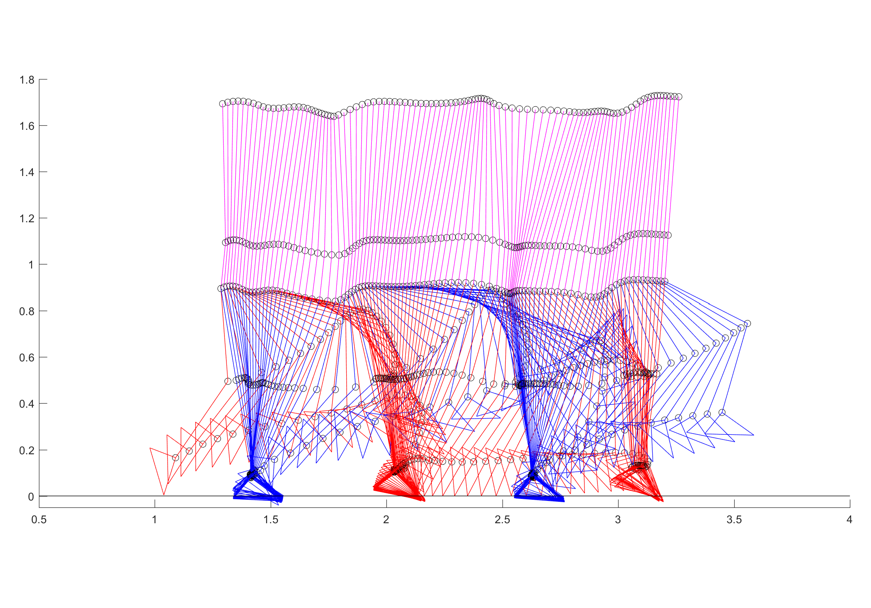
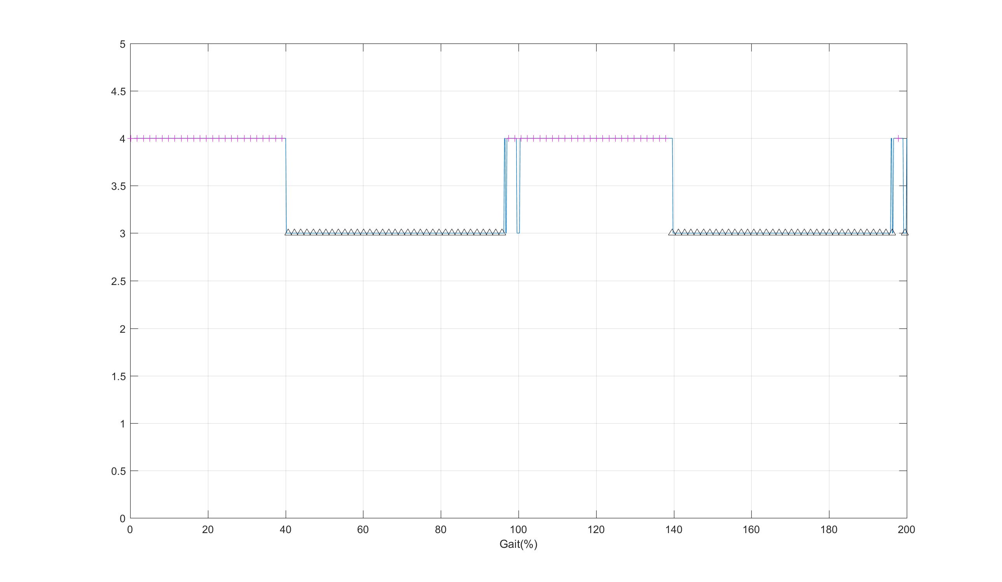
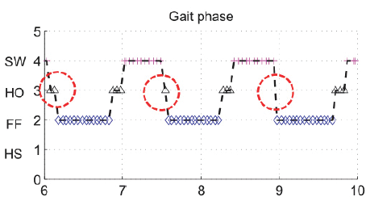
Set u(13) = 0
Initial Condition, u(13)=0; u_dot(13)=0;
Result I: Stance Sequence
Stance
Heel off
Flat foot
Heel strike
Toe dragging

Slide 6
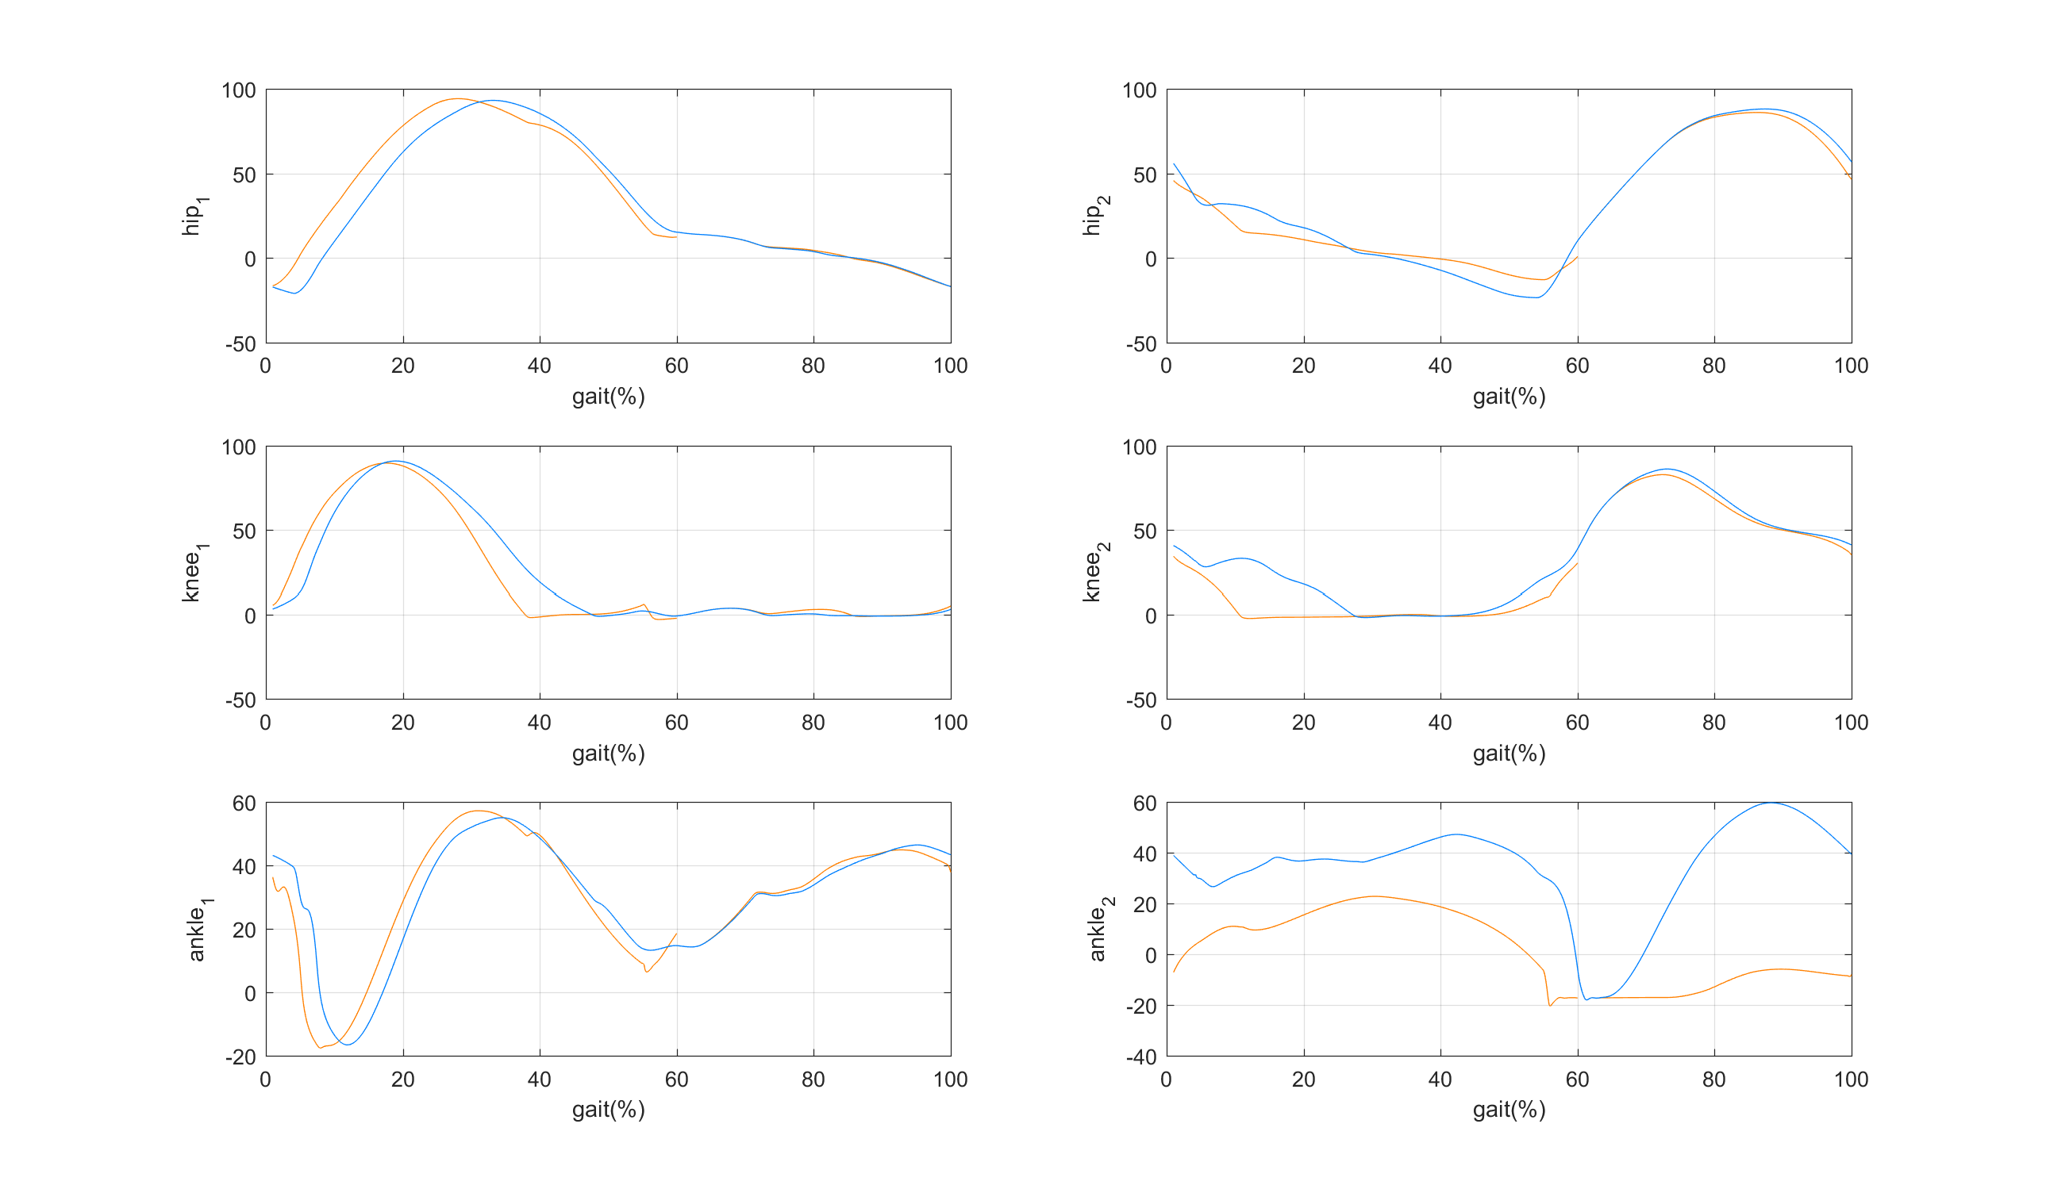
Result II: Joint Angle
Stance
Swing
Normal
Foot Drop
Ankle
Knee
Hip
Reference 1
Reference 2

Slide 7
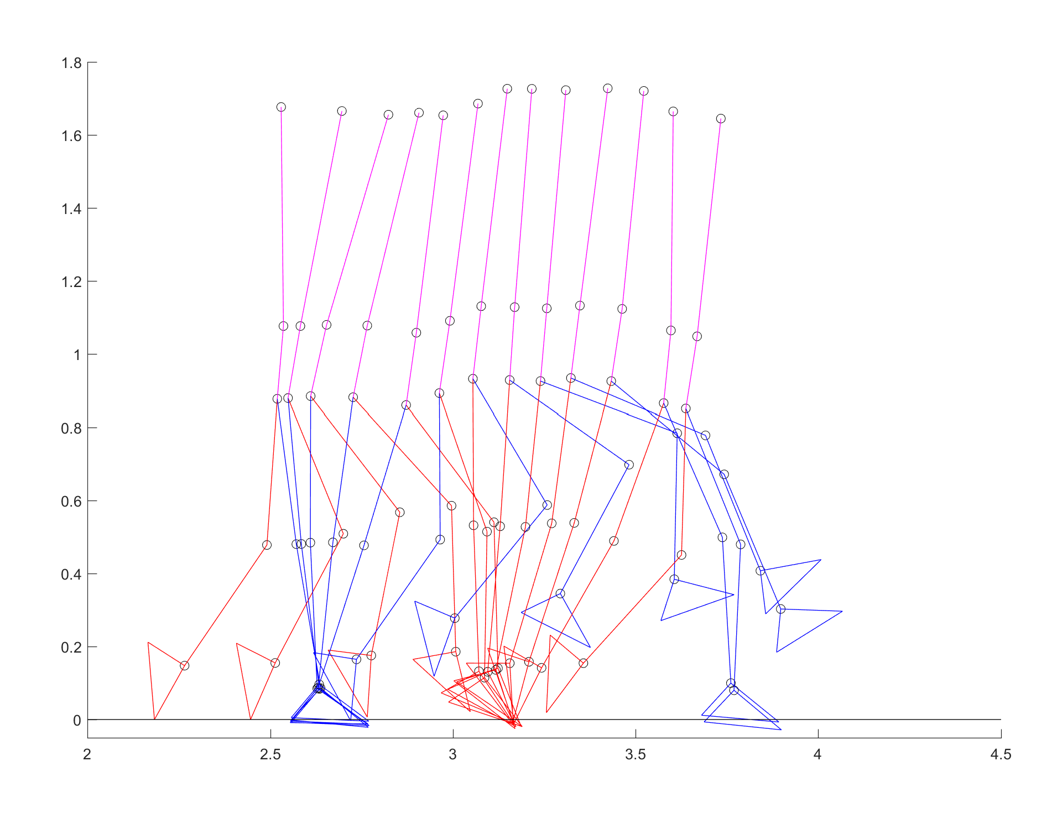
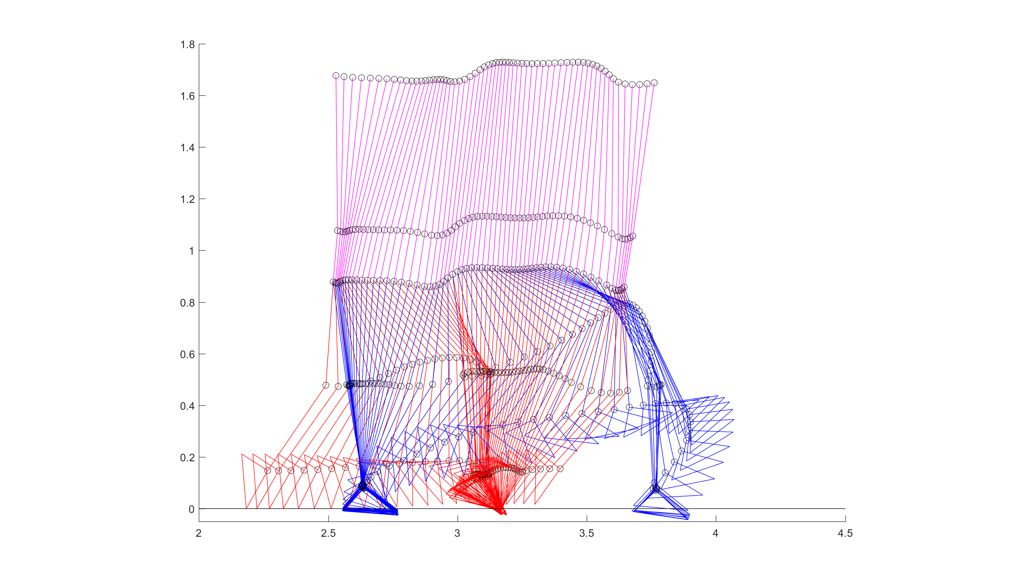
Set u(13) = 0 and Start from initial condition of foot drop
Result I: Walking
Toe dragging

Slide 8
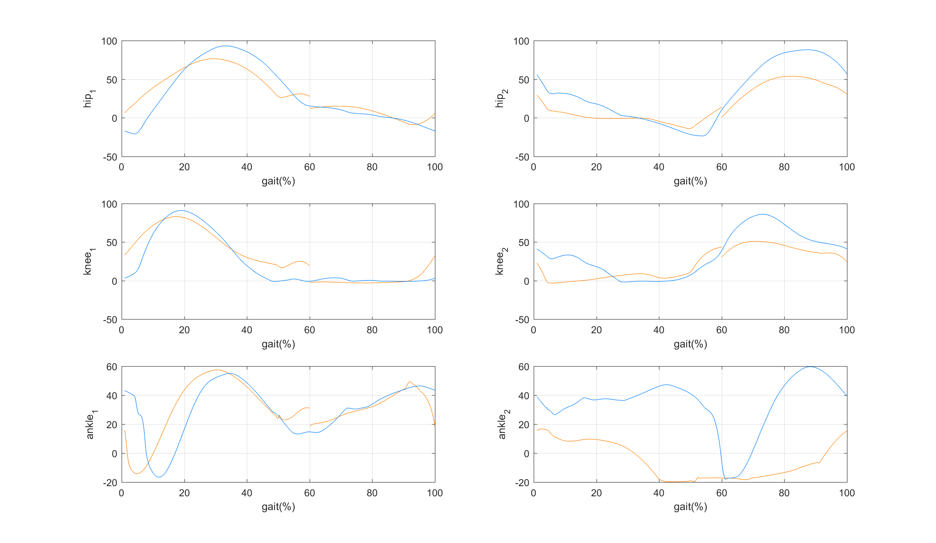
Result II: Joint Angle
Stance
Swing
Normal
Foot Drop
Ankle
Knee
Hip
Reference 1
Reference 2

Slide 9
Tm(15)
$$T_{m15}=\left(S_{ron}p_{14}+S_{roff}p_{15}\right)f\left(u_{11}\right)+S_{rst}p_{i7}f(\dot{θ_{7}}−\dot{θ_{5}})$$
Normal
Stage 1
$$T_{m15}=\left(S_{ron}p_{14}\right)f\left(u_{11}\right)+S_{rst}p_{i7}f(\dot{θ_{7}}−\dot{θ_{5}})$$
Stance
Stage 2
$$T_{m15}=\left(S_{ron}p_{14}\right)f\left(u_{11}\right)+S_{rst}p_{i7}f(\dot{θ_{7}}−\dot{θ_{5}})$$
Stage 3
$$T_{m15}=\left(S_{ron}p_{14}\right)f\left(u_{11}\right)+S_{rst}p_{i7}f(\dot{θ_{7}}−\dot{θ_{5}})$$
Stage 4
$$T_{m15}=\left(S_{ron}p_{14}\right)f\left(u_{11}\right)$$
Stage 5
$$T_{m15}=\left(S_{roff}p_{15}\right)f\left(u_{11}\right)$$
Swing
Stage 6
$$T_{m15}=\left(S_{roff}p_{15}\right)f\left(u_{11}\right)$$

Slide 10
Tm(17)
$$T_{m17}=\left(S_{lon}p_{14}+S_{loff}p_{15}\right)f\left(u_{13}\right)+S_{lst}p_{i7}f(\dot{θ_{8}}−\dot{θ_{6}})$$
Normal
Stage 1
$$T_{m17}=\left(S_{lon}p_{14}\right)f\left(u_{13}\right)$$
Stage 2
$$T_{m17}=\left(S_{loff}p_{15}\right)f\left(u_{13}\right)$$
Stance
Stage 3
$$T_{m17}=\left(S_{loff}p_{15}\right)f\left(u_{13}\right)$$
Stage 4
$$T_{m17}=\left(S_{lon}p_{14}\right)f\left(u_{13}\right)+S_{lst}p_{i7}f(\dot{θ_{8}}−\dot{θ_{6}})$$
Stage 5
$$T_{m17}=\left(S_{lon}p_{14}\right)f\left(u_{13}\right)+S_{lst}p_{i7}f(\dot{θ_{8}}−\dot{θ_{6}})$$
Swing
Stage 6
$$T_{m17}=\left(S_{lon}p_{14}\right)f\left(u_{13}\right)+S_{lst}p_{i7}f(\dot{θ_{8}}−\dot{θ_{6}})$$

