Slide 1
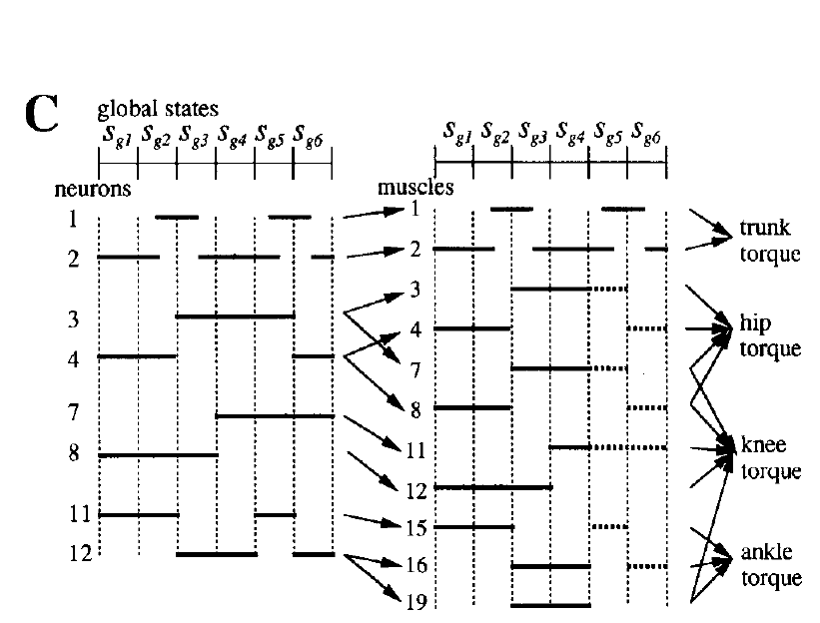
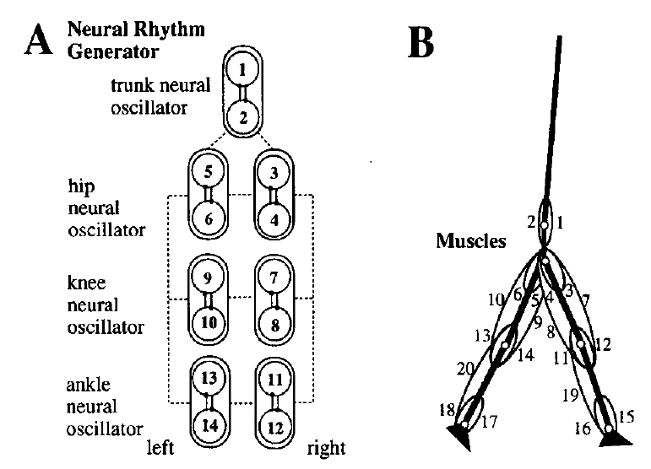
Muscles in the Model
1 Rectus abdominis
2 Erector spinae
3,5 Iliopsoas
4,6 gluteus maximus
7,9 Rectus Femoris
8,10 Hamstrings
11,13 Biceps femoris
12,14 Vastus
15,17 Tibialis anterior
16,18 Soleus
19,20 Gastrocnemius
Tibialis anterior for dorsiflexion can be the muscle mostly influenced by foot drop.
And the spasticity in soleus and gastrocnemius also exists in the presence of foot drop occasionally
Neuron 11 and 13 are responsible for tibialis anterior of two shanks, while Neuron 12 and 14 are
Responsible for soleus and gastrocnemius

Slide 2
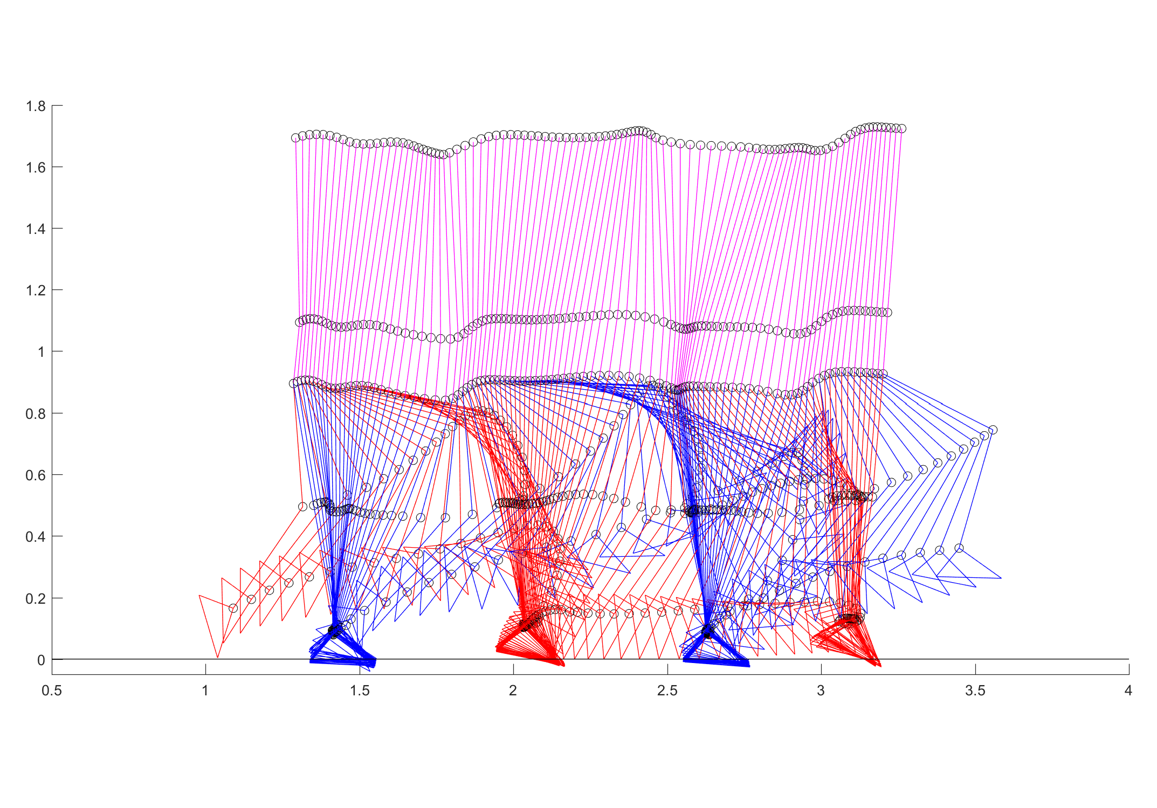
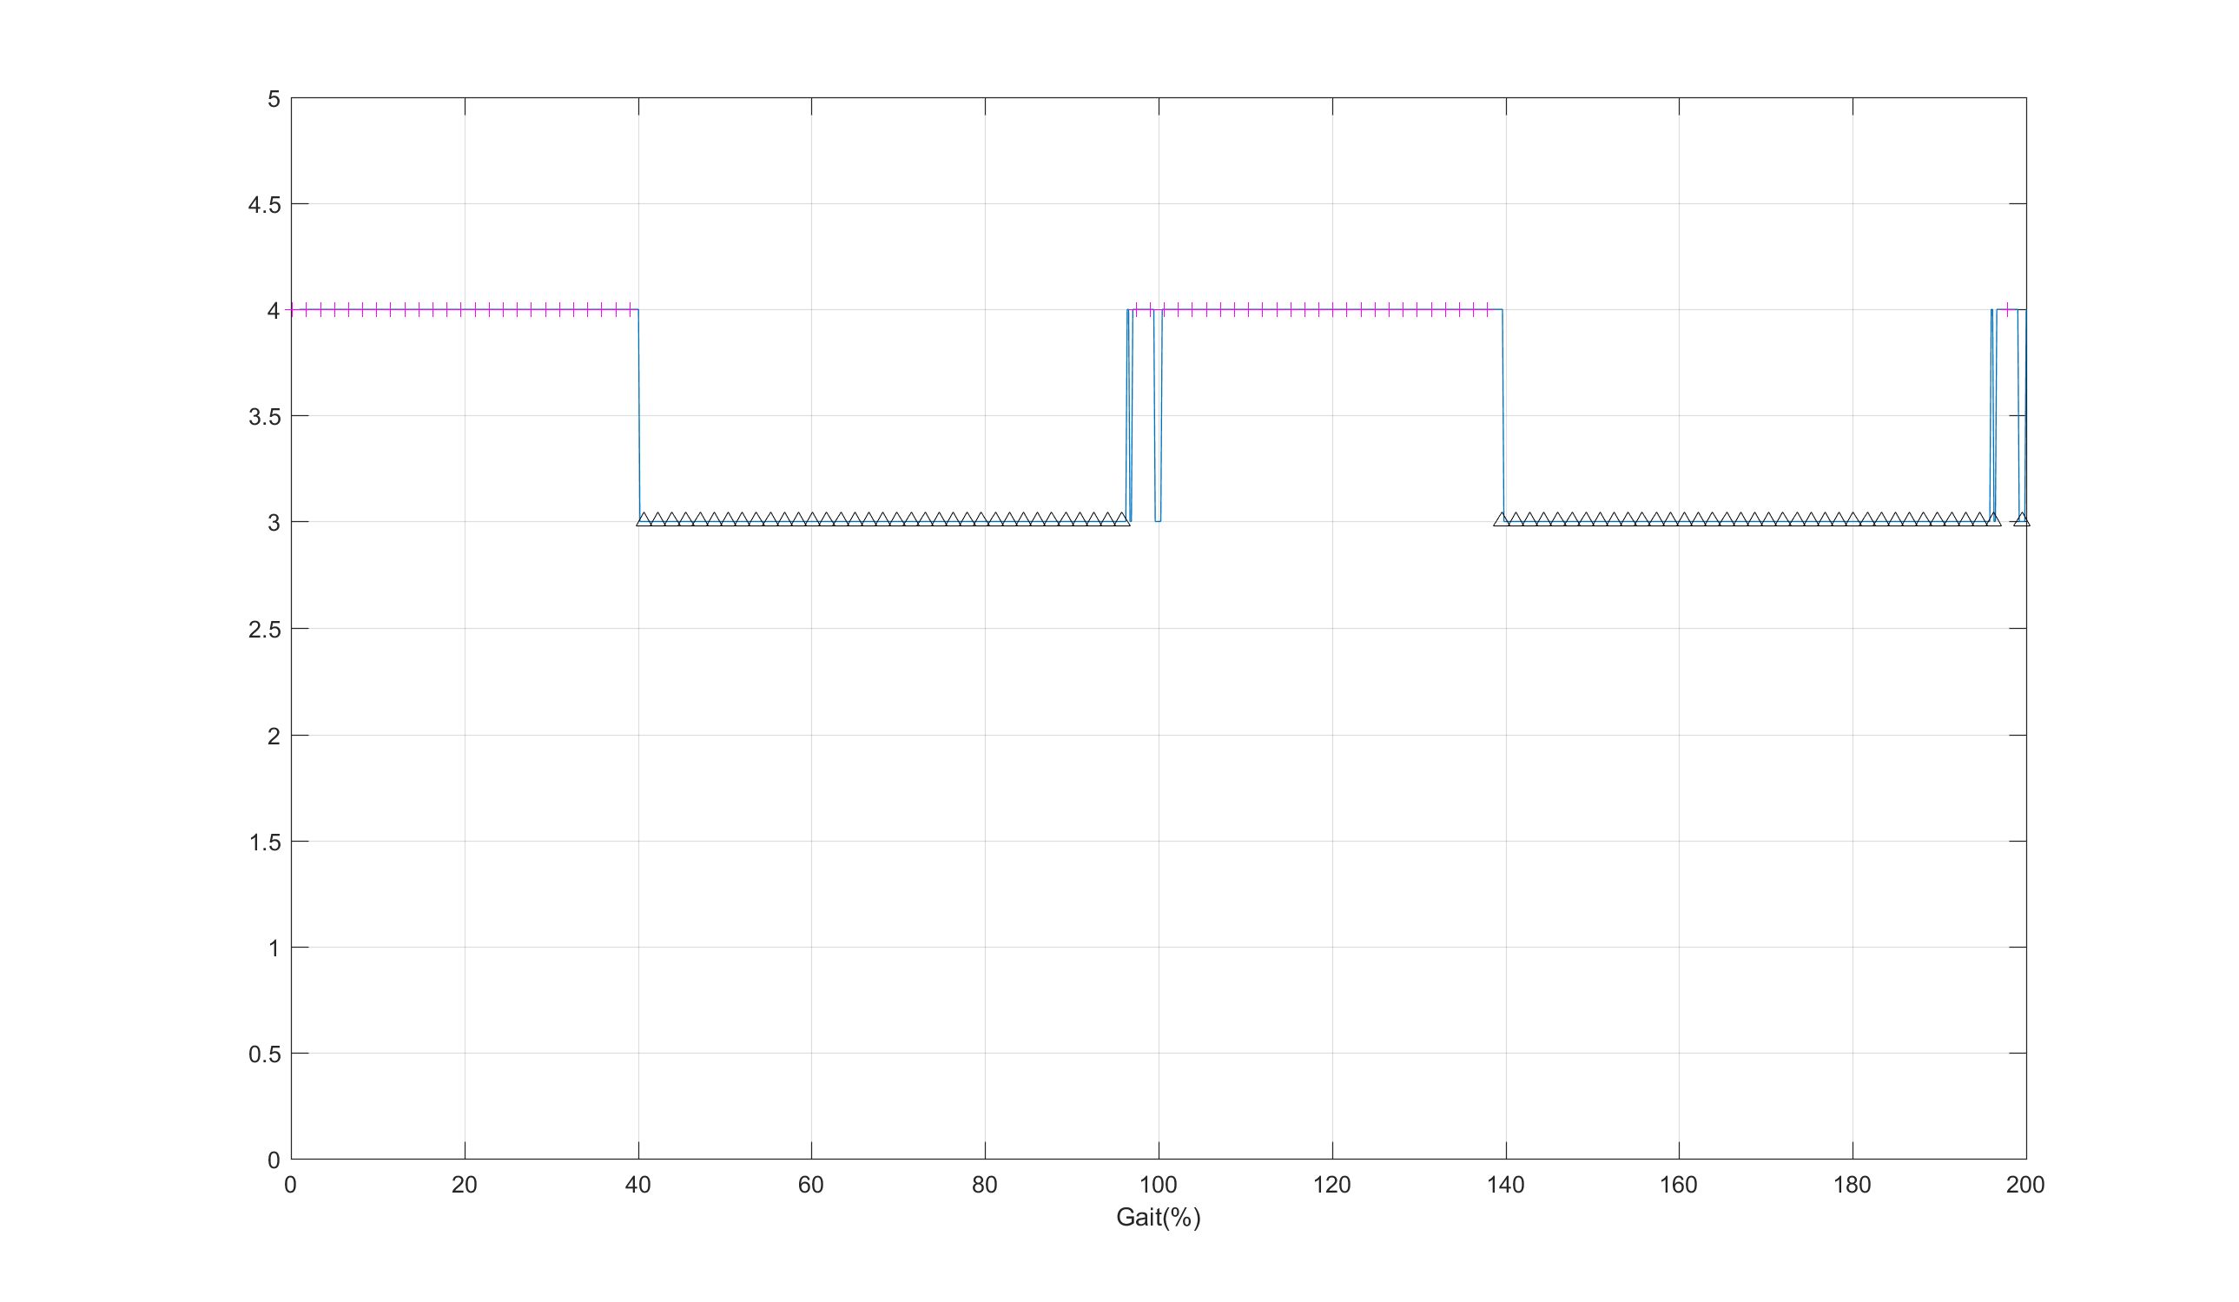
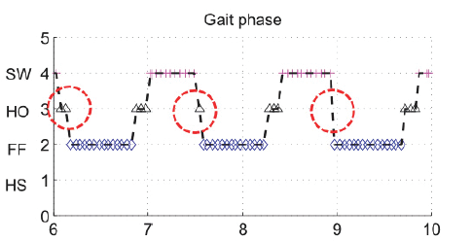
Set u(13) = 0
Initial Condition, u(13)=0; u_dot(13)=0;
Result I: Stance Sequence
Stance
Heel off
Flat foot
Heel strike
Toe dragging
The problem is that the model does not have flat.

Slide 3
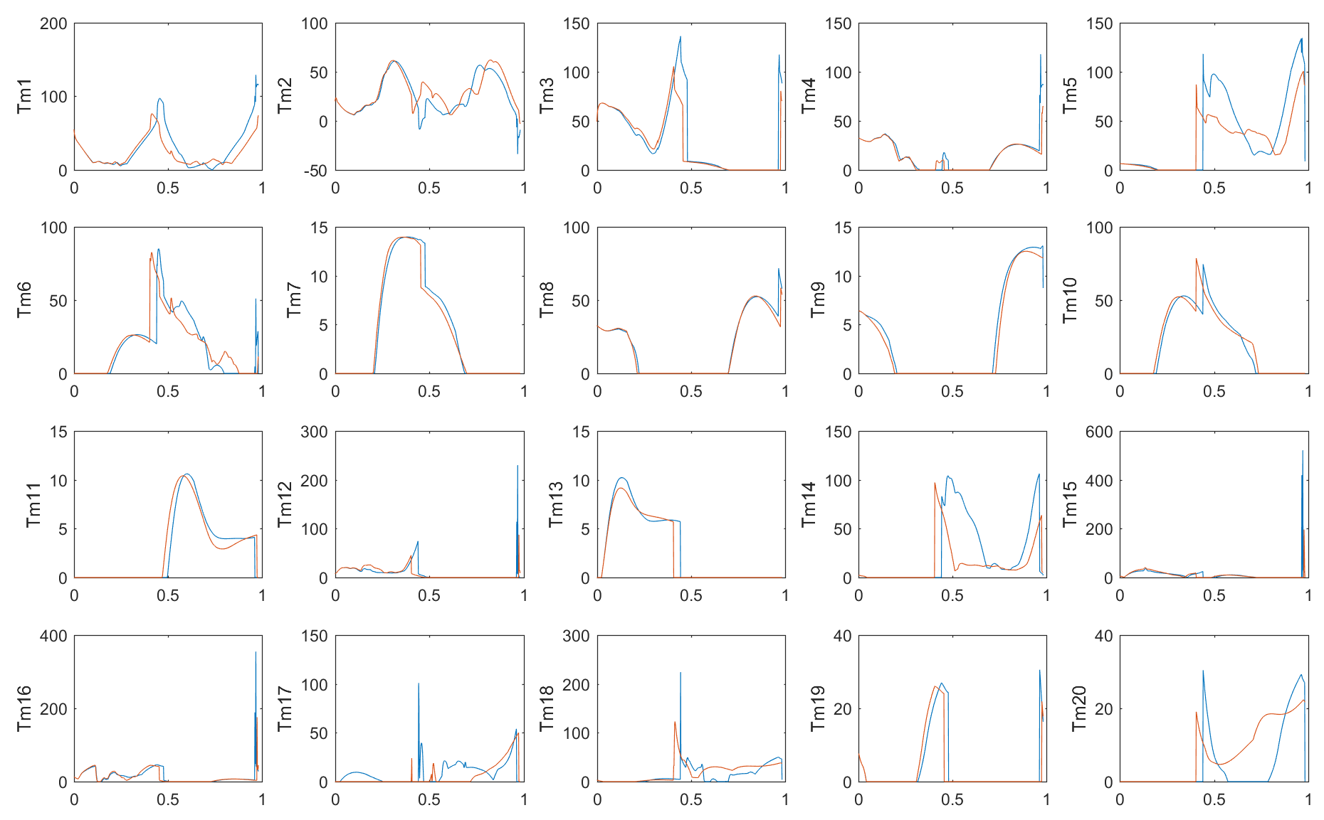
Set u(13) = 0
Analysis of muscle torque explains the reason of absence of flat foot
Because of increase of plantarflexion during stance phase
Normal
DisableU13

Slide 4
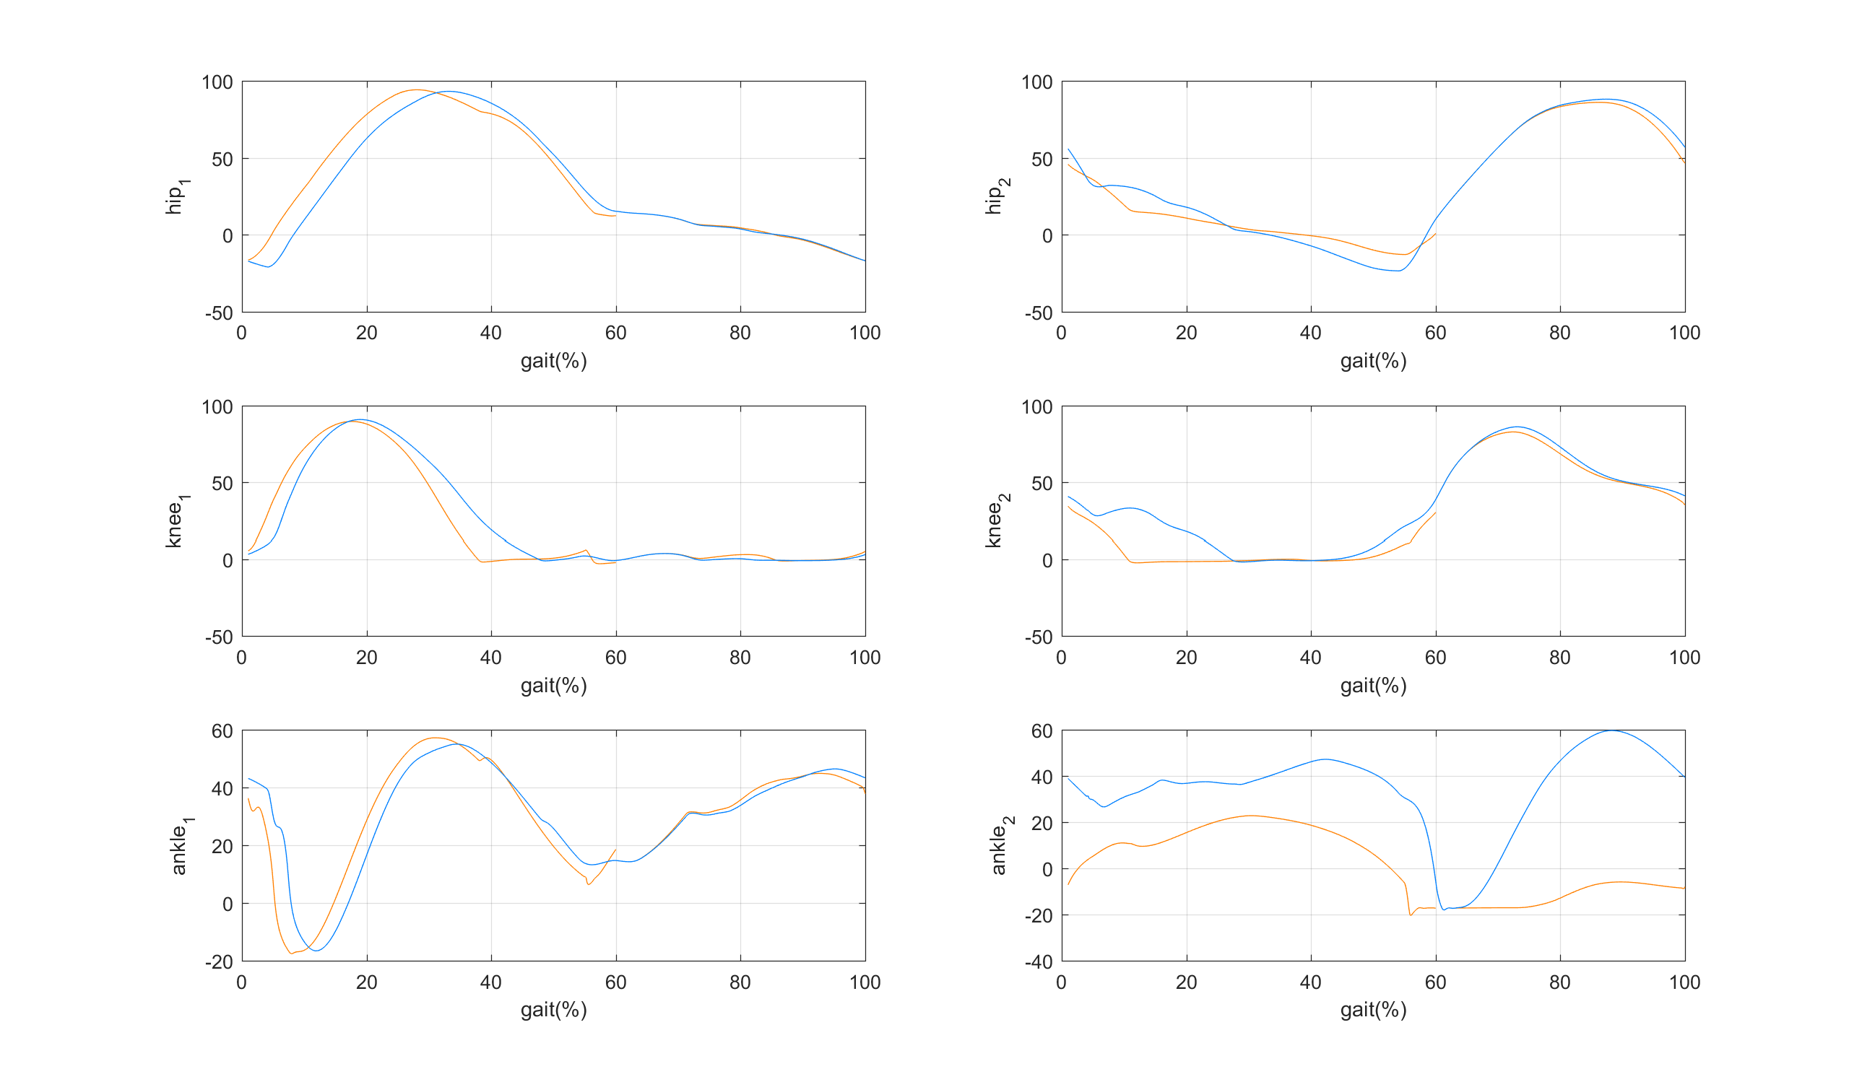
Set u(13) = 0
Result II: Joint Angle
Stance
Swing
Normal
Foot Drop
Ankle
Knee
Hip
Reference 1
Reference 2

Slide 5
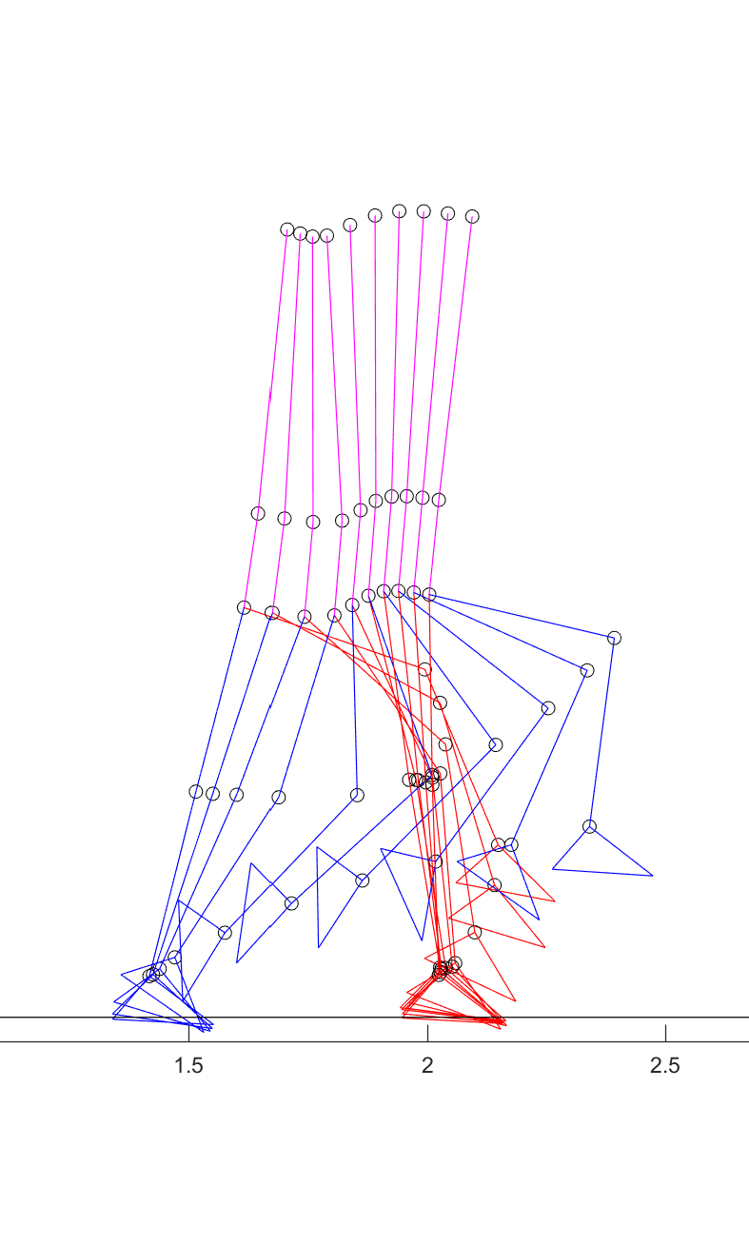
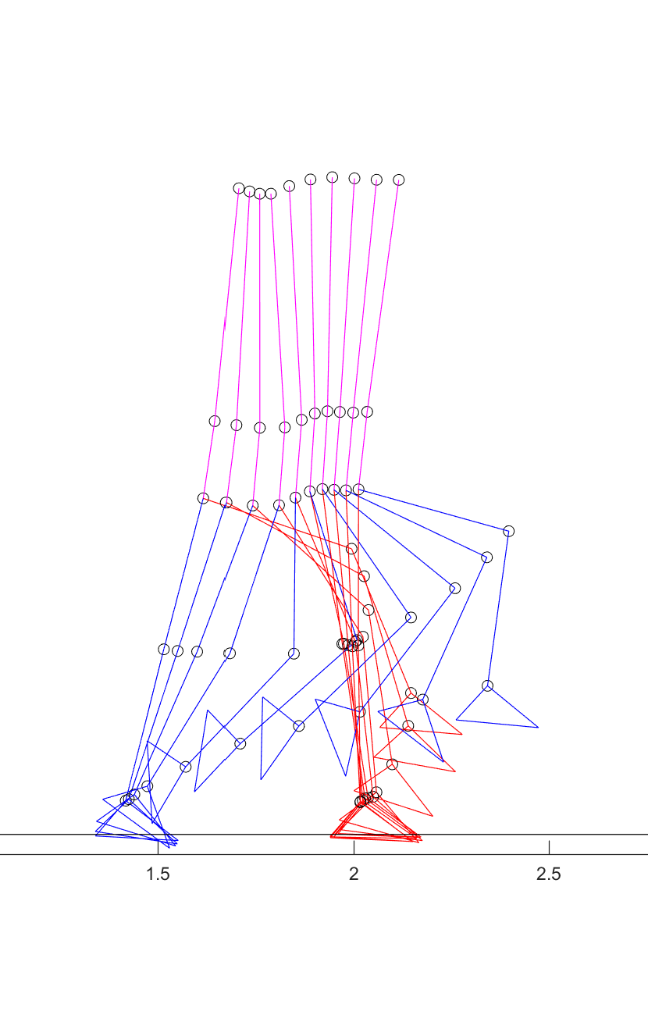

New Simulation Result
So I set low u(13) instead of zero, and also consider the case to reduce u(14)
Set u(13) = 0.01*u(13)
Set u(13) = 0.02*u(13)
Set u(13) = 0.02*u(13)
u(14) = 0.9*u(14)
Foot Drop

Slide 6
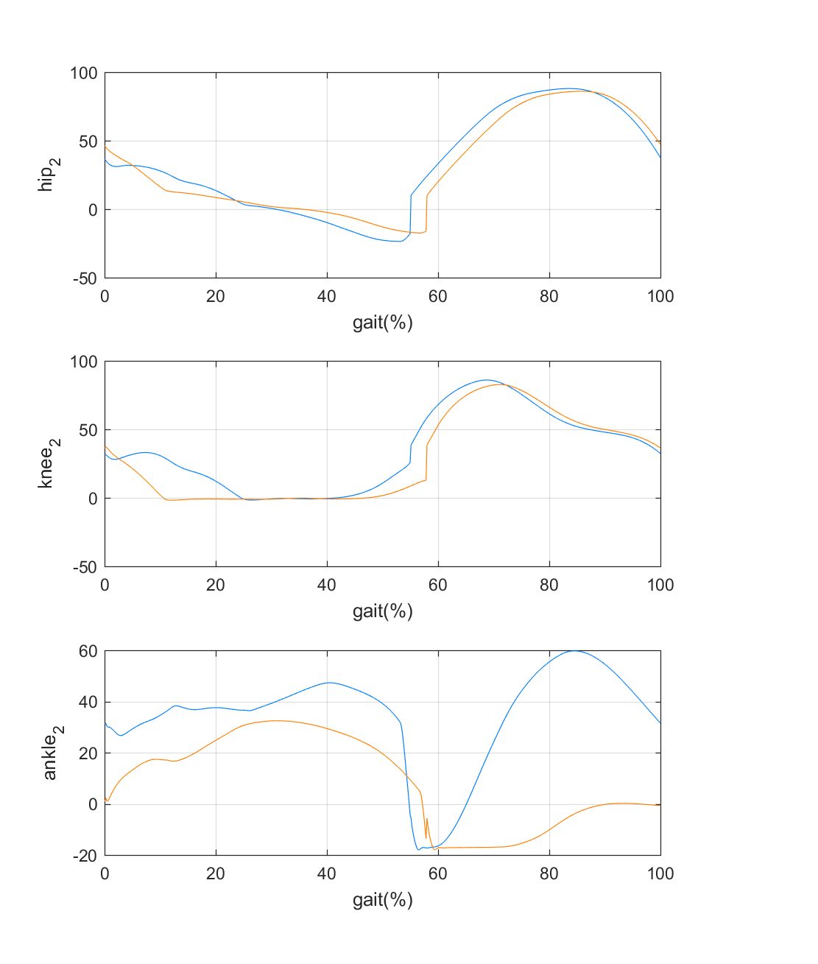
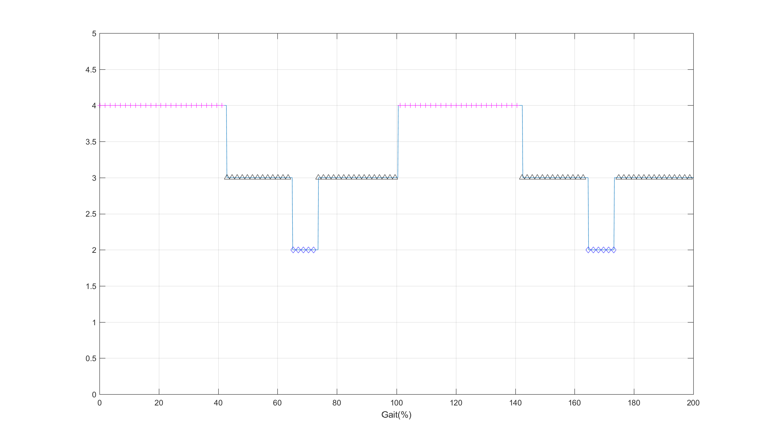
Set u(13) = 0.01*u(13)
Initial Condition, u(13)=0.01*u(13); u_dot(13)=0.01*u_dot(13);
Result I: Stance Sequence
Result II: Joint Angle
Normal
Foot Drop
Stance
Heel off
Flat foot
Heel strike

Slide 7
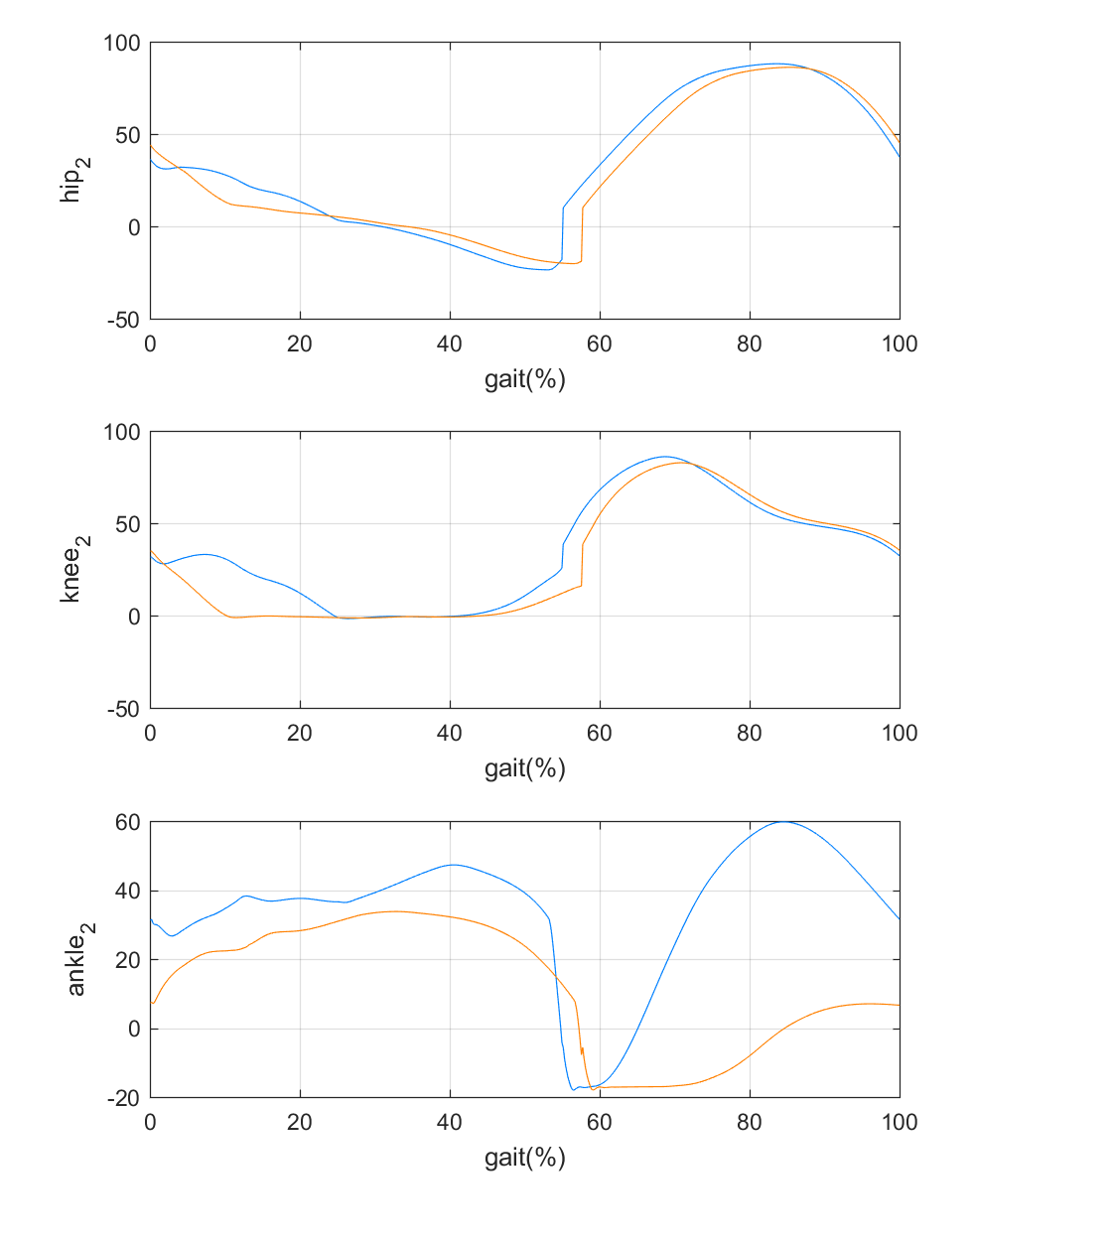
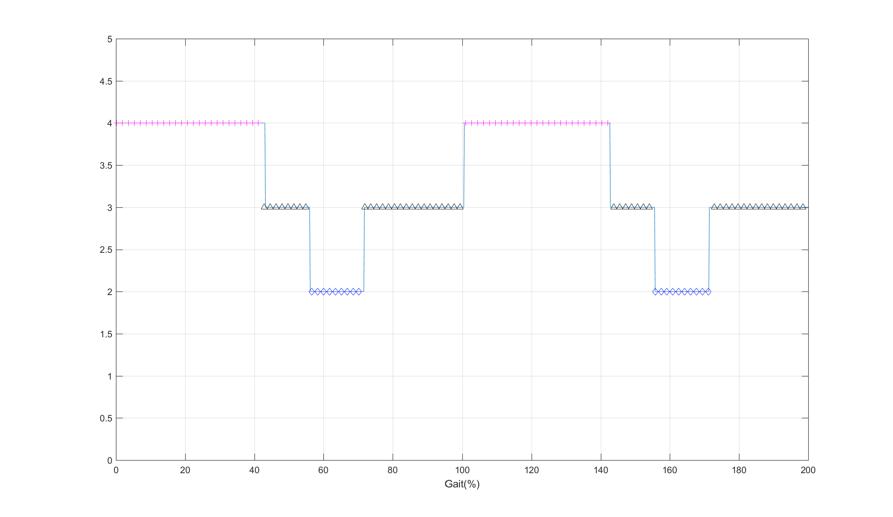
Set u(13) = 0.02*u(13)
Initial Condition, u(13)=0.02*u(13); u_dot(13)=0.02*u_dot(13);
Result I: Stance Sequence
Result II: Joint Angle
Normal
Foot Drop
Stance
Heel off
Flat foot
Heel strike

Slide 8
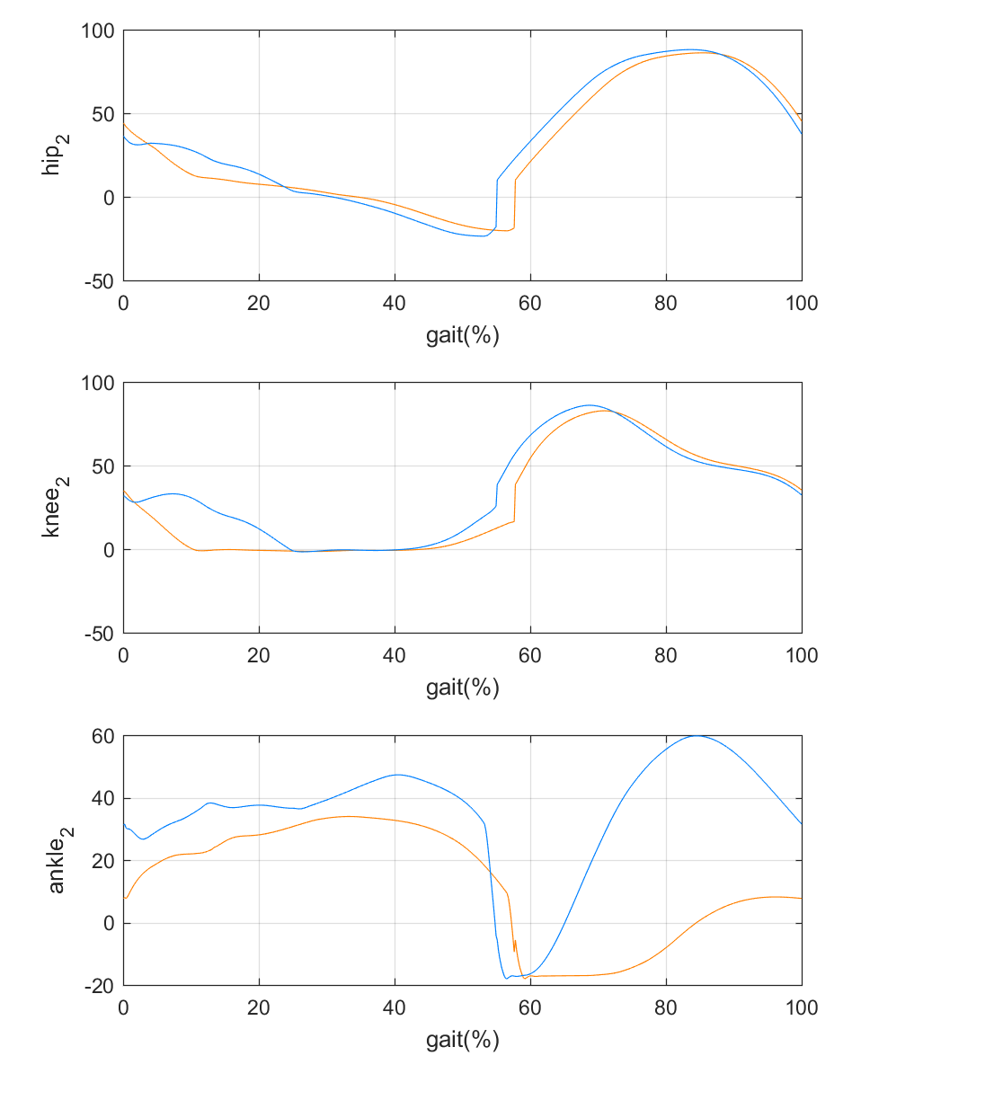
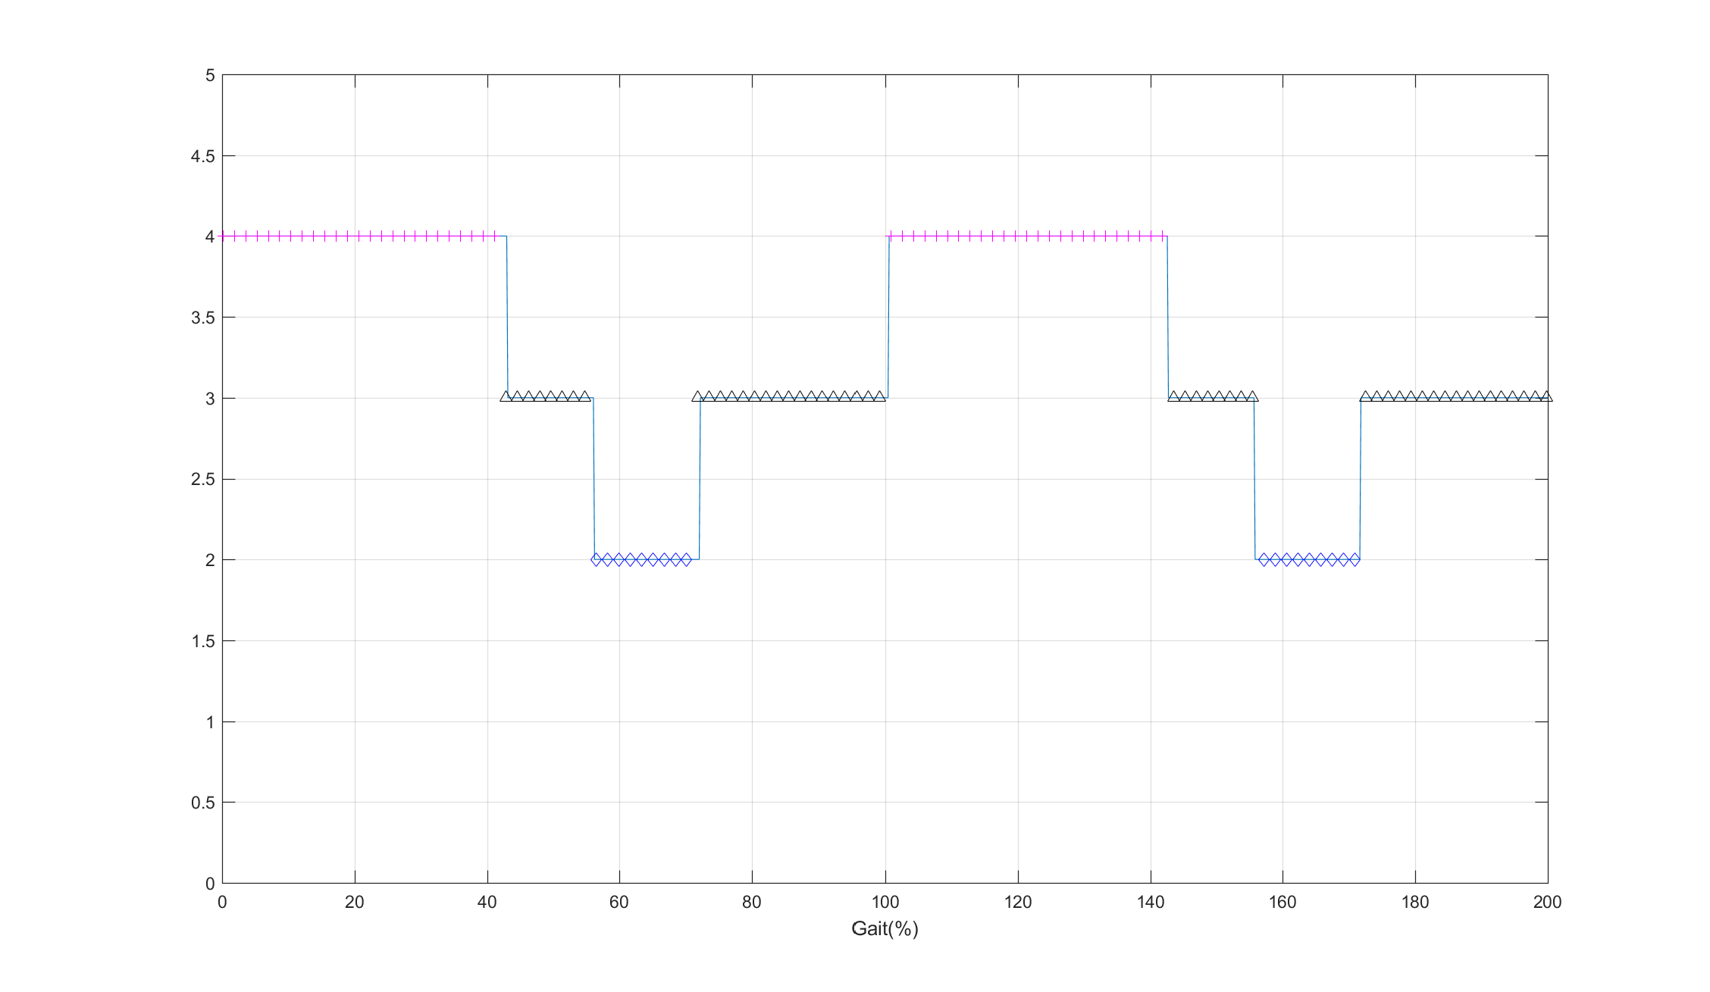
Set u(13) = 0.02*u(13) and u(14) = 0.9*u(14)
Initial Condition, u(13)=0.02*u(13) , u(14)=0.9*u(14); ; u_dot(13)=0.02*u_dot(13), u_dot(14)=0.9*u_dot(14);
Result I: Stance Sequence
Result II: Joint Angle
Normal
Foot Drop
Stance
Heel off
Flat foot
Heel strike

