Slide 1












$$r_{1} t_{1}$$
$$r_{2} t_{2}$$
$$t$$
$$E_{0}t_{1}$$
$$E_{0}t_{1}t$$
$$E_{0}tt_{1}t_{2}$$
$$E_{0}$$
$$E_{0}r_{2}t_{1}t^{2}$$
$$E_{0}r_{2}t_{1}t$$
$$E_{0}{r_{1}r}_{2}t_{1}t^{2}$$
$$E_{0}{r_{1}r}_{2}t_{1}t^{3}$$
$$E_{0}{r_{1}r}_{2}t_{1}t_{2}t^{3}$$

Slide 2
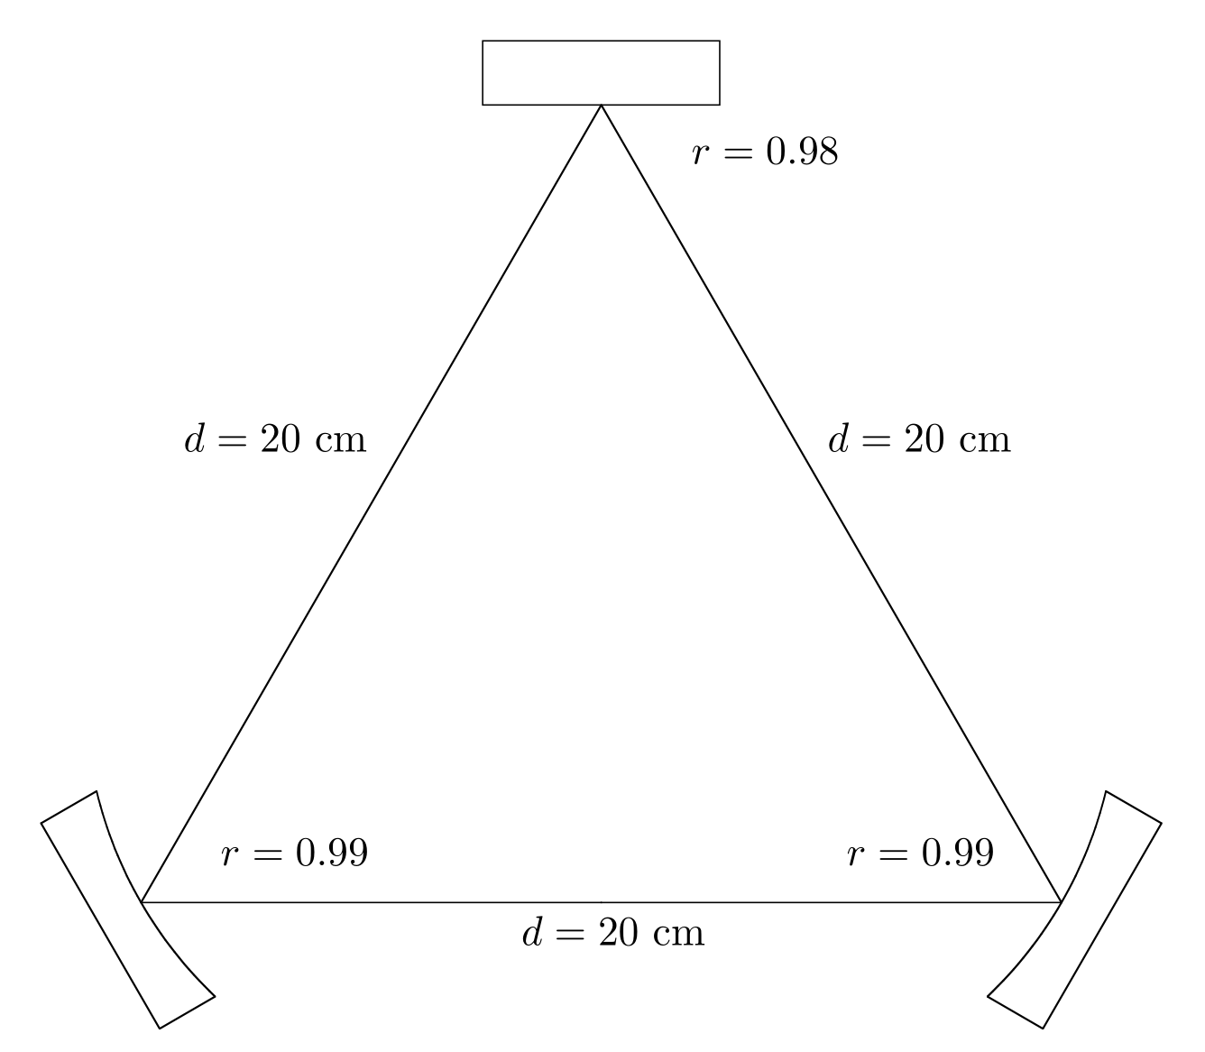



$$r_{1}$$
$$r_{3}$$
$$r_{2}$$

Slide 3






$$r_{1} t_{1}$$
$$r_{2} t_{2}$$
$$n$$
$$θ$$
$$θ_{1}$$
$$θ$$

Slide 4
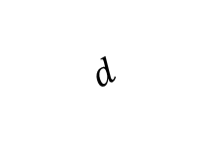






$$t_{1} r_{1}$$
$$n$$
$$θ$$
$$θ_{1}$$
$$θ$$
$$d$$
$$r_{2} t_{2}$$

