Slide 1
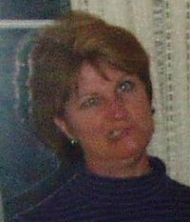
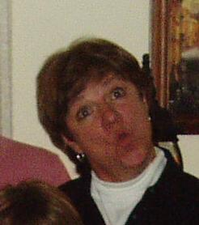
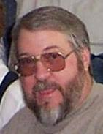
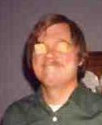
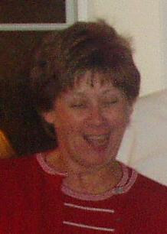
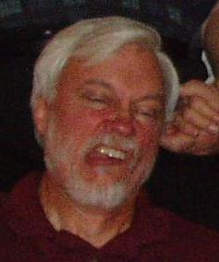
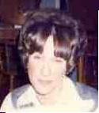
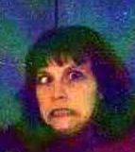

DBC
DBC
DBC
DBC
Alane Inaz
Sharkaway
Macaroni
N. Slots
Machine Lloyd
Fred
Weird Beer
Lloyd
Mgus
Not the Shark
Sickis
DBC
DBC
DBC
DBC
I am
Teresa!
Mungo
Sickis
LaConte
of J. Sickis
Chip off
the Block
Wilhelm

Slide 2
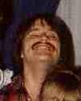
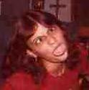
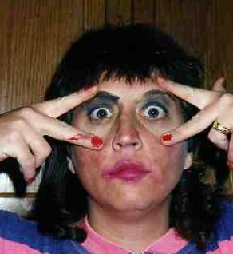
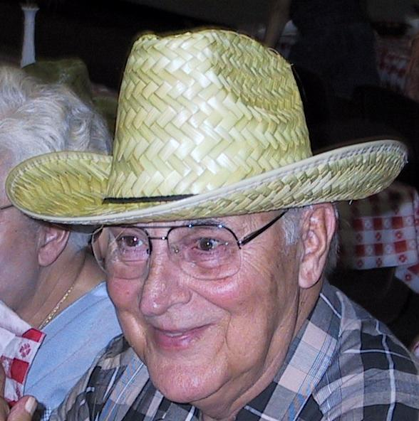
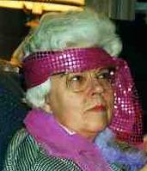
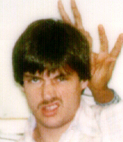
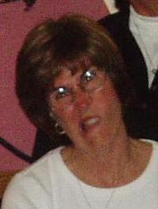
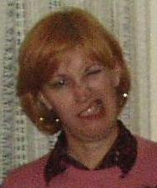
DBC
DBC
DBC
DBC
Wally Ball
Wilhelm
Dixie McCall
BooBash
Miss Kitty
Sickis
Big "O"
DBC
DBC
DBC
DBC
Our
Favorite
Jinny
Pablo
El Diablo
Intergalactic
Janet
Rhea
Madea

Slide 3
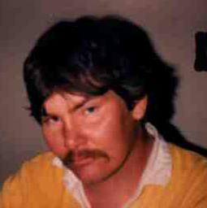
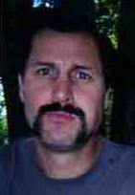
DBC
DBC
Mafia A.
Macaroni
BanjoMan
BooBash

