Slide 1
Probability and Tidyverse II
bio5312 Fall2017
stephanie j. spielman, PhD

Slide 2
Probability vocabulary
Sample space
Event
Probability
Mutually exclusive
Probability distribution
Independent

Slide 3
Sample space and event
Sample space is the set of all possible outcomes of a random trial
Event is a subset of this set
Example: Roll a die
Sample space is <1,2,3,4,5,6>
Events: roll a 4, roll something >=5, etc.

Slide 4
Probability
Probability of an event is the proportion of times the event would occur., i.e. event frequency, in an infinite number of trials
Empirical probabilities are based on a finite amount of data. If sample size expanded indefinitely, probabilities are measured with increasing precision and approach the true event probability. This is pretty much what we can measure.

Slide 5
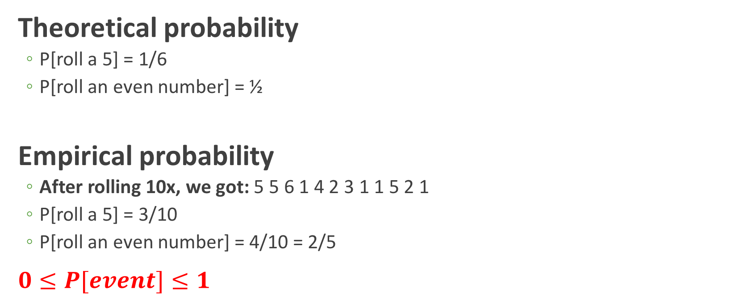
Probability: roll a die
Theoretical probability
P[roll a 5] = 1/6
P[roll an even number] = ½
Empirical probability
After rolling 10x, we got: 5 5 6 1 4 2 3 1 1 5 2 1
P[roll a 5] = 3/10
P[roll an even number] = 4/10 = 2/5
$0≤P[event]≤1$

Slide 6
Mutually exclusive
Two events are mutually exclusive if they cannot both occur simultaneously
Mutually exclusive events: roll a 4 and a 1
Not mutually exclusive events: roll an even # and a 2

Slide 7
Probability distribution
The list of probabilities for all mutually exclusive outcomes of a random trial
A fair die has this distribution:
P[roll 1] = 1/6
P[roll 2] = 1/6
P[roll 3] = 1/6
P[roll 4] = 1/6
P[roll 5] = 1/6
P[roll 6] = 1/6
This is a discrete probability distribution

Slide 8
Independent
Two events are independent if the occurrence of one does not change the occurrence of another.

Slide 9
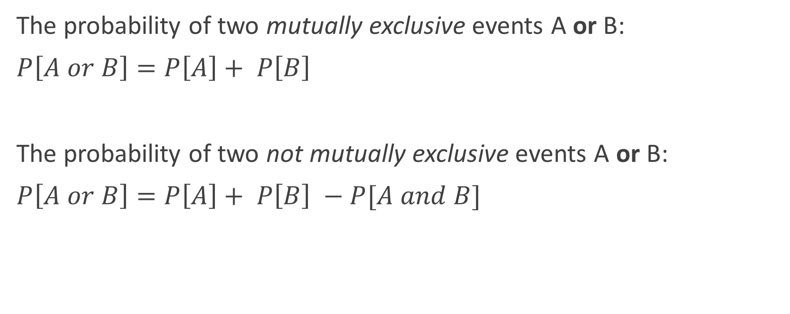
Probability rules
The probability of two mutually exclusive events A or B:
$P\left[A or B\right]=P\left[A\right]+ P\left[B\right]$
The probability of two not mutually exclusive events A or B:
$P\left[A or B\right]=P\left[A\right]+ P\left[B\right] −P[A and B]$

Slide 10

What is the probability of rolling a 2 or a 5 on a fair die?
Are these events mutually exclusive? Yes.
$P\left[2 or 5\right]=P\left[roll 2\right]+ P\left[roll 5\right]=\frac{1}{6}+\frac{1}{6}=\frac{1}{3}$

Slide 11
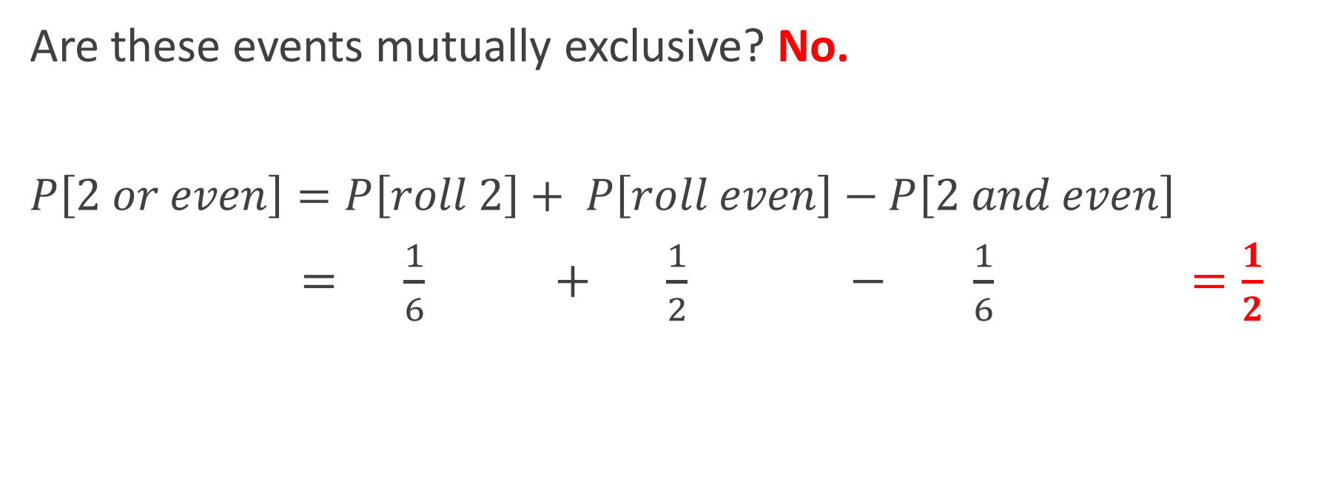
What is the probability of rolling a 2 or an even number on a fair die?
Are these events mutually exclusive? No.
$P\left[2 or even\right]=P\left[roll 2\right]+ P\left[roll even\right]−P\left[2 and even\right]$
$= \frac{1}{6} + \frac{1}{2} − \frac{1}{6} =\frac{1}{2}$

Slide 12
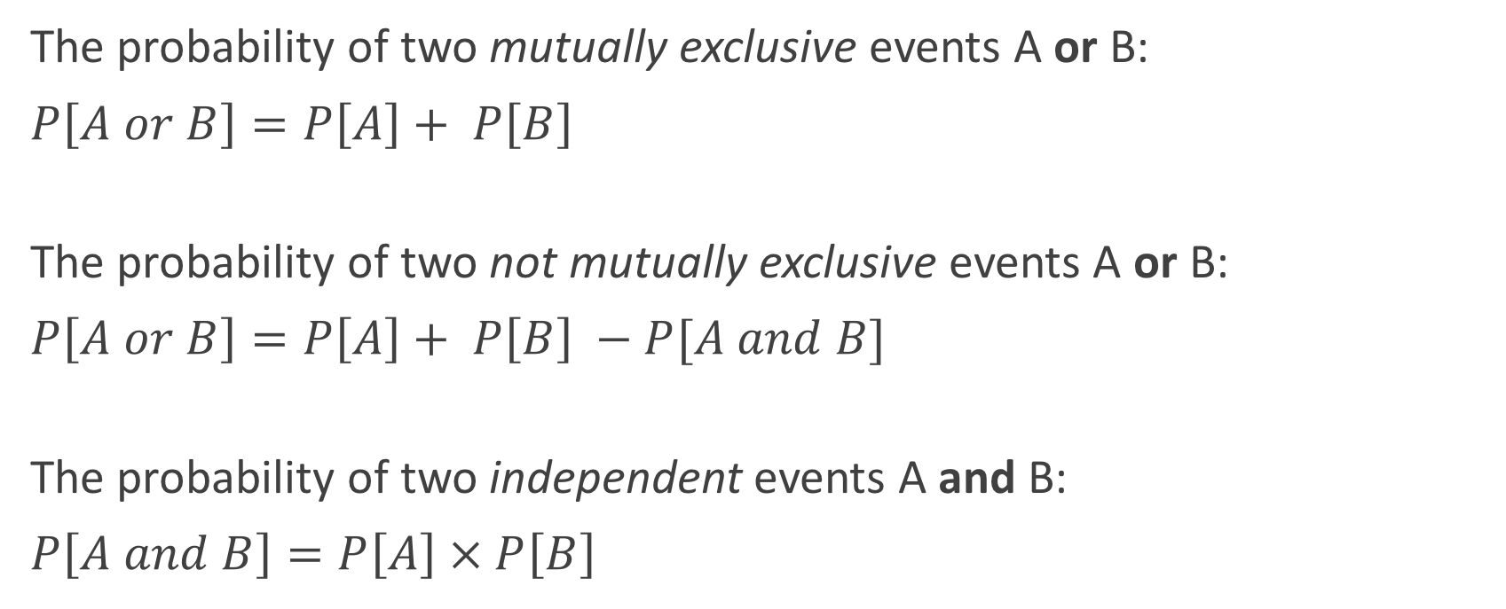
Probability rules
The probability of two mutually exclusive events A or B:
$P\left[A or B\right]=P\left[A\right]+ P\left[B\right]$
The probability of two not mutually exclusive events A or B:
$P\left[A or B\right]=P\left[A\right]+ P\left[B\right] −P[A and B]$
The probability of two independent events A and B:
$P\left[A and B\right]=P\left[A\right] × P\left[B\right]$

Slide 13

Event independence
Mendel's experiment yielded 1600 pea pods:
900 were tall and green
300 were tall and yellow
300 were short and green
100 were short and yellow
Are tall and green pods independent?
Yes, if
$$P\left[A and B\right]=P\left[A\right] × P\left[B\right]$$

Slide 14
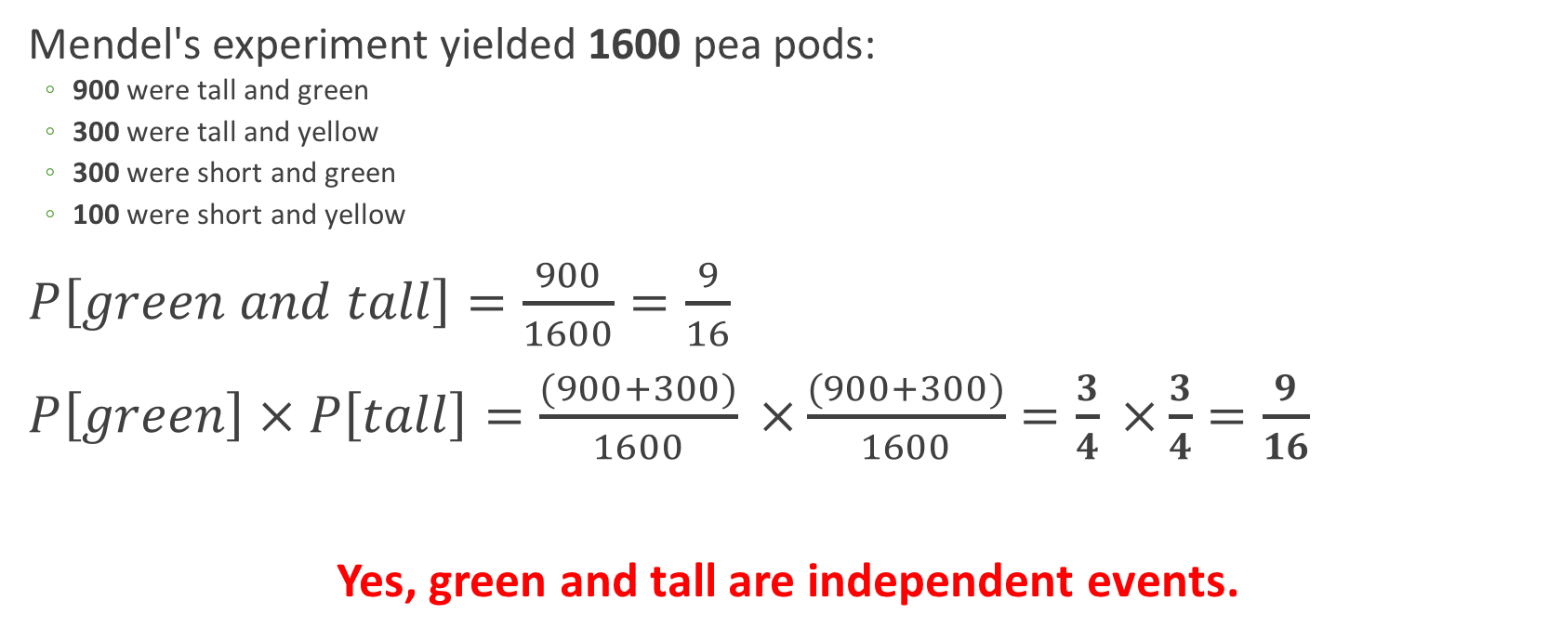

Event independence
Mendel's experiment yielded 1600 pea pods:
900 were tall and green
300 were tall and yellow
300 were short and green
100 were short and yellow
$P\left[green and tall\right]=\frac{900}{1600}=\frac{9}{16}$
$P\left[green\right] × P\left[tall\right]=\frac{(900+300)}{1600} ×\frac{(900+300)}{1600}=\frac{3}{4} ×\frac{3}{4}=\frac{9}{16}$
Yes, green and tall are independent events.
$$P\left[A and B\right]=P\left[A\right] × P\left[B\right]$$

Slide 15
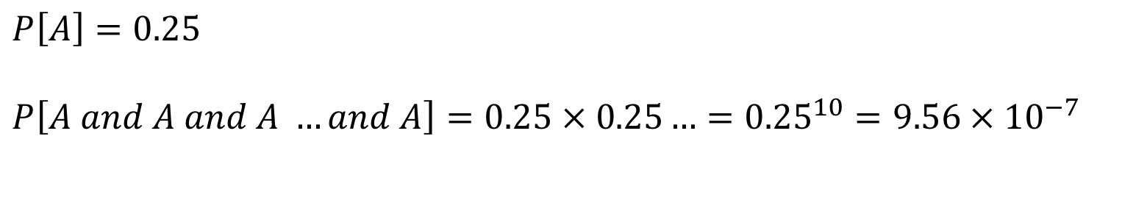
Question
Assume that a long (~infinite) stretch of DNA has A, C, G, T's in equal proportions, randomly occurring throughout.
What is the probability of seeing 10 A nucleotides in a row?
$$P\left[A\right]=0.25$$
$$P\left[A and A and A …and A\right]=0.25 × 0.25…={0.25}^{10}=9.56 × {10}^{−7}$$

Slide 16
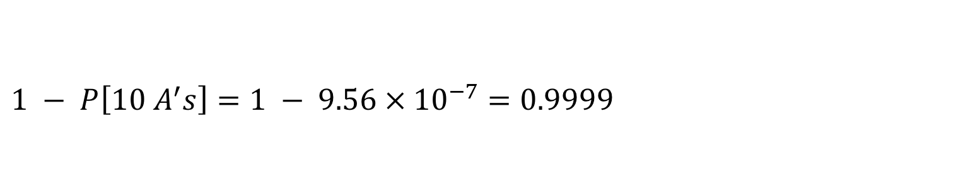
Question
Assume that a long (~infinite) stretch of DNA has A, C, G, T's in equal proportions, randomly occurring throughout.
What is the probability of not seeing 10 A nucleotides in a row?
$$1 − P\left[10 A^{′}s\right]=1 − 9.56 × {10}^{−7}=0.9999$$

Slide 17
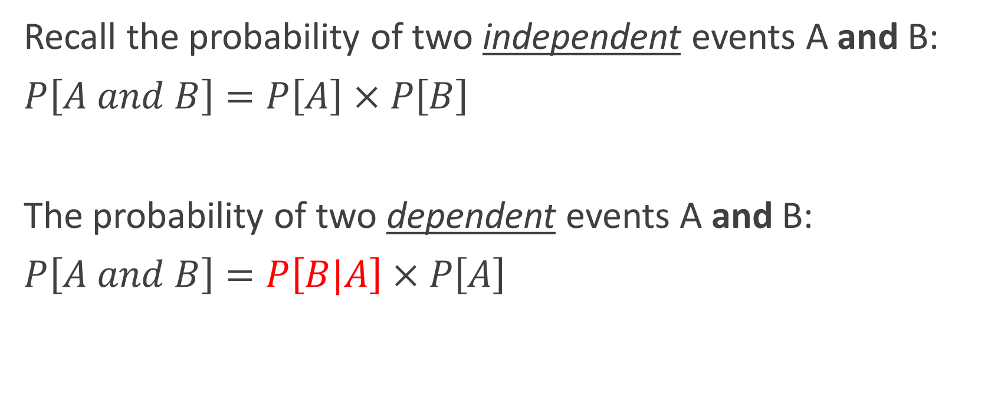
Dependent events
Recall the probability of two independent events A and B:
$P\left[A and B\right]=P\left[A\right] × P\left[B\right]$
The probability of two dependent events A and B:
$P\left[A and B\right]=P\left[B|A\right] × P\left[A\right]$
Conditional Probability: Probability of B given A

Slide 18

Conditional probability, $P\left[A | B\right]$
Probability that a sick person is coughing
Probability that a person is coughing and sick
Probability that coughing person is sick
What is the probability statement for each? (i.e. P[..])

Slide 19

Conditional probability, $P\left[A | B\right]$
Probability that a sick person is coughing.
P[coughing | sick]
Probability that a person is coughing and sick
P[coughing and sick]
We condition on the a priori knowledge of sickness.

Slide 20
Example
false negative/positive stuff.

Slide 21
note the and/or mult/add situation

Slide 22
run through example converting sentences to probability statements

Slide 23
seed example from claus class

Slide 24
bayes

Slide 25
breast cnancer exam example

Slide 26
Example: Probability of independent events X and Y

Slide 27
Example: Probability of dependent events X and Y

Slide 28
Example: Probability of event X or event Y?
Depends on dep/inde

Slide 29
Example: Probability of independent events X or Y

Slide 30
Example: Probability of dependent events X or Y

Slide 31
Conditional Probability

Slide 32
Example: conditional probability

Slide 33
Bayes Theorem

Slide 34
Example: Bayes Theorem and disease

Slide 35
BREAK

Slide 36
Focus is on tidy dataframes
Each variable forms a column.
Each observation forms a row.
Each type of observational unit forms a table.
Tidy data provides a consistent approach to data management that greatly facilitates downstream analysis and viz

Slide 37
Messy vs tidy data
What are the variables in this data?
What are the observations in this data?

Slide 38
Exercise
How can we convert this table into a tidy data frame?
 | survived | died
drug | 15 | 3
placebo | 4 | 11
treatment | outcome | count
drug | survived | 15
placebo | survived | 4
drug | died | 3
placebo | died | 11
What are the variables?
Remember: categories of a categorical variable are not variables
What are the observations?

Slide 39
The fundamental verbs of tidyr
gather() | Gather multiple columns into key:value pairs
spread() | Spread key:value pairs over multiple columns
separate() | Separate columns
unite() | Join columns
There are more functions but these ones are key!

Slide 40
gather() makes wide tables narrow
data
tree treat t152 t174 t201 t227 t258
1 ozone 4.51 4.98 5.41 5.90 6.15
2 ozone 4.24 4.20 4.68 4.92 4.96
3 ozone 3.98 4.36 4.79 4.99 5.03
tree treat time measure
1 ozone t152 4.51
1 ozone t174 4.98
1 ozone t201 5.41
1 ozone t227 5.90
1 ozone t258 6.15
...
data %>% gather(time, measure, t152:t258)
KEY
VALUE

Slide 41
spread() makes narrow tables wide
tree treat time measure
1 ozone t152 4.51
1 ozone t174 4.98
1 ozone t201 5.41
1 ozone t227 5.90
1 ozone t258 6.15
...
tree treat t152 t174 t201 t227 t258
1 ozone 4.51 4.98 5.41 5.90 6.15
2 ozone 4.24 4.20 4.68 4.92 4.96
3 ozone 3.98 4.36 4.79 4.99 5.03
data %>% spread(time, measure)

Slide 42
separate() separates columns
tree treat time measure
1 ozone t152 4.51
1 ozone t174 4.98
1 ozone t201 5.41
1 ozone t227 5.90
1 ozone t258 6.15
...
tree treat t152 t174 t201 t227 t258
1 ozone 4.51 4.98 5.41 5.90 6.15
2 ozone 4.24 4.20 4.68 4.92 4.96
3 ozone 3.98 4.36 4.79 4.99 5.03

Slide 43
unite() …unites columns
tree treat time measure
1 ozone t152 4.51
1 ozone t174 4.98
1 ozone t201 5.41
1 ozone t227 5.90
1 ozone t258 6.15
...
tree treat t152 t174 t201 t227 t258
1 ozone 4.51 4.98 5.41 5.90 6.15
2 ozone 4.24 4.20 4.68 4.92 4.96
3 ozone 3.98 4.36 4.79 4.99 5.03

Slide 44
Brief return to dplyr
Joining related data frames
inner_join()
outer_join()
left_join()

Slide 45
ggplot2: Faceting plots
ggplot(iris, aes(x = Sepal.Length, fill = Species)) + geom_density( alpha = 0.5 )

Slide 46
ggplot2: Faceting plots
ggplot(iris, aes(x = Sepal.Length, fill = Species)) + geom_density() + facet_grid(~Species)

Slide 47
ggplot2: Faceting plots
head(iris2)
Source: local data frame [150 x 6]
Groups: Species [3]
Sepal.Length Sepal.Width Petal.Length Petal.Width Species size
<dbl> <dbl> <dbl> <dbl> <fctr> <chr>
1 5.1 3.5 1.4 0.2 setosa big
2 4.9 3.0 1.4 0.2 setosa small
3 4.7 3.2 1.3 0.2 setosa small
4 4.6 3.1 1.5 0.2 setosa small
5 5.0 3.6 1.4 0.2 setosa big
6 5.4 3.9 1.7 0.4 setosa big

Slide 48
ggplot2: Faceting plots
ggplot(iris, aes(x = Sepal.Length, fill = Species)) + geom_density() + facet_grid(size~Species)

Slide 49
dplyr: Joining related dataframes
> data1
x y z
1 1 3.108060 61.48849
2 2 8.976264 55.68174
3 3 11.673850 56.32225
4 4 8.551282 58.53424
5 5 5.819844 61.71424
> data2
x a b
1 1 -2.76205636 112.9588
2 2 -1.44485264 149.3682
3 3 -1.14390532 132.8789
4 4 -2.86488120 143.6860
5 5 -2.91982194 121.3927
> left_join(data1, data2)
Joining, by = "x"
x y z a b
1 1 3.108060 61.48849 -2.76205636 112.9588
2 2 8.976264 55.68174 -1.44485264 149.3682
3 3 11.673850 56.32225 -1.14390532 132.8789
4 4 8.551282 58.53424 -2.86488120 143.6860
5 5 5.819844 61.71424 -2.91982194 121.3927

Slide 50
left_join() creates NA's when missing
> data1
x y z
1 1 3.108060 61.48849
2 2 8.976264 55.68174
3 3 11.673850 56.32225
4 4 8.551282 58.53424
5 5 5.819844 61.71424
> data3
x a b
1 1 -2.76205636 112.9588
2 2 -1.44485264 149.3682
3 3 -1.14390532 132.8789
5 5 -2.91982194 121.3927
> left_join(data1, data3)
Joining, by = "x"
x y z a b
1 1 3.108060 61.48849 -2.762056 112.9588
2 2 8.976264 55.68174 -1.444853 149.3682
3 3 11.673850 56.32225 -1.143905 132.8789
4 4 8.551282 58.53424 NA NA
5 5 5.819844 61.71424 -2.919822 121.3927

Slide 51
left_join() only preserves what is in the left data frame
> data1
x y z
1 1 3.108060 61.48849
2 2 8.976264 55.68174
3 3 11.673850 56.32225
4 4 8.551282 58.53424
5 5 5.819844 61.71424
> data3
x a b
1 1 -2.76205636 112.9588
2 2 -1.44485264 149.3682
3 3 -1.14390532 132.8789
5 5 -2.91982194 121.3927
> left_join(data3, data1)
Joining, by = "x"
x y z a b
1 1 3.108060 61.48849 -2.762056 112.9588
2 2 8.976264 55.68174 -1.444853 149.3682
3 3 11.673850 56.32225 -1.143905 132.8789
4. 5 5.819844 61.71424 -2.919822 121.3927

Slide 52
right_join() is the opposite
> data1
x y z
1 1 3.108060 61.48849
2 2 8.976264 55.68174
3 3 11.673850 56.32225
4 4 8.551282 58.53424
5 5 5.819844 61.71424
> data3
x a b
1 1 -2.76205636 112.9588
2 2 -1.44485264 149.3682
3 3 -1.14390532 132.8789
5 5 -2.91982194 121.3927
> right_join(data1, data3) ## Equivalent to left_join(data3, data1)
Joining, by = "x"
x y z a b
1 1 3.108060 61.48849 -2.762056 112.9588
2 2 8.976264 55.68174 -1.444853 149.3682
3 3 11.673850 56.32225 -1.143905 132.8789
4. 5 5.819844 61.71424 -2.919822 121.3927

Slide 53
inner_join() only joins what the tables have in common
> data4
x y z
1 1 3.108060 61.48849
3 3 11.673850 56.32225
4 4 8.551282 58.53424
5 5 5.819844 61.71424
> data3
x a b
1 1 -2.76205636 112.9588
2 2 -1.44485264 149.3682
3 3 -1.14390532 132.8789
5 5 -2.91982194 121.3927
> inner_join(data4, data3)
Joining, by = "x"
x y z a b
1 1 3.108060 61.48849 -2.762056 112.9588
2 3 11.673850 56.32225 -1.143905 132.8789
3 5 5.819844 61.71424 -2.919822 121.3927

Slide 54
Joins galore
See this vignette: https://cran.r-project.org/web/packages/dplyr/vignettes/two-table.html

Slide 55
ggplot2 moar: stats(?) and scales
scalexlog10 etc

Slide 56
coordinates and axes
xlim, coord

