Slide 1
Enter the Tidyverse
bio5312 Fall2017
stephanie j. spielman, phD

Slide 2
What is the “tidyverse”?
A collection of R packages largely developed by Hadley Wickham and others at Rstudio
Have emerged as staples of modern-day data science in the past 5—10 years
We will focus on:
Visualization/plotting with ggplot2
Data management and ”wrangling” with dplyr and tidyr
Document presentation with RMarkdown

Slide 3
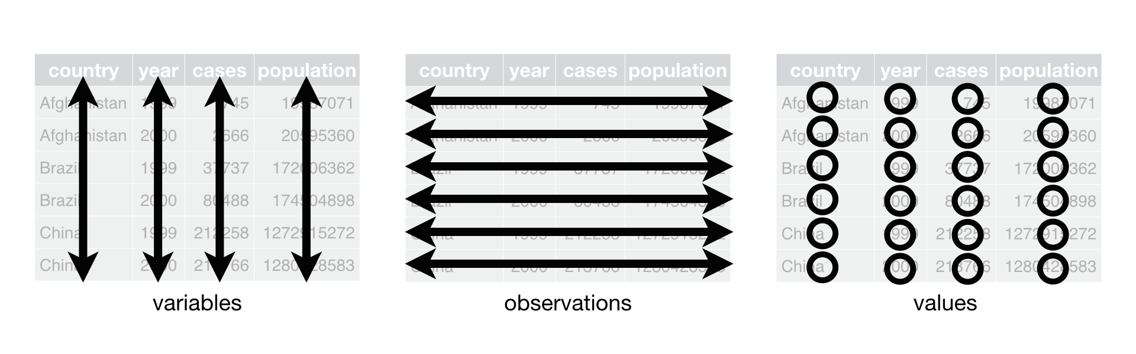
Focus is on tidy dataframes
Each variable forms a column.
Each observation forms a row.
Each type of observational unit forms a table.
Tidy data provides a consistent approach to data management that greatly facilitates downstream analysis and viz

Slide 4
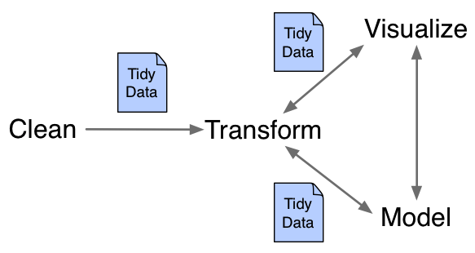
Working with tidy data
The package dplyr can manipulate and manage tidy data
The package tidyr can rearrange data to convert to/from tidy data
The package ggplot2 is used for visualization/plotting

Slide 5
The fundamental verbs of dplyr
filter() | select rows
select() | select columns
mutate() | create new columns
group_by() | establish a data grouping
tally() | count observations in a grouping
summarize() | calculate summary statistic
arrange() | arrange rows
There are more functions but these ones are key!

Slide 6
The pipe operator %>%
“Pipes” output from one function/operation as input to the next
## Start simple: display data
head(iris)
## Using %>%
iris %>% head()
## Find the mean of iris sepal lengths
mean.sepal <- mean(iris$Sepal.Length)
## Using %>%
mean.sepal <- iris$Sepal.Length %>% mean()
iris$Sepal.Length %>% mean() -> mean.sepal
iris %>% mean(Sepal.Length) -> mean.sepal
“forward assignment” operator follows the logical flow of piping

Slide 7
dplyr demo
Commands in demo are on sjspielman.org/bio5312_fall2017/day2_tidyverse1

Slide 8
Visualizing with ggplot2
The package ggplot2 is a graphics package that implements a grammar of graphics
Operates on data frames, not vectors like Base R
Explicitly differentiates between the data and the representation of the data

Slide 9
The ggplot2 grammar
Grammar element* | What is it
Data | The data frame being plotted
Geometrics | The geometric shape that will represent the data Point, boxplot, histogram, violin, bar, etc.
Aesthetics | The aesthetics of the geometric object Color, size, shape, etc.
*Table is tiny subset of what ggplot2 has to offer

Slide 10
Example: scatterplot
> ggplot(iris, aes(x = Sepal.Length, y = Petal.Length)) + geom_point()

Slide 11
Example: scatterplot
> ggplot( iris, aes(x = Sepal.Length, y = Petal.Length) ) + geom_point()
Pass in the data frame as your first argument
Aesthetics map the data onto plot characteristics, here x and y axes
Display the data geometrically as points

Slide 12
Example: scatterplot with color
> ggplot(iris, aes(x = Sepal.Length, y = Petal.Length)) + geom_point(color = "red" )

Slide 13
Example: scatterplot with aes color
> ggplot(iris, aes(x = Sepal.Length, y = Petal.Length, color = Species)) + geom_point()
Placing color inside aesethetic maps it to the data.

Slide 14
Example: scatterplot with aes color, shape
> ggplot(iris, aes(x = Sepal.Length, y = Petal.Length, color = Species, shape = Species)) + geom_point()

Slide 15
Aesthetics may be placed inside the relevant geom
ggplot(iris, aes(x = Sepal.Length, y = Petal.Length)) + geom_point(aes(color = Species, shape = Species))
## Remember dplyr!
iris %>% ggplot(aes(x = Sepal.Length, y = Petal.Length)) + geom_point(aes(color = Species, shape = Species))

Slide 16
Aesthetics are for mapping only
> ### Color all points blue?
ggplot(iris, aes(x = Sepal.Length, y = Petal.Length, color = "blue")) + geom_point()

Slide 17
Aesthetics are for mapping only
> ### Color all points blue?
ggplot(iris, aes(x = Sepal.Length, y = Petal.Length, color = "blue")) + geom_point()
### Correctly color all points blue
ggplot(iris, aes(x = Sepal.Length, y = Petal.Length)) + geom_point(color = "blue")

Slide 18
Example: multiple geoms
### Use some fake data:
fake.data <- data.frame(t = 1:10, y = runif(10, 1, 100))
ggplot(fake.data, aes(x = t, y = y)) + geom_point() + geom_line()

Slide 19
Make sure aesthetic mappings are properly applied
ggplot(fake.data, aes(x = t, y = y, size = y)) + geom_point() + geom_line()

Slide 20
Make sure aesthetic mappings are properly applied
ggplot(fake.data, aes(x = t, y = y, size = y)) + geom_point() + geom_line()
ggplot(fake.data, aes(x = t, y = y)) + geom_point( aes(size=y) ) + geom_line()

Slide 21
Histograms
ggplot(iris, aes(x = Sepal.Length)) + geom_histogram()

Slide 22
Histograms
ggplot(iris, aes(x = Sepal.Length)) + geom_histogram( fill = "orange" )

Slide 23
Histograms
ggplot(iris, aes(x = Sepal.Length)) + geom_histogram( fill = "orange", color = "brown" )

Slide 24
Histograms
ggplot(iris, aes(x = Sepal.Length)) + geom_histogram( fill = "orange", color = "brown" ) + xlab("Sepal Length") + ylab("Count") + ggtitle("Histogram of iris sepal lengths")

Slide 25
Boxplots
ggplot(iris, aes(x = "", y = Sepal.Length)) + geom_boxplot()

Slide 26
Boxplots
ggplot(iris, aes(x = "", y = Sepal.Length)) + geom_boxplot(fill = "green")

Slide 27
Boxplots
ggplot(iris, aes(x = Species, y = Sepal.Length)) + geom_boxplot(fill = "green")

Slide 28
Boxplots
ggplot(iris, aes(x = Species, y = Sepal.Length, fill = Species)) + geom_boxplot()

Slide 29
Boxplots: Customizing the fill mappings
ggplot(iris, aes(x = Species, y = Sepal.Length, fill = Species)) + geom_boxplot() + scale_fill_manual(values=c("red", "blue", "purple"))

Slide 30
scale_fill_manual() also tweaks legend
ggplot(iris, aes(x = Species, y = Sepal.Length, fill = Species)) + geom_boxplot() + scale_fill_manual(values=c("red", "blue", "purple"), name = "Species name", labels=c("SETOSA", "VIRGINICA", "VERSICOLOR"))

Slide 31
Changing the order
### Ordering depends on factor levels
levels(iris$Species)
[1] "setosa" "versicolor" "virginica"
### Change order of levels
iris$Species <- factor(iris$Species, levels=c("virginica", "setosa", "versicolor"))
[1] "virginica" "setosa" "versicolor"
> ### Replot
ggplot(iris, aes(x = Species, y = Sepal.Length, fill = Species)) +
geom_boxplot() +
scale_fill_manual(values=c("red", "blue", "purple"))

Slide 32
Grouped boxplots
This will apply to violin plots as well.
## Create another categorical variable for grouping purpopses
iris %>%
group_by(Species) %>%
mutate(size = ifelse( Sepal.Width > median(Sepal.Width) , "big" , "small" )) -> iris2
head(iris2)
Source: local data frame [150 x 6]
Groups: Species [3]
Sepal.Length Sepal.Width Petal.Length Petal.Width Species size
<dbl> <dbl> <dbl> <dbl> <fctr> <chr>
1 5.1 3.5 1.4 0.2 setosa big
2 4.9 3.0 1.4 0.2 setosa small
3 4.7 3.2 1.3 0.2 setosa small
4 4.6 3.1 1.5 0.2 setosa small
5 5.0 3.6 1.4 0.2 setosa big
6 5.4 3.9 1.7 0.4 setosa big
Condition
Value if TRUE
Value if FALSE

Slide 33
Grouped boxplots
> ggplot(iris2, aes( x = Species, fill=size, y=Sepal.Width)) + geom_boxplot()

Slide 34
Grouped boxplots
> ggplot(iris2, aes( x = size, fill = Species, y=Sepal.Width)) + geom_boxplot()

Slide 35
Detour: scale_color_manual() customizes color
ggplot(iris, aes(x = Sepal.Length, y = Petal.Length)) +
geom_point(aes(color = Species)) +
scale_color_manual(values=c("cornflowerblue", "deepskyblue4", "lightcyan4"))

Slide 36
Detour round 2: scale_<fill/color>_??
There are many scales to use besides default and custom.
scale_<fil/color>_brewer() uses pre-made color schemes from colorbrewer.org
scale_color_gradient() can take a low and high to fill along a spectrum
See here: http://ggplot2.tidyverse.org/reference/#scales

Slide 37
Violin plot
ggplot(iris, aes(x = Species, y = Sepal.Length, fill = Species)) + geom_violin()

Slide 38
Bar plot
ggplot(iris, aes(x = Species, fill = Species)) + geom_bar()

Slide 39
Stacked/grouped bar plot
head(iris2)
Source: local data frame [150 x 6]
Groups: Species [3]
Sepal.Length Sepal.Width Petal.Length Petal.Width Species size
<dbl> <dbl> <dbl> <dbl> <fctr> <chr>
1 5.1 3.5 1.4 0.2 setosa big
2 4.9 3.0 1.4 0.2 setosa small
3 4.7 3.2 1.3 0.2 setosa small
4 4.6 3.1 1.5 0.2 setosa small
5 5.0 3.6 1.4 0.2 setosa big
6 5.4 3.9 1.7 0.4 setosa big

Slide 40
Stacked/grouped bar plot
ggplot(iris, aes(x = Species, fill = size)) + geom_bar()

Slide 41
Stacked/grouped bar plot
ggplot(iris, aes(x = Species, fill = size)) + geom_bar( position = "dodge" )

Slide 42
Density plot
ggplot(iris, aes(x = Sepal.Length, fill = Species)) + geom_density()
What does the tail of the setosa distribution look like?

Slide 43
Density plot
ggplot(iris, aes(x = Sepal.Length, fill = Species)) + geom_density( alpha = 0.5 )

Slide 44
Themes
Gray background and grid not working for you? Me neither.
Built-in other themes: http://ggplot2.tidyverse.org/reference/ggtheme.html
Customize your theme: http://ggplot2.tidyverse.org/reference/theme.html
Use somebody else's themes:
https://cran.r-project.org/web/packages/ggthemes/vignettes/ggthemes.html
https://cran.r-project.org/web/packages/cowplot/vignettes/introduction.html

