Slide 1
Probability
bio5312 Fall2017
stephanie j. spielman, PhD

Slide 2
Skew
Symmetric
Left-skew
Right-skew

Slide 3
Mean vs median
Symmetric
Left-skew
Right-skew
Mean gets dragged towards skew direction

Slide 4
Mean vs median
When it is difficult to tell which might be "better", default to median.
This is particularly true for small sample sizes (more on why in coming weeks)

Slide 5
Does sparrow weight influence survival?
> summary(sp$Weight[sp$Survival == "Alive"])
Min. 1st Qu. Median Mean 3rd Qu. Max.
22.60 24.20 24.90 25.21 26.30 28.00
> summary(sp$Weight[sp$Survival == "Dead"])
Min. 1st Qu. Median Mean 3rd Qu. Max.
22.60 24.80 25.95 25.86 26.58 31.00

Slide 6
Probability vocabulary
Sample space
Event
Probability
Mutually exclusive
Probability distribution
Independent

Slide 7
Sample space and event
Sample space is the set of all possible outcomes of a random trial
Event is a subset of this set
Example: Roll a die
Sample space is <1,2,3,4,5,6>
Events: roll a 4, roll something >=5, etc.

Slide 8
Probability
Probability of an event is the proportion of times the event would occur., i.e. event frequency, in an infinite number of trials
Empirical probabilities are based on a finite amount of data. If sample size expanded indefinitely, probabilities are measured with increasing precision and approach the true event probability. This is pretty much what we can measure.

Slide 9
Probability: roll a die
Theoretical probability
P[roll a 5] = 1/6
P[roll an even number] = ½
Empirical probability
After rolling 10x, we got: 5 5 6 1 4 2 3 1 1 5 2 1
P[roll a 5] = 3/10
P[roll an even number] = 4/10 = 2/5

Slide 10


Basic properties of probabilities
Probabilities are always between 0 and 1
The sum of probabilities for all events equals 1
$$0≤P[event]≤1$$
$$\sum_{i}{P_{i}=1}$$

Slide 11
Mutually exclusive
Two events are mutually exclusive if they cannot both occur simultaneously
Mutually exclusive events: roll a 4 and a 1
Not mutually exclusive events: roll an even # and a 2

Slide 12
Probability distribution
The list of probabilities for all mutually exclusive outcomes of a random trial
A fair die has this distribution:
P[roll 1] = 1/6
P[roll 2] = 1/6
P[roll 3] = 1/6
P[roll 4] = 1/6
P[roll 5] = 1/6
P[roll 6] = 1/6
This is a discrete probability distribution

Slide 13
Independent
Two events are independent if the occurrence of one does not change the occurrence of another.

Slide 14
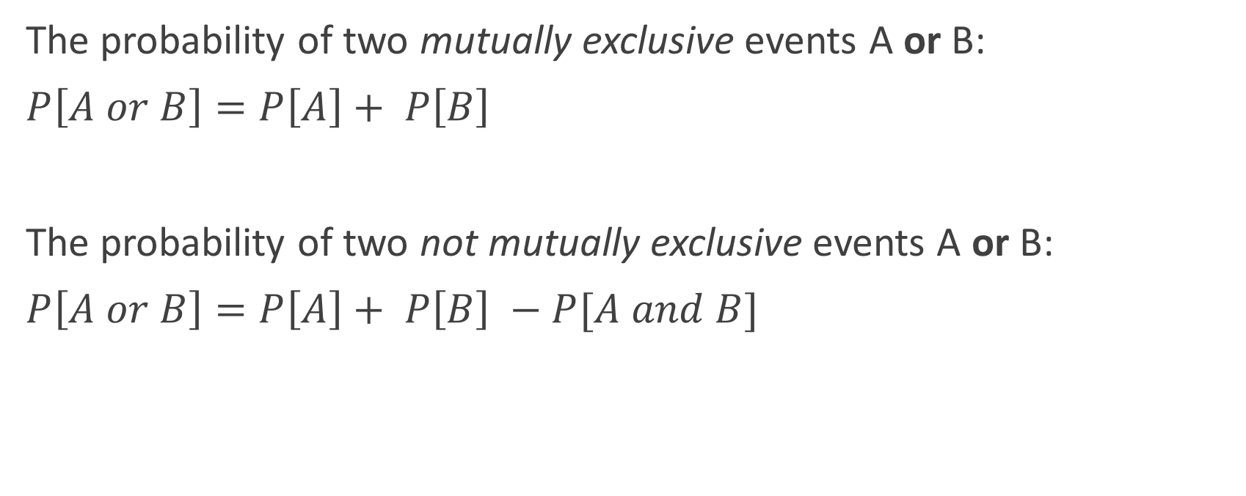
Probability rules
The probability of two mutually exclusive events A or B:
$P\left[A or B\right]=P\left[A\right]+ P\left[B\right]$
The probability of two not mutually exclusive events A or B:
$P\left[A or B\right]=P\left[A\right]+ P\left[B\right] −P[A and B]$

Slide 15

What is the probability of rolling a 2 or a 5 on a fair die?
Are these events mutually exclusive? Yes.
$P\left[2 or 5\right]=P\left[roll 2\right]+ P\left[roll 5\right]=\frac{1}{6}+\frac{1}{6}=\frac{1}{3}$

Slide 16
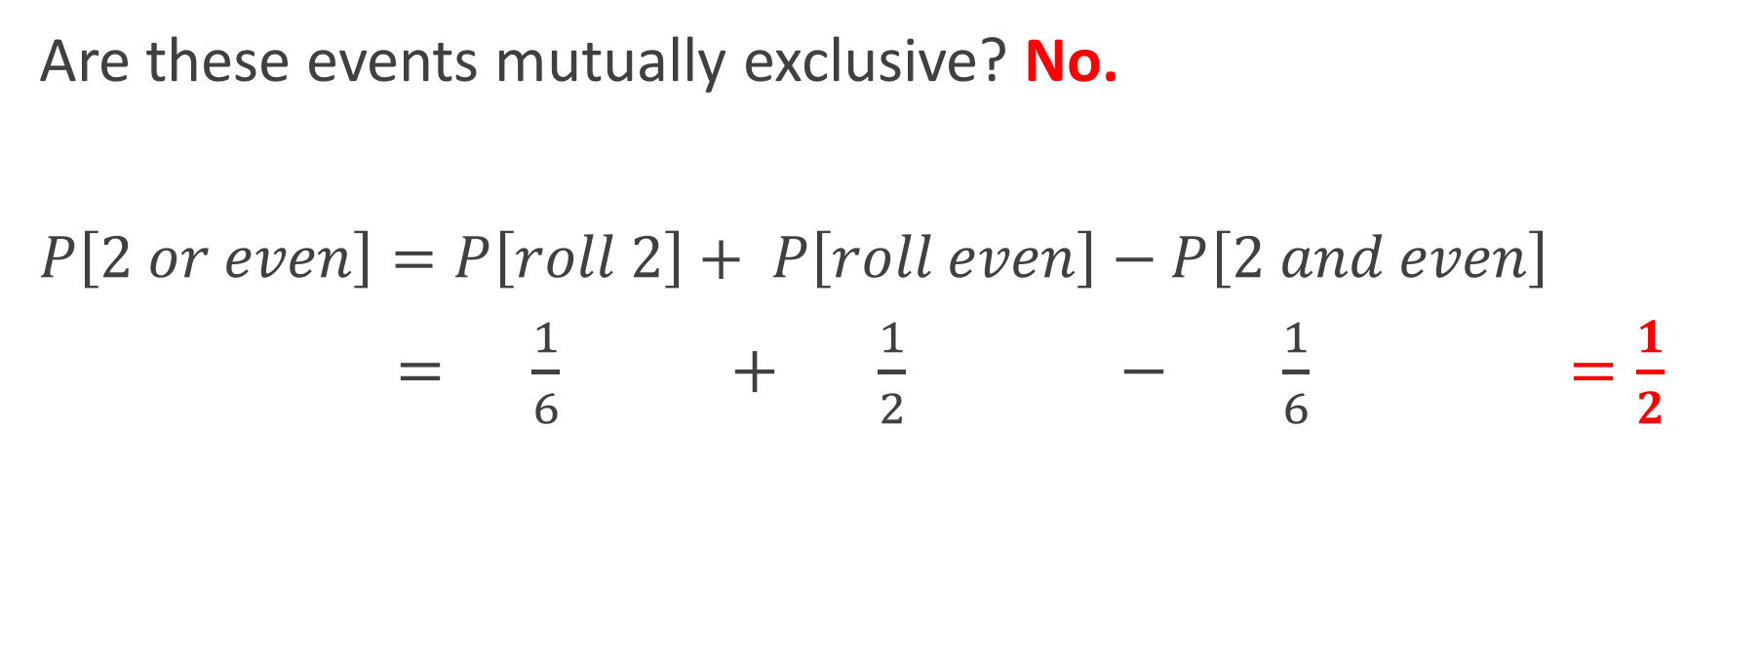
What is the probability of rolling a 2 or an even number on a fair die?
Are these events mutually exclusive? No.
$P\left[2 or even\right]=P\left[roll 2\right]+ P\left[roll even\right]−P\left[2 and even\right]$
$= \frac{1}{6} + \frac{1}{2} − \frac{1}{6} =\frac{1}{2}$

Slide 17
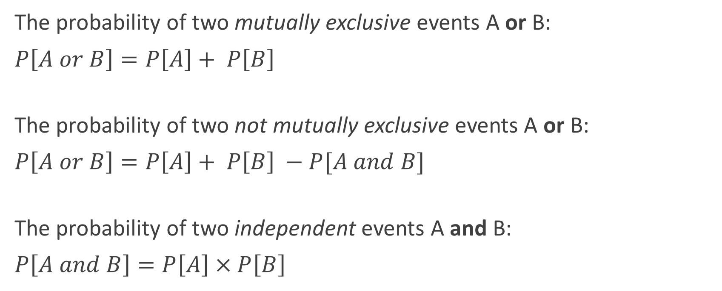
Probability rules
The probability of two mutually exclusive events A or B:
$P\left[A or B\right]=P\left[A\right]+ P\left[B\right]$
The probability of two not mutually exclusive events A or B:
$P\left[A or B\right]=P\left[A\right]+ P\left[B\right] −P[A and B]$
The probability of two independent events A and B:
$P\left[A and B\right]=P\left[A\right] × P\left[B\right]$
We add "or"
We multiply "and"

Slide 18
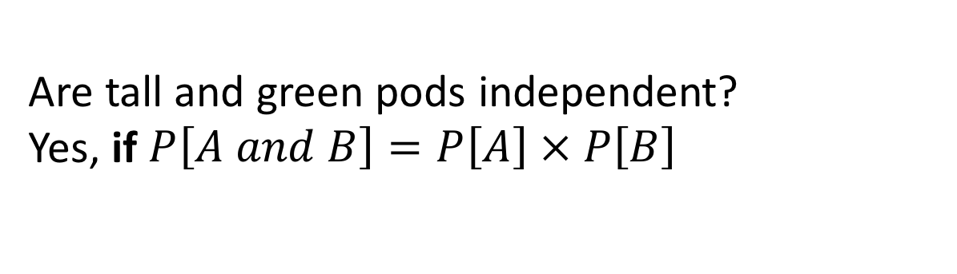
Event independence
Mendel's experiment yielded 1600 pea pods:
900 were tall and green
300 were tall and yellow
300 were short and green
100 were short and yellow
Are tall and green pods independent?
Yes, if $P\left[A and B\right]=P\left[A\right] × P\left[B\right]$

Slide 19
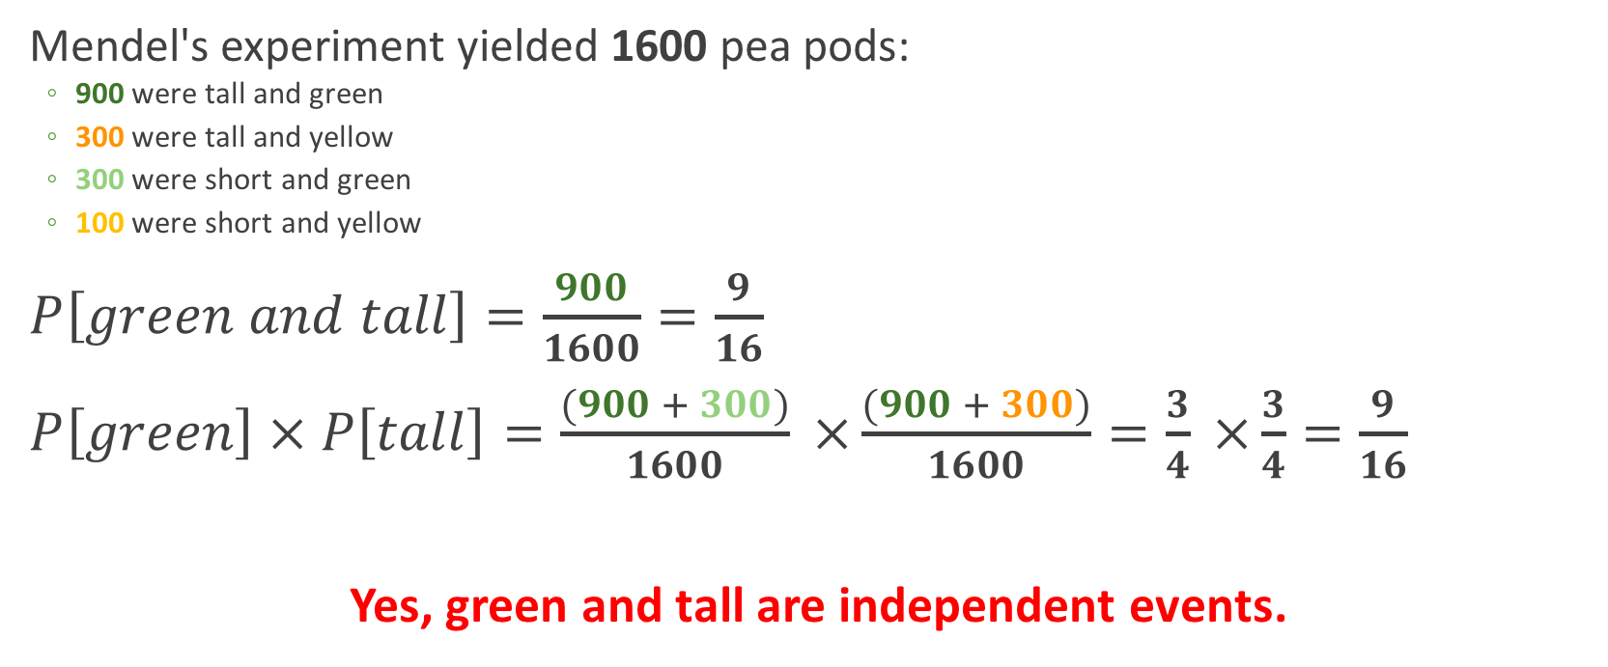

Event independence
$$P\left[A and B\right]=P\left[A\right] × P\left[B\right]$$
Mendel's experiment yielded 1600 pea pods:
900 were tall and green
300 were tall and yellow
300 were short and green
100 were short and yellow
$P\left[green and tall\right]=\frac{900}{1600}=\frac{9}{16}$
$P\left[green\right] × P\left[tall\right]=\frac{(900 + 300)}{1600} ×\frac{(900 + 300)}{1600}=\frac{3}{4} ×\frac{3}{4}=\frac{9}{16}$
Yes, green and tall are independent events.

Slide 20
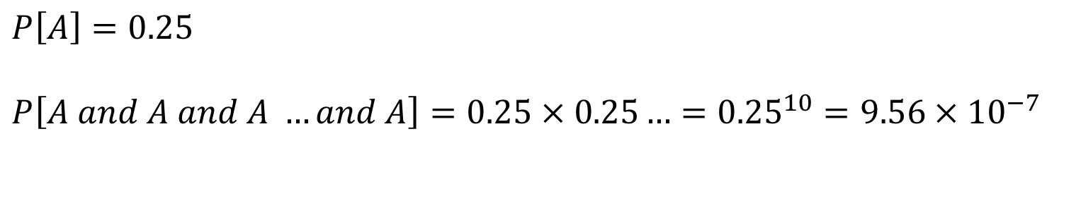
Question
Assume that a long (~infinite) stretch of DNA has A, C, G, T's in equal proportions, randomly occurring throughout.
What is the probability of seeing 10 A nucleotides in a row?
$$P\left[A\right]=0.25$$
$$P\left[A and A and A …and A\right]=0.25 × 0.25…={0.25}^{10}=9.56 × {10}^{−7}$$

Slide 21
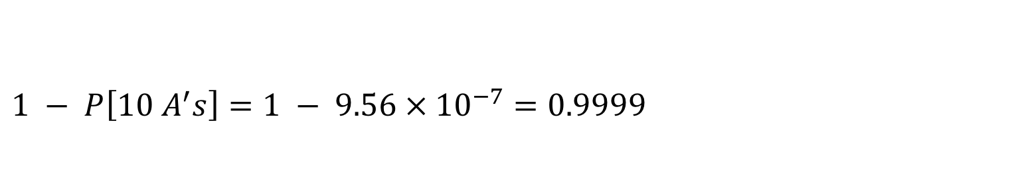
Question
Assume that a long (~infinite) stretch of DNA has A, C, G, T's in equal proportions, randomly occurring throughout.
What is the probability of not seeing 10 A nucleotides in a row?
$$1 − P\left[10 A^{′}s\right]=1 − 9.56 × {10}^{−7}=0.9999$$

Slide 22
We can calculate empirical probabilities directly from data
Example: A study assessed HIV risk associated with intravenous drug users and found these results:
 | HIV+ | HIV- | Total
Intravenous user | 8 | 12 | 20
Not intravenous user | 2 | 13 | 15
Total | 10 | 25 | 35

Slide 23
Q1: What is the probability that a randomly chosen study participant is HIV+?
 | HIV+ | HIV- | Total
user | 8 | 12 | 20
not user | 2 | 13 | 15
Total | 10 | 25 | 35
P(HIV+) = (number of HIV+) / (number participants)
= 10 / 35 = 2/7

Slide 24
Q2: What is the probability that a randomly chosen study participant who is not HIV+ is a user?
 | HIV+ | HIV- | Total
user | 8 | 12 | 20
not user | 2 | 13 | 15
Total | 10 | 25 | 35
= (HIV+ non-user) / (all HIV+)
= 2 / 10 = 1/5

Slide 25
Q3: What is the probability that a randomly chosen study participant is either HIV+ or user but not both?
 | HIV+ | HIV- | Total
user | 8 | 12 | 20
not user | 2 | 13 | 15
Total | 10 | 25 | 35
X
X
= (2+12)/35 = 14/35 = 2/5

Slide 26
Calculating probabilities directly from data frames
What is the probability of an iris being virginica, in the iris dataset?
# The denominator
> nrow(iris)
[1] 150
# The numerator
> iris %>% filter(Species == "virginica") %>% tally()
n
1 50
## The probability is 50/150 = 0.3333

Slide 27
Calculating probabilities directly from data frames
What is the probability of an iris being virginica and having petal lengths less than 5?
# The denominator
> nrow(iris)
[1] 150
# The numerator
> iris %>% filter(Species == "virginica", Petal.Length < 5) %>% tally()
n
1 6
## The probability is 6/150 = 0.04

Slide 28
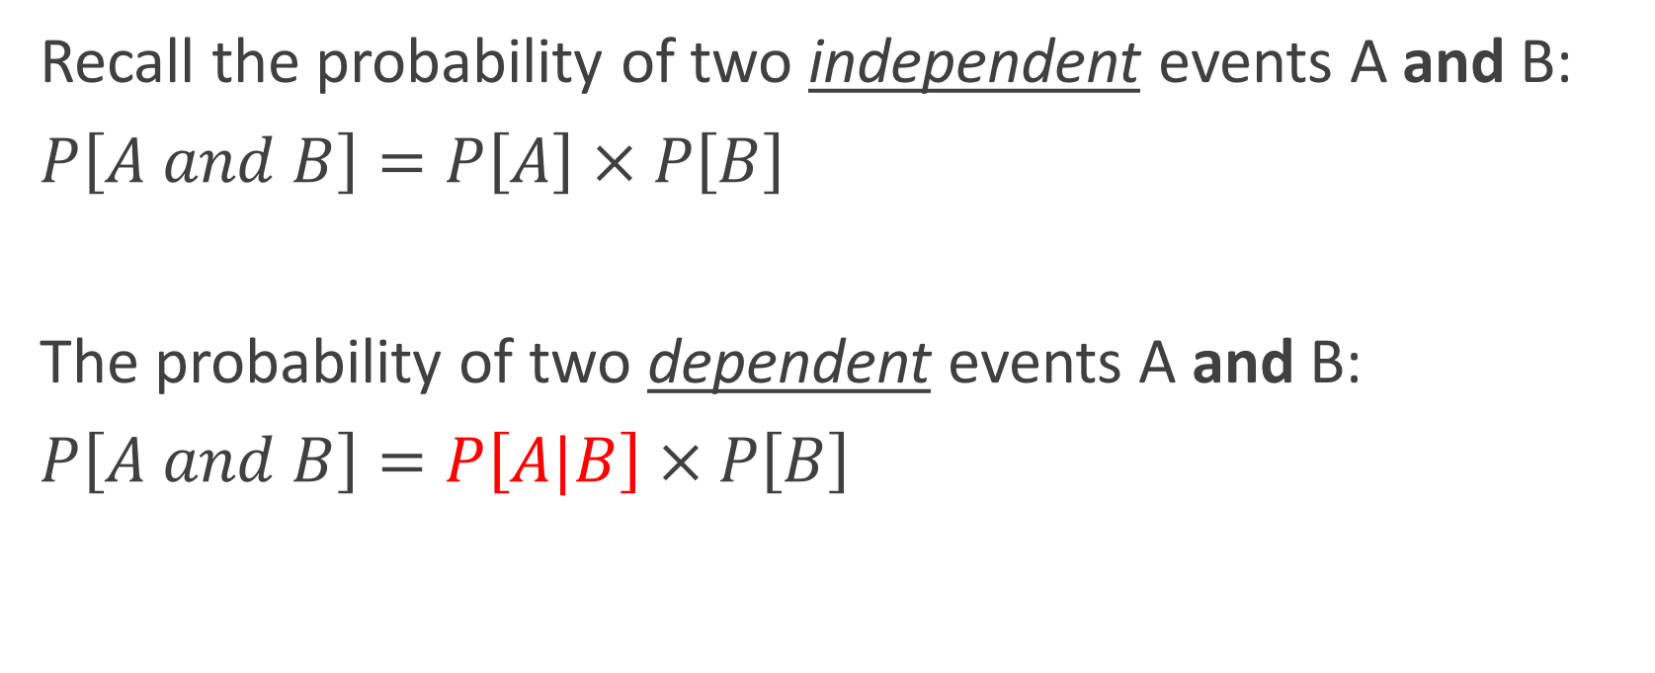
Dependent events
Recall the probability of two independent events A and B:
$P\left[A and B\right]=P\left[A\right] × P\left[B\right]$
The probability of two dependent events A and B:
$P\left[A and B\right]=P\left[A|B\right] × P\left[B\right]$
Conditional Probability: Probability of A given B

Slide 29

Conditional probability, $P\left[A | B\right]$
Probability that a sick person is coughing
Probability that a person is coughing and sick
Probability that coughing person is sick

Slide 30
Conditional probability, $P\left[A | B\right]$
Probability that a sick person is coughing P[ coughing | sick ]
Probability that a person is coughing and sick P[ coughing and sick ]
Probability that coughing person is sick P[ sick | coughing]
Conditional probabilities condition on a priori information

Slide 31
Example: Theoretical probabilities
A seed blows around a complex habitat. It can land on one of three (high-quality, medium-quality, poor-quality) soil types.
The probability of landing on each habitat is:
High-quality, 30%, Medium-quality, 20%, Low-quality, 50%
The probability of surviving each habitat is :
High-quality, 80%, Medium-quality, 30%, Low-quality, 10%
Question: What the probability a seed survives?

Slide 32
Example: Theoretical probabilities
Step 1: Convert text to probability statements
Step 2: Determine probability equation to solve the problem
Step 3: Plug in and solve

Slide 33
Convert text to prob. statements
The probability of landing on each habitat is:
High-quality, 30%, Medium-quality, 20%, Low-quality, 50%
The probability of surviving each habitat is :
High-quality, 80%, Medium-quality, 30%, Low-quality, 10%
P[land on high quality] = 0.3
P[land on med quality] = 0.2
P[land on low quality] = 0.5
P[survive on high quality] = 0.8
P[survive on med quality] = 0.3
P[survive on low quality] = 0.1

Slide 34
Determine probability equation
Seed can survive in three mutually exclusive ways:
Land on high quality and survive
Land on medium quality and survive
Land on low quality and survive
P[seed survives] =
P[high qual. & survives] + P[med qual. & survives] + P[low qual. & survives] =
P[high qual]*P[survives|high qual] + …
Survival is dependent on land quality

Slide 35
Step 3: Plug in and solve
P[land on high quality] = 0.3
P[land on med quality] = 0.2
P[land on low quality] = 0.5
P[survive on high quality] = 0.8
P[survive on med quality] = 0.3
P[survive on low quality] = 0.1
P[seed survives] =
P[high qual. & survives] + P[med qual. & survives] + P[low qual. & survives] =
P[high qual]*P[survives|high qual] + … =
0.3*0.8 + 0.2*0.3 + 0.5*0.1 = 0.35
Followup: What is the probability that a seed does not survive?

Slide 36
Part II
Now assume there is a 0.2 chance of not landing on any habitat, and therefore the seed will die. What is the new probability of survival?

Slide 37
Step 1: Text to probabilities
P[lands] = 0.8
P[does not land] = 0.2

Slide 38
Step 2: Probability equation
P[seed survives] = P[seed survives | seed lands] = ?????

Slide 39
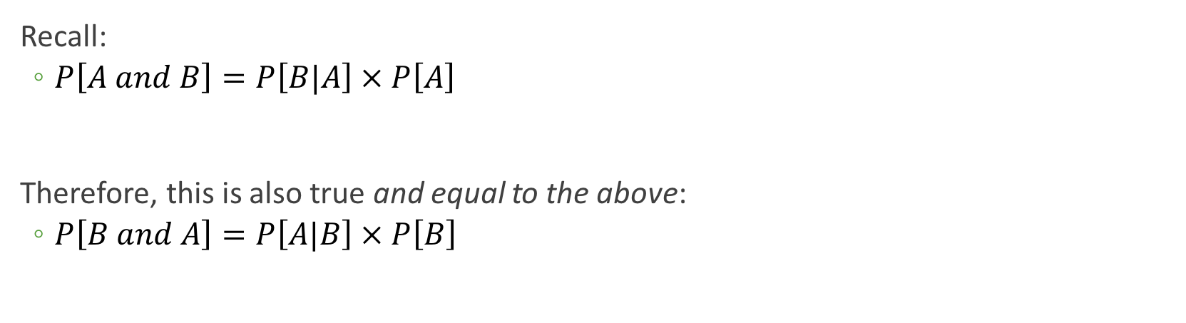
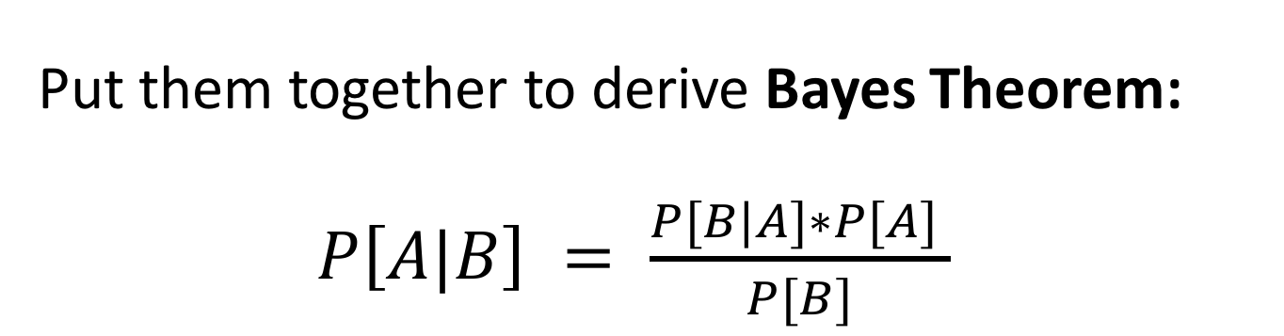
Enter, Bayes Theorem
Recall:
$P\left[A and B\right]=P\left[B|A\right] × P\left[A\right]$
Therefore, this is also true and equal to the above:
$P\left[B and A\right]=P\left[A|B\right] × P\left[B\right]$
Put them together to derive Bayes Theorem:
$P\left[A|B\right] = \frac{P[B|A]∗P[A] }{P[B]}$

Slide 40
Step 2: Probability equation
P[seed survives] = P[seed survives | seed lands] =
(P[lands | survives] * P[survives]) / P(lands)
TAKE NOTICE:
THIS IS THE TYPE OF STATEMENT YOU WILL HAVE TO WRITE ON HW3

Slide 41
Step 3: Plug in and solve
P[land on high quality] = 0.3
P[land on med quality] = 0.2
P[land on low quality] = 0.5
P[survive on high quality] = 0.8
P[survive on med quality] = 0.3
P[survive on low quality] = 0.1
P[seed survives] = P[seed survives | seed lands] =
(P[lands | survives] * P[survives]) / P(lands)
= (1 * 0.35) / 0.2
= 0.175

Slide 42
Example: Theoretical probability and Bayes
Mammograms have a 7% false positive rate and a 25% false negative rate.
Assume women in the general population, have a 0.5% chance of having cancer at any time.
Probability statements:
P[positive result | healthy] = 0.07
P[negative result | cancer ] = 0.25
P[cancer ] = 0.005

Slide 43
Example 1
P[positive result | healthy] = 0.07
P[negative result | cancer ] = 0.25
P[cancer] = 0.005
What is the probability that a healthy woman who gets a mammogram is given a negative result?
1. P[negative | healthy]
2. P[negative | healthy] = 1– P[positive|healthy]
Remember, possible events sum to 1.
3. P[negative | healthy ] = 1 – 0.07 = 0.93

Slide 44
Example 2
P[positive result | healthy] = 0.07
P[negative result | cancer ] = 0.25
P[cancer] = 0.005
A woman gets a positive result from her mammogram. What is the probably she has cancer?
1. P[cancer| positive result]
2. P[cancer| positive result ] =
(P[positive result | cancer] *P[cancer])/P[positive result]

Slide 45
Example 2
P[positive result | healthy] = 0.07
P[negative result | cancer ] = 0.25
P[cancer] = 0.005
P[cancer| positive result ] =
(P[positive result | cancer] * P[cancer])/P[positive result]
P[positive result] = P[positive and cancer] + P[positive and healthy]
When solving Bayes Theorem, the denominator generally requires a bit more work – Must consider all situations where it applies (remember seed survival?)

Slide 46
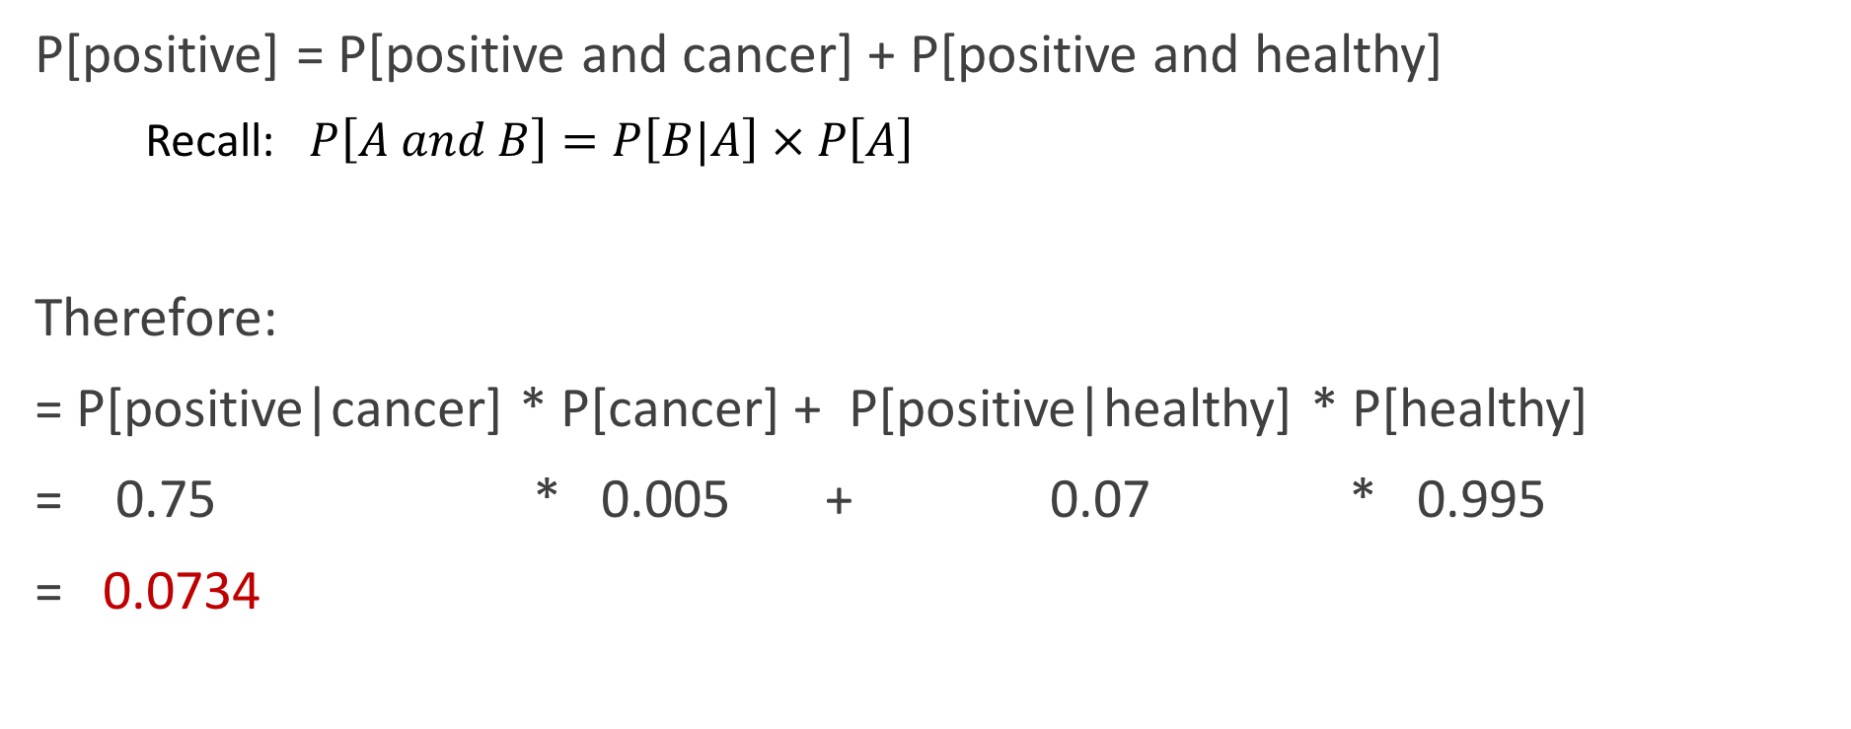
Solving the denominator
P[positive result | healthy] = 0.07
P[negative result | cancer ] = 0.25
P[cancer] = 0.005
P[positive] = P[positive and cancer] + P[positive and healthy]
Recall: $P\left[A and B\right]=P\left[B|A\right] × P\left[A\right]$
Therefore:
= P[positive|cancer] * P[cancer] + P[positive|healthy] * P[healthy]
= 0.75 * 0.005 + 0.07 * 0.995
= 0.0734

Slide 47
Put it all together
P[positive result | healthy] = 0.07
P[negative result | cancer ] = 0.25
P[cancer] = 0.005
P[cancer| positive result ] =
(P[positive result | cancer] * P[cancer])/P[positive result] =
( 0.75 * 0.005 )/ 0.0734 = 0.514

Slide 48
BREAK

Slide 49
ggplot2: saving plots
ggplot(iris, aes(x = Sepal.Length, fill = Species)) + geom_density( alpha = 0.5 )

Slide 50
ggplot2: saving plots
P <- ggplot(iris, aes(x = Sepal.Length, fill = Species)) + geom_density( alpha = 0.5 )
### Save as PNG
ggsave("plot.png", P)
### Save as PDF
ggsave("plot.pdf", P)

Slide 51
ggplot2: Faceting plots
ggplot(iris, aes(x = Sepal.Length, fill = Species)) + geom_density() + facet_grid(~Species)

Slide 52
ggplot2: Faceting plots
head(iris2)
Source: local data frame [150 x 6]
Groups: Species [3]
Sepal.Length Sepal.Width Petal.Length Petal.Width Species size
<dbl> <dbl> <dbl> <dbl> <fctr> <chr>
1 5.1 3.5 1.4 0.2 setosa big
2 4.9 3.0 1.4 0.2 setosa small
3 4.7 3.2 1.3 0.2 setosa small
4 4.6 3.1 1.5 0.2 setosa small
5 5.0 3.6 1.4 0.2 setosa big
6 5.4 3.9 1.7 0.4 setosa big

Slide 53
ggplot2: Faceting plots
ggplot(iris, aes(x = Sepal.Length, fill = Species)) + geom_density() + facet_grid(size~Species)

Slide 54
dplyr: Joining related dataframes
> data1
x y z
1 3.108060 61.48849
2 8.976264 55.68174
3 11.673850 56.32225
4 8.551282 58.53424
5 5.819844 61.71424
> data2
x a b
1 -2.76205636 112.9588
2 -1.44485264 149.3682
3 -1.14390532 132.8789
4 -2.86488120 143.6860
5 -2.91982194 121.3927
> left_join(data1, data2)
Joining, by = "x"
x y z a b
1 3.108060 61.48849 -2.76205636 112.9588
2 8.976264 55.68174 -1.44485264 149.3682
3 11.673850 56.32225 -1.14390532 132.8789
4 8.551282 58.53424 -2.86488120 143.6860
5 5.819844 61.71424 -2.91982194 121.3927

Slide 55
left_join() creates NA's when missing
> data1
x y z
1 3.108060 61.48849
2 8.976264 55.68174
3 11.673850 56.32225
4 8.551282 58.53424
5 5.819844 61.71424
> data3
x a b
1 -2.76205636 112.9588
2 -1.44485264 149.3682
3 -1.14390532 132.8789
5 -2.91982194 121.3927
Missing
x=4
> left_join(data1, data3)
Joining, by = "x"
x y z a b
1 3.108060 61.48849 -2.762056 112.9588
2 8.976264 55.68174 -1.444853 149.3682
3 11.673850 56.32225 -1.143905 132.8789
4 8.551282 58.53424 NA NA
5 5.819844 61.71424 -2.919822 121.3927

Slide 56
left_join() only preserves what is in the left data frame
> data1
x y z
1 3.108060 61.48849
2 8.976264 55.68174
3 11.673850 56.32225
4 8.551282 58.53424
5 5.819844 61.71424
> data3
x a b
1 -2.76205636 112.9588
2 -1.44485264 149.3682
3 -1.14390532 132.8789
5 -2.91982194 121.3927
> left_join(data3, data1)
Joining, by = "x"
x y z a b
1 3.108060 61.48849 -2.762056 112.9588
2 8.976264 55.68174 -1.444853 149.3682
3 11.673850 56.32225 -1.143905 132.8789
5 5.819844 61.71424 -2.919822 121.3927

Slide 57
right_join() is the opposite
> data1
x y z
1 3.108060 61.48849
2 8.976264 55.68174
3 11.673850 56.32225
4 8.551282 58.53424
5 5.819844 61.71424
> data3
x a b
1 -2.76205636 112.9588
2 -1.44485264 149.3682
3 -1.14390532 132.8789
5 -2.91982194 121.3927
> right_join(data1, data3) ## Equivalent to left_join(data3, data1)
Joining, by = "x"
x y z a b
1 3.108060 61.48849 -2.762056 112.9588
2 8.976264 55.68174 -1.444853 149.3682
3 11.673850 56.32225 -1.143905 132.8789
5 5.819844 61.71424 -2.919822 121.3927

Slide 58
inner_join() only joins what the tables have in common
> data4
x y z
1 3.108060 61.48849
3 11.673850 56.32225
4 8.551282 58.53424
5 5.819844 61.71424
> data3
x a b
1 -2.76205636 112.9588
2 -1.44485264 149.3682
3 -1.14390532 132.8789
5 -2.91982194 121.3927
Missing
x=2
> inner_join(data4, data3)
Joining, by = "x"
x y z a b
1 3.108060 61.48849 -2.762056 112.9588
3 11.673850 56.32225 -1.143905 132.8789
5 5.819844 61.71424 -2.919822 121.3927

Slide 59
Joins galore
See this vignette if you're extra curious (not required): https://cran.r-project.org/web/packages/dplyr/vignettes/two-table.html

