Slide 1
Linear modeling II and logistic regression
Stephanie J. spielman, phd
bio5312, Fall 2017

Slide 2
General linear models
Single numeric predictor: Regression
Single categorical predictor: ANOVA
Multiple numeric predictors: multiple regression
Multiple categorical predictors: n-way ANOVA
Single categorical and n numeric predictors: ANCOVA
Multiple categorical and n numeric predictors: linear model
lm(Numeric response ~ <predictors>)
How does each predictor affect the response?
Goal is to model the response (predict outcomes) with a set of explanatory variables

Slide 3
General linear models
Interpreting coefficients depends on type of variable
Categorical predictors: Increase/decrease in Y relative to first category
Numeric predictors: Increase/decrease in Y for every 1 unit increase in X

Slide 4
Linear model coefficients
> summary( lm(Sepal.Length ~ Sepal.Width, data = setosa) )
Coefficients:
Estimate Std. Error t value Pr(>|t|)
(Intercept) 2.6390 0.3100 8.513 3.74e-11 ***
Sepal.Width 0.6905 0.0899 7.681 6.71e-10 ***
Single numeric predictor
> summary(lm(calcium ~ group, data = tidy.data))
Coefficients:
Estimate Std. Error t value Pr(>|t|)
(Intercept) 938.33 74.02 12.676 2.04e-09 ***
grouposteopenia -138.33 104.69 -1.321 0.206168
grouposteoporosis -540.00 104.69 -5.158 0.000117 ***
Single categorical predictor (with three levels)

Slide 5

Linear models with multiple predictors
Additive effects consider the independent effect of each predictor on the response
$$Y=β_{o}+β_{1}X_{1}+β_{2}X_{2}+ ℇ$$
lm(Numeric response ~ predictor1 + predictor2, data = data)

Slide 6
Linear models with multiple predictors
Interaction effects consider the interaction between potentially non-independent predictors
$$Y=β_{o}+β_{1}X_{1}+β_{2}X_{2}+β_{3}\left(X_{1}∗X_{2}\right)+ℇ$$
lm(Numeric response ~ predictor1 * predictor2, data = data)
lm(numeric response ~ predictor1 + predictor2 + predictor1:predictor2, data=data)
Wikipedia's "real world example": Adding sugar to coffee and stirring the coffee. Neither of the two individual variables has much effect on sweetness but a combination of the two does.

Slide 7
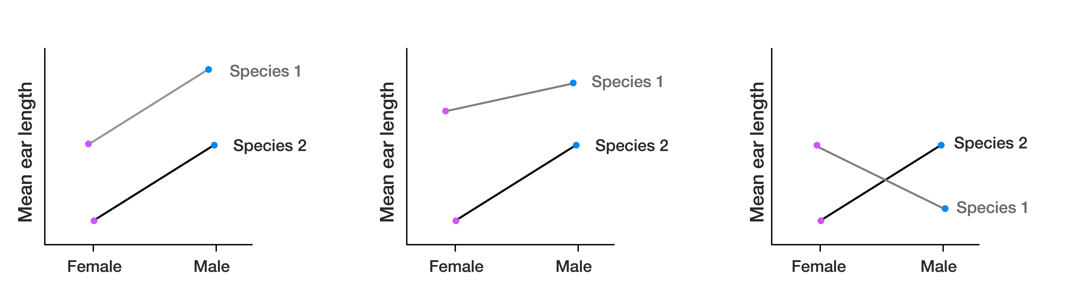
Interaction plots
Visualize the interaction between two categorical predictors
How do species and sex influence ear length in rabbits?
Does ear length differ between different rabbit species, controlling for sex?
Does ear length differ between different rabbit sexes, controlling for species?
Independent
Interaction
Interaction
Effect of sex in sp1
Effect of species??
Effect of species??
Effect of sex
Effect of sex in sp2

Slide 8
Two-way ANOVA = linear model with two categorical predictors
How do herbivores and intertidal zone affect the abundance of algae living in an intertidal habitat?
With and without herbivore predation
Low-tide vs mid-tide zone
Measured surface area of algae after treatment
> head(algae)
tide herbivores area
1 low no 9.405573
2 low no 34.467736
3 low no 46.673485
4 low no 16.642139
5 low no 24.377498
6 low no 38.350604

Slide 9
Visualize the data distributions
> ggplot(algae, aes(x = tide, y = area, fill = herbivores)) + geom_boxplot()

Slide 10
Visualize the data as interaction plot
> algae %>%
group_by(tide, herbivores) %>%
summarize(mean.area = mean(area)) -> algae.int
> algae.int
tide herbivores mean.area
<fctr> <fctr> <dbl>
1 low no 32.91450
2 low yes 10.40376
3 mid no 22.48360
4 mid yes 25.55094

Slide 11
Visualize the data as interaction plot
> ggplot(algae.int, aes(x=tide,
y=mean.area,
group=herbivores,
color=herbivores)) + geom_point() + geom_line()

Slide 12
Visualize the data as interaction plot, 2
> ggplot(algae.int, aes(x=herbivores,
y=mean.area,
group=tide,
color=tide)) + geom_point() + geom_line()

Slide 13
Fit the model
> model.additive <- lm(area ~ herbivores + tide, data = algae)
> model.interaction <- lm(area ~ herbivores * tide, data = algae)
> tidy(model.additive)
term estimate std.error statistic p.value
1 (Intercept) 26.519979 3.602368 7.3618178 5.526594e-10
2 herbivoresyes -9.721701 4.159657 -2.3371402 2.273087e-02
3 tidemid 2.358142 4.159657 0.5669078 5.728570e-01
> tidy(model.interaction)
term estimate std.error statistic p.value
1 (Intercept) 32.91450 3.855532 8.536955 5.979662e-12
2 herbivoresyes -22.51075 5.452546 -4.128484 1.145511e-04
3 tidemid -10.43090 5.452546 -1.913034 6.051935e-02
4 herbivoresyes:tidemid 25.57809 7.711064 3.317064 1.548555e-03
Interaction model preferred

Slide 14
Examine the model in full
> tidy(model.interaction)
term estimate std.error statistic p.value
1 (Intercept) 32.91450 3.855532 8.536955 5.979662e-12
2 herbivoresyes -22.51075 5.452546 -4.128484 1.145511e-04
3 tidemid -10.43090 5.452546 -1.913034 6.051935e-02
4 herbivoresyes:tidemid 25.57809 7.711064 3.317064 1.548555e-03
> glance(model.interaction)
r.squared adj.r.squared sigma statistic p.value df logLik AIC
1 0.2281462 0.1895535 15.42213 5.911644 0.001329155 4 -263.8382 537.6765
BIC deviance df.residual
1 548.4709 14270.52 60
Ignore additive effects when interaction is sig.

Slide 15
Examine the ANOVA table (if you want)
> anova(model.interaction)
Analysis of Variance Table
Response: area
Df Sum Sq Mean Sq F value Pr(>F)
herbivores 1 1512.2 1512.18 6.3579 0.014360 *
tide 1 89.0 88.97 0.3741 0.543096
herbivores:tide 1 2617.0 2616.96 11.0029 0.001549 **
Residuals 60 14270.5 237.84
---
Signif. codes: 0 ‘***’ 0.001 ‘**’ 0.01 ‘*’ 0.05 ‘.’ 0.1 ‘ ’ 1

Slide 16
Results and conclusions
We find a significant interaction effect between tidal zone and herbivore presence on algae growth area. On average, herbivores marginally increase algae growth in mid-tide, and herbivores greatly decrease algae growth in mid-tide.
Our model has a significant R²=0.189, meaning that tidal zone and herbivore presence explain ~18.9% of the variation seen in algae growth area.
IS THIS A GOOD MODEL?

Slide 17
Hypothetically, let's say interaction was NS
> tidy(model.additive)
term estimate std.error statistic p.value
1 (Intercept) 26.519979 3.602368 7.3618178 5.526594e-10
2 herbivoresyes -9.721701 4.159657 -2.3371402 2.273087e-02
3 tidemid 2.358142 4.159657 0.5669078 5.728570e-01
> glance(model.additive)
r.squared adj.r.squared sigma statistic p.value df logLik AIC
1 0.08660222 0.05665475 16.63863 2.891804 0.06311441 3 -269.2263 546.4526
BIC deviance df.residual
1 555.0881 16887.48 61
The mean growth area is 26.52 under low-tide, no-herbivore conditions
Herbivores decrease algae growth by a factor of 9.722, compared to no herbivores.
Mid-tide increases algae growth by a factor of 2.358, compared to low-tide.

Slide 18
Results and conclusions
We find that herbivore presence significantly influences algae growth area. Herbivores decrease algae growth, on average, by a factor of 9.722, compared to no herbivores. Low vs. mid tide does not have a significant effect on algae growth. We did not detect an interaction effect between tide and herbivores.
Our model has a significant R²=0.05665, meaning that tidal zone and herbivore presence explain ~5.7% of the variation seen in algae growth area.

Slide 19
The R² output
R² will always increase with more predictors
It will fit noise if no signal
When fitting a single model, consider this quantity
Adjusted R² accounts for presence of fitted noise
When fitting multiple models and selecting a model based on R², consider this quantity, see next week for details
Model | R-squared | Adjusted R-squared
area ~ herbivores | 0.0818 | 0.067
area ~ herbivores + tide | 0.0866 | 0.05665
Notes:
\

Slide 20
Breathe break

Slide 21
ANCOVA: Analayis of Covariance
Mole rats have distinct social castes, where in a given colony only the single queen and a few males reproduce. The remaining males are workers. Researchers suspect that there may be also worker castes, with "frequent" and "infrequent" workers. They measured body mass and daily energy expenditure between the two groups of candidate castes.
Is energy expenditure different between castes,
controlling for body weight?
Body weight is the covariate

Slide 22
Visualize the data
> head(mole)
caste lnmass lnenergy
1 worker 3.850148 3.688879
2 worker 3.988984 3.688879
3 worker 4.110874 3.688879
4 worker 4.174387 3.663562
5 worker 4.248495 3.871201
6 worker 4.262680 3.850148
> ggplot(mole, aes(x = lnmass, y = lnenergy,
color = caste)) + geom_point()

Slide 23
Visualize the data, 2
> ggplot(mole, aes(x = lnmass, y = lnenergy, color = caste)) + geom_point() +
geom_smooth(method = "lm", aes(group = caste))

Slide 24
Fit the model, first with interaction effect
> model <- lm(lnenergy ~ lnmass * caste, data = mole)
> model <- lm(lnenergy ~ lnmass + caste + lnmass:caste, data = mole)
> tidy(model)
term estimate std.error statistic p.value
1 (Intercept) 1.2939446 1.6691352 0.7752186 0.44408413
2 lnmass 0.6068898 0.3427563 1.7706163 0.08645869
3 casteworker -1.5712513 1.9518215 -0.8050179 0.42694079
4 lnmass:casteworker 0.4186224 0.4147347 1.0093740 0.32060937

Slide 25
Fit the additive model
> model <- lm(lnenergy ~ lnmass + caste, data = mole)
> tidy(model)
term estimate std.error statistic p.value
1 (Intercept) -0.09686842 0.9423033 -0.1027996 9.187635e-01
2 lnmass 0.89281513 0.1930335 4.6251819 5.886779e-05
3 casteworker 0.39334235 0.1461059 2.6921734 1.119835e-02
> glance(model)
r.squared adj.r.squared sigma statistic p.value df
1 0.4090389 0.3721038 0.2965689 11.07454 0.0002212804 3
Live exercise: Interpret this model

Slide 26
Breathe break

Slide 27
Multiple numeric predictors
> head(trees)
Girth Height Volume
1 8.3 70 10.3
2 8.6 65 10.3
3 8.8 63 10.2
4 10.5 72 16.4
5 10.7 81 18.8
6 10.8 83 19.7
> nrow(trees)
[1] 31

Slide 28
Visualize the data
> ggplot(trees, aes(x = Height, y = Volume, color = Girth)) + geom_point()

Slide 29
Interpreting multiple numeric predictors
> model <- lm(Volume ~ Girth + Height, data = trees)
> tidy(model)
term estimate std.error statistic p.value
1 (Intercept) -57.9876589 8.6382259 -6.712913 2.749507e-07
2 Girth 4.7081605 0.2642646 17.816084 8.223304e-17
3 Height 0.3392512 0.1301512 2.606594 1.449097e-02
A tree with girth and height of 0 will yield a timber volume of -57.99, on average.
For every unit increase in tree girth, timber volume increases by 4.708, on average.
For every unit increase in tree height, timber volume increases by 0.34, on average.

Slide 30
Interpreting multiple numeric predictors
> model <- lm(Volume ~ Girth + Height, data = trees)
> glance(model)
r.squared adj.r.squared sigma statistic p.value df
1 0.94795 0.9442322 3.881832 254.9723 1.071238e-18 3
R² = 0.95, meaning that 95% of the variation in cherry tree timber volume can be explained by tree girth and height.

Slide 31
Interaction effect interpretation
> tidy(lm(Volume ~ Girth * Height, data = trees))
term estimate std.error statistic p.value
1 (Intercept) 69.3963156 23.83575455 2.911438 7.130666e-03
2 Girth -5.8558479 1.92133589 -3.047800 5.108696e-03
3 Height -1.2970834 0.30984288 -4.186262 2.699338e-04
4 Girth:Height 0.1346544 0.02437731 5.523759 7.484103e-06
There is a significant interaction effect between girth and height for modeling volume of cherry tree timber.
The effect of girth on timber volume increases by 0.135 for every unit increase of height.

Slide 32
Interaction effect interpretation
> glance(lm(Volume ~ Girth * Height, data = trees))
r.squared adj.r.squared sigma statistic p.value df logLik AIC
1 0.9755642 0.9728491 2.70855 359.3122 7.290458e-22 4 -72.73458 155.4692
BIC deviance df.residual
1 162.6391 198.0786 27
Our R² = 0.97, meaning that 97% of the variation in timber volume can be explained by the interaction between tree girth and height.
Always prefer the interaction model, if effect is significant.

Slide 33
Recap on interpreting coefficients
Categorical variable coefficients
Increase in Y relative to other levels of X
Numeric variable coefficients
Increase in Y for every unit increase in X
Interaction coefficients
Categorical-numeric: Different slopes across categories
Numeric-numeric: One numeric modulates the influence of the other

Slide 34
Exercise break

Slide 35
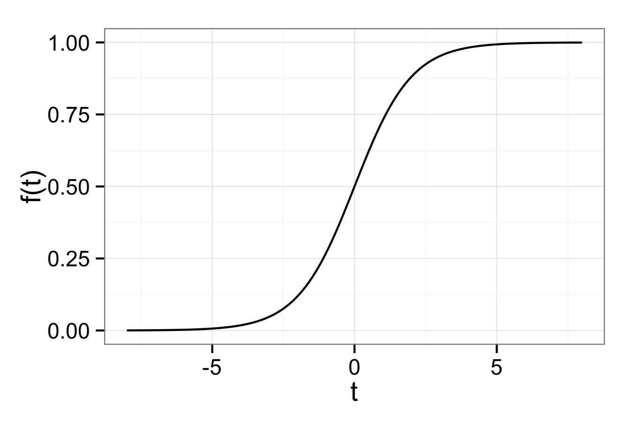
Logistic regression
Model a binary response instead of a numeric response by fitting a logistic curve to the data
Pr(success) > 0.5
Pr(success) < 0.5

Slide 36
Logistic regression is a classifier
See machine learning classes for more details

Slide 37
Logistic regression with biopsy data
> head(biopsy)
clump_thickness uniform_cell_size uniform_cell_shape marg_adhesion
1 5 1 1 1
2 5 4 4 5
3 3 1 1 1
4 6 8 8 1
5 4 1 1 3
6 8 10 10 8
epithelial_cell_size bare_nuclei bland_chromatin normal_nucleoli mitoses
1 2 1 3 1 1
2 7 10 3 2 1
3 2 2 3 1 1
4 3 4 3 7 1
5 2 1 3 1 1
6 7 10 9 7 1
outcome
1 benign
2 benign
3 benign
4 benign
5 benign
6 malignant

Slide 38
Running a logistic regression
glm(binary response ~ <predictors>)
> model <- glm(outcome ~ clump_thickness +
uniform_cell_size +
uniform_cell_shape +
marg_adhesion +
epithelial_cell_size +
bare_nuclei +
bland_chromatin +
normal_nucleoli +
mitoses,
data=biopsy,
family=binomial)
> model <- glm(outcome ~ ., data=biopsy, family=binomial)

Slide 39
Logistic regression output
> tidy(model)
term estimate std.error statistic p.value
1 (Intercept) -10.103942243 1.17487744 -8.59999681 7.971831e-18
2 clump_thickness 0.535014068 0.14201743 3.76724220 1.650608e-04
3 uniform_cell_size -0.006279717 0.20907739 -0.03003537 9.760388e-01
4 uniform_cell_shape 0.322706496 0.23060065 1.39941710 1.616879e-01
5 marg_adhesion 0.330636915 0.12345089 2.67828703 7.399977e-03
6 epithelial_cell_size 0.096635417 0.15659236 0.61711452 5.371592e-01
7 bare_nuclei 0.383024572 0.09384327 4.08153469 4.473930e-05
8 bland_chromatin 0.447187920 0.17138238 2.60929928 9.072785e-03
9 normal_nucleoli 0.213030682 0.11287348 1.88734050 5.911454e-02
10 mitoses 0.534835631 0.32877389 1.62675821 1.037885e-01
> glance(model)
null.deviance df.null logLik AIC BIC deviance df.residual
1 884.3502 682 -51.4441 122.8882 168.1531 102.8882 673

Slide 40
Interpreting coefficients
For every unit increase in the predictor, the log odds of the response (malignancy) increases by the coefficient
Log odds = Log( Pr(success)/Pr(failure))
> tidy(model)
term estimate std.error statistic p.value
2 clump_thickness 0.535014068 0.14201743 3.76724220 1.650608e-04
5 marg_adhesion 0.330636915 0.12345089 2.67828703 7.399977e-03
7 bare_nuclei 0.383024572 0.09384327 4.08153469 4.473930e-05
8 bland_chromatin 0.447187920 0.17138238 2.60929928 9.072785e-03

Slide 41
Logistic regression output
> head( model$fitted.values )
1 2 3 4 5 6
0.016046581 0.908808622 0.008137623 0.760934919 0.018166848 0.999973622
> head( model$linear.predictors )
1 2 3 4 5 6
-4.116083 2.299174 -4.803086 1.157812 -3.989823 10.542969

Slide 42
Visualize the logistic regression
> model.fit <- tibble(x = model$linear.predictors,
y = model$fitted.values,
outcome = biopsy$outcome)
> ggplot(model.fit, aes(x = x, y = y)) + geom_line()

Slide 43
Visualize the logistic regression with a rug
> ggplot(model.fit, aes(x = x, y = y)) + geom_line() + geom_rug(sides = "tr")

Slide 44
Logistic regression clearly separated the groups
> ggplot(model.fit, aes(x = x, y = y, color = outcome)) +
geom_line() +
geom_point() +
geom_rug(sides = "t")

Slide 45
Using the logistic regression
> new.patient <- tibble(clump_thickness = 4,
uniform_cell_size = 2,
uniform_cell_shape = 7,
marg_adhesion = 3,
epithelial_cell_size = 8,
bare_nuclei = 1,
bland_chromatin =5,
normal_nucleoli = 2,
mitoses = 0)
> predict(model, new.patient)
1
-0.9074803
> predict(model, new.patient, type = "response")
1
0.2875157
Our logistic model gives a 28.7% probability that the new patient has a malignancy.

Slide 46
Next week we will evaluate models
How do we choose the best predictors, i.e. select the best model?
This week's homework will teach you a very common, but very mediocre, approach
How can we evaluate model performance?
What procedures can we use to build models as robustly as possible?

