Slide 2
http://blog.minitab.com/blog/adventures-in-statistics-2/choosing-between-a-nonparametric-test-and-a-parametric-test
http://biostat.mc.vanderbilt.edu/wiki/pub/Main/AnesShortCourse/NonParametrics.pdf

Slide 3
Focus is on tidy dataframes
Each variable forms a column.
Each observation forms a row.
Each type of observational unit forms a table.
Tidy data provides a consistent approach to data management that greatly facilitates downstream analysis and viz

Slide 4
Messy vs tidy data
What are the variables in this data?
What are the observations in this data?

Slide 5
Exercise
How can we convert this table into a tidy data frame?
 | survived | died
drug | 15 | 3
placebo | 4 | 11
treatment | outcome | count
drug | survived | 15
placebo | survived | 4
drug | died | 3
placebo | died | 11
What are the variables?
Remember: categories of a categorical variable are not variables
What are the observations?

Slide 6
The fundamental verbs of tidyr
gather() | Gather multiple columns into key:value pairs
spread() | Spread key:value pairs over multiple columns
separate() | Separate columns
unite() | Join columns
There are more functions but these ones are key!

Slide 7
gather() makes wide tables narrow
data
tree treat t152 t174 t201 t227 t258
1 ozone 4.51 4.98 5.41 5.90 6.15
2 ozone 4.24 4.20 4.68 4.92 4.96
3 ozone 3.98 4.36 4.79 4.99 5.03
tree treat time measure
1 ozone t152 4.51
1 ozone t174 4.98
1 ozone t201 5.41
1 ozone t227 5.90
1 ozone t258 6.15
...
data %>% gather(time, measure, t152:t258)
KEY
VALUE

Slide 8
spread() makes narrow tables wide
tree treat time measure
1 ozone t152 4.51
1 ozone t174 4.98
1 ozone t201 5.41
1 ozone t227 5.90
1 ozone t258 6.15
...
tree treat t152 t174 t201 t227 t258
1 ozone 4.51 4.98 5.41 5.90 6.15
2 ozone 4.24 4.20 4.68 4.92 4.96
3 ozone 3.98 4.36 4.79 4.99 5.03
data %>% spread(time, measure)

Slide 9
separate() separates columns
tree treat time measure
1 ozone t152 4.51
1 ozone t174 4.98
1 ozone t201 5.41
1 ozone t227 5.90
1 ozone t258 6.15
...
tree treat t152 t174 t201 t227 t258
1 ozone 4.51 4.98 5.41 5.90 6.15
2 ozone 4.24 4.20 4.68 4.92 4.96
3 ozone 3.98 4.36 4.79 4.99 5.03

Slide 10
unite() …unites columns
tree treat time measure
1 ozone t152 4.51
1 ozone t174 4.98
1 ozone t201 5.41
1 ozone t227 5.90
1 ozone t258 6.15
...
tree treat t152 t174 t201 t227 t258
1 ozone 4.51 4.98 5.41 5.90 6.15
2 ozone 4.24 4.20 4.68 4.92 4.96
3 ozone 3.98 4.36 4.79 4.99 5.03

Slide 11
Brief return to dplyr
Joining related data frames
inner_join()
outer_join()
left_join()

Slide 12
Estimation
An estimator is a statistic (~formula) for estimating a parameter
A good estimator is unbiased
The expected value (expectation) of the estimator should equal the parameter being estimated
Mean of the sampling distribution of the statistic should equal the parameter being estimated
A good estimator is consistent
Increasing the sample size produces an estimate with smaller SE
A good estimator is efficient
Has the smallest SE among any estimator you could have chosen

Slide 13
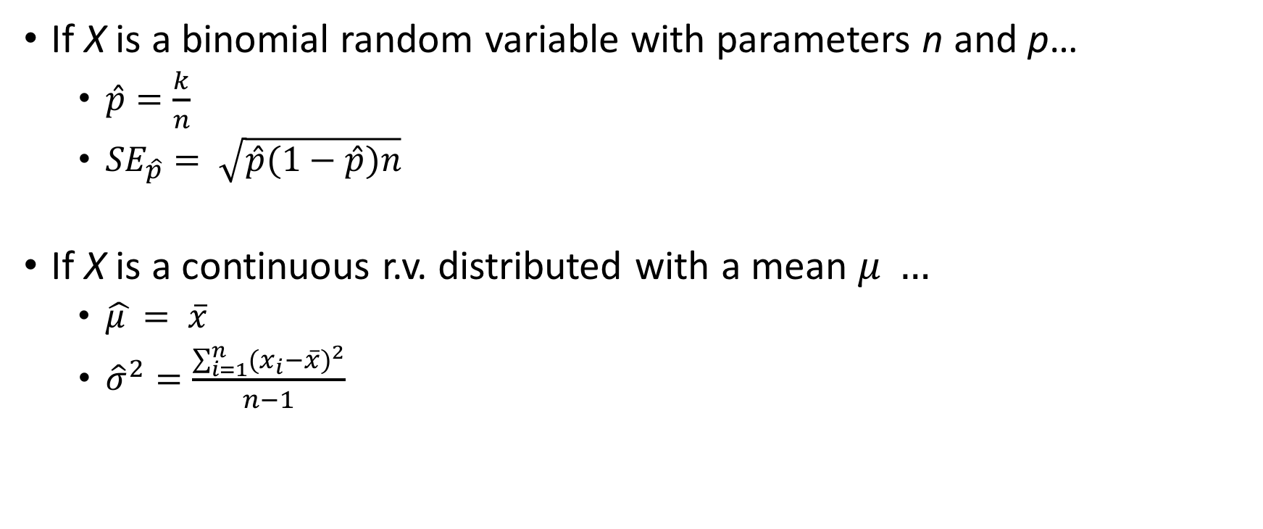
Point estimation
If X is a binomial random variable with parameters n and p…
$\hat{p}=\frac{k}{n}$
${SE}_{\hat{p}}= \sqrt{\hat{p}(1−\hat{p})n}$
If X is a continuous r.v. distributed with a mean $μ …$
$\hat{μ }= \overline{x}$
${\hat{σ}}^{2}=\frac{\sum_{i=1}^{n}{{{(x}_{i}−\overline{x})}^{2}}}{n−1}$

