Slide 1
Linear modeling I
Stephanie J. spielman, phd
bio5312, Fall 2017

Slide 2
Announcing Final Project (25%)
Identify a dataset and ask four scientific questions about the data
Use any of the statistical approaches we have learned to answer each question
Make a descriptive figure for each scientific question

Slide 3
Scientific questions
Recall HW7:
Do PHA levels tend to differ between the birds that received supplemental carotenoids and those that did not? Based on your results, can you infer anything about immune differences between birds that did and did not receive carotenoids?
Use a Mann Whitney U test to answer the scientific question
"Run a Mann Whitney U test on PHA levels between bird treatments" is not a scientific question
What figure might be good to make here?
What figures would not be good here?

Slide 4
Linear Modeling
ANOVA
Correlation
Regression
Multiple regression

Slide 5
ANOVA: Analysis of Variance
Used to compare more than 2 means (among k groups)
Ho: All means are the same, i.e. 𝜇₁ = 𝜇₂ = … = 𝜇_{k}
Ha: At least one mean is different, i.e. at least one 𝜇_{<1-k>} differs
Why "can't" we use a t-test?
We can do all the comparisons and use a P-value correction
ANOVA is preferred

Slide 6
ANOVA Example
A clinical trial asks if there is a difference in mean daily calcium intake in adults with normal bone density, adults with osteopenia, and adults with osteoporosis. Each participant's daily calcium intake is measured based on reported food intake.
Is there a difference in mean calcium intake across groups?
Normal Bone Density | Osteopenia | Osteoporosis
1200 | 1000 | 490
1000 | 1100 | 650
980 | 700 | 200
900 | 800 | 300
750 | 500 | 400
800 | 700 | 350

Slide 7
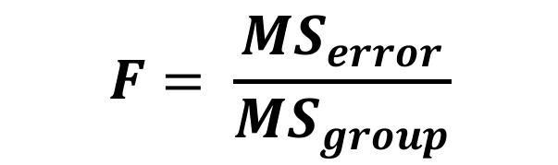
ANOVA compares sources of variance with the F statistic
Variance within each group is the error mean square (MS_{error})
Pooled sample variance
Variance between each group is the group mean square (Ms_{group})
MS_{group}
$$F= \frac{{MS}_{error}}{{MS}_{group}}$$
MS_{error}

Slide 8
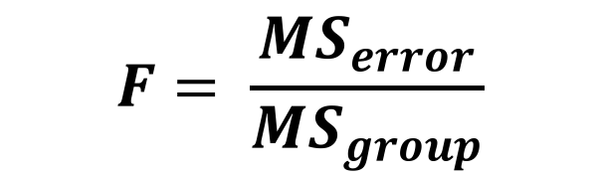
The F statistic
$$F= \frac{{MS}_{error}}{{MS}_{group}}$$
If Ho is true, MS_{error} ≅ MS_{group}
If Ho is false, MS_{error} < MS_{group}
DF for MS_{error} = N – k
DF for MS_{group} = k – 1
We use only the upper tail for P-value
https://en.wikipedia.org/wiki/F-distribution#/media/File:F-distribution_pdf.svg

Slide 9
Computing the F statistic
$$F= \frac{{MS}_{error}}{{MS}_{group}}$$

Slide 10

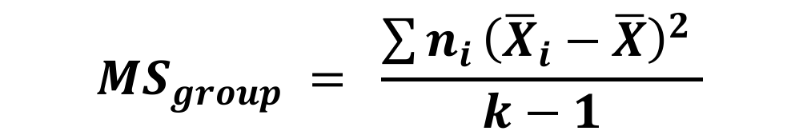
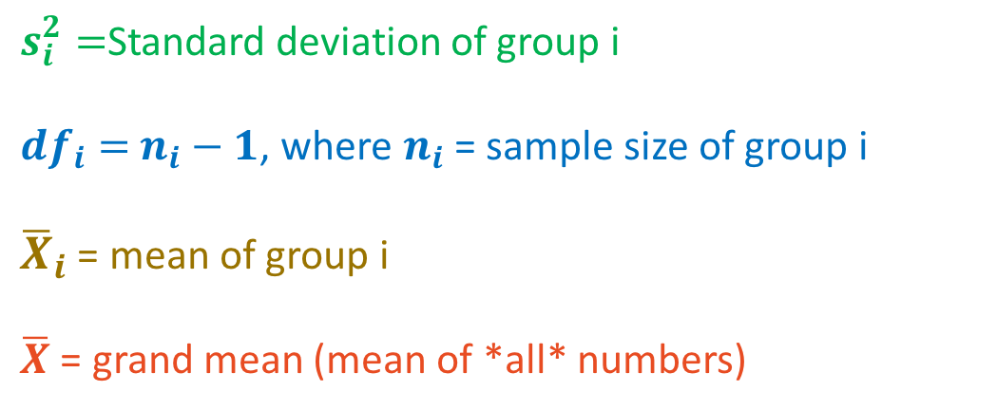
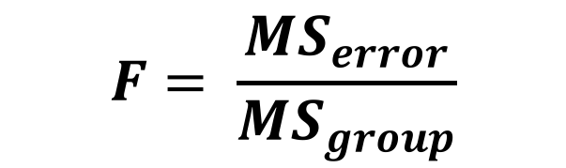
Computing the F statistic
$$F= \frac{{MS}_{error}}{{MS}_{group}}$$
Sum of squares
$s_{i}^{2}=$Standard deviation of group i
${df}_{i}=$ $n_{i}−1$, where $n_{i}$ = sample size of group i
${\overline{X}}_{i}$ = mean of group i
$\overline{X}$ = grand mean (mean of *all* numbers)
$${MS}_{error} = \frac{\sum{s_{i}^{2}}{df}_{i}}{N−k}$$
$${MS}_{group} = \frac{\sum{n_{i}}{\left({\overline{X}}_{i}−\overline{X}\right)}^{2} }{k−1}$$

Slide 11
Computing the F statistic
$$F= \frac{{MS}_{error}}{{MS}_{group}}$$
Normal Bone Density | Osteopenia | Osteoporosis
1200 | 1000 | 490
1000 | 1100 | 650
980 | 700 | 200
900 | 800 | 300
750 | 500 | 400
800 | 700 | 350
$${MS}_{error} = \frac{\sum{s_{i}^{2}}{df}_{i}}{N−k}$$
$${MS}_{group} = \frac{\sum{n_{i}}{\left({\overline{X}}_{i}−\overline{X}\right)}^{2} }{k−1}$$

Slide 12
Running the ANOVA
Ho: Groups have the same mean calcium intake.
Ha: At least one group has a different calcium intake.
group calcium
1 normal 1200
2 normal 1000
3 normal 980
4 normal 900
5 normal 750
6 normal 800
7 osteopenia 1000
8 osteopenia 1100
9 osteopenia 700
10 osteopenia 800
11 osteopenia 500
12 osteopenia 700
...
data <- tibble("normal" = c(1200, 1000, 980, 900, 750, 800),
"osteopenia" = c(1000, 1100, 700, 800, 500, 700),
"osteoporosis" = c(490, 650, 200, 300, 400, 350))
data %>% gather(group, calcium, normal:osteoporosis) -> tidy.data

Slide 13
Running the ANOVA
> aov(calcium ~ group, data = tidy.data)
Call:
aov(formula = calcium ~ group, data = tidy.data)
Terms:
group Residuals
Sum of Squares 944144.4 493166.7
Deg. of Freedom 2 15
Residual standard error: 181.3223
Estimated effects may be unbalanced
error

Slide 14
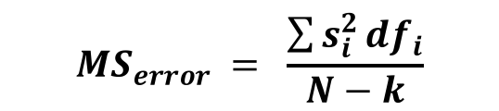
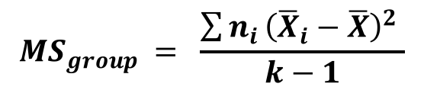

Obtaining the ANOVA table
> summary( aov(calcium ~ group, data = tidy.data) )
Df Sum Sq Mean Sq F value Pr(>F)
group 2 944144 472072 14.36 0.000328 ***
Residuals 15 493167 32878
---
Signif. codes: 0 ‘***’ 0.001 ‘**’ 0.01 ‘*’ 0.05 ‘.’ 0.1 ‘ ’ 1
> 1-pf(14.36, 2, 15)
[1] 0.0003277806
error
$${MS}_{group} = \frac{\sum{n_{i}}{\left({\overline{X}}_{i}−\overline{X}\right)}^{2} }{k−1}$$
$${MS}_{error} = \frac{\sum{s_{i}^{2}}{df}_{i}}{N−k}$$
$$F= \frac{{MS}_{error}}{{MS}_{group}}$$

Slide 15
Reports and conclusions
Our P = 0.000328, which is less than alpha. We reject the null hypothesis and we have evidence that at least one mean (normal bone density, osteopenia, or osteoporosis calcium intake) differs from the other.

Slide 16
Unplanned comparisons with the Tukey-Kramer Method
AKA Tukey's test, Tukey's method, Tukey's HSD (honest significant difference) test
Tests all pairs of means
Normal vs. osteopenia
Normal vs. osteoporosis
Osteopenia vs. osteoporosis
Roughly, multiple t-tests where FWER is controlled but using the q-statistic (similar to t)

Slide 17
Running Tukey's test on ANOVA
> TukeyHSD( aov(calcium ~ group, data = tidy.data) )
Tukey multiple comparisons of means
95% family-wise confidence level
Fit: aov(formula = calcium ~ group, data = tidy.data)
$group
diff lwr upr p adj
osteopenia-normal -138.3333 -410.2534 133.5867 0.4054988
osteoporosis-normal -540.0000 -811.9200 -268.0800 0.0003238
osteoporosis-osteopenia -401.6667 -673.5867 -129.7466 0.0043335

Slide 18
Reports and conclusions, round 2
Our P = 0.000328, which is less than alpha. We reject the null hypothesis and we have evidence that at least one mean (normal bone density, osteopenia, or osteoporosis calcium intake) differs from the other.
After running the post-hoc Tukey's test, we find that osteoporosis groups have a significantly higher average calcium intake than normal groups (P=0.0003), and that osteoporosis groups have a significantly higher average calcium intake than osteopenia groups P=0.004). However, we do not find a significant difference in calcium intake between normal and osteopenia groups.

Slide 19
ANOVA assumptions
Samples are random
Samples are normally distributed
Robust to violations when study is large
Samples have the same variance
Robust to violations when study is balanced
Nonparametric alternative is Kruskal-Wallis

Slide 20
Kruskal-Wallis is the non-parametric alternative
> kruskal.test(calcium ~ as.factor(group), data = tidy.data)
Kruskal-Wallis rank sum test
data: calcium by as.factor(group)
Kruskal-Wallis chi-squared = 11.439, df = 2, p-value = 0.003281
Unless something is really really weird, you "can" use ANOVA

Slide 21
Exercise break

Slide 22
Correlation
Measures the strength and direction of the linear association between two numeric variables
-1 ≤ r ≤ 1

Slide 23
Perfect correlations
r = 1
r = -1

Slide 24
Variability (error) has a substantial influence

Slide 25

Calculating the correlation coefficient
$$r= \frac{cov(X,Y)}{s_{X}s_{Y}}=\frac{\sum{(X_{i}−\overline{X)}(Y_{i}−\overline{Y)}}}{\sqrt{\sum{{(X_{i}−\overline{X)}}^{2}}}\sqrt{\sum{{(Y_{i}−\overline{Y)}}^{2}}}}$$

Slide 26
Example: correlation between irises
> setosa <- iris %>% filter(Species == "setosa")
> cor(setosa$Sepal.Length, setosa$Sepal.Width)
[1] 0.7425467
> cor(setosa$Sepal.Width, setosa$Sepal.Length)
[1] 0.7425467

Slide 27
Example: correlation between irises
> cor(setosa$Petal.Length, setosa$Sepal.Width)
[1] 0.1777

Slide 28
Hypothesis testing: tests r = 0
> cor.test(setosa$Petal.Length, setosa$Sepal.Width)
Pearson's product-moment correlation
data: setosa$Petal.Length and setosa$Sepal.Width
t = 1.2511, df = 48, p-value = 0.217
alternative hypothesis: true correlation is not equal to 0
95 percent confidence interval:
-0.1058851 0.4345536
sample estimates:
cor
0.1777
There is no evidence that the correlation between petal lengths and sepal width in Setosa irises differs from 0.

Slide 29
Nonlinear data

Slide 30
Nonlinear data
> cor.test(x, y)
Pearson's product-moment correlation
data: x and y
t = 13.089, df = 48, p-value < 2.2e-16
alternative hypothesis: true correlation is
not equal to 0
95 percent confidence interval:
0.8030401 0.9327180
sample estimates:
cor
0.8838302

Slide 31
Spearman rank nonparametric correlation
Assumes data is monotonic (ordinal)
> cor.test(x, y, method = "spearman" )
Spearman's rank correlation rho
data: x and y
S = 0, p-value < 2.2e-16
alternative hypothesis: true rho is not equal to 0
sample estimates:
rho
1

Slide 32
Assumptions
Data are linearly related without any severe outliers
Both X and Y are normally distributed
Robust to large N
Cloud of points is not "funnel-shaped" (fans out at end(s))

Slide 33
Exercise break

Slide 34

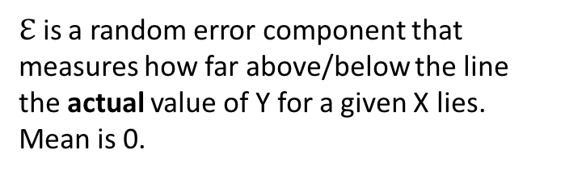
Regression
The simplest type of linear model
Predicts the value of one numeric variable from another via "line of best fit"
$$Y=a+bX$$
$$Y=β_{o}+β_{1}X+ ℇ$$
$ℇ$ is a random error component that measures how far above/below the line the actual value of Y for a given X lies. Mean is 0.

Slide 35
Least squares approach
Find the line which minimizes the sum of squared residuals

Slide 36
Least squares approach
Find the line which minimizes the sum of squared residuals

Slide 37

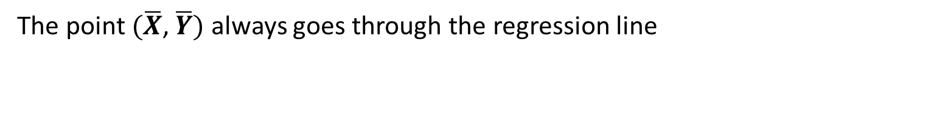

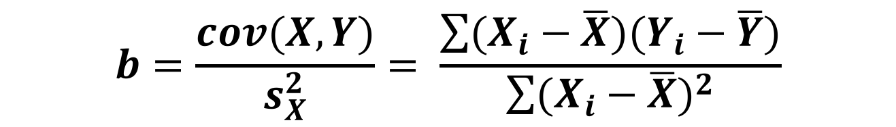
Calculating slope and intercept
$$Y=a+bX$$
$$b=\frac{cov(X,Y)}{s_{X}^{2}}= \frac{\sum{(X_{i}−\overline{X})(Y_{i}−\overline{Y})}}{\sum{{(X_{i}−\overline{X})}^{2}}}$$
$$a=\overline{Y} −b\overline{X}$$
The point $(\overline{X}$, $\overline{Y})$ always goes through the regression line

Slide 38
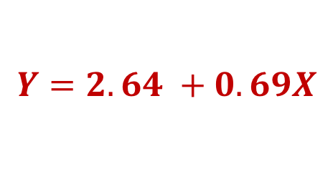
Executing a linear model
> lm(Sepal.Length ~ Sepal.Width, data = setosa)
Call:
lm(formula = Sepal.Length ~ Sepal.Width, data = setosa)
Coefficients:
(Intercept) Petal.Width
2.6390 0.6905
$$Y=2.64 +0.69X$$

Slide 39
Testing a linear model
> summary( lm(Sepal.Length ~ Sepal.Width, data = setosa) )
Call:
lm(formula = Sepal.Length ~ Sepal.Width, data = setosa)
Residuals:
Min 1Q Median 3Q Max
-0.52476 -0.16286 0.02166 0.13833 0.44428
Coefficients:
Estimate Std. Error t value Pr(>|t|)
(Intercept) 2.6390 0.3100 8.513 3.74e-11 ***
Sepal.Width 0.6905 0.0899 7.681 6.71e-10 ***
---
Signif. codes: 0 ‘***’ 0.001 ‘**’ 0.01 ‘*’ 0.05 ‘.’ 0.1 ‘ ’ 1
Residual standard error: 0.2385 on 48 degrees of freedom
Multiple R-squared: 0.5514, Adjusted R-squared: 0.542
F-statistic: 58.99 on 1 and 48 DF, p-value: 6.71e-10
Five number summary of the distribution of residuals
SE of $ℇ$
Test for model improvement over slope=0

Slide 40
Coefficients
Y
X
lm(Sepal.Length ~ Sepal.Width)
Coefficients:
Estimate Std. Error t value Pr(>|t|)
(Intercept) 2.6390 0.3100 8.513 3.74e-11 ***
Sepal.Width 0.6905 0.0899 7.681 6.71e-10 ***
Expected value of Y when X=0
Expected unit increase in X for every
unit increase in Y
Null hypotheses:
Intercept != 0
Slope != 0
What can we conclude?
For every unit increase in setosa Sepal Length, setosa Sepal Width increases by 0.6905, on average.
[If P < alpha, don't conclude this..]

Slide 41
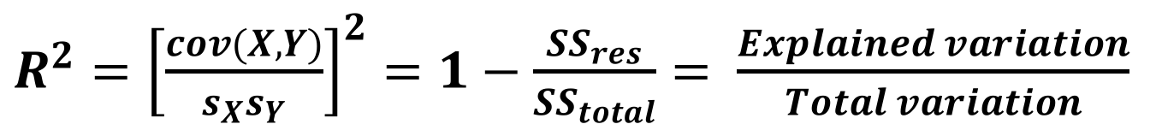
R²
R² is the percent of variation in Y than can be explained by X
0 ≤ R² ≤ 1
Multiple R-squared: 0.5514, Adjusted R-squared: 0.542
$R^{2}={\left[\frac{cov(X,Y)}{s_{X}s_{Y}}\right]}^{2}=1−\frac{{SS}_{res}}{{SS}_{total}}= \frac{Explained variation}{Total variation}$
What can we conclude?
~55% of the variation in Setosa sepal lengths can be explained by Setosa sepals widths
[If P < alpha, don't conclude this..]

Slide 42
Visualizing the regression
ggplot(setosa, aes(x = Sepal.Width, y = Sepal.Length)) +
geom_point() + geom_smooth(method = "lm")

Slide 43
Visualizing the regression
ggplot(setosa, aes(x = Sepal.Width, y = Sepal.Length)) +
geom_point() + geom_smooth(method = "lm") +
geom_text(x = 2.75, y = 5.5, label = "y=2.639 + 0.69x", color="red")

Slide 44
Visualizing the regression
ggplot(setosa, aes(x = Sepal.Width, y = Sepal.Length)) +
geom_point() + geom_smooth(method = "lm") +
geom_text(x=2.75, y=5.5, label="r^2 == 0.585", parse=TRUE, color="red")

Slide 45
Exercise break

Slide 46
Linear Models
Numeric response ~ <predictors>

Slide 47
Linear Models, broadly
Single numeric predictor: Regression
Single categorical predictor: ANOVA!
Multiple numeric predictors: multiple regression
Multiple categorical predictors: MANOVA
Single categorical and n numeric predictors: ANCOVA
Multiple categorical and n numeric predictors: MANCOVA
lm(Numeric response ~ <predictors>)

Slide 48
ANOVA meets linear modeling
group calcium
1 normal 1200
2 normal 1000
3 normal 980
4 normal 900
5 normal 750
6 normal 800
7 osteopenia 1000
8 osteopenia 1100
9 osteopenia 700
10 osteopenia 800
11 osteopenia 500
12 osteopenia 700
...
> summary(aov(calcium ~ group, data = tidy.data))
Df Sum Sq Mean Sq F value Pr(>F)
group 2 944144 472072 14.36 0.000328 ***
Residuals 15 493167 32878
> summary(lm(calcium ~ group, data = tidy.data))
Coefficients:
Estimate Std. Error t value Pr(>|t|)
(Intercept) 938.33 74.02 12.676 2.04e-09 ***
grouposteopenia -138.33 104.69 -1.321 0.206168
grouposteoporosis -540.00 104.69 -5.158 0.000117 ***
Residual standard error: 181.3 on 15 degrees of freedom
Multiple R-squared: 0.6569, Adjusted R-squared: 0.6111
F-statistic: 14.36 on 2 and 15 DF, p-value: 0.000328
For every unit increase in normal group calcium intake, osteopenia calcium intake decreases by 138.33 on average
For every unit increase in normal group calcium intake, osteoporosis calcium intake decreases by 540 on average
What group you belong to explains ~61% of the variation in calcium intake

