Slide 1
Enter the Tidyverse
bio5312 Fall2017
Dr. stephanie j. spielman

Slide 2
What is the “tidyverse”?
A collection of R packages largely developed by Hadley Wickham and others at Rstudio
Have emerged as staples of modern-day data science in the past 5—10 years
We will focus on:
Visualization/plotting with ggplot2
Data management and ”wrangling” with dplyr and tidyr

Slide 3
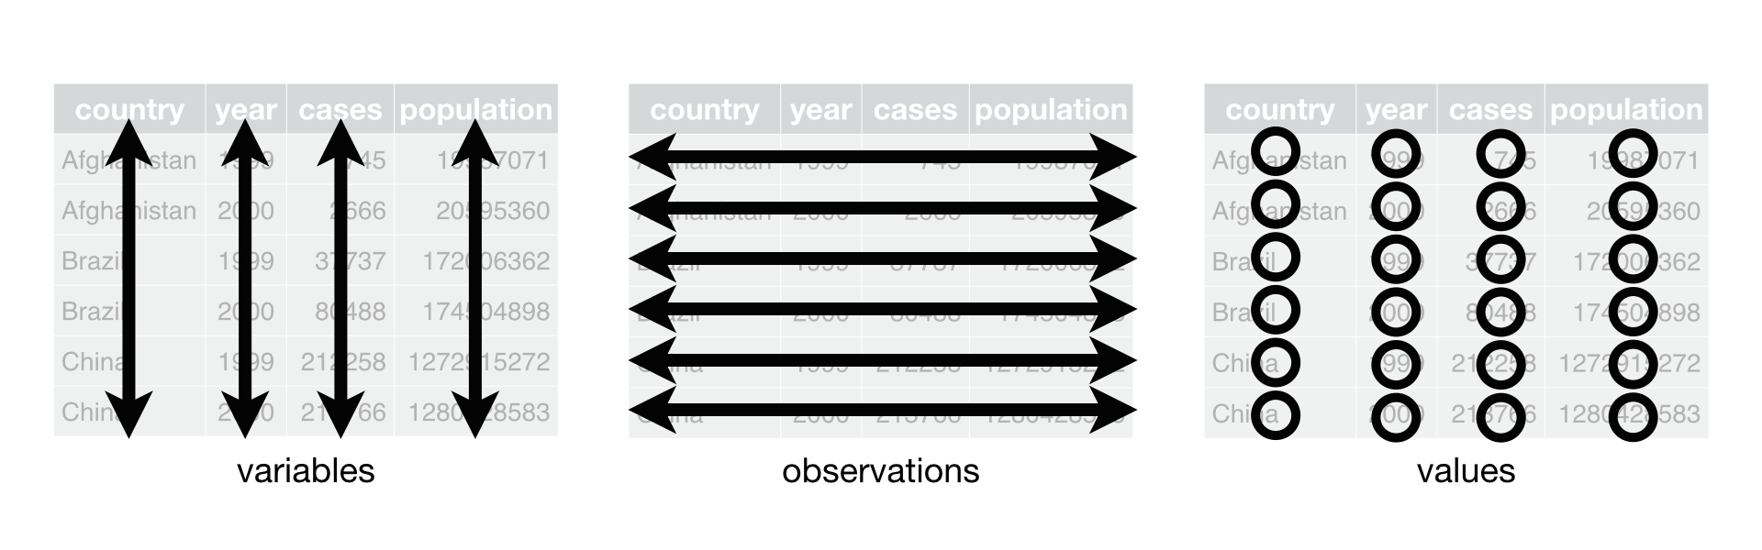
Focus is on tidy dataframes
Each variable forms a column.
Each observation forms a row.
Each type of observational unit forms a table.
Tidy data provides a consistent approach to data management that greatly facilitates downstream analysis and viz

Slide 4
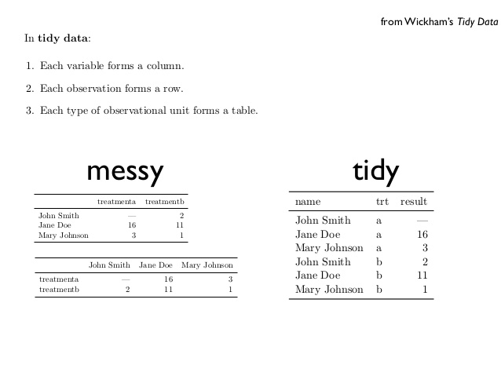
Messy vs tidy data
What are the variables in this data?
What are the observations in this data?

Slide 5
Exercise
How can we convert this table into a tidy data frame?
 | survived | died
drug | 15 | 3
placebo | 4 | 11
treatment | outcome | count
drug | survived | 15
placebo | survived | 4
drug | died | 3
placebo | died | 11
What are the variables?
Remember: categories of a categorical variable are not variables
What are the observations?

Slide 6
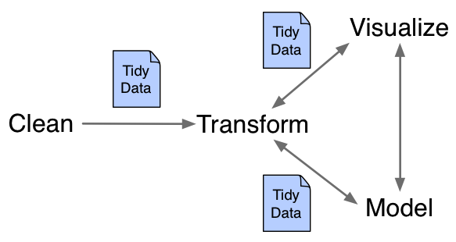
Working with tidy data
The package dplyr can manipulate and manage tidy data
The package tidyr can rearrange data to convert to/from tidy data
The package ggplot2 can plot tidy data

Slide 7
The fundamental verbs of dplyr
filter() | select rows
select() | select columns
mutate() | create new columns
group_by() | establish a data grouping
summarize() | calculate summary statistic
arrange() | arrange rows

Slide 8
The pipe operator %>%
“Pipes” output from one function/operation as input to the next
## Start simple: display data
head(iris)
## Using %>%
iris %>% head()
## Find the mean of iris sepal lengths
mean.sepal <- mean(iris$Sepal.Length)
## Using %>%
mean.sepal <- iris$Sepal.Length %>% mean()
iris$Sepal.Length %>% mean() -> mean.sepal
iris %>% mean(Sepal.Length) -> mean.sepal
“forward assignment” operator follows the logical flow of piping

Slide 9
Example: data manipulation with dplyr
> head(iris)
Sepal.Length Sepal.Width Petal.Length Petal.Width Species
1 5.1 3.5 1.4 0.2 setosa
2 4.9 3.0 1.4 0.2 setosa
3 4.7 3.2 1.3 0.2 setosa
4 4.6 3.1 1.5 0.2 setosa
5 5.0 3.6 1.4 0.2 setosa
6 5.4 3.9 1.7 0.4 setosa
> iris %>% filter(Species == “setosa”) ## Equivalent to iris[iris$Species == “setosa”,]
> iris %>% filter(Species == “setosa”) -> iris.setosa

