Slide 1
Descriptive and Summary Statistics
bio5312 Fall2017
stephanie j. spielman, PhD

Slide 2
Logistics
All course materials will be hosted here: http://sjspielman.org/bio5312_fall2017
Submit assignments via Canvas: https://templeu.instructure.com
Please bring your laptop to class!!!
Office SERC 643
Weekly office hours Friday 1-3 ground floor of SERC ← vote?

Slide 3
Course goals
The primary goal is to analyze, interpret, and visualize data in the biological sciences
Achieved via statistical analysis and data science techniques in R
This is not a course in statistical theory.

Slide 4
Course topics
Descriptive and Summary Statistics
Data visualization
Fundamentals in probability, distributions
Statistical inference: hypothesis testing and confidence intervals
Linear modeling
Multiple testing
Binary classification
Clustering methods
Special topics in current biological data analysis

Slide 5
Course topics
Descriptive and Summary Statistics
Data visualization
Fundamentals in probability, distributions
Statistical inference: hypothesis testing and confidence intervals
Linear modeling
Multiple testing
Binary classification
Clustering methods
Special topics in current biological data analysis

Slide 6
But first, what are we doing here?
Statistics is the study of the collection, analysis, interpretation, presentation, and organization of data.
We use statistics to make inferences about phenomena using samples and quantify uncertainty of data
Biostatistics is (surprisingly!) a branch of applied statistics geared towards to medical and biological problems

Slide 7
Populations and samples
Populations are the entire collection of individuals/units/etc. a researcher is interested in
Generally we can never know the true composition of a population
Populations are described with parameters
Samples are subsets of individuals/units from populations
We use hypothesis testing to (try to) draw population-level conclusions from samples
Samples are described with estimates
Parameters and estimates use different notations, as we will see

Slide 8
What makes a good sample?
In an ideal world, a sample is unbiased and features low sampling error
Bias is a systematic discrepancy between estimate and parameter
Samples should be randomly chosen
Each population unit should have an equal and independent chance of being chosen for a given sample
Sampling error
Low bias and low sampling error
Bias

Slide 9
Pop quiz: Is it random?
A researcher selects the first 58 student volunteers that sign up for a study
A computer program numbers all residents in a community, and then uses a random-number generator to select 26 residents
A researcher vigorously shakes a box containing equally sized balls and takes the first 3 that fall out of the box.
A researcher selects all study participants whose first name starts with an A, B, K, M, or O.

Slide 10
Pop quiz: Is it random?
A researcher selects the first 58 student volunteers that sign up for a study
A computer program numbers all residents in a community, and then uses a random-number generator to select 26 residents
A researcher vigorously shakes a box containing equally sized balls and takes the first 3 that fall out of the box.
A researcher selects all study participants whose first name starts with an A, B, K, M, or O.

Slide 11
Descriptive and Summary Statistics
Tools to concisely describe data, numerically and visually
Generally the first step in data exploration and statistical analysis
Identify missing values, outliers, etc.
Check assumptions required to fit models or perform statistical tests
Identify trends that merit further study

Slide 12
Types of data
How you analyze and visualize data depends on the type of data you have
Quantitative data
Continuous
Discrete (includes count data)
Categorical data
Nominal
Ordinal
Binary*

Slide 13
Quantitative data
Continuous
Any real-number value within some range
Discrete
Values are in indivisible units, i.e. whole or counting numbers
Includes count data (number of cups of coffee per day, number of amino acids in a protein…)

Slide 14
Categorical data
Nominal
Hair color, eye color, sex genotypes (XX, XY, XXY, XYY, XO).
Ordinal – categories with a natural ordering
Bad, fair, good, excellent
A, B, C, D
Binary
Yes/No
True/False
Bonus: names of sex genotypes?

Slide 15
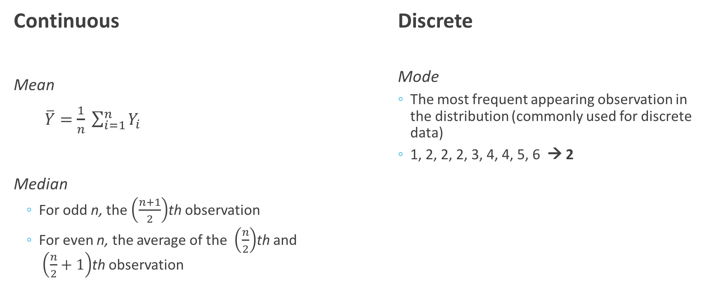
Measures of Location
Continuous
Mean
$\overline{Y}=$ $\frac{1}{n} \sum_{i=1}^{n}{Y_{i}}$
Median
For odd n, the $\left(\frac{n+1}{2}\right)$th observation
For even n, the average of the $\left(\frac{n}{2}\right)$th and $\left(\frac{n}{2}+1\right)$th observation
Discrete
Mode
The most frequent appearing observation in the distribution (commonly used for discrete data)
1, 2, 2, 2, 3, 4, 4, 5, 6 → 2

Slide 16
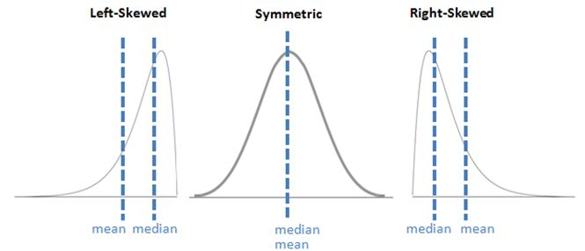
Measures of location in distributions
http://i.imgur.com/YSEYhha.jpg

Slide 17
Measures of spread
Range
Standard deviation and variance
Interquartile range

Slide 18
Range
Difference between largest and smallest value in a distribution
1, 2, 3, 7, 9 → 8
1, 2, 3, 7, 9, 500 → 499
Range is very sensitive to extreme observations and becomes very unwieldy very quickly.

Slide 19
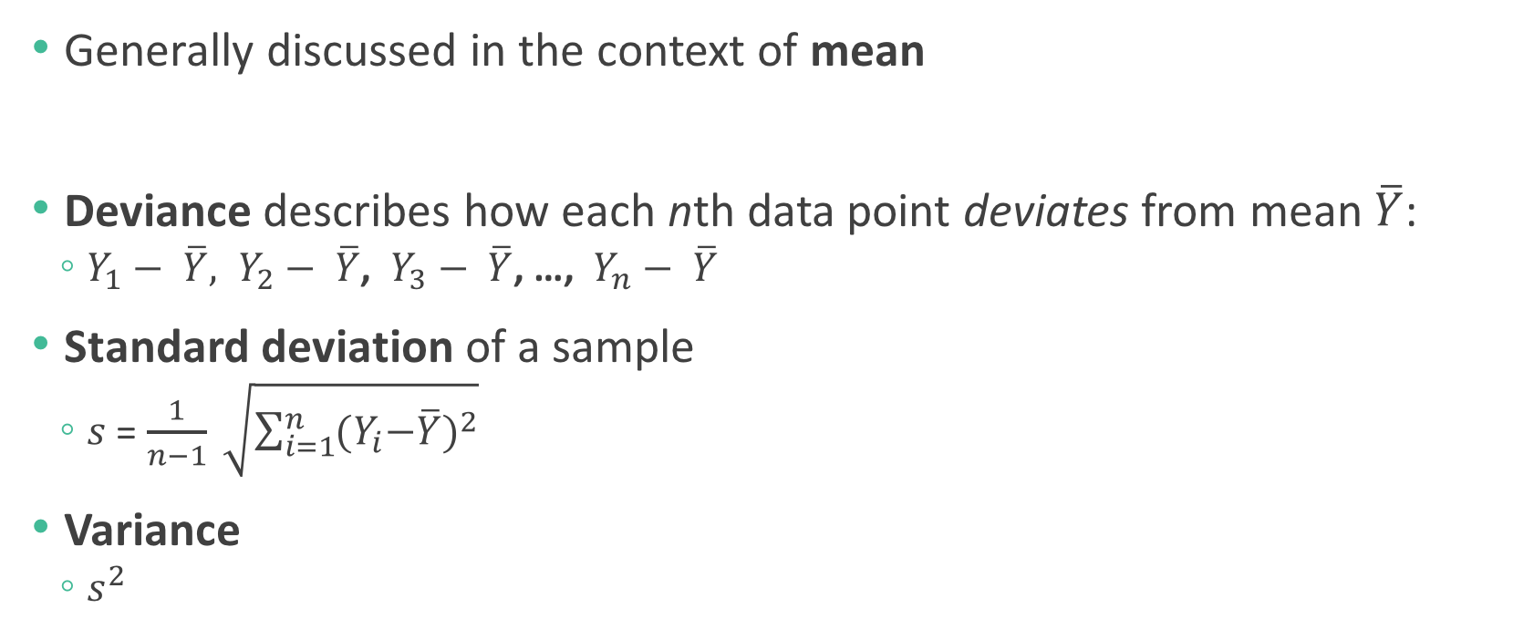
Standard deviation and variance
Generally discussed in the context of mean
Deviance describes how each nth data point deviates from mean $\overline{Y}$:
$Y_{1}− \overline{Y}, Y_{2}− \overline{Y}$, $Y_{3}− \overline{Y}$, …, $Y_{n}− \overline{Y}$
Standard deviation of a sample
$s$ = $\frac{1}{n−1} \sqrt{\sum_{i=1}^{n}{{{(Y}_{i}−\overline{Y})}^{2}}}$
Variance
$s^{2}$

Slide 20
Interquartile range
Generally discussed in the context of median
Quartiles divide the data into four equal parts (“quar”!)
Interquartile range (IQR) is the difference between the third and first quartile
How much of the data does the IQR encompass?
Five number summary: min, Q1, median, Q3, max

Slide 21
Mean or median?
The median is much more robust to outliers compared to the mean.
Which would you choose for a symmetric distribution and why?

Slide 22
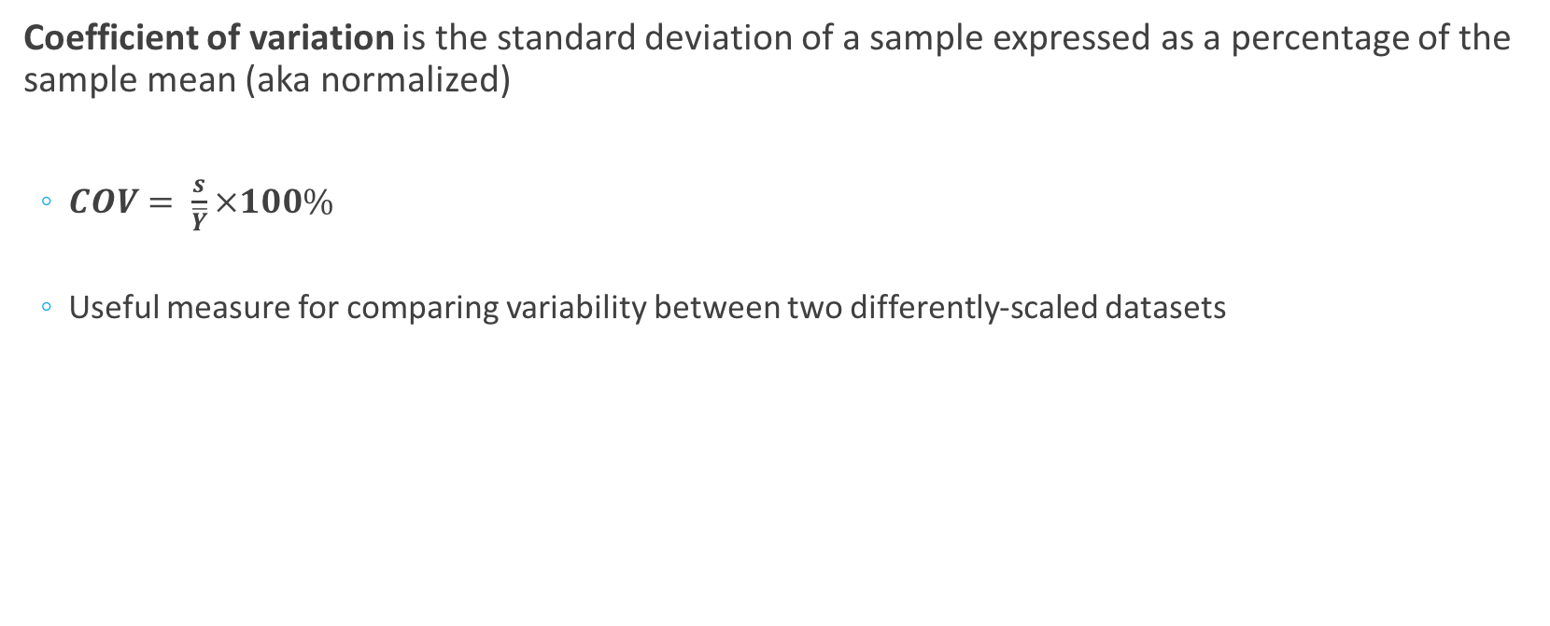
Measures of variability
Coefficient of variation is the standard deviation of a sample expressed as a percentage of the sample mean (aka normalized)
$COV= \frac{s}{\overline{Y}}×100\%$
Useful measure for comparing variability between two differently-scaled datasets

Slide 23
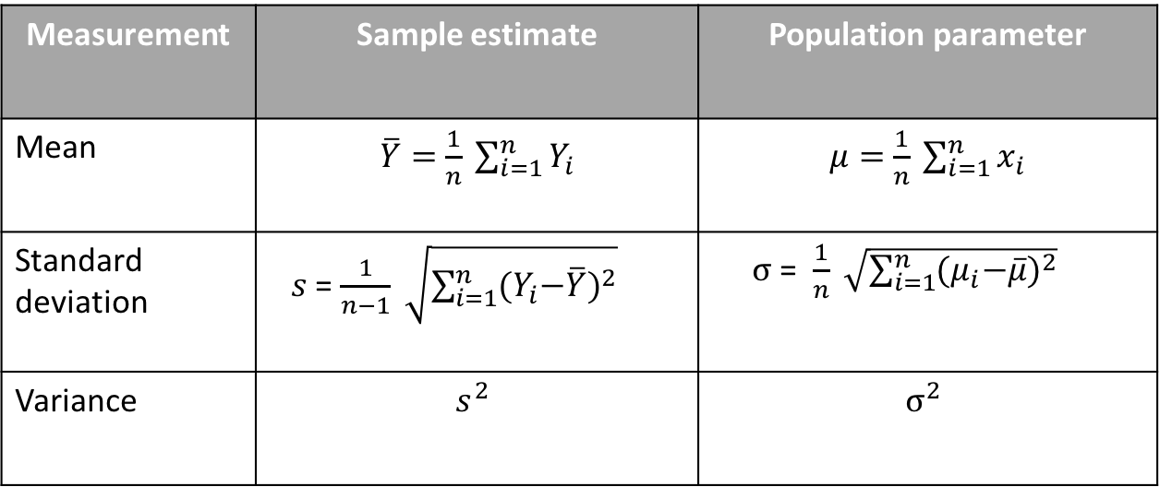
Sample vs population notation
Measurement | Sample estimate | Population parameter
Mean | $\overline{Y}=$ $\frac{1}{n} \sum_{i=1}^{n}{Y_{i}}$ | $μ=$ $\frac{1}{n} \sum_{i=1}^{n}{x_{i}}$
Standard deviation | $s$ = $\frac{1}{n−1} \sqrt{\sum_{i=1}^{n}{{{(Y}_{i}−\overline{Y})}^{2}}}$ | $σ$ = $\frac{1}{n} \sqrt{\sum_{i=1}^{n}{{{(μ}_{i}−\overline{μ})}^{2}}}$
Variance | $$s^{2}$$ | $$σ^{2}$$

Slide 24
Visualizing data
Different types of plots are used to represent different types of data
Continuous data
Histogram
Density plot
Boxplot
Violin plot
Discrete data
Bar plot
Comparing two continuous variables
Scatterplot
Trend over time
Line plot

Slide 25
Histogram

Slide 26
Using histograms to describe distributions

Slide 27
Density plots smoothen histograms

Slide 28
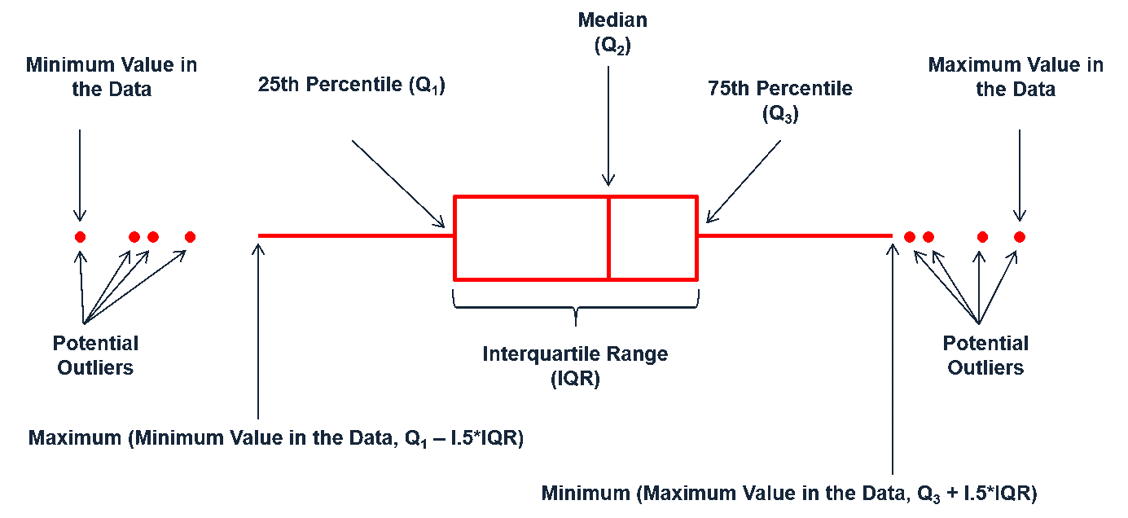
Boxplot
Graphical representation of a five-number summary
“Whiskers” calculated as data within +/- 1.5 IQR
“whiskers”
Q3
Median
IQR
Q1
outliers

Slide 29
Boxplots: The plot thickens*
*Pun intended.
Notes:
So why are there outliers in one and not the other?

Slide 30
What can we say about this distribution based on its boxplot?
Symmetry?
Skewness?
Modality?
Asymmetric
Left-skewed
Unclear
Notes:
Mean vs median, symmetric or asym, is it unimodal?

Slide 31
Violin plot: Density meets boxplot
N(5, 4)
N(2, 1)
N(4, 0.09)
Violin plot
Density plot
Boxplot

Slide 32
Barplot

Slide 33
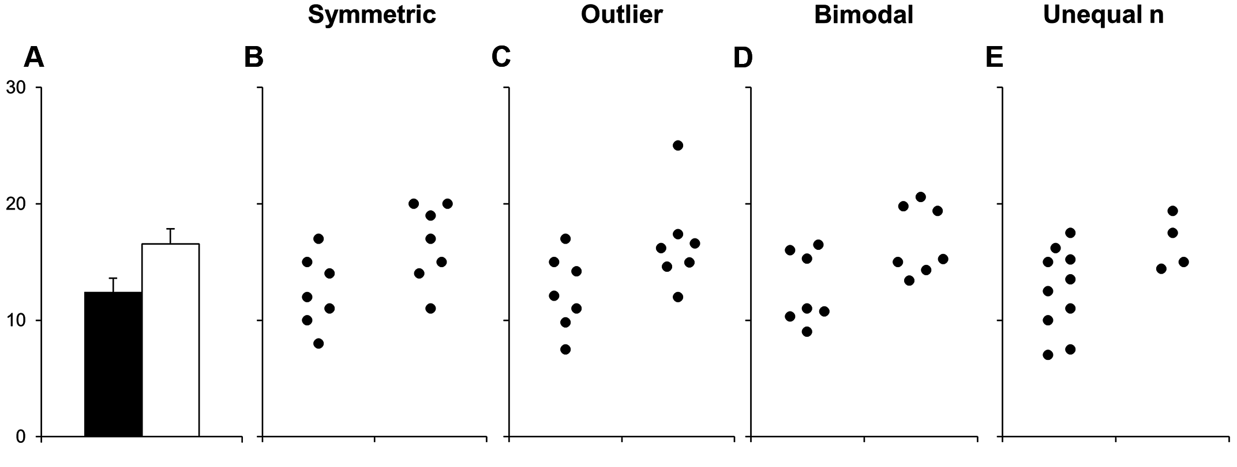
Cautionary tale in barplots
http://journals.plos.org/plosbiology/article?id=10.1371/journal.pbio.1002128

Slide 34
Scatterplot
response/dependent variable
explanatory/independent variable

Slide 35
Time series data

Slide 36
BREAK

