Slide 1
Probability and Tidyverse II
bio5312 Fall2017
stephanie j. spielman, PhD

Slide 2
Probability vocabulary
Sample space
Event
Probability
Probability distribution
Independent
Mutually exclusive

Slide 3
Sample space

Slide 4
Event

Slide 5
Probability

Slide 6
Probability distribution

Slide 7
Mutually exclusive

Slide 8
Independent

Slide 9
Fun facts about probabilities
➢The symbol { } is used as shorthand for the phrase “the event.” ➢A  B is the event that either A or B occurs, or they both occur. ➢A  B is the event that both A and B occur simultaneously. ➢Â is the event that A does not occur. It is called the complement of A. Notice that Pr(Â) = 1 – Pr(A), because Â occurs only when A does not occur.

Slide 10
Probability rules

Slide 11
Example: Probability of event X and event Y?
Depends on dep/inde

Slide 12
Example: Probability of independent events X and Y

Slide 13
Example: Probability of dependent events X and Y

Slide 14
Example: Probability of event X or event Y?
Depends on dep/inde

Slide 15
Example: Probability of independent events X or Y

Slide 16
Example: Probability of dependent events X or Y

Slide 17
Conditional Probability

Slide 18
Example: conditional probability

Slide 19
Bayes Theorem

Slide 20
Example: Bayes Theorem and disease

Slide 21
BREAK

Slide 22
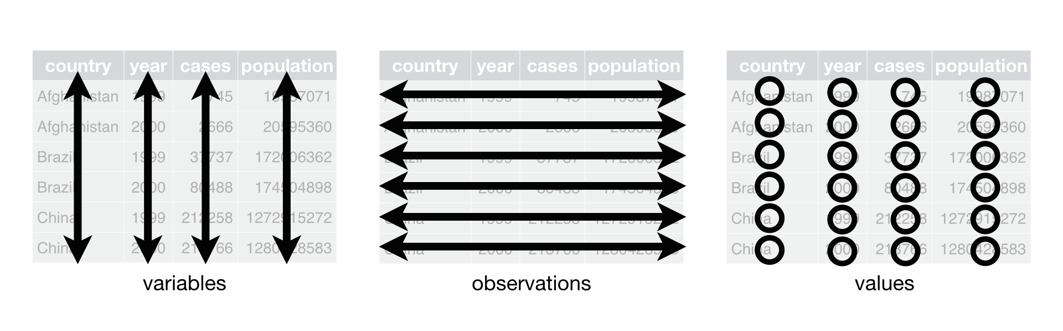
Focus is on tidy dataframes
Each variable forms a column.
Each observation forms a row.
Each type of observational unit forms a table.
Tidy data provides a consistent approach to data management that greatly facilitates downstream analysis and viz

Slide 23
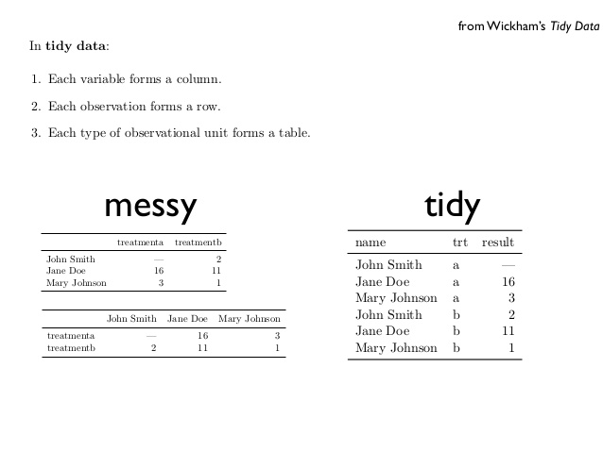
Messy vs tidy data
What are the variables in this data?
What are the observations in this data?

Slide 24
Exercise
How can we convert this table into a tidy data frame?
 | survived | died
drug | 15 | 3
placebo | 4 | 11
treatment | outcome | count
drug | survived | 15
placebo | survived | 4
drug | died | 3
placebo | died | 11
What are the variables?
Remember: categories of a categorical variable are not variables
What are the observations?

Slide 25
The fundamental verbs of tidyr
gather() | Gather multiple columns into key:value pairs
spread() | Spread key:value pairs over multiple columns
separate() | Separate columns
unite() | Join columns
There are more functions but these ones are key!

Slide 27
gather() makes wide tables narrow
data
tree treat t152 t174 t201 t227 t258
1 ozone 4.51 4.98 5.41 5.90 6.15
2 ozone 4.24 4.20 4.68 4.92 4.96
3 ozone 3.98 4.36 4.79 4.99 5.03
tree treat time measure
1 ozone t152 4.51
1 ozone t174 4.98
1 ozone t201 5.41
1 ozone t227 5.90
1 ozone t258 6.15
...
data %>% gather(time, measure, t152:t258)
KEY
VALUE

Slide 28
spread() makes narrow tables wide
tree treat time measure
1 ozone t152 4.51
1 ozone t174 4.98
1 ozone t201 5.41
1 ozone t227 5.90
1 ozone t258 6.15
...
tree treat t152 t174 t201 t227 t258
1 ozone 4.51 4.98 5.41 5.90 6.15
2 ozone 4.24 4.20 4.68 4.92 4.96
3 ozone 3.98 4.36 4.79 4.99 5.03
data %>% spread(time, measure)

Slide 29
separate() separates columns
tree treat time measure
1 ozone t152 4.51
1 ozone t174 4.98
1 ozone t201 5.41
1 ozone t227 5.90
1 ozone t258 6.15
...
tree treat t152 t174 t201 t227 t258
1 ozone 4.51 4.98 5.41 5.90 6.15
2 ozone 4.24 4.20 4.68 4.92 4.96
3 ozone 3.98 4.36 4.79 4.99 5.03

Slide 30
unite() …unites columns
tree treat time measure
1 ozone t152 4.51
1 ozone t174 4.98
1 ozone t201 5.41
1 ozone t227 5.90
1 ozone t258 6.15
...
tree treat t152 t174 t201 t227 t258
1 ozone 4.51 4.98 5.41 5.90 6.15
2 ozone 4.24 4.20 4.68 4.92 4.96
3 ozone 3.98 4.36 4.79 4.99 5.03

Slide 31
Brief return to dplyr
Joining related data frames
inner_join()
outer_join()
left_join()

Slide 32
ggplot2 moar: facets

Slide 33
ggplot2 moar: stats and scales
scalexlog10 etc

Slide 34
coordinates and axes
xlim, coord

