Slide 1
Probability and Tidyverse, continued
bio5312 Fall2017
Dr. stephanie j. spielman

Slide 3
BREAK

Slide 4
What is the “tidyverse”?
A collection of R packages largely developed by Hadley Wickham and others at Rstudio
Have emerged as staples of modern-day data science in the past 5—10 years
We will focus on:
Visualization/plotting with ggplot2
Data management and ”wrangling” with dplyr and tidyr

Slide 5
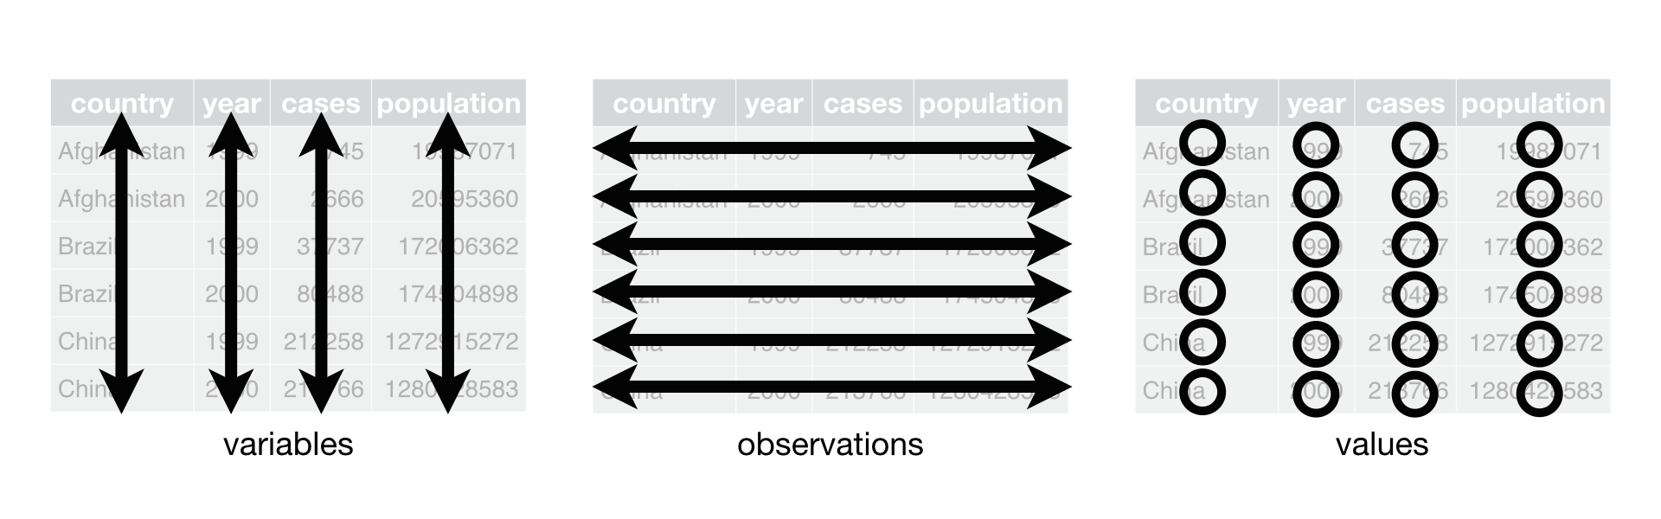
Focus is on tidy dataframes
Each variable forms a column.
Each observation forms a row.
Each type of observational unit forms a table.
Tidy data provides a consistent approach to data management that greatly facilitates downstream analysis and viz

Slide 6
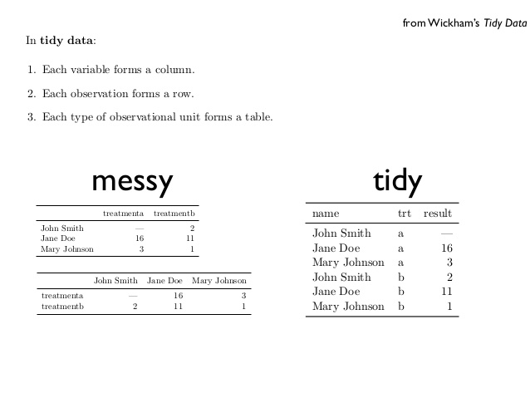
Messy vs tidy data
What are the variables in this data?
What are the observations in this data?

Slide 7
Exercise
How can we convert this table into a tidy data frame?
 | survived | died
drug | 15 | 3
placebo | 4 | 11
treatment | outcome | count
drug | survived | 15
placebo | survived | 4
drug | died | 3
placebo | died | 11
What are the variables?
Remember: categories of a categorical variable are not variables
What are the observations?

Slide 8
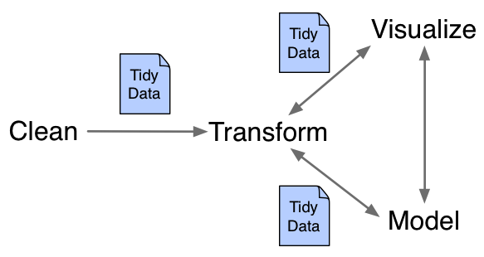
Working with tidy data
The package dplyr can manipulate and manage tidy data
The package tidyr can rearrange data to convert to/from tidy data
The package ggplot2 can plot tidy data

