Slide 1
Grabbag!
Stephanie J Spielman, Phd
Bio5312, fall 2017

Slide 2
Regular expressions
Pattern-based search and replace
Extremely powerful beyond all reason
Excellent for text (file) manipulation!

Slide 3
critical psa: text editors
Microsoft Word is not a text editor!!!!!!! I’m so serious!!!
GUI
TextEdit and Notepad
Textwrangler/BBEdit for Macs
Sublime 3 for everyone else
Newer, awesome one called Atom
CLI
Vim/vi, emacs, nano, pico (b/c puns)
https://en.wikipedia.org/wiki/Editor_war

Slide 4
Regular expressions
String: Mus musculus
Regex: Mus
Match: Mus musculus

Slide 5
Regular expressions
String: Mus musculus
Regex: Mus musculus
Match: Mus musculus

Slide 6
Regular expressions
String: Mus musculus
Regex: [mM]us
Match: Mus musculus

Slide 7
Regular expressions
String: Mus musculus
Regex: [A-Za-z]us
Match: Mus musculus

Slide 8
Regular expressions
String: Mus musculus
Regex: \wus
Match: Mus musculus

Slide 9
Regular expressions
String: Mus musculus
Regex: \w+
Match: Mus musculus

Slide 10
Regular expressions
String: Mus musculus
Regex: [A-Z]\w+ \w+
Match: Mus musculus

Slide 11
Regular expressions
String: Mus musculus
Regex: ([A-Z])\w+ (\w+)
Replace: \1. \2
New string: M. musculus

Slide 12
Regular expressions
String: 85.34 cm
Regex: \d+
Match: 85.34 cm

Slide 13
Regular expressions
String: 85.34 cm
Regex: \d+\.\d+
Match: 85.34 cm

Slide 14
Regular expressions
String: 85.34 cm
Regex: \d+\.\d+ \w+
Match: 85.34 cm

Slide 15
Regular expressions
String: 85 cm
Regex: \d+\.\d+ \w+
Match: 85 cm

Slide 16
Regular expressions
String: 85 cm
Regex: \d+\.*\d* \w+
Match: 85 cm

Slide 17
Regular expressions
String: 85 cm
Regex: ^\d
Match: 85 cm

Slide 18
Regular expressions
String: 85 cm
Regex: \w$
Match: 85 cm

Slide 19
Regular expressions
String: 85.341234 cm
Regex: (\d+\.\d{3})\d+ cm
Replace: \1
New string: 85.341

Slide 20
Regular expressions
String: 85.34 cm
Regex: (\d+\.\d{3})\d+ cm
Replace: \1
New string: ?????

Slide 21
Group Exercise
Come up with a regular expression to convert the following text:
85.34 cm 85.3 cm
85.678 cm 85.6 cm
923.1115 cm 923.1 cm
1.95 cm 1.9 cm
6 cm 6 cm

Slide 22
break

Slide 24
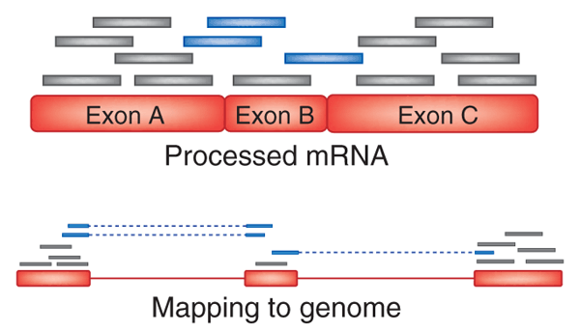
Use a splice-aware aligner
https://genomebiology.biomedcentral.com/articles/10.1186/s13059-016-0881-8

Slide 25
Aligners and pseudo-
THIS IS THE NEW TOPHAT2

