Slide 1
Nonparametric methods and tidyr
bio5312 Fall2017
stephanie j. spielman, PhD

Slide 2
General notes
Results means the literal results of the test
Value of the test statistic
P-value
Estimate, CI
Conclusions means our interpretation of those results
If P > alpha
Fail to reject Ho, no evidence in favor of Ha
If P <= alpha,
Reject Ho, found evidence in favor of Ha, make directional conclusion if possible

Slide 3
Our bag of tests
Numeric data: t-tests
One sample/paired
Two sample
Categorical data
One categorical variable with two levels: Binomial
One categorical variable with >two levels: Chi-squared goodness of fit
Two categorical variables: Contingency table
Chi-squared for large samples
Fisher's exact test for small samples

Slide 4
Nonparametric tests
Make no* assumptions about how your samples are distributed
Also known as distribution-free tests
Lower false positive rate than parametric methods when assumptions not met
Less powerful than parametric methods
Used primarily when sample sizes are small or non-normal (for a t-test)

Slide 5
Our new bag of tests
One sample or paired t-test
Sign test
Wilcoxon signed-rank test
Two sample t-test
Mann Whitney U-test (Wilcoxon rank sum test)

Slide 6
Many nonparametric tests are based on data ranks
X
10.8
13.5
9.1
11.5
15.7
4.3
8.4
Ranks
4
6
3
5
7
1
2

Slide 7
The sign test for single numeric samples
H₀: The median of a sample is equal to <null median>
H_{A}: The median of a sample is not equal to <null median>
Procedure:
Determine your null median
Assign each value in your sample as + or - if above or below median
Test whether there are same number of +, -

Slide 8
Example: Sign test
An environmental biologist measured the pH of rainwater on 7 different days in Washington state and wants to know if rainwater in the region can be considered acidic (< pH 5.2).
pH
4.73
5.28
5.06
5.16
5.25
5.11
4.79
Sign
-
+
-
-
+
-
-
5+
2-

Slide 9
The sign test is a binomial test with p=0.5
H₀: The median pH of WA rain is 5.2.
H_{A}: The median pH of WA rain is less then 5.2
> binom.test(2, 7, 0.5, alternative = "less")
Exact binomial test
data: 2 and 7
number of successes = 2, number of trials = 7, p-value = 0.4531
alternative hypothesis: true probability of success is not equal to 0.5
95 percent confidence interval:
0.03669257 0.70957914
sample estimates:
probability of success
0.2857143

Slide 10
Results and conclusions
Our test gave P=0.4531. This is greater than 0.05 so we fail to reject the null hypothesis. We have no evidence that rainwater in WA state is acidic.

Slide 11
Sign test in R
rain <- tibble(pH = c(4.73, 5.28, 5.06, 5.16, 5.25, 5.11, 4.79))
rain %>% mutate(sign = sign(5.2 - pH))
pH sign
<dbl> <dbl>
1 4.73 1
2 5.28 -1
3 5.06 1
4 5.16 1
5 5.25 -1
6 5.11 1
7 4.79 1
rain %>% mutate(sign = sign(5.2 - pH)) %>% group_by(sign) %>% tally()
sign n
<dbl> <int>
1 -1 2
2 1 5

Slide 12
See one, do one

Slide 13
Wilcoxon signed-rank test
Updated version of sign test that also considers magnitude
pH | Sign
4.73 | -
5.28 | +
5.06 | -
5.16 | -
5.25 | +
5.11 | -
4.79 | -

Slide 14
Adding ranks to the procedure
H₀: The median pH of WA rain is 5.2.
H_{A}: The median pH of WA rain is not then 5.2
pH | Sign
4.73 | -1
5.28 | 1
5.06 | -1
5.16 | -1
5.25 | 1
5.11 | -1
4.79 | -1
|x – null|
0.47
0.08
0.14
0.04
0.05
0.09
0.41
rank
7
3
5
1
2
4
6
Notes:
df$Difference <- d df <- df %>% mutate(rank=rank(abs(Difference))) %>% mutate(sign=sign(Difference)) %>% arrange(rank) df

Slide 15
Compute the test statistic W (R)
W = min(sum negative sign ranks, sum positive sign ranks)
Negative sign ranks:
7+5+1+4+6 = 23
Positive sign ranks:
3+2 = 5
Sign | rank
-1 | 7
1 | 3
-1 | 5
-1 | 1
1 | 2
-1 | 4
-1 | 6
### Two sided P-value ###
### psignrank(w, n) ###
> 2*psignrank(5,7)
[1] 0.15625

Slide 16
Wilcoxon signed-rank, the long way
> rain %>% mutate(sign = sign(5.2 - pH), rank = rank(abs(5.2 - pH)))
pH sign rank
<dbl> <dbl> <dbl>
1 4.73 1 7
2 5.28 -1 3
3 5.06 1 5
4 5.16 1 1
5 5.25 -1 2
6 5.11 1 4
7 4.79 1 6
> rain %>% mutate(sign = sign(5.2 - pH), rank = rank(abs(5.2 - pH))) %>% group_by(sign) %>% summarize(sum(rank))
sign `sum(rank)`
<dbl> <dbl>
1 -1 5
2 1 23
> psignrank(5, nrow(rain))
[1] 0.078125

Slide 17
Wilcoxon signed-rank, the obvious way
> rain <- tibble(pH = c(4.73, 5.28, 5.06, 5.16, 5.25, 5.11, 4.79))
> wilcox.test(rain$pH, mu = 5.2)
Wilcoxon signed rank test
data: rain$pH
V = 5, p-value = 0.1563
alternative hypothesis: true location is not equal to 5.2
Notes:
rain <- tibble(pH = c(4.73, 5.28, 5.06, 5.16, 5.25, 5.11, 4.79))

Slide 18
Wilcoxon signed-rank is not foolproof
Although nonparametric, assumes population are symmetric around the median (no skew)
This is hard to meet, so recommendation is to use the sign test.

Slide 19
See one, do one

Slide 20
Mann-Whitney U test (aka Wilcoxon rank sum)
Nonparametric test to compare two numeric samples
Assumes samples have the same shape and detects a shift between distributions.
H₀: Sample 1 and sample 2 have the same underlying distribution location.
H_{A}: Sample 1 and sample 2 have different (>/<) underlying distribution location.

Slide 21
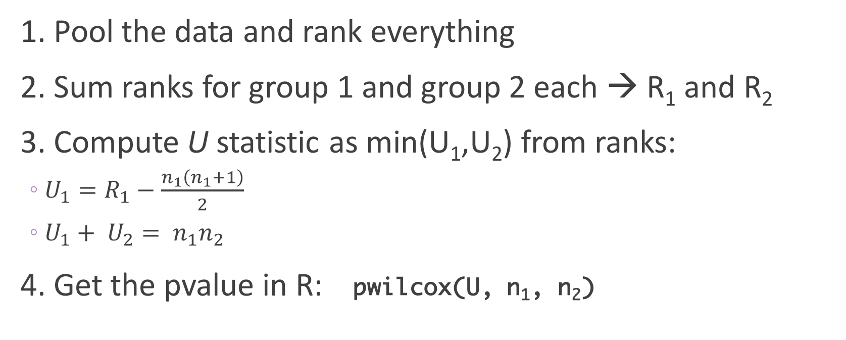
The tedious steps to MW-U test
1. Pool the data and rank everything
2. Sum ranks for group 1 and group 2 each → R₁ and R₂
3. Compute U statistic as min(U₁,U₂) from ranks:
$U_{1}=R_{1}−\frac{n_{1}\left(n_{1}+1\right)}{2}$
$U_{1}+ U_{2}= n_{1}n_{2}$
4. Get the pvalue in R: pwilcox(U, n₁, n₂)

Slide 22
Minimal example
Sample 1: 8, 15, 17
Sample 2: 22, 10, 16, 28
R1 = 1+3+5 = 9
R2 = 2+4+6+7 = 19
8 | 1
10 | 2
15 | 3
16 | 4
17 | 5
22 | 6
28 | 7
U₁ = R₁ – [n₁(n₁+1)/2]
= 9 – [3(4)/2] = 3
U₂ = n₁n₂ – U₁
= 3*4 - 3 = 9
### One tailed P ###
> pwilcox(3, 3, 4)
[1] 0.2

Slide 23
Minimal example… in R
> wilcox.test(c(8, 15, 17), c(22, 10, 16, 28))
Wilcoxon rank sum test
data: c(8, 15, 17) and c(22, 10, 16, 28)
W = 3, p-value = 0.4
alternative hypothesis: true location shift is not equal to 0

Slide 24
Major caveat: ties in data
Test assumes all data is ordinal
8 | 1
10 | 2
15 | 3
16 | 4
17 | 5.5
17 | 5.5
22 | 7
Sample 1: 8, 15, 17
Sample 2: 22, 10, 16, 17
Assign all values in tie the average rank

Slide 25
Example in R, with ties
> wilcox.test(c(8, 15, 17), c(22, 10, 16, 17))
Wilcoxon rank sum test with continuity correction
data: c(8, 15, 17) and c(22, 10, 16, 17)
W = 3.5, p-value = 0.4755
alternative hypothesis: true location shift is not equal to 0
Warning message:
In wilcox.test.default(c(8, 15, 17), c(22, 10, 16, 17)) :
cannot compute exact p-value with ties

Slide 26
See one, do one

Slide 27
What is a dataset?
A collection of values
Each value belongs to a variable and an observation
Variables contain all values that measure the same underlying attribute ("thing")
Observations contain all values measured on the same unit across attributes.
Hadley Wickham
https://cran.r-project.org/web/packages/tidyr/vignettes/tidy-data.html

Slide 28
The iris dataset (what else?)
Variable
Sepal.Length Sepal.Width Petal.Length Petal.Width Species
1 5.1 3.5 1.4 0.2 setosa
2 4.9 3.0 1.4 0.2 setosa
3 4.7 3.2 1.3 0.2 setosa
4 4.6 3.1 1.5 0.2 setosa
5 5.0 3.6 1.4 0.2 setosa
6 5.4 3.9 1.7 0.4 setosa
Observation
Value

Slide 29
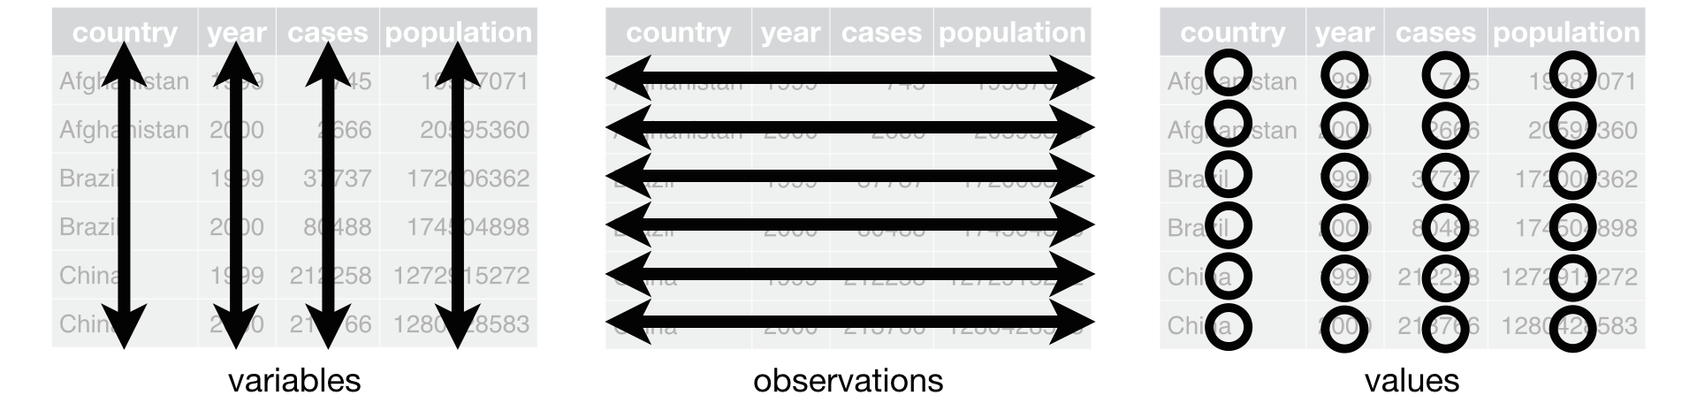
This is a tidy dataset
Each variable forms a column.
Each observation forms a row.
Each type of observational unit forms a table.
Tidy data provides a consistent approach to data management that greatly facilitates downstream analysis and viz

Slide 30
Messy vs tidy data
What are the variables in this data?
What are the observations in this data?

Slide 31
Do it yourself: Convert to tidy data
treatment | outcome | count
drug | survived | 15
placebo | survived | 4
drug | died | 3
placebo | died | 11
 | survived | died
drug | 15 | 3
placebo | 4 | 11

Slide 32
The fundamental verbs of tidyr
gather() | Gather multiple columns into key:value pairs
spread() | Spread key:value pairs over multiple columns
separate() | Separate columns
unite() | Join columns

Slide 33
gather() makes wide tables narrow
data
tree treat t_152 t_174 t_201 t_227 t_258
1 ozone 4.51 4.98 5.41 5.90 6.15
2 ozone 4.24 4.20 4.68 4.92 4.96
3 ozone 3.98 4.36 4.79 4.99 5.03
tree treat time measure
1 ozone t_152 4.51
1 ozone t_174 4.98
1 ozone t_201 5.41
1 ozone t_227 5.90
1 ozone t_258 6.15
...
data %>% gather(time, measure, t_152:t_258)
KEY
VALUE

Slide 34
spread() makes narrow tables wide
tree treat time measure
1 ozone t_152 4.51
1 ozone t_174 4.98
1 ozone t_201 5.41
1 ozone t_227 5.90
1 ozone t_258 6.15
...
data
tree treat t_152 t_174 t_201 t_227 t_258
1 ozone 4.51 4.98 5.41 5.90 6.15
2 ozone 4.24 4.20 4.68 4.92 4.96
3 ozone 3.98 4.36 4.79 4.99 5.03
data %>% spread(time, measure)

Slide 35
separate() separates columns
tree treat time measure
1 ozone t_152 4.51
1 ozone t_174 4.98
1 ozone t_201 5.41
1 ozone t_227 5.90
1 ozone t_258 6.15
...
tree treat t seconds measure
1 ozone t 152 4.51
1 ozone t 174 4.98
1 ozone t 201 5.41
1 ozone t 227 5.90
1 ozone t 258 6.15
...
data %>% separate(time, into=c("t", "seconds"), sep = "_")

Slide 36
unite() unites columns
tree treat t seconds measure
1 ozone t 152 4.51
1 ozone t 174 4.98
1 ozone t 201 5.41
1 ozone t 227 5.90
1 ozone t 258 6.15
...
tree treat time measure
1 ozone t_152 4.51
1 ozone t_174 4.98
1 ozone t_201 5.41
1 ozone t_227 5.90
1 ozone t_258 6.15
...
data %>% unite(time, t, seconds)

Slide 37
unite() unites columns
tree treat t seconds measure
1 ozone t 152 4.51
1 ozone t 174 4.98
1 ozone t 201 5.41
1 ozone t 227 5.90
1 ozone t 258 6.15
...
tree treat time measure
1 ozone t152 4.51
1 ozone t174 4.98
1 ozone t201 5.41
1 ozone t227 5.90
1 ozone t258 6.15
...
data %>% unite(time, t, seconds, sep = "" )

