Slide 1
Linear modeling II
Stephanie J. spielman, phd
bio5312, Fall 2017

Slide 2
General linear models
Single numeric predictor: Regression
Single categorical predictor: ANOVA
Multiple numeric predictors: multiple regression
Multiple categorical predictors: n-way ANOVA
Single categorical and n numeric predictors: ANCOVA
Multiple categorical and n numeric predictors: linear model
lm(Numeric response ~ <predictors>)
How does each predictor affect the response?
Goal is to model the response (predict outcomes) with a set of explanatory variables

Slide 3
General linear models

Slide 4
Linear models with multiple predictors
Additive models consider the independent effect of each predictor on the response
Interaction models consider how the interaction between predictors effects the response
lm(Numeric response ~ predictor1 + predictor2, data = data)
lm(Numeric response ~ predictor1 * predictor2, data = data)
lm(numeric response ~ predictor1 + predictor2 + predictor1*predictor2, data=data)

Slide 5
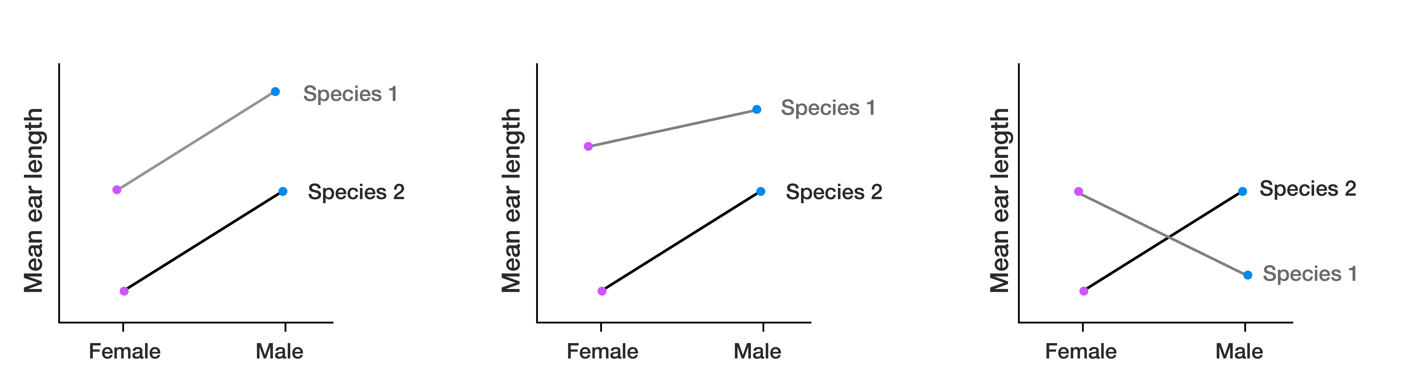
Interaction plots
Visualize the interaction between two categorical predictors
How do species and sex influence ear length in rabbits?
Does ear length differ between different rabbit species, controlling for sex?
Does ear length differ between different rabbit sexes, controlling for species?
Independent
Interaction
Interaction
Effect of sex in sp1
Effect of species??
Effect of species??
Effect of sex
Effect of sex in sp2

Slide 6
Two-way ANOVA = linear model with two categorical predictors
How do herbivores and intertidal zone affect the abundance of algae living in an intertidal habitat?
With and without herbivore predation
Low-tide vs mid-tide zone
Measured surface area of algae after treatment
> head(algae)
tide herbivores area
1 low no 9.405573
2 low no 34.467736
3 low no 46.673485
4 low no 16.642139
5 low no 24.377498
6 low no 38.350604

Slide 7
Visualize the data distributions
> ggplot(algae, aes(x = tide, y = area, fill = herbivores)) + geom_boxplot()

Slide 8
Visualize the data as interaction plot
> algae %>%
group_by(tide, herbivores) %>%
summarize(mean.area = mean(area)) -> algae.int
> algae.int
tide herbivores mean.area
<fctr> <fctr> <dbl>
1 low no 32.91450
2 low yes 10.40376
3 mid no 22.48360
4 mid yes 25.55094

Slide 9
Visualize the data as interaction plot
> ggplot(algae.int, aes(x=tide,
y=mean.area,
group=herbivores,
color=herbivores)) + geom_point() + geom_line()

Slide 10
Visualize the data as interaction plot, 2
> ggplot(algae.int, aes(x=herbivores,
y=mean.area,
group=tide,
color=tide)) + geom_point() + geom_line()

Slide 11
Fit the model
> model.additive <- lm(area ~ herbivores + tide, data = algae)
> model.interaction <- lm(area ~ herbivores * tide, data = algae)
> tidy(summary(model.additive))
term estimate std.error statistic p.value
1 (Intercept) 26.519979 3.602368 7.3618178 5.526594e-10
2 herbivoresyes -9.721701 4.159657 -2.3371402 2.273087e-02
3 tidemid 2.358142 4.159657 0.5669078 5.728570e-01
> tidy(summary(model.interaction))
term estimate std.error statistic p.value
1 (Intercept) 32.91450 3.855532 8.536955 5.979662e-12
2 herbivoresyes -22.51075 5.452546 -4.128484 1.145511e-04
3 tidemid -10.43090 5.452546 -1.913034 6.051935e-02
4 herbivoresyes:tidemid 25.57809 7.711064 3.317064 1.548555e-03
Interaction model preferred

Slide 12
Examine the model in full
> summary(model.interaction)
Coefficients:
Estimate Std. Error t value Pr(>|t|)
(Intercept) 32.915 3.856 8.537 5.98e-12 ***
herbivoresyes -22.511 5.453 -4.128 0.000115 ***
tidemid -10.431 5.453 -1.913 0.060519 .
herbivoresyes:tidemid 25.578 7.711 3.317 0.001549 **
---
Signif. codes: 0 ‘***’ 0.001 ‘**’ 0.01 ‘*’ 0.05 ‘.’ 0.1 ‘ ’ 1
Residual standard error: 15.42 on 60 degrees of freedom
Multiple R-squared: 0.2281, Adjusted R-squared: 0.1896
F-statistic: 5.912 on 3 and 60 DF, p-value: 0.001329

Slide 13
Examine the model in full
> summary(model.interaction)
Coefficients:
Estimate Std. Error t value Pr(>|t|)
(Intercept) 32.915 3.856 8.537 5.98e-12 ***
herbivoresyes -22.511 5.453 -4.128 0.000115 ***
tidemid -10.431 5.453 -1.913 0.060519 .
herbivoresyes:tidemid 25.578 7.711 3.317 0.001549 **
---
Signif. codes: 0 ‘***’ 0.001 ‘**’ 0.01 ‘*’ 0.05 ‘.’ 0.1 ‘ ’ 1
Residual standard error: 15.42 on 60 degrees of freedom
Multiple R-squared: 0.2281, Adjusted R-squared: 0.1896
F-statistic: 5.912 on 3 and 60 DF, p-value: 0.001329
Ignore additive effects when interaction is sig.

Slide 14
Examine the ANOVA table (if you want)
> anova(model.interaction)
Analysis of Variance Table
Response: area
Df Sum Sq Mean Sq F value Pr(>F)
herbivores 1 1512.2 1512.18 6.3579 0.014360 *
tide 1 89.0 88.97 0.3741 0.543096
herbivores:tide 1 2617.0 2616.96 11.0029 0.001549 **
Residuals 60 14270.5 237.84
---
Signif. codes: 0 ‘***’ 0.001 ‘**’ 0.01 ‘*’ 0.05 ‘.’ 0.1 ‘ ’ 1

Slide 15
Results and conclusions
We find a significant interaction effect between tidal zone and herbivore presence on algae growth area. On average, herbivores marginally increase algae growth in mid-tide, and herbivores greatly decrease algae growth in mid-tide.
Our model has a significant R²=0.189, meaning that tidal zone and herbivore presence explain ~18.9% of the variation seen in algae growth area.
IS THIS A GOOD MODEL?

Slide 16
Interpreting additive effects
> model.additive <- lm(area ~ herbivores + tide, data = algae)
> model.interaction <- lm(area ~ herbivores * tide, data = algae)
## Alternatively: lm(area ~ herbivores + tide + herbivores:tide, data = algae)
> tidy(summary(model.additive))
term estimate std.error statistic p.value
1 (Intercept) 26.519979 3.602368 7.3618178 5.526594e-10
2 herbivoresyes -9.721701 4.159657 -2.3371402 2.273087e-02
3 tidemid 2.358142 4.159657 0.5669078 5.728570e-01
> tidy(summary(model.interaction))
term estimate std.error statistic p.value
1 (Intercept) 32.91450 3.855532 8.536955 5.979662e-12
2 herbivoresyes -22.51075 5.452546 -4.128484 1.145511e-04
3 tidemid -10.43090 5.452546 -1.913034 6.051935e-02
4 herbivoresyes:tidemid 25.57809 7.711064 3.317064 1.548555e-01
NS, prefer the additive model

Slide 17
Interpreting additive effects
> summary(model.additive)
Coefficients:
Estimate Std. Error t value Pr(>|t|)
(Intercept) 26.520 3.602 7.362 5.53e-10 ***
herbivoresyes -9.722 4.160 -2.337 0.0227 *
tidemid 2.358 4.160 0.567 0.5729
Residual standard error: 16.64 on 61 degrees of freedom
Multiple R-squared: 0.0866, Adjusted R-squared: 0.05665
F-statistic: 2.892 on 2 and 61 DF, p-value: 0.06311
The mean growth area is 26.52 under low-tide, no-herbivore conditions
Herbivores decrease algae growth by a factor of 9.722, compared to no herbivores.
Mid-tide increases algae growth by a factor of 2.358, compared to low-tide.

Slide 18
Results and conclusions
We find that herbivore presence significantly influences algae growth area. Herbivores decrease algae growth, on average, by a factor of 9.722, compared to no herbivores. Low vs. mid tide does not have a significant effect on algae growth. We did not detect an interaction effect between tide and herbivores.
Our model has a significant R²=0.05665, meaning that tidal zone and herbivore presence explain ~5.7% of the variation seen in algae growth area.

Slide 19
Reduce noise by removing NS predictors
> model <- lm(area ~ herbivores, data = algae)
> summary(model)
Coefficients:
Estimate Std. Error t value Pr(>|t|)
(Intercept) 27.699 2.925 9.469 1.18e-13 ***
herbivoresyes -9.722 4.137 -2.350 0.022 *
---
Signif. codes: 0 ‘***’ 0.001 ‘**’ 0.01 ‘*’ 0.05 ‘.’ 0.1 ‘ ’ 1
Residual standard error: 16.55 on 62 degrees of freedom
Multiple R-squared: 0.08179, Adjusted R-squared: 0.06698
F-statistic: 5.523 on 1 and 62 DF, p-value: 0.02197
Multiple R-squared: 0.0866, Adjusted R-squared: 0.05665

Slide 20
The R² output
R² will always increase with more predictors
It will fit noise if no signal
When fitting a single model, consider this quantity
Multiple R² accounts for presence of fitted noise
When fitting multiple models and selecting a model based on R², consider this quantity

Slide 21
Exercise break

Slide 22
Multiple numeric predictors
> head(trees)
Girth Height Volume
1 8.3 70 10.3
2 8.6 65 10.3
3 8.8 63 10.2
4 10.5 72 16.4
5 10.7 81 18.8
6 10.8 83 19.7
> nrow(trees)
[1] 31

Slide 23
Visualize the data
> ggplot(trees, aes(x = Height, y = Volume, color = Girth)) + geom_point()

Slide 24
Interpreting multiple numeric predictors
> model <- lm(Volume ~ Girth + Height, data = trees)
> tidy(summary(model))
term estimate std.error statistic p.value
1 (Intercept) -57.9876589 8.6382259 -6.712913 2.749507e-07
2 Girth 4.7081605 0.2642646 17.816084 8.223304e-17
3 Height 0.3392512 0.1301512 2.606594 1.449097e-02
A tree with girth and height of 0 will yield a timber volume of -57.99, on average.
For every unit increase in tree girth, timber volume increases by 4.708, on average.
For every unit increase in tree height, timber volume increases by 0.34, on average.

Slide 25
Interpreting multiple numeric predictors
> model <- lm(Volume ~ Girth + Height, data = trees)
> glance(summary(model))
r.squared adj.r.squared sigma statistic p.value df
1 0.94795 0.9442322 3.881832 254.9723 1.071238e-18 3
R² = 0.95, meaning that 95% of the variation in cherry tree timber volume can be explained by tree girth and height.

Slide 26
Interaction effect interpretation
> tidy(lm(Volume ~ Girth * Height, data = trees))
term estimate std.error statistic p.value
1 (Intercept) 69.3963156 23.83575455 2.911438 7.130666e-03
2 Girth -5.8558479 1.92133589 -3.047800 5.108696e-03
3 Height -1.2970834 0.30984288 -4.186262 2.699338e-04
4 Girth:Height 0.1346544 0.02437731 5.523759 7.484103e-06
There is a significant interaction effect between girth and height for modeling volume of cherry tree timber.

Slide 27
Interaction effect interpretation
> glance(lm(Volume ~ Girth * Height, data = trees))
r.squared adj.r.squared sigma statistic p.value df logLik AIC
1 0.9755642 0.9728491 2.70855 359.3122 7.290458e-22 4 -72.73458 155.4692
BIC deviance df.residual
1 162.6391 198.0786 27
Our R² = 0.97, meaning that 97% of the variation in timber volume can be explained by tree girth and height.
Always prefer the interaction model, if effect is significant.

Slide 28
ANCOVA
Mole rats have distinct social castes, where in a given colony only the single queen and a few males reproduce. The remaining males are workers. Researchers suspect that there may be also worker castes, with "frequent" and "infrequent" workers. They measured body mass and daily energy expenditure between the two groups of candidate castes.
Is energy expenditure different between castes,
controlling for body weight?

Slide 29
Visualize the data
> head(mole)
caste lnmass lnenergy
1 worker 3.850148 3.688879
2 worker 3.988984 3.688879
3 worker 4.110874 3.688879
4 worker 4.174387 3.663562
5 worker 4.248495 3.871201
6 worker 4.262680 3.850148
> ggplot(mole, aes(x = lnmass, y = lnenergy,
color = caste)) + geom_point()

Slide 30
Visualize the data, 2
> ggplot(mole, aes(x = lnmass, y = lnenergy, color = caste)) + geom_point() +
geom_smooth(method = "lm", aes(group = caste))

Slide 31
Fit the model, first with interaction effect
> model <- lm(lnenergy ~ lnmass * caste, data = mole)
> tidy(summary(model))
term estimate std.error statistic p.value
1 (Intercept) 1.2939446 1.6691352 0.7752186 0.44408413
2 lnmass 0.6068898 0.3427563 1.7706163 0.08645869
3 casteworker -1.5712513 1.9518215 -0.8050179 0.42694079
4 lnmass:casteworker 0.4186224 0.4147347 1.0093740 0.32060937

Slide 32
Fit the additive model
> model <- lm(lnenergy ~ lnmass + caste, data = mole)
> tidy(summary(model))
term estimate std.error statistic p.value
1 (Intercept) -0.09686842 0.9423033 -0.1027996 9.187635e-01
2 lnmass 0.89281513 0.1930335 4.6251819 5.886779e-05
3 casteworker 0.39334235 0.1461059 2.6921734 1.119835e-02
> glance(summary(model))
r.squared adj.r.squared sigma statistic p.value df
1 0.4090389 0.3721038 0.2965689 11.07454 0.0002212804 3

Slide 33
Multiple regression

Slide 34
Exercise break

Slide 35
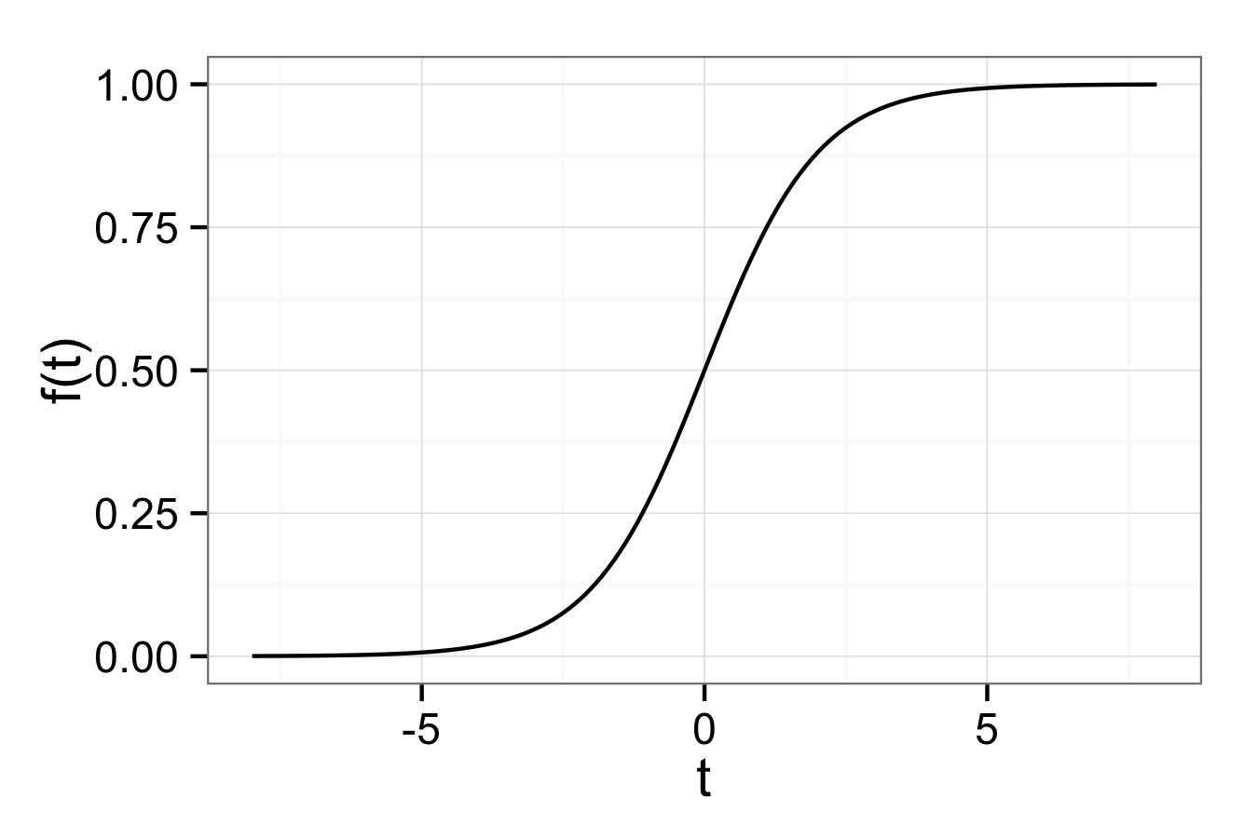
Logistic regression
Model a binary response instead of a numeric response
Pr(success) > 0.5
Pr(success) < 0.5

Slide 36
Logistic regression with biopsy data
> head(biopsy)
clump_thickness uniform_cell_size uniform_cell_shape marg_adhesion
1 5 1 1 1
2 5 4 4 5
3 3 1 1 1
4 6 8 8 1
5 4 1 1 3
6 8 10 10 8
epithelial_cell_size bare_nuclei bland_chromatin normal_nucleoli mitoses
1 2 1 3 1 1
2 7 10 3 2 1
3 2 2 3 1 1
4 3 4 3 7 1
5 2 1 3 1 1
6 7 10 9 7 1
outcome
1 benign
2 benign
3 benign
4 benign
5 benign
6 malignant

Slide 37
Running a logistic regression
glm(binary response ~ <predictors>)
> model <- glm(outcome ~ clump_thickness +
uniform_cell_size +
uniform_cell_shape +
marg_adhesion +
epithelial_cell_size +
bare_nuclei +
bland_chromatin +
normal_nucleoli +
mitoses,
data=biopsy,
family=binomial)

Slide 38
Logistic regression output
> tidy(model)
term estimate std.error statistic p.value
1 (Intercept) -10.103942243 1.17487744 -8.59999681 7.971831e-18
2 clump_thickness 0.535014068 0.14201743 3.76724220 1.650608e-04
3 uniform_cell_size -0.006279717 0.20907739 -0.03003537 9.760388e-01
4 uniform_cell_shape 0.322706496 0.23060065 1.39941710 1.616879e-01
5 marg_adhesion 0.330636915 0.12345089 2.67828703 7.399977e-03
6 epithelial_cell_size 0.096635417 0.15659236 0.61711452 5.371592e-01
7 bare_nuclei 0.383024572 0.09384327 4.08153469 4.473930e-05
8 bland_chromatin 0.447187920 0.17138238 2.60929928 9.072785e-03
9 normal_nucleoli 0.213030682 0.11287348 1.88734050 5.911454e-02
10 mitoses 0.534835631 0.32877389 1.62675821 1.037885e-01
> glance(model)
null.deviance df.null logLik AIC BIC deviance df.residual
1 884.3502 682 -51.4441 122.8882 168.1531 102.8882 673

Slide 39
Logistic regression output
> augment(model) %>% head()
outcome clump_thickness uniform_cell_size uniform_cell_shape marg_adhesion
1 benign 5 1 1 1
2 benign 5 4 4 5
3 benign 3 1 1 1
4 benign 6 8 8 1
5 benign 4 1 1 3
6 malignant 8 10 10 8
epithelial_cell_size bare_nuclei bland_chromatin normal_nucleoli mitoses
1 2 1 3 1 1
2 7 10 3 2 1
3 2 2 3 1 1
4 3 4 3 7 1
5 2 1 3 1 1
6 7 10 9 7 1
.fitted .se.fit .resid .hat .sigma .cooksd
1 -4.116083 0.5224590 -0.179870630 4.309916e-03 0.3912276 7.089710e-06
2 2.299174 0.8263439 -2.188513162 5.659129e-02 0.3815135 6.336778e-02
3 -4.803086 0.5600651 -0.127835158 2.531851e-03 0.3912583 2.087787e-06
4 1.157812 0.9845930 -1.691756164 1.763504e-01 0.3846252 8.274139e-02
5 -3.989823 0.5113911 -0.191488338 4.664777e-03 0.3912194 8.712324e-06
6 10.542969 1.2699804 0.007263326 4.254456e-05 0.3912893 1.122349e-10
.std.resid
1 -0.180259501
2 -2.253197298
3 -0.127997295
4 -1.864088462
5 -0.191936532
6 0.007263481

Slide 40
Logistic regression output
> head( model$fitted.values )
1 2 3 4 5 6
0.016046581 0.908808622 0.008137623 0.760934919 0.018166848 0.999973622
> head( model$linear.predictors )
1 2 3 4 5 6
-4.116083 2.299174 -4.803086 1.157812 -3.989823 10.542969

Slide 41
Visualize the logistic regression
> model.fit <- tibble(x = model$linear.predictors,
y = model$fitted.values,
outcome = biopsy$outcome)
> ggplot(model.fit, aes(x = x, y = y)) + geom_line()

Slide 42
Visualize the logistic regression with a rug
> ggplot(model.fit, aes(x = x, y = y)) + geom_line() + geom_rug(sides = "tr")

Slide 43
Logistic regression clearly separated the groups
> ggplot(model.fit, aes(x = x, y = y, color = outcome)) +
geom_line(color = "black") +
geom_point() +
geom_rug(sides = "t")

Slide 44
Using the logistic regression
> new.patient <- tibble(clump_thickness = 4,
uniform_cell_size = 2,
uniform_cell_shape = 7,
marg_adhesion = 3,
epithelial_cell_size = 8,
bare_nuclei = 1,
bland_chromatin =5,
normal_nucleoli = 2,
mitoses = 0)
> predict(model, new.patient)
1
-0.9074803
> predict(model, new.patient, type = "response")
1
0.2875157
Our logistic model gives a 28.7% probability that the new patient has a malignancy.

Slide 45
Next week we will evaluate models
How do we choose the best predictors, i.e. select the best model?
How can we evaluate model performance?
What procedures can we use to build models as robustly as possible?

