Slide 1
Recognising the English Language using Context Free Grammar with PyFormlang
Submitted by: GM Mohaiminuzzaman Apurbo
ID: 20301100
Submitted to: Annajiat Alim Rasel
RA: Farah & Sabbir
Individual Task 2
Group-40

Slide 2
Table of Contents
Introduction
Motivation
Contribution
Methodology
Result
Limitations
Future Work
Conclusion

Slide 3
01
Introduction

Slide 4
Introduction
Natural Language Processing (NLP) is a research field that combines linguistics, computer science, artificial intelligence, and machine learning to enable computers to understand human languages.
Automata theory and Context-Free Grammar (CFG) are used for this purpose. CFG is a powerful and computationally tractable formalism for expressing the structure and relations of a natural language.
The paper presents a custom English CFG for language recognition. The CFG is defined with parts-of-speech (POS) tags as constituents, and it has proven to be effective in recognizing syntactically accurate English sentences with an accuracy of 84.90%

Slide 5
02
Motivation

Slide 6
Motivation
NLP is important for machines to understand complex human languages.
Pre-processing and parsing statements are the first steps in NLP.
Automata theory and CFG are useful for checking if a statement is a legitimate sentence.
Pyformlang library provides a convenient way to implement CFG for English language recognition.
The paper aims to demonstrate the usage of Pyformlang and provide a set of rules for lexical parsing of the English language .

Slide 7
03
Contribution

Slide 8
Contribution
The paper demonstrates the usage of the Pyformlang library for English language recognition using context-free grammar (CFG). It provides a practical application for beginners to understand parsing sentences using formal language concepts. [2]
The paper lays out a detailed set of rules for lexical parsing of the English language, ensuring reusability of the process followed. [1a]
The paper presents a custom English CFG with parts-of-speech (POS) tags as constituents, which is implemented using the Pyformlang library. The CFG is defined with a start symbol, terminals, and non-terminals, and it has an accuracy of 84.90%
The paper highlights the advantages of the Pyformlang library over other libraries for text parsing. Pyformlang provides functions for working with regular expressions, indexed grammars, and finite state automata.
The paper contributes to the field of natural language processing (NLP) by emphasizing the importance of pre-processing and parsing statements to check for legitimate sentences.

Slide 9
04
Methodology

Slide 10
Methodology
Introduction to Pyformlang
Defining the CFG
Pre-processing and Parsing
Rule-based Parsing
Evaluation and Results

Slide 11
05
Results

Slide 12
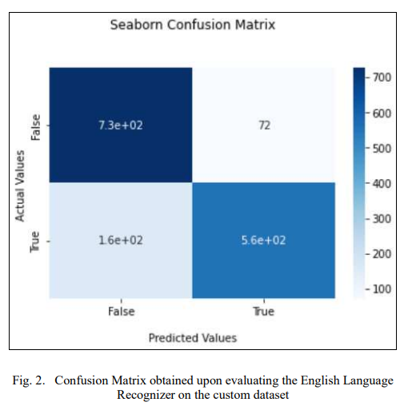
Results
A custom CFG for the English language is presented, with parts-of-speech (POS) tags as constituents
The accuracy of the English language recognizer implemented using the provided CFG and Pyformlang is 84.90%
The advantages of using Pyformlang library over other libraries for text parsing are highlighted, and its features and functionalities are discussed
The document also provides a set of rules for lexical parsing of the English language, ensuring reusability of the process.

Slide 13
06
Limitations

Slide 14
Limitations
Complexity of CFG: Context-free grammars can become quite complex, especially for languages with highly ambiguous and nuanced syntactic structures like English. Creating an accurate and comprehensive CFG for English requires careful consideration of all possible sentence structures, which can be time-consuming and prone to human error.
Lack of semantic analysis: While CFG and Pyformlang are effective in syntactic parsing and checking the grammatical correctness of sentences, they do not consider the semantic meaning of the sentences.

Slide 15
07
Future Works

Slide 16
Future Works
Improving the accuracy of the English language recognizer
Extending the CFG for more complex sentences
Incorporating semantic analysis

Slide 17
08
Conclusion

Slide 18
Conclusion
The conclusion of the paper states that the English language recognizer, implemented using the Pyformlang library and a custom Context-Free Grammar (CFG), has achieved an accuracy of 84.90% for parsing English sentences. The metrics used to evaluate the recognizer, such as accuracy score, precision score, recall score, and f1_score, demonstrate the effectiveness of the CFG in recognizing syntactically accurate sentences. The paper also mentions the potential applications of Pyformlang in various fields of computer science and highlights the advantages of using CFGs for language recognition.

Slide 19
Thank you for Watching

