Slide 1

Java™ Software Solutions: Foundations of Program Design
Ninth Edition
Chapter 6
More Conditionals and Loops
Copyright © 2018 Pearson Education, Inc. All Rights Reserved
Notes:
If this PowerPoint presentation contains mathematical equations, you may need to check that your computer has the following installed:
1) MathType Plugin
2) Math Player (free versions available)
3) NVDA Reader (free versions available)

Slide 2
More Conditionals and Loops
Now we can fill in some additional details regarding Java conditional and repetition statements
Chapter 6 focuses on:
  the switch statement
  the conditional operator
  the do loop
  the for loop
  using conditionals and loops with graphics
  graphic transformations

Slide 3
Outline (1 of 6)
The switch Statement
The Conditional Operator
The do Statement
The for Statement
Using Loops and Conditionals with Graphics
Graphic Transformations

Slide 4
The Switch Statement (1 of 6)
The switch statement provides another way to decide which statement to execute next
The switch statement evaluates an expression, then attempts to match the result to one of several possible cases
Each case contains a value and a list of statements
The flow of control transfers to statement associated with the first case value that matches

Slide 5
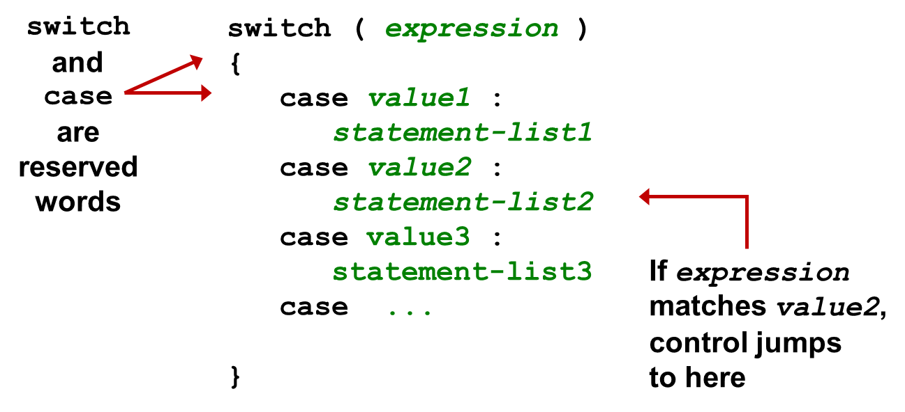
The Switch Statement (2 of 6)
The general syntax of a switch statement is:

Slide 6
The Switch Statement (3 of 6)
Often a break statement is used as the last statement in each case’s statement list
A break statement causes control to transfer to the end of the switch statement
If a break statement is not used, the flow of control will continue into the next case
Sometimes this may be appropriate, but often we want to execute only the statements associated with one case

Slide 7
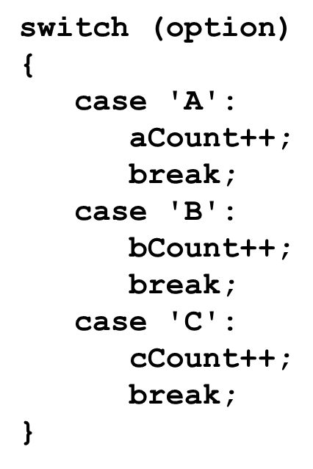
The Switch Statement (4 of 6)
An example of a switch statement:

Slide 8
The Switch Statement (5 of 6)
A switch statement can have an optional default case
The default case has no associated value and simply uses the reserved word default
If the default case is present, control will transfer to it if no other case value matches
If there is no default case, and no other value matches, control falls through to the statement after the switch

Slide 9
The Switch Statement (6 of 6)
The type of a switch expression can be integers, characters, enumerated types, or String objects
You cannot use a switch with floating point values
The implicit boolean condition in a switch statement is equality
You cannot perform relational checks with a switch statement
See GradeReport.java

Slide 10
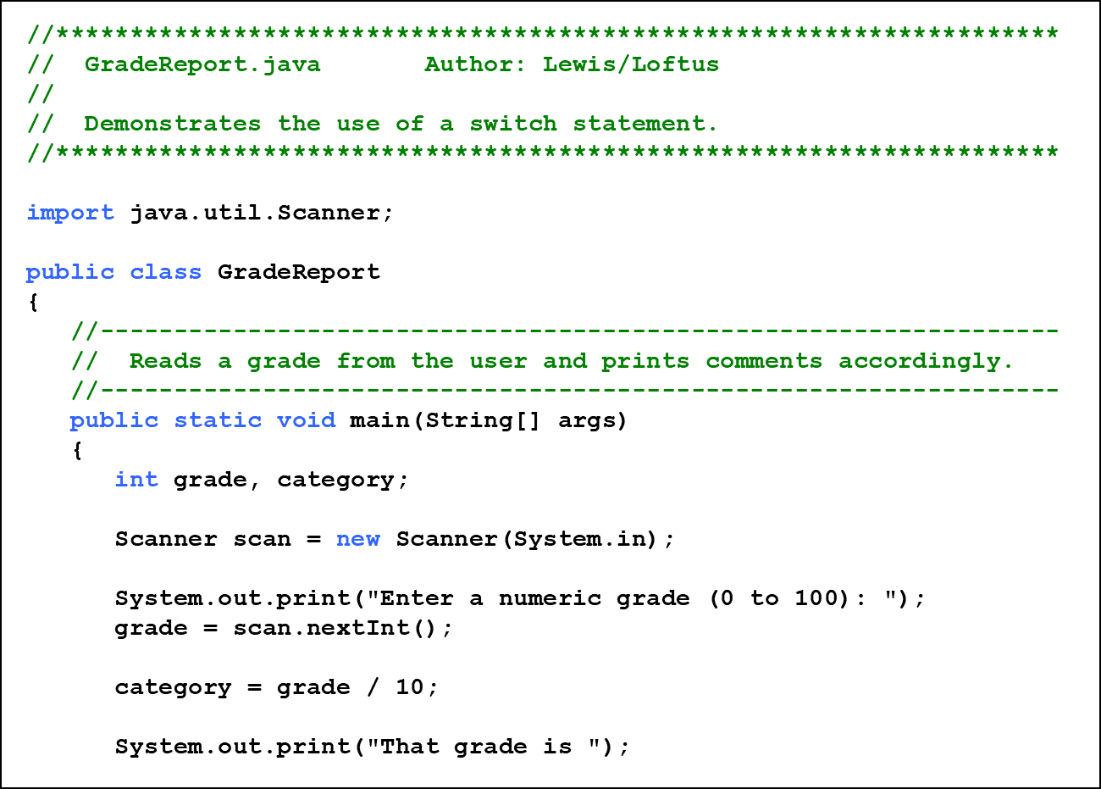
Listing 6.1 (1 of 3)

Slide 11
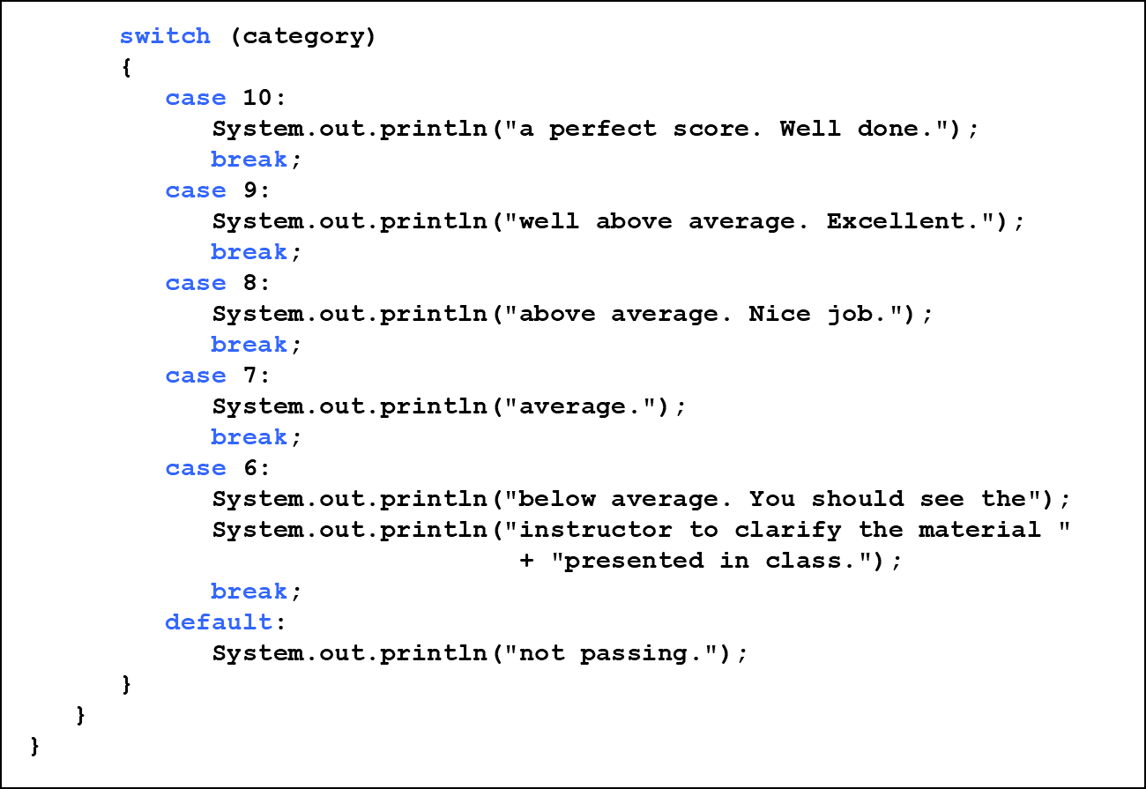
Listing 6.1 (2 of 3)

Slide 12
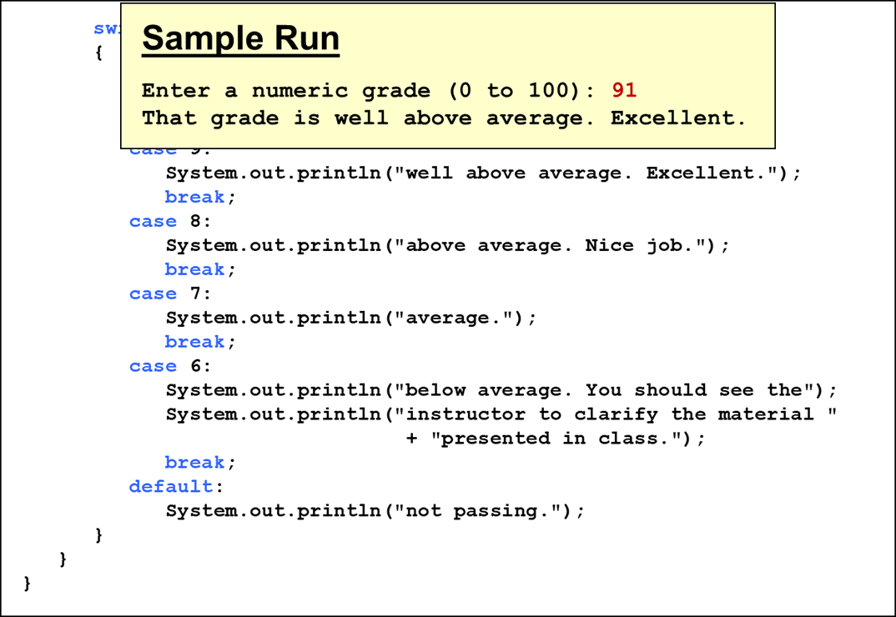
Listing 6.1 (3 of 3)

Slide 13
Outline (2 of 6)
The switch Statement
The Conditional Operator
The do Statement
The for Statement
Using Loops and Conditionals with Graphics
Graphic Transformations

Slide 14
The Conditional Operator (1 of 3)
The conditional operator evaluates to one of two expressions based on a boolean condition
Its syntax is:
If the condition is true, expression1 is evaluated; if it is false, expression2 is evaluated
The value of the entire conditional operator is the value of the selected expression

Slide 15
The Conditional Operator (2 of 3)
The conditional operator is similar to an if-else statement, except that it is an expression that returns a value
For example:
If num1 is greater than num2, then num1 is assigned to larger; otherwise, num2 is assigned to larger
The conditional operator is ternary because it requires three operands

Slide 16
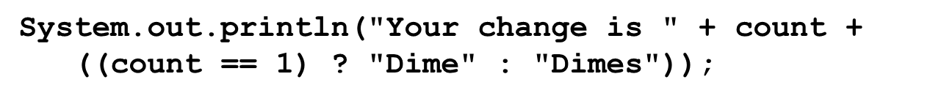
The Conditional Operator (3 of 3)
Another example:
If count equals 1, then "Dime" is printed
If count is anything other than 1, then "Dimes" is printed

Slide 17
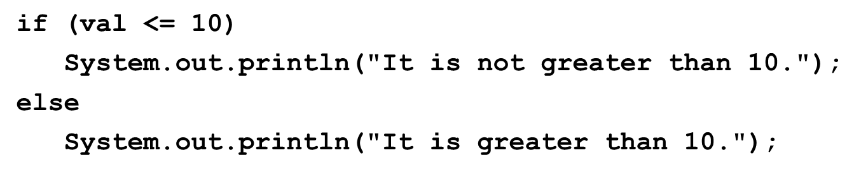
Quick Check 1 (1 of 2)
Express the following logic in a succinct manner using the conditional operator.

Slide 18
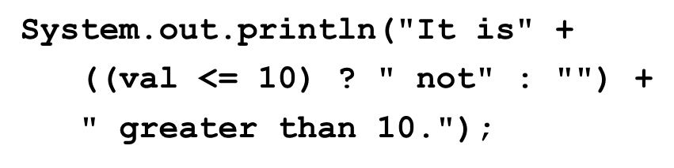
Quick Check 1 (2 of 2)
Express the following logic in a succinct manner using the conditional operator.

Slide 19
Outline (3 of 6)
The switch Statement
The Conditional Operator
The do Statement
The for Statement
Using Loops and Conditionals with Graphics
Graphic Transformations

Slide 20
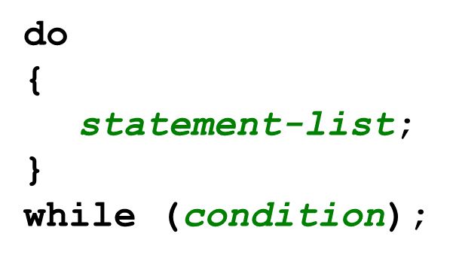
The do Statement (1 of 2)
A do statement has the following syntax:
The statement-list is executed once initially, and then the condition is evaluated
The statement is executed repeatedly until the condition becomes false

Slide 21
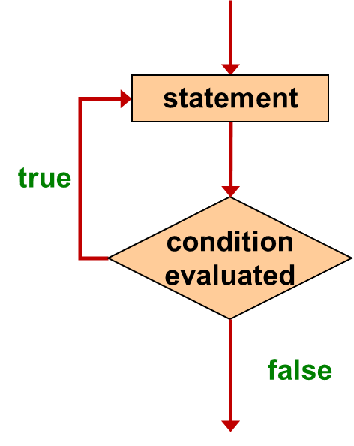
Logic of a do Loop

Slide 22
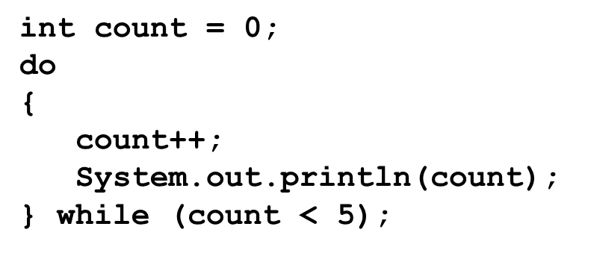
The do Statement (2 of 2)
An example of a do loop:
The body of a do loop executes at least once
See ReverseNumber.java

Slide 23
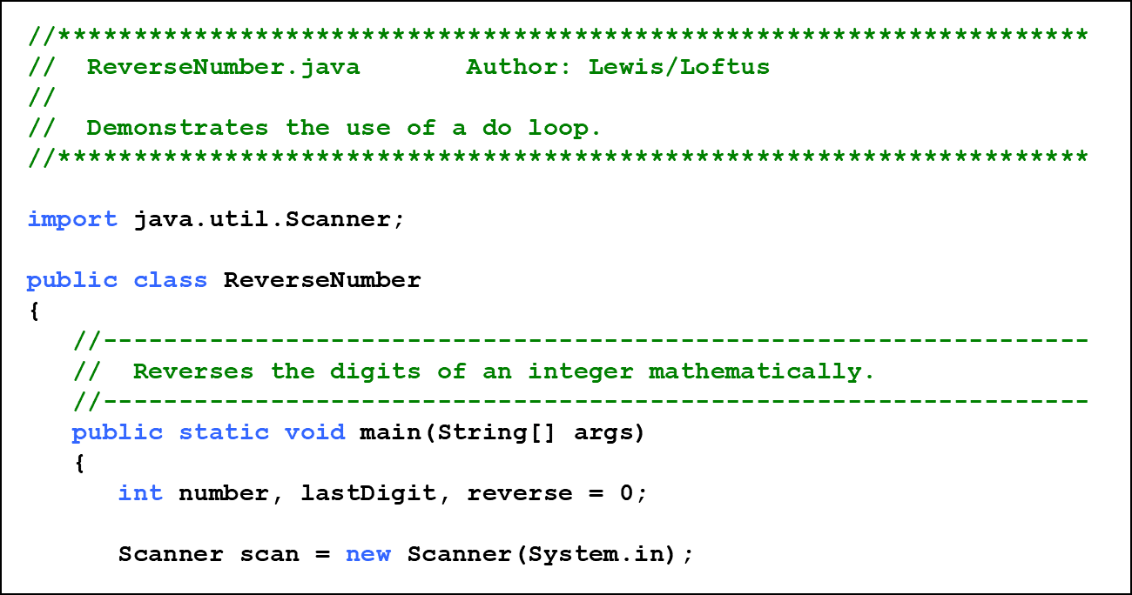
Listing 6.2 (1 of 3)

Slide 24
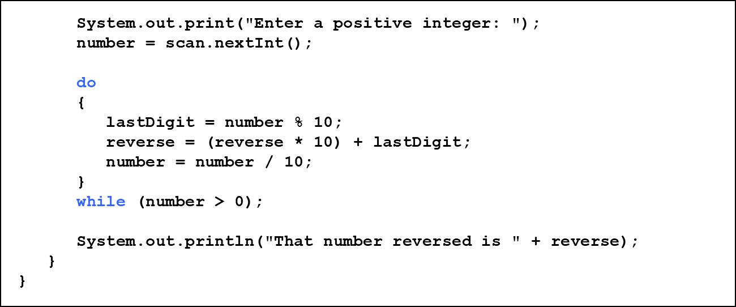
Listing 6.2 (2 of 3)

Slide 25
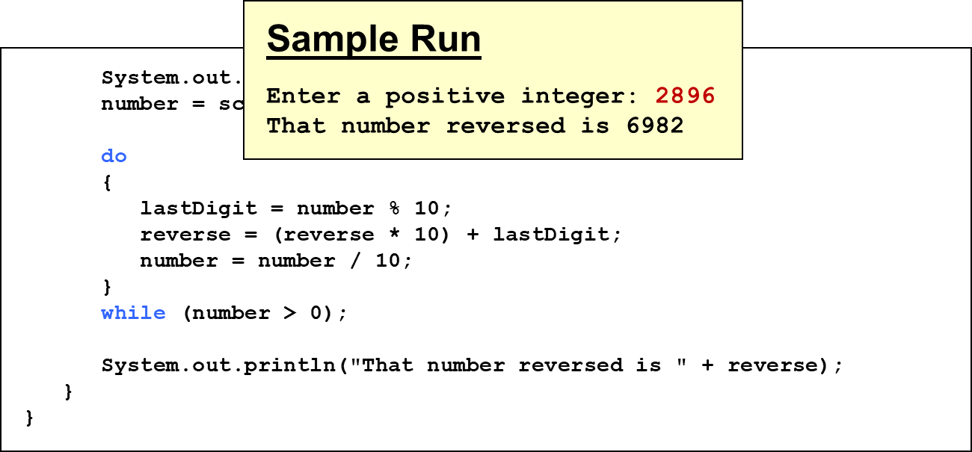
Listing 6.2 (3 of 3)

Slide 26
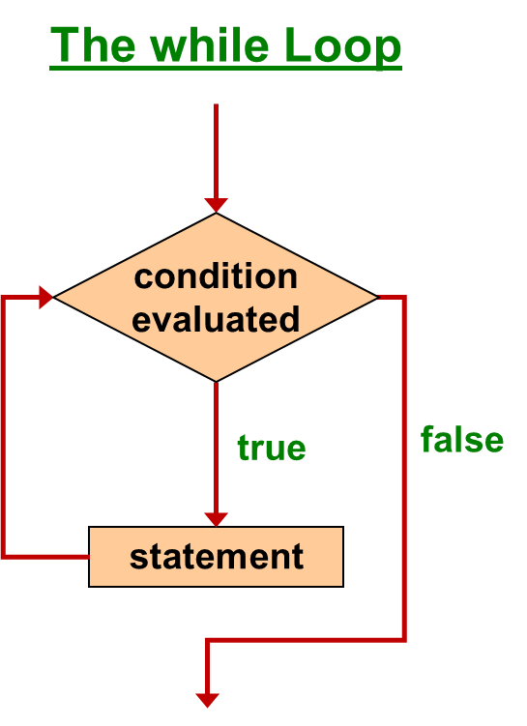
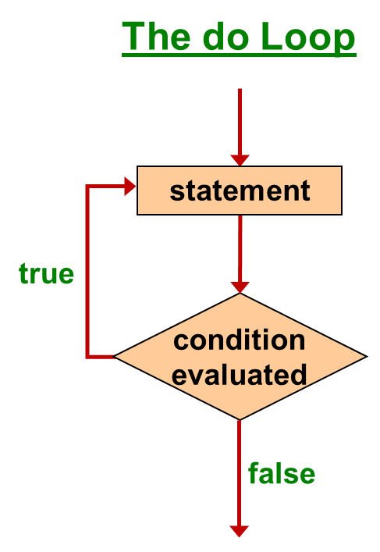
Comparing while and do

Slide 27
Outline (4 of 6)
The switch Statement
The Conditional Operator
The do Statement
The for Statement
Using Loops and Conditionals with Graphics
Graphic Transformations

Slide 28
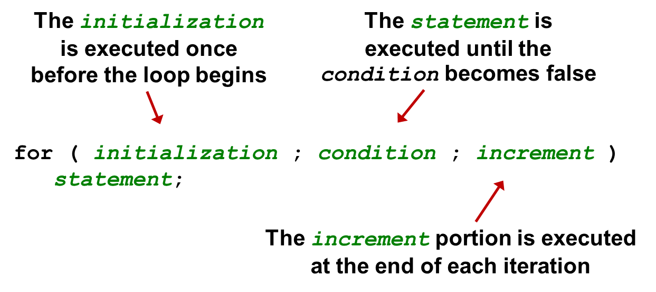
The for Statement (1 of 5)
A for statement has the following syntax:

Slide 29
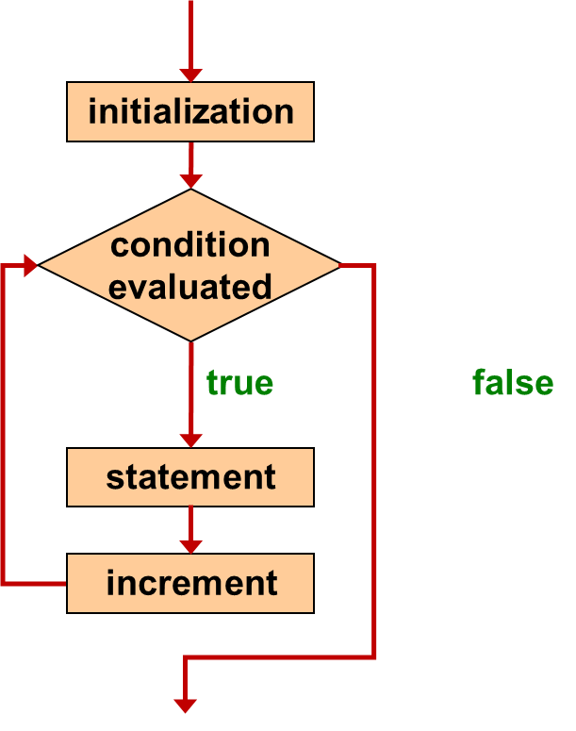
Logic of a for loop

Slide 30
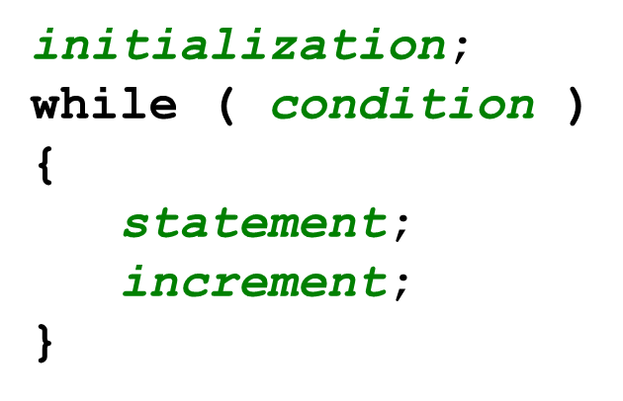
The for Statement (2 of 5)
A for loop is functionally equivalent to the following while loop structure:

Slide 31
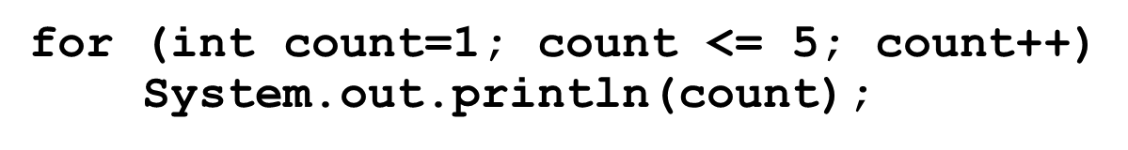
The for Statement (3 of 5)
An example of a for loop:
The initialization section can be used to declare a variable
Like a while loop, the condition of a for loop is tested prior to executing the loop body
Therefore, the body of a for loop will execute zero or more times

Slide 32
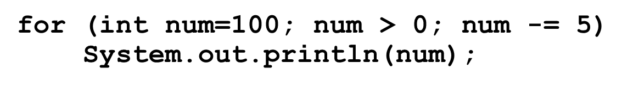
The for Statement (4 of 5)
The increment section can perform any calculation:
A for loop is well suited for executing statements a specific number of times that can be calculated or determined in advance
See Multiples.java
See Stars.java

Slide 33
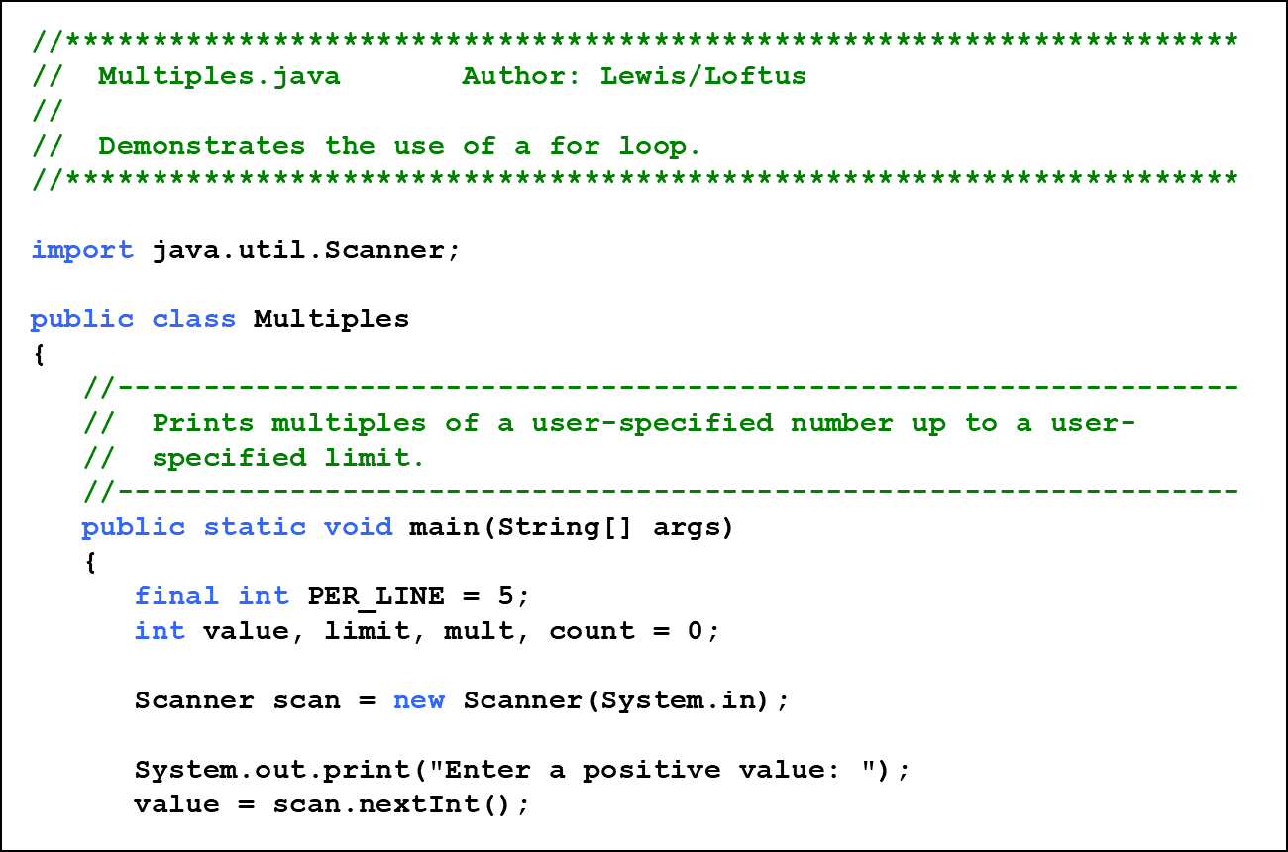
Listing 6.3 (1 of 3)

Slide 34
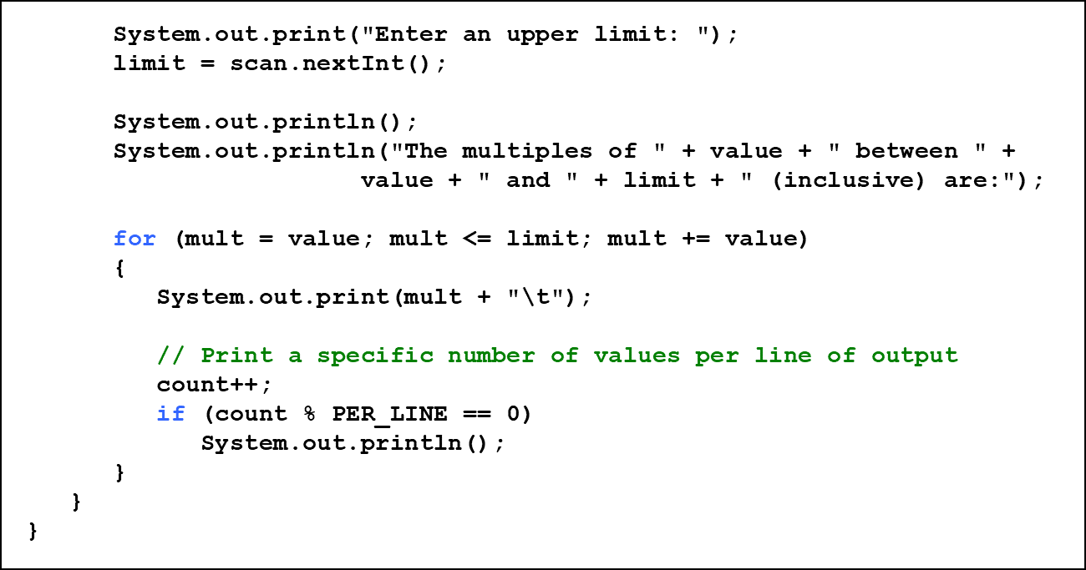
Listing 6.3 (2 of 3)

Slide 35
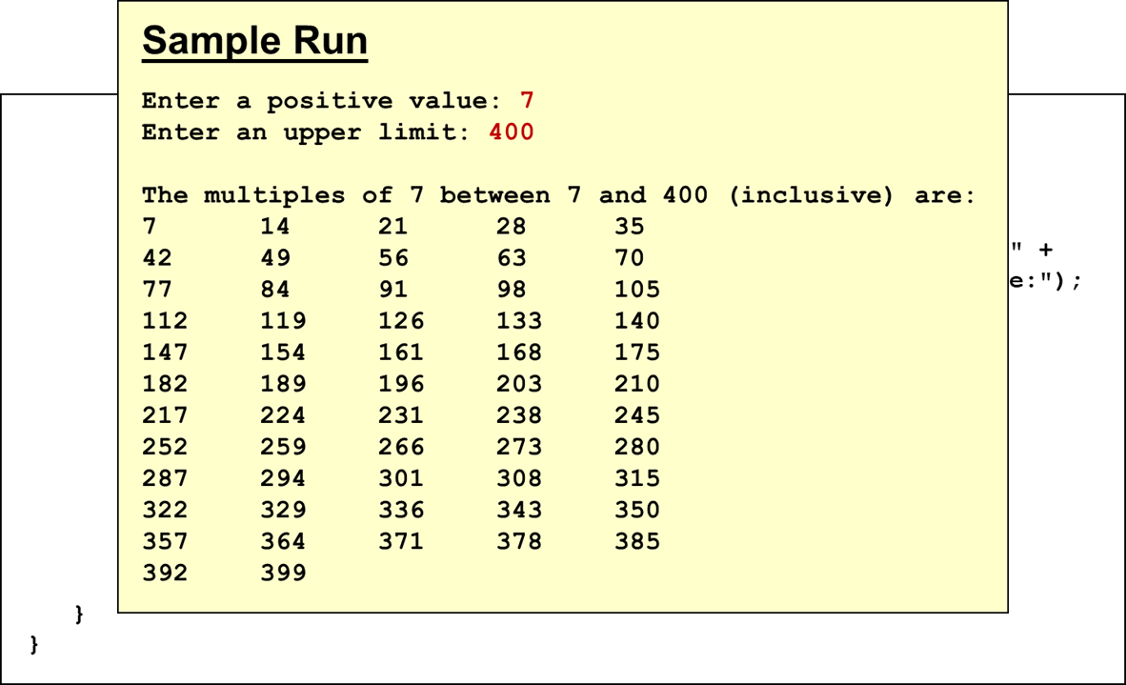
Listing 6.3 (3 of 3)

Slide 36
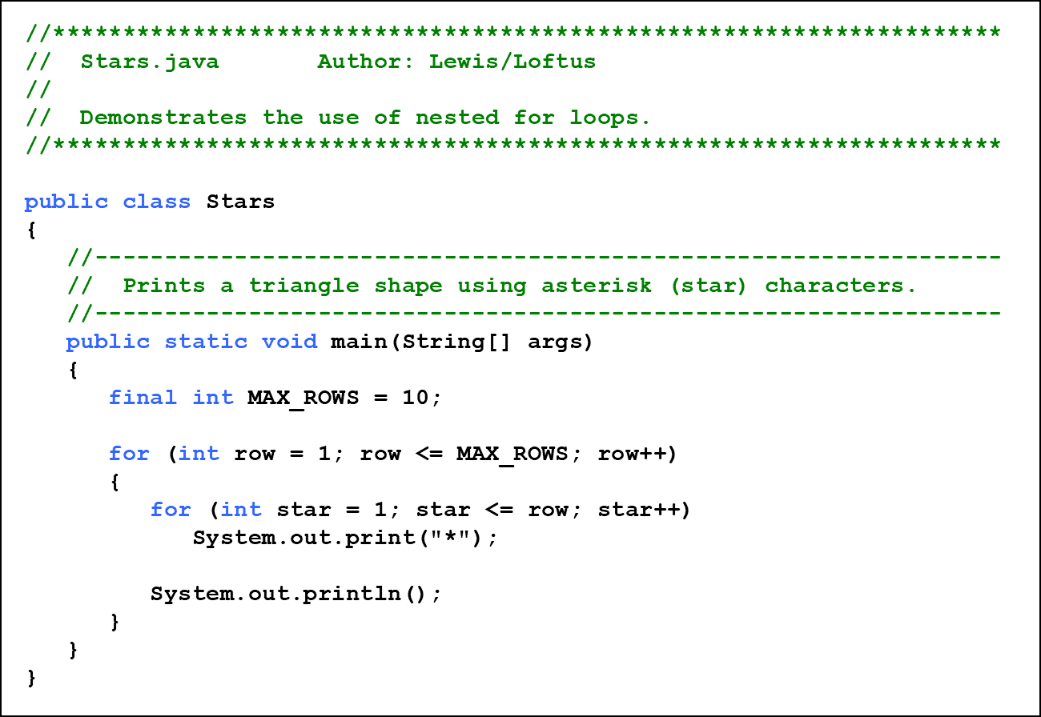
Listing 6.4 (1 of 2)

Slide 37
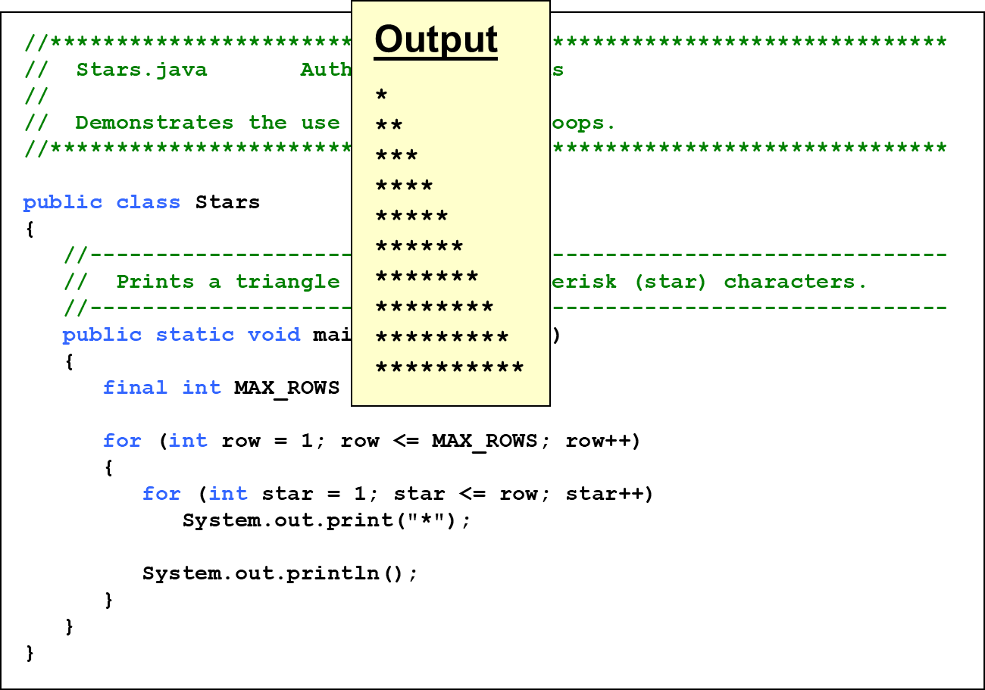
Listing 6.4 (2 of 2)

Slide 38
Quick Check 2 (1 of 2)
Write a code fragment that rolls a die 100 times and counts the number of times a 3 comes up.

Slide 39
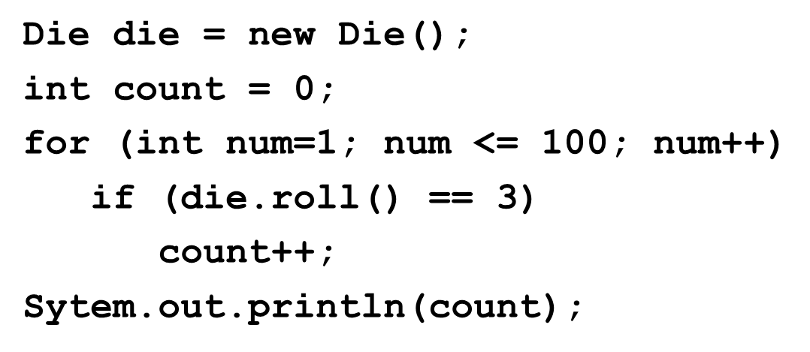
Quick Check 2 (2 of 2)
Write a code fragment that rolls a die 100 times and counts the number of times a 3 comes up.

Slide 40
The for Statement (5 of 5)
Each expression in the header of a for loop is optional
If the initialization is left out, no initialization is performed
If the condition is left out, it is always considered to be true, and therefore creates an infinite loop
If the increment is left out, no increment operation is performed

Slide 41
For-each Loops (1 of 2)
A variant of the for loop simplifies the repetitive processing of items in an iterator
For example, suppose bookList is an
object
The following loop will print each book:
This version of a for loop is often called a for-each loop

Slide 42
For-each Loops (2 of 2)
A for-each loop can be used on any object that implements the Iterable interface
It eliminates the need to retrieve an iterator and call the hasNext and next methods explicitly
It also will be helpful when processing arrays, which are discussed in Chapter 8

Slide 43
Quick Check 3 (1 of 2)
Write a for-each loop that prints all of the Student objects
in an
object called roster.

Slide 44
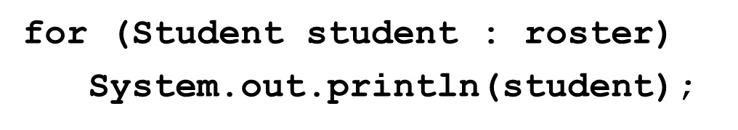
Quick Check 3 (2 of 2)
Write a for-each loop that prints all of the Student objects
in an
object called roster.

Slide 45
Outline (5 of 6)
The switch Statement
The Conditional Operator
The do Statement
The for Statement
Using Loops and Conditionals with Graphics
Graphic Transformations

Slide 46
More Graphics
Conditionals and loops enhance our ability to generate interesting graphics
See Bullseye.java
See Boxes.java

Slide 47
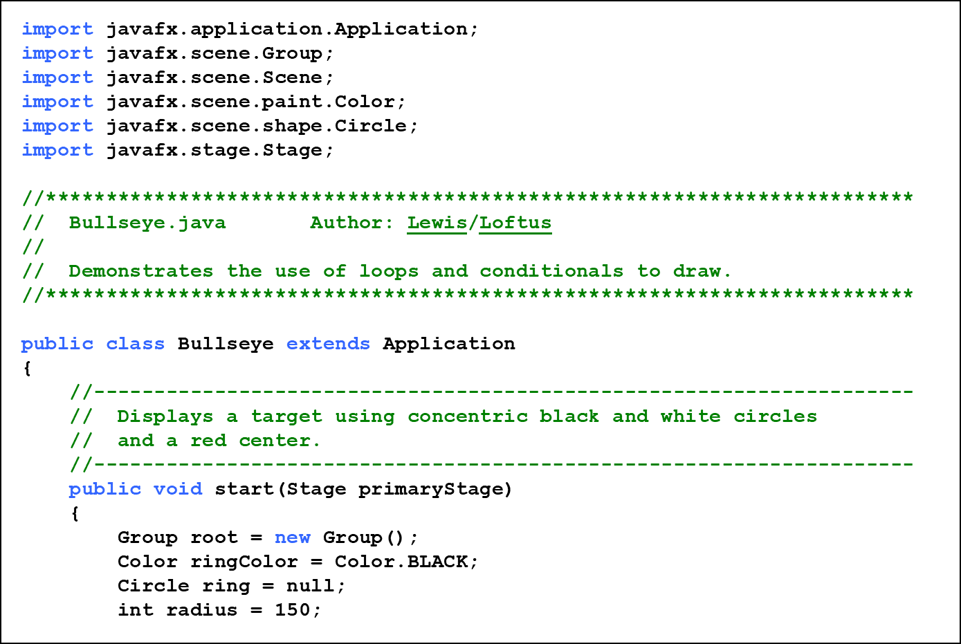
Listing 6.5 (1 of 3)

Slide 48
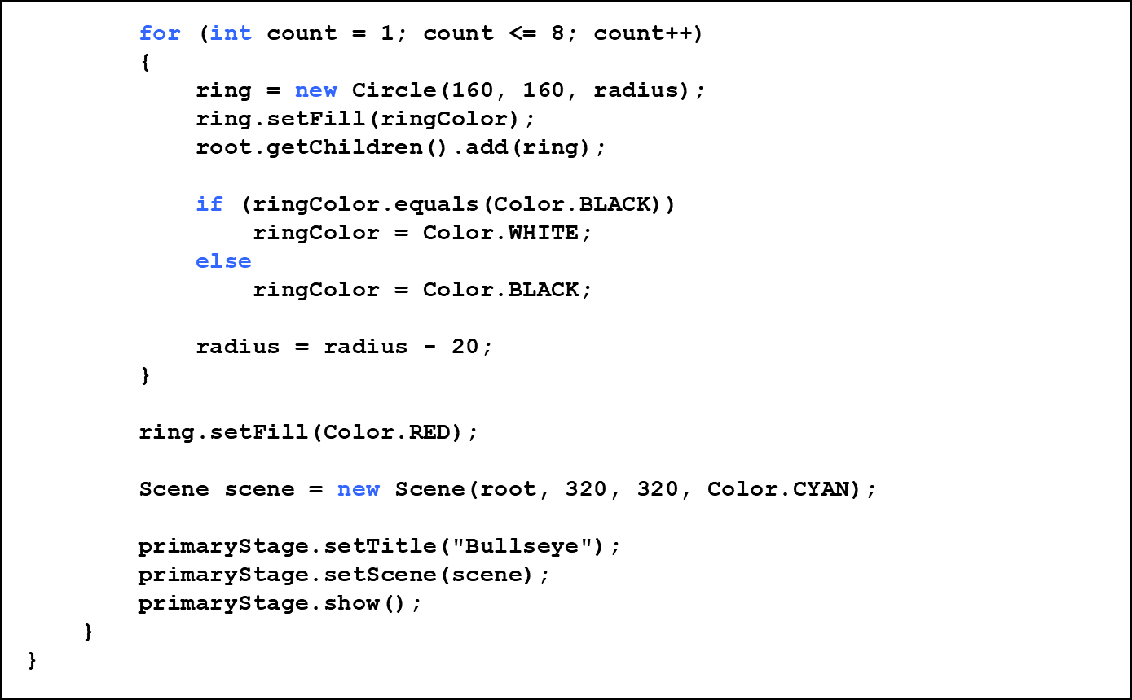
Listing 6.5 (2 of 3)

Slide 49
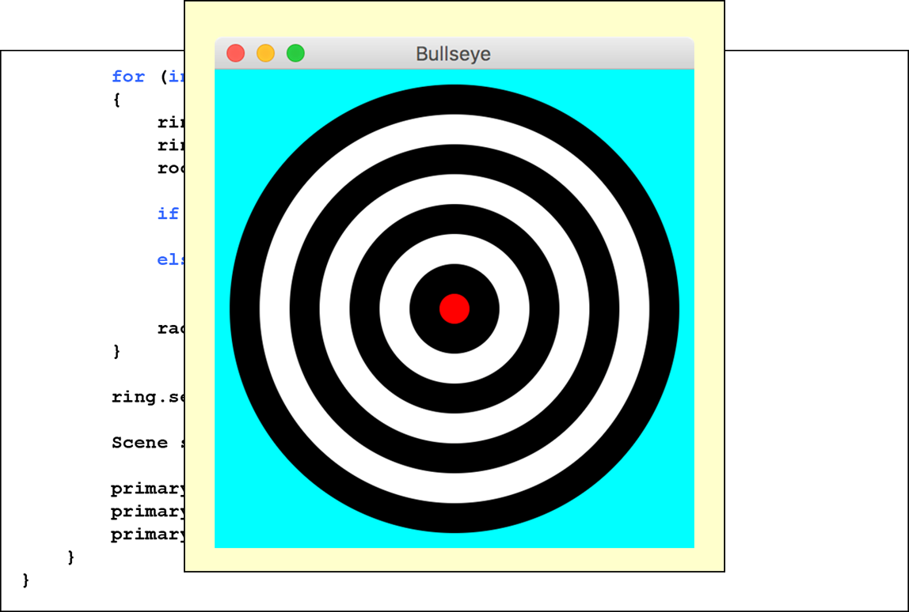
Listing 6.5 (3 of 3)

Slide 50
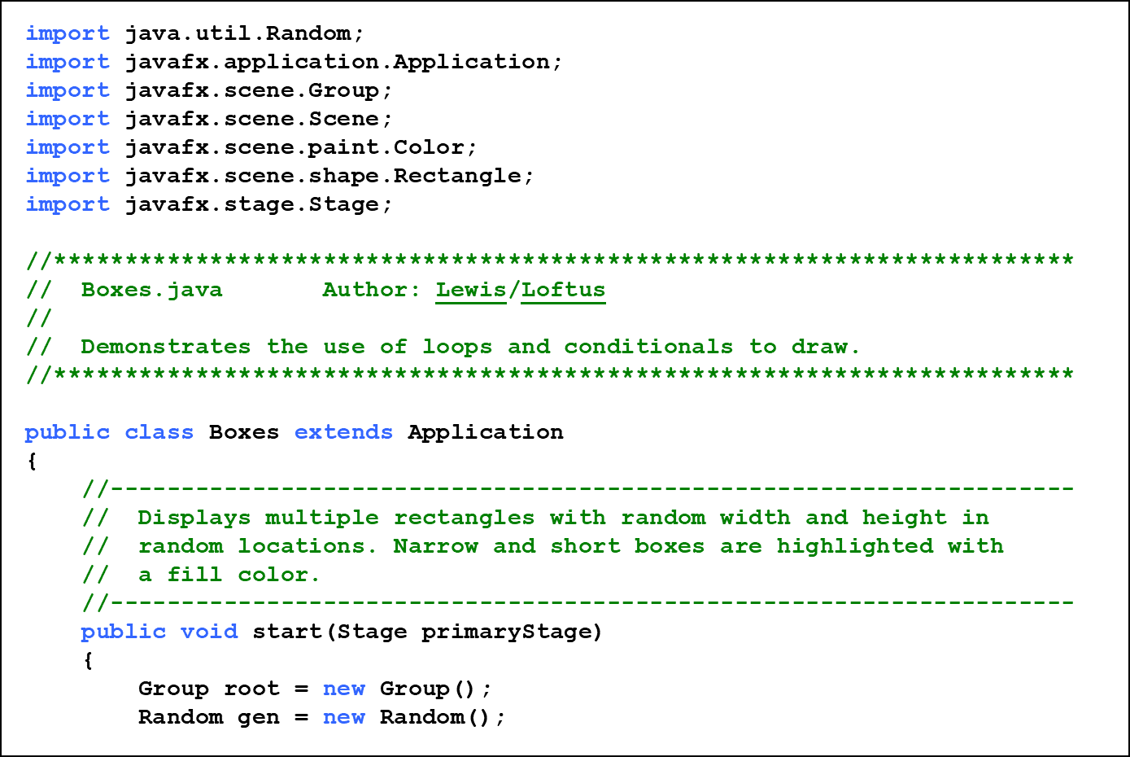
Listing 6.6 (1 of 4)

Slide 51
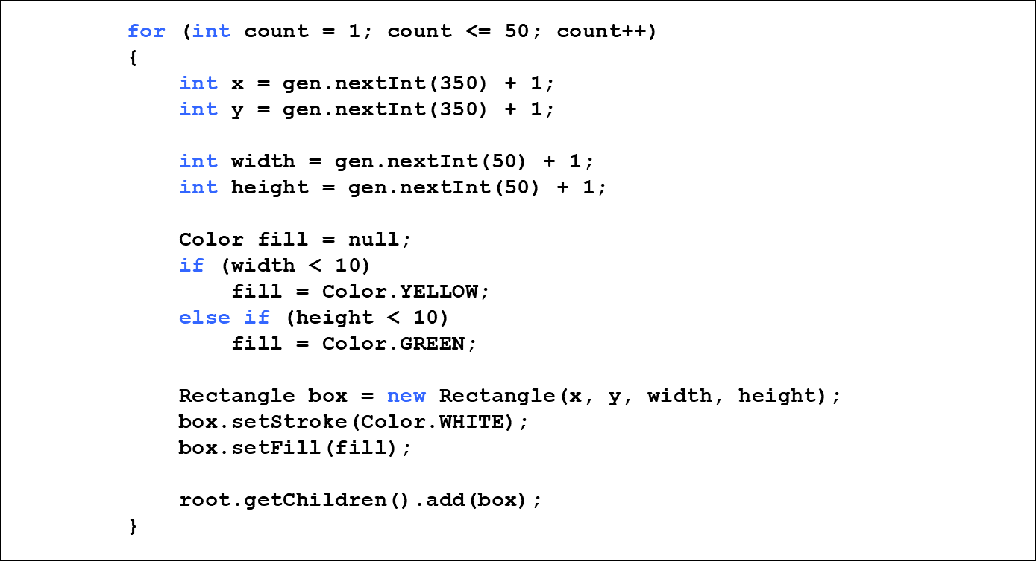
Listing 6.6 (2 of 4)

Slide 52
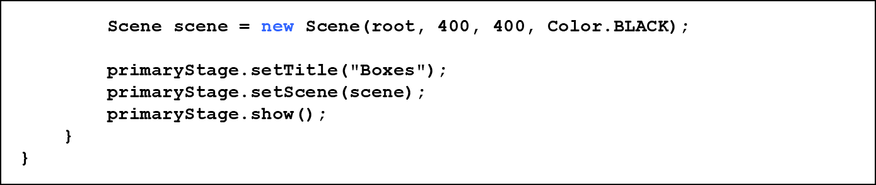
Listing 6.6 (3 of 4)

Slide 53
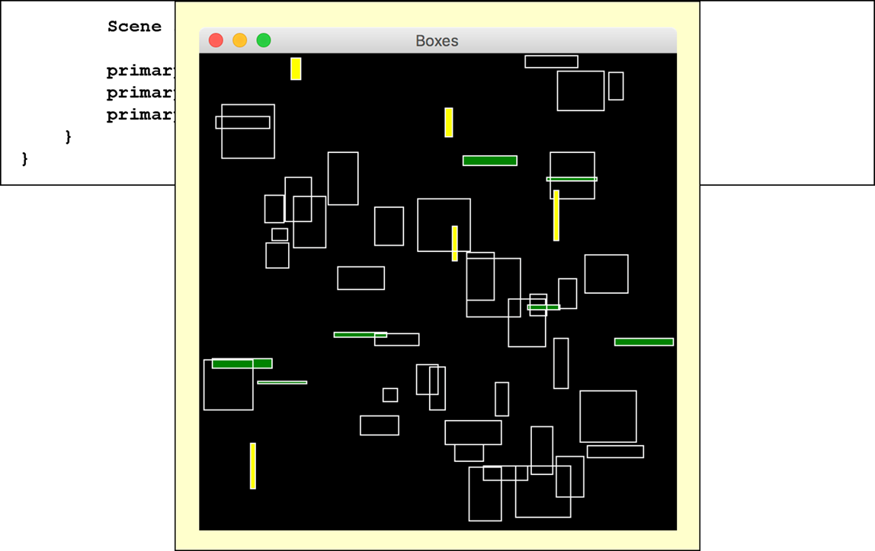
Listing 6.6 (4 of 4)

Slide 54
Outline (6 of 6)
The switch Statement
The Conditional Operator
The do Statement
The for Statement
Using Loops and Conditionals with Graphics
Graphic Transformations

Slide 55
Graphic Transformations
A Java F X transformation changes the way a node is presented visually
  translation - shifts the position along the x or y axis
  scaling - causes the node to appear larger or smaller
  rotation - rotates the node around its center point
  shearing - rotates one axis so that the x and y axes are no longer perpendicular

Slide 56
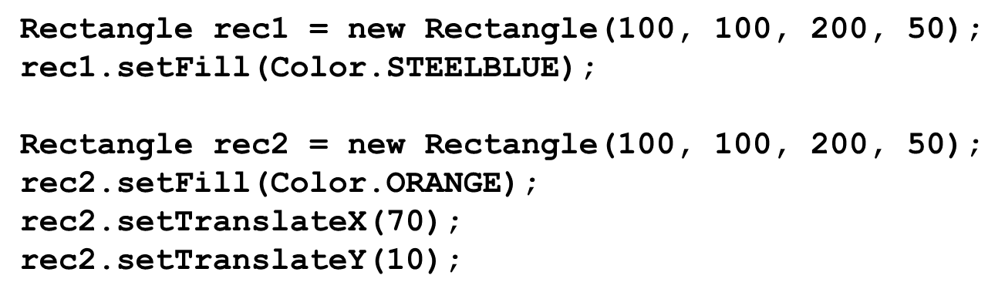

Translation
The following creates two rectangles in the same position, then shifts the second one:

Slide 57
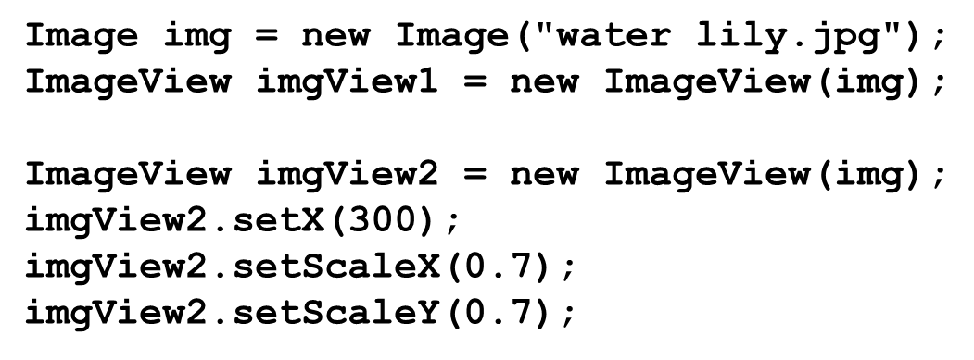

Scaling
The following displays two ImageView objects, the second scaled to 70%:

Slide 58
Rotation (1 of 3)
The parameter to setRotate determines how many degrees the node is rotated
If the parameter positive, the node is rotated clockwise
If the parameter is negative, the node is rotated counterclockwise

Slide 59
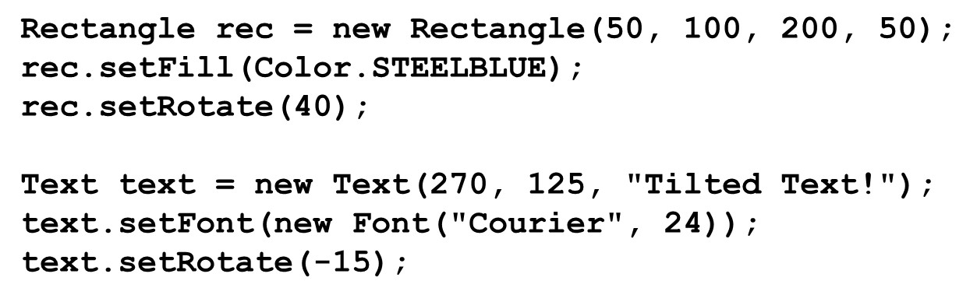

Rotation (2 of 3)

Slide 60
Rotation (3 of 3)
To rotate a node around a point other than its center point, create a Rotate object and add it to the node’s list of transformations
The following rotates a node 45 degrees around the point (70, 150):

Slide 61
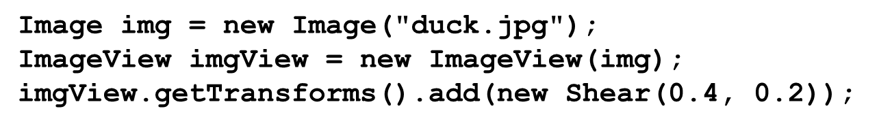

Shearing
Shearing is accomplished by creating a Shear object and adding it to this list of transformations
The following applies a shear of 40% on the x axis and 20% on the y axis to an ImageView object:

Slide 62
Transformations on Groups
Transformations can be applied to any Java F X nodes
  shapes, images, controls
  groups and panes
When applied to a group or pane, the transformation is applied to each node it contains
See RobotFace.java
See Robots.java

Slide 63
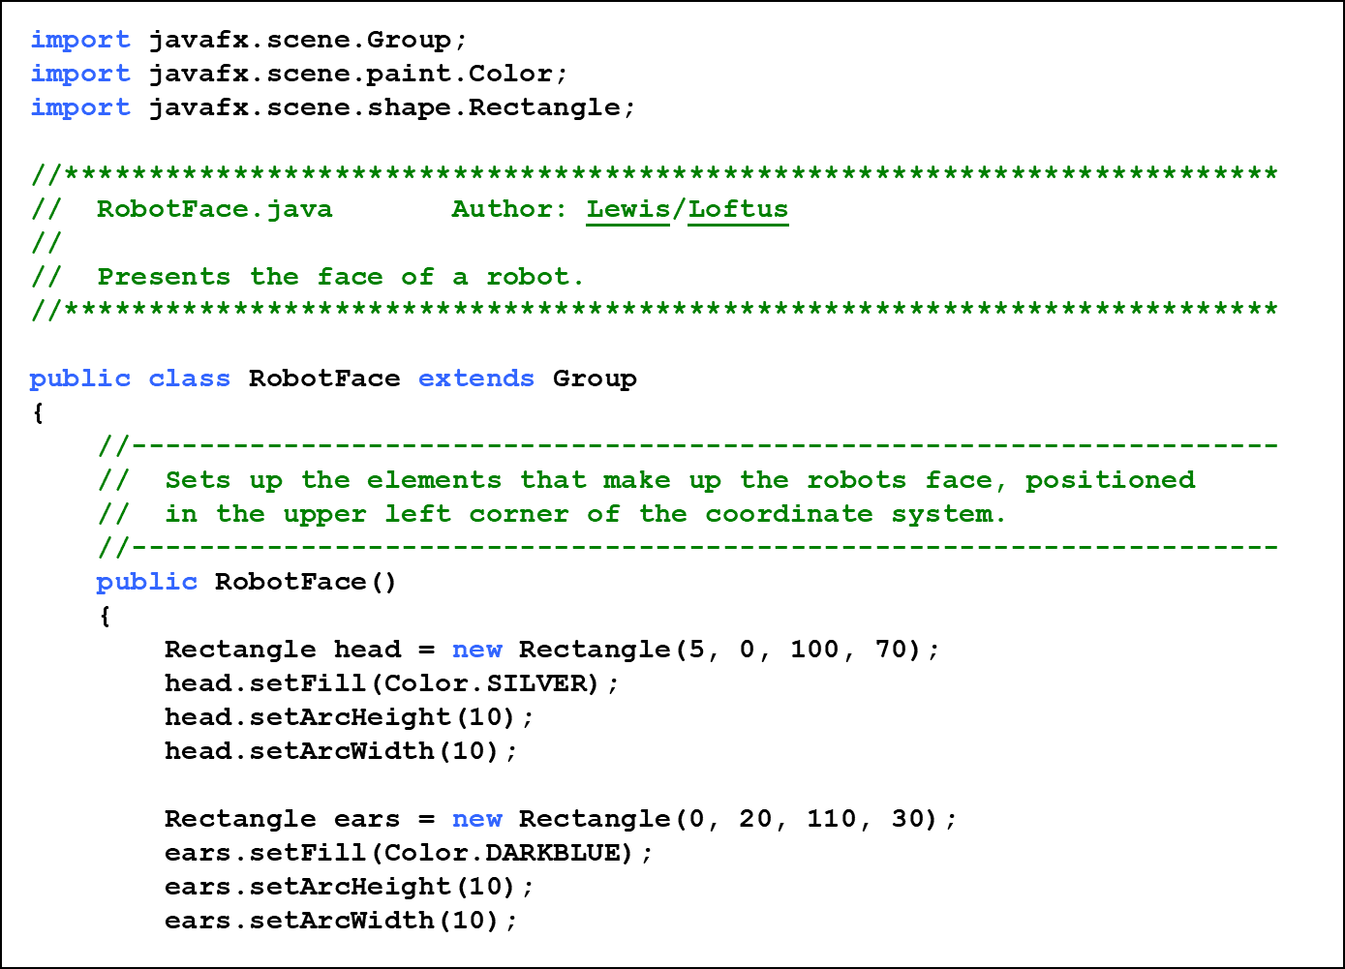
Listing 6.7 (1 of 3)

Slide 64
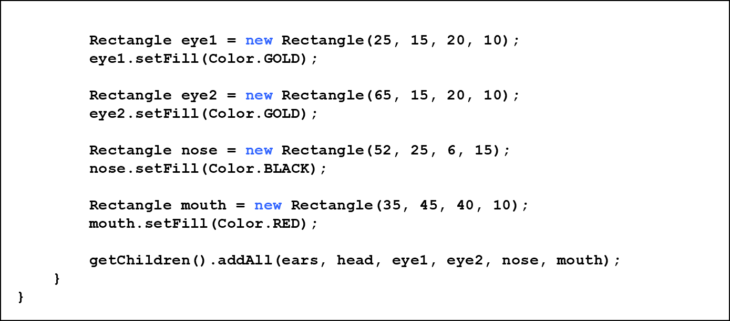
Listing 6.7 (2 of 3)

Slide 65
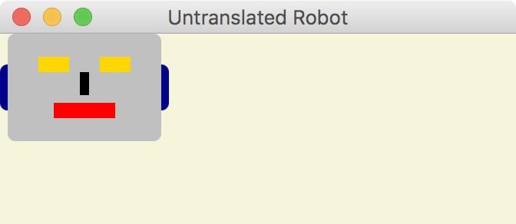
Listing 6.7 (3 of 3)
If presented as defined, the robot face would be displayed in the upper left corner:

Slide 66
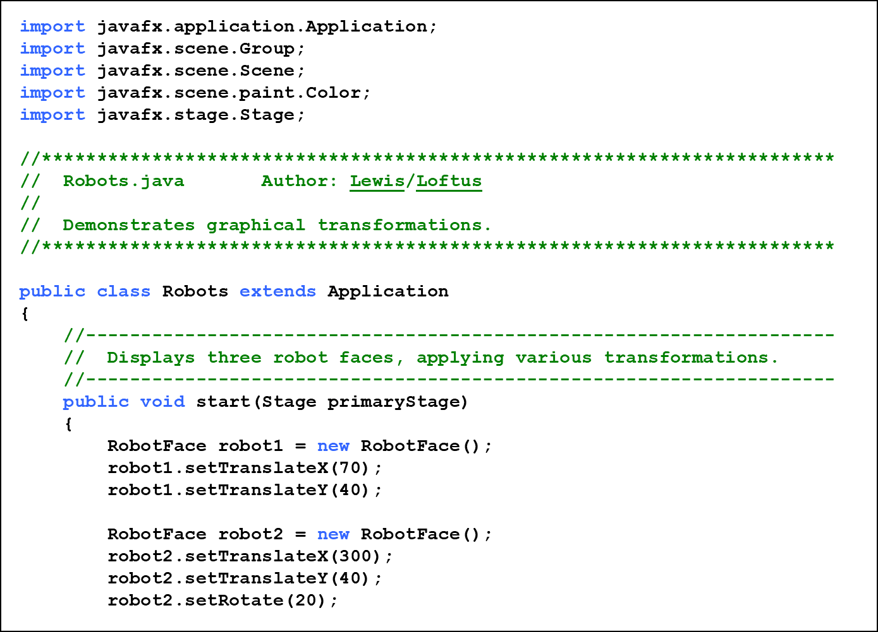
Listing 6.8 (1 of 3)

Slide 67
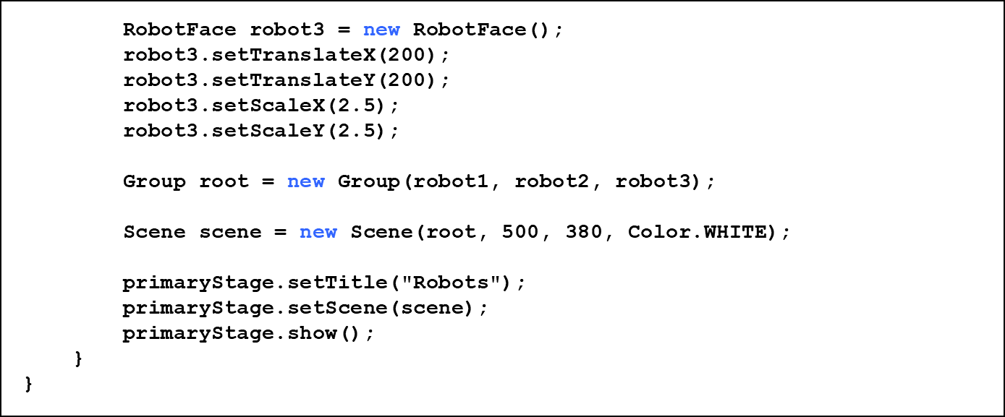
Listing 6.8 (2 of 3)

Slide 68
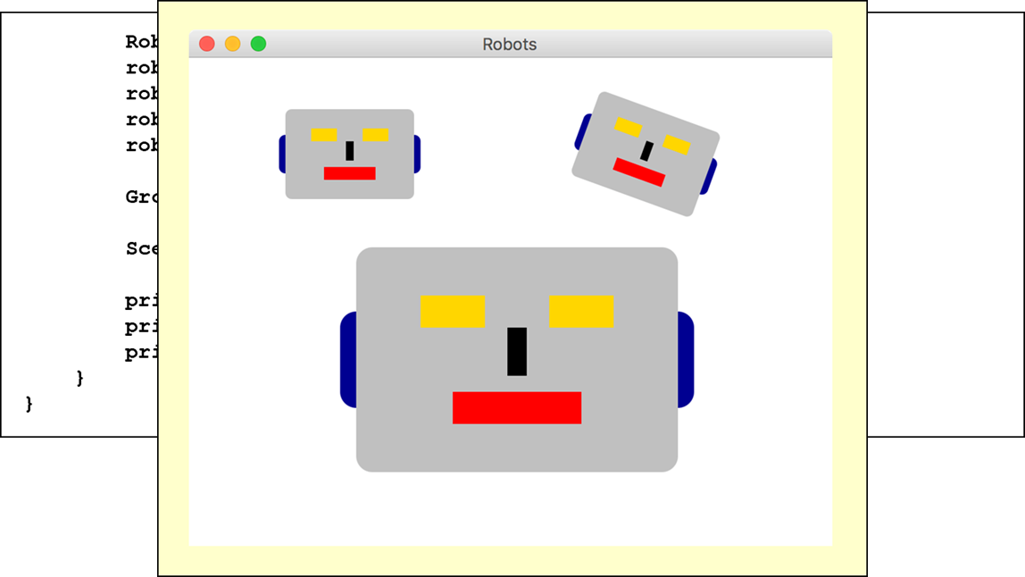
Listing 6.8 (3 of 3)

Slide 69
Summary
Chapter 6 focused on:
  the switch statement
  the conditional operator
  the do loop
  the for loop
  using conditionals and loops with graphics
  graphic transformations

Slide 70

Copyright
This work is protected by United States copyright laws and is provided solely for the use of instructors in teaching their courses and assessing student learning. Dissemination or sale of any part of this work (including on the World Wide Web) will destroy the integrity of the work and is not permitted. The work and materials from it should never be made available to students except by instructors using the accompanying text in their classes. All recipients of this work are expected to abide by these restrictions and to honor the intended pedagogical purposes and the needs of other instructors who rely on these materials.

