Slide 1
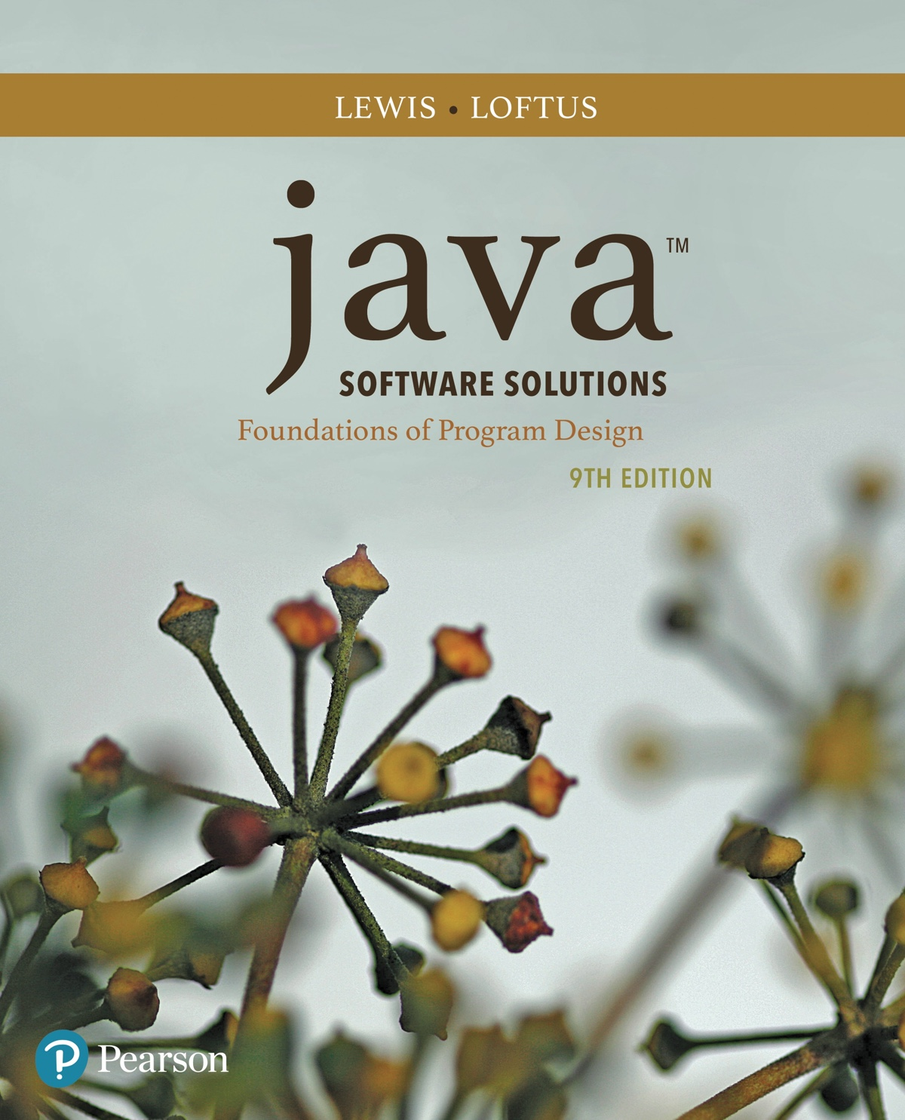
Java™ Software Solutions: Foundations of Program Design
Ninth Edition
Chapter 8
Arrays
Copyright © 2018 Pearson Education, Inc. All Rights Reserved
Notes:
If this PowerPoint presentation contains mathematical equations, you may need to check that your computer has the following installed:
1) MathType Plugin
2) Math Player (free versions available)
3) NVDA Reader (free versions available)

Slide 2
Arrays (1 of 7)
Arrays are objects that help us organize large amounts of information
Chapter 8 focuses on:
  array declaration and use
  bounds checking and capacity
  arrays that store object references
  variable length parameter lists
  multidimensional arrays
  polygons and polylines
  choice boxes

Slide 3
Outline (1 of 7)
Declaring and Using Arrays
Arrays of Objects
Variable Length Parameter Lists
Two-Dimensional Arrays
Polygons and Polylines
Array of Color Objects
Choice Boxes

Slide 4
Arrays (2 of 7)
The ArrayList class, introduced in Chapter 5, is used to organize a list of objects
It is a class in the Java A P I
An array is a programming language construct used to organize a list of objects
It has special syntax to access elements
As its name implies, the ArrayList class uses an array internally to manage the list of objects

Slide 5
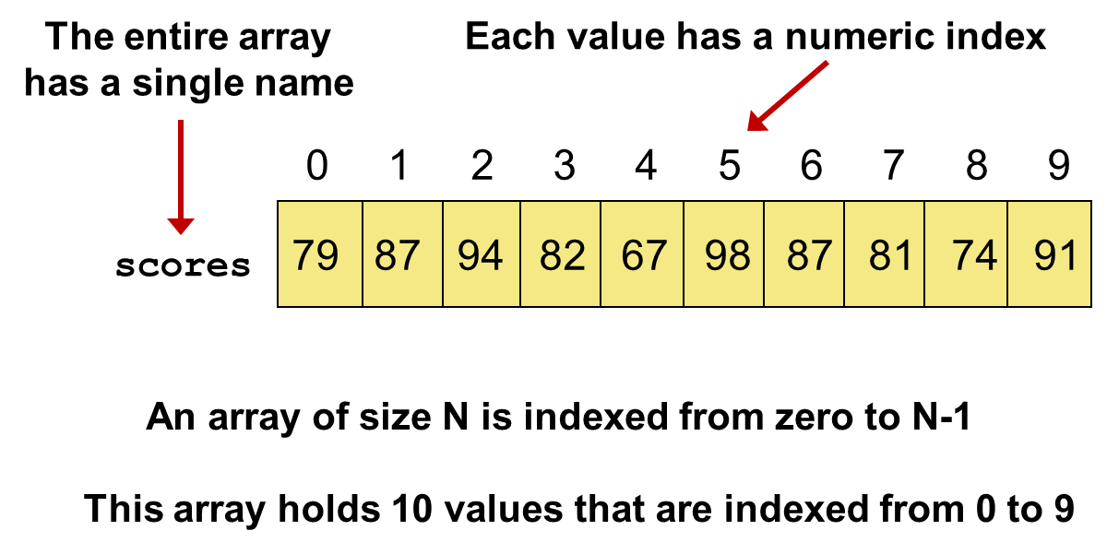
Arrays (3 of 7)
An array is an ordered list of values:

Slide 6

Arrays (4 of 7)
A particular value in an array is referenced using the array name followed by the index in brackets
For example, the expression
refers to the value 94 (the 3rd value in the array)
That expression represents a place to store a single integer and can be used wherever an integer variable can be used

Slide 7
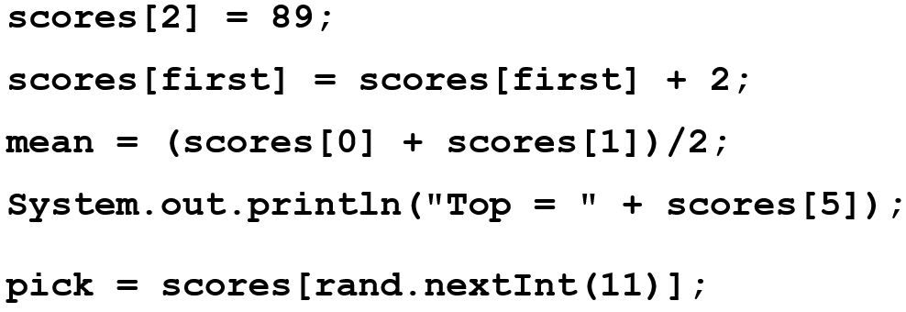
Arrays (5 of 7)
For example, an array element can be assigned a value, printed, or used in a calculation:

Slide 8
Arrays (6 of 7)
The values held in an array are called array elements
An array stores multiple values of the same type - the element type
The element type can be a primitive type or an object reference
Therefore, we can create an array of integers, an array of characters, an array of String objects, an array of Coin objects, etc.

Slide 9
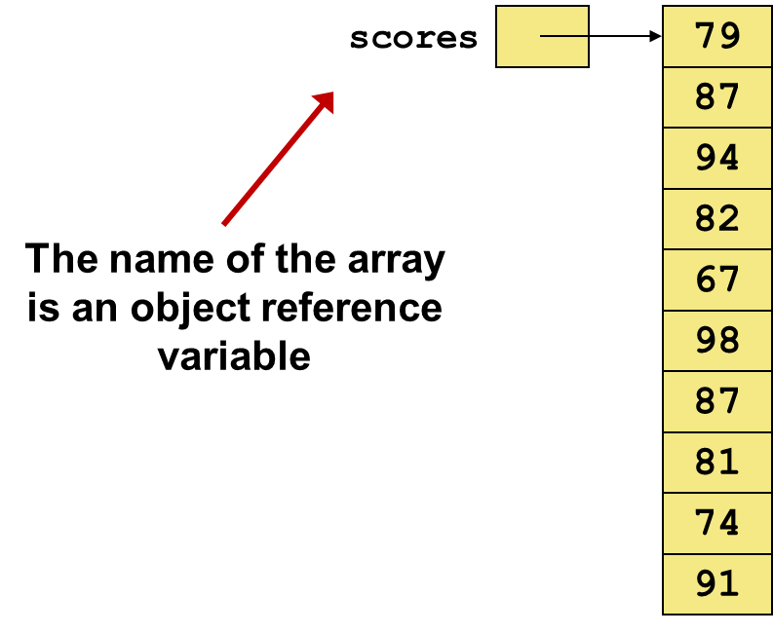
Arrays (7 of 7)
In Java, the array itself is an object that must be instantiated
Another way to depict the scores array:

Slide 10
Declaring Arrays (1 of 2)
The scores array could be declared as follows:
The type of the variable scores is int[] (an array of integers)
Note that the array type does not specify its size, but each object of that type has a specific size
The reference variable scores is set to a new array object that can hold 10 integers

Slide 11
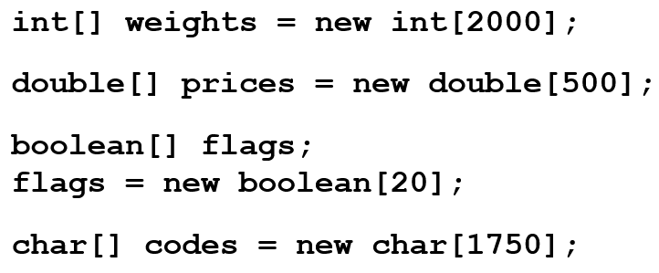
Declaring Arrays (2 of 2)
Some other examples of array declarations:

Slide 12
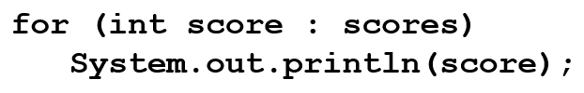
Using Arrays
The for-each version of the for loop can be used when processing array elements:
This is only appropriate when processing all array elements starting at index 0
It can’t be used to set the array values
See BasicArray.java

Slide 13
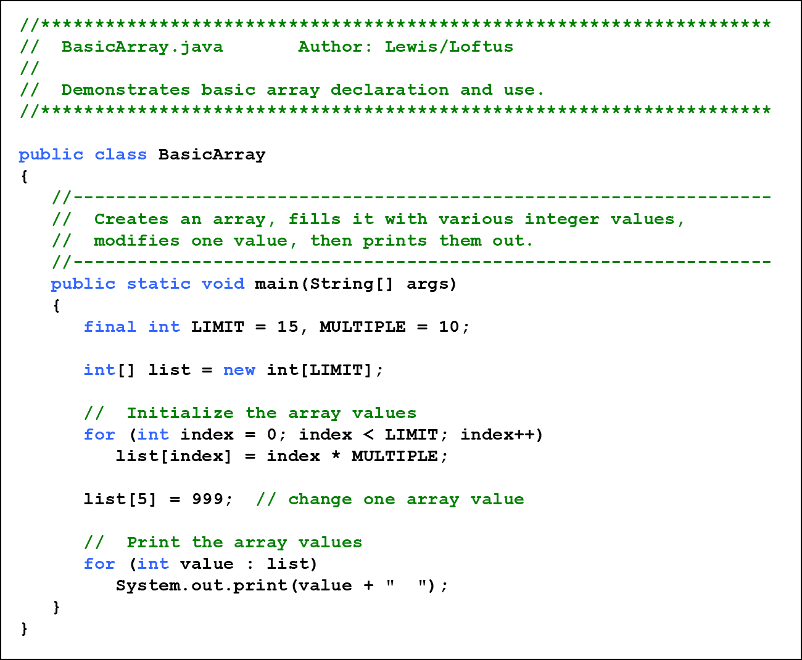
Listing 8.1 (1 of 2)

Slide 14
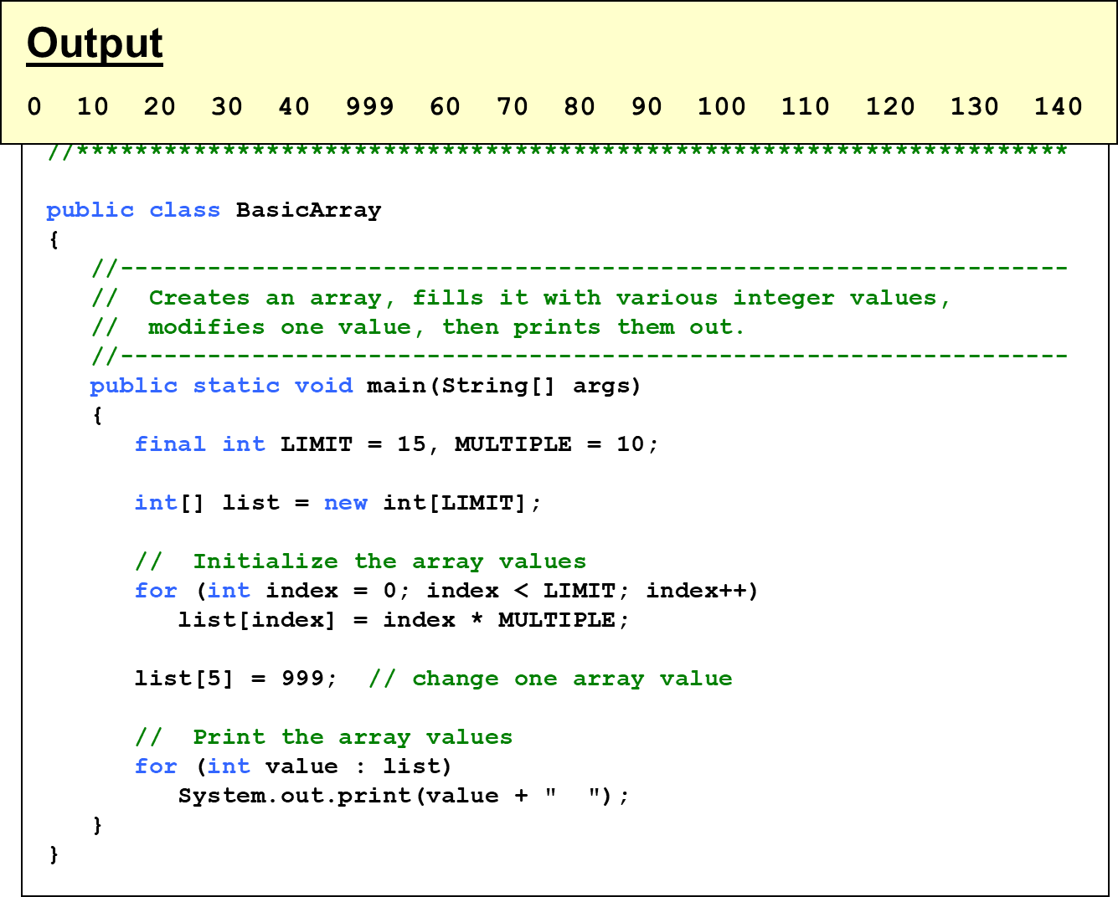
Listing 8.1 (2 of 2)

Slide 15
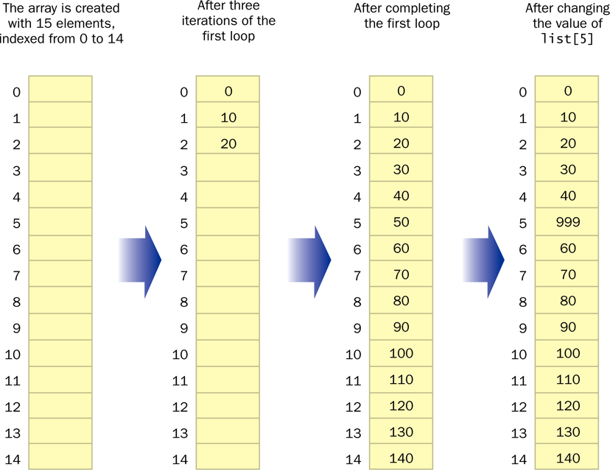
Basic Array Example

Slide 16
Quick Check 1 (1 of 2)
Write an array declaration to represent the ages of 100 children.
Write code that prints each value in an array of integers named values.

Slide 17
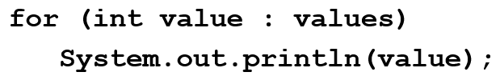
Quick Check 1 (2 of 2)
Write an array declaration to represent the ages of 100 children.
Write code that prints each value in an array of integers named values.

Slide 18
Bounds Checking (1 of 3)
Once an array is created, it has a fixed size
An index used in an array reference must specify a valid element
That is, the index value must be in range 0 to N−1
The Java interpreter throws an ArrayIndexOutOfBoundsException if an array index is out of bounds
This is called automatic bounds checking

Slide 19
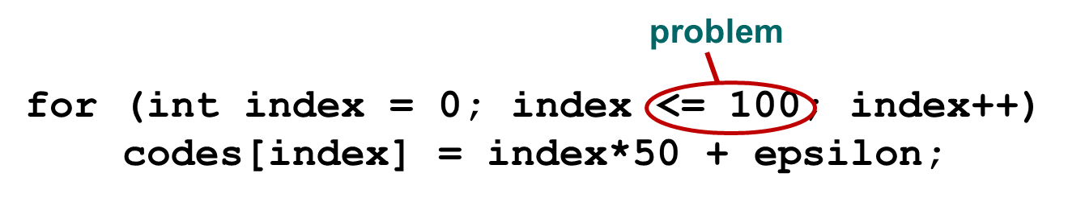
Bounds Checking (2 of 3)
For example, if the array codes can hold 100 values, it can be indexed from 0 to 99
If the value of count is 100, then the following reference will cause an exception to be thrown:
It’s common to introduce off-by-one errors when using arrays:

Slide 20

Bounds Checking (3 of 3)
Each array object has a public constant called length that stores the size of the array
It is referenced using the array name:
Note that length holds the number of elements, not the largest index
See ReverseOrder.java
See LetterCount.java

Slide 21
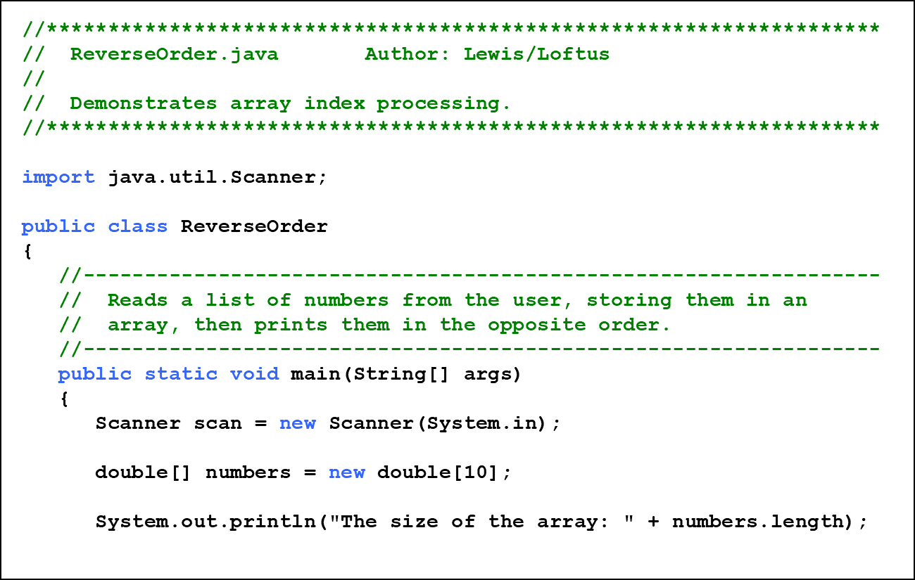
Listing 8.2 (1 of 3)

Slide 22
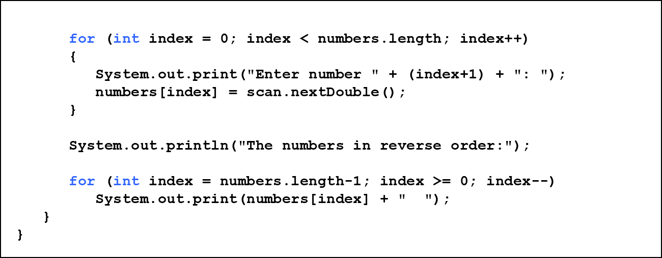
Listing 8.2 (2 of 3)

Slide 23
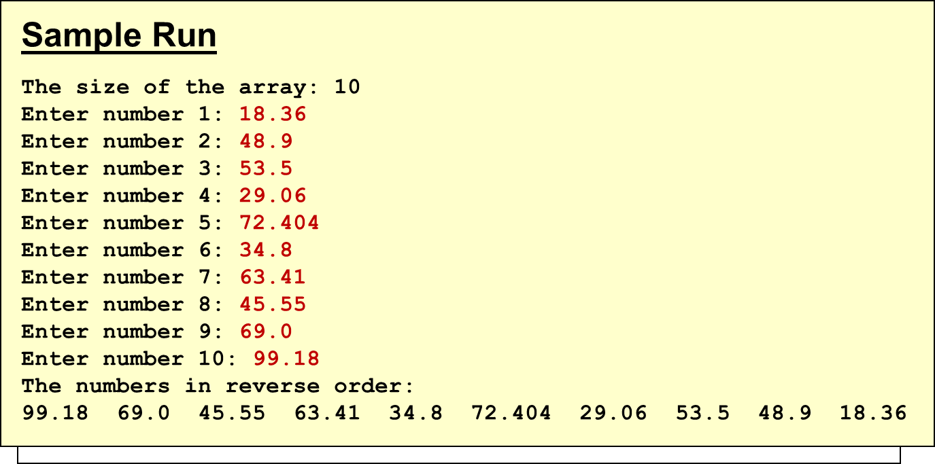
Listing 8.2 (3 of 3)

Slide 24
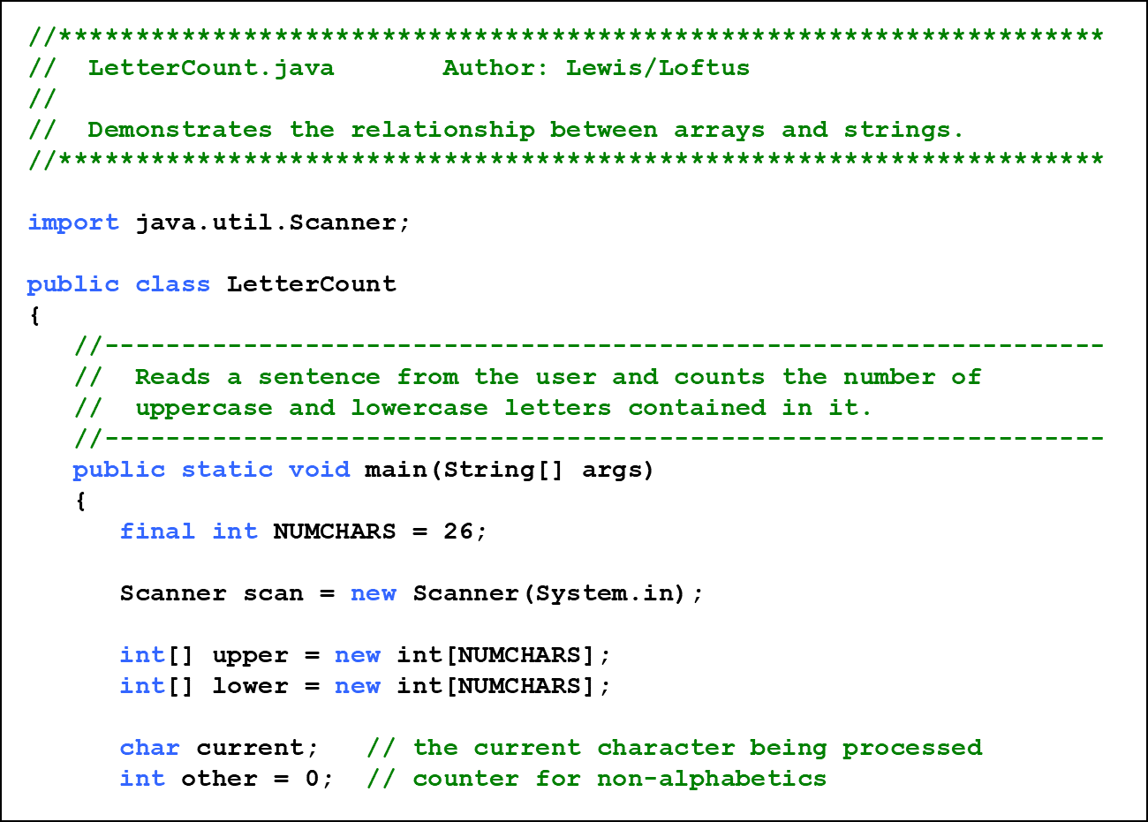
Listing 8.3 (1 of 4)

Slide 25
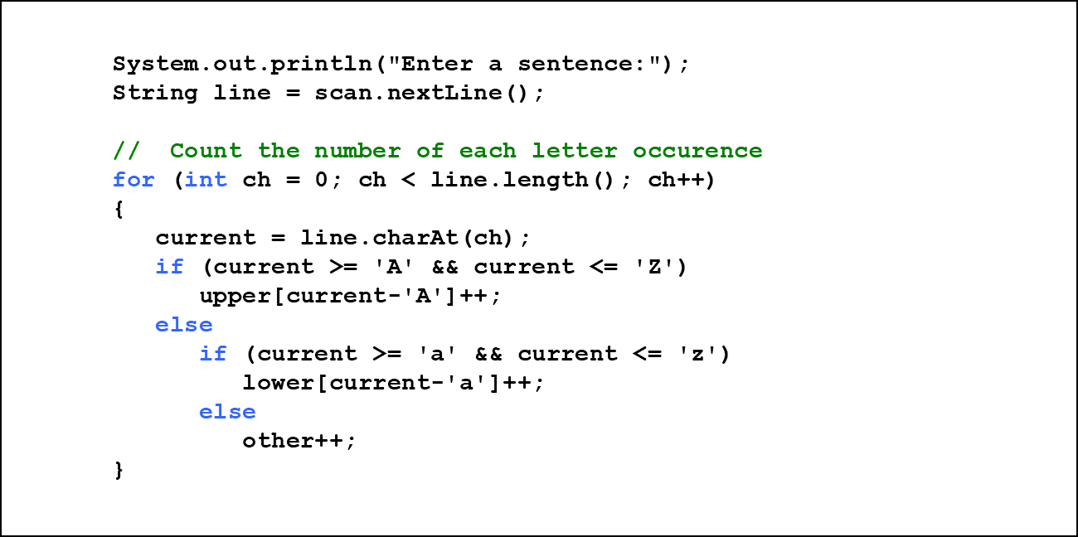
Listing 8.3 (2 of 4)

Slide 26
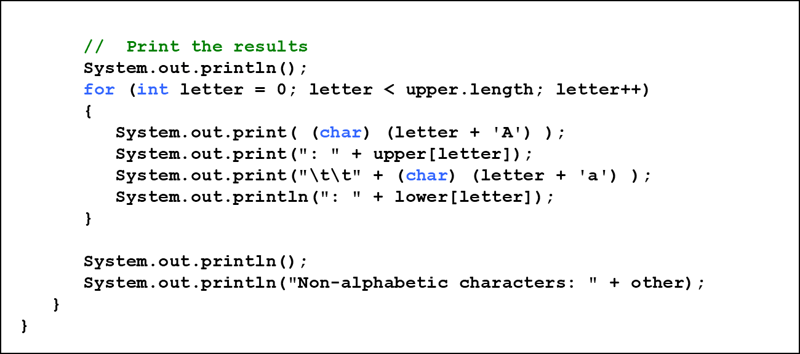
Listing 8.3 (3 of 4)

Slide 27
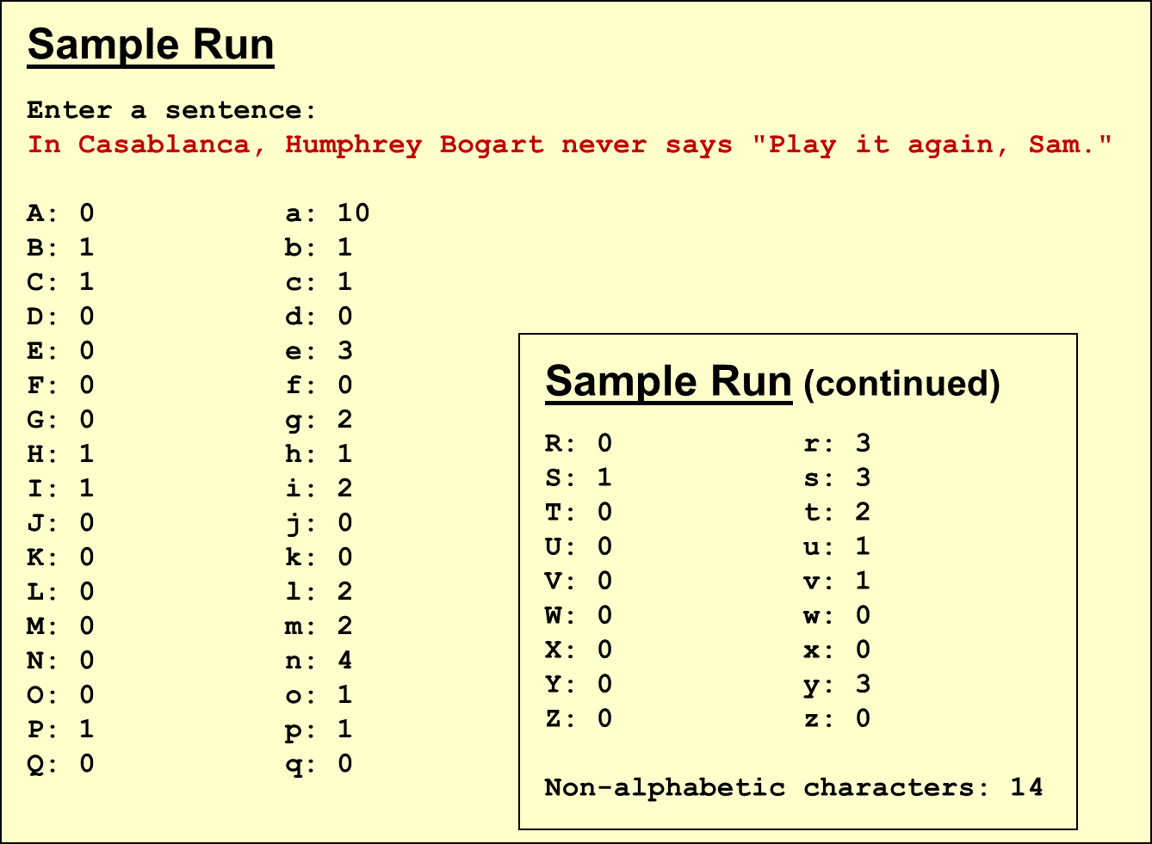
Listing 8.3 (4 of 4)

Slide 28

Alternate Array Syntax
The brackets of the array type can be associated with the element type or with the name of the array
Therefore the following two declarations are equivalent:
The first format generally is more readable and should be used

Slide 29
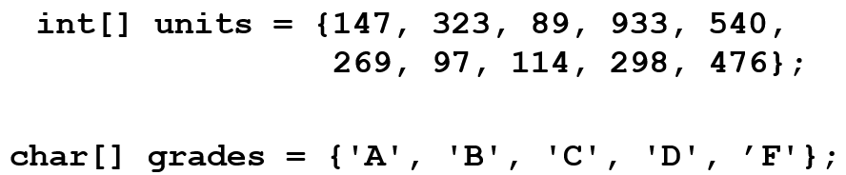
Initializer Lists (1 of 2)
An initializer list can be used to instantiate and fill an array in one step
The values are delimited by braces and separated by commas
Examples:

Slide 30
Initializer Lists (2 of 2)
Note that when an initializer list is used:
  the new operator is not used
  no size value is specified
The size of the array is determined by the number of items in the list
An initializer list can be used only in the array declaration
See Primes.java

Slide 31
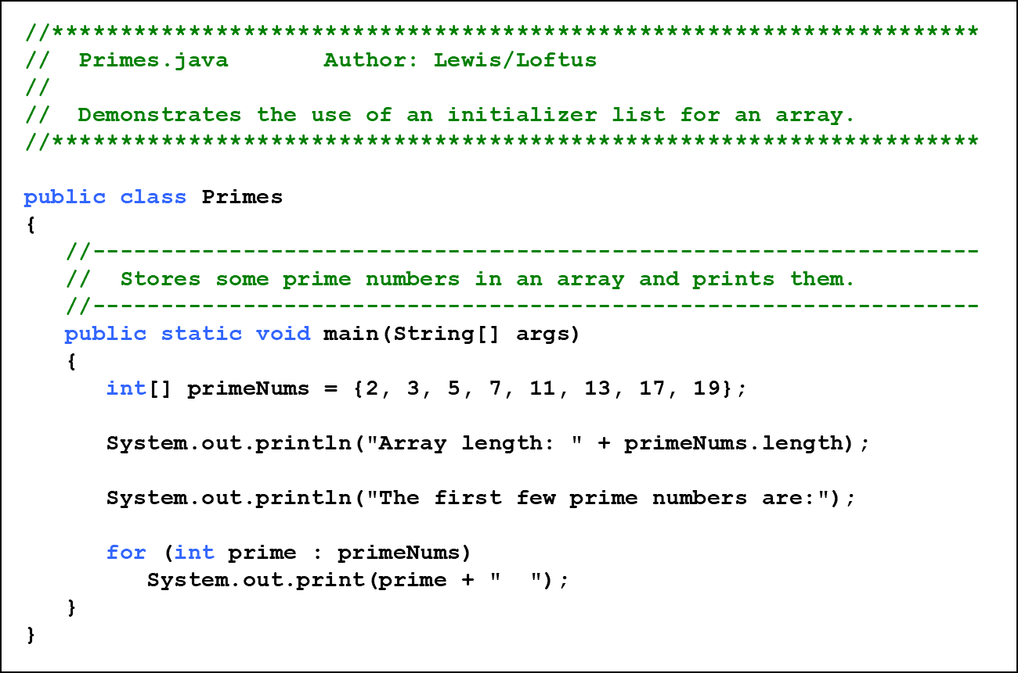
Listing 8.4 (1 of 2)

Slide 32
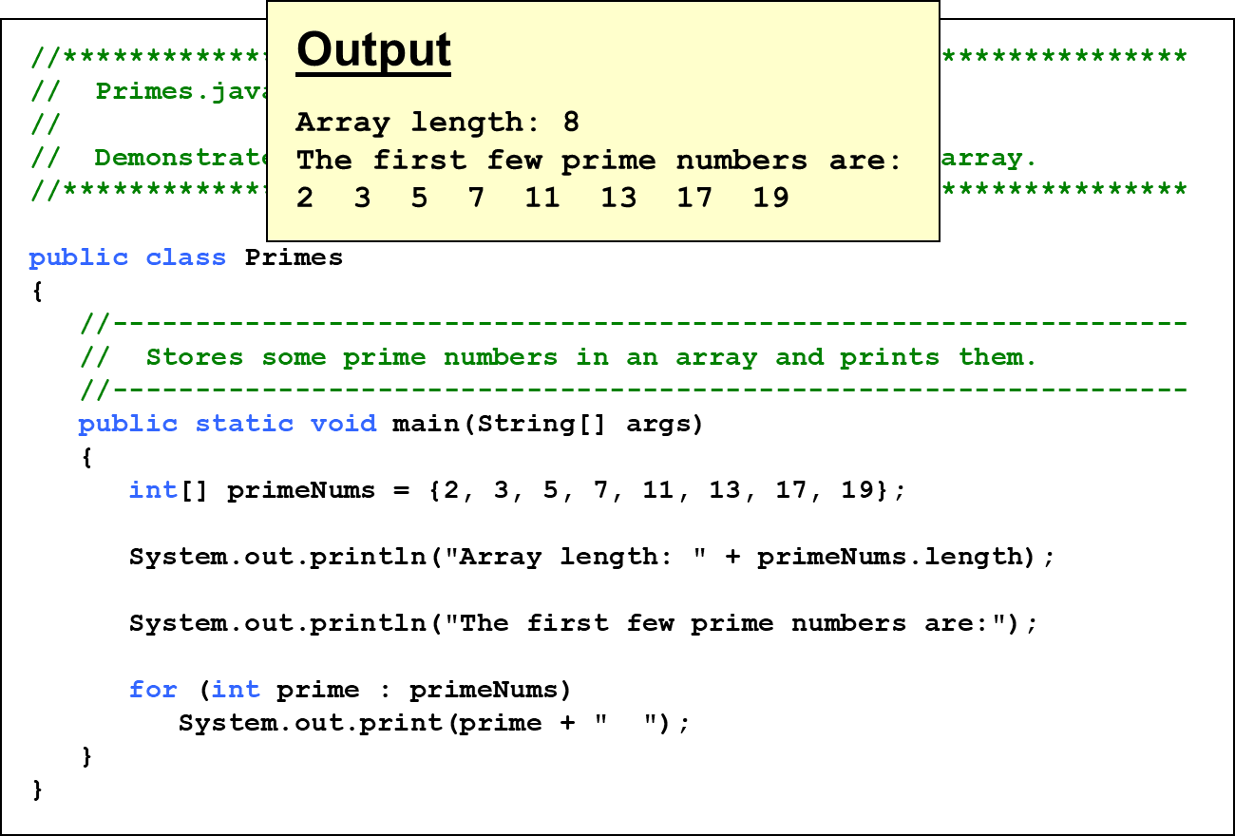
Listing 8.4 (2 of 2)

Slide 33
Arrays as Parameters
An entire array can be passed as a parameter to a method
Like any other object, the reference to the array is passed, making the formal and actual parameters aliases of each other
Therefore, changing an array element within the method changes the original
An individual array element can be passed to a method as well, in which case the type of the formal parameter is the same as the element type

Slide 34
Outline (2 of 7)
Declaring and Using Arrays
Arrays of Objects
Variable Length Parameter Lists
Two-Dimensional Arrays
Polygons and Polylines
Array of Color Objects
Choice Boxes

Slide 35
Arrays of Objects (1 of 7)
The elements of an array can be object references
The following declaration reserves space to store 5 references to String objects
It does NOT create the String objects themselves
Initially an array of objects holds null references
Each object stored in an array must be instantiated separately

Slide 36
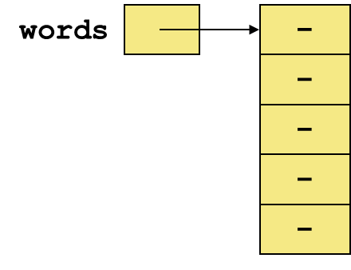
Arrays of Objects (2 of 7)
The words array when initially declared:
At this point, the following line of code would throw a NullPointerException:

Slide 37
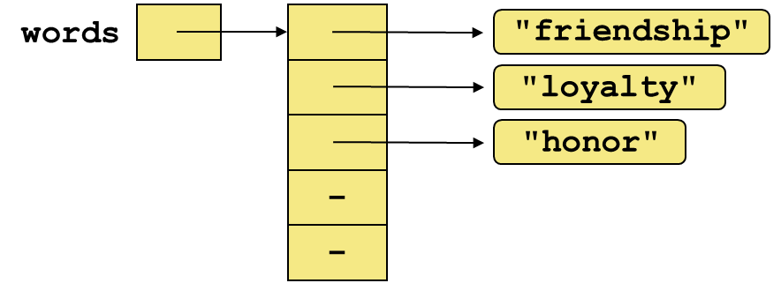
Arrays of Objects (3 of 7)
After some String objects are created and stored in the array:

Slide 38

Arrays of Objects (4 of 7)
Keep in mind that String objects can be created using literals
The following declaration creates an array object called verbs and fills it with four String objects created using string literals

Slide 39
Arrays of Objects (5 of 7)
The following example creates an array of Grade objects, each with a string representation and a numeric lower bound
The letter grades include plus and minus designations, so must be stored as strings instead of char
See GradeRange.java
See Grade.java

Slide 40
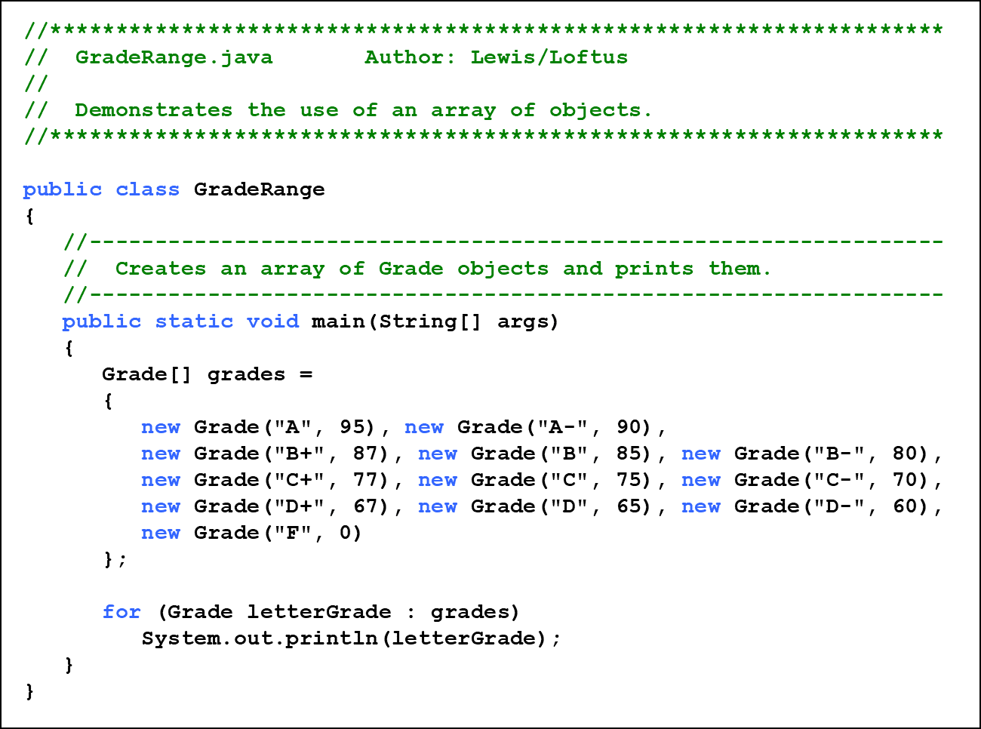
Listing 8.5 (1 of 2)

Slide 41
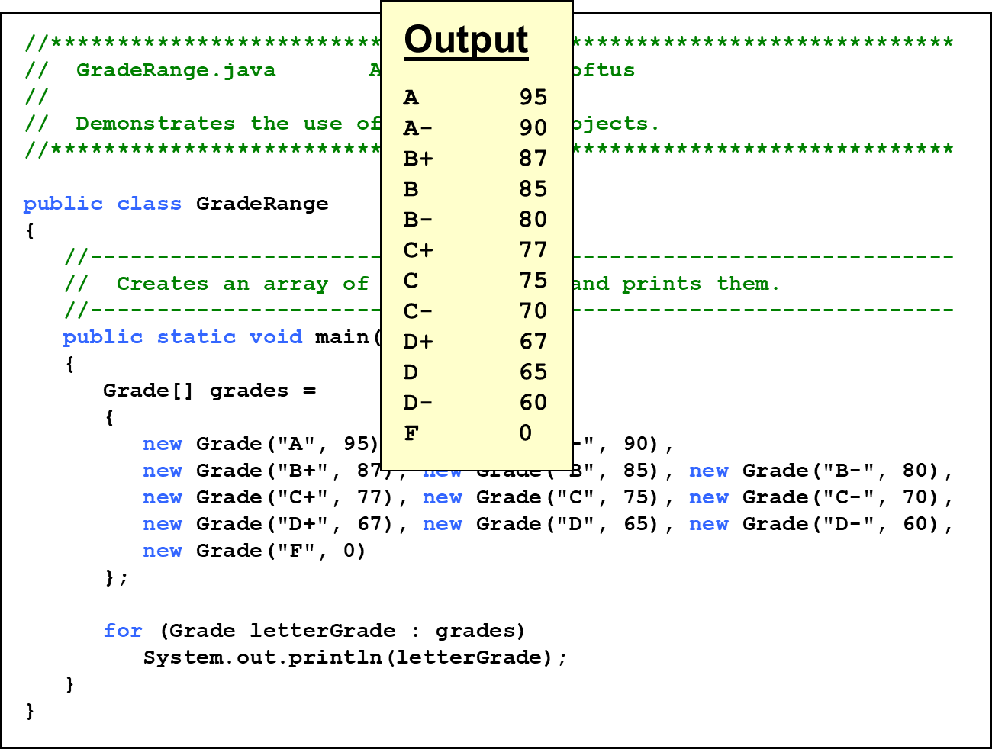
Listing 8.5 (2 of 2)

Slide 42
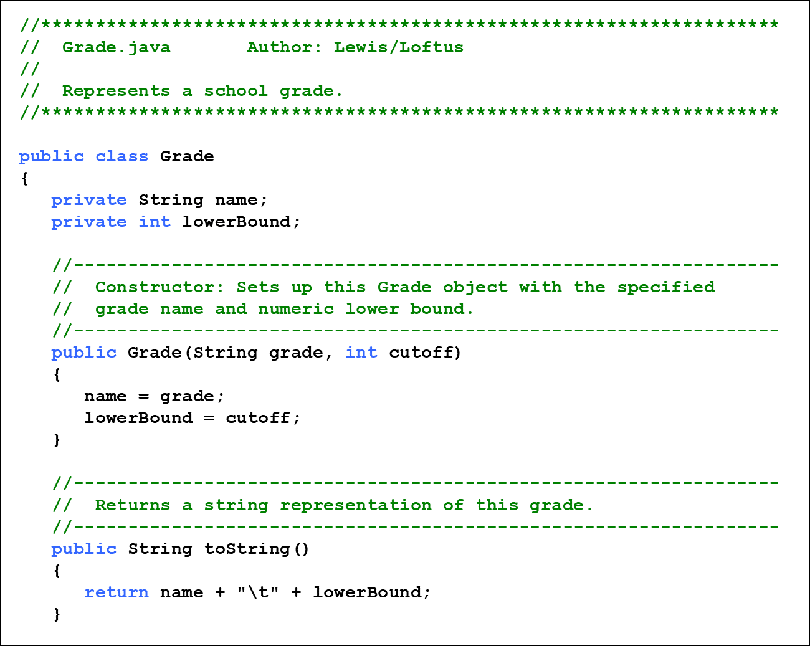
Listing 8.6 (1 of 3)

Slide 43
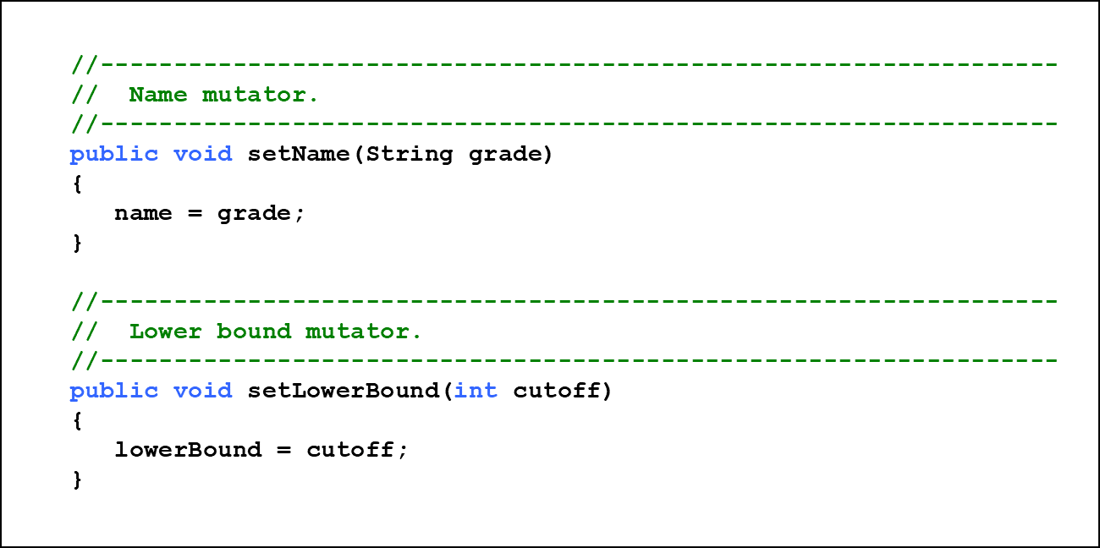
Listing 8.6 (2 of 3)

Slide 44
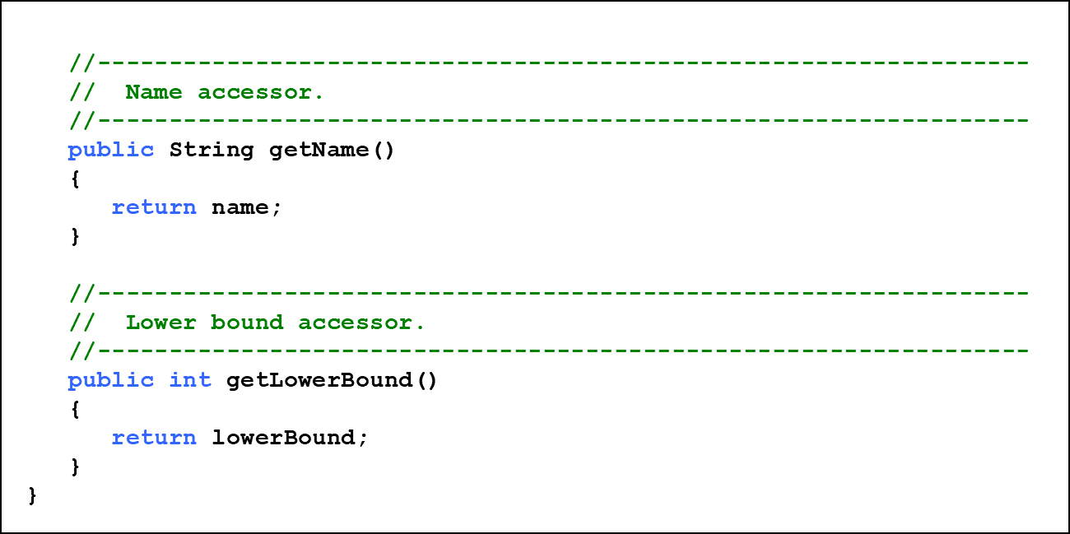
Listing 8.6 (3 of 3)

Slide 45
Arrays of Objects (6 of 7)
Now let’s look at an example that manages a collection of D V D objects
An initial capacity of 100 is created for the collection
If more room is needed, a private method is used to create a larger array and transfer the current D V Ds
See Movies.java
See D V D Collection.java
See D V D.java

Slide 46
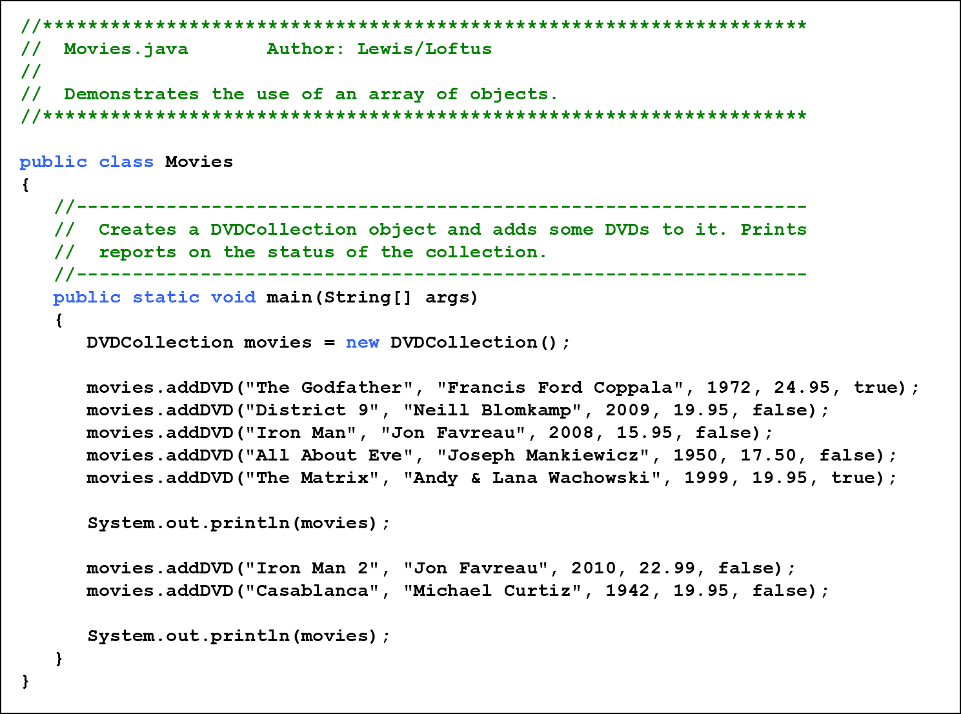
Listing 8.7 (1 of 3)

Slide 47
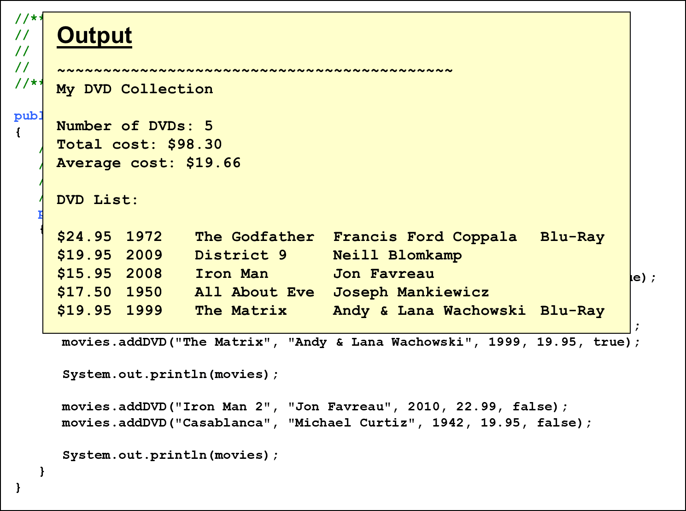
Listing 8.7 (2 of 3)

Slide 48
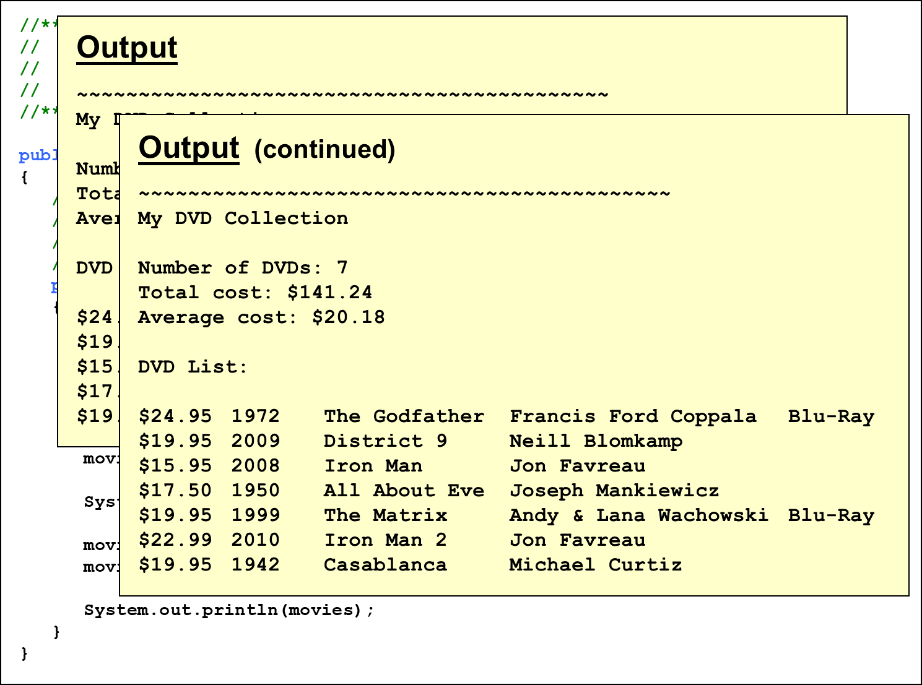
Listing 8.7 (3 of 3)

Slide 49
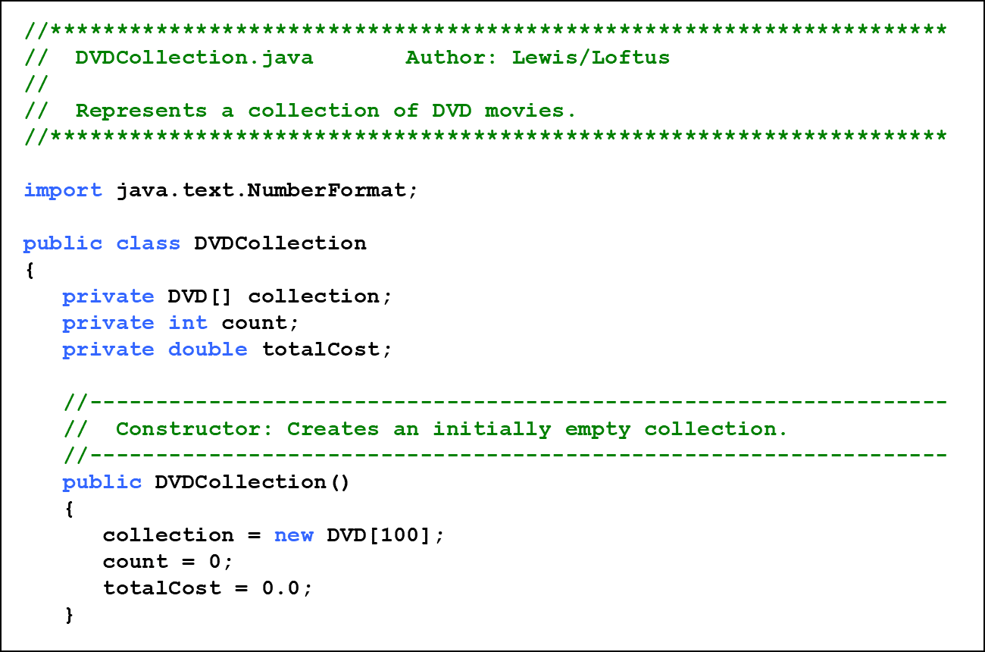
Listing 8.8 (1 of 4)

Slide 50
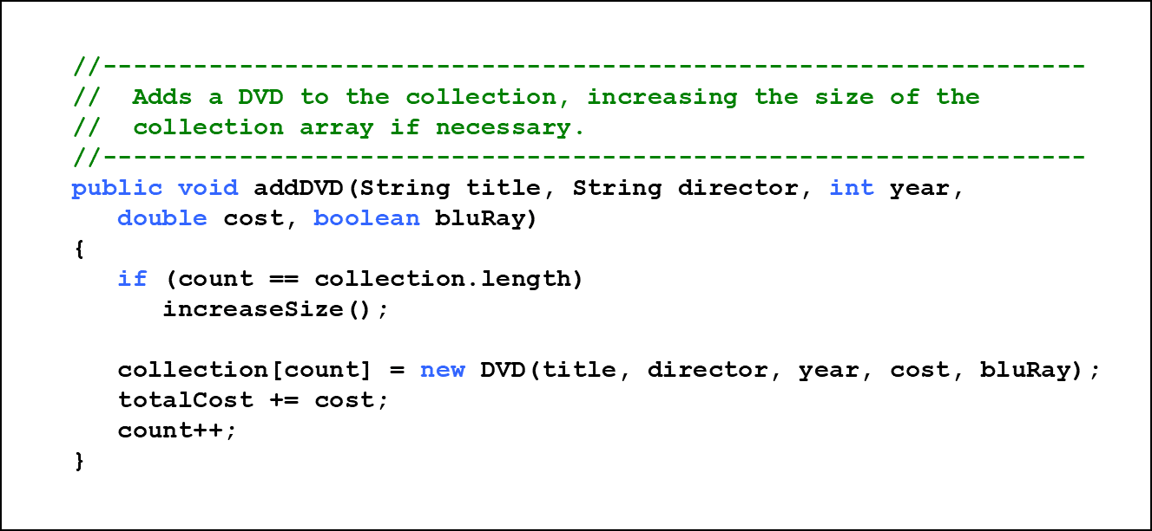
Listing 8.8 (2 of 4)

Slide 51
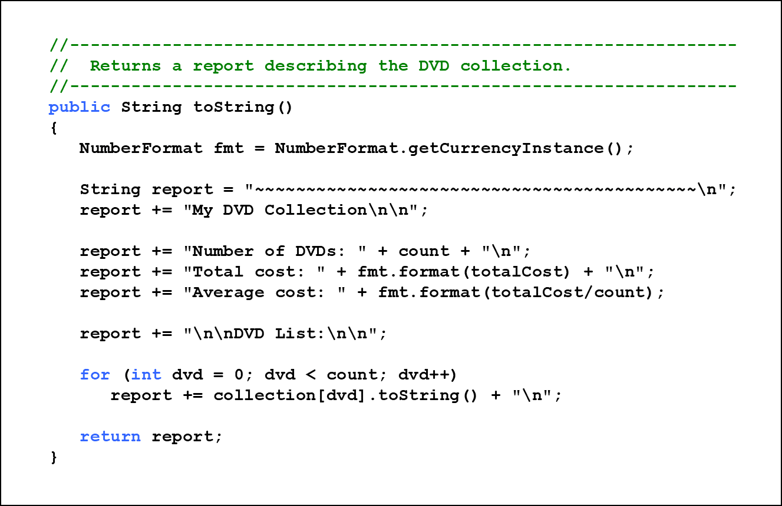
Listing 8.8 (3 of 4)

Slide 52
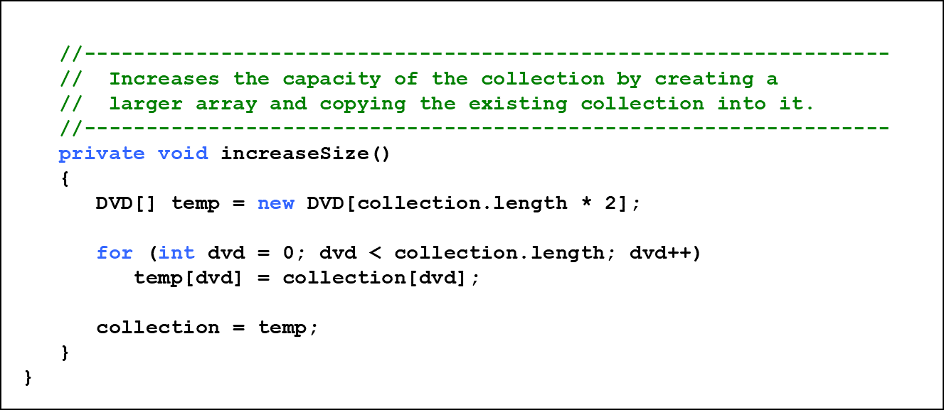
Listing 8.8 (4 of 4)

Slide 53
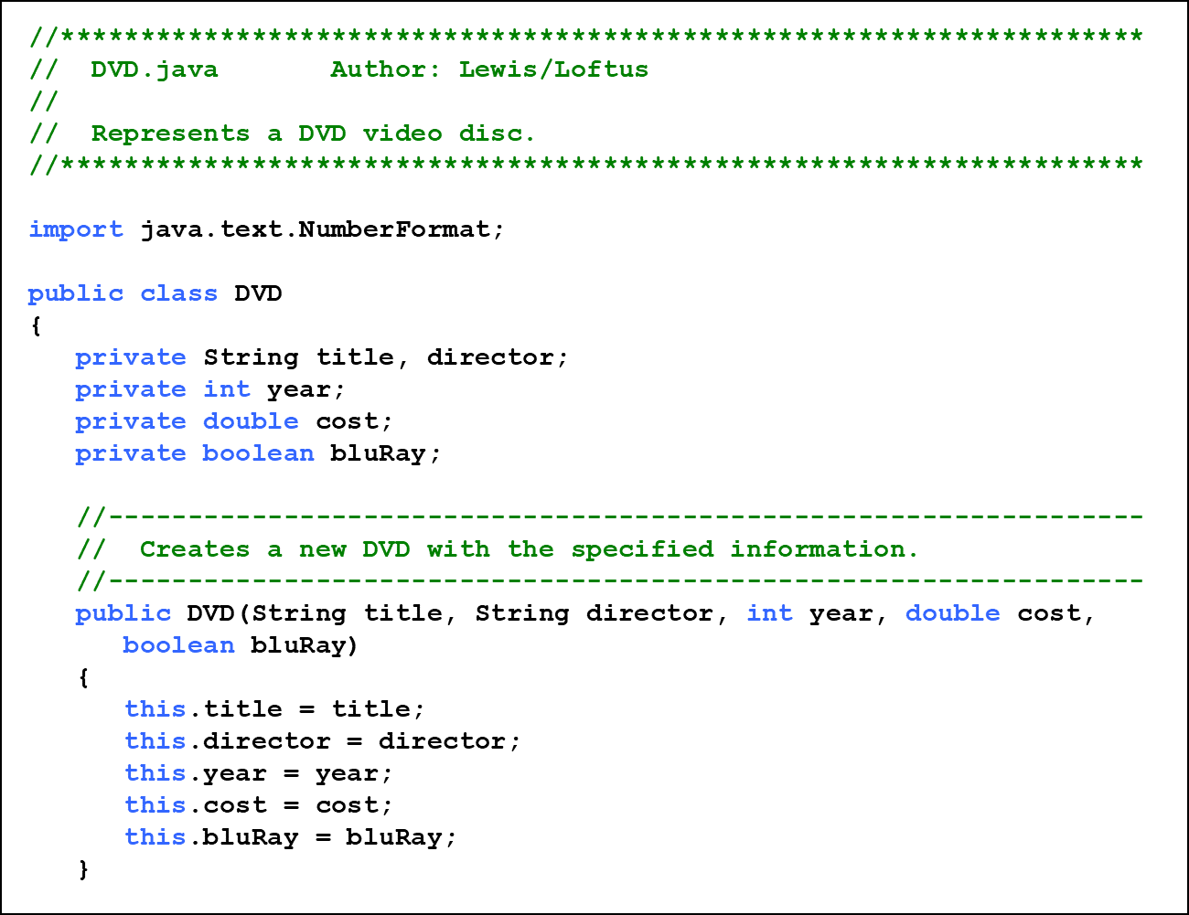
Listing 8.9 (1 of 2)

Slide 54
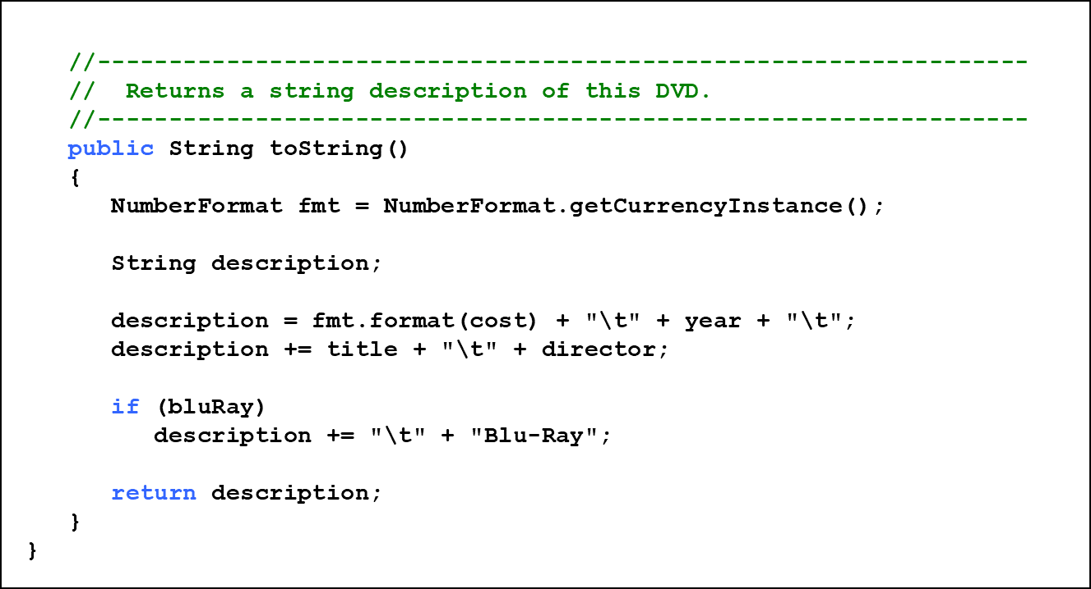
Listing 8.9 (2 of 2)

Slide 55
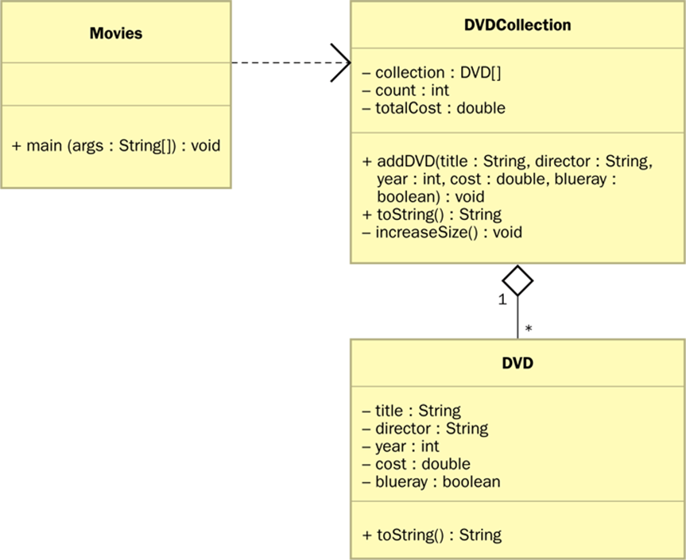
Arrays of Objects (7 of 7)
A U M L diagram for the Movies program:

Slide 56
Command-Line Arguments
The signature of the main method indicates that it takes an array of String objects as a parameter
These values come from command-line arguments that are provided when the interpreter is invoked
For example, the following invocation of the interpreter passes three String objects into the main method of the StateEval program:
See NameTag.java

Slide 57
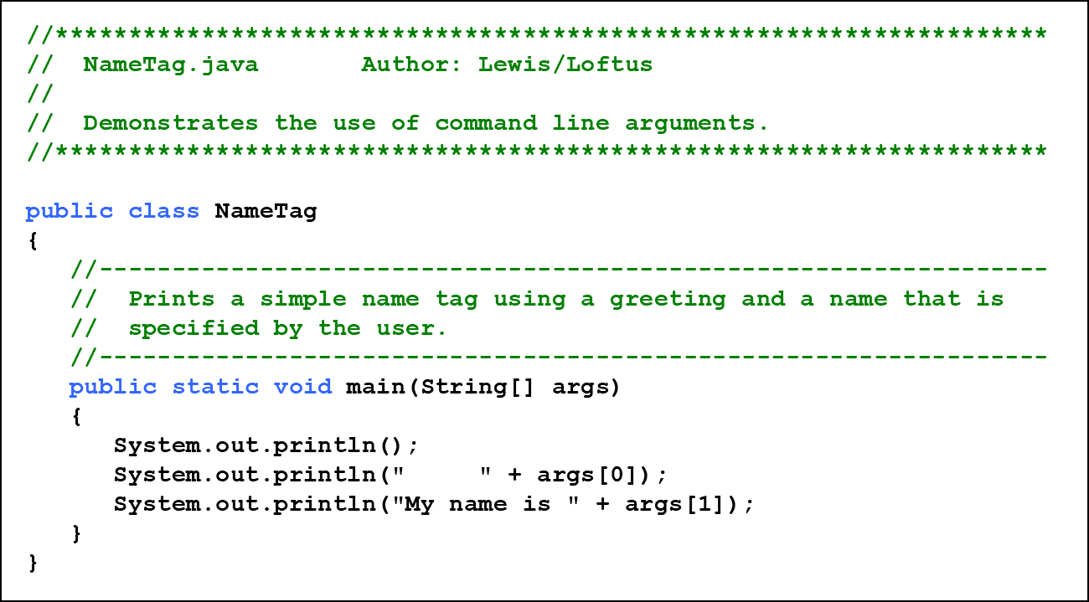
Listing 8.10 (1 of 2)

Slide 58
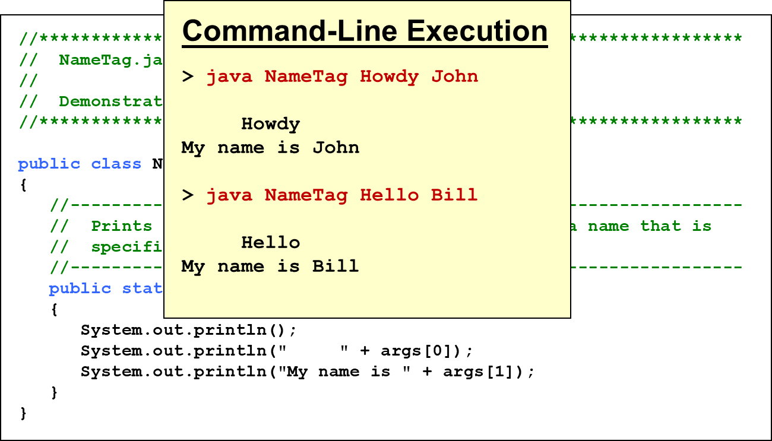
Listing 8.10 (2 of 2)

Slide 59
Outline (3 of 7)
Declaring and Using Arrays
Arrays of Objects
Variable Length Parameter Lists
Two-Dimensional Arrays
Polygons and Polylines
Array of Color Objects
Choice Boxes

Slide 60
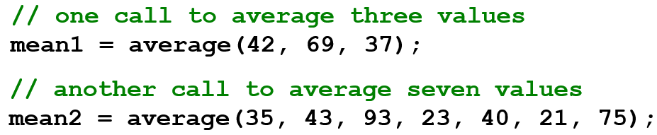
Variable Length Parameter Lists (1 of 7)
Suppose we wanted to create a method that processed a different amount of data from one invocation to the next
For example, let’s define a method called average that returns the average of a set of integer parameters

Slide 61
Variable Length Parameter Lists (2 of 7)
We could define overloaded versions of the average method
  Downside: we’d need a separate version of the method for each additional parameter
We could define the method to accept an array of integers
  Downside: we’d have to create the array and store the integers prior to calling the method each time
Instead, Java provides a convenient way to create variable length parameter lists

Slide 62
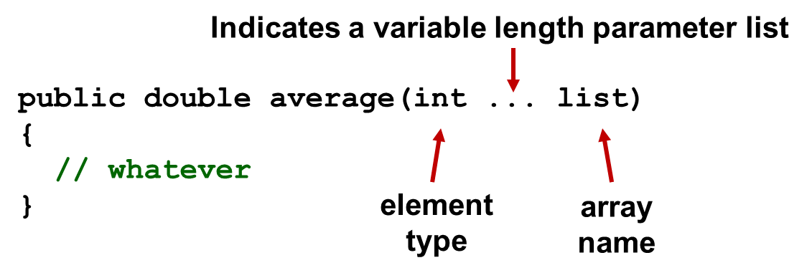
Variable Length Parameter Lists (3 of 7)
Using special syntax in the formal parameter list, we can define a method to accept any number of parameters of the same type
For each call, the parameters are automatically put into an array for easy processing in the method

Slide 63
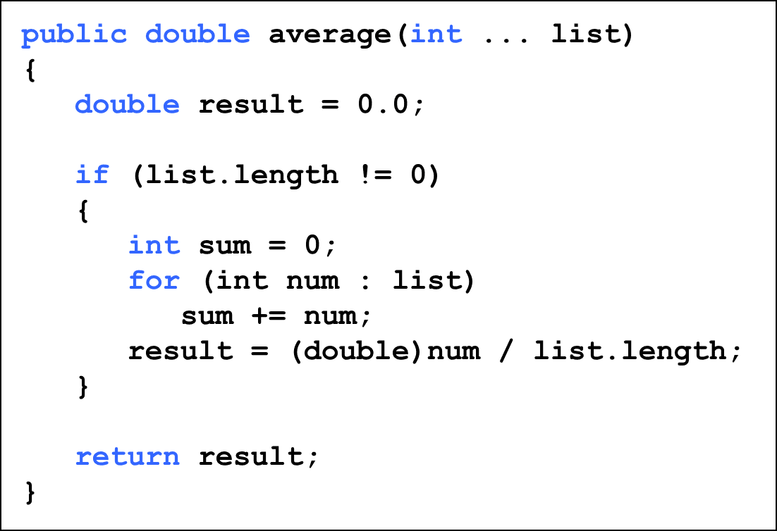
Variable Length Parameter Lists (4 of 7)

Slide 64
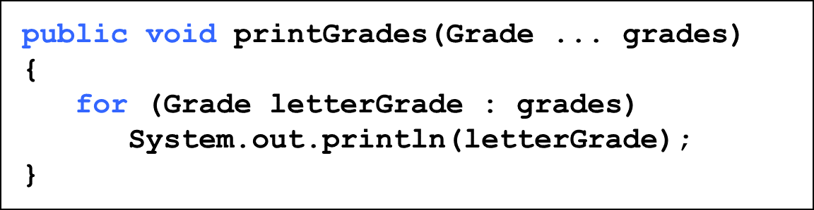
Variable Length Parameter Lists (5 of 7)
The type of the parameter can be any primitive or object type:

Slide 65
Quick Check 2 (1 of 2)
Write method called distance that accepts a variable number of integers (which each represent the distance of one leg of a trip) and returns the total distance of the trip.

Slide 66
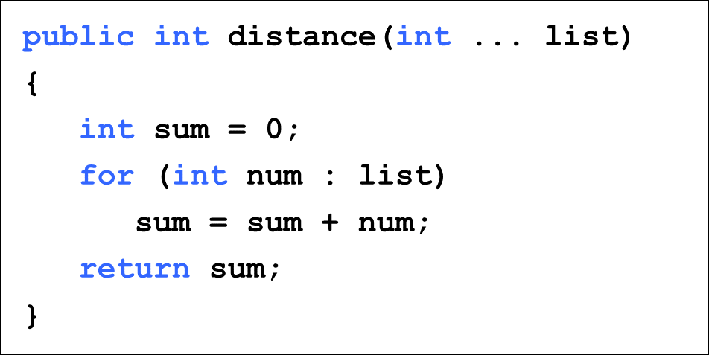
Quick Check 2 (2 of 2)
Write method called distance that accepts a variable number of integers (which each represent the distance of one leg of a trip) and returns the total distance of the trip.

Slide 67
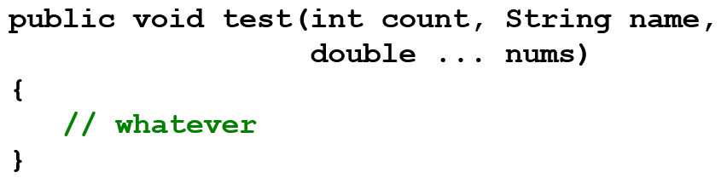
Variable Length Parameter Lists (6 of 7)
A method that accepts a variable number of parameters can also accept other parameters
The following method accepts an int, a String object, and a variable number of double values into an array called nums

Slide 68
Variable Length Parameter Lists (7 of 7)
The varying number of parameters must come last in the formal arguments
A method cannot accept two sets of varying parameters
Constructors can also be set up to accept a variable number of parameters
See VariableParameters.java
See Family.java

Slide 69
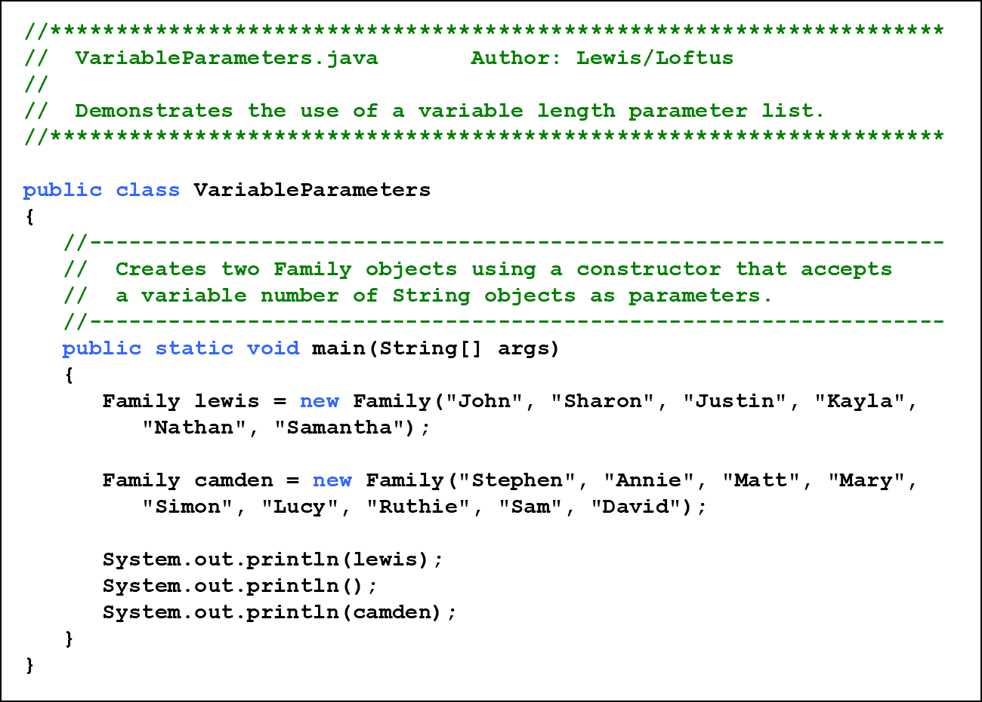
Listing 8.11 (1 of 2)

Slide 70
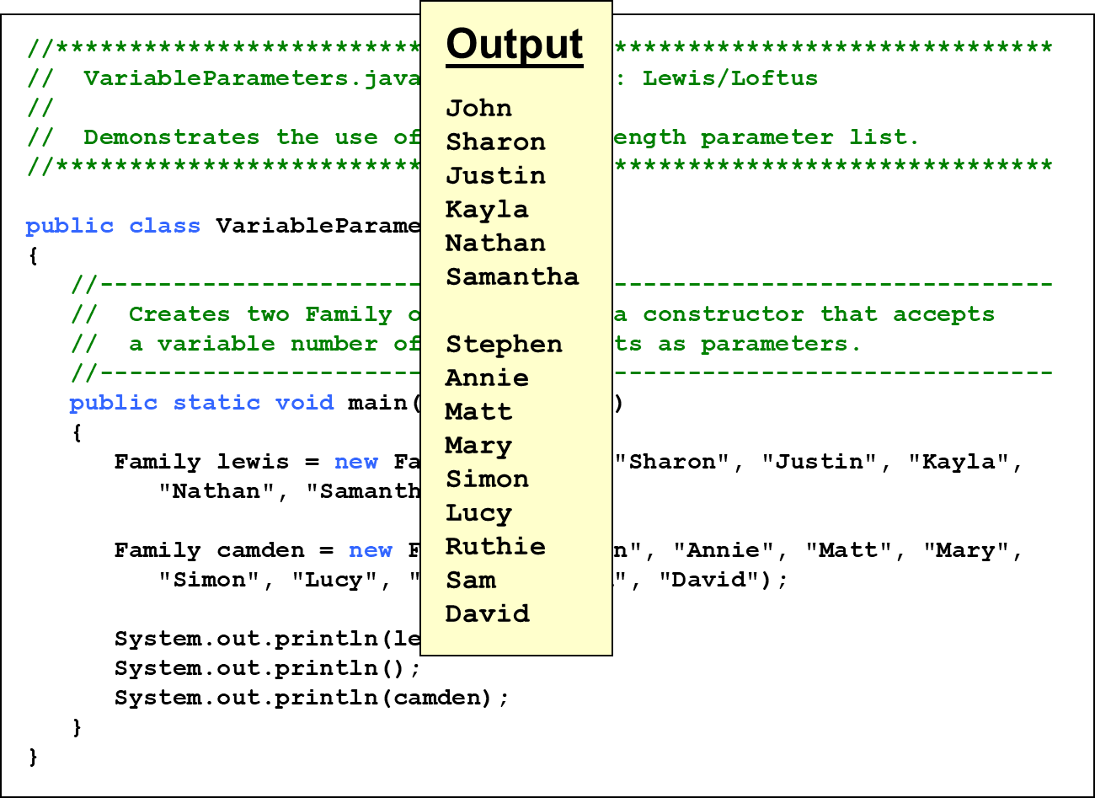
Listing 8.11 (2 of 2)

Slide 71
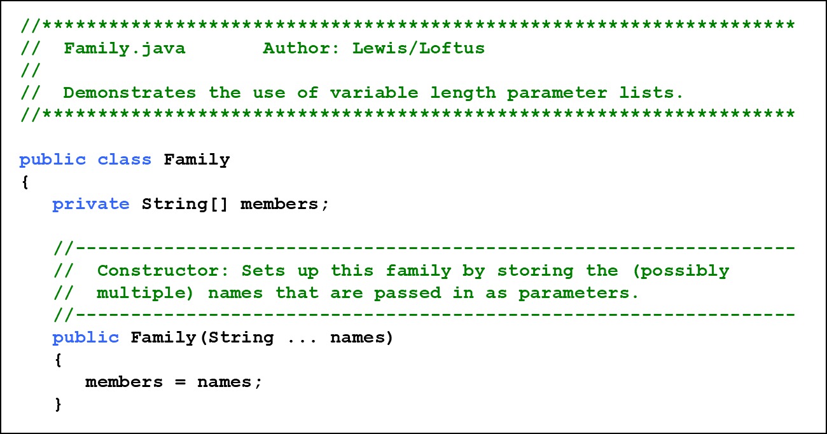
Listing 8.12 (1 of 2)

Slide 72
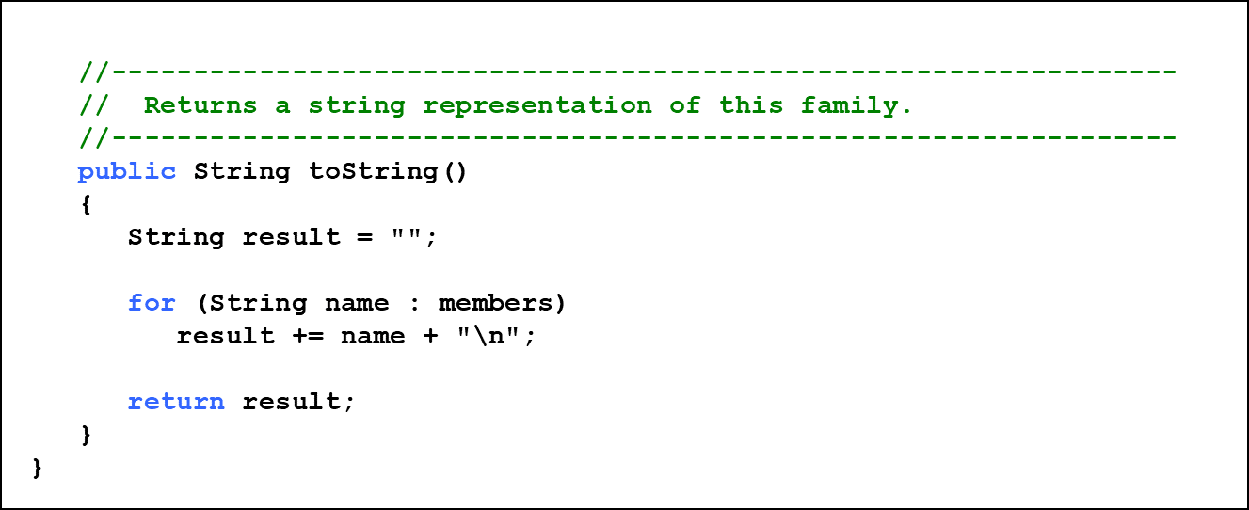
Listing 8.12 (2 of 2)

Slide 73
Outline (4 of 7)
Declaring and Using Arrays
Arrays of Objects
Variable Length Parameter Lists
Two-Dimensional Arrays
Polygons and Polylines
Array of Color Objects
Choice Boxes

Slide 74

Two-Dimensional Arrays (1 of 3)
A one-dimensional array stores a list of elements
A two-dimensional array can be thought of as a table of elements, with rows and columns

Slide 75
Two-Dimensional Arrays (2 of 3)
To be precise, in Java a two-dimensional array is an array of arrays
A two-dimensional array is declared by specifying the size of each dimension separately:
A array element is referenced using two index values:
The array stored in one row can be specified using one index

Slide 76
Two-Dimensional Arrays (3 of 3)
Expression | Type | Description
table | Computer code reads, i n t left bracket right bracket left bracket right bracket | 2D array of integers, or array of integer arrays
table[5] | Computer code reads, i n t left bracket right bracket | array of integers
table[5][12] | Computer code reads, i n t | Integer
See TwoDArray.java
See SodaSurvey.java

Slide 77

Listing 8.13 (1 of 2)

Slide 78

Listing 8.13 (2 of 2)

Slide 79

Listing 8.14 (1 of 3)

Slide 80

Listing 8.14 (2 of 3)

Slide 81

Listing 8.14 (3 of 3)

Slide 82
Multidimensional Arrays
An array can have many dimensions - if it has more than one dimension, it is called a multidimensional array
Each dimension subdivides the previous one into the specified number of elements
Each dimension has its own length constant
Because each dimension is an array of array references, the arrays within one dimension can be of different lengths
  these are sometimes called ragged arrays

Slide 83
Outline (5 of 7)
Declaring and Using Arrays
Arrays of Objects
Variable Length Parameter Lists
Two-Dimensional Arrays
Polygons and Polylines
Array of Color Objects
Choice Boxes

Slide 84
Polygons and Polylines
Arrays can be helpful in graphics processing
For example, they can be used to store a list of coordinates
A polygon is a multisided, closed shape
A polyline is similar to a polygon except that its endpoints do not meet, and it cannot be filled
See Rocket.java

Slide 85

Listing 8.15 (1 of 3)

Slide 86

Listing 8.15 (2 of 3)

Slide 87

Listing 8.15 (3 of 3)

Slide 88
Outline (6 of 7)
Declaring and Using Arrays
Arrays of Objects
Variable Length Parameter Lists
Two-Dimensional Arrays
Polygons and Polylines
Array of Color Objects
Choice Boxes

Slide 89
Arrays of Color Objects
Let’s look at an example that uses an array of Color objects
When the mouse button is clicked, a colored dot is displayed
A double-click clears the window
See Dots.java

Slide 90

Listing 8.16 (1 of 4)

Slide 91

Listing 8.16 (2 of 4)

Slide 92

Listing 8.16 (3 of 4)

Slide 93

Listing 8.16 (4 of 4)

Slide 94
Outline (7 of 7)
Declaring and Using Arrays
Arrays of Objects
Variable Length Parameter Lists
Two-Dimensional Arrays
Polygons and Polylines
Array of Color Objects
Choice Boxes

Slide 95
Choice Boxes
A choice box lets the user select one of several options from a drop down menu
The JukeBox example allows the user to select a song from a choice box
Play and Stop buttons control the song playback
See JukeBox.java

Slide 96

Listing 8.17 (1 of 5)

Slide 97

Listing 8.17 (2 of 5)

Slide 98

Listing 8.17 (3 of 5)

Slide 99

Listing 8.17 (4 of 5)

Slide 100

Listing 8.17 (5 of 5)

Slide 101
Summary
Chapter 8 has focused on:
  array declaration and use
  bounds checking and capacity
  arrays that store object references
  variable length parameter lists
  multidimensional arrays
  polygons and polylines
  choice boxes

Slide 102

Copyright
This work is protected by United States copyright laws and is provided solely for the use of instructors in teaching their courses and assessing student learning. Dissemination or sale of any part of this work (including on the World Wide Web) will destroy the integrity of the work and is not permitted. The work and materials from it should never be made available to students except by instructors using the accompanying text in their classes. All recipients of this work are expected to abide by these restrictions and to honor the intended pedagogical purposes and the needs of other instructors who rely on these materials.

