Slide 1

A Brief Intro to Scala
Tim Underwood

Slide 2
About Me
Tim Underwood
Co-Founder of Frugal Mechanic
Software Developer
Perl, PHP, C, C++, C#, Java, Ruby and now Scala
Before Scala default languages were Ruby and Java

Slide 3
Dynamic vs. Static
Dynamic (Ruby)
Static (Java)
Concise
Scriptable
Read-Eval-Print Loop (irb)
Higher Order Functions
Extend existing classes
Duck Typing
method_missing
Better IDE Support
Fewer Tests
Documentation
Open Source Libs
Performance
JVM Tools (VisualVM)
True Multi-threading

Slide 4
Scala
Concise
Scriptable
Read-Eval-Print Loop
Higher Order Functions
Extend existing classes
Duck Typing
method_missing
Better IDE Support
Fewer Tests
Documentation
Open Source Libs
Performance
JVM Tools (VisualVM)
True Multi-threading

Slide 5
Scalable language

Slide 6
Scala is a modern multi-paradigm programming language designed to express common programming patterns in a concise, elegant, and type-safe way.

Slide 7
Scala
Statically Typed
Runs on JVM, full inter-op with Java
Object Oriented
Functional
Dynamic Features

Slide 8
Scala is Practical
Can be used as drop-in replacement for Java
Mixed Scala/Java projects
Use existing Java libraries
Use existing Java tools (Ant, Maven, JUnit, etc…)
Decent IDE Support (NetBeans, IntelliJ, Eclipse)

Slide 9
Scala is Concise

Slide 10
Type Inference
val sum = 1 + 2 + 3
val nums = List(1, 2, 3)
val map = Map("abc" -> List(1,2,3))

Slide 11
Explicit Types
val sum: Int = 1 + 2 + 3
val nums: List[Int] = List(1, 2, 3)
val map: Map[String, List[Int]] = ...

Slide 12
Higher Level
// Java – Check if string has uppercase character
boolean hasUpperCase = false;
for(int i = 0; i < name.length(); i++) {
if(Character.isUpperCase(name.charAt(i))) {
hasUpperCase = true;
break;
}
}

Slide 13
Higher Level
// Scala
val hasUpperCase = name.exists(_.isUpperCase)

Slide 14
Less Boilerplate
// Java
public class Person {
private String name;
private int age;
public Person(String name, Int age) { // constructor
this.name = name;
this.age = age;
}
public String getName() { // name getter
return name;
}
public int getAge() { // age getter
return age;
}
public void setName(String name) { // name setter
this.name = name;
}
public void setAge(int age) { // age setter
this.age = age;
}
}

Slide 15
Less Boilerplate
// Scala
class Person(var name: String, var age: Int)

Slide 16
Less Boilerplate
// Scala
class Person(var name: String, private var _age: Int) {
def age = _age // Getter for age
def age_=(newAge:Int) { // Setter for age
println("Changing age to: "+newAge)
_age = newAge
}
}

Slide 17
Variables and Values
// variable
var foo = "foo"
foo = "bar" // okay
// value
val bar = "bar"
bar = "foo" // nope

Slide 18
Scala is Object Oriented

Slide 19
Pure O.O.
// Every value is an object
1.toString
// Every operation is a method call
1 + 2 + 3 → (1).+(2).+(3)
// Can omit . and ( )
"abc" charAt 1 → "abc".charAt(1)

Slide 20
Classes
// Classes (and abstract classes) like Java
abstract class Language(val name:String) {
override def toString = name
}
// Example implementations
class Scala extends Language("Scala")
// Anonymous class
val scala = new Language("Scala") { /* empty */ }

Slide 21
Traits
// Like interfaces in Java
trait Language {
val name:String
// But allow implementation
override def toString = name
}

Slide 22
Traits
trait JVM {
override def toString = super.toString+" runs on JVM" }
trait Static {
override def toString = super.toString+" is Static" }
// Traits are stackable
class Scala extends Language with JVM with Static {
val name = "Scala"
}
println(new Scala) → "Scala runs on JVM is Static"

Slide 23
Singleton Objects
// Replaces static methods from Java
// Can extend/implement classes & traits
object Hello {
def world = println("Hello World"}
}
Hello.world → Hello World

Slide 24
Scala is Functional

Slide 25
First Class Functions
// Lightweight anonymous functions
(x:Int) => x + 1
// Calling the anonymous function
val plusOne = (x:Int) => x + 1
plusOne(5) → 6

Slide 26
Closures
// plusFoo can reference any values/variables in scope
var foo = 1
val plusFoo = (x:Int) => x + foo
plusFoo(5) → 6
// Changing foo changes the return value of plusFoo
foo = 5
plusFoo(5) → 10

Slide 27
Higher Order Functions
val plusOne = (x:Int) => x + 1
val nums = List(1,2,3)
// map takes a function: Int => T
nums.map(plusOne) → List(2,3,4)
// Inline Anonymous
nums.map(x => x + 1) → List(2,3,4)
// Short form
nums.map(_ + 1) → List(2,3,4)

Slide 28
Higher Order Functions
val nums = List(1,2,3,4)
// A few more examples for List class
nums.exists(_ == 2) → true
nums.find(_ == 2) → Some(2)
nums.indexWhere(_ == 2) → 1
nums.reduceLeft(_ + _) → 10
nums.foldLeft(100)(_ + _) → 110
// Many more in collections library

Slide 29
Higher Order Functions
// functions as parameters
def call(f: Int => Int) = f(1)
call(plusOne) → 2
call(x => x + 1) → 2
call(_ + 1) → 2

Slide 30
Higher Order Functions
// functions as parameters
def each(xs: List[Int], fun: Int => Unit) {
if(!xs.isEmpty) {
fun(xs.head)
each(xs.tail, fun)
}
}
each(List(1,2,3), println)
→ 1
→ 2
→ 3

Slide 31
Higher Order Functions
// More complex example with generics & pattern matching
@tailrec
def each[T](xs: List[T], fun: T => Unit): Unit = xs match {
case Nil =>
case head :: tail => fun(head); each(tail, fun)
}
each(List(1,2), println)
→ 1
→ 2
each(List("foo", "bar"), println)
→ foo
→ bar

Slide 32
Pattern Matching
def what(any:Any) = any match {
case i:Int => "It's an Int"
case s:String => "It's a String"
case _ => "I don't know what it is"
}
what(123) → "It's an Int"
what("hello") → "It's a String"
what(false) → "I don't know what it is"

Slide 33
Pattern Matching
val nums = List(1,2,3)
// Pattern matching to create 3 vals
val List(a,b,c) = nums
a → 1
b → 2
c → 3

Slide 34
Immutable Types
// Immutable types by default
var nums = Set(1,2,3)
nums += 4 → nums = nums.+(4)
// Mutable types available
import scala.collection.mutable._
val nums = Set(1,2,3)
nums += 4 → nums.+=(4)

Slide 35
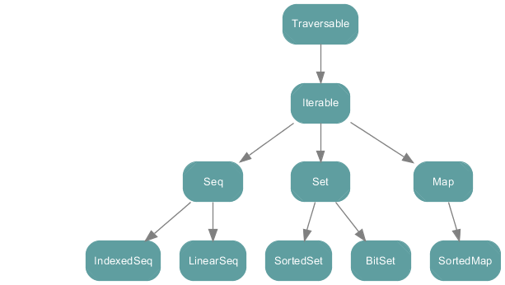
scala.collection

Slide 36
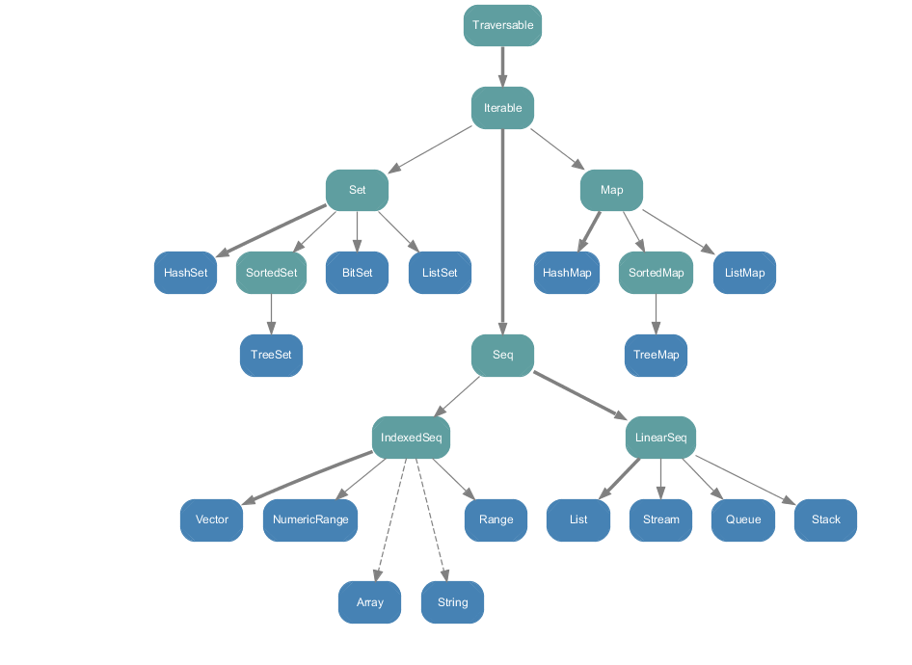
scala.collection.immutable

Slide 37
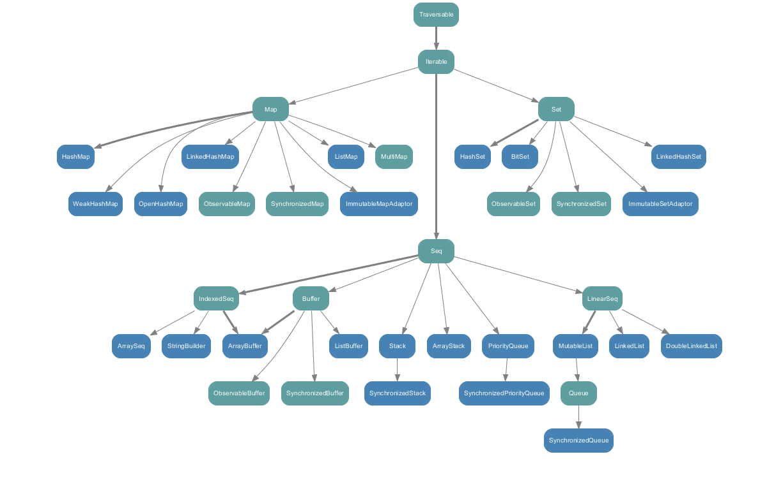
scala.collection.mutable

Slide 38
Or Use Existing Java Collections
java.util
Apache Commons Collections
fastutil
Trove
Google Collections
scala.collection.JavaConversion available to convert to and from java.util Interfaces

Slide 39
Scala is Dynamic
(Okay not really, but it has lots of features typically only found in Dynamic languages)

Slide 40
Scriptable
// HelloWorld.scala
println("Hello World")
bash$ scala HelloWorld.scala
Hello World
bash$ scala -e 'println("Hello World")'
Hello World

Slide 41
Read-Eval-Print Loop
bash$ scala
Welcome to Scala version 2.8.1.final (Java HotSpot(TM) 64-Bit Server VM, Java 1.6.0_22).
Type in expressions to have them evaluated.
Type :help for more information.
scala> class Foo { def bar = "baz" }
defined class Foo
scala> val f = new Foo
f: Foo = Foo@51707653
scala> f.bar
res2: java.lang.String = baz

Slide 42
Structural Typing
// Type safe Duck Typing
def doTalk(any:{def talk:String}) {
println(any.talk)
}
class Duck { def talk = "Quack" }
class Dog { def talk = "Bark" }
doTalk(new Duck) → "Quack"
doTalk(new Dog) → "Bark"

Slide 43
Implicit Conversions
// Extend existing classes in a type safe way
// Goal: Add isBlank method to String class
class RichString(s:String) {
def isBlank = null == s || "" == s.trim
}
implicit def toRichString(s:String) = new RichString(s)
// Our isBlank method is now available on Strings
" ".isBlank → true
"foo".isBlank → false

Slide 44
Implicit Conversions
// Does not type check
"abc".isBlank
// Search in-scope implicits defs that take a
// String & return a type with an isBlank method
implicit def toRichString(s:String):RichString
// Resulting code that type checks
new RichString("abc").isBlank

Slide 45
method_missing (Scala 2.9 Feature)
// Dynamic is a marker trait used by the compiler
class Foo extends Dynamic {
def typed[T] = error("not implemented")
def applyDynamic(name:String)(args:Any*) = {
println("called: "+name+"("+args.mkString(",")+")")
}
}
val f = new Foo
f.helloWorld → called: helloWorld()
f.hello("world") → called: hello(world)
f.bar(1,2,3) → called: bar(1,2,3)

Slide 46
Scala has tons of other cool stuff

Slide 47
Default Parameter Values
def hello(foo:Int = 0, bar:Int = 0) {
println("foo: "+foo+" bar: "+bar)
}
hello() → foo: 0 bar: 0
hello(1) → foo: 1 bar: 0
hello(1,2) → foo: 1 bar: 2

Slide 48
Named Parameters
def hello(foo:Int = 0, bar:Int = 0) {
println("foo: "+foo+" bar: "+bar)
}
hello(bar=6) → foo: 0 bar: 6
hello(foo=7) → foo: 7 bar: 0
hello(foo=8,bar=9) → foo: 8 bar: 9

Slide 49
Everything Returns a Value
val a = if(true) "yes" else "no"
val b = try{
"foo"
} catch {
case _ => "error"
}
val c = {
println("hello")
"foo"
}

Slide 50
Lazy Vals
// initialized on first access
lazy val foo = {
println("init")
"bar"
}
foo → init
foo →
foo →

Slide 51
Nested Functions
// Can nest multiple levels of functions
def outer() {
var msg = "foo"
def one() {
def two() {
def three() {
println(msg)
}
three()
}
two()
}
one()
}

Slide 52
By-Name Parameters
// msg parameter automatically wrapped in closure
def log(doLog:Boolean, msg: => String) {
if(doLog) {
msg // evaluates msg
msg // evaluates msg again!
}
}
def foo:String = {
println("in foo"); "Foo"
}
log(true, foo+" Bar") // foo called twice
→ in foo
→ in foo
log(false, foo+" Bar") // foo never called

Slide 53
Many More Features
Actors
Annotations → @foo def hello = "world"
Case Classes → case class Foo(bar:String)
Currying → def foo(a:Int,b:Boolean)(c:String)
For Comprehensions
→ for(i <- 1.to(5) if i % 2 == 0) yield i
Generics → class Foo[T](bar:T)
Package Objects
Partially Applied Functions
Tuples → val t = (1,"foo","bar")
Type Specialization
XML Literals → val node = <hello>world</hello>
etc…

Slide 54
Personal Experiences
Productive from Day 1
Drop in replacement for Java giving you more Ruby-like syntax and features
Can pickup the functional and higher-level programming concepts as you go

Slide 55
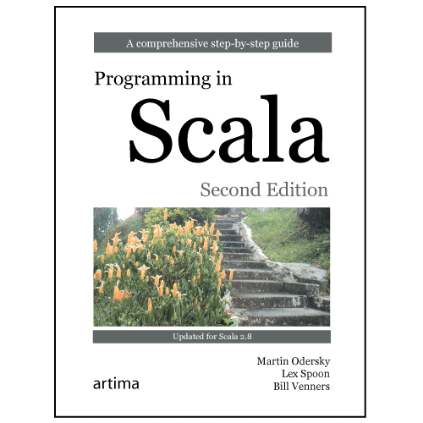
Great Book for a Deep Dive into Scala

Slide 56
www.scala-lang.org

