Slide 1
DESN 368
web 1.0 → 2.0
+ semantics
week 3 · day 1 · spring 2026

Slide 2
Today
Debrief: Web 1.0 vs 2.0 — what did you find?
Understand what semantic HTML is and why it matters
Practice choosing the right HTML elements
In-class: Semantics Challenge

Slide 3
web 1.0 → 2.0
what did you find?

Slide 4
Discussion
What surprised you about early websites?
What could users DO on Web 1.0 sites vs Web 2.0?
How did the role of the user change?
Where do you think we are now — Web 2.0? 3.0?

Slide 5
Web 1.0 — read only
Static HTML pages — no interaction
Content created by a few, consumed by many
No user accounts, no comments, no uploads
Think: digital brochures, encyclopedias
Sites like early Yahoo, Geocities, personal homepages

Slide 6
Web 2.0 — read + write
Users create content (posts, comments, uploads)
Social platforms, wikis, blogs
Dynamic pages — JavaScript everywhere
Think: YouTube, Instagram, Wikipedia, CodePen
The web becomes a platform, not just pages

Slide 7
semantics
what does your HTML mean?

Slide 8
Semantic HTML
Semantic = meaning
Semantic HTML uses elements that describe what the content is, not just how it looks.
Focus on the significance of each tag you use.

Slide 9
Semantic vs Non-Semantic
SEMANTIC (HAS MEANING)
NON-SEMANTIC (NO MEANING)
<header> —> page header
<nav> —> navigation
<main> —> primary content
<article> —> self-contained
<section> —> thematic group
<footer> —> page footer
<h1>–<h6> —> headings
<p> —> paragraph
<div> —> generic container
<span> —> generic inline
These have no meaning.
The designer/coder gives
them purpose via class
names and CSS.

Slide 10
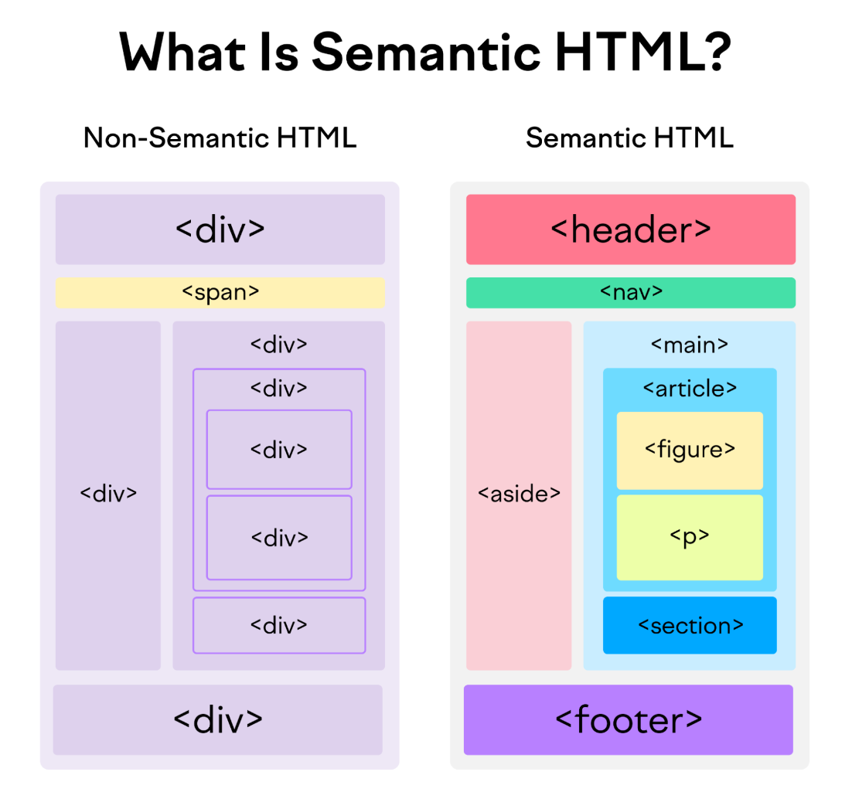

Slide 11
Why This Matters
Accessibility — screen readers use your tags to navigate
SEO — search engines understand your content structure
Developer experience — readable, maintainable code
It's the difference between a pile of divs and a well-organized document

Slide 12
div soup vs semantic HTML
<!-- div soup --> <!-- semantic -->
<div class="header"> <header>
<div class="nav"> <nav>...</nav>
...</div> </header>
</div> <main>
<div class="content"> <article>
<div class="article"> ...
...</div> </article>
</div> </main>

Slide 13
in-class challenge
Acme Supply — fix the semantics

Slide 14
Semantics Challenge
Open the assignment on Canvas
You'll get an codepen.io HTML doc for Acme Supply's website
It's built with divs and spans — no semantic meaning
Your job: replace them with the right semantic elements
Work individually — I'll be floating around

Slide 15
For Thursday
Finish the semantics challenge if you didn't in class
Homework: Codecademy: Learn CSS Introduction (on Canvas) wk 2 visual notes : Semantic HTML
r
Thursday: GitHub Codespace, clean up + CSS basics
We start making things look good

