Slide 1
Database System Implementation CSE 507
Introduction and File Structures
Some slides adapted from R. Elmasri and S. Navathe, Fundamentals of Database Systems, Sixth Edition, Pearson.
And Silberschatz, Korth and Sudarshan Database System Concepts – 6th Edition.

Slide 2
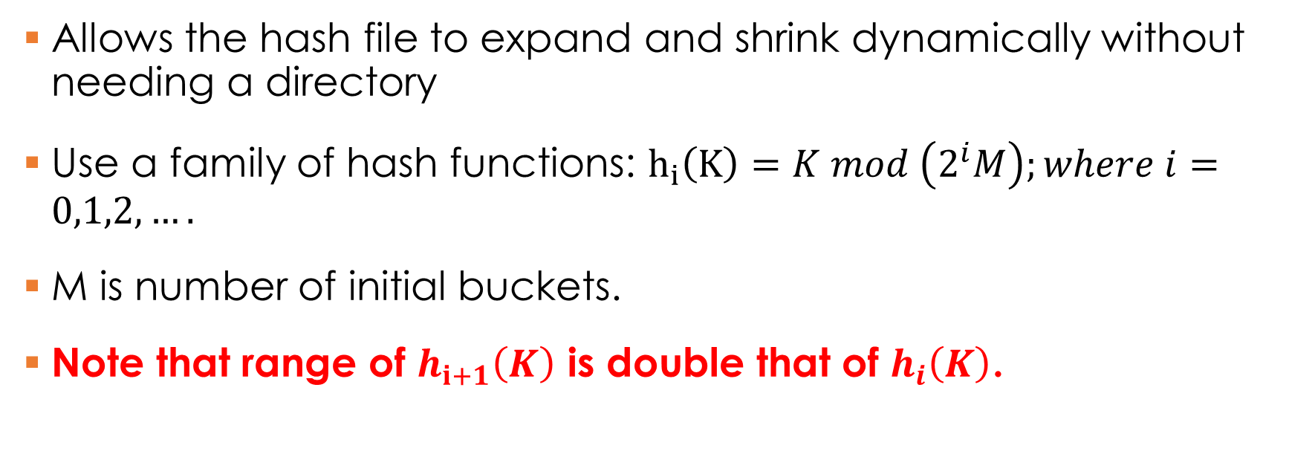
Linear Hashing
Allows the hash file to expand and shrink dynamically without needing a directory
Use a family of hash functions: $h_{i}\left(K\right)=K mod \left(2^{i}M\right);where i=0,1,2,….$
M is number of initial buckets.
Note that range of $h_{i+1}\left(K\right)$ is double that of $h_{i}\left(K\right)$.

Slide 3
Linear Hashing
Directory is avoided in Linear Hash.
Choosing bucket to split in a round-robin fashion.
Splitting proceeds in “rounds.”
Round ends when all the initial buckets (Nr) for a round R are split.
At any stage during a round, the buckets 0 to Next-1 have been split.
The new buckets results from splits are placed after Nr.
Some material adapted from Prof J. Harista IISC Bangalore.

Slide 4

Linear Hashing (LH)
At any stage, the file would be using at most two hash functions
$h_{i+1}\left(K\right)$ o$r h_{i}\left(K\right)$
Some material adapted from Prof J. Harista IISC Bangalore.

Slide 5

Linear Hashing (LH)
At any stage, the file would be using at most two hash functions
$h_{i+1}\left(K\right)$ o$r h_{i}\left(K\right)$
The index i or (i+1) finally used for a bucket is called the bucket level.
Some material adapted from Prof J. Harista IISC Bangalore.

Slide 6
Snapshot of a LH file
……
Buckets at the beginning of a round R.
……

Slide 7
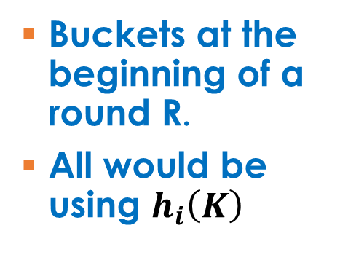
Snapshot of a LH file
……
Buckets at the beginning of a round R.
All would be using $h_{i}\left(K\right)$
……

Slide 8
Snapshot of a LH file
Pointer (Next) to the bucket to be split
……
Buckets at the beginning of a round R.
All would be using $h_{i}\left(K\right)$
……

Slide 9
Snapshot of a LH file
When this is split a new bucket is created at the end.
……
Buckets at the beginning of a round R.
All would be using $h_{i}\left(K\right)$
……

Slide 10

Snapshot of a LH file
……
Buckets at the beginning of a round R.
These would be using $h_{i+1}\left(K\right)$
……

Slide 11

Snapshot of a LH file
……
Buckets at the beginning of a round R.
These would still be using $h_{i}\left(K\right)$
……

Slide 12
Snapshot of a LH file
Buckets already split
h_{i+1}(K)
……
Buckets at the beginning of a round R.
Buckets to be split
……
New Buckets
According to h_{i+1}(K)

Slide 13
Snapshot of a LH file
Buckets to be split next
……
Buckets at the beginning of a round R.
Buckets to be split
Use h_{i}(k)
……
New Buckets
According to h_{i+1}(K)

Slide 14
Search Algorithm for a Key k
Buckets already split
h_{i+1}(K)
Check if h_{i} (k) falls in the red region
……
Buckets to be split
h_{i}(K)
……
New Buckets
According to h_{i+1}(K)

Slide 15
Search Algorithm for a Key k
Buckets already split
h_{i+1}(K)
If yes then use h_{i+1} (k)
Why??
……
Buckets to be split
h_{i}(K)
……
New Buckets
According to h_{i+1}(K)

Slide 16
Search Algorithm for a Key k
Else h_{i} (k) gives the correct bucket.
Why??
Buckets already split
h_{i+1}(K)
……
Buckets to be split
h_{i}(K)
……
New Buckets
According to h_{i+1}(K)

Slide 17
Searching Algorithm
Step 1: bucketaddr h_{i} (key)
Step 2: bucketaddr < Nexttosplit
Then bucketaddr h_{i+1}(key)

Slide 18
Snapshot of overflow in insertion algo
Next Bucket to be split
All records in this bucket are re-hashed using h_{i+1}
……
Insertion over here caused an overflow
……

Slide 19
Insert Algorithm for Linear Hashing
Find bucket by applying h_{i}/ h_{i+1}:
–If bucket to insert into is full:
Add overflow page and insert data entry.
Split Next bucket and increment Next pointer
(Uncontrolled split)
Some material adapted from Prof J. Harista IISC Bangalore.

Slide 20
Some Comments
Since buckets are split round-robin, long overflow chains don’t develop!
Doubling of directory in Extendible Hashing is similar;
switching of hash functions is implicit in how the # of bits examined is increased
Splits can be controlled using load factor.
Some material adapted from Prof J. Harista IISC Bangalore.

Slide 21
LH* --- Linear Hashing in a Distributed Setting
Litwin et. Al. “LH* -- A Scalable, Distributed Data Structure,” ACM Transactions on Database Systems, 21(4), 480--525

Slide 22
LH* --- Linear Hashing in a Distributed Setting
Setting:
Several client sites share a file F.
The clients insert records given keys.
F is stored on server sites
Clients and server are whole machines, i.e., nodes of a network.
Each server provides a storage space for objects of F called a bucket.
A server can send records to other servers.
LH* can accommodate any number of clients and servers.

Slide 23
LH* --- Linear Hashing in a Distributed Setting
LH* meets the following criteria:
The file expands to new servers gracefully, and only when already used servers are efficiently loaded.
There is no master site that the record address computations must go through.
The file access and maintenance primitives, e.g, search, insertion and split, etc., never require atomic updates to multiple clients.

Slide 24
Key Features of LH*
The file can grow to practically any size, with load factor about constant.
Insertion usually requires one message, and three in worst case.
Retrieval usually requires two messages, and four on worst case.
Supports parallel operations.

Slide 25
Key Features of LH*
With and without a specialized Split Coordinator site.
In basic version (these slides) splitting is serialized by the split coordinator.
Several other variants, e.g., parallel splits and autonomous splitting.

Slide 26
Snapshot of LH*
Client 1
N’ = 5
I’ = 6
Client 2
N’ = 0
I’ = 2
Client M
N’ = 31
I’ = 9
J = 10
J = 10
J = 9
J = 10
J = 10
Server 0
Server 1
Server 80
Server 583
Server 591
Next Split (N)

Slide 27
Addressing in LH*
Records of a LH* file are manipulated by the clients.
LH is based on the assumption that we know the correct N and I.
In a distributed setting with multiple clients this is only possible if we have master site (inefficient).
LH* do not require all the clients to have a consistent view of N and I.
Each client has its own view of N (N’) and I (I’).

Slide 28
Addressing in LH*
Step1: Client address calculation.
Step2: Server address calculation.

Slide 29
Addressing in LH* --- Algorithm at Client
Algorithm at Client (A1) with its own N’ and I’
Step 1: bucketaddr h_{i’} (key)
Step 2: bucketaddr < N’
Then bucketaddr h_{i’+1}(key)

Slide 30
Addressing in LH*
Step1: Client address calculation.
Client computing the address using its N’ and I’ (both initialized to 0).
Sends the request to the concerned server.
Client image is updated in case of an addressing error.
Global N and I are not known to client, it slowly reaches there through updates.
Step2: Server address calculation.

Slide 31
Addressing in LH*
Step1: Client address calculation.
Step2: Server address calculation.
A server receiving a key, first verifies whether it should be the recipient.
If not the server re-calculates the address and forwards.
This is forwarding can at most take place 2 times.

Slide 32
Example on Client side Addressing
Actual File
N =7 and I=4
J = 5
J = 4
J = 5
0
6
7
15
16
22
Insert Key = 7
Client Image
N’ =3 and I’=3
J = 4
J = 3
J = 4
0
2
3
7
8
10

Slide 33
Example on Client side Addressing
Actual File
N =7 and I=4
J = 5
J = 4
J = 5
0
6
7
15
16
22
Insert Key = 15
Client Image
N’ =3 and I’=3
J = 4
J = 3
J = 4
0
2
3
7
8
10

Slide 34
Example on Client side Addressing
Actual File
N =7 and I=4
J = 5
J = 4
J = 5
0
6
7
15
16
22
Insert Key = 20
Client Image
N’ =4 and I’=3
J = 4
J = 3
J = 4
0
3
4
7
8
10

Slide 35
Addressing in LH* --- Algorithm at Server
Each Bucket (server) in LH* retains its level (J = I or J = I + 1).
Value of N (next bucket to be split) is not known to servers.
A server with bucket address A, recalculates the Key’s address A’
Step 1: A’ h_{J} (key)
Step 2: If A’ != A
A’’ h_{J-1}(key)
If A’’ > A and A’’ < A’ then A’ A’’
Forward the message to A’

Slide 36
Some things to Remember About Addressing
Item 1: h_{J+1} (key) >= h_{J} (key)
Item 2: At instant the LH* can only have buckets
at I or I+1

Slide 37
Example on Server side Addressing
Actual File
N =7 and I=4
J = 5
J = 4
J = 5
0
6
7
15
16
22
Client Image was
N’ =3 and I’=3
Insert Key = 15; Client – 7; Actual 15
Step 1: A’ = 15 Mod 2^4 (J=4 for server 7)= 15
Step 2: A’ != A (15 != 7)
A’’ = 15 Mod 8
If condition not satisfied (A’’ is not > A, they are ==)
Message Forwarded to server 15 (Correct address)
Server Side Algorithm

Slide 38
Example on Server side Addressing
32
216
251
153
10
6
Client at N’=0 and I’= 0
Actual File
N =1 and I=1
J = 2
J = 1
J = 2
Insert Key = 7; Client – 0; Actual 1

Slide 39
Example on Server side Addressing
32
216
251
153
10
6
Client at N’=0 and I’= 0
Actual File
N =1 and I=1
J = 2
J = 1
J = 2
Insert Key = 7; Client – 0; Actual 1
Server 3 does not exist !
Step 1: A’ = 7 Mod 2^2 (J=2 for server 0)= 3
Step 2: A’ != A (3 != 0)
A’’ = 7 Mod 2 = 1
If condition satisfied (A’’ > A && A’ > A’’)
Message Forwarded to server 1 (Correct address)
Server Side Algorithm
Prevents requests from going to invalid servers

Slide 40
Example on Sever side Addressing
216
12
145
321
10
6
251
215
Actual File
N =0 and I=2
Client at N’=0 and I’= 0
J = 2
J = 2
J = 2
J = 2
Insert Key = 7; Client – 0; Actual 3

Slide 41
Example on Sever side Addressing
216
12
145
321
10
6
251
215
Actual File
N =0 and I=2
Client at N’=0 and I’= 0
J = 2
J = 2
J = 2
J = 2
Insert Key = 7; Client – 0; Actual 3
But can send them to a more conservative place
Step 1: A’ = 7 Mod 2^2 (J=2 for server 0)= 3
Step 2: A’ != A (3 != 0)
A’’ = 7 Mod 2 = 1
If condition satisfied (A’’ > A && A’ > A’’)
Message Forwarded to server 1 (Not Correct address)
Sever Side Algorithm

Slide 42
Example on Server side Addressing
216
12
145
321
10
6
251
215
Actual File
N =0 and I=2
Client at N’=0 and I’= 0
J = 2
J = 2
J = 2
J = 2
Insert Key = 7; Client – 0; Actual 3; Forwarded from 0
But can pull this off only once.
Step 1: A’ = 7 Mod 2^2 (J=2 for server 1)= 3
Step 2: A’ != A (3 != 1)
A’’ = 7 Mod 2 = 1
If condition not satisfied (A’’ > A && A’ > A’’)
Message Forwarded to server 3 (Correct address)
Server Side Algorithm

Slide 43
Example on Server side Addressing
Actual File
N =7 and I=4
J = 5
J = 4
J = 5
0
6
7
15
16
22
Client Image
N’=0 and I’=0
Insert Key = 20; Client – 0; Actual 20
Step 1: A’ = 20 Mod 2^5 (J=5 for server 0)= 20
Step 2: A’ != A (20 != 0)
A’’ = 20 Mod 16 = 4
If condition satisfied (A’’ > A && A’ > A’’)
Message Forwarded to server 4 (Incorrect address)
Server Side Algorithm

Slide 44
Example on Server side Addressing
Actual File
N =7 and I=4
J = 5
J = 4
J = 5
0
6
7
15
16
22
Client Image
N’=0 and I’=0
Insert Key = 20; Client – 0; Actual 20; From Server 0
Step 1: A’ = 20 Mod 2^5 (J=5 for server 0)= 20
Step 2: A’ != A (20 != 0)
A’’ = 20 Mod 16 = 4
If condition not satisfied (A’’ == A && A’ > A’’)
Message Forwarded to server 20 (Correct address)
Server Side Algorithm

Slide 45
Client Image Adjustment
Client updates its N’ and I’ whenever it encounters a addressing error.
A is the address where the client sent its key.
J is the level at server A (J is returned in image adj message).
Certainly not the accurate but it gets closer with each error.
Step 1: I’ J -1; N’ A + 1;
Step 2: If N’ >= 2^I’ then
N’ 0
I’ I’ + 1

Slide 46
Client Image Adjustment Example
Client Image
N’ =3 and I’=3
J = 4
J = 3
J = 4
0
2
3
7
8
10
Insert Key = 15; Client – 7; Actual 15; Server 7 was at level 4
Adjusted Image
N’ =0 and I’=4
J = 4
0
15

Slide 47
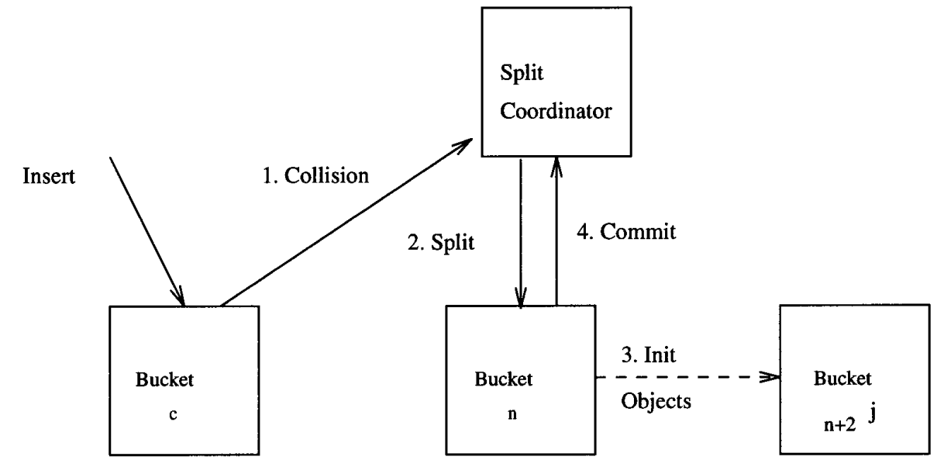
Splitting in LH* (Uncontrolled)

Slide 48
Splitting in LH*
Splitting coordinator computes the value of new I and NexttoSplit
Server n (with bucket level J) which receives a message to split.
Step 1: Creates a bucket n + 2^j with level J+1
Step 2: splits bucket n applying h_{J+1}
Step 3: Updates J J + 1
Step 4: Commits the split to the splitting coordinator

Slide 49
Introduction to Buffering in Databases

Slide 50
Buffer Managers
Buffer manager: A module in a database intelligently shuffles data from main memory to disk.
It is transparent to higher levels of DBMS operation
Material adapted from Prof Chris Re Stanford.

Slide 51
Buffer Managers
Page Requests from Higher Levels
READ
WRITE
BUFFER POOL
disk page
free frame
INPUT
OUTUPT
MAIN MEMORY
DISK
choice of frame dictated
by replacement policy
DB
Data must be in RAM for DBMS to operate on it!
Table of <frame#, pageid> pairs is maintained
Material adapted from Prof Chris Re Stanford.

Slide 52
When a bucket/page is requested
If the requested page/bucket in the buffer pool
No need to go back to the disk!
If not? Choose a frame to replace.
If there is a free frame, use it!
Terminology: We pin a page (means it’s in use)
If not? We need to choose a page to remove!
What would be good strategy? --- Replacement policy
Material adapted from Prof Chris Re Stanford.

Slide 53
A simple strategy
A page is dirty, if its contents have been changed after writing
Buffer Manager keeps a dirty bit
Say we choose to evict P
If P is dirty, we write it to disk
What if no page is dirty?
Or multiple pages are dirty?
Material adapted from Prof Chris Re Stanford.

Slide 54
Review of Some strategies from OS-- LRU
Order pages by the time of last accessed
Always replace the least recently accessed
P5, P2, P8, P4, P1, P9, P6, P3, P7
Access P6
P6, P5, P2, P8, P4, P1, P9, P3, P7
Material adapted from Prof Chris Re Stanford.

Slide 55
Some strategies from OS– Clock algorithm
Instead we maintain a “last used clock”
Think of buckets ordered 1…N around a clock
“The hand” sweeps around
Buckets keep a “ref bit” set to 1 or 0.
Whenever a bucket is fetched in its “ref bit” is set to 1.
Similarly it is set to “1” whenever it is referenced.
The buffer manager’s “hand” looks for the first 0 for replacement.
Whenever it passes by a “1” it is set to “0”.

Slide 56
Some strategies from OS– MRU algorithm
Most Recently Used.
Are you kidding me? Why would you ever want to use this?
Hint: Consider scanning a relation that has 1 Million buckets, but we only have 1000 buffer pages…
Material adapted from Prof Chris Re Stanford.

Slide 57
Consider a database operation– Nested Join
For each record in Relation R
For each record in Relation S
Test the join condition specified
End For
End For
How would LRU and Clock algorithm on this Nested join algorithm?

Slide 58
Database Buffer managers can be much smarter these!
We will cover some popular buffer managers after discussing query processing algorithms.

