Slide 1

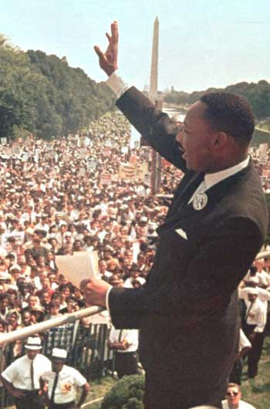
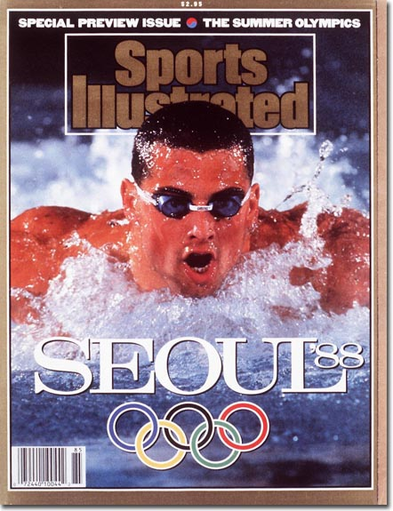
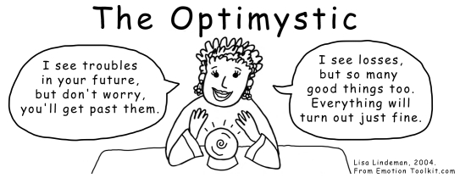
Beliefs as
Self-Fulfilling Prophecies.
Dr.Akshay

Slide 2
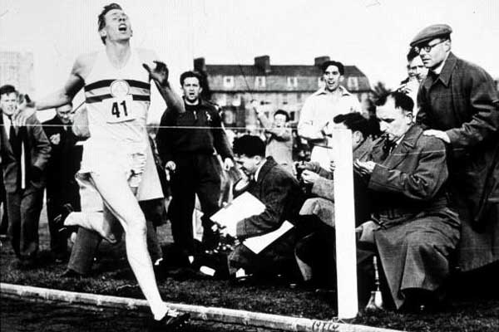
Roger Bannister

Slide 3
Outline
Beliefs shape reality
How it works
Optimizing optimism
Raising our beliefs

Slide 4
We are what we think.
All that we are arises with our thoughts.
With our thoughts, we make our world.
The Buddha

Slide 5
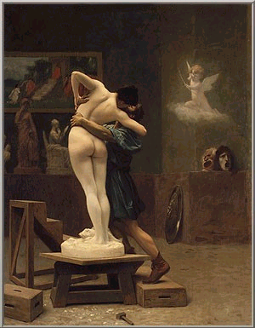
Pygmalion

Slide 6
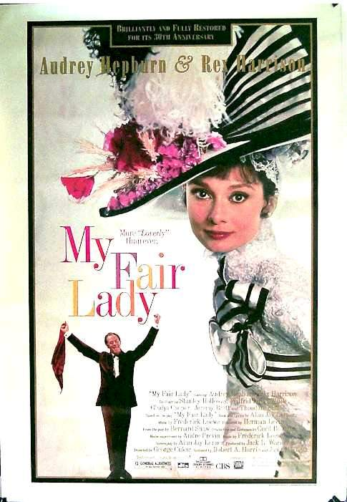
Pygmalion

Slide 7
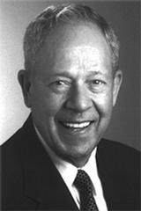
Pygmalion
in the classroom -(Robert Rosenthal, UC)
-In the
workplace
-Jamieson (1987),
Students were told teacher is better than others

Slide 8
“Treat a man as a he is and he will remain as he is. Treat a man as he can and should be and he shall become as he can and should be.”
Johann Wolfgang von Goethe

Slide 9
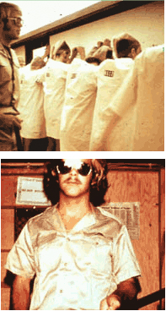
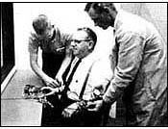
The Power of the Situation
Milgram’s Obedience to Authority
Zimbardo’s Stanford Prison
Experiment

Slide 10
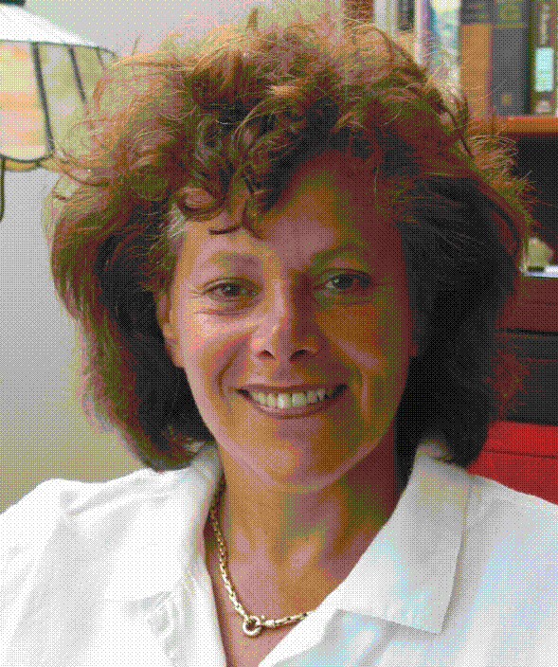
The (Positive) Power of the Situation
  men above 75
  week in “1959” resort
  mental and biological age decreases
Langer (1989)
  testing eyesight
  Improves with role
Langer (1979)

Slide 11
Positive Priming
Bargh (1999): Primed of Old age words.
Dijksterhuis & Van Knippensberg (1998) Experiment on describing Soccer hooligan, secretary and and professor then made to do Memory and IQ test.
Creating a positive environment
  pictures (people, places, etc)
  pleasant objects (memorabilia, flowers, etc)
  Quotes
  Music
  Books
  Movies

Slide 12

The Self-Help Movement
“Whatever your mind can conceive and believe it can achieve” Napoleon Hill
“Whether you think you can or can’t—you are right.”
Henry Ford

Slide 13

The Self-Help Movement
“Have great hopes and dare to go all out for them. Have great dreams and dare to live them. Have tremendous expectations and believe in them.” Norman Vincent Peale

Slide 14

Law of Attraction
We Co- create reality
But a lot of hard work and failure and learning from that failure

Slide 15
Albert Bandura on Self Efficacy
“Beliefs in personal efficacy affect life choices, level of motivation, quality of functioning, resilience to adversity and vulnerability to stress and depression.”
“People who regard themselves as highly efficacious act, think, and feel differently from those who perceive themselves as inefficacious. They produce their own future, rather than simply foretell it.”
Cultivated over time (can be learnt)
Curry (1997) on college athletes: 56% of your success depends upon how much you believe that you are going to succeed. (Correlates with research by Prof. John Clotcher HBS)

Slide 16
Nathaniel Branden on Self-Esteem
“The level of our self-esteem has profound consequences for every aspect of our existence: how we operate in the workplace, how we deal with people, how high we are likely to rise, how much we are likely to achieve—and, in the personal realm, with whom we are likely to fall in love, how we interact with our spouse, children, and friends, what level of personal happiness we attain.”
Very little correlation between material and place where live with wellbeing.
Very High Correlation between Self esteem and well being. (0.7)
“Self concept is destiny.”

Slide 17
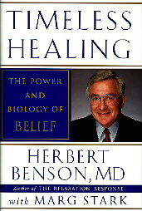
The Placebo Effect
-Doctor give you a medicine for headache and it actually was a sugar pill, but you are cured. Why?
Herbert Benson Research. Research on nausea. 2 groups, one with sugar pill and one group with ipecac (Drug which causes vomiting for food poisoning)
People were touched with the plant they were allergic to. (Benson).
Discovered by Henry Beecher when he ran out of morphine

Slide 18
Beliefs as Self-fulfilling Prophecies
Subjective
Beliefs
Expectations
Motivation
Interpretation
Consistency
Objective
Performance
Cognitive Dissonance – Fistinger

Slide 19
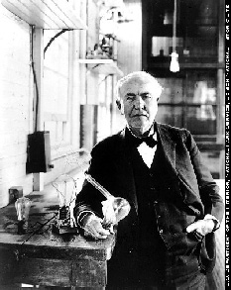
“I failed my way to success”
Thomas Edison
(31st Dec. 1979)
Patented 1097 patents.
The scientist who failed the most times also.
-Learn to fail or fail to learn

Slide 20
Martin Seligman research
Pessimistic are realistic towards short term goals and realistic towards long term goals. Low expectations so achieve and satisfied by low results.
Optimists are unrealistic towards there short term goals but realistic towards long term goals. Lets look at the model again!!!

Slide 21
Optimism and Pessimism (Seligman)
Interpretation style
Success (Failure permanent or temporary)
Mental/physical health
  immune system
  resilience
  Happiness (8 times less likely to fall in depression)
  Longevity (Karen Reivich. Uni. Of Penn)
It can be learned!
Matt Biond (1988)

Slide 22

Optimizing Optimism
What about unrealistic beliefs?

Slide 23
Optimizing Optimism
What about unrealistic beliefs?
  The Stockdale Paradox
  Positive thinking is not enough, hardwork needs to be put in
“False optimism sooner or later means disillusionment, anger and hopelessness.”
Abraham Maslow

Slide 24
The “Secret” of Success
Optimism, passion, hard work.
“I am a great believer in luck, and I find that the harder I work, the luckier I get.”
Thomas Jefferson
“There is no substitute for hard work.” Thomas Edison

Slide 25
What About Happiness and Self-Esteem?
Do high expectations lead to disappointment?
Self-esteem=success/Expectations
William James
Eg. Maths
Coping versus Avoidance (Self Perception theory by Daryl Bem, Cornell University)
To increase elf esteem:This Is one thing that you would do from now when you move out from class.

Slide 26
On Becoming An Optimist
Just do it! (action)
Imagine that… (visualization) Prof. Steven Koslynn, HOD Neuroscience Dept, Harvard, Stanford)
Cognitive therapy (rational thinking)

Slide 27
Imagining Success
The mind as simulator (Kosslyn, 1994)
Focus on journey and destination (Taylor, 2005)
Involve different senses
Evoke emotions

