Slide 1






CBT
Akshay Kumar
Positive Psychology

Slide 2
Define CBT
CBT represents the hybrid of Behavior strategies and cognitive processes with the goal of achieving behavioral and cognitive change

Slide 3
Three fundamental proposition
Cognitive activity affects behavior
Cognitive activity maybe monitored and altered
Desired behavior change may be affected through cognitive change

Slide 4
Evolved as..
Alternative to traditional non directive and insight oriented therapy

Slide 5
Theoretical assumptions of CBT
Psycho-educational orientation
Home work
Objective assessment
Structured and directive
Time limited
Empirical evidence

Slide 6
Common patterns of irrational thinking (Beck, 1988)
Over generalization: Evidence generrated from small set of experiences that reach unwarrented conclusions.
Catastrophic thinking: Extreme thinking
Maximizing and minimizing: Exaggerating negative experience and minimizing positive experience
All or none/Absolute thinking: Unnecessary division of complex outcomes into polarization extremes Eg. I am successful or a failure.
Jumping to conclusions: Use pessimissim of earlier experiences of failure to prematurely predict failure.
Personalization: Interpretaion of an event as negative aspect of self
Self negative focus: Distorted self image and ignoring positives.

Slide 7
The Ten Cognitive Distortions (David Burns)
1. All-or-nothing thinking
2. Over-generalization
3. Mental filter
4. Disqualifying the positive
5. Jumping to conclusions
  Mind reading
  Fortune telling
6. Magnifying or minimizing
7. Emotional reasoning
8. ‘Should’ or ‘must’ statements
9. Labeling
10. Personalization and blame

Slide 8
Premises of CBT (Albert Ellis, 1962)
New and logical thoughts can be learnt.
Irrational thinking can be changed
Psychological distress/disorder: Fundamental role is of primitive, irrational and illogical thinking
This thinking is self defeating and inconclusive
Time consuming

Slide 9
Thought pattens manifest themselves into chains of preconscious and explicit verbalizations from the assumptions that constitutes an individuals belief system.
Every individual has a Belief system and a self concept
Sometimes individuals form faulty B.S and SC. Eg. I am not good.

Slide 10
Talking to self: Everyone talks to self: That’s inevitable, Therapist teaches to talk to self in a logical realistic way.
Definition of Therapy: Therapy is defined as a learning process through which an individual acquires an ability to speak to himself in appropriate ways so as to control his own conduct. (Ellis, 1962)

Slide 11
Reasons and Emotions in Psychotherapy (Book by Albert Ellis, 1969)
Psychological disorders arise from chains of preconscious and implicit verbalizations
Thought process shapes self verbalization which shapes belief systems
Individual examines bits of irrational thought, PROCESSES it , ENLARGES, FOCUSES and put them into here and now.

Slide 12
Avoiding the 3 M’s…
Magnifying (exaggerating)
  Permanent and Pervasive (over-generalizing)
  All-or-nothing thinking
Minimizing (underplaying)
  Tunnel vision
  Dismissal of positive or negative
Making up (fabricating)
  Personalization or blame
  Emotional reasoning

Slide 13
Get Real!
Is my conclusion tied to reality?
Is my conclusion rational?
Am I ignoring something important?
What important evidence do I still need to take into consideration?
What am I magnifying?
What am I minimizing?
Am I ignoring anything that is going well?
Am I ignoring anything that is not going well?
What is the big picture?

Slide 14
BELIEF SYSTEM in 3 Major Headings
I
YOU
WORLD

Slide 15
ABCDE Theory
A: Activating event
Event that triggers
Event that causes stress or Happiness.
Def: Real external event to which individual is exposed

Slide 16
B: Belief System
Chain of self verbalizations of chain of thoughts in response to A
rB and iB
Cognitive masturbating: Holding a thought in the mind and processing it time and again which leads to negative emotional consequences.

Slide 17
C: Consequences
- Symbolizes emotions and behavior that results from B.

Slide 18
D: Disputing. Ellis 1997: Logico Emperico method of scientific questioning.
Involves challenging and debating

Slide 19
E: Effect
- Individual Needs explains the effects of changing an irrational thinking by rational one.

Slide 20
4 Root Faulty Beliefs
Helplessness
Hopelessness
Unlovable
Incompetent

Slide 21
ITS OK TO FAIL SOMETIMES

Slide 22
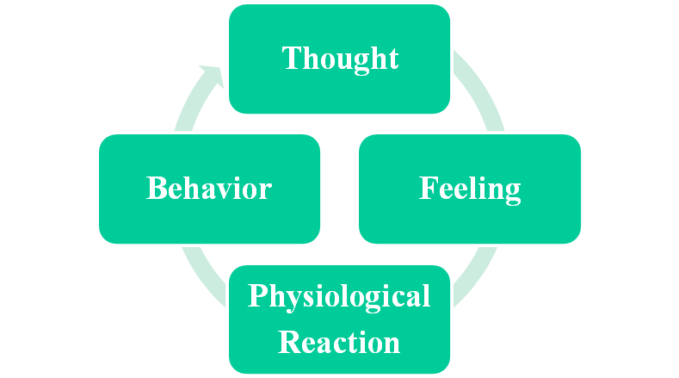
Event

Slide 23
Exercise

Slide 24
Fly on the wall
Helicopter view

Slide 25
Formulation for Treatment
1. Indications for treatment:
CBT are indicated as primary treatment for adults suffering from various non psychotic non organic disorders.
2. Selection of modality
Selection of CBT for an individual should be based on the appropriateness of CBT for the treatment situation
The criteria includes.
Does the person suffer from disorder known to be responsible for CBT
Chronicity, severity, and comorbidity (Whisman, 1993)
Patients from mild to moderately severe mood and anxiety disorders are best candidates of CBT (Thase, 1995)

Slide 26
3. Issues of Gender: Equally effective for both genders (Dobson, 1989)
4. Preparation of patient
CBT incorporates strategies to increase involvement and preparedness of person for therapy
People are encouraged to read relevant materials.
Active participation is required
Home Work

Slide 27
Phases of Treatment
3 Stages
Initial Phase: Includes clinical assessments, case formulations, Establishment of therapeutic relation, Psych education, and introduction.
Middle phase: Mastery of Cognitive and behavior strategies.
Termination phase: Preparedness for termination, sessions are reduced, steady transfer of responsibility, also cues on relapse prevention

Slide 28
Interventions for CBT
Collaborative empiricism
Therapeutic relationship is important
Therapist is responsible for managing pace of session.
Cognitive techniques
Challenging automatic thoughts
This is done by the use of Dysfunctional Thought Record (DRT)
Therapist works with the client to develop more ADAPTIVE ALTERNATIVES to unrealistic and irrational thoughts

Slide 29
Guided Discovery/Questioning (Beck, 1979): Throught simple questions, such as “ Then what?” and “What would it mean to you?” thr therapist can help the client some significance.
Challenging: By challenging the ideas of the client to its full extreme to help the client move to a moderate view.
Examining the Evidence: This is a collaborative exercise used to test the intensity of the negative automatic thoughts.
Conditions are put forth as hypothesis rather than established facts.
Patients are told to write down evidences that either support or refute the negative thought.

Slide 30
Generating alternatives: Generating alternative thoughts to dysfunctional thoughts
Cognitive response prevention: In this the client agrees to complete Home work in which he is she has to behave in a way that is inconsistent with the pathological schema.
In vivo desensitization

Slide 31
Behavioral techniques
Systematic desensitization
Reinforcing
Exposure and flooding: Fearful responses are reinforced by avoidance behavior (Rachman 1986)
Fear is irrational exposure to feared activity without aversive consequences.
Breathing control

Slide 32


