Slide 1
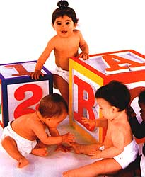
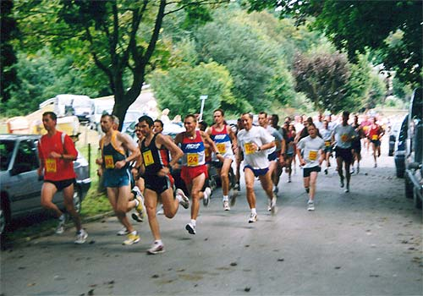
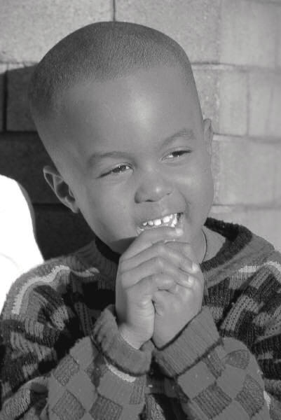
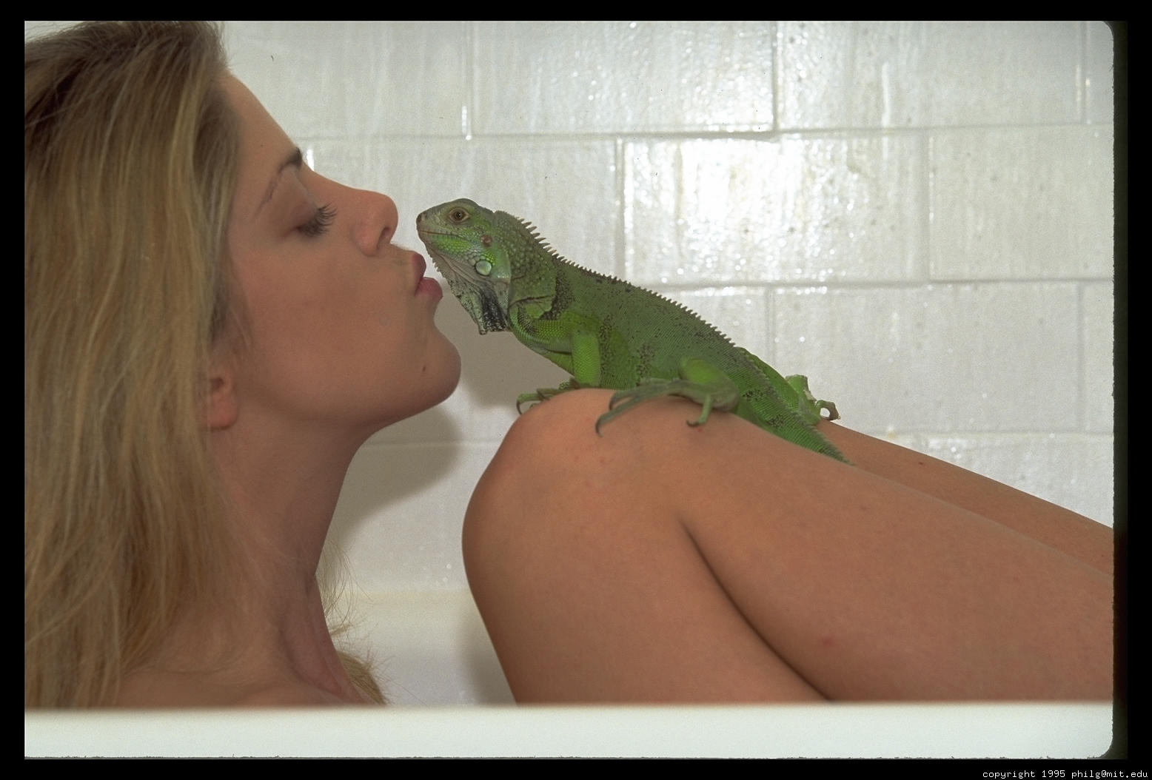
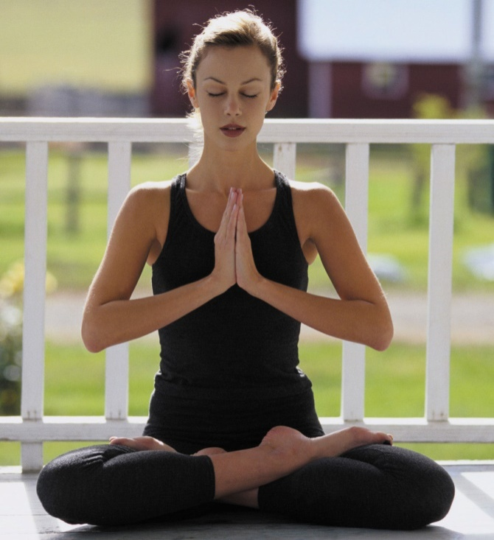
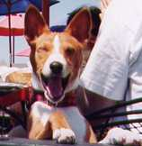
FOCUS, APPRECIATION AND GRATITUDE Dr. AKSHAY KUMAR y Kumar
Positive Psychology

Slide 2
“It appears that the way people perceive the world is much more important to happiness than objective circumstances.” Ed Diener
Emotions determined by external and internal
Choice of focus
“To the different minds, the same world is a hell, and a heaven.” Ralph Waldo Emerson
“Nothing is good or bad but thinking makes it so.”
William Shakespeare

Slide 3
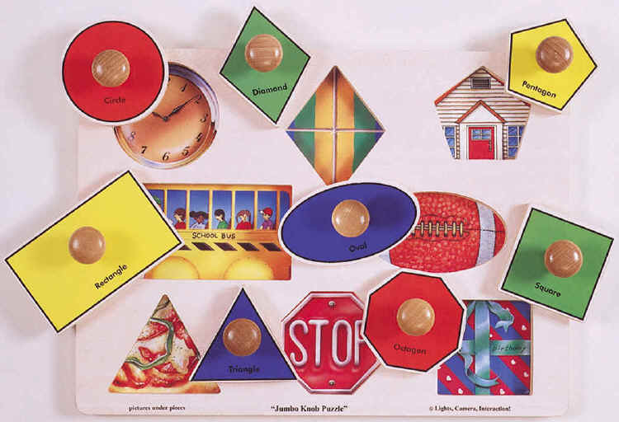

Slide 4
Two Archetypes
The Fault-Finder
“The fault-finder will find faults even in paradise” Henry David Thoreau
  Could lead to resignation
The Benefit-Finder (Bower, 2007, UCLA)
  Could lead to detachment
  The need to respect reality
“The invariable mark of wisdom is to see the miraculous in the common.” Ralph Waldo Emerson

Slide 5
2 types of personalities
Fault Finder V/S Benefit finder
We co create our reality “Now however fixed these element of reality maybe, we still have a certain freedom in our dealings with them. Take our sensations, that they are undoubtedly beyond our control; but which we attend to, note and make emphatic in our conclusions depends on our own interests; and according as we lay the emphasis here or there, quite different formulations of truth result. What we say about reality depends on the perspective into which we throw it.” – William James

Slide 6
“Princes & Kings
“Isn't it strange how princes and kings,
and clowns that caper in sawdust rings,
and common people, like you and me,
are builders for eternity?
Each is given a list of rules;
a shapeless mass; a bag of tools.
And each must fashion, ere life is flown,
A stumbling block, or a Stepping-Stone.”- R. L Sharpe

Slide 7
A Matter of Interpretation
“Never let a good crisis go to waste.” Anne Harbison
Warren Bannis, University of Southern California: Research on Geeks and Geysers. Numerous differences. One similarity, all great leaders had been through great cruisibles and lived to tell the tale
“Things don’t necessarily happen for the best, but some people are able to make the best of things that happen.”

Slide 8


Slide 9
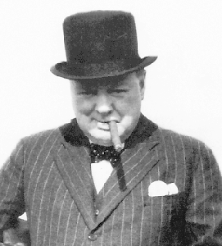
A Matter of Interpretation
“A pessimist sees the difficulty in every opportunity;
an optimist sees the opportunity in every difficulty.”
Winston Churchill

Slide 10
A Question of Interpretation
The world according to the fault-finder
The (same) world according to the benefit-finder
My story

Slide 11
The Benefits of Being a Benefit Finder
Feels good.
Well-being (Suzzane Thompson, Pomona University, 1985): Research on people whose houses were burnt. Long term Benefit finders were happier, less anxious and more physically healthy.
Health
  Glenn Affleck et al. (1987): Research on people with Heart attack. Less likely to have a 2nd Heart attack and were alive 8 years later
  Julierne Bower, UCLA (1998): Research on AIDS patients.
  Benefit finders dint say obviously We are so glad it happened to us for the best: 5-9 years later were more likely to be alive.

Slide 12
  King & Miner (2000): Can be used Intervention. He took people who experienced trauma and made them write what could be the ‘perceived benefits’ of trauma: Physically and psychologically healthier.
Longevity: 839 residents in mayo clinic. Benefit finders 19% more likely to survive after 2 years.

Slide 13
The Nun Study (Danner et al., 2001)
Started in 1932
Nuns who were just strarting their journey as Nuns. Avg age 22.
In 2001 picked up the writing that they have to write.
Only one thing and one thing alone that predicted longivity. positive feelings predicted longevity
Not Place of residence, not intellectual capacities.

Slide 14
“God started my life off well by bestowing upon me grace of inestimable value... The past year which I spent as a candidate studying at Notre Dame has been a very happy one. Now I look forward with eager joy to receiving the Holy Habit of Our Lady and to a life of union with Love Divine.”
Celia O’Payne
“I was born on September 26, 1909, the eldest of seven children, five girls and two boys... My candidate year was spent in the mother-house, teaching chemistry and second year Latin at Notre Dame Institute. With God’s grace, I intend to do my best for our Order, for the spread of religion and for my personal sanctification.”
Marguerite Donnelly

Slide 15
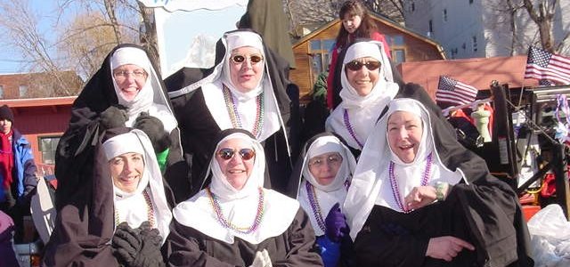
The Nun Study (Danner et al., 2001)
Only positive feelings predicted longevity
  Age 85: 90% of most cheerful quartile alive; 34% of least cheerful quartile alive.
  Age 94: 54% of most cheerful quartile alive; 11% of least cheerful quartile alive
  This is quite a significant difference.

Slide 16
“The joyfulness of a man prolongeth his days.”
Ecclesiastes

Slide 17
Why arn’t more people optimistic:
Because optimistic people are considered detached
Media leads to this notion. Media shows blood shed, hatred , crime etc. Eg. Mother leaves her child.
But the media doesn’t talk about the billions of the taking care of their children as we talk right now

Slide 18
Get Real!
The world according to the media
Media bias
  magnifying glass rather than looking glass
  accentuating the negative
  under-representing the positive
Who is really detached?
Focusing on the 90% full part of the glass
Focus creates reality: Like the children on the bus
IT IS A WONDER THAT THERE IS SO MUCH GOOD IN THE WORLD
Self Negative chatter in the mind: Mostly negative. Eg. The most important thing that he did was to make India Proud of its self.

Slide 19
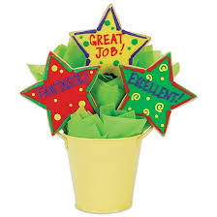
APPRECIATE
Definition: Valuing/ The act of recognizing the best about things and people around

Slide 20
Appreciating Appreciation
Ap-pre’ci-ate v., 1. Valuing; the act of recognizing the best in people or the world around us, affirming past and present strengths and potentials; to perceive those things that give life (health, vitality, excellence) to living systems. 2. To increase in value, e.g., the economy has appreciated in value.
Creating a growth spiral
Genuine appreciation!
There is always something to appreciate

Slide 21
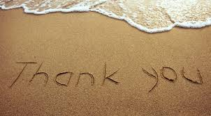
Appreciation
The 1st step of appreciation is saying THANK YOU.
Appreciate: The good things you see, good things in our selves and good things in others, else those good things wont exist for you just like the children on the bus.
Appreciation creates a upward growth spiral.
Eg. Walking towards class and a friend meets

Slide 22
Appreciation
It has to be connected to reality and be real.
The Key: There is always something real to appreciate, always. Eg. A research even cancer and AIDS patients had things to appreciate in their lives.
If we don’t water a seed it will wither and die, that is same fate of most people’s talent’s , potentials, relationships. Water the seeds with appreciation, recognize them if you want them to grow.

Slide 23
Appreciation
Pygmalion effect: The Pygmalion effect, or Rosenthal effect, is the phenomenon whereby the greater the expectation placed upon people, the better they perform.
Experiment by Rosenthel

Slide 24
How to do it?
Societal Level: Make good news. Eg. Goodnews.
Art: Appreciate positive, appreciate art. Eg. Renaissance movement. Artists focused on the light.
Aristotle: “Fiction is more important than history, because history depicts life as it is and fiction depicts life as it can be and as it aught to be.”

Slide 25
Change detectors
Nature created us change detectors
Why do we tend to ignore the good and focus on what is bad?
Because we adapt to what is common and our attention is diverted towards what is uncommon. Eg. Loud Sounds startle us.
Because there is so much good in the world and it is common.
So we adapt towards it and STOP NOTICING it.
Bad captures our attention =Change detectors

Slide 26
It is good: Helps us detect danger Eg. If there is a Lion here.
It is also good that we adapt: If we focus on all we will go crazy. Eg. So many noises around now but we arnt noticing. Eg. Relatives near the railway track.
That’s why people Can go to sleep on the road
Story of loss: Going to get over this: we all do
We adapt and that’s a good thing

Slide 27
Another side to that
When we adapt we take things for granted.
Our families, friends, food. What a luxury. The person sitting next to us, the classes that we are taking
Why? Because we adapt.

Slide 28
The question is
Is it possible to adapt to negative and at the same time not adapt to the positive.
The Jewish story

Slide 29
DO THINGS NEED TO GET WORSE BEFORE WE START APPRECIATING THEM, WHEN THEY ARE RIGHT INFRONT OF US AND WE HAVE THEM ALREADY.
When do we appreciate our health?
Our life?
Must something go wrong a tragedy for us to appreciate happiness? NO

Slide 30
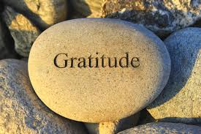
HOW
The answer is GRATITUDE.
Just as people have cultivated fault finding we can cultivate benefit finding
When we develop Gratitude we no longer take things for granted.

Slide 31
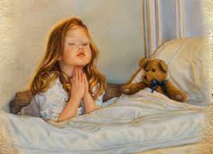
G.K Chesterton “ People say prayer of gratitude before they eat, but I do before a concert, a movie, before I open a book, before a walk, before swimming, reading, dancing, playing, gratitude before I dip my pen in the ink”
Gratitude brings the most joyful moments ever known to me.
Think of a moment When you expressed Grartude or someone did it to you.

Slide 32
How do we cultivate gratitude
Simple advise by Brother David Staindl Rast
Start by surveying a simple day eg. A cup of tea. How it warms and wakes you up
It’s a matter of practice doing it over and over again. Till it becomes a second nature, a habit
Change the state of gratitude into a trait

Slide 33
What are the ways
Become a life appreciater

Slide 34
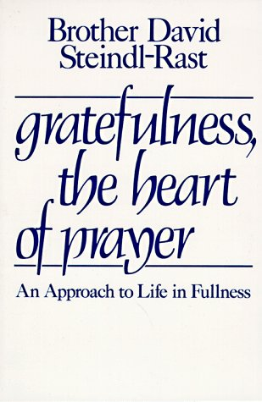
“Why not start by surveying a typical day? What is it you tend to tackle with spontaneous mindfulness, so that without an effort your whole heart is in it? Maybe it’s that first cup of coffee in the morning, the way it warms you and wakes you up, or taking your dog for a walk, or giving a little child a piggyback ride.... [It is] a matter of practice, of doing it over and over again, till it becomes second nature.”
“Gratefulness is the measure of our aliveness. Are we not dead to whatever we take for granted? Surely to be numb is to be dead.”

Slide 35
Survey by Irvin Yalon, Stanford University
On terminally ill patients: “ For the 1st time I am feeling that I am alive.”
They reported “ For the 1st time in my life I appreciate breathing, for the 1st time in many years I appreciated my husband, my children, a flower, the grass, a conversation.”
Does it need a terminal disease to give us a wake up call to what is right around us, in us? WHY WAIT?

Slide 36
Research on the value of Gratitude
Robert Emmons and Michael McCullough, University of California, Davis.
1st group: Before going to bed, write atleast 5 things for which you are grateful for
Group 2: 5 hassles in the day
Group 3: 5 things in which you are superior than the other
Group 4: Control: Any 5 things from the day.

Slide 37
Tracked the following:
Optimism
Happiness
Physical Health
Generosity
Successful and goal achievement

Slide 38
My diary activity
Do it over and over again: To make it into a trait
Big things and little things
Maintain freshness

Slide 39
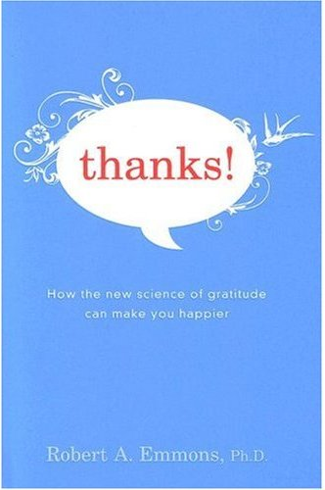
Research on Gratitude
Emmons and McCullough (2002)
  Four groups: gratitude, hassles, superior, control
  Psychological and health benefits
Physiological benefits, activation of parasympathetic nervous system. (McCraty & Childre 2004): Healthier heart & Immunity
Benefits of trait gratefulness
Maintaining freshness
  Weekly? (Lyubomirsky, 2008)
  Variety ( Write about different aspects)
  Mindfulness (Try descovering something new) (Langer, 1989)
  Visualize (Kosslyn, 2005): Kids visualize the words.

Slide 40


Slide 41
Gratitude Cont.
Why arnt we benefit finders when, gratitude pays us both? Hard Currency and Ultimate currency... Media... Adaptation
How can we change it?
-Macro level: Good news, art etc
Micro level: not waiting for bad things to happen, not taking things for granted and just being aware and grateful.
Maintain freshness

Slide 42
Emerson, “If stars would shine only only once in a thousand years, we would all look up and praise the glory of this world.”
The key to CHANGE it is: JUST DO IT, just do it…
Just knowing is not enough: You need to experience it to feel it, for the biology to function in your body and for your mind to respond

Slide 43
Counter the current state in which you are literally IMPROSONED into.
William James (1980), 21 days to change a habit.
You are gradually chipping off the excess stone, it’s a gradual process.
There are no short cuts: you need to do it, experience it.

Slide 44

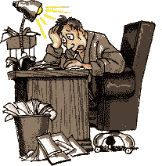
Try It!
Becoming a benefit-finder
21 days or your money back
Chipping away negativity
Thanks for reminding me…
Co-creating reality with questions

Slide 45
O Hart Cummin story: Isreal to Holland.
He started to see not just the impossibilities but the possibilities.
We are literally living in luxury, even Kings and Queens dint have that Luxury, Eg. You can listen to music at the touch of the finger, who could think of this a 100 years ago.

Slide 46
Start co creating realities
What am I grateful for? And suddenly you start seeing new possibilities. Eg. A beautiful drive, You just start noticing so many new things.
You start noticing things that you couldn’t have ever noticed in life.

Slide 47
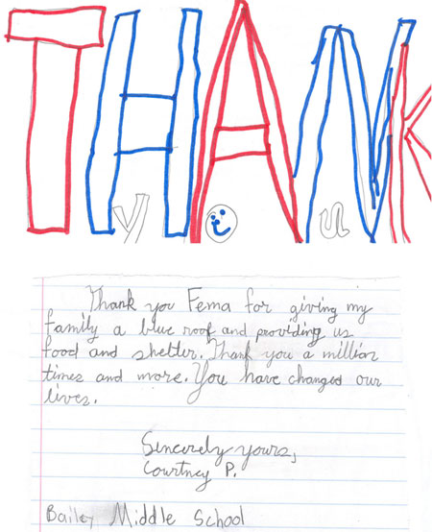

Gratitude to Others (Seligman, 2005)
Take time to reflect (What did the person do for me?)
Letter, phone, or in-person
Largest boost in wellbeing
Regularly (weekly, bi-weekly or monthly)
Writing helps even if letter not sent (Sonja Lyobomirsky)

Slide 48
Gratitude visit
Gratitude phone call
Gratitude letter

Slide 49
It’s the highest peak of wellbeing
It’s a win win
But: The spike goes up for 10-15 days and you are back again, so do it regularly

Slide 50
Assignment
Gratitude letter: Recommended Gratitude visit
Yes it is cheezy, but YES IT IS BENIFICIAL.

Slide 51
Permission to be Human
Give yourself the permission to feel the negative emotions aswell, all emotions.
The problem is the lack of acceptance of the negative emotions: Only 2 people don’t feel the negative emotions: Psychopaths and the dead.
Its good that you feel it. After a while ask? What would be the most effective way to act.

Slide 52
Acceptance and then finding a way eg. Pink elephant
Difference between Vietnam war and Israel Holocaust. Study, more PTSD in Vietnam war survivors.

Slide 53
The Morality of Gratitude
“We live in a ‘given’ world... What brings fulfillment is gratefulness, the simple response of our heart to this given life in all its fullness.” Brother David Steindl-Rast
“To live and die in gratefulness, if in no other virtue.” Galway Kinnel
“Gratitude is not only the greatest of virtues, but the parent of all others”. Cicero

Slide 54
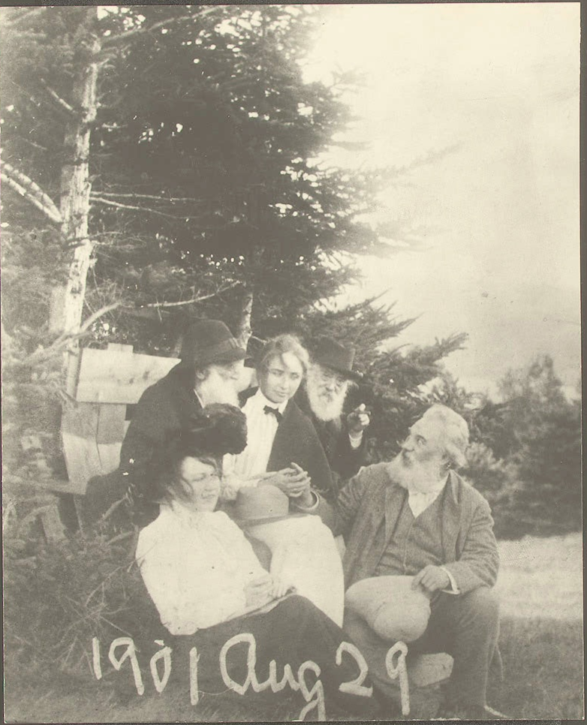
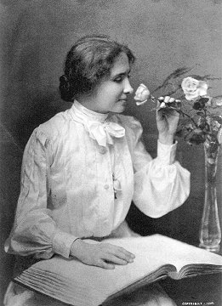

Slide 55
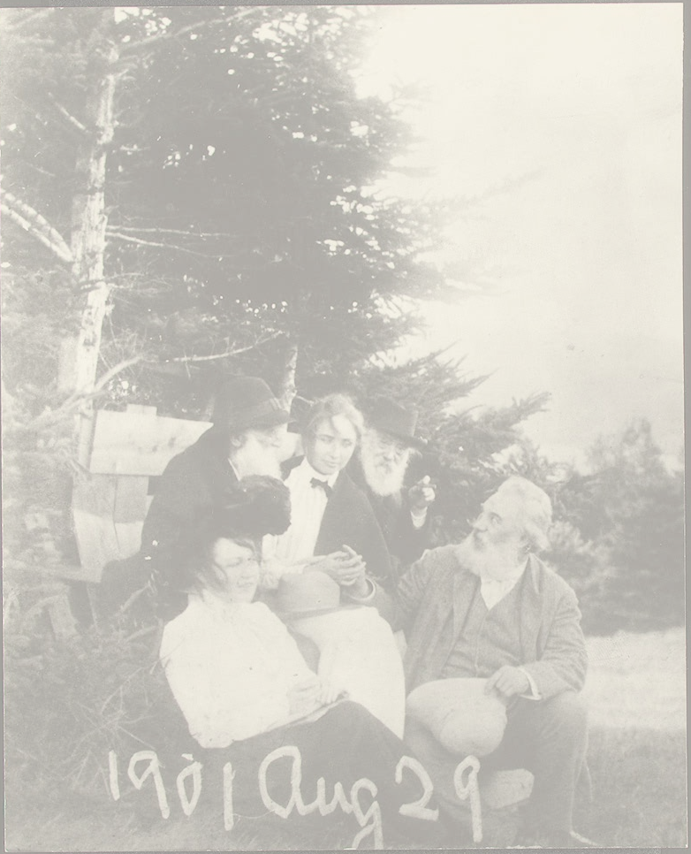
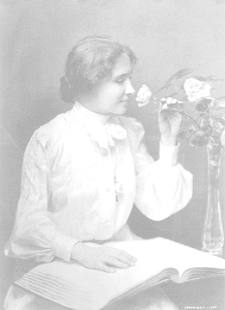
“I wondered how it was possible to walk for an hour through the woods and see nothing of note. I who cannot see find hundreds of things: the delicate symmetry of a leaf, the smooth skin of a silver birch, the rough, shaggy bark of a pine. I who am blind can give one hint to those who see: use your eyes as if tomorrow you will have been stricken blind. Hear the music of voices, the songs of a bird, the mighty strains of an orchestra as if you would be stricken deaf tomorrow. Touch each object as if tomorrow your tactile sense would fail. Smell the perfume of flowers, taste with relish each morsel, as if tomorrow you could never taste or smell again. Make the most of every sense. Glory in all the facets and pleasures and beauty which the world reveals to you.”
Hellen Keller

Slide 56
Just bite your food a little bit slow, and brush your teeth a little knowingly
It’s a privilege the food we have, the friends we share, the family we care, the world we have. Don’t wait for a tragedy to start appreciating
Exercise: Write down the things, people, activities, whatever, you are grateful for, about the wonderful things in life and share with the person next to you.

Slide 57
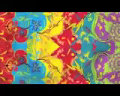

Slide 58
Bibliography and Recommendations
http://www.gratefulness.org
http://www.luckfactor.co.uk/
Danner, D., Snowdon, D., and Friesen, W. (2001). Positive emotions in early life and longevity: Finding from the nun study. Journal of Personality and Social Psychology, 80, 804-813.
Emmons R. A. (2007). Thanks! How the New Science of Gratitude Can Make You Happier. Houghton Mifflin.
Seligman, M. (2002). Authentic Happiness. Free Press.
Brother David Steindl-Rast (1984). Gratefulness, the Heart of Prayer. Paulist Press.
Wiseman, R (2003). The Luck Factor. Miramax.

