Slide 1
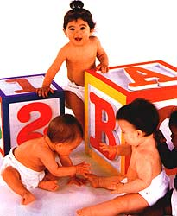
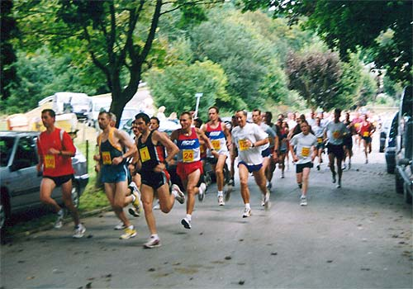
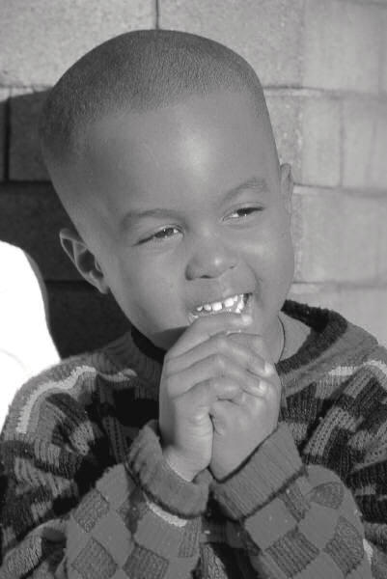
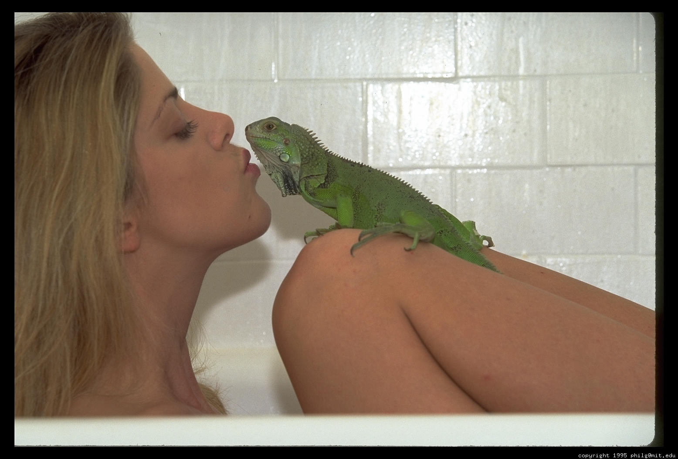

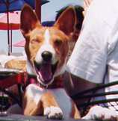
Positive Psychology
HAPPINESS AKSHAY KUMAR

Slide 2

HAPPINESS
Life long journey
Ends when life
The ultimate currency
Hamburger story

Slide 3


Hamburger Model
Future benefit
Healthy and untasty
Healthy and Tasty
Present Benefit
Present Harm
Unhealthy and untasty
Unhealthy and tasty
Future Harm

Slide 4
HAPPINESS MODEL
FUTURE BENEFIT
(Meaningful)
Rat Race Quadrant
Happiness
Quadrant
PRESENT
HARM
(Pain)
PRESENT BENEFIT
(Pleasure)
Resign Quadrant
Hedonism
Quadrant
FUTURE HARM
(Meaninglessness)

Slide 5

Rat Race Quadrant
Story
Lives ONLY for the future
Focuses on the destination only
MISTAKES RELIEF FOR HAPPINESS
PHILOSOPHY: No pain no gain
More and more people are realizing this prescription is not good, its false
Eg. Stress even at the age of kindergarten at the age of 3, with their reumes.
Diary: Did you ever resemble Rahul and were in the Rat race quad,? If not write about someone who you know was.

Slide 6
HAPPINESS MODEL
FUTURE BENEFIT
(Meaningful)
Rat Race Quadrant
Happiness
Quadrant
PRESENT
HARM
(Pain)
PRESENT BENEFIT
(Pleasure)
Resign Quadrant
Hedonism
Quadrant
FUTURE HARM
(Meaninglessness)

Slide 7

HEDONISM QUADRANT
Lives ONLY for the present
Gets to know that Rat race is not working, so totally changes the pendulum
PHILOSOPHY: Life is short, live the moment
Life is just in the present
Engages into Addictions, harmful sexual acts etc
Suddenly start feeling numb
No longer pleasure in activities
Eg. Have to increase alcohol quantity for the same pleasure
Unhappy again
Helpless
MISTAKES PLEASURE FOR HAPPINESS

Slide 8
HAPPINESS MODEL
FUTURE BENEFIT
(Meaningful)
Rat Race Quadrant
Happiness
Quadrant
PRESENT
HARM
(Pain)
PRESENT BENEFIT
(Pleasure)
Resign Quadrant
Hedonism
Quadrant
FUTURE HARM
(Meaninglessness)

Slide 9
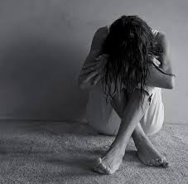
RESIGNATION QUADRANT
Seligman dog study: Learnt helplessness Theory.
When tried both and failed. Resign and stay in depression
Live ONLY in the past
PHILOSOPHY: Given up happiness
Eg. Great Actors/Rock stars

Slide 10
HAPPINESS MODEL
FUTURE BENEFIT
(Meaningful)
Rat Race Quadrant
Happiness
Quadrant
PRESENT
HARM
(Pain)
PRESENT BENEFIT
(Pleasure)
Resign Quadrant
Hedonism
Quadrant
FUTURE HARM
(Meaninglessness)

Slide 11

HAPPINESS QUADRANT
Human being need something to look forward to.
A destination
Peak of a mountain to reach
But, also they need to enjoy the journey
PHILOSOPHY: Journey aswell as a worthy goal

Slide 12
HAPPINESS QUADRANT
Definition: Happiness is the overall experience of PLEASURE and MEANING. (M. Seligman)
A happy person enjoys positive emotions, while perceiving his/her life as purposeful.
*A person can endure emotional pain at times and yet be happy overall
Pleasure as well as meaning. Eg. A Relationship

Slide 13
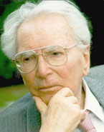
HAPPINESS QUADRANT
Its very difficult to separate meaning and pleasure: What is pleasurable; our mind will start believing it is meaningful too, in reality it may not be.
Experiment: Victor Frankl (Nazi Camp survivor)
Man’s search for meaning.
Survivors: Who had a future purpose. Weather it was writing a book or meeting their family.
Those who died had lost a sense of purpose.
He gave a talk in Vienna and said to them, you
Saved my life.
No matter how much purpose they had, ofcourse they were not happy.

Slide 14
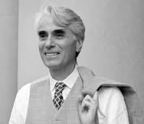

HAPPINESS QUADRANT
Just meaning is not enough
Sigmund Freud Pleasure Principle
Just Pleasure is not enough: Pleasure machine survey by Robert Nozick
PLEASURABLE EXPERIENCE TO BE MEANINGFUL
Amalgamate Frankl and Freud

Slide 15
HAPPINESS QUADRANT
Happiness is not just a constant high
Unrealistic
If we expect that: We would be more unhappy: Frustrated
PHILOSOPHY: Give your self permission to be human, to experience painful experiences aswell.

Slide 16
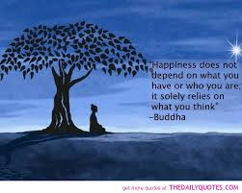
HAPPINESS QUADRANT
Survey: 5:1 ratio between good and bad experiences (Eg. Ideal Relationships by John Gotman)
Through conflicts and hardships: Learn new things: Important.

Slide 17
Being in the here and now (Absorbed in the present) AND at the same time doing something which is meaningful.

Slide 18
EXCERCISE
WHAT TO YOU IS BOTH MEANINGFUL AND PLEASUREABLE

Slide 19
TOOL
What is meaningful to me? What is important to me? (Future Benefits)
What is pleasurable to me? What do I enjoy doing? What is fun to me? (Present Benefit)
What are my strengths? What are my talents? What am I good at? (To be in reality and to be grounded)

Slide 20
Tool
The questions will help us chalk a path
Next step: Find an overlap
AT THE OVERLAP THE PATH RESIDES, THE PATH OF HAPPINESS.

Slide 21
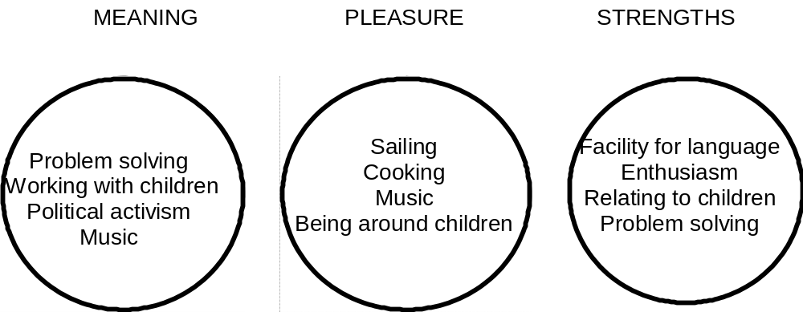

Slide 22
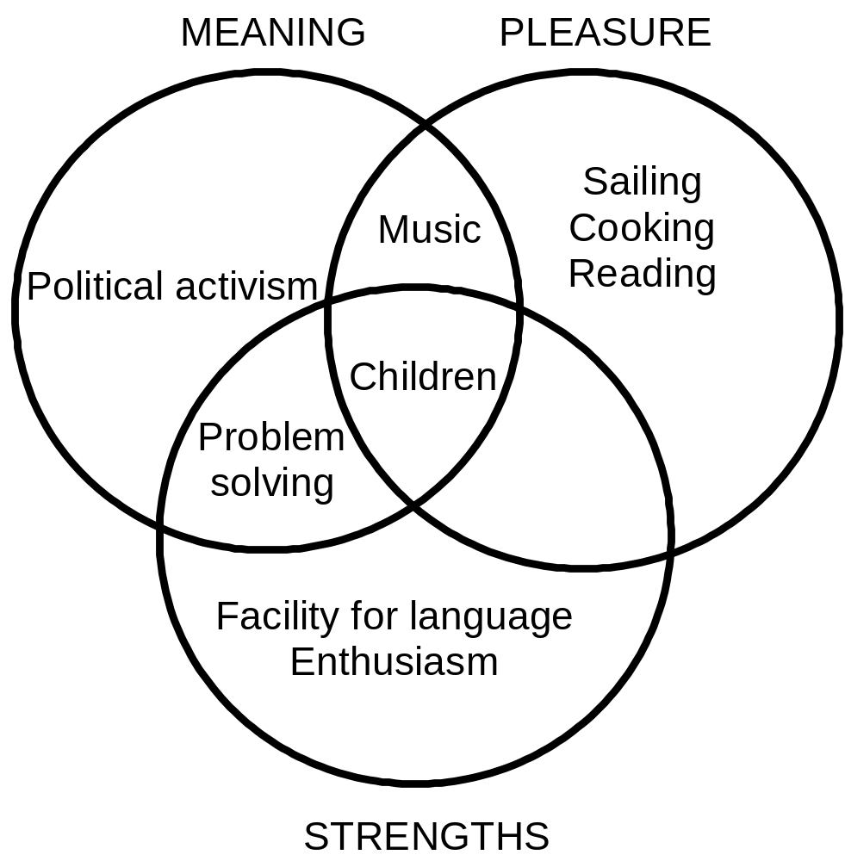

Slide 23


HELP OTHERS: LEAD BY EXAMPLE

