Slide 1
Hypnosis
Dr. Akshay Kumar, Ph.D.
(Accredited by American Hypnosis Association)

Slide 2


Slide 3


Māndūkya Upaniṣhad
A study of consciousness is the subject of the Māndūkya Upaniṣhad.

Slide 4
States of Consciousness
1. jagrata, (awakened state)
2. svapna, (dreaming state)
3. susupti, (deep sleep)
4. Turya (State of pure consciousness and infinite knowledge): It silently witnesses all the 3 states all the time.

Slide 5
Normal Mind has 4 different levels of activity
1st Level: Beta Activity State – Completely awake and conscious
2nd level: Alfa State – Corresponds to subconscious mind. Seen in Hypnosis, meditation bio feedback
3rd level: Theta State – The part of unconscious mind that functions in light sleep
4th level: Delta State – Deep sleep. Unconscious mind is also resting

Slide 6
Sri Aurobindo’s Concept of Mind
In his books Savitri and Letters of Yoga:
Higher Mind - the first and lowest of the spiritual mental grades.
Spiritual Mind - general term for levels of mind above the normal mental level
Inner mind - the mental component of the Inner Being, which lies behind the surface mind or ordinary consciousness and can only be directly experienced by sadhana
True mental being - is the Purusha of the mental level freed from the error and ignorance of the lower Prakriti and open to the knowledge and guidance above.
Mind Proper - consisting of Thinking Mind, dynamic and externalising Mind.
Thinking Mind - mind proper, concerned with ideas and knowledge in their own right.
Dynamic Mind - ordinary mind that puts out of mental forces for realisation, acting by the idea and by reason.
Externalising Mind - the most "external" part of the mind proper, concerned with the expression of ideas in speech, in life, or in any form it can give.

Slide 7
HYPNOSIS
Hypnosis is a temporary condition of altered perception in the subject which may be induced by another person and in which a variety of phenomena may appear spontaneously or in response to verbal or other stimuli.
(British Medical Association, 1955, 1982)

Slide 8
TRANCE
Have you ever heard a song playing and you instantly remembered an event that happened years before?

Slide 9
TRANCE
Have you ever read a good book and were totally oblivious to someone asking you a question?

Slide 10
TRANCE
Have you ever watched children closely when they’re watching TV ?

Slide 11
TRANCE
Have you ever fallen in love?

Slide 12
These are times when go into a different state of awareness.

Slide 13
This is a state of TRANCE.

Slide 14

You have already experienced hypnosis!!

Slide 15
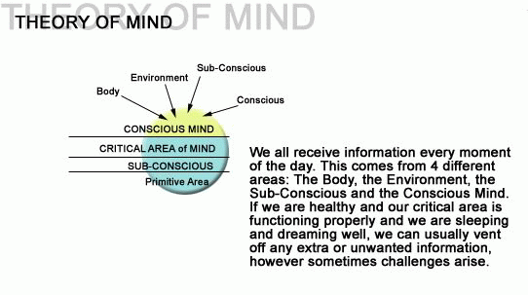
THEORY OF MIND
By Milton Erikson and John Kappas
12%
88%

Slide 16
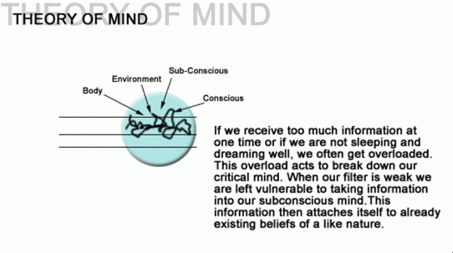

Slide 17
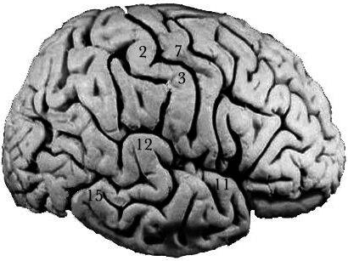
“What the
mind of man
conceives and believes,
the mind of man
can achieve.”

Slide 18
Human Mind and its history
Mind: Field of all experiences.
- Environment Inside
- Environment outside
- Conscious Mind
- Unconscious Mind

Slide 19
Decision Making
The process of Decision Making involves the phenomenon of Hypnosis
Governing part Before: Con., Uncon., E.O., E.I
Governing Part during: Uncon., E.I., E.O., Con. Mind.

Slide 20
Development of the mind
Started with just instincts: Flight or fight. .. 2 fears: Sound and falling
Development of the capability to think: Living in groups, using skins to cover, methods to urinate etc
Thinking led to rules: Sharing, dos and donts, family, sexual behavior
Rules led to inhibition: (Unacceptable and acceptable pleasures needed to be supressed)
Pleasurable donts and unpleasurable dos
How are habits formed.
Gave rise to emotions
Gave rise to emotional illnesses

Slide 21
History
Franz Mesmer (1700s): Theory of Animal Magnitism
James Braid: Scientific Explanation.. Coined the term Hypnosis…. Nervous sleep .. Greek Word Hypnos.. Means sleep
Sigmund Freud with Charcot. To cure Hysteria
Hypnosis was successfully used to cure war traumas during WWI and WW II
Dr Jon Kappas and Milton Ericson : Found only 50 % of people were getting hypnotized
He discovered people are of 2 types. Emotionally Suggestible and Physically suggestible.. Ranges from 100% Literal (Physically) to 100% Inferential (Emotionally)
Emotionally: Feel love-hug Physically: Hug- Feel Love
Thinkers Practical
Logical Creative
Little Mistrusting More trusting

Slide 22
 | Waking State | Hypnotic state | Sleeping state
Conscious Mind | Awake | Awake | Asleep
Unconscious Mind | Awake | Awake | Awake

Slide 23
Demo1

Slide 24
Laws of suggestibility
Law of repetition
Law of Dominance
Law of association
Law of delayed action
Law of reverse action

Slide 25
Depths of Hypnosis
Depth: Loss of grip of conscious mind on the control it exercises.
Hypnoidal: Lightest
Cataleptic: Medium. Eyes movement side to side
Somnabulism: Eyes upwards

Slide 26
Suggestions
Suggestion archetechture
What you dont want... What you want... What will be the consequence
Build associations Eg. Strong as a lion

Slide 27


Slide 28


Slide 29


Slide 30
Hypnoanesthesia
Hypnosis is a fascinating domain of clinical research and practice that involves the study of how ordinary people like you and me can accomplish extraordinary things by using our minds.

Slide 31
There's a great deal of flexibility in what the mind experiences, including perceptions about the body that we in health care professions have learned through the study of hypnosis.

Slide 32
METHODOLOGY

Slide 33
Process of Hypnotherapy
1. Objective or Goal Setting
2. Establishing Rapport / Preparing the Patient
9. Discussion with the Patient
Process of
Hypnotherapy
8. Termination of Trance
3. Induction and deepening of trance
7. Post Hypnotic Suggestion
4. Ego Strengthening
6. Reorientation
5. Therapeutic Utilization

Slide 34
Myths of Hypnosis
You do not lose control

Slide 35



