Slide 1
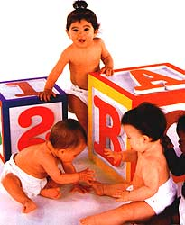
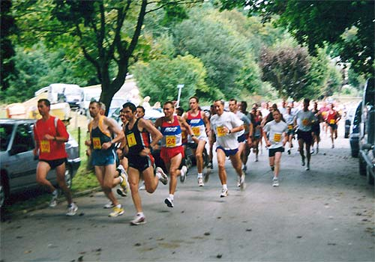
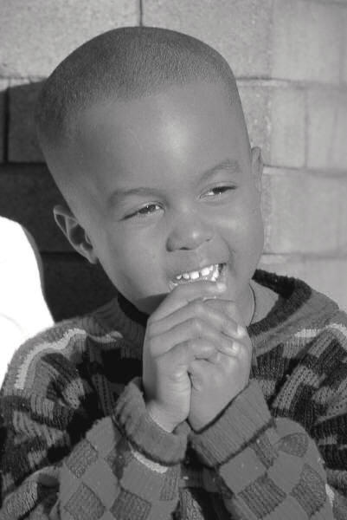

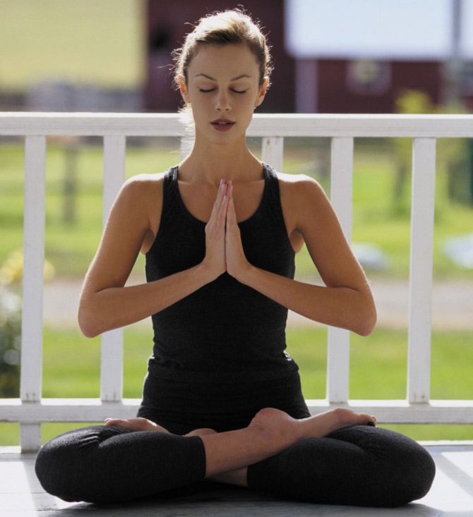

Resilience
Dr. Akshay

Slide 2
Psychological Abstracts (1967-2000)
Anger: 5,584
Anxiety: 41,416
Depression: 54,040
Joy: 415
Happiness: 1,710
Life satisfaction: 2,582
Ratio: 21/1
(Stats by David Mayers)
Just studying what’s not working

Slide 3
Focusing on the Negative
“The science of psychology has been far more successful on the negative than on the positive side; it has revealed to us much about man’s shortcomings, his illnesses, his sins, but little about his potentialities, his virtues, his achievable aspirations, or his psychological height. It is as if psychology had voluntarily restricted itself to only half its rightful jurisdiction, and that the darker, meaner half.”
Abraham Maslow

Slide 4
Does Psychology Need Help?
21/1 ratio of studies is unhealthy…
… but it reflects reality
  depression 10 times higher today than 1960
  mean age for depression today is 14.5 (compared to 29.5 in 1960)
  80% of College students depressed at least once last year
  45% of college students depressed; 94% overwhelmed (Kadison, 2005); the best 4 years of life. Something is wrong.
  IT’S A GLOBAL EPIDEMIC

Slide 5
Why More “Positive” Research?
Psychology as creative rather than merely reactive (It is important to focus on what works, because what works creates realities)
Happiness is not the negation of unhappiness
Prevention through cultivating the positive

Slide 6
Accentuating the Positive
“The aim of Positive Psychology is to catalyze a change in psychology from a preoccupation only with repairing the worst things in life to also building the best qualities in life.”
Martin Seligman

Slide 7

Unhappiness Spiral
“Negative” Research
Negative Experiences

Slide 8

Happiness Spiral
“Positive” Research
Heisenberg Uncertainty Principle
Positive Experiences

Slide 9
Case Example
A study in late 1940’s started studying at risk population.
A lot of money and effort was put into at risk population.: Depression, addictions, dropouts, teen pregnancies etc
Question they asked: Why do these individuals fail?
Very little change came despite money, research effort

Slide 10
Then here was a paradigm shift through the work of Antanovsky, 1980’s
Changed the research question: What makes some individual succeed despite unfavourable conditions.
THAT MADE ALL THE DIFFERENCE
Started to study successful individuals and there were tangible results.
SIMPLY BASED ON THE QUESTION

Slide 11
The Power of Positive Psychology:
Studying At-Risk Population
Traditional psychology (Post-WWII)
  “Why do these individuals fail?”
Positive psychological approach (1980s-)
  “What makes some individuals succeed despite unfavorable circumstances?”

Slide 12
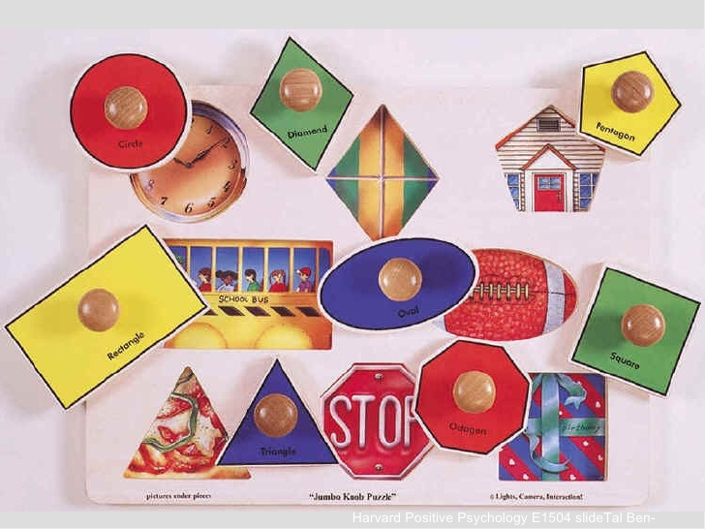
21:1 ratio Psychology needs a psychologist, psychology needs help.
What if a man was 21 days depressed and only 1 day happy, wouldn’t he need help.

Slide 13
Cross culturally: What are my weaknesses?
Could a person who just concentrates on his weaknesses and doesn't even think about his strengths, could experience high levels of happiness, confidence, respect?

Slide 14
“Human systems grow in the direction of what they persistently ask questions about.”
Cooperrider and Whitney

Slide 15
Appreciate our strengths/what’s working
APPRECIATE : 2 meanings: to say Thank you and to grow
WHEN WE APPRECIATE THE GOOD, THE GOOD APPRECIATES
When we don’t, the good depreciates.
Appreciate what’s good inside me.

Slide 16
Resilience
Lay mans terms: Bouncing back

Slide 17
Resilience
“A class of phenomena characterized by patterns of positive adaptation in the context of significant adversity or risk.”
Masten & Reed
Superkids? (1 in a thousand)
Ordinary characteristics, extraordinary results
  Social support

Slide 18
Resilience
“A class of phenomena characterized by patterns of positive adaptation in the context of significant adversity or risk.”
Masten & Reed
Superkids?
Ordinary characteristics, extraordinary results
  Social support (I am tough enough to reach out for help)
  Optimism and self-esteem (Believed in what they did)
  Faith and a sense of meaning (Religious and faith in themselves), (Sense of purpose/contribution).
  Prosocial behavior (Upward spiral between self help and Helping others). Shift from HELPLESSNESS to HELPFULNESS
  Focusing on strengths (What am I good at?)
  Set goals
  A role model (Family, social figure, fictional character). Gives sense of direction.

Slide 19


Slide 20
Power of question
Question creates realities
For years the children who could be helped were not helped till the time the right question was asked
Question begins a quest

Slide 21

Role models
Optimism and faith
Blame to responsibility
Deficiencies focus to strengths focus

Slide 22
Passive Victim Vs. Active Agent
___________________________________________
self pity
blame
frustration
anger
confidence
responsibility
hope and optimism
forgive/forget

Slide 23
Happiness isn’t the Negation of Unhappiness
neurosis, anger, anxiety, wellbeing, satisfaction, joy
depression, psychosis excitement, happiness
_______________________ 0 ____________________ +
Disease Model Health Model
Focus on weaknesses Focus on strengths
Overcoming deficiencies Building competencies
Avoiding pain Seeking pleasure
Running from unhappiness Pursuing happiness
Neutral state (0) as ceiling No ceiling
Tensionless as ideal Creative tension as ideal

Slide 24
“Have become comfortably numb.” Pink Floyed

Slide 25
Global Poll: By Galop organization. We should focus on weaknesses to succeed.
The other group was more successful.
Running away from unhappiness v/s pursuing happiness.

Slide 26
In the diease Model. The optimum level is ZERO.
Health model: Optimum level has no limit of health.

Slide 27
Pursuing happiness its imp to be in the stretch zone. Going outside comfort level.
Not panic zone but stretch zone

Slide 28
Why Positive Psychology? Another reason
Positive Psychology not only takes us from zero to Positive, but also deal with the Negative (Depression and anxiety).
To ask a question what’s my purpose, what’s my meaning of life?
Meaning in life gives you happiness.

Slide 29
Prevention through cultivating positive
Illness as the absence of health (vs. health as the absence of illness)
“It [neurosis] is a falling short of what one could have been, and even, one could say, of what one should have been, biologically speaking, that is, if one had grown and developed in an unimpeded way. Human and personal possibilities have been lost. The world has been narrowed, and so has consciousness. Capacities have been inhibited.” Abraham Maslow
Stronger “psychological immune system”
Mental health at Harvard (Capacity to deal with Negativity)
Analogy with Physical immune system: we get ill but less num. of times and bounce back soon.

Slide 30
“We have discovered that there are human strengths that act as buffers against mental illness: courage, future-mindedness, optimism, interpersonal skill, faith, work ethic, hope, honesty, perseverance, the capacity for flow and insight, to name several... We have shown that learning optimism prevents depression and anxiety in children and adults, roughly halving their incidence over the next two years... Similarly, I believe, that if we wish to prevent drug abuse in teenagers who grow up in a neighborhood that puts them at risk, that the effective prevention is not remedial. Rather it consists of identifying and amplifying the strengths that these teens already have.”
Martin Seligman

Slide 31
Resilience is all about having your resources in place for when the difficulties arrive, because they will.

Slide 32
“The message of the Positive Psychology movement is to remind our field that it has been deformed. Psychology is not just the study of disease, weakness, and damage; it also is the study of strength and virtue. Treatment is not just fixing what is wrong; it also is building what is right. Psychology is not just about illness or health; it is about work, education, insight, love, growth, and play. And in this quest for what is best, Positive Psychology does not rely on wishful thinking, self-deception or hand-waving; instead it tries to adapt what is best in the scientific method to the unique problems that human behavior presents in all its complexity.” Martin Seligman

Slide 33
Bibliography and Recommendations
Excellent website: www.psychologymatters.org
Antonovsky (1979). Health, Stress, and Coping. San Fransisco: Jossey-Bass.
Masten, A. S. & Reed, M. J. (2002). Resilience in development. In C. R. Snyder and S. J. Lopez (Eds.), Handbook of Positive Psychology, 528-540. Oxford University Press.
Seligman, M. E. P., & Csikszentmihalyi, M. (2000). Positive Psychology. American Psychologist, 55, 5-14.
Sheldon, K. M. & King, L (2001). Why Positive Psychology Is Necessary. American Psychologist, 56, 216-217.
Snyder, C. R. & Lopez, S. J. (Eds.) (2002). Handbook of Positive Psychology, 528-540. Oxford University Press.
Collins, M. & Tamarkin, C. (1990). Marva Collins’ Way. Putnam: New York.
Werner, E. & Smith, R. (2001). Journeys from Childhood to Midlife: Risk, Reilience and Recovery. Cornell University Press.

