Slide 1
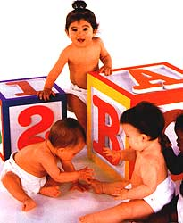
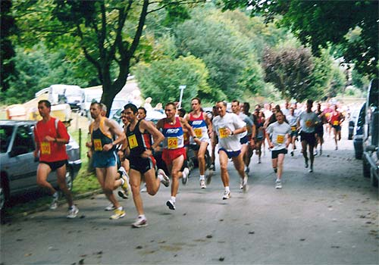
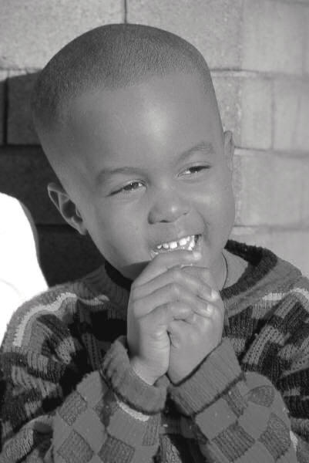



Positive Psychology
Introduction Dr. Akshay

Slide 2
The Road to Positive Psychology
Humanistic Psychology (50’s)
  The Third Force
Reaction to behaviorism: 1st force
Reaction to psychoanalysis: 2nd force
BUT, Lacked rigorous methodology: So fell into the self help movement.

Slide 3
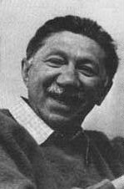
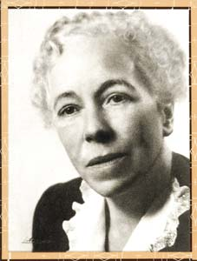
Meet the Grandparents
Abraham Maslow (1908-1970)
Karen Horney (1885-1952)

Slide 4
Maslow (1954) wrote a chapter , Towards a Positive Psychology: Need to research kindness, goodness, hope , happiness and optimism.
Psychoanalyst by training: realized psychoanalysis was not all to human life.

Slide 5
Aron Antonovsky
Also one of the pioneers, 1970’s
SOLUTOGENISIS
(Origin of health)

Slide 6
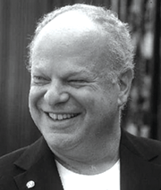
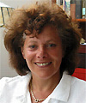
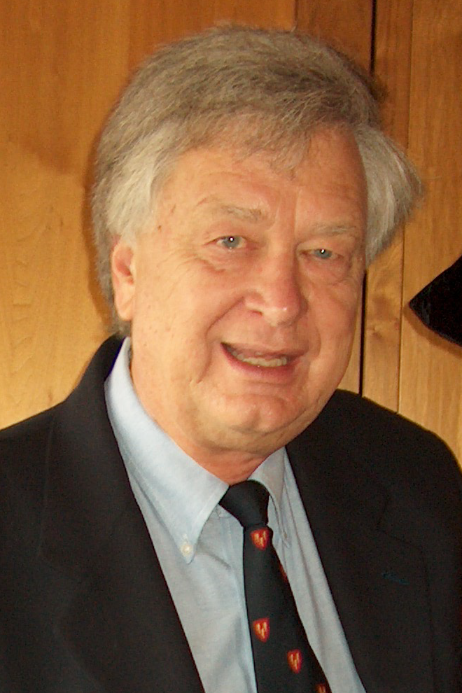
Meet the Parents
Martin Seligman
(APA Predident: 1996)
Ellen Langer
(Prof. at harvard)
Philip Stone
(1st lecture of Positive
Psychology at Harvard, 1999)

Slide 7

Meet Positive HSS216

Slide 8
It is not merely about information
It is also about transformation
Covering less; uncovering more
“Happiness is much more contingent on our state of mind than our state or the state of our bank account”

Slide 9
Trans-form (Changing the form)
Changing the way you perceive/look at the world (Research after 1999, Davidson), even physically
Learn to fail or fail to learn Eg. Athletic race and people having everything.

Slide 10
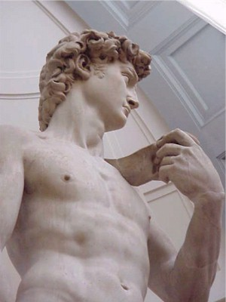
“The soul grows by subtraction, not addition.”
Thoreau
“In pursuit of knowledge, every day something is acquired; in pursuit of wisdom, every day something is dropped.”
Lao Tzu

Slide 11
UNCOVERING POTENTIAL
“Common sense is not so common” - Voltaire

Slide 12
Information is not enough
“What is wrong is not the great discoveries of science—information is always better than ignorance, no matter what information or what ignorance. What is wrong is the belief behind the information, the belief that information will change the world. It won’t.”
Archibald MaCleish

Slide 13
Information is not enough
“Humanistic philosophy [offers] a new conception of learning, of teaching, and of education. Stated simply, such a concept holds that the function of education, the goal of education—the human goal, the humanistic goal, the goal so far as human beings are concerned—is ultimately the ‘self-actualization’ of a person, the becoming fully human, the development of the fullest height that the human species can stand up to or that the particular individual can come to. In a less technical way, it is helping the person to become the best that he is able to become.”
Abraham Maslow

Slide 14
What goes in does not determine happiness
The way we look at the world determines happiness

Slide 15
It is not about providing definitive answers concerning the good life
It is about identifying the right questions
Education is the quest for information and transformation, and therefore must begin with a question.
“Children enter school as question marks and leave as periods.” Neil Postman

Slide 16
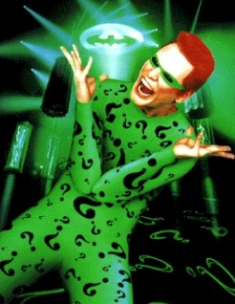
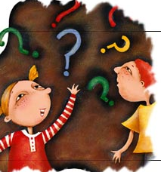
“The one real object of education is to leave a man in the condition of continually asking questions.” Bishop Creighton

Slide 17
Research
Prof. John Clotcher, at HBS did a 20 Years research study (1974). Found 2 groups, successful and extraordinary successful.
1st : really believed in themselves: Beliefs the self fulfilling prophecies
2nd: Always asking questions. Learning, curious. (Wanting to understand the world more)
Not IQs, not backgrounds, not grades.

Slide 18
The Question of Questions
How can we help ourselves and others—individuals, communities, and society—become happier?

Slide 19
Happier not happy (There is no fixed point beyond you would be happy, its not binary)
How can I improve, how can I get better. To pursue it constantly.

Slide 20
It is not a survey of positive psychology
It is a selective exploration of the ‘question of questions.’
Cross cultural psychology (Many more similarities than differences)
Eclectic
Studying others and ourselves

Slide 21
It is not English or Math
It is about rigorous fun
“I would not give a fig for the simplicity on this side of complexity, but I would give my life for the simplicity on the other side of complexity.”
Oliver Wendell Holmes
A different kind of effort: Effort of Application
Change is hard
Rigorous fun???

Slide 22
We will study real life, ourselves and others. Not just books.
It’s a class about making our lives better.
Karl Rogers said “ What is most personal, is most general.”
So, if we understand ourselves well, we understands others better. Look inside your selves.
Requires effort: effort to change.

Slide 23
Empathy

Slide 24
Mid Sems: 25%
End Sems: 50%
Project: 20%
Diaries: 3%
Assignments: 2%

Slide 25
Final Project
20-30 mins Presentation
  Topic within positive psychology
  Written text (10-15 pages double spaced)
  Slides
Include:
  Reference to research
  stories, film clips, exercises
  field research and surveys etc
  Theories with references
Why a presentation?
  Teaching as learning
  Spread goodness, also teaching 3 other people .

Slide 26
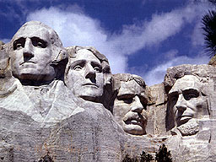

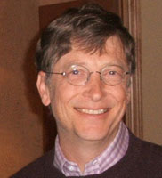
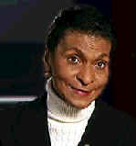
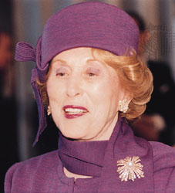
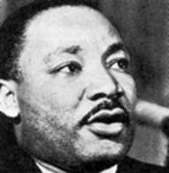
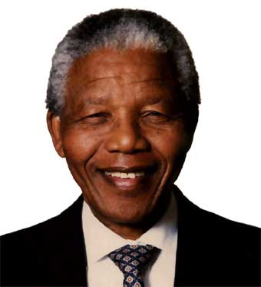
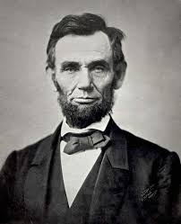


Positive uncovering
“Most men and women go through their lives using no more than a fraction—usually a rather small fraction—of the potentialities within them. The reservoir of unused human talent and energy is vast, and learning to tap that reservoir more effectively is one of the exciting tasks ahead for humankind. Among the untapped capabilities are leadership gifts... We can do better. Much, much better.”
John Gardner, On Leadership

Slide 27
This class in not about rote learning, feeding information, its about transformation
We need to apply the ideas in real life
It requires courage to look inside ourselves, because change is hard, it difficult.
“1st we make our habits and then our habits make us.”

Slide 28

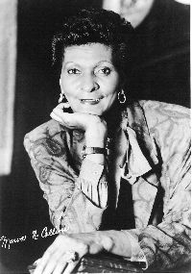

Why Positive Psychology?

Slide 29

Maslow rejected Freud’s ideas
Psychoanalysis based on what went wrong.
Theories based on clinically ill patients.
Repressing strong sexual urges.
Animal passions.

Slide 30
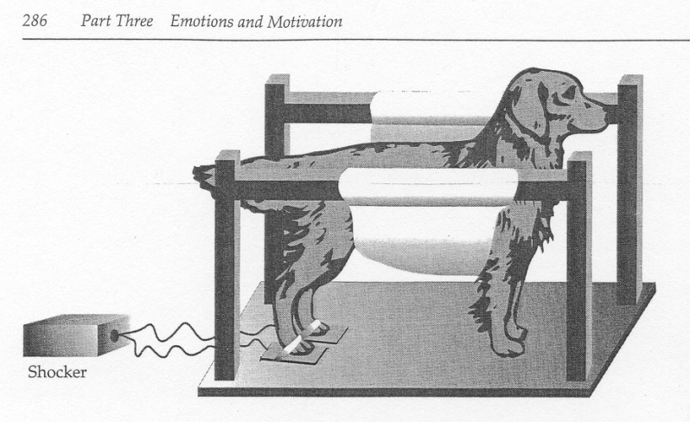

Seligman Experiment: part 1
Inescapable shock.
Got shock.
No coping mechanism.
No way to terminate shock.
“Passive
Escapable shock.
Had coping mechanism.
Press nose button to terminate shock.
“Active”

Slide 31

Parallels with Reactive Depression
Triggered by traumatic life event (ex. death of loved one).
Passivity
Difficulty in learning responses that bring relief.
Physical symptoms.
Stress related disorders.
LEARNT HELPLESSNESS

Slide 32
Human strengths
Despite all the difficulties of life, majority of people manage to live with dignity and purpose.
Positive psychology adopts a more optimistic perspective on human potential, motives, and capacities.
Humanistic psychology with scientific methods.

Slide 33
Positive Psychology
Positive psychology is the branch of psychology that uses scientific understanding and effective intervention to aid in the achievement of a satisfactory life, rather than merely treating mental illness.
- Martin Seligman (Authentic Happiness, 2000)

Slide 34
Bibliography and Recommendations
Excellent website: www.psychologymatters.org
Antonovsky (1979). Health, Stress, and Coping. San Fransisco: Jossey-Bass.
Masten, A. S. & Reed, M. J. (2002). Resilience in development. In C. R. Snyder and S. J. Lopez (Eds.), Handbook of Positive Psychology, 528-540. Oxford University Press.
Seligman, M. E. P., & Csikszentmihalyi, M. (2000). Positive Psychology. American Psychologist, 55, 5-14.
Sheldon, K. M. & King, L (2001). Why Positive Psychology Is Necessary. American Psychologist, 56, 216-217.
Snyder, C. R. & Lopez, S. J. (Eds.) (2002). Handbook of Positive Psychology, 528-540. Oxford University Press.
Collins, M. & Tamarkin, C. (1990). Marva Collins’ Way. Putnam: New York.
Werner, E. & Smith, R. (2001). Journeys from Childhood to Midlife: Risk, Reilience and Recovery. Cornell University Press.

