Slide 1




Dr. Akshay Kumar

Slide 2
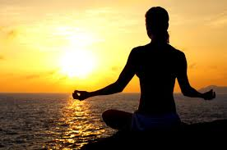
Meditation (Walsh & Shapiro, 2006, p 228)
Refers to a family of self regulation practices that focus on training attention and awareness in order to bring mental processes under greater voluntary control and there by foster general mental wellbeing and development of specific capacities such as calmness, clarity and concentration.

Slide 3
Meditation
Shapiro (1984): As a family of techniques which have in common a conscious attempt to focus attention in a non analytical way and an attempt not to dwell on discursive and ruminative thoughts.
Benson (1975): Meditation is a technique of relaxation

Slide 4
Based on 2 principles
Auto-suggestion
Classical conditioning

Slide 5
Aspects of Meditation (Shapiro)
Monitoring ones consciousness
Attempt at meditation
Non cultic

Slide 6
Aspects continued…
Content of thought is not important
Consciousness is important
Posture is important

Slide 7
Types of Mediation
Object exclusion approach (Anand & Chinna and Singh, 1961): Individual excludes a particular thought.
Concentrative approach (Dhayaanaa): Sitting quietly produces a a state of restfulness.
Zen Shikan Taza: Not focussed in any specific object, aimless meditation…. Order out of disorder\

Slide 8
Moment meditation: Sufi, Tai Chi etc

Slide 9
Attention strategies (Shapiro)
On the field strategy ( Mindfulness)
Specific object within the field strategy (Concentrative Meditation)
Shifting back and forth between the 2.

Slide 10
Thought process during Med.
De-automatization: Ignoring or excluding thoughts (Benson)
With teeth clinched and tongue pressed against jaws, by means of mental effort burning thoughts
Self regulation
Self suggestion
Auto suggestion

Slide 11
Contraindications
Psychiatric disorders

Slide 12
Studying meditatin : methodology
Quantified observing
Forming logical hypothesis
Testability: To see its effect on a particular asspect
Factor analysis of self reports

Slide 13

Dr. Akshay Kumar

Slide 14
Meditation (Walsh & Shapiro, 2006, p 228)
Refers to a family of self regulation practices that focus on training attention and awareness in order to bring mental processes under greater voluntary control and there by foster general mental wellbeing and development of specific capacities such as calmness, clarity and concentration.

Slide 15
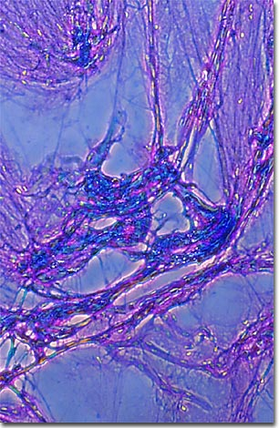

The Anatomy of Change
Neuroplasticity (Davidson, 2000)
Neuro Genisis (8 weeks)
Neural pathways (channels)
Created through experience
We 1st make our habits
and then they make us.

Slide 16
Introduction
Grown from the merger of Eastern and Western Philosophy
Origins from the Buddhist meditation
Entered into Western Psychological research.
Pioneers: Prof. Ellen Langer (Langer, 1989, 2002)
Meditation came out of the spiritual realms of spiritality and came into empirical main stream academics under the heading of Levels of Consciousness.

Slide 17
Mindfulness
Slippery concept
For now: Present centered attention, focused on here and now of our experience.
Seeing what is clearly what is going on in our lives, when our perception is uncluttered by wishes, desires, needs or anxiety.
Mindfulness meditation is a means of increasing the clarity of perception by observing and learning about the self.
Enhanced quality of life

Slide 18
Most extensively investigated as a therapeutic practice for people dealing with a variety of mental and physical disorders, particularly those caused by high levels of stress.

Slide 19
Disorders cured by Mindfulness
(Research studies)
Shaphiro and Schwartz, 2002)
Cardiovascular Disorder
Psychosomatic disorders
Asthema
Hypertension
Anxiety
Panic attacks
Chronic pain
Cancer
Depression
OCD

Slide 20
Jon Kabat Zinn (1990)
Developed a new form of therapy at the University of Massachusetts Medical School.
MBCT (Mindfulness based cognitive therapy)

Slide 21
Mindlessness
Opposite of mindfulness is mindlessness, which is easier to define. Eg. Going through the ride but my heart is not in it.
Mindlessness is defined as a state of consciousness marked by little awareness of what is going on in the present moment. (Langer, 2002)
State governed by routine.
Reading a book but thinking of something else.
In a typical day many of our behaviors are habituated and automatic.
Life as an unbearable auotomaticity of being (Bargh,1999)

Slide 22
Mindlessness
When you are mindless you are not there in very real ways to know that your are not there
I am mindless most of the times like everybody else but I am oblivious to it

Slide 23
When you are mindless you are not there in very real ways to know that your are not there
I am mindless most of the times like everybody else but I am oblivious to it
If you want to change and get rid of it. Its not that we can just think of it and get rid of it.
Everybody wants to be in the present: BUT NO BODY THINKS THAT WE ARE NOT IN THE PRESENT

Slide 24
Mindlessness
An active state of mind characterized by reliance on distinctions, categories drawn in the past:
The past over determines the present
Trapped in a single perspective
Insensitive to context
Rules and routine governed
Typically by default not by design
Its just like we are robots

Slide 25
Actively Notice new things

Slide 26
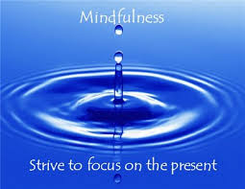
Mindfulness
A state of mind of being present in the here and now.
Active state of mind characterized by actively noticing things

Slide 27

Mindfulness meditation
Qualities that need to be developed:
Relaxation
Stability
Clarity
It is a technique to learn the skill of relaxation, attention and concentration, which enables one to develop thought control and be present in the current moment.

Slide 28
Qualities to develop
QUALITIES | FAULTS
Relaxation | Tightness, tension
2. Stability (Ability to focus without getting distracted) | Agitation, distraction (Pulled away by the senses)
3. Clarity (Not only focus, but focus clearly) | Dullness (Laxative)
These faults stop us from developing the qualities

Slide 29
Most of our suffering, physical and psychological is the direct or indirect effect of mindlessness.
Study after study when people were taught to be mindful and improved physical and psychological wellbeing.

Slide 30
No matter what you do taking notes, eating a sandwhich, watching TV, writing an exam, playing football, whatever you either do mindfully or mindlessly.

Slide 31
Mindfulness should be the base. But he problem is that we are not mindful enough to know that we are mindless.

Slide 32
Mindlessly faking it
- Children and even animals know that whether you are there in that moment or not. Eg. Dolphins.

Slide 33
Being mindful speaks silently and people are attracted towards you and you are perceived as charismatic (Langer, 1989)
People were liked more, trusted more and rated more positively

Slide 34
Mindfulness without meditation
Active state of mind characterized by actively noticing things
A state of mind characterized by novel distinction:
Being situated in the present: Noticing new things.
When you notice new things it puts you to present
Your mind shouldn’t be chaotic
Sensitive to context and perspective
Rule and routine guiding not determining what you do
Phenomenological experience of engagement (Passion): People will envy you. Eg. Smiling. (People ask why are you smiling, then I realizes I should ask why arnt they smiling)

Slide 35
Each time I undertake to paint a picture I have a sensation of leaping into space. I never know whether I shall fall on my feet.. – Picasso
If you are in the present, you cant know exactly where you are going to go. That’s why we are afraid and drive on the notions of the past.

Slide 36
What stops us from being mindful
Fear of evaluation!!!!
Fear making mistakes: Making mistakes is the cue to be in the present.
MINDFULLY INCORPORATE THE MISTAKE. IMPROVED PRODUCTS

Slide 37
Study by Dr. Ellen Langer
The Mindful groups paintings and essays were sold more.

Slide 38
Being afraid of ones error turns them into crime. – Confucius

Slide 39

Life as a meditation
How to improve your relationship
Notice new things

Slide 40
Its very hard to break free from this mindlessness
We don’t taste things because we know how it tastes like
We don’t hear things because we know how it sounds like
We don’t think creative new things because we are trapped by the thoughts that we have learned before
So we become so much expert in mindless seeing, hearing and thinking, that WE ACTUALLY BECOME STUPID.

Slide 41

Stein: “ A rose is a rose is a rose.”
Akshay: “A rose is not a rose, is not a rose”

Slide 42
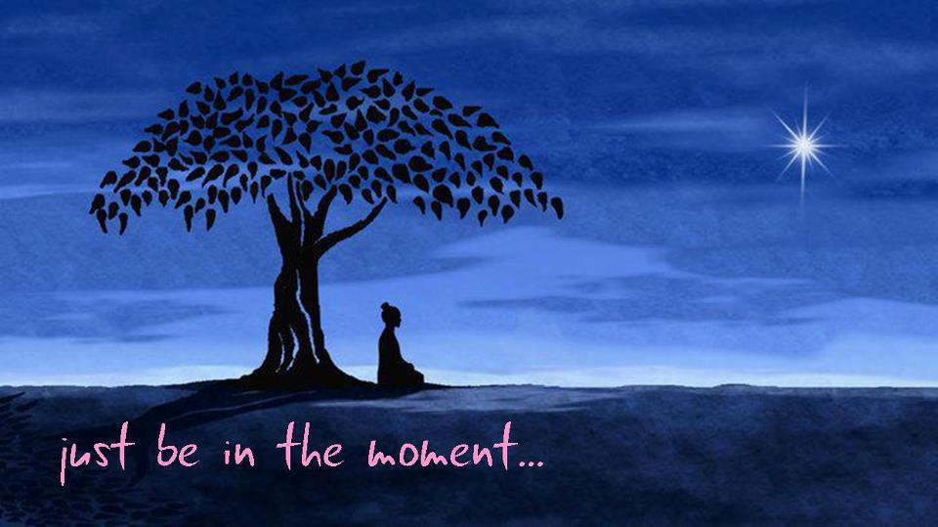
Diane Arbus: “My favorite thing is to go where iv never been.”
Akshay: “Right where we are is where we’ve never been.”

Slide 43
Do we know our mind?
We see the works and habits of our mind, when we focus on our mind.
Live mindfully.

Slide 44

Till now we are slaves of our minds.
We can become its masters. And the only way is to observe the mind

Slide 45

Events do not come with evaluation. We impose them on events, thus creating the mental filter. – Ellen langer

Slide 46
Conclusions
Be authentic: Mindlessness is visible
Mindfulness engagement is essence of charisma and being liked.
Don’t assume we know it: Our mind is stable not the environment
Mistakes are cues to be in the present moment: Incorporate them don’t hide them.
Feeling engaged results from noticing/creating novel distinctions

Slide 47


