Slide 1
Virtues of Positive Psychology
“authoritative classification and measurement system for the human strengths”
-(Seligman, 2002)

Slide 2
6 core positive virtues
They were surprised to find 6 particular virtues that were valued in almost every culture, valued in their own right and are attainable.

Slide 3
6 core virtues
wisdom & knowledge
courage
love & humanity
justice
Temperance (Self control)
spirituality & transcendence

Slide 4
Strengths
For Seligman, the strengths are the “route” through we achieve virtues in our life.

Slide 5
Life (Seligman 2002, p. 249)
The pleasant life: a life that successfully pursues the positive emotions about the present, past, and future.
The good life: using your signature strengths to obtain abundant gratification (through activities we like doing) in the main realms of your life.
The meaningful life: using your signature strengths and virtues in the service of something much larger than you are. (Seligman 2002, p. 249).

Slide 6
Life
Pleasant life: Positive emotions
Good life: Flow and mindfulness
Meaningful life: Meaning and purpose

Slide 7
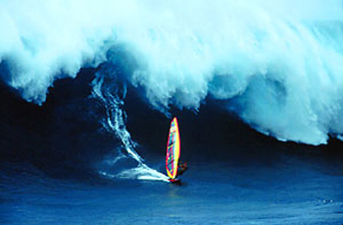
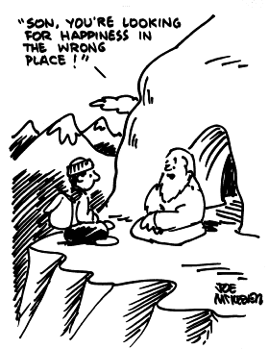
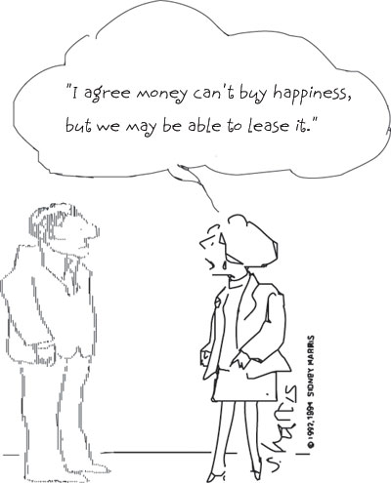
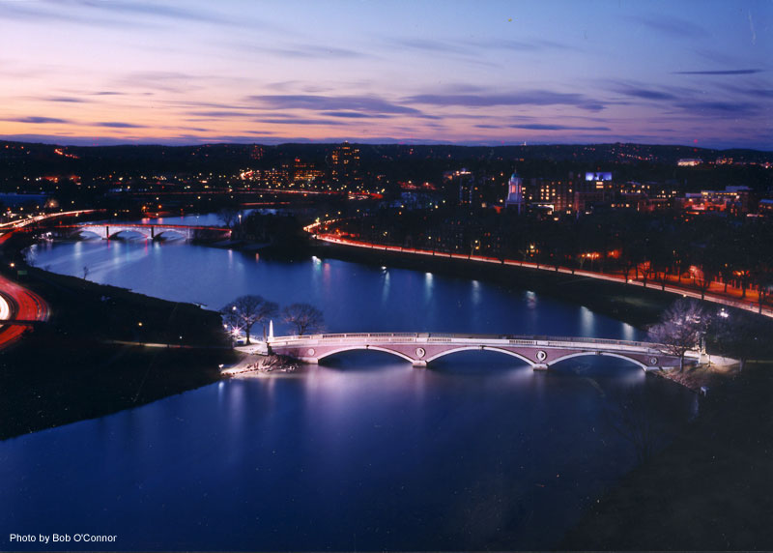
Basic Premises

Slide 8
Marva Collins: 1930’S: STOP BLAMING. YOU CAN DO IT, ITS UP TO YOU.
From passive victim to active agent
Self responsibility: No one is coming

Slide 9
Stop asking whether the student is smart or not....start asking what the student is smart at. -Gardner

Slide 10
The Premises
Bridge building Vs. Division and separation
Change is possible Vs. Change is illusive
Internal factors primarily determine happiness Vs. Happiness is primarily a function of external circumstances
Human nature must be obeyed Vs. Human nature must be perfected (Conflict throughout human history)
Happiness is and ought to be the ultimate end Vs. Happiness should be a secondary pursuit

Slide 11
PREMISE 1:
Bridge building
VS.
Division and separation

Slide 12
The Need for Practical Idealists
The desire to make a difference
False stereotypes

Slide 13
Psychology Can Help
Applied research
  in the classroom: Eg. Pygmalion Effect
  for increasing self-esteem: Praising children: Stanford research
  bridging mind and body: Eg. Yoga practice decreases 2nd time offenders in jail. Strange but true.
  Meditation literally transforms the brain
  Physical exercise 3 times a week = Most powerful medicine
  in conflict resolution: Muzaffar Sherif and Elliot Aronson 1954 contact hypothesis of getting people together
Taking research seriously
Taking responsibility!

Slide 14
PREMISE 2:
Change is possible
VS.
Change is illusive

Slide 15
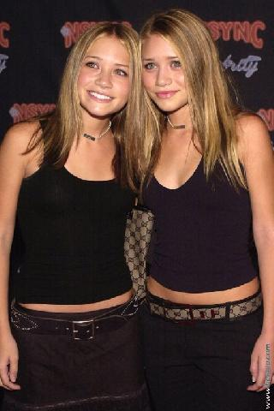
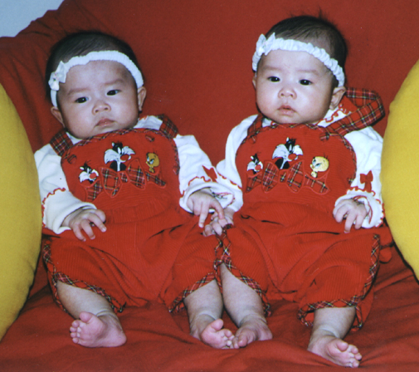
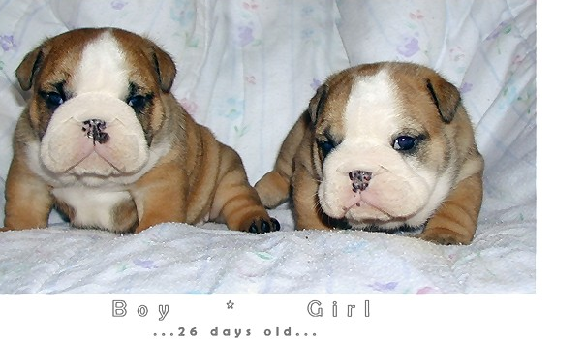
Minnesota Twin Studies
“It may be that trying to be happier is as futile as trying to be taller and is therefore counterproductive.” Lykken and Tellegan (1996)
How much does genes matter?

Slide 16
Change is Possible
Counter evidence: People do change
Therapy
Albert Bandura, Stanford, Experience encounters
PTSD as well as growth
Error of the average: Avg might be the same not all are the same. Eg. Statistician drowned in the pool with an average depth of 3 ft.
Exception proves the rule
Studying the best: Lets study the happiest people, lets study the best relationships, the top 5%

Slide 17
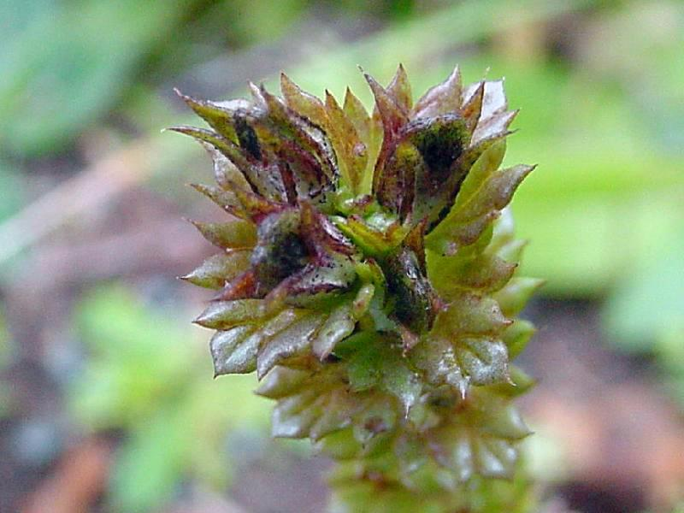

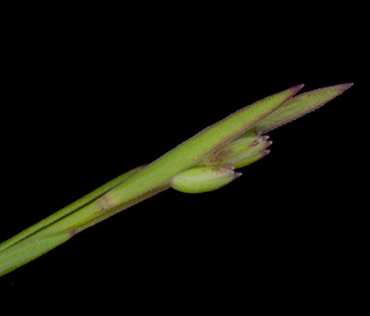
Growing-Tip Statistics
“What this kind of research design means is a change in our conception of statistics, and especially of sampling theory. What I am frankly espousing here is what I have been calling ‘growing-tip statistics,' taking my title from the fact that it is at the growing tip of a plant that the greatest genetic action takes place...”
Abraham Maslow

Slide 18
“If we want to know how fast a human being can run, then it is no use to average out the speed of a ‘good sample’ of the population; it is far better to collect Olympic gold medal winners and see how well they can do. If we want to know the possibilities for spiritual growth, value growth, or moral development in human beings, then I maintain that we can learn most by studying our most moral, ethical, or saintly people. On the whole I think it is fair to say that human history is a record of the ways in which human nature has been sold short. The highest possibilities of human nature have practically always been underrated.... Certainly it seems more and more clear that what we call ‘normal’ in psychology is really a psychopathology of the average, so undramatic and so widely spread that we don’t even notice it ordinarily.”

Slide 19

Growing-Tip Statistics
Doesn’t exclude studying the average
Everyone benefits
  Study of resilience
  Study of meditation: Study saints or random someone
  Study of relationships
  Study our personal best
  Study of teaching

Slide 20
Studying Our Personal Best
Describe or prescribe
“Few in number though they be, we can learn a great deal about values from the direct study of these highly evolved, most mature, psychologically healthiest individuals, and from the study of the peak moments of average individuals, moments in which they become transiently self-actualized.” Abraham Maslow

Slide 21
Changing the World?
(Societal Change)
The Cambridge-Somerville Youth Study
  A five year intervention
  Twice-a-month caseworkers visit
  Academic tutoring
  Psychiatric attention
  Boy Scouts, YMCA, etc.

Slide 22
Measuring Outcome
Random assignment
40 year followup
Shocking results
  No difference in juvenile offenses
  No difference in adult offenses
  No difference on health, mortality, wellbeing
  Significant difference on alcoholism and job status
… IN THE “WRONG” DIRECTION

Slide 23
Is Societal Change Possible?
Exception proves the rule
Practical idealists unite!
“What I am suggesting is Manhattan-Project-type attacks upon what I consider to be the truly Big Problem of our time, not only for psychology but for all human beings with any sense of historical urgency...”
Abraham Maslow

Slide 24
The Power of One
“All history is a record of the power of minorities, and of minorities of one.”
Ralph Waldo Emerson
“Never doubt that a small group of thoughtful, committed citizens can change the world. Indeed, it is the only thing that ever has.”
Margaret Mead
Human networks as exponential Eg. Butterfly effect
Eg.2. Smile is contagious: 3 people made 3 people smile within 20 degree of separation the whole world smiling.

Slide 25
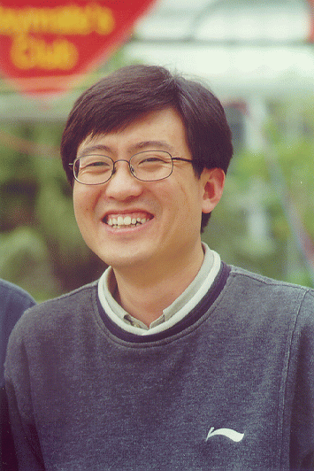
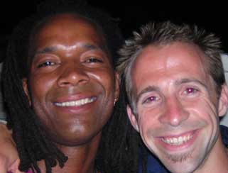

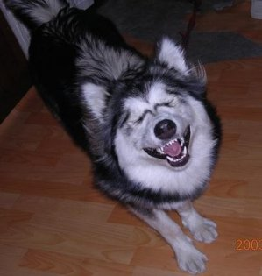
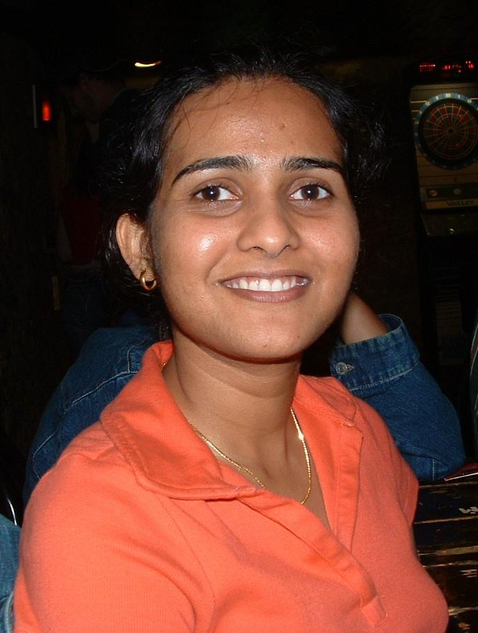
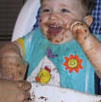

Slide 26
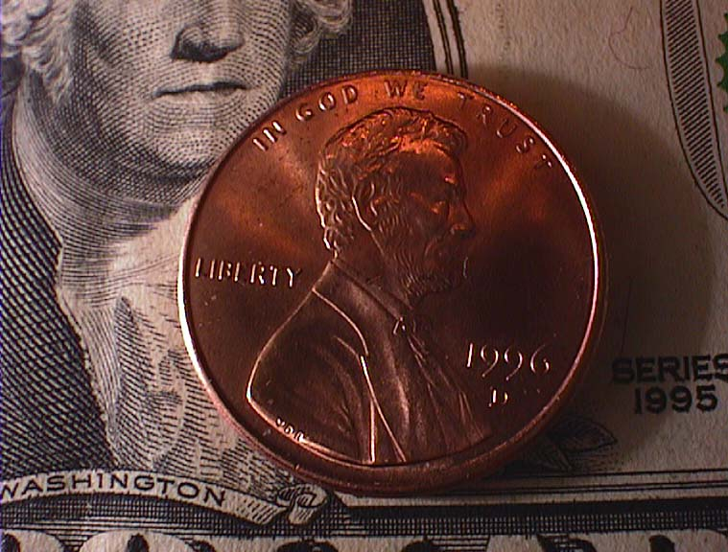
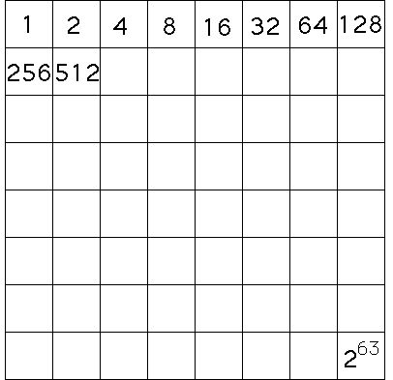
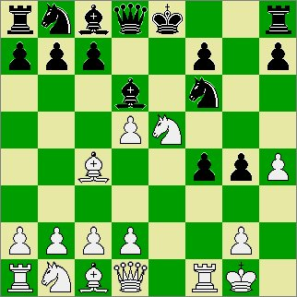
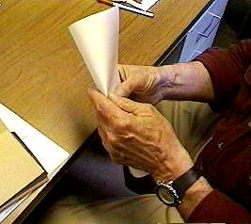
Exponential Growth

Slide 27
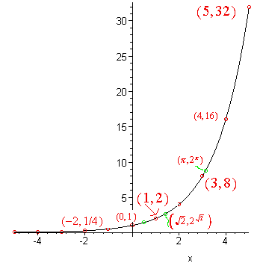
We underestimate our capacity to effect change because we underestimate the growth of an exponential function.

Slide 28
PREMISE 3:
Internal factors primarily determine happiness
VS.
Happiness is primarily a function of external circumstances

Slide 29
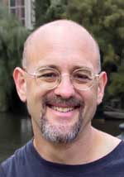
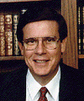
Subjective Well-Being Research
Affective forecasting (Dan Gilbert)
-How happy will you be when you get your tenure? For how long would you be happy for?
How sad will you be? For how long? After 6 months
Happiness levels (Ed Diener)
  Income matters little
  No change across generations
  Place of residence irrelevant
  Think about your own experience.. Both good and bad
  News when you got in IIITD

Slide 30
Subjective Well-Being Research
Affective forecasting (Dan Gilbert)
Happiness levels (Ed Diener)
  Income matters little
  No change across generations
  Place of residence irrelevant
  Beyond the Basic needs
Democracy/oppression matter!

Slide 31


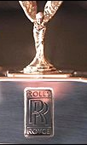
Is Change Illusive?
Our readiness and potential to experience happiness is mostly dependent on our state of mind, not on our status or the state of our bank account.
Focus on trans-formation

Slide 32
PREMISE 4:
Human nature must be obeyed
VS.
Human nature must be perfected

Slide 33
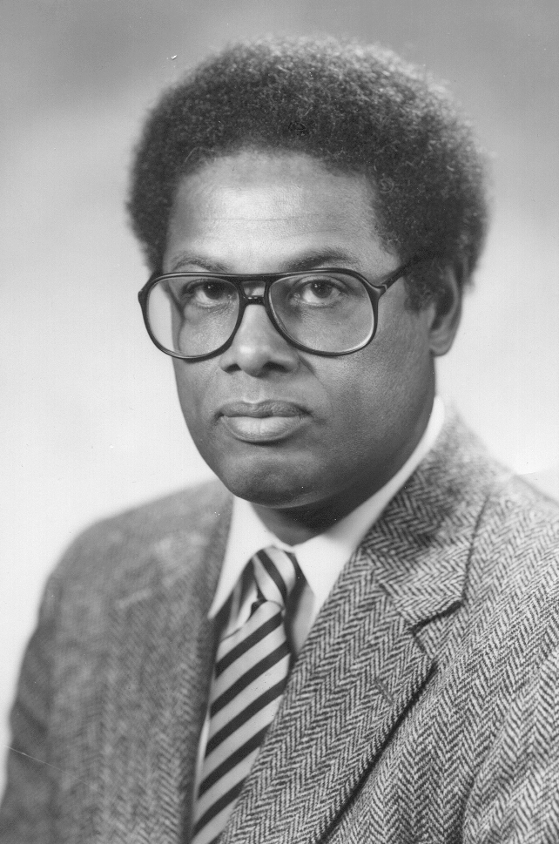


Slide 34
Nature is fixed Perfectionism
_____________________________________________
Human nature immutable
Flaws inevitable
Acceptance
Channel nature
Cannot change it so make the best of it
Can be improved
Perfectible
Change nature
“Nature to be commanded must be obeyed”
Francis Bacon
“It is for self-perfectioning that destiny calls us”
Benjamin Constant

Slide 35
Vision of Psychology
Human nature immutable (constrained)
Role is to understand nature…
We may not like it but..
… and make best use of it

Slide 36
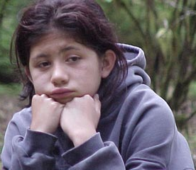
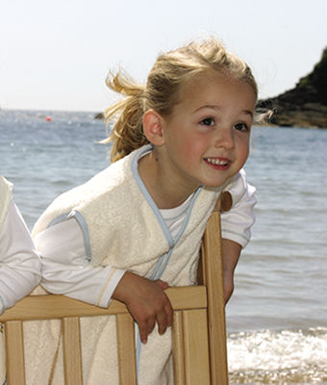



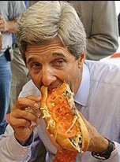
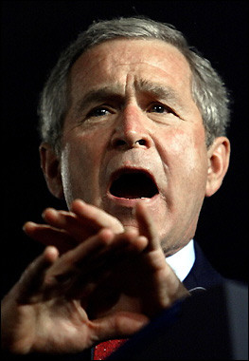
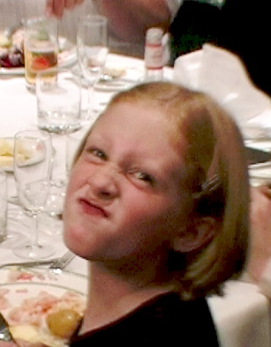

The Permission to be Human

Slide 37
Unconditional Acceptance
(Rogers, 1961)
Rejecting our nature leads to unhappiness
Paradox: “Ironic Processing” (Wegner, 1994)
The Great Deception (Mind conflict)
Not resignation
Active acceptance
True to reality

Slide 38
“God, grant me the serenity to accept the things I cannot change, the courage to change the things I can change, and the wisdom to know the difference.”
Reinhold Niebuhr

Slide 39
PREMISE 5:
Happiness is and ought to be our ultimate end
VS.
Happiness should be a secondary pursuit

Slide 40
Happiness as the Highest End
“Happiness is the meaning and purpose of life, the whole aim and end of human existence.”
Aristotle
“If we were to ask the question: ‘What is human life's chief concern?’ one of the answers we should receive would be: ‘It is happiness.’ How to gain, how to keep, how to recover happiness, is in fact for most men at all times the secret motive of all they do, and of all they are willing to endure.” William James
“Whether one believes in religion or not, whether one believes in this religion or that religion, the very purpose of our life is happiness, the very motion of our life is towards happiness.”
Dalai Lama

Slide 41
What’s Good About Positive Emotions?
It feels good to feel good (Aristotle’s Law of Identity: A is A)
Broaden and build (Barbara Fredrickson, 2002, U penn.) Evolutionary basis
“We should work to cultivate positive emotions in ourselves and in those around us not just as end states in themselves, but also as a means to achieving psychological growth and improved psychological and physical health over time... I call this the broaden-and-build theory of positive emotions because positive emotions appear to broaden people’s momentary thought-action repertoires and build their enduring personal resources... Through experiences of positive emotions people transform themselves, becoming more creative, knowledgeable, resilient, socially integrated, and healthy individuals.”

Slide 42
What’s Good About Positive Emotions?
It feels good to feel good
Broaden and build (Fredrickson, 2002)
Overcoming negative emotions
Increased creativity
Increased motivation and energy
Success
Physical health

Slide 43
But what about others?
Happiness is a positive sum game (don’t feel guilty).
“Thousands of candles can be lighted from a single candle, and the life of the candle will not be shortened. Happiness never decreases by being shared.”
Buddha
Better relationships
Helping Ourselves → Helping Others (Isen, 2002)
Helping Others → Helping Ourselves (Lyubomirsky 2006)

Slide 44
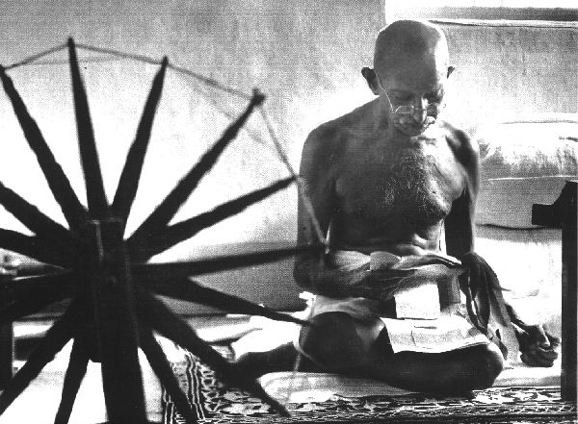
Spreading Happiness
“Be the change you want to see in the world.”
Gandhi

Slide 45
The Premises
Bridge building Vs. Division and separation
Change is possible Vs. Change is illusive
Internal factors primarily determine happiness Vs. Happiness is primarily a function of external circumstances
Human nature must be obeyed Vs. Human nature must be perfected
Happiness is and ought to be the ultimate end Vs. Happiness should be a secondary pursuit

Slide 46
Bibliography and Recommendations
Diener, E., Suh, E. M., Lucas, R. E., & Smith, H. L. (1999). Subjective well-being: Three decades of progress. Psychological Bulletin, 125: 276-302.
Gilbert, D. T., Pinel, E. C., Wilson, T. D., Blumberg, S. J., & Wheatley, T. P. (1998). Immune Neglect: A Source of Durability Bias in Affective Forecasting. Journal of Personality and Social Psychology, 75, 617-638.
Lykken, D., & Tellegen, A. (1996). Happiness is a stochastic phenomenon. Psychological Science, 7, 186–189.
Maslow, A. H. (1993). The Farther Reaches of Human Nature. Arkana.
Snyder, C. R. & Lopez, S. J. (Eds.) (2002). Handbook of Positive Psychology, 528-540. Oxford University Press.
Sowell, T. (2002). A Conflict of Visions: Ideological Origins of Political Struggles. Basic Books.

