Slide 1
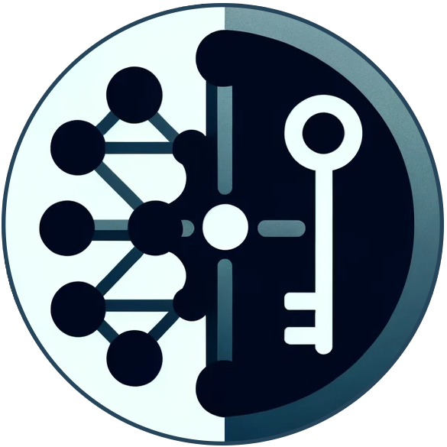

CellulOS: Building an OS on seL4
Arya Stevinson, Linh Pham
Advised by: Margo Seltzer, Reto Achermann, Aastha Mehta
Grads: Sid Agrawal, Shaurya Patel
Notes:
As part of OSmosis, we worked on the CellulOS implementation on top of seL4. As a microkernel, seL4 provides very little, so we had the fun job of implementing a lot of core OS functionality.

Slide 2
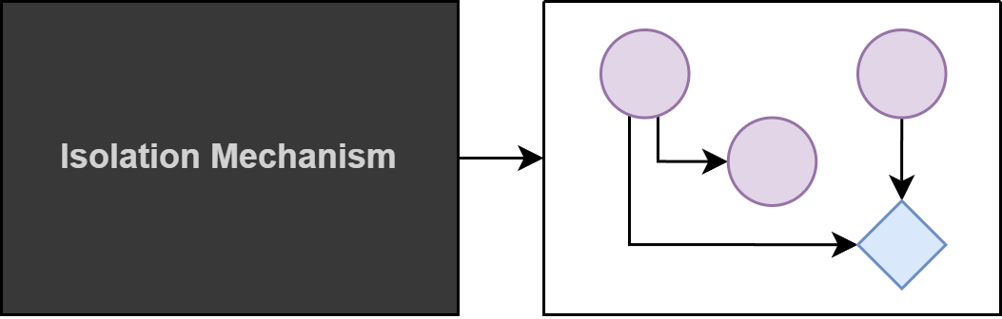
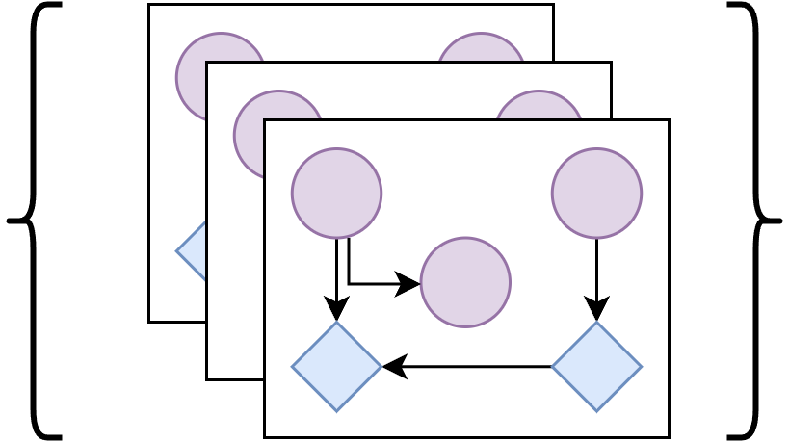
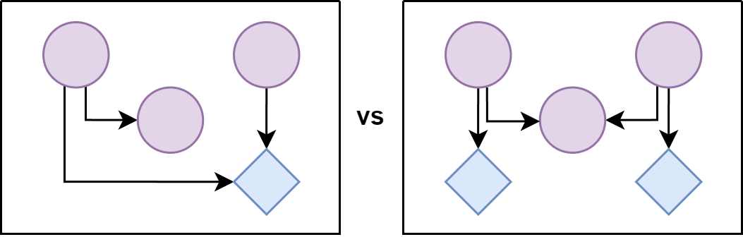
The Big Picture
1. Modelling
3. Enumerating & Exploring
2. Comparing
Notes:
We won’t go into much detail on the greater OSmosis project, as you are likely familiar with it from Sid’s previous presentations.
Here we have some of the main goals of OSmosis.
The first two go hand in hand: we want to generate a model state from an isolation mechanism, and then compare mechanisms. You might say, this could be done by hand. But in practice we want to be able to evaluate real programs, on a real operating system, in different configurations. That’s going to require an implementation.
The third step pushes it even further: we want to enumerate the design space of isolation mechanisms. At this point, we definitely need an implementation.
So, what does an implementation mean for us?

Slide 3




Why OSmosis?
What we have been working on!
We want the ability to…
quantify the degree of isolation between PDs in a system
described in detail at: https://sid-agrawal.ca/agrawal_osmosis_2024.pdf
build isolation abstractions in a unified way
flexibly define system cleanup policies
Notes:
Quantify isolation:
No more “I think these two processes won’t interfere with one another, but I don’t have any concrete proof”. We want to say with certainty that two processes may never share a type of resource or never request resources from the same resource server.

Slide 4
What do we need from a custom OS?
Ability to extract the model state
Ability to build isolation abstractions in a unified way

Slide 5



What do we need from a custom OS?
Ability to extract the model state
request
hold
hold
hold
Track and/or extract:
resources and their dependencies
active entities (protection domains), their resources, and their dependencies

Slide 6
What is OSmosis?
A model of a system that describes…
any active entities (protection domains) in the system
the resources which they have access to, can allocate
how protection domains interact with one another
how protection domains may share resources
request
hold
hold
hold

Slide 7
Why do we need a custom OS?
We need a system from which we can extract an OSmosis model state
We want to demonstrate that we can build various isolation abstractions (e.g. processes, threads, virtual machines) in an abstract and unified way
Notes:
(2) Linux already has pre-defined and pre-implemented abstractions for processes and threads. What if we wanted a slightly modified process that’s not exactly the one which you can create in Linux? E.g. one that shares the heap

Slide 8



What do we need from a custom OS?
A protection domain (PD) is simply an active entity in the system that runs some code
2. Ability to build isolation abstractions in a unified way
Hmm… This looks like a process
Create PD
App
Process-like PD
PD Creation
config
Notes:
In order to do anything useful, our OS needs the ability to spawn programs - most commonly done by creating processes and threads.
However, CellulOS is special in that a user can create any type of entity (not necessarily just processes and threads) that runs some task, with a set of resources and connections to other entities, without needing to do much additional workarounds for any special configurations.
We use the terms thread, processes, PDs interchangeably, but these are all just PDs in our system

Slide 9
Minimum specification of a Configuration
The core components required for any PD to run:
Address space
An execution context
Communication channels
Resources
Notes:
seL4 luckily provides us with these “primitive” components, so that we may use them however we like. E.g. A PD can have multiple address spaces, and the execution context simply needs to be changed to point to the one that the PD wants to use at a certain time

Slide 10
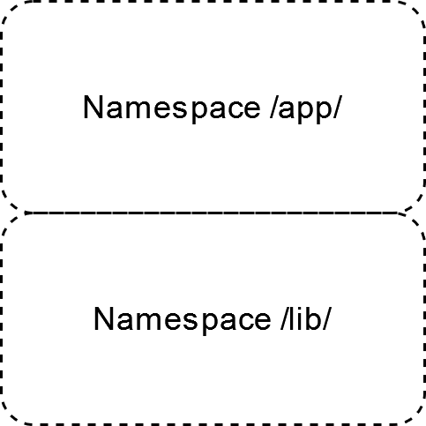


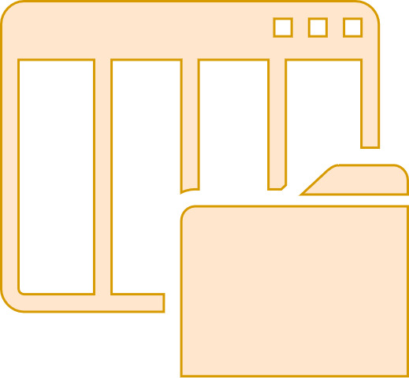
PDs for specialized use-cases
Heap memory
Main thread
File System
App
Library thread
Notes:
Processes and threads are common enough abstractions, so I won’t really go over how CellulOS creates them.
Suppose we’re running an app, and we’re using some Key-Value store library. The key-value store heavily uses the heap for various metadata, and we don’t want it to be able to access any of our app’s data that may be on the heap. However, we’re ok with all other memory in our address space to be shared.
To do this on Linux, we would need to allocate some virtual memory region for the library’s separate heap, then configure whatever malloc implementation we’re using to swap between the two heaps when the library’s code is invoked. Even then, the library code will still be able to access the app’s heap, since we’re still sharing the same address space.

Slide 11
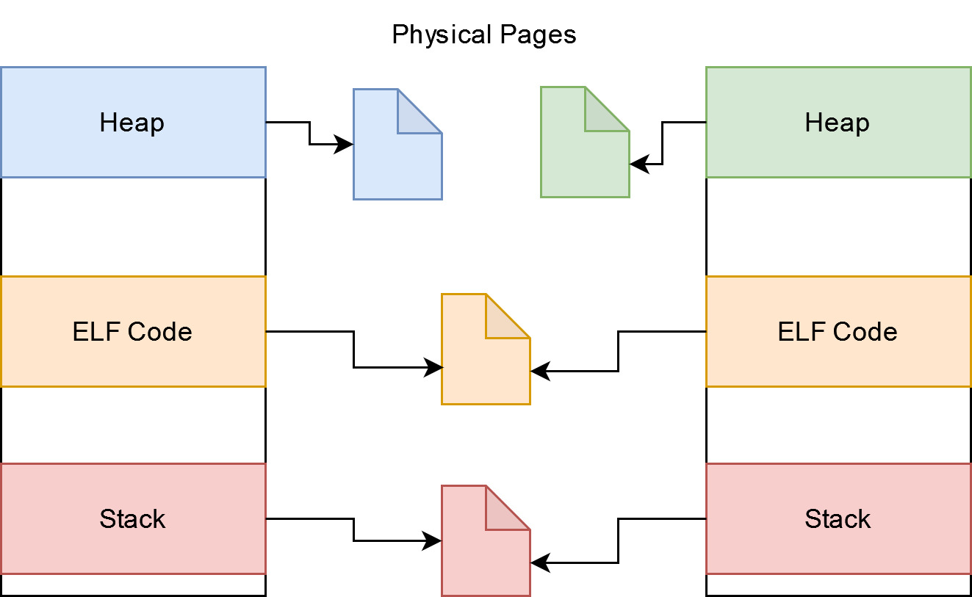
Special configs for special PDs
Configuration is always in reference to another PD
Create PD
App
Address Space Configuration
Notes:
Because of the way seL4 works, we can create PDs with multiple ADSes, and swap between them
Most focus on VMR configuration, since other resource configs are relatively straightforward (e.g. to share a file, or to not share a file)

Slide 12
Special configs for special PDs
Create PD
namespace /lib/
File System
App
File System Configuration
Notes:
Because of the way seL4 works, we can create PDs with multiple ADSes, and swap between them
Most focus on VMR configuration, since other resource configs are relatively straightforward (e.g. to share a file, or to not share a file)

Slide 13
Setting up PDs based on Configuration
Create a new address space
Code region is shared?
Omit C runtime setup
Heap is separate?
Allocate new physical memory
We currently assume all libraries are statically linked.
PD Creation
etc…
Notes:
Our PD generator will read this configuration and try to determine how to setup the new PD’s resources such that it can actually run (provided that an invalid configuration hasn’t been given)
Dynamically linked libraries can be supported by marking it with a separate virtual memory region type, and handling that separately when setting up the PD

Slide 14
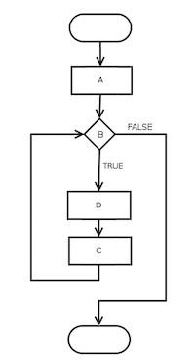
Setting up PDs based on Configuration
PD Creation
Notes:
Our PD generator will read this configuration and try to determine how to setup the new PD’s resources such that it can actually run (provided that an invalid configuration hasn’t been given)
Dynamically linked libraries can be supported by marking it with a separate virtual memory region type, and handling that separately when setting up the PD

Slide 15
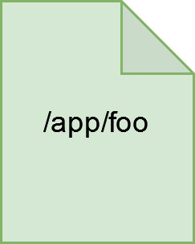
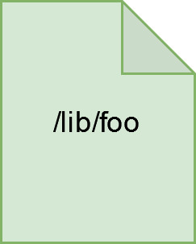
Specialized PD in action
Heap
open(“foo”, O_CREAT, mode)
Main thread
File Client
Heap
open(“foo”, O_CREAT, mode)
File System
App
Library thread

Slide 16



A Useful OS Runs Programs (it’s kind of the point)
INSERT INTO …
write(fd, …)
write block …
App
SQLite
Disk Driver
File System
User
Kernel
Notes:
This is great! But we were preparing a submission to SOSP, so we needed to show that our OS actually can actually do something, like running programs. Because that’s what an operating system is supposed to do.
We decided to start with SQLite, which is a small database library that stores its data in the local file system.
An application will execute a SQL statement using SQLite, which uses system calls to manage its database files. In a traditional, monolithic operating system, the system calls cross the barrier from user space to kernel space, where the file system in turn makes calls to the disk driver to read / write blocks.

Slide 17


A Useful OS Runs Programs (but seL4 doesn’t do much for us)
INSERT INTO …
write(fd, …)
write block …
App
SQLite
Disk Driver
File System
User
???
Notes:
But in the seL4 kernel we don’t have even have a file system or a disk driver, let alone ones that deal in OSmosis-tracked resources. We needed to add these, and it also served as an opportunity to research what it takes to integrate OSmosis with a real system.

Slide 18

A Useful OS Runs Programs (in the microkernel way)
INSERT INTO …
write(fd, …)
write block …
File Client
xv6
App
SQLite
Disk Driver
File System
User
File Server
Notes:
The first step was to add a file server. I converted this from the file system used in the xv6 operating system, which is a teaching operating system. It runs in its own PD, and applications call it to obtain or perform operations on file resources (represented by the green key). Calls may include other resources such as a memory object containing data to write (the black key). On the user side, the file client is installed to intercept system calls and reroute them to the file server.

Slide 19


A Useful OS Runs Programs (in the microkernel way)
INSERT INTO …
write(fd, …)
write block …
File Client
xv6
App
SQLite
Ramdisk
File System
Block Server
User
File Server
Notes:
The file system needs somewhere to store the files, so I added another PD to be the block server. To get things off the ground, I used some ram as a simulated disk, rather than porting a disk driver. Modelling drivers is likely going to be part of future work. Like the file server, clients of the block server interact with it using block resources.

Slide 20
A Useful OS Runs Programs (in the microkernel way)
INSERT INTO …
write(fd, …)
write block …
getcwd(...)
open(...)
geteuid(...)
read(...)
File Client
xv6
close(...)
fchmod(...)
fstat(...)
fsync(...)
App
fcntl(...)
SQLite
File System
Ramdisk
unlinkat(...)
lseek(...)
pread(...)
Block Server
User
File Server
Notes:
Of course, SQLite does make use of a subset of libc, so we had to support a number of other calls.

Slide 21
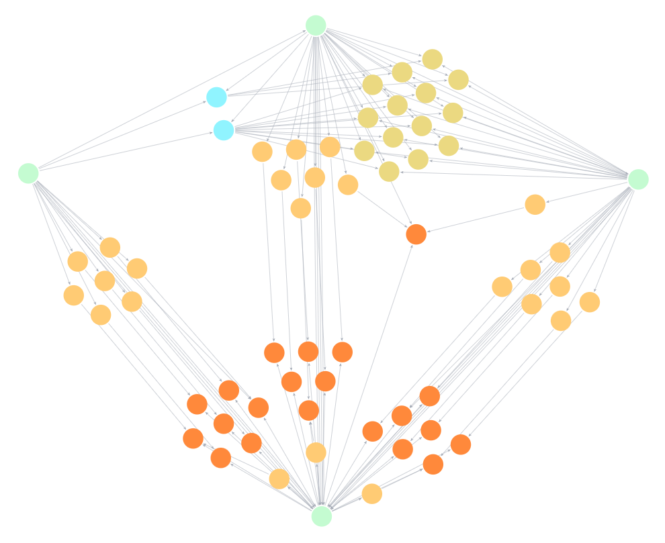
File Server
App
Block Server
Root Task
Notes:
Root task is similar to the linux init task, provides core OS functionality.
And the beautiful thing about CellulOS is, once this was all in place, we could view the system's resources graphically.
This is a SIMPLIFIED version of the model state for a simple app running SQLite (missing CPU resources, resource spaces, and the rest of the blocks). It is missing a few key parts of the model for readibility.

Slide 22
File Server
Files
Blocks
App
Block Server
Virtual Memory
Physical Memory
Root Task
Notes:
Files: 2 databases, that has to do with the isolation mechanisms but I’m not going to go into that now.

Slide 23
File Server
App
Block Server
Root Task
Notes:
We also see some interesting details like a page, shared by both the file server and block server, that is used as a buffer for block operations
Mention we also extracted a graph for linux from proc

Slide 24
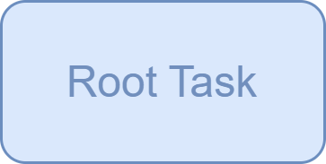
An Interesting Challenge: Communication & Deadlock
open(“foo”)
fetch state
give resource
extract state
Notes:
We don’t have time to go into much more of the implementation, but I thought I’d wrap up with an interesting challenge we came across.
The model state tracking is distributed across the system: for example the root task is a process that tracks most state, but the file server tracks files and how they map to blocks.
The root task may need to send messages to the file system: for example, to fetch information about the model state.
The file system may need to

Slide 25
An Interesting Challenge: Communication & Deadlock
open(“foo”)
fetch state
give resource
extract state
Notes:
If they ask about multithreaded: not a permanent solution, if one thread is blocked, others may get blocked with other tasks

Slide 26

An Interesting Challenge: Communication & Deadlock
open(“foo”)
signal
give resource
queue
‘fetch state’
extract state
work queue

Slide 27
An Interesting Challenge: VMM
Hmm… This looks like a VM
Create PD
App
PD with a Guest OS
PD Creation
config

Slide 28

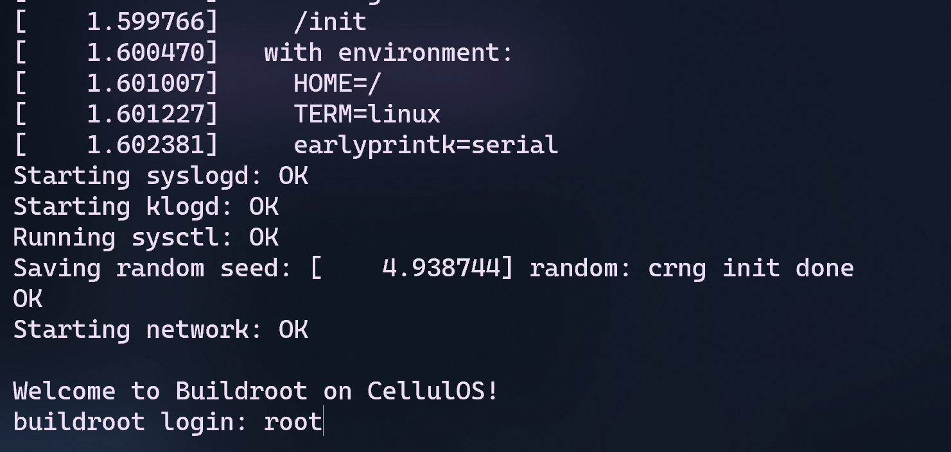
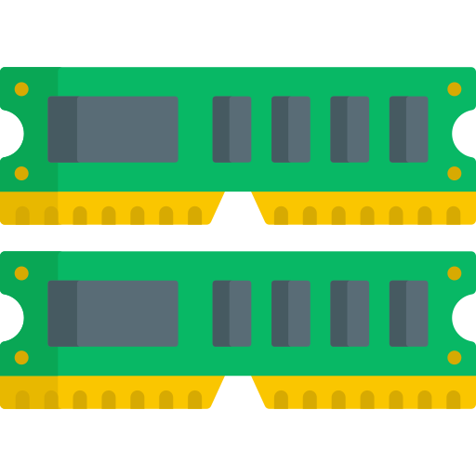


An Frustrating Challenge: VMM

Slide 29
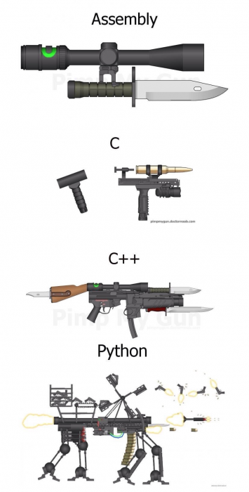
Other Things We Did
Programming for a Microkernel
Implementing the Root Task
RPC mechanism
Resource cleanup
Flexible cleanup policies
CellulOS model state workflow
Neo4j scripts & docker container
Metrics calculations
Model state extraction from Linux /proc
Wiki
Lines of code:
C: 58k
Python: 2k
Programming for Linux
Notes:
Implementing root task includes: tracking OSmosis model state, designing the system in which core resources are managed and allocated
Why did you implement for a microkernel?
The purpose was to have a clean slate, something without the builtin concept of process/thread/etc. in the kernel. It’s also much easier to understand the sel4 kernel than, say, the linux kernel.

Slide 30
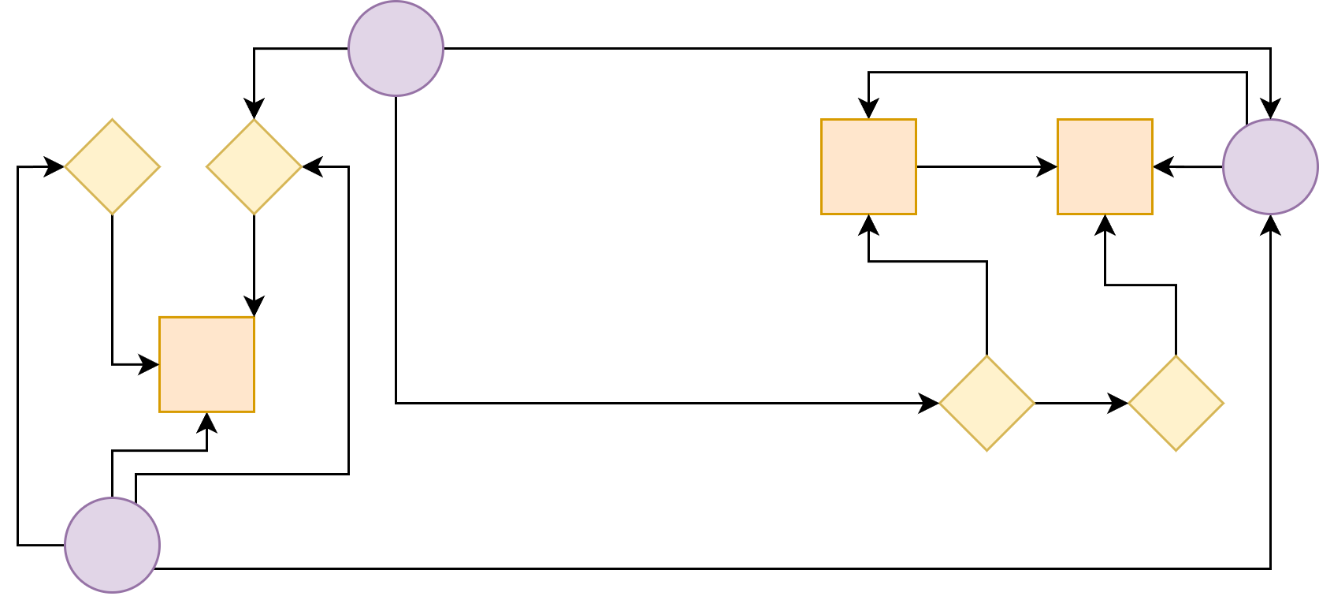
Thank You
We’ve had a fantastic time at Systopia!
Wiki: https://cellulosdocs.readthedocs.io/en/cellulos/

