Slide 1

Basic Details of the Team and Problem Statement
Ministry/Organization Name/Student Innovation: Ministry of Kerala PS Code: SIH1322 Problem Statement Title: Domestic Waste Management Team Name: Beyond Infinity Team Leader Name: Parwez Alam Ansari Institute Code (AISHE): U-0567 Institute Name: Aliah University Theme Name: Clean & Green Technology

Slide 2
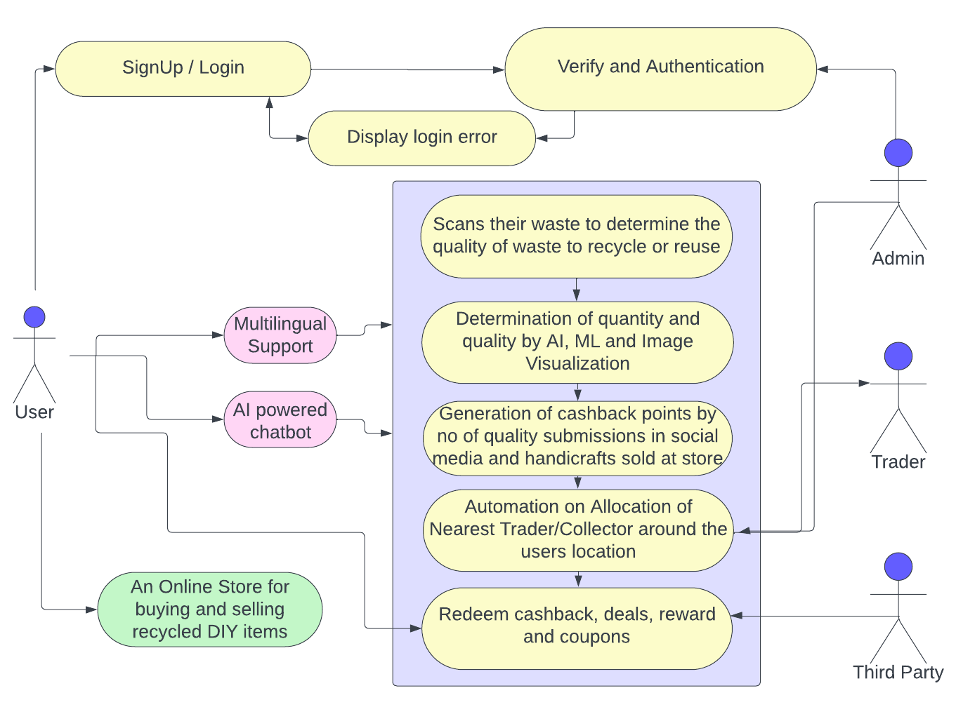
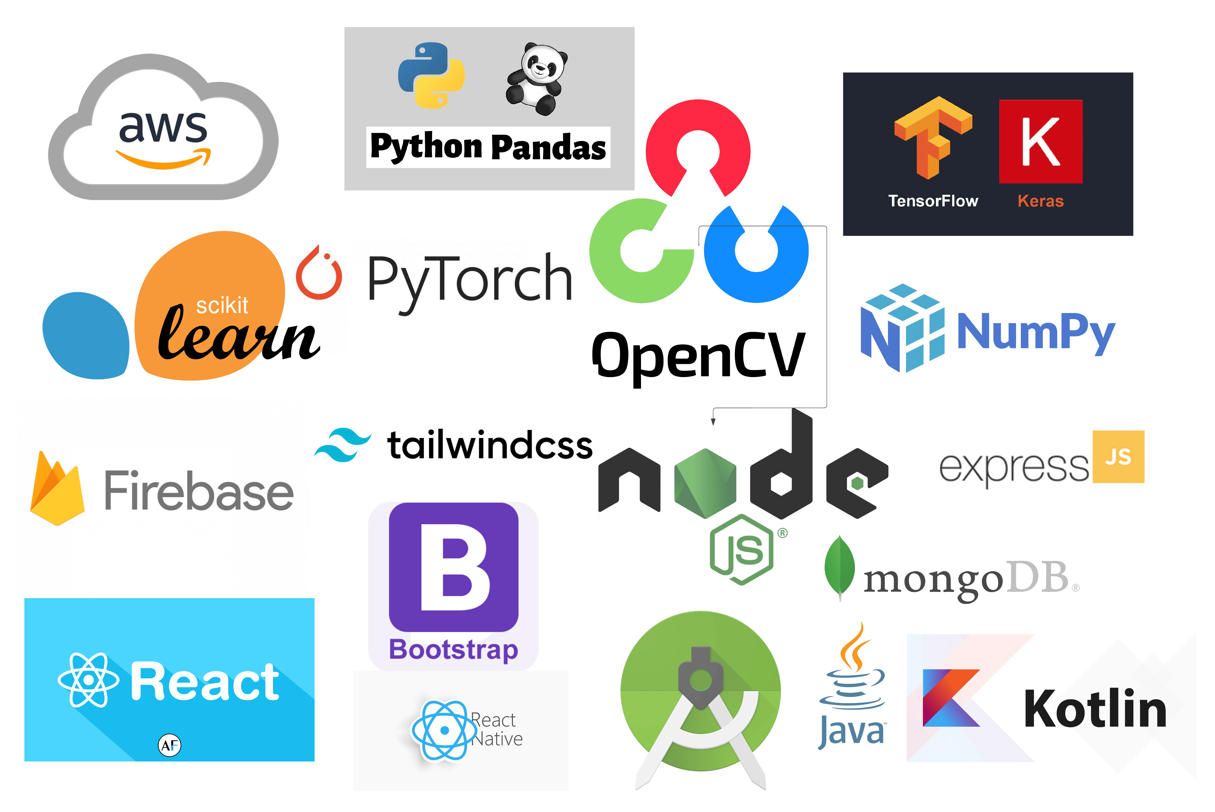
Idea/Approach Details
The software will serve as a comprehensive waste management platform and it will promote responsible waste disposal practices, educate users, facilitate e-waste recycling, and foster community engagement, scheduling pickups. The prototype works as follows:
Social interaction page where people share eco-friendly DIY ideas and crafts using recyclable wastes, stay updated on waste-related news & find events like community clean-ups and workshops
User can keep track of their collected waste, recycled items, and personal achievements by creating a profile logging in through SMS or password
Users can scan their E-wastes to check its quality, which can be sold or donated
Create a dedicated page for users to trade crafts from recycled items and sell recyclables to traders at flexible prices determined through Data Analysis and ML along with providing storage tips for recyclables
Establish a Support page for user complaints and inquiry & user can request local waste facilities, like bins, through location data analyzed through KNN Algorithms
Notifications & daily pop ups for scheduled disposal of wastes when Garbage Truck is located nearby for maximum rewards to counter waste accumulation
Dumping locations for biodegradable wastes and compatibility with smart bins for non-biodegradable wastes to reward users with more tokens when dumping to nearest garbage facilities located through KNN and Machine Learning (ML)
Support for contact officials to collect house/hotel kitchen waste to reuse as fodder materials in breeding colonies for fishery, poultry, worm and farms
Describe your Technology stack here:

Slide 3
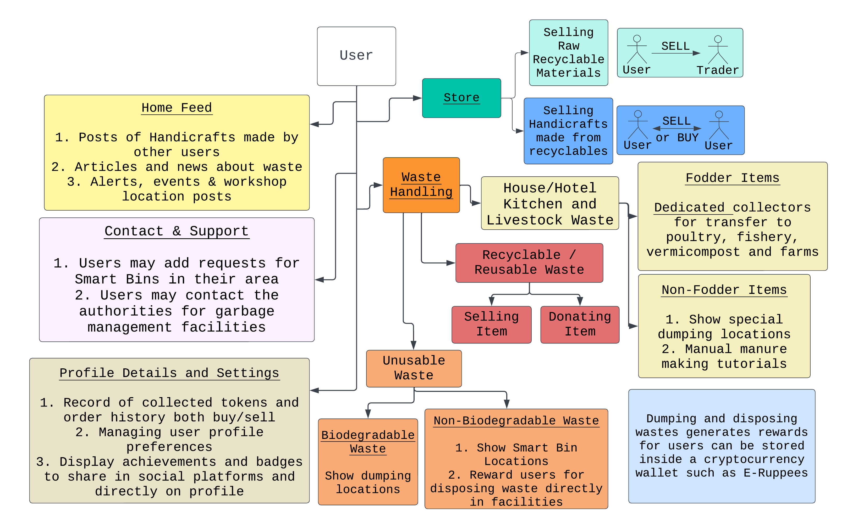
Idea/Approach Details
Describe your Dependencies / Show stopper here
Provides innovative ways to locate Smart Bins and rewards users with incentives as tokens simply by disposing / dumping the wastes
Provides efficient and community-engaging fun ways to reduce the waste and reuse some or most of the waste generated
Users can generate revenue based on selling handmade items they built and sold through our platform
Users can sell their recyclable wastes directly to the traders at negotiable prices profiting both the trader and the user
An AI chatbot is available for assistance at all times for everyone including users as well as the traders
Using Image Recognition a reusable item’s quality is checked to mark the item for donation through the user
Generated tokens are stored inside a cryptocurrency wallet (E-Rupees)
Gift cards and Cashback Coupons can be redeemed by the user through the generated tokens
Describe your Use Cases here

Slide 4
Team Member Details
Team Leader Name: Parwez Alam
Branch (Btech/Mtech/PhD etc): B. tech Stream (ECE, CSE etc): CSE Year (I,II,III,IV): IV
Team Member 1 Name: Aman Ahmed Siddiqui
Branch (Btech/Mtech/PhD etc): B. tech Stream (ECE, CSE etc): EEN Year (I,II,III,IV): IV
Team Member 2 Name: Asif Mondal
Branch (Btech/Mtech/PhD etc): B. tech Stream (ECE, CSE etc): CSE Year (I,II,III,IV): IV
Team Member 3 Name: Miran Hamid
Branch (Btech/Mtech/PhD etc): B. tech Stream (ECE, CSE etc): EEN Year (I,II,III,IV): IV
Team Member 4 Name: Mohsin Raja
Branch (Btech/Mtech/PhD etc): B. tech Stream (ECE, CSE etc): CSE Year (I,II,III,IV): IV
Team Member 5 Name: Wasiqah Neyaz
Branch (Btech/Mtech/PhD etc): B. tech Stream (ECE, CSE etc): EEN Year (I,II,III,IV): IV
Team Mentor 1 Name: Sajda Begum
Category (Academic/Industry): Industry Expertise (AI/ML/Blockchain etc): AI/ML Domain Experience (in years): 2

