Slide 1
RunOps – Ansible + Python Automation Framework
Role Documentation & Usage Guide

Slide 2
Overview
RunOps provides reusable Ansible + Python automation framework
Inventories for dev, stage, prod with environment-specific vars
Roles: common, linux, windows
Molecule tests for Linux & Windows
CI ready (GitHub Actions + Jenkins)

Slide 3
Role: common
Applies to all hosts
Linux: installs chrony, configures /etc/chrony.conf and resolv.conf
Windows: configures NTP via w32tm, sets DNS with win_dns_client
Uses inventory vars: ntp_server, dns_servers, greeting

Slide 4
Role: linux
Applies to linux group hosts
Installs baseline packages: curl, vim, git
Extend with more Linux-specific tasks
Automatically included in site.yml

Slide 5
Role: windows
Applies to windows group hosts
Installs Notepad++ via Chocolatey
Requires WinRM enabled and accessible
Automatically included in site.yml

Slide 6
Usage Example
Run playbooks with CLI wrapper:
python scripts/cli.py run playbook -p playbooks/site.yml -i inventories/dev/hosts.yml
Molecule tests: cd roles/common && molecule test
Extend roles or add new ones under roles/

Slide 7
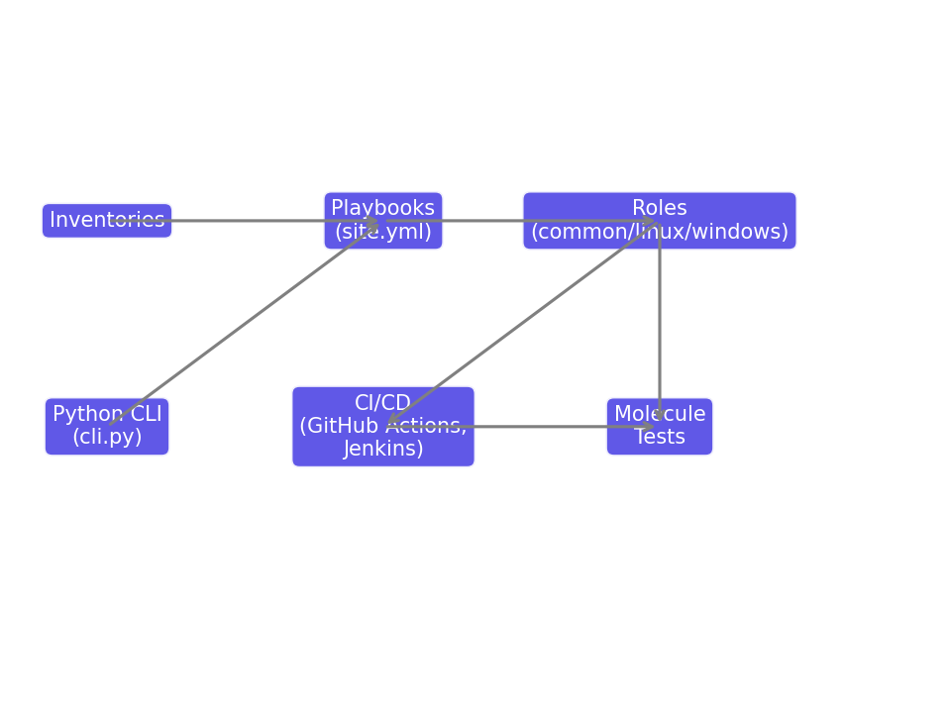
RunOps Architecture

