Slide 1
Neural nets, simply explained
How a network learns to recognize cats
A short lesson for readers new to AI
AIML-500 · Communication for Learning
Portfolio adaptation by Siddharth Jadhav
Notes:
Ask what a person needs to see before they can recognize a cat. Then explain that the lesson focuses on supervised image classification, where the training examples have labels. It takes about five to seven minutes including the audience check. The original group is credited on the final slide.

Slide 2
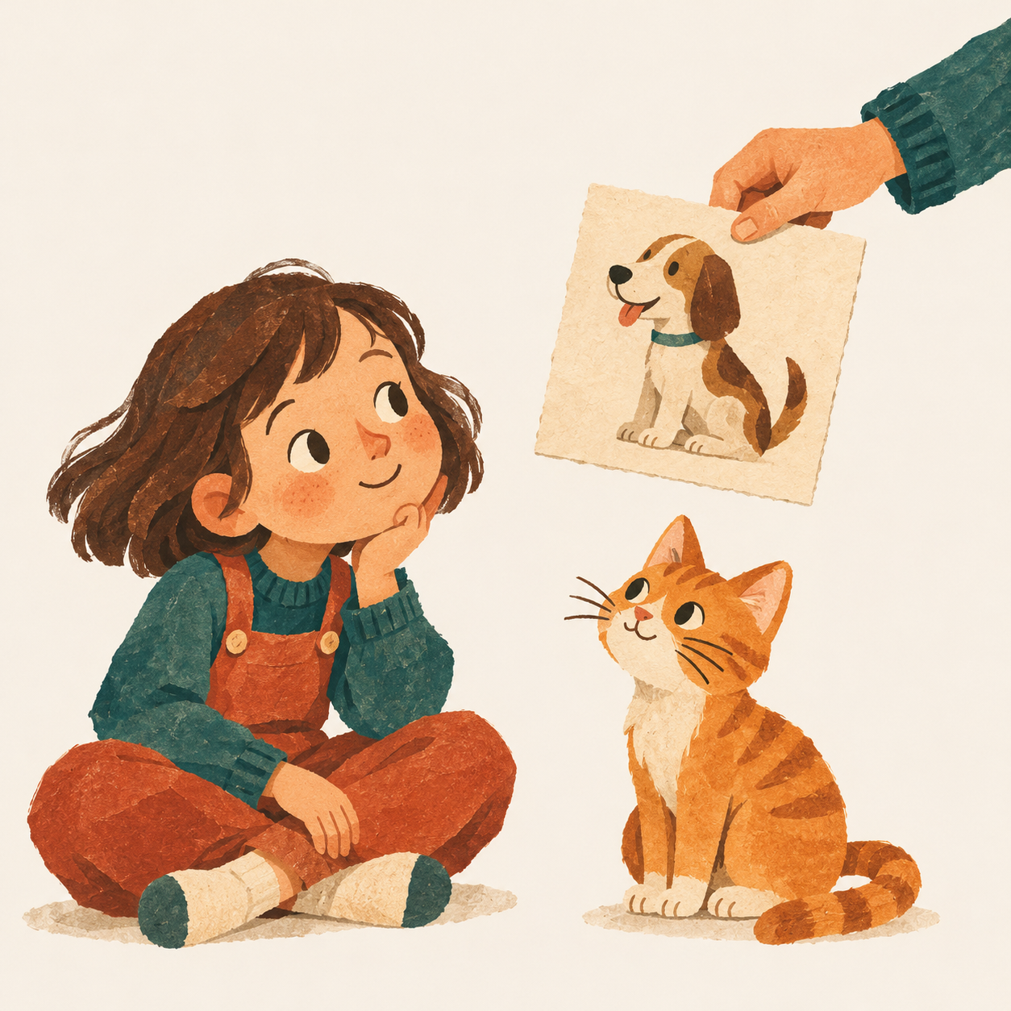
Teaching someone to recognize a cat
“Cat!”
At first, anything furry
might seem like a cat.
More examples and corrections
help the child spot the difference.
02
Notes:
Imagine a child points at a dog and proudly says, Cat! You gently say, That is a dog. Then you show them different cats and dogs. Over time, the child can recognize a cat they have never met. A neural network learns in a loosely similar way through examples and feedback. This is a hypothetical anecdote and a loose analogy, not an account of how brains and neural networks are identical. Illustration created for this presentation with the built-in image generation tool.

Slide 3
Inside a neural net
Picture information
Layers of tiny calculators
A guess
Cat
Weights work like dials that change how strongly signals affect the next layer.
03
Notes:
Use the schematic to follow the picture information from left to right. The nodes perform calculations, and the weights control how incoming signals contribute. A network can combine simple visual patterns into more complex ones. This simplified diagram omits architectural details. Source: Google Machine Learning Crash Course, Nodes and hidden layers, https://developers.google.com/machine-learning/crash-course/neural-networks/nodes-hidden-layers

Slide 4
Learning through feedback
1
2
3
4
See a picture
Make a guess
Check the answer
Adjust weights
A cat
“Dog”
The label says “cat”
Reduce the error
Repeat across many varied examples.
04
Notes:
Walk through a labeled cat picture that the network predicts as a dog. A loss function measures how far the prediction is from the label. The training procedure adjusts the weights with the aim of reducing loss across examples. An individual update need not improve every prediction. Source: Google Machine Learning Crash Course, Training neural networks, https://developers.google.com/machine-learning/crash-course/neural-networks/backpropagation

Slide 5
The wrong clue
What if every training cat sits on a sofa?
Training pictures
Cats on sofas
Possible shortcut
“Sofa means cat”
A new picture
Cat outdoors
The network may struggle. Varied examples matter.
05
Notes:
Suppose every training cat appears on a sofa and the training dogs do not. A model could pick up the background as a shortcut and struggle with a cat outdoors. This is a hypothetical example. Ask whether including more of the same picture type would address the problem. Reference: Geirhos et al., Shortcut learning in deep neural networks, https://arxiv.org/abs/2004.07780

Slide 6
Training and using the network
During training
After training
Examples include answers.
Feedback adjusts the weights.
A new picture goes in.
The learned weights
produce a guess.
Making a guess does not automatically teach it something new.
06
Notes:
During training, the model adjusts its weights from labeled examples. During inference, it uses those learned weights to predict a label for a new input. A standard prediction leaves the weights as they were. Future training is a separate step. Source: Google Machine Learning Glossary, training and inference, https://developers.google.com/machine-learning/glossary/fundamentals

Slide 7
A fair test uses new pictures
Set aside pictures the model never sees during training.
Cats in different places
Dogs in similar places
Include cats indoors and outdoors.
Include dogs on sofas and away from them.
Check which examples the model gets wrong.
07
Notes:
Explain that a separate test set checks whether what the model learned carries over to unfamiliar images. Both kinds of animal should appear in different settings so a sofa cannot reliably stand in for the label. Comparing errors with and without sofas can help spot the specific shortcut in this example. Keep the final test set separate while making training choices. Source: Google Machine Learning Crash Course, Dividing datasets, https://developers.google.com/machine-learning/crash-course/overfitting/dividing-datasets

Slide 8
A quick teach-back
The model calls a dog on a sofa a cat.
1. What clue might the model be using?
2. Which new pictures would test your guess?
Take a moment to explain your reasoning.
08
Notes:
Pause before offering an answer. A possible answer is that the model relies on the sofa as a clue for cat. Try fresh pictures of cats and dogs both on and off sofas, then compare the errors across those groups. One wrong answer suggests a question to investigate. The pattern across new examples provides stronger evidence. This is a hypothetical classroom check.

Slide 9

The explanation to remember
During training, a network uses labeled
examples to adjust its weights. For a new
picture, it uses those weights to make
a prediction.
A good test includes unfamiliar examples.
Notes:
Invite the learner to explain the difference between training and inference using the cat example. A complete response mentions labels during training, learned weights during prediction and separate pictures for checking. Illustration from the original group deck, identified there as AI generated. Source: Google Machine Learning Glossary, supervised learning, training and inference, https://developers.google.com/machine-learning/glossary/fundamentals

Slide 10
Coursework credits
AIML-500 · Assignment 3.4 · Communication for Learning
Portfolio adaptation by Siddharth Jadhav
Original group contributors
Gu, Yuchen
Singh, Akash
Jadhav, Siddharth Sahebrao
Suhit Nadal, Estanislao
Kanakam, Balachander
Sultan, Mohammed
Mariy Krishan, Mohammed
Sun, Yeque
Mohammed Khursheed Ali, Mazhar
Uppuluri, Jayasri
Punyamurthula, Krishna Saketh
Notes:
Original group presentation: Neural nets, simply explained (Indiana Wesleyan University, AIML-500 Assignment 3.4). The contributor list preserves the original byline. The two illustrations are retained from the original deck, which identifies them as AI generated. Additional teaching references are recorded on the slides where they apply.

