Slide 1
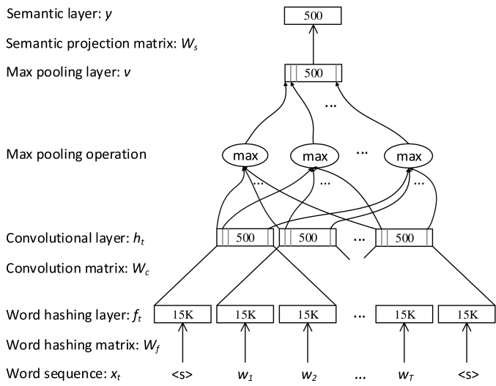

Learning to Prune:
Pareto
Exploring the Frontier of Fast & Accurate Parsing
Pareto frontier
accuracy
Tim Vieira & Jason Eisner
Johns Hopkins University
runtime
Notes:
Today I'm going to talk about learning fast and accurate parsers using ideas from reinforcement learning
But first, I want to emphasize what it means to be both fast *CLICK* and accurate at the same time
I'll illustrate this with this scatter plot
Here each point represents a system for doing some task, say parsing.
Its POSITION is determined by measuring the system's *CLICK* accuracy and *CLICK* runtime on some evaluation data.
The reason we have so many points is that we have
varied the underlying models *CLICK*
and the "black magic" used to make it fast *CLICK*
The Pareto frontier captures the essence of what it means to be both fast and accurate.
It is a curve that represents the BEST ACCURACY THAT CAN BE ACHIEVED WIHTIN A RUNTIME BUDGET
In other words, there is NO INCENTIVE to use a system that isn't the Pareto frontier
SUCH AS this one with the red "x" -- BECAUSE …

Slide 2
Learning to Prune:
Pareto
Exploring the Frontier of Fast & Accurate Parsing
as fast
Pareto frontier
more
accurate
accuracy
runtime
Notes:
There is a system ON THE FRONTIER which is just as fast
but more accurate

Slide 3
Need systems with tunable runtimes
Learning to Prune:
Pareto
Exploring the Frontier of Fast & Accurate Parsing
Pareto frontier
We already use ML to learn be accurate.
This work uses ML to learn to be fast too!
accuracy
runtime
Notes:
The big idea in this line of work
In NLP, we already use ML to learn be accurate.
This work uses ML to LEARN TO BE FAST at the same time!
In achieve this goal, we need systems with TUNABLE runtimes.
Here we look at pruned dynamic programming, which is widely used in NLP, especially in constituency parsing.

Slide 4

Learning to be Fast & Accurate
Tradeoff parameter
reward
=
accuracy
-
runtime
Accuracy and runtime
of the end-to-end system
accuracy
Optimizing for different λ's gives a Pareto frontier of systems
runtime
Notes:
LEARNING to be fast and accurate means that we need to put runtime in our training objective!
In this work, we propose a linear combination of
end-to-end accuracy and runtime measure, which are
combined using a scalar TRADEOFF parameter (λ)
we can VISUALIZE λ as the direction in RUNTIME-accuracy space that we'd like to improve in.
If we optimize FOR different λs, we get a Pareto frontier of LEARNED systems.
TODO: possibly show multiple green arrows when I say "optimizing for different …"

Slide 5
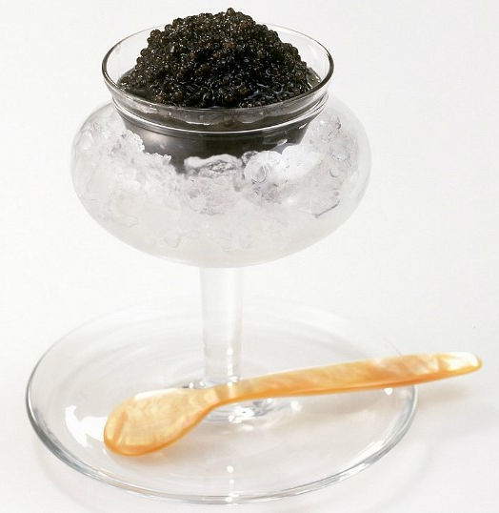
Parsing
ROOT
Grammar @S → NP VP
VP → VBD NP
NP → DT NN
DT → the
VBG → cooks
NN → chef
…
S
VP
VP
PP
NP
NP
NP
VBD
DT
NN
IN
DT
NN
<.>
Papa
ate
the
caviar
with
a
spoon
.
Notes:
Since this is a SYNTAX session, I don't need to spend time introducing parsing…
Nonetheless, lets look at a parse of my favorite sentence
"Papa ate the caviar with a spoon."
which has a PP attachment ambiguity
Here is the desired parse.
And here is a simple grammar that tells us the rules for building valid parse trees.

Slide 6
Parsing
ROOT
ROOT₀
Grammar @S₀ → NP₀ VP₀
@S₀ → NP₀ VP₁
@S₀ → NP₀ VP₂
…
@S₀ → NP₁ VP₀
…
@S₁ → NP₀ VP₀
…
VP₀ → VBD₀ NP₀
…
NP₀→ DT₀ NN₀
…
NN₃₉ → spoon
VBD₂ → ate
DT₀ → the
…
Grammar @S → NP VP
VP → VBD NP
NP → DT NN
DT → the
VBG → cooks
NN → chef
…
S
S₀
VP
VP₀
Berkeley Grammar (sm6):
up to 64 refinements to each non-terminal
PP
VP
PP₅
VP₁₉
NP
NP₃₅
NP
NP₃₈
NP
NP₃₁
VBD
VBD₂
DT
DT₀
IN
IN₂₃
DT
DT₁₅
NN
NN₃₉
<.>
NN
<.> ₂
NN₈
Papa
ate
the
caviar
with
a
spoon
.
Notes:
A real grammar – like th the Berkeley split-merge grammar, which we use in our experiments
contains up to 64 refinements to each nonterminal
and thus the grammar explodes to hundreds of thousands of rules
In this work, WE WILL NOT CHANGE THE GRAMMAR WEIGHTS – WE'LL JUST LEARN TO PRUNE

Slide 7
Pruned CKY parsing
Notes:
The primarily algorithm used for parsing is called CKY.
I'll describe a variant which leverages pruning for efficiency.

Slide 8
Parsing in a nutshell
O(|G|· width) runtime per span – SLOW!
VP
VP
PP
Papa
ate
the
caviar
with
a
spoon
.
Notes:
CKY -- like all dynamic programming algorithms -- fills-in an array – called a "chart"
I'll make use of the this chart as a visual aid throughout the talk. So it's important that you all know how to "read" it.
The cells in the chart represent spans of the input sentence.
Here we see that pink cell spans the VP "at the caviar"
and purple cell spans the PP "with a spoon"
To discover that there is an @S in this span we have to do work proportional to the width of the span and proportional to the size of the very large grammar
loops over ways to split the span
and loop over ways of combining the items in the splits according to the grammar

Slide 9
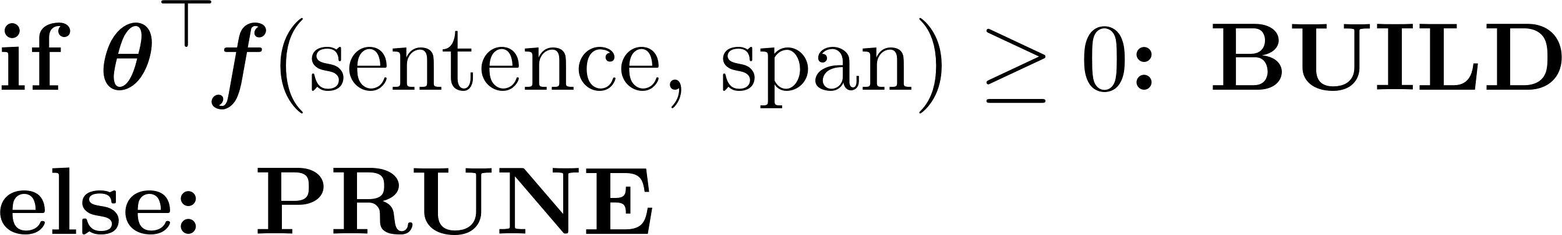
What could we easily prune?
Speeding up parsing
Pruning saves runtime by avoiding the fill operation
Prunes all nonterminals that might cover that span
Roark & Hollingshead (2008)
Bodenstab et al. (2011)
Final "." attaches
at the top
"[… with ] a" is a bad place to end a constituent
Papa
ate
the
caviar
with
a
spoon
.
Notes:
A great method for speeding-up parsing is to us a classifier to predict whether to BUILD or PRUNE a span.
Pruning a span saves runtime by skipping the expensive filling operation.
Note that when we prune a span prunes all nonterminals that might cover it.
This was first done by Roark & Hollingshead in 2008 and later improved in 2011 by Nate Bodenstab and company.
Let's look a few simple spans that we could easily prune away.
The final "." always attaches at the top of the sentence.
a PREPOSITION is not something that you would want to END A CONSIT WITH -- especially when it's followed by a DETERMINER

Slide 10
Ideally
Train a classifier to predict whether a span is
GOLD or NON-GOLD
ROOT
(Bodenstab et al., 2011)
S
@S
VP
PP
NP
NP
NP
VBD
DT
NN
IN
DT
NN
<.>
Papa
ate
the
caviar
with
a
spoon
.
Notes:
Ideally we'd prune everything except for the spans that are in the gold parse

Slide 11
Impact of PRUNE depends on context (sentence, grammar, other PRUNE choices)
Gold spans are bad to prune, but not equally bad …
recovers by finding a pretty good parse
fails with no parse :-(
Notes:
How important to predict these decisions correctly?
Well, IT DEPENDS because these decisions interact.
So although gold spans are bad to prune, not all mistakes are equally bad.
In this case, we can work around the mistake and still find a pretty good parse,
but in this case we find no parse at all.

Slide 12
Impact of PRUNE depends on context (sentence, grammar, other PRUNE choices)
Gold spans are bad to prune, but not equally bad …
Non-gold spans are good to prune, but not equally good …
saves a lot of BUILD time for this span and other spans built as a result :-)
saves a tiny bit of BUILD time
also, kills off a top-scoring but wrong parse :-)
Notes:
similarly, non-gold spans are good to prune, but not equally good
Narrow spans are fast no matter what, so pruning this one doesn't save MUCH time.
Pruning this one saves all the work of building a wide span AND several other spans it would have given birth to.
A subtle point is that pruning a non-gold span might also improve accuracy, by blocking a bad parse that the grammar didn't know was bad.

Slide 13
Impact of PRUNE depends on context
Want our classifier to take this into account
Bodenstab et al. (2011) just weight gold errors more than non-gold
We refine this approach by considering the real cost of each error in context
a few mild errors
really bad error
BUILD
PRUNE
Notes:
We want our classifier to take costs and benefits into account
Here the gold and non-gold spans aren't not linearly separable.
Here's a really bad classification error that results in no parse at all!
By shifting the decision boundary a bit to avoid this bad error, we preserve accuracy, at the cost of making some other mild errors that only cause a little increase in runtime.
Bodenstab et al do this by weighting gold errors more heavily than non-gold.
We' REFINE this approach by considering the REAL cost of each error in context

Slide 14
End-to-end training
Notes:
and this is called end-to-end training

Slide 15
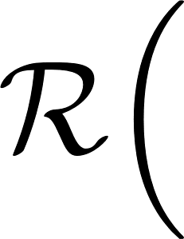

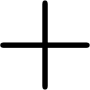
End-to-end training
What if we prune
here instead?
rollout
=
accuracy
-
runtime
15
Notes:
The end-to-end approach evaluates THE ACTUALY REWARD of the current classifier
by evaluating the reward of the pruning masks it predicts. with the reward function from the introduction
And quite usefully, we can ALSO evaluate changes to our current classifier
by actually running the parser on the changed pruning mask
IT'S CALLED A ROLLOUT
If the reward is better, then we'd wish that the classifier had made that change.

Slide 16
Rolling out lots of changes to get training data
prohibitively slow
to train!
"second-guess" each decision
the current classifier makes
Weighted classification dataset
LOLS (Chang+,2015)
Retrain the classifier
16
Notes:
Our learning algorithm does a TON of rollouts
where we second guess all decisions that the current classifier makes
From this we get an weighted classification dataset
where the weights say that some decisions have a stronger impact on reward
And we re-train the classifier on it.
If we iterate and get a new classifier, do more rollouts and get new data…
This algorithm is a special case of LOLS (locally optimal learning to search)
This is a type of reinforcement learning
But, as you know from personal experience "second-guessing" every decision you make is prohibitively slow.
We found some nice ways to speed this bit up, which I'll tell you about now

Slide 17
Making rollouts fast
Notes:
So the last ingredient we need before we get to experiments is making the rollouts fast.

Slide 18
Change propagation
Already computed this
This is such a tiny change.
Do you really want to re-run the parser from scratch?
Notes:
change propagation is based on the following observation
We have already computed this
And then we ask about a TINY change.
Do we REALLY want to re-run the parser again FROM SCRATCH??
Nah! we can do better!

Slide 19
Changeprop
Changes quickly "peter out" because each span only cares about its best derivation.
Immediate effects lie in this range
Changes may cascade
90% of rollouts change
< 10% of the chart
Change this span
Homework: figure out the rest.
Hints:
use indexing data structures
a priority queue of changes to process
and an undo list (to flip back quickly)
Notes:
Suppose we want to change this span
It turns out that the IMMEDIATE EFFECTS of this change must lie in this "V shaped" range.
We can see that visually:
The pink span can only combine with some green span immediately to its left or right
Of course, changes can then cascade and potentially change this entire blue region BUT…
In practice, changes to the blue region are quite sparse
as changes PETER OUT quickly
because each span only cares about its BEST derivation, which RARLEY changes.
In our experiments we find that 90% of rollouts change <10% of the chart
HOMEWORK
HINTS
indexing data structures
a priority queue of changes to process
and an undo list to flip back to the original mask quickly
The solution can be found in our paper and on github!

Slide 20
Dynamic programming speedup
Rollouts are basically computing a gradient!
change in input
change in reward
Notes:
We came up with an even faster way to compute rollouts by dynamic programming.
Here we really push through the idea that rollouts are basically computing a gradient
Rollouts measure
the change in reward,
given a change to the input (a pruning mask)

Slide 21
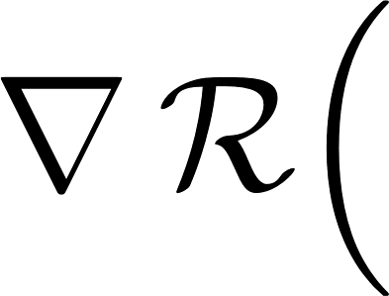

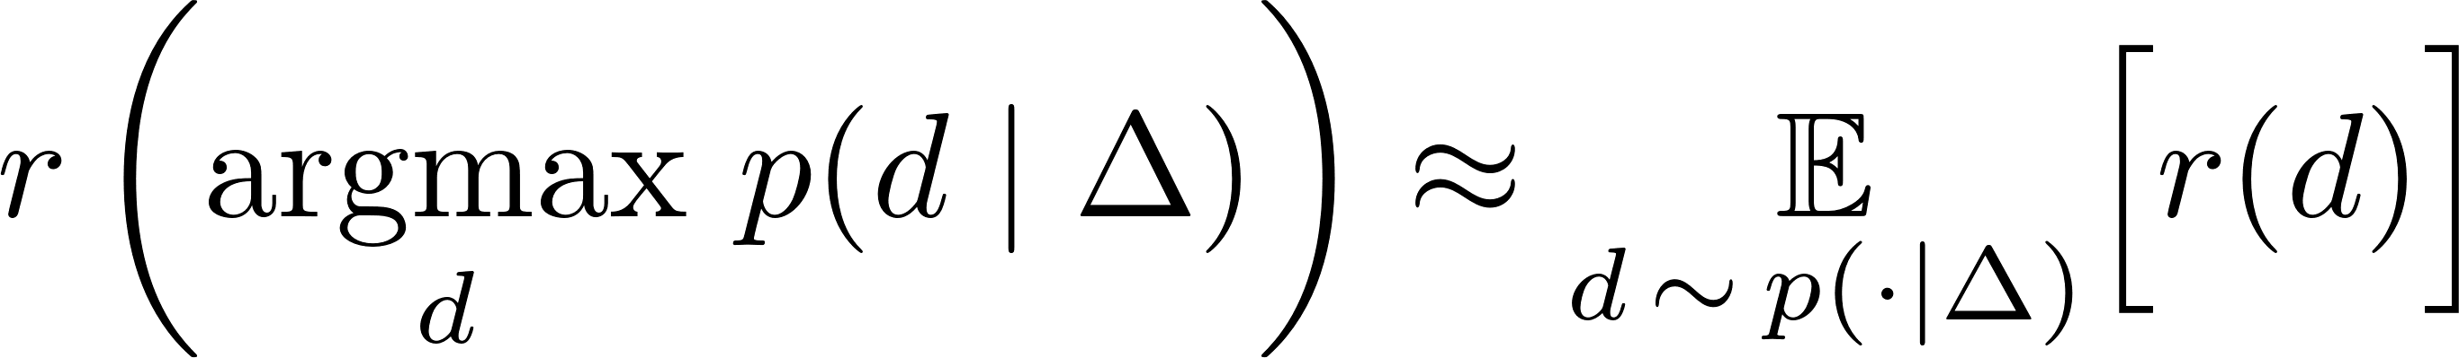
Dynamic programming speedup
Not differentiable!
We use expected reward as a differentiable proxy
Relax decoding to be stochastic
Notes:
So here is a vector of all the rollouts
And I've said that want to compute it like we'd compute a gradient
Of course, this isn't differentiable because CKY decoding isn't differentiable
However, if we relax this to stochastic decoding
then we can actually use gradients to compute our rollouts!
You might think that the 0/1 nature of pruning would be a problem
but our function has some special properties such that LINEAR extrapolation along the gradient actually gets an exact answer

Slide 22
Dynamic programming speedup
10-14x faster!
O(n²) · O(G n³)
= O(G · n⁵)
O(G · n³)
* Efficient for a certain class of reward functions with a variant of inside-outside (Li & Eisner,'09)
Notes:
This is great because we can compute the gradient in the same time as computing expected reward!
The most naïve method takes time n^5
However, with DP we can get this down to cubic time
For a class of additively decomp reward functions using a variant of inside-outside
We estimate that DP speeds-up TRAINING by a factor of 10-14 over individual rollouts.

Slide 23
Experiments

Slide 24
Controlled experiment
Setup
Data: English Penn Treebank
Reward:
corpus-level F₁ - λ number of edges built
Grammar:
Coarse: Vanilla PTB grammar
Fine: Berkeley split-merge grammar level 6
Two training speed-ups
changeprop (CP):
per-sentence F₁ - λ number of nodes built
dynamic programming (DP):
expected recall - λ size of mask

Slide 25
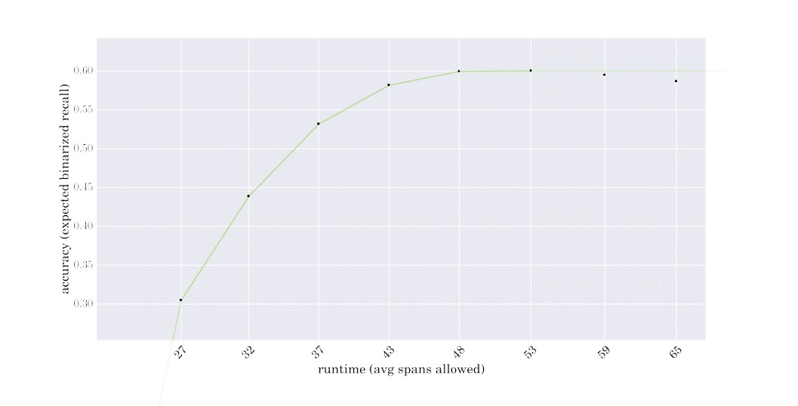
Learning curve
Sweep baseline curve by varying asymmetric penalty
Notes:
Our experimental design is a pretty neat way to compare methods for PUSHING OUT the speed-accuracy frontier. – We're proud of the design :-)
Here I'm showing some learning curves on DEV data.
We use Bodestab's method to generate a bunch of baseline systems with different speed-accuracy tradeoffs and now we'll try to improve them.
The ones at the LEFT prune MORE AGGRESSIVELY

Slide 26
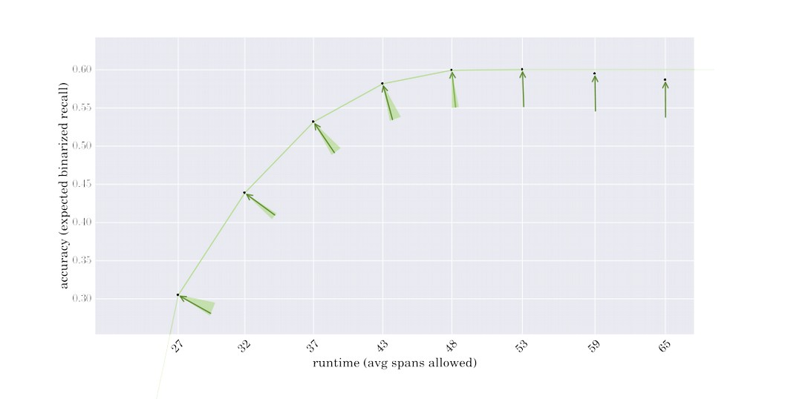
Learning curve
Infer a λ value that the baseline seems to optimize
Notes:
We then "infer" the value of λ that the baseline seems to optimize and then we try to beat it at it's own game.
We take the baseline as initialization and optimize under the reward function given by it's value of λ

Slide 27
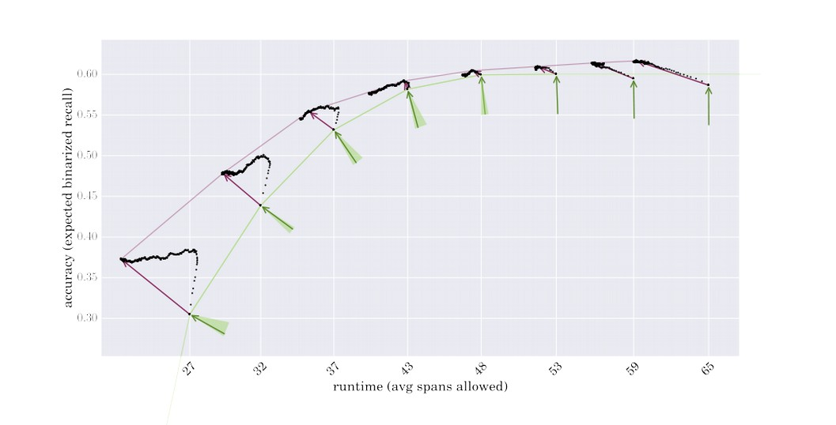
Learning curve
Train with LOLS
for 6 days
On the 7th day, LOLS rested, and performance was good!
Notes:
We train each system WITH LOLS for 6 days!
An on the 7th day…
LOLS rested
evaluated on test.
and found that performance was good! :-P

Slide 28
Learning curve
Notes:
Let's look briefly into one of these learning curves to see some of LOLS's behavior qualitatively.

Slide 29
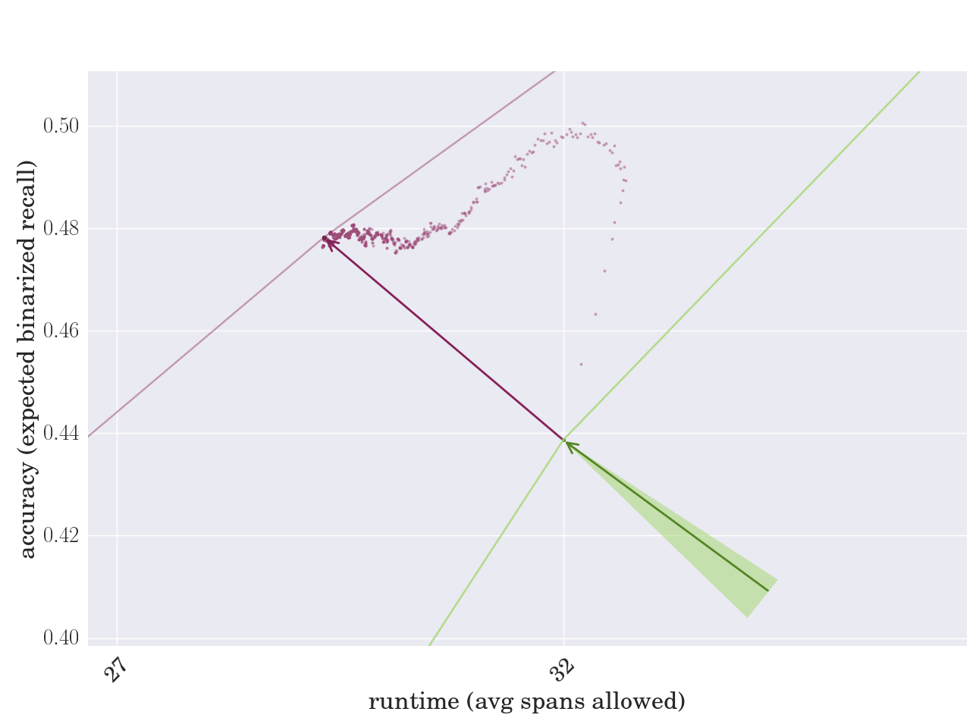
Learning curve
Notes:
Here we see that locally optimal learning is doing something nontrivial
It's quite a soap opera!
LOLS initially starts aggressively favoring accuracy
but then TAKES AN UNEXPECTED TURN towards runtime!
and finally it fine tunes its runtime … in a epic montage sequence
At the end, accuracy and runtime live happily every after because …
the DOT PRODUCT with the fateful green arrow is strong

Slide 30
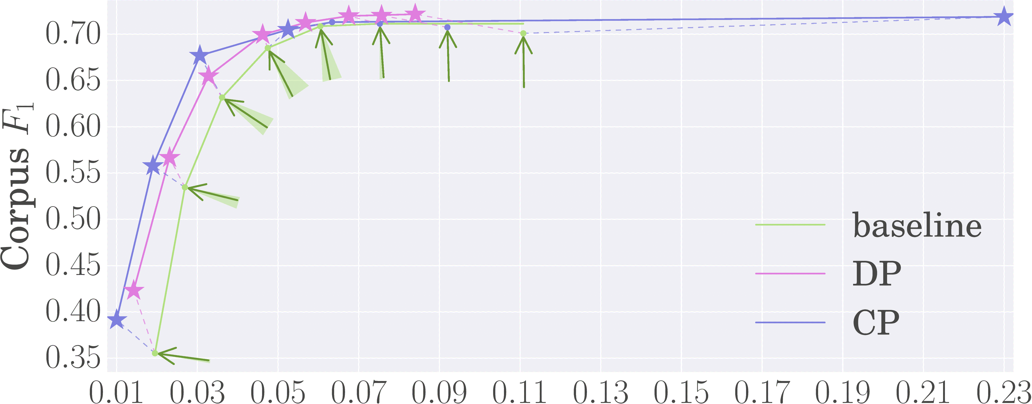
Test set results: Coarse-grained grammar
millions of edges built per sentence
★ = significantly higher reward
(paired permutation test, p < 0.05)
Notes:
So we should also check that this holds up on test data…
Since our surrogate measures may be more or less aligned with the true task reward.
And basically the results hold up!
Here I an showing results on the coarse grammar
where we are comparing the baseline against our method under the two training speedups.
I won't say much about it other than neither changeprop or dynamic programming is uniformly better.
I will also point out that we get a near 10-point improvement over an unpruned parser while being 8x faster.
It's sow much slower that it wouldn't fit on the graph.
This is because the grammar is very poor, that there is room for learning beneficial search error.

Slide 31
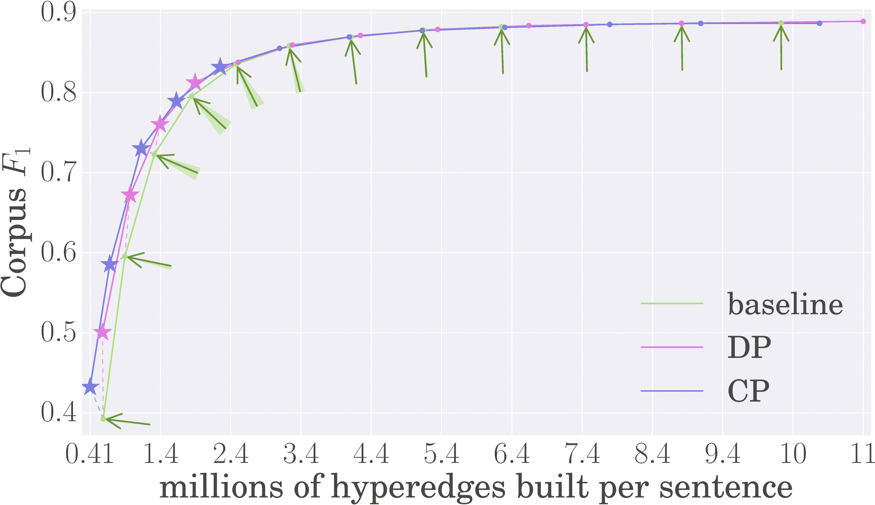
Test set results: Fine-grained grammar
Notes:
Improvements on the fine-grained grammar, are smaller. As there is less room for improvement.
LOLS-training never hurts performance
in high accuracy region – there is a marginal gain at some points, but it is not statistically significant.
Similar to the coarse grammar, we also find that pruning is a good idea.
Our most accurate learned parser is a tiny bit more accurate than exact inference while being almost 9x faster.
We present an in-depth analysis in the paper of why LOLS doesn't improve learning as much in the high-accuracy region
because the supervision given by both methods is very similar
and we drill down into the differences in the paper.

Slide 32
Conclusions
Learning systems that are fast and accurate (in the Pareto sense) is an exciting new area.
We looked at pruned dynamic programming.
We found that optimizing end-to-end performance lead to better frontier in the case of parsing.
Not all errors are equal, so we must measure the consequences of each pruning decision.
Measuring these consequences requires running the system over and over again with different pruning masks.
We sped this up with our change propagation and dynamic programming algorithms.

Slide 33


Thanks!
@xtimv
github.com/timvieira/learning-to-prune

Slide 35
Backup slides

Slide 36
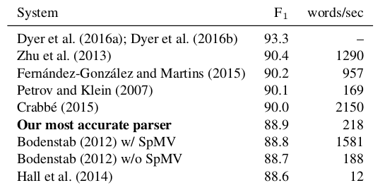
Relationship to other parsers
Slightly faster & more accurate than the method that inspired our baseline
Notes:
Since, I know it's likely that someone will ask in the question session.
Here is a big table of state-of-the-art systems.
I won't discuss this is must detail. Since we are not a state-of-the-art system.
I will point out that the method we do out perform the best span-based pruning system in Nate Bodenstab's thesis both in accuracy and speed… this might just be because our parser isn't written in Java :P

Slide 37
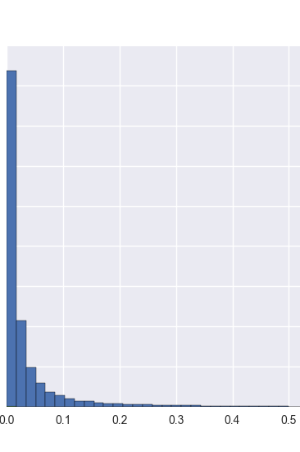
Changes are really sparse!
% of chart changed
37
Notes:
In case, it wasn't clear enough from the previous discussion, changes in chart are really sparse.
90% of rollouts change <10% of the chart
75% of rollouts change <3.5% of the chart

Slide 38
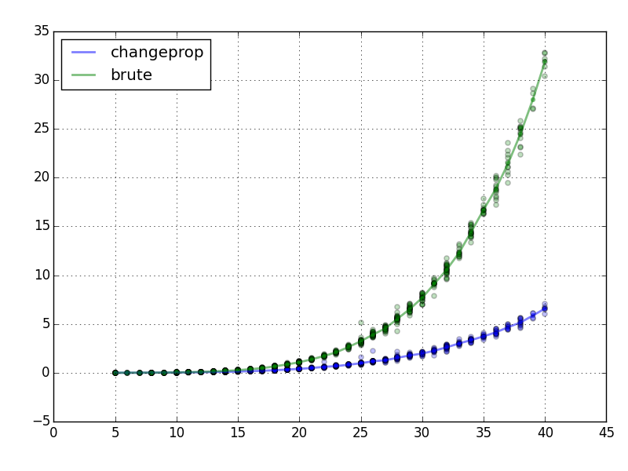
Empirical comparison
Runtime (seconds)
Average time to do
all rollouts
Sentence length
Notes:
Here is plot showing the average runtime of doing all rollouts per sentence broken down by sentence length.
As you can see, changeprop really enabled us to train on longer sentences.
Prior to this we limited our experiments to length <= 20.
We found that change prop gives a 2-6x speedup (depending on the grammar and amount of pruning)
TODO: animate in lines and change colors

Slide 39
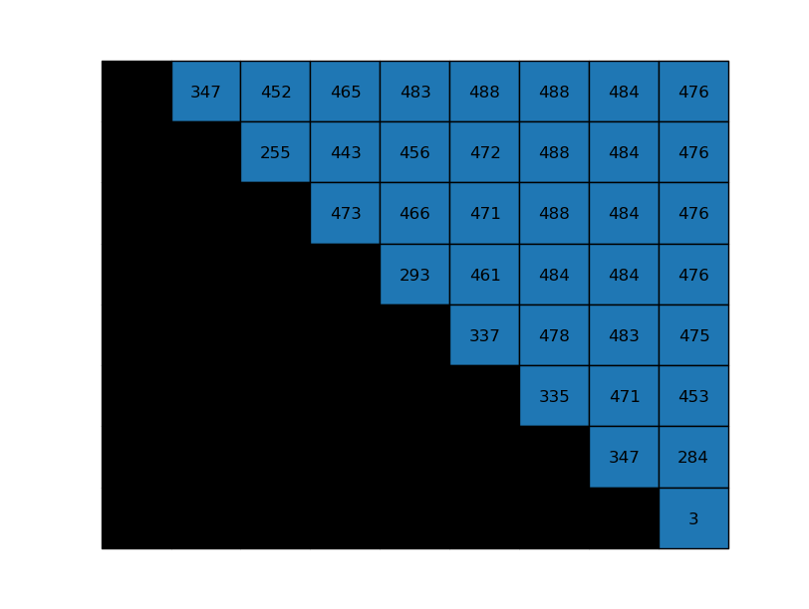
Runtime?
#symbols in each cell of a realistic grammar
O(G*n^3)
O(n^2) cells
O(G*n) time to fill each cell
How many grammar lookups
to fill this cell
255*484
+ 443*484
+ 456*483
+ 472*471
+ 488*347
= 949,728
Almost a million lookups
for one cell!

Slide 40
Speeding-up rollouts
CP
coarse grammar: 4.9-6.6x faster
fine grammar: 1.9-2.4x faster
DP
coarse grammar: 10.4-11.9x
fine grammar: 10.5-13.8x

Slide 41
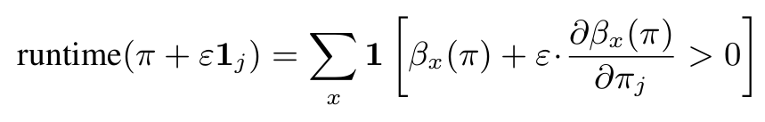
Runtime with Jacobian
General trick: apply expansion before nonlinearity.
Needs T Jacobian-vector products which is asymptotically as slow as running inference n^2 times
This is because computing marginals happens has worse constant factors than one-best so It's better to use Changeprop is much faster.

Slide 42
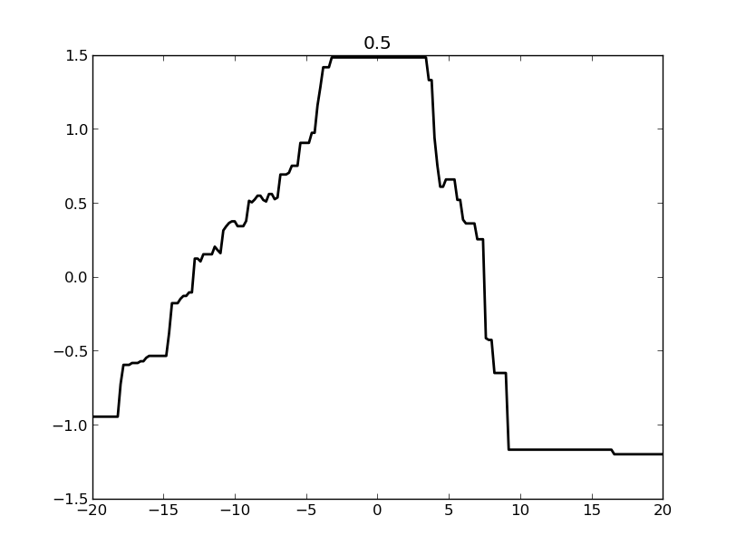
Hard to optimize
Cross-section of objective along a random direction
high-dimensional
riddled with
local optima
Hard to search directly in parameter space
piecewise
constant
Instead, we optimize by iteratively refining the supervision given to the classifier
Notes:
Ok, so how do we train to optimize this objective?

