Slide 1
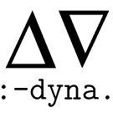
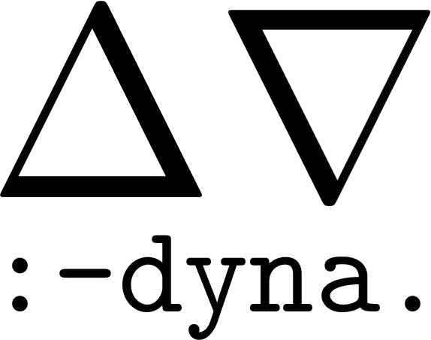
Tim Vieira, Matthew Francis-Landau,
Nathaniel Wesley Filardo, Farzad Khorasani,
and Jason Eisner
Notes:
Hello, I am Matthew Francis-Landau from Johns Hopkins University where we are developing the Dyna programming language, and I will be giving the first half of this talk.

Slide 2
Dyna: Toward a Self-Optimizing Declarative Language for Machine Learning Applications
Faster execution
ML
PL
Faster to implement
Notes:
(click) Today we are going to be talking about Dyna, a programming language that we have been developing that sits in the (click) intersection of programming languages and machine learning.
(click)We hope that Dyna to make many it easy to implement machine learning algorithms
(click) as well provide “declarative definition” of algorithms which will allow us to perform more advanced optimizations using reinforcement learning.
(click) For the first part of this talk we are going to be looking at how to PL can help ML in implementing algorithms faster.

Slide 3

Outline
Why Declarative Programming?
Quick introduction to the Dyna language
Automatic optimization of Dyna programs
ML
PL
ML
PL
Notes:
(click) Our outline for today is to first introduce Declarative programming and why we want it,
(click) Then we will introduce the dyna programming language and provide a quick taste for why it makes implementing machine learning algorithms fast
(click) Finally, we will discuss our techniques for optimizing Dyna programs using Reinforcement Learning

Slide 4
Declarative Programming
A programming paradigm where the programmer specifies what to compute
and leaves how to compute it to a solver.
Examples: SQL, Prolog/Datalog, Mathematica, Regex, TensorFlow/Theano
Solver seeks an efficient strategy (e.g., SQL query planning)
Notes:
So a declarative program (click) is a programming paradigm where the programmer specifics what to compute without explicitly stating how to compute the result.
(click) This concept is already fairly common in languages such as SQL where the database is free to choose between a number of different execution plans, or regex where the underlying code is automatically generated from an pattern matching expression.
(click) We then want our solver or execution engine to choose a good strategy, this is also fairly common for example, query planning where there are a plethora ideas

Slide 5
Why declarative programming?
Many ML algorithms have a concise declarative program
There are many choices to make when writing a fast program
Loop orders
Data structures (e.g., hash map, dense array, linked list)
Global execution strategy (e.g., depth vs. breadth-first search)
Parallelization opportunities
Manually experimenting with all possibilities is time consuming
Programmers usually only implement one
Researchers don’t have time to optimize the efficiency of their code
We can do better with automatic optimization
Notes:
(Read slide)
1.
2.
3.
4. Code is often run once so we researchers only care about performance to the point that their program finishes, not that it is highly performant

Slide 6
Why not optimize Python/Java/C++ etc.?
Less flexibility
Choices of loop orders / data structures already decided by the human programmer
Semantics of the program are not invariant to
Changing execution and loop order
Eager vs. lazy evaluation, top-down vs bottom-up evaluation.
Data structures
Concurrency
Difficult to reliably discover long range interactions in a program
Notes:
To cause the changes would require the underlying math/dyna program
Why not optimize a imperative language like Python/Java/C++.
We would essentially have to recover some underlying more general definition of a program, perform optimizations on that representation.
Instead we would rather that programs just give us the general definition of their algorithms.

Slide 7
What is Dyna?
Declarative language
Based on weighted logic programming
Prolog / Datalog like syntax
Uses pattern matching to define computation graphs
Reactive
Dyna programs are close to their mathematical description
Similar to functional programs
Notes:
(Read slide)

Slide 8
Dyna Day 1
a = b * c.
a will be kept up to date if b or c changes. (Reactive)
b += x. b += y. equivalent to b = x+y. (almost)
b is a sum of two variables. Also kept up to date.
c += z(1). c += z(2). c += z(3).
c += z("four"). c += z(foo(bar,5)).
a “patterns”
the capitalized N matches anything
c += z(N).
c is a sum of all defined z(…) values.
Notes:
(click) Here we have a definition for “a” where it is defined to be the product of two other terms “b” and “c”, the value of “a” will be kept up to date since dyna is a reactive language
(click) Now we can modify the definition of “b” by making it the sum of two other terms, “x”, and “y” and it will also be kept up to date.
(click) instead of having to individually name all of the terms in our program, we allow for using some value expression as shown here with “z 1”
(click) however having to enumerate all of these expressions is very tedious, so we introduce “patterns” which allow for automatically matching all defined values of “z”
(click) we can also match against strings or structures types such as “foo bar 5”

Slide 9
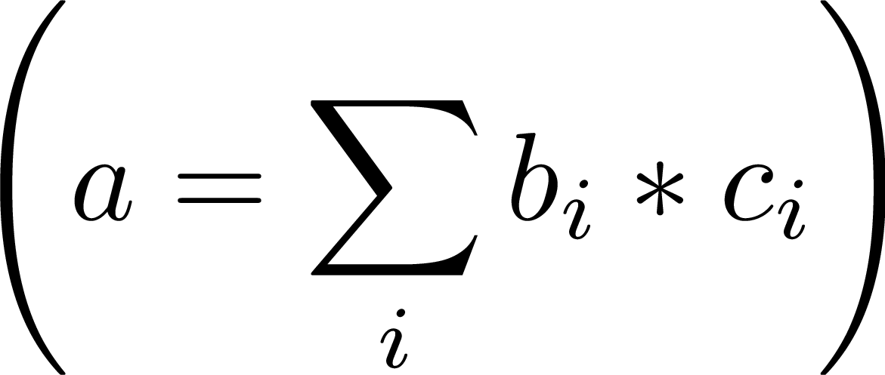
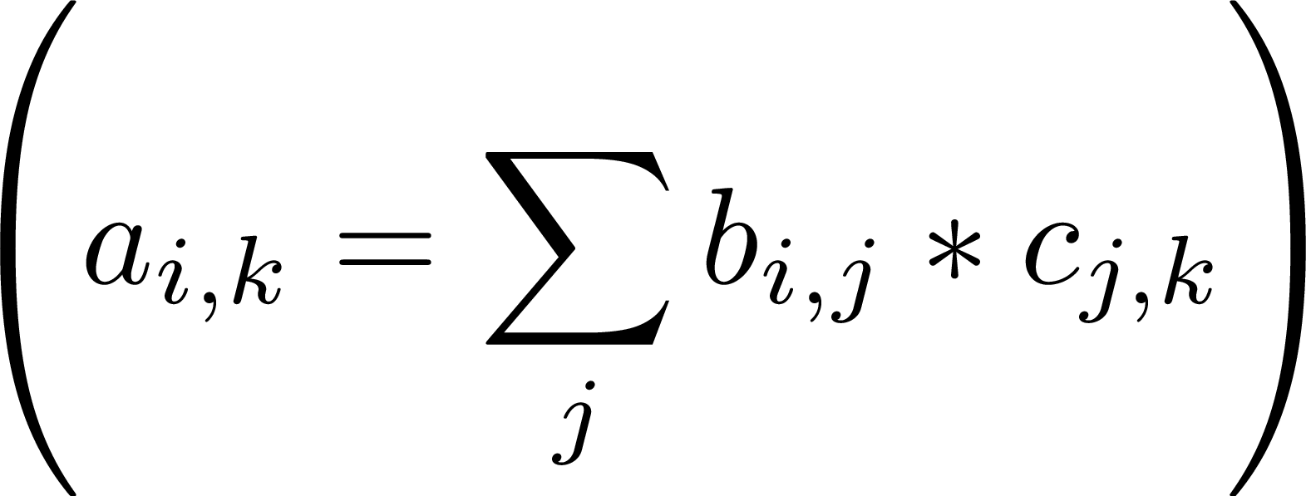
More interesting use of “patterns”
a(I) = b(I) * c(I).
pointwise multiplication
a += b(I) * c(I).
dot product; could be sparse
a(I,K) += b(I,J) * c(J,K).
matrix multiplication; could be sparse
J is free on the right-hand side, so we sum over it
. . . + b("yetis") * c("yetis")
+ b("zebra") * c("zebra")
Notes:
Using these patterns we can define more complicated structures
(click) for example, a point wise multiplication where the pattern or variable occurs on both the left hand and right hand side.
(click) we can also define a dot product where the variable only appears on the right hand side of the equation. The “+=“ here serves as an aggregator which defines how we combine multiple values together
(click) now this expression could be operating over a sparse object such as a numerical vector, or we might have string keys such as yetis or zebra.
(click) combining these we can also define a matrix product
(click) The “I” and “K” appear in the head of this expression which means that they will be filled in for the “b” and “c” terms
(click) The “J” only appears on the right hand side, which means that it will be aggregator over using the summation

Slide 10
Dyna vs. Prolog
Prolog has Horn clauses:
a(I,K) :- b(I,J) , c(J,K).
Dyna has “Horn equations”:
a(I,K) += b(I,J) * c(J,K).
prove a value for it
e.g., a real number, but could be any term
definition from other values
b*c only has value when b and c do
if no values enter into +=, then a gets no value
Like Prolog:
Allow nested terms
Syntactic sugar for lists, etc.
Turing-complete
Unlike Prolog:
Terms can have values Terms are evaluated in place
Not just backtracking!
Notes:
There is a nice similarity between prolog’s If ( :- ) and our aggregators ( += ). Also between methods inside of our expression such as times ( * ) and conjunctions in prolog

Slide 11
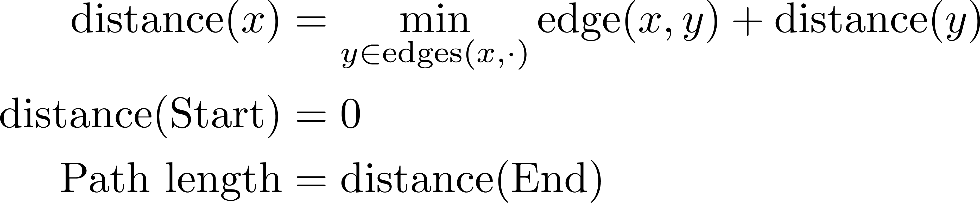
Shortest path
Note: Aggregation was already present in our mathematical definition.
distance(X) min= edge(X, Y) + distance(Y).
distance(start) min= 0.
path_length := distance(end).
Here the “min=“ aggregator only keeps the minimal value that we have computed
After this converges we can query the state of the Dyna program.
Variables not present in the head of an expression are aggregated over like with the dot product example.
edge("a", "b") = 10.
edge("b", "c") = 2.
edge("c", "d") = 7.
edge("d", "b") = 1.
start = "a".
end = "d".
? path_length
? distance("c")
? distance(X)
? distance(X) > 7
? edge("a",X)
All of the vertices
The distance of some other vertex
Length at the end
All the vertices more than 7 away
All of the edges leaving "a"
Notes:
To see a more concrete example, we can look at shortest path. (click) The single source definition is definable using three lines of dyna. (click) This definition would be accompanied with a set of edges as well as some starting and ending location as shown. (click) We can see that this looks very similar to a mathematical definition of shortest path. (click) Again we have that a variable not present in the head of the expression is getting aggregated over just like in the inner-product examples before. Unlike before, we have that the aggregator is min= which is selecting the value that minimizes this expression instead of summing over all of them. (click) Note that even the concept of min= is already present inside of our mathematical definition.
(click) Now once our program has converged, we can perform queries against the state of the program. (click) For example, we can simply query the length of the entire path, (click) or the distance at a specific vertex in the graph. (click) We can also query all of the distances in the graph, (click) or restrict which items are returned, eg selecting only the items which are greater than 7 units away from the start. Note that these queries are similar to the statements which appear on our right-hand-side, and in computing these expressions we might have internal queries such as (click) edge’s leaving “a”.

Slide 12
Aggregators
Associative/commutative:
b += a(X). % number
c max= a(X).
q |= p(X). % boolean
r &= p(X).
Require uniqueness:
d = b+c.
Last one wins:
fly(X) := true if bird(X).
fly(X) := false if penguin(X).
fly(bigbird) := false.
Choose any value:
e ?= b.
e ?= c.
User definable aggregators
a(X) smiles= b(X, Z).
(Just define all of the operation of an commutative semigroup)
Notes:
Given that we have all these ways of defining sets, on the right-hand-side and from queries, we need to perform a reduce like operation.
So min= with shortest path, we have a number of different aggregators. (click) We have all of the aggregators that you would expect in a math equation such as addition, multiplication, min, max. We also have logical aggregators such as and “and” “or.” (click) Standard equality aggregators for simply setting a single value, or (click) last one wins when we might want to override the value later in the program. (click) There are also choice aggregators which allow for user’s to define multiple ways of computing the same value, which allows for dyna to automatically choose the most efficient. (click) Finally, we allow for user’s to define custom aggregators by simply providing definitions of a mathematical commutative semigroup.

Slide 13
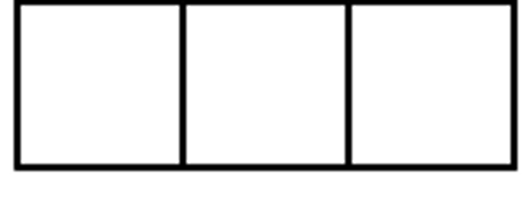
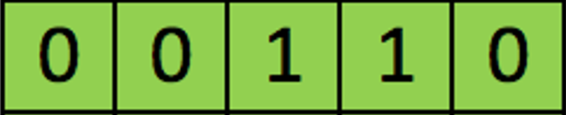
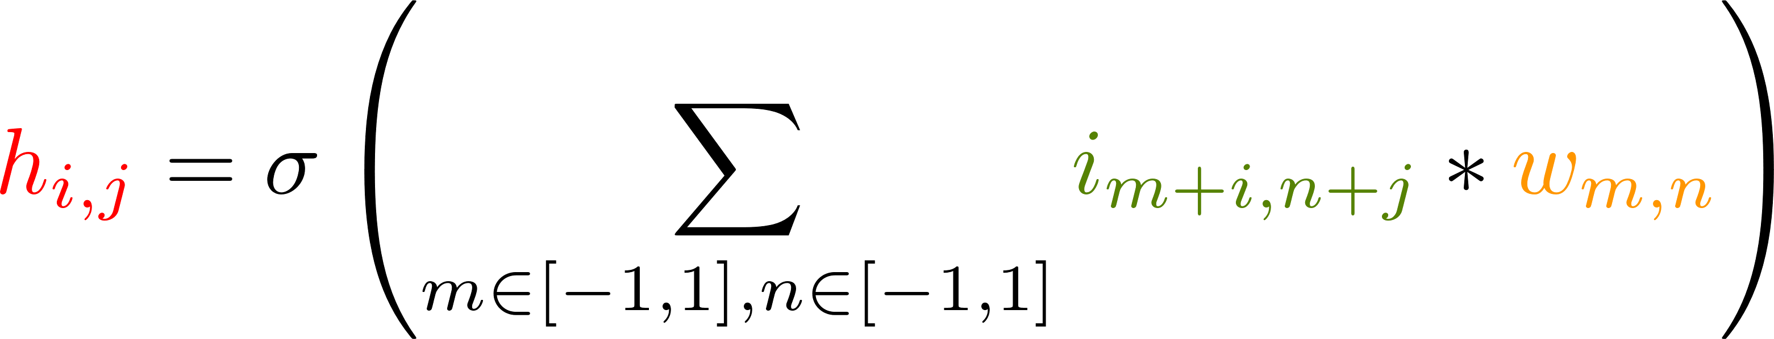
Neural Convolutional Layer
Convolution output
Some nonlinearity
Learned feature weights
Input image
Convolution output
Input image
http://deeplearning.stanford.edu/wiki/index.php/Feature_extraction_using_convolution
Notes:
Given that Deep learning is all the rage these days, we are going to look at one of the main work horses, a convolution.
Essentially we have parameters shown in yellow which slide over an input image shown in green. This generates an output value at each location which represents if the feature that we are looking for was found at some location in the image. If we were to be reading something about a convolution, then we might see an equation like this (click), we can see the input image (click) is referenced here along with the weights (click), we then apply some non linearity (click) to the sum of these values and this results in the value at the output (click)

Slide 14
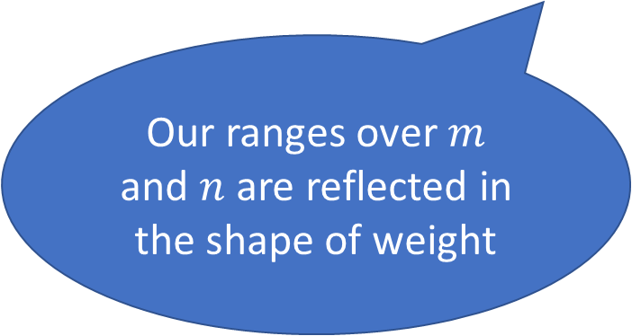
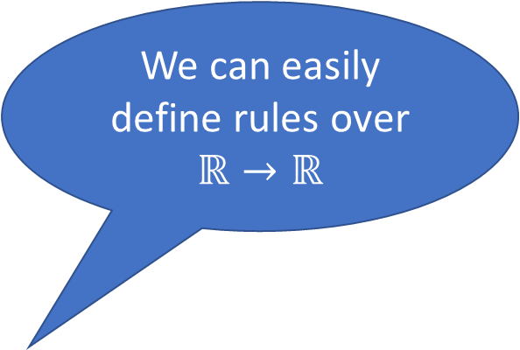
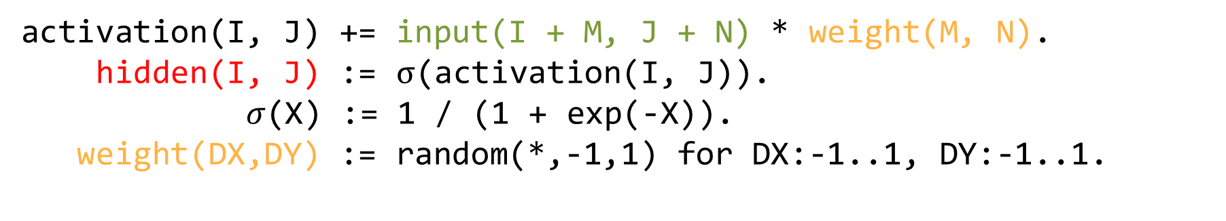
Neural Convolutional layer
We can easily define rules over $ℝ→ℝ$
activation(I, J) += input(I + M, J + N) * weight(M, N).
hidden(I, J) := $σ$(activation(I, J)).
$σ$(X) := 1 / (1 + exp(-X)).
weight(DX,DY) := random(*,-1,1) for DX:-1..1, DY:-1..1.
Here keys are integers but we can also support more complicated structures
Summation became an aggregator
Our ranges over $m$ and $n$ are reflected in the shape of weight

Slide 15
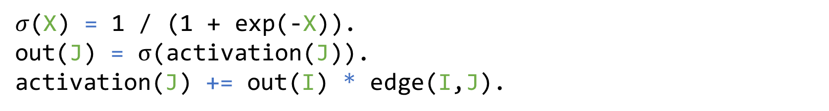
More Neural
Note: nowhere in this program do we specify the form of our variables I, J
Instead we can specify the structure of keys inside the definition of edge.
$σ$(X) = 1 / (1 + exp(-X)).
out(J) = $σ$(activation(J)).
activation(J) += out(I) * edge(I,J).
The output of a neuron is our nonlinearity applied to the sum of its inputs
All weights have been rolled into the edges connecting neurons
edge(input(X,Y),hidden(X+DX,Y+DY)) = weight(DX,DY).
weight(DX,DY) := random(*,-1,1) for DX:-1..1, DY:-1..1.
The weight do not depend on the absolute location of the input, so this is a convolution again.

Slide 16
Dyna Makes Algorithms Easy
All use graphs to propagate changes
Gibbs, MCMC – flip variable, compute likelihood ratio, accept or reject
Iterative algorithms – loopy belief propagation, numerical optimization
Neural networks – computation graphs passing dense matrices
Branch-and-bound, Davis–Putnam–Logemann–Loveland (DPLL)
Implementations and more in:
Dyna: Extending Datalog for modern AI. (Eisner & Filardo 2011)
Dyna: A non-probabilistic language for probabilistic AI. (Eisner 2009)
Notes:
We have show a few simple algorithms so far today, however we can implement a whole gauntlet of algorithms as many are easily represented as graph with the propagation of changes. For example,
(click) Gibbs and MCMC are two algorithms which change a value in a graph and need to recompute the likelihood of an entire expression which maps nicely to reactive programming.
(click) Iterative algorithms also work well as once we have defined a computation graph we want to pass changes until we converge.
(click) Neural networks are increasingly defined as graphs where we are passing vectors between different elements of the graph.
(click) Branch-and-bound and DPLL choose a variable to assign a value to and then will propagate the change around the graph to determine what else is open to choose.
(click) So, all of these are using graphs and propagating information to determine their solution.
(click) For more information on writing programs in dyna and more sample programs see “Eisner & Filardo 2011” and “Eisner 2009” cited here at the bottom.

Slide 17
How much can a declarative language save us?

Slide 18
Implementing shortest path
Dyna (Declarative)
Java (Procedural)
placeIndex = new HashMap<String,Integer>();
edges = new float[num_places][num_places];
// load edges
float distance(from) {
if(from == placeIndex.get("start")) {
return 0;
}
l = edges[from];
r = infinity;
for(j = 0; j < l.length; j++) {
n = distance(j) + l[j];
if(n < r)
r = n;
}
return r;
}
path_length = distance(placeIndex.get("end"));
A single Dyna program can represent hundreds of possible implementations.
Other implementations (not shown here) include A* and bidirectional search, and choice of data structures to support dynamic graphs
placeIndex = new HashMap<String,Integer>();
queue = new PriorityQueue<Integer, Float>();
distances = new float[num_places];
edges = new float[num_places][num_places];
// load edges
queue.push(placesIndex.get("start"), 0);
while(!queue.empty()) {
d = queue.pop();
l = edges[d.first()];
for(j = 0; j < l.length; j++) {
n = d.second() + l[j];
if(distances[j] < n) {
distances[j] = n;
queue.push(j, n);
}
}
}
path_length = distances[placeIndex.get("end")];
queue = new FifoQueue<Pair<String, Float>>();
distances = new HashMap<String, Float>();
edges = new HashMap<Pair<String, String>,Float>();
// load edges
queue.push("start");
while(!queue.empty()) {
d = queue.pop();
for(e : edge) {
if(e.first().second().equals(d.first())) {
if(distance.get(e.first()) <
d.second() + e.second()) {
distance.put(e.first(),
d.second() + e.second());
queue.push(e.first());
}
}
}
}
path_length = distances.get("end");
queue = new PriorityQueue<String, Float>();
distances = new HashMap<String, Float>();
edges = new HashMap<Pair<String, String>,Float>();
// load edges
queue.push("start", 0);
while(!queue.empty()) {
d = queue.pop();
for(e : edge) {
if(e.first().second().equals(d.first())) {
n = d.second() + e.second();
if(distance.get(e.first()) < n) {
distance.put(e.first(), n);
queue.push(e.first(), n);
}
}
}
}
path_length = distances.get("end");
distance(X) min= edge(X, Y)
+ distance(Y).
distance(start) min= 0.
path_length = distance(end).
queue = new PriorityQueue<String, Float>();
distances = new HashMap<String, Float>();
edges = new HashMap<String,Map<String,Float>>();
// load edges
queue.push("start", 0);
while(!queue.empty()) {
d = queue.pop();
for(e : edge.get(d.first())) {
n = d.second() + e.second();
if(distance.get(e.first()) < n) {
distance.put(e.first(), n);
queue.push(e.first(), n);
}
}
}
path_length = distances.get("end");
Notes:
(click) Here we have the same shortest path program that we had a few slides ago. (click) If we look procedural implementation in pseudo Java, we first have:
Methods: 1) FIFO queue, Pair represent the edges and strings for keys inside of the hash map
2) Priority queue
3) Nested hash map to represent edges, (faster lookups if we know the first entry for an edge)
4) Mapping places to integers so that we can use a dense array to store distances and edges
5) Recursive distance with depth first based computation (good for trees)

Slide 19
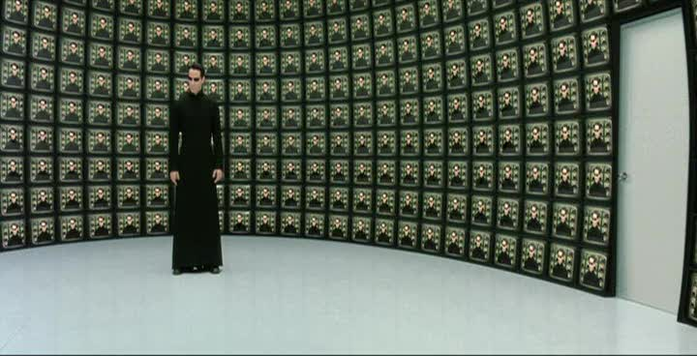
Given all of these implementations,
the problem is choice
The Matrix Reloaded (2003)

Slide 20
If you are Neo, you have two choices
Take the Architect’s deal
Restart the Matrix
Let all the humans in Zion die
But restart Zion with 16 females and 7 males (fight another day)
Already tried this 5 times
Current argmax
Follow “an emotion specifically designed to overwhelm logic & reason”
Save Trinity
YOLO, figure this out as we go (unknown reward)

Slide 21


This raises the next question …
can machines love
or at least make irrational choices
The “Rational” Choice
The “Irrational” Choice
(Randomly sample)
Exploitation
Exploration

Slide 22
Outline
Why Declarative Programming?
Quick introduction to the Dyna language
Automatic optimization of Dyna programs
ML
PL
ML
PL
Notes:
Thanks, Matthew.
Hi everyone I'm Tim Vieira.
I'll be wrapping up this talk with our plans for optimizing Dyna programs as they run.

Slide 23
Dyna
output
query
Dynamic data
structure
response
output = 2
input("b") := 0
update
output
query
response
output = 1
compile
Lazy only helps if there is a enough work to consolidate between queries.
So in practice, we may want to handle some updates eagerly.
The choice depends on the specific workload (might depend on what gets updated and when).
Dyna source code
(micro-example)
output max= input(I).
input("a") := 1.
input("b") := 2.
23
Notes:
Let's start with the outer-most level: the user-facing "API".
Here we have an micro-example of a Dyna program for a maintaining the *maximum* of a collection of *inputs*.
This program gets compiled into --- what can best be described as --- a *dynamic data structure*.
Because this data structure supports queries…
… and updates

Slide 24
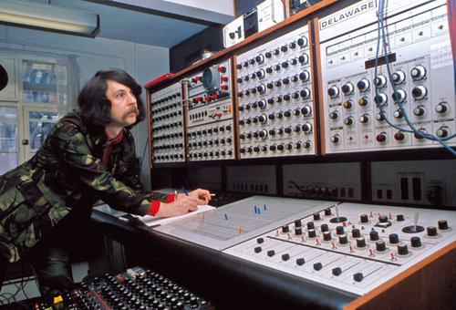
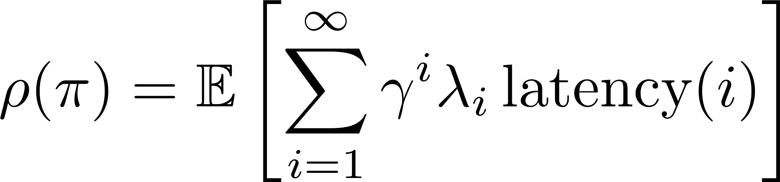
Tuning Dyna
Solver has “knobs“ to tune
Dynamic data
structure
Workload
update
response
(via callback)
query
I
latency
Optimizer
Total cost knob setting
Average latency on workload
Encourage earlier jobs to finish first
Lazy only helps if there is a enough work to consolidate between queries.
So in practice, we may want to handle some updates eagerly.
The choice depends on the specific workload (might depend on what gets updated and when).
urgency
Example knob: eager or lazy updates?
e.g., dynamic max data structure
% Dyna:
output max= input(I).
Max-heap:
O(log n) per update
O(n) per batch update (“heapify”)
knob settings
24
Notes:
Here, I've abstracted away the specific queries and updates into what I'll refer from here on as a "workload".
So our goal in *TUNING* dyna is to reduce the latency between QUERIES and their RESPONSES
Abstractly, the solver backing this data structure has a bunch of "knobs" that will be tuned by an optimizer
Like this guy with a mustache fine tuning his synthesizer's sound.
Just to give an example of coarse-grained knob: we might consider whether or not to process updates eagerly or lazily. These types of decisions matter, even in simple programs like this one that computes the maximum.
We define the long-term cost (of a specific knob setting) as the temporally discounted average latency with the option for users to specify an query "urgency".

Slide 25
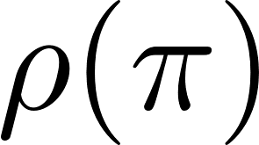
Off-line training
Slow!
Run entire workload
Fiddle
with knobs
Feedback
Reasonable way to tune knobs off-line (used by PhiPac, ATLAS, SATZilla)
Open up the solver
The inefficiency: this loop explores one policy per run.
How do we tighten the loop to get feedback more often?
Notes:
One way to train this system would be to have an outer loop which fiddles with the knobs
Runs the entire workload.
And receives feedback in terms of the cost function (from the previous slide)
Then fiddles with the policy and repeats
===
This is a reasonable way to train that is actually used by a number of fairly well known systems.
However, there is a serious inefficiency in that only one policy is explored per run.
How can we tighten up this loop to get feedback earlier and more often?
To do that we'll need to look inside the solver

Slide 26
Tasks on agenda can be executed in any order!
Interpolates between eager and lazy strategies
% matrix multiplication
c(I,K) += a(I,J) * b(J,K).
Inside the solver
Task:
Compute c(I,4)for all I
agenda
choose!
Tons of admissible strategies. Each attempts to make progress toward an answer to open queries
queries &
updates
pop
task
choose!
dispatch
Memos are optional.
Solver can create or flush memos anytime.
(memos save recomputation, but require maintenance)
push
run
Strategy:
for J in b(:,4):
for I in a(:,J):
c(I,4) += a(I,J) * b(:,4)
new
tasks
strategy
choose!
cache
memoize
computed
values
response
TODO: for an update task, we would has actual new tasks…
TODO add cache later. For some tasks it’s crucial to cache stuff, e.g., shortest path
lookup
thread
Notes:
Here's a sketch of what's going on in our solver.
When a query OR update comes in, it gets scheduled on an agenda (a work list of tasks that must be completed eventually)
We then have several threads running the following loop…
pop a task from the agenda, for example computing the 4th column of the matrix c defined as the product of two other matrices a and b.
We then dispatch to an appropriate strategy for COMPLETING the task. Here's one strategy for our simple column query.
We then run the strategy:
It will compute a bunch of values, which might be answers to an open query
and it might add new tasks to the agenda
Of course, it also essential to cache (or memoize) computed values for efficiency. These memos can later be looked up by other strategies saving the cost of recomputation.
I'll now tell you about some of the flexibility that we've baked in!
Task on the agenda can be executed in any order… so we need to choose a good order
There are tons of admissible strategies to pick from, I'll say more on this shortly … choose
The solver is free to create or flush memos anytime… so again choose!

Slide 27
Strategy options
Solver should systematize all the reasonable implementation tricks that programmers might use and make them work together correctly.
Parallelizing independent computations
Ordering dependent computations
Join strategies
Forward vs. backward chaining (update-driven vs. query-driven)
Dynamically identify unnecessary computation
Short-circuiting, branch-and-bound/A*, watched variables
Consolidating related work
Static or dynamic batching (consolidating similar tasks, including GPU)
Inlining depth (consolidating caller-callee)
Storage
Memoization policy; choose low-level data structures
Many strong interactions among decisions
Notes:
Our solver has been designed from the ground up to be able to recover all the reasonable implementation tricks that we've ever seen used.
These tricks include…
Parallelization of independent computations
Ordering of dependent computations, including join strategies, forward vs backward chaining, and identifying computations that provably can be skipped.
(In general, a program specifies a lot of computations, but in practice, which computations you do first determines which other ones you need to do.)
We're also concerned with consolidating related work, including batching and inlining.
Lastly, we also need to determine what computations get stored and the low-level details of how they get stored.

Slide 28

The Dyna solver
Lots of challenges in defining this giant space while preserving correctness
Most systems avoid choices. We embrace choice because we have machine learning to choose intelligently.
Further reading
Mixed-chaining / arbitrary memoization (Filardo & Eisner, 2012)
Set-at-a-time inference (Filardo & Eisner, 2017, in preparation)
Lots of progress to come!
Nathaniel Wesley Filardo is tying up many loose ends in his thesis (September 2017)
He’s on the job market!
Notes:
There are a ton of interesting challenges in defining the giant space while preserving correctness.
Most systems avoid giving themselves so many choices. We embrace them, because we have machine learning to help us choose!
Here's some pointers to some paper describing the architecture
There is lots of progress to come, especially because Wes is tying up a lot of loose ends in his thesis.
p.s. he's awesome and he's on the job market!

Slide 29
Sequential choices at runtime (some stochastic)
edge(…) query
edge(x,Y) for some x
…
…
edge(x,y)
…
…
edge(X,Y)
rand() ≤ 0.3
answer from edge rules using join strategy 1
otherwise
…
join strategy 2
Notes:
Let's look at the sequential choices made by the policy at runtime.
We've been asked to answer an edge query
The specific query is where X and Y are free variables – i.e., we want all edges
Here we use a randomize to pick join strategy1 30% of the time and join strategy2 70% of the time.
The number 0.3 will be tuned to favor the faster strategy
Let's look at the other queries we might been asked to answer
We have the set of outgoing edges for some x.
and the value of a specific edge(x, y)

Slide 30
Sequential choices at runtime (some stochastic)
edge(…) query
edge(x,Y) for some x
hash(x)/H ≤ 0.2
answer will be an iterator over outgoing edges (adjacency list)
z
look up answer in dense array A4 indexed by x (where x is an integer or is represented as one)
…
edge(x,y)
otherwise
look for answer in sparse hash table H5
…
…
cached
return answer
edge(X,Y)
answer from edge rules using join strategy 1
`
rand() ≤ 0.3
otherwise
query edge(X,Y) and filter to X=x
otherwise
…
join strategy 2
rand () ≤ 0.1
otherwise
Policy probabilities that are tuned over time (typically approaching 0 or 1)
return answer
memoize & return
Notes:
Let's play out what this branch might look like..
The answer to this query is an iterator over outgoing edges
Based on a hash on x, we will "randomly" choose between two strategies
(1) looking up the answer in a dense array indexed by x's interned value.
(2) looking up the answer in a hash table, where it might not be computed yet
Suppose we are in the latter case, here we check if x has been cached, if so we return the answer
otherwise, we compute it via the edge(X,Y) query and FILTER the results to match x. Notice that this strategy will recurse to another node in this decision graph.
Lastly we return the answer and memoize the result 90% of the time
These probabilities highlighted in yellow will be tuned over time, typically approaching 0 or 1

Slide 31
Policy probabilities can be sensitive to context of task
Stochastically conditioned on the following information (features).
Task characteristics
What type of task?
What are the task parameters?
Who requested the task?
Dataflow
What depends on this task (children)?
What does this task depend on (parents)?
Agenda characteristics
Are there a lot of open queries?
What’s on the agenda? How long has it been there?
Cache characteristics
Statistics: number, hit rate, frequency, & recency of memos (broken down by type)
Notes:
Those policy probabilities can be sensitive to the context of the task.
I don't have time to go through all of these sources of information (or "features" in ML terminology)

Slide 32



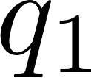
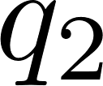
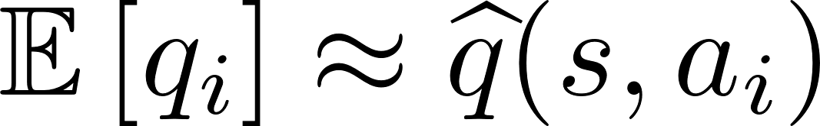
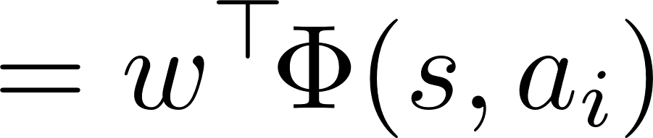
Tuning probabilities
query edge(X,Y) and filter to X=x
If we knew the long-term cost of each action in context, we could update the policy now!
rand () ≤ 0.1
otherwise
return answer
memoize & return
hypothetically, fork state and run finish workload
Slow!
Generalize from past experience to new situations
Use ML to predict future costs!
Notes:
Now, let's talk about tuning those probabilities…
Here we have the memoization probability from before
If we know the long-term cost of each action we could update the policy now!
Here's a slightly more abstract view in terms of "states" and "actions"
Suppose we – hypothetically – forked the state of the solver, ran the workload to completion, and measured the long-term costs of each of those actions (denoted here by q1 and q2)
Of course, this would be insanely slow
So we use machine learning to PREDICT these future costs from context
Importantly, this will generalize from past experience (state-action pairs) to knew ones.
and we could imagine using a linear function of various features (PhI) of the state of the solver

Slide 33
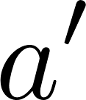


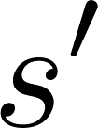
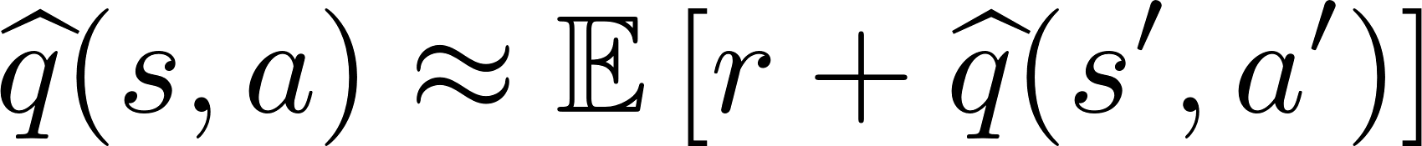
Temporal difference learning
Make estimator agree with itself
Approximate dynamic programming
Notes:
We can tune our q-estimator using temporal difference learning
This is a pretty simple algorithm, which is doing a type of approximate dynamic programming
Which, intuitively, just says that q-hat should agree with itself by looking one step ahead.

Slide 34
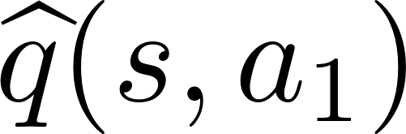
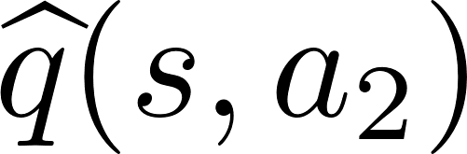
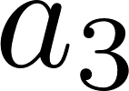


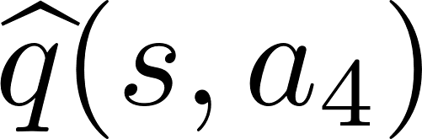
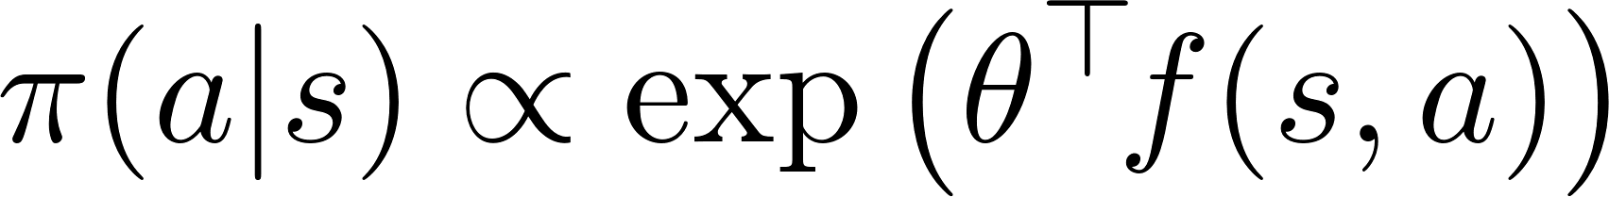
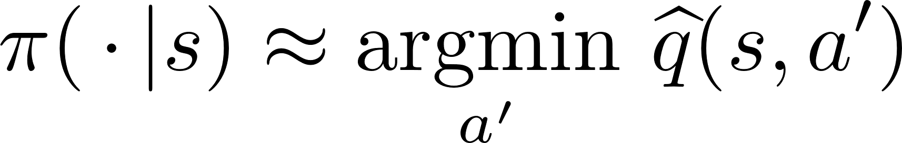
Actor-critic policy gradient
Says increase the probability of lower cost actions.
update q
Notes:
The overall algorithm is called "actor-critic policy gradient"
when we're in a state we sample according to a log-linear distribution, which allows for context-dependent features f(s,a)
We have a really simple update rule, which intuitively says increase the probability of lower cost actions
This means that this distribution will approximate the argmin of qhat
Of course, we also have to update q-hat, which also has a fairly simple update rule.

Slide 35
Summary
Declarative languages lend themselves to automated optimization because their solvers have a lot of freedom.
Tuning such as solver is a sequential decision making problem that can be tuned with online reinforcement learning techniques.
Dyna
Has been designed from the ground up be as flexible as possible.
A powerful language for specifying machine learning applications.
Check out the paper! Lots of great technical details in the paper that didn't have time to get into.

Slide 36
State of the language
We have to two language prototypes
Dyna 1 prototype (2005) was used in Jason’s lab, fueling a dozen NLP papers!
Dyna 2 prototype (2013) was used for teaching an NLP course to linguists with no programming background.
Both were inefficient because they used too many one-size-fits-all strategies.

Slide 37

Thanks!
Questions? Comments?
http://dyna.org
Hire Wes Filardo!
http://cs.jhu.edu/~nwf
@xtimv
@matthewfl

Slide 39
Sparse vector choices
Suppose that you are writing a sparse vector class, then you are likely to have something like:
Dot(a, b) {
if(a.size() > b.size()) {
swap(a,b);
}
// . . .
This is always choosing to “drive” the join using the smaller object

Slide 40
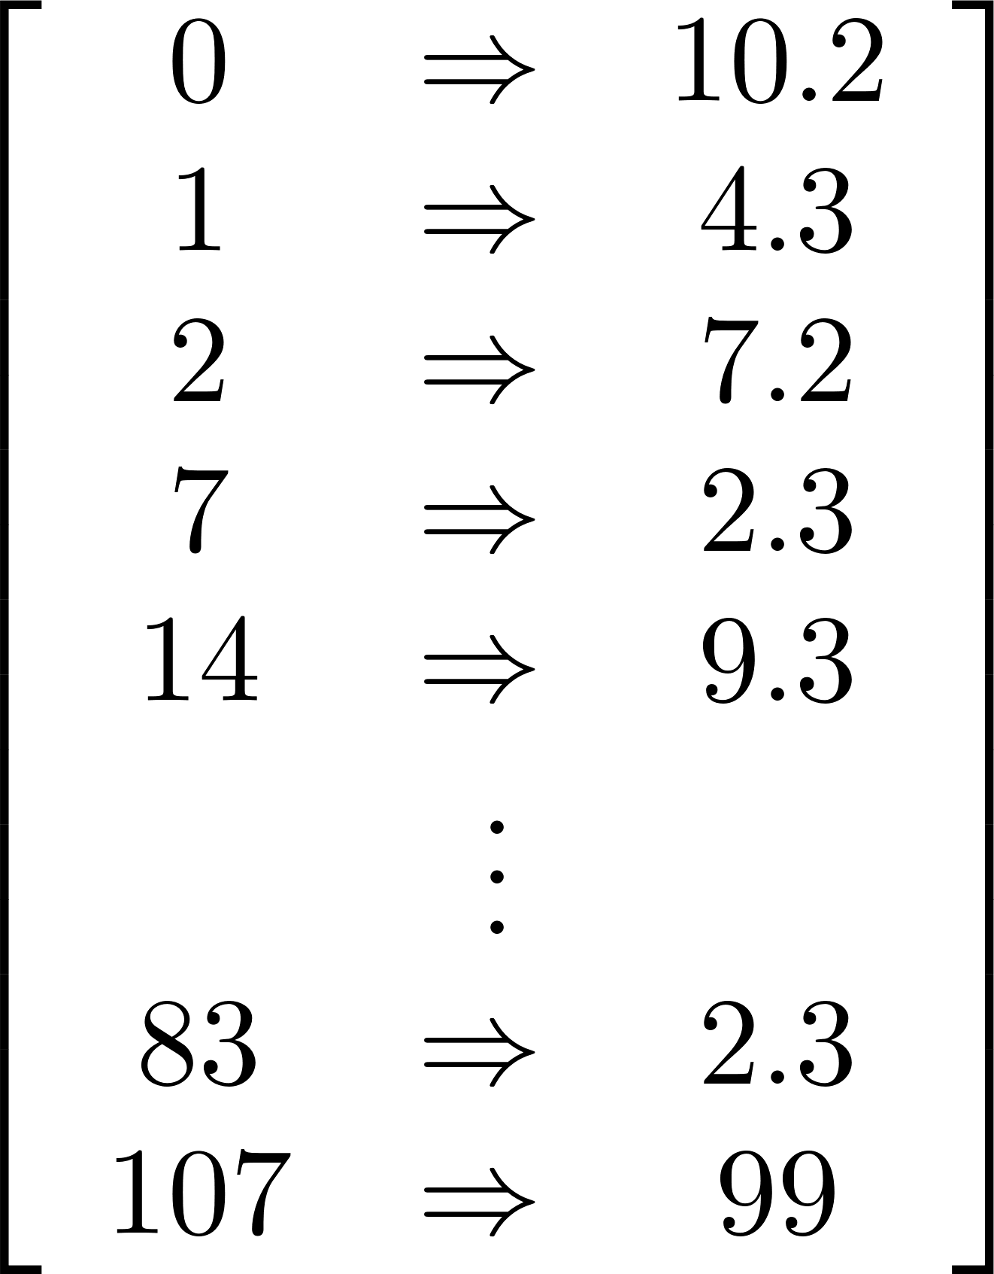
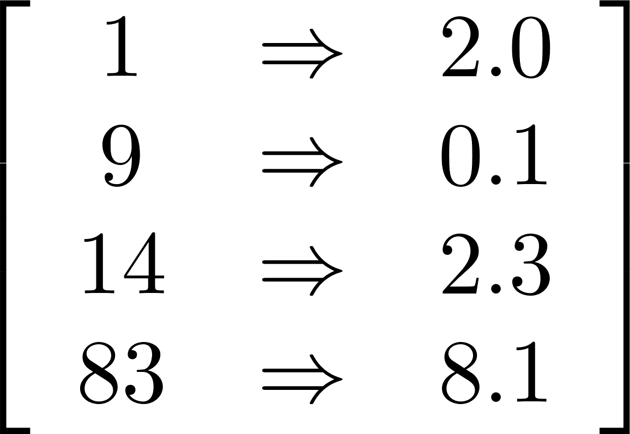
Loop order, sparse vector product example

Slide 41
Don’t do c(I,4) until a(I,J) and b(J,4) are ready! Maybe even wait until all of b is ready.
Join strategies
Outer loop on b(J,4), inner loop a(I,J)
Outer loop on a(I,J), inner loop b(J,K), filter K==4
Sort a and b on J and use Baeza-Yates intersection
What if we can’t loop over b? e.g.,
b(I,K) = X*Y.
In natural language parsing with the CKY algorithm, an unexpected loop order turned out to be 7-9x faster than the loop order presented in most textbooks because of cache locality (Dunlop et al. 2010).
% matrix multiplication
c(I,K) += a(I,J) * b(J,K).

Slide 42
Don’t do c(I,4) until a(I,J) and b(J,4) are ready! Maybe even wait until all of b is ready.
Memoization and data structures
Do we store results for future use?
(tradeoff: memos must be kept up-to-date!)
What data structure?

Slide 43
Don’t do c(I,4) until a(I,J) and b(J,4) are ready! Maybe even wait until all of b is ready.
Batching, answering bigger queries/updates
Batch pending c queries.
Preemptively compute a broader query, c(I,K)
Use clever mat-mul alg. (sparse or dense?)

Slide 44
Don’t do c(I,4) until a(I,J) and b(J,4) are ready! Maybe even wait until all of b is ready.
Inlining
Inline a and/or b queries.
Bypass agenda and route directly to consumer, e.g.,
d(I) max= c(I,K).
Reduce overhead of method calls
Reduce overhead of task indirection through agenda

Slide 45
Mixed policies
Mixed task strategies selection
Policy will encounter similar tasks frequently
Mixed storage strategies
e.g., use a hash table, prefix trie, dense array, …
Problem: random choice of strategy might not be consistent
E.g. might write to A and read from B (because of randomness)
Notes:
Policy maintains a distribution $π$(strategy|state, task, args) over all choices rather than committing to a single choice.
Explore many options randomly and get feedback (like an A/B test, a.k.a. bandit)
Smoothly change from strategy A to B by gradually shifting probability mass (favoring the best over time)
Conditioning on state, task, args (contextual bandits)
Delayed reward (reinforcement learning)
e.g., creating a memo has delayed benefit
Problem: It’s expensive to explore multiple storage strategies
duplicate: expensive to maintain several copies of data
convert: expensive to converting from one strategy to another
We use a hybrid strategy. (More on next slide)

Slide 46
Storage
Implementations?
Hash cons, trie (different orders on keys), dense vs. sparse, sorted (what to sort on)
key
Name of map
edge("a", "b") = 1.
edge("b", "c") = 2.
edge("c", "d") = 5.
pathCost("a", "d") = 8.
pathCost("a", "c") = 3.
Named maps
key -> value
value
Queries
Efficiency depends on
Frequency of different queries
Overhead of read/writes
Sizes
Lower-level thresholds
What’s the weight of edge a->b
Outgoing edges from a
Incoming edges to b
List all edges
List all self loops
Edges with weight >= 10
? edge("a","b")
? edge("a",Y)
? edge(X,"b")
? edge(X,Y)
? edge(X,X)
? edge(X,Y) >= 10

Slide 47

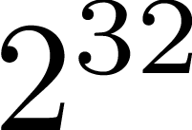
Mixed storage solution
:any
Make a diagram for the
decision tree part
edge(:any,:any)
pathCost(:any,:any)
How does the query edge(+,-) leverage this data structure?
edge(:int,:int)
edge(:str,:str)
edge("a",:str)
Fast, stable lookup and update
Stability: when we store/lookup an item we need to know where we last put it!
Inefficient to constantly move data, especially for just “randomness” in the policy
Need off-policy learning correction (see paper)
Timeline
storage policy changes; temporary duplication of a small part of the data
Background thread migrates data between strategies
Migration completes
Small, temporary data duplication
hash(edge("a", "b")) / 2^32 ~ Uniform(0,1)
Hash table
Trie 1->2
Trie 2->1

Slide 48
Learning to choose a good strategy
Bandit: Each time we execute a task (e.g., compute c(I,j) for an argument j):
Randomly try one of the available strategies (explore) according to some probability distribution
Bias this distribution in favor of strategies with lower measured cost (exploit).
Contextual bandit: Allows distribution to depend on task arguments (e.g., j) and solver state.
Reinforcement learning: Accounts for delayed costs of actions.
queries &
updates
agenda
choose!
pop
task
choose!
dispatch
push
new
tasks
run
strategy
choose!
cache
memoize
computed
values
response
lookup
thread

Slide 49
Back to online training…
Run entire workload
Fiddle
with policy
Feedback

Slide 50
Solver Actions
Workload
Policy actions

Slide 51
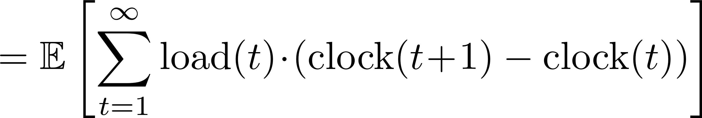
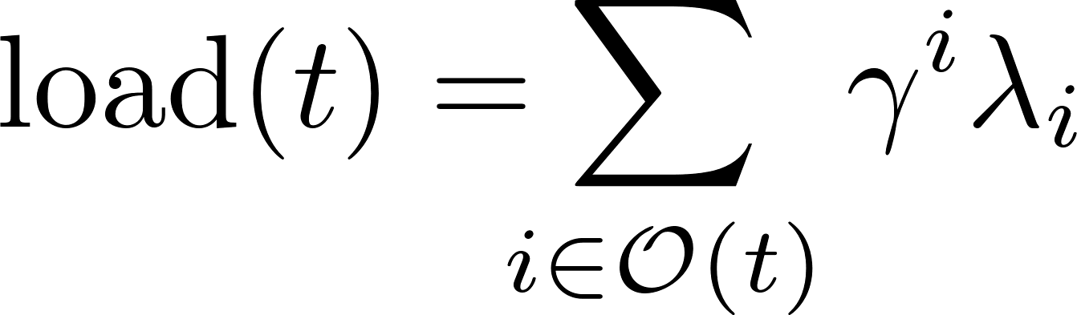
Rewrite the objective function
Workload i
Actions t
Rewrite in terms of the policy’s time scale (used in RL)
Each step tries to decrease the load
TODO inline in parens
use underbrace to give it a name
Add Jason integral picture?

Slide 52
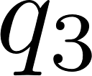
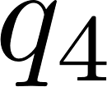
Life of π
Features:
Memos (number, hit rate, frequency, recency)
Pending tasks (number, age)
Current load (proximity-to-completion heuristics)
Dataflow graph
Will this be used again?
Are other jobs blocking on it?
Generalize from past experience to new situations
Use ML to predict future costs!

Slide 53
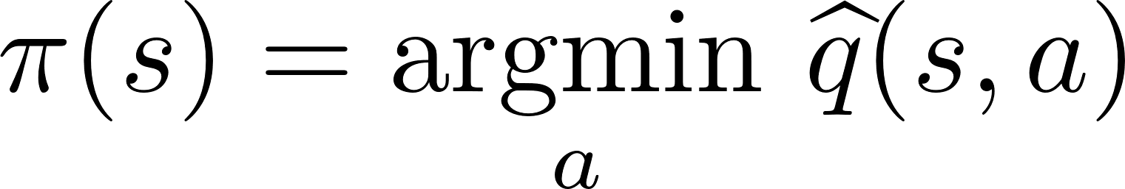
Back to π
Predicting the future requires richer features than simply learning to take good actions.
What should π do in this state?
We need π to be really fast to execute!

Slide 54
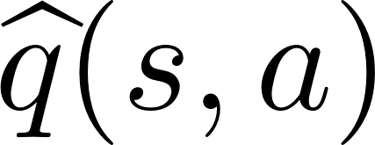


Fiddle
with policy
Run entire workload
Feedback
Feedback
update
update

